Slide 1







LEARNING
AND SHARING
SUMMIT 2025
MOBILE CLINICS BREAKING THE DIVIDE THROUGH INCREASED ACCESSIBILITY
(Zimbabwe, , date and Tinotenda Matenda)
Women’s Voice and Leadership Learning and Sharing Summit 2025

Slide 2
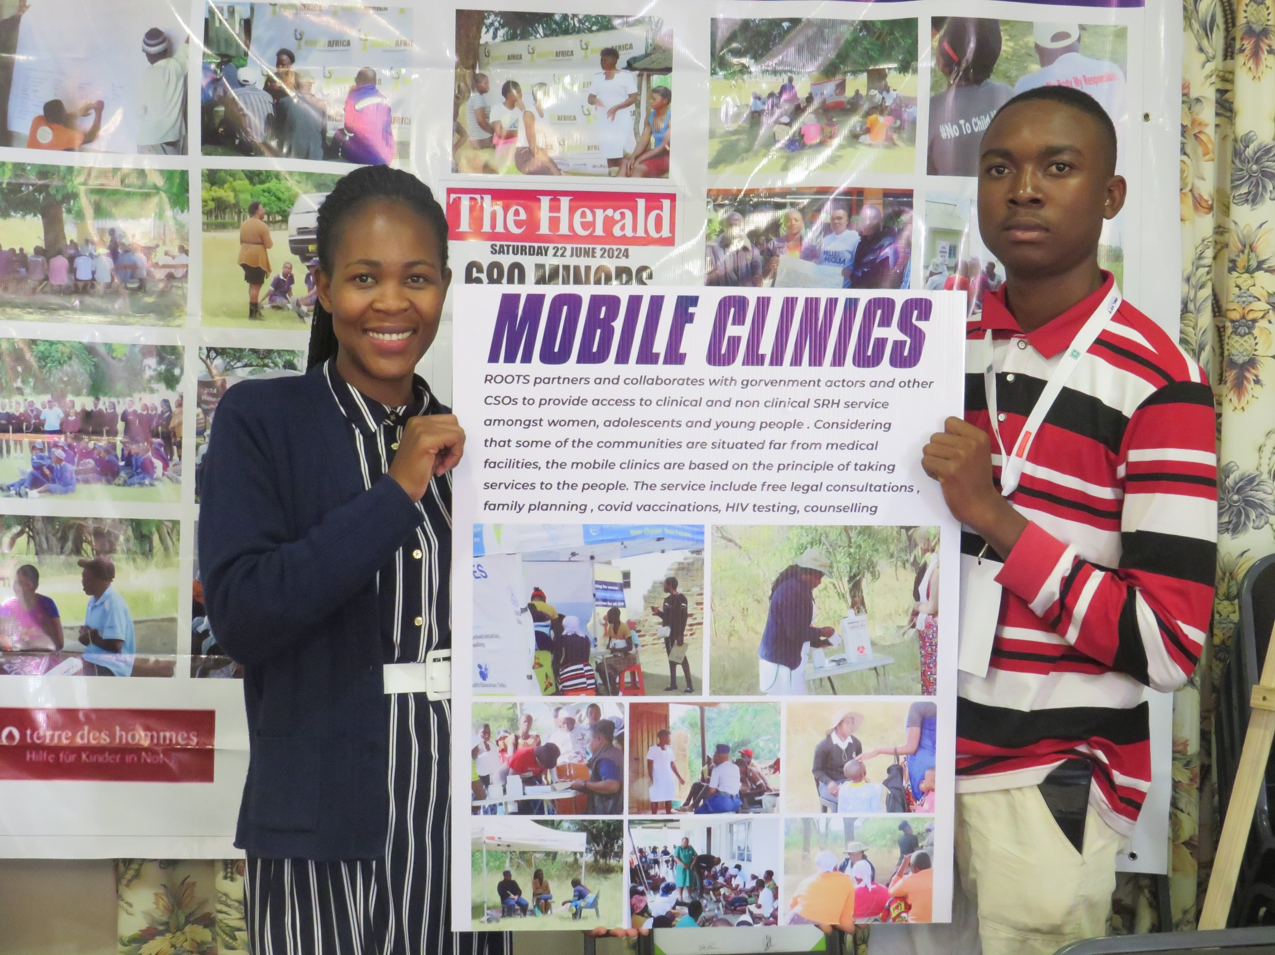

Slide 3
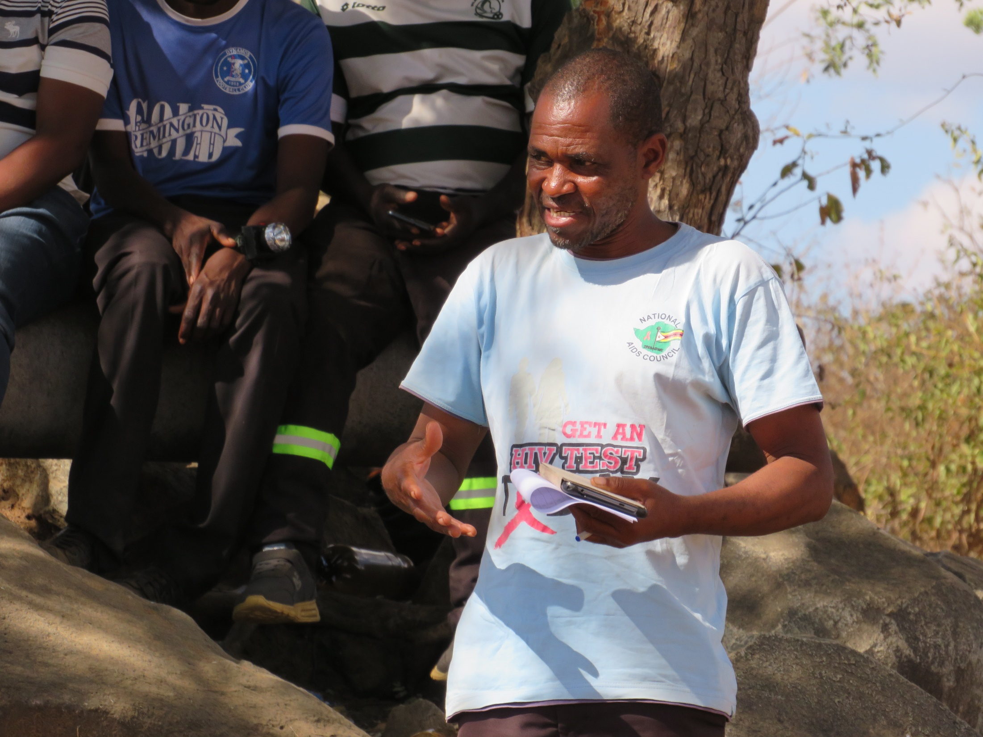

Slide 4
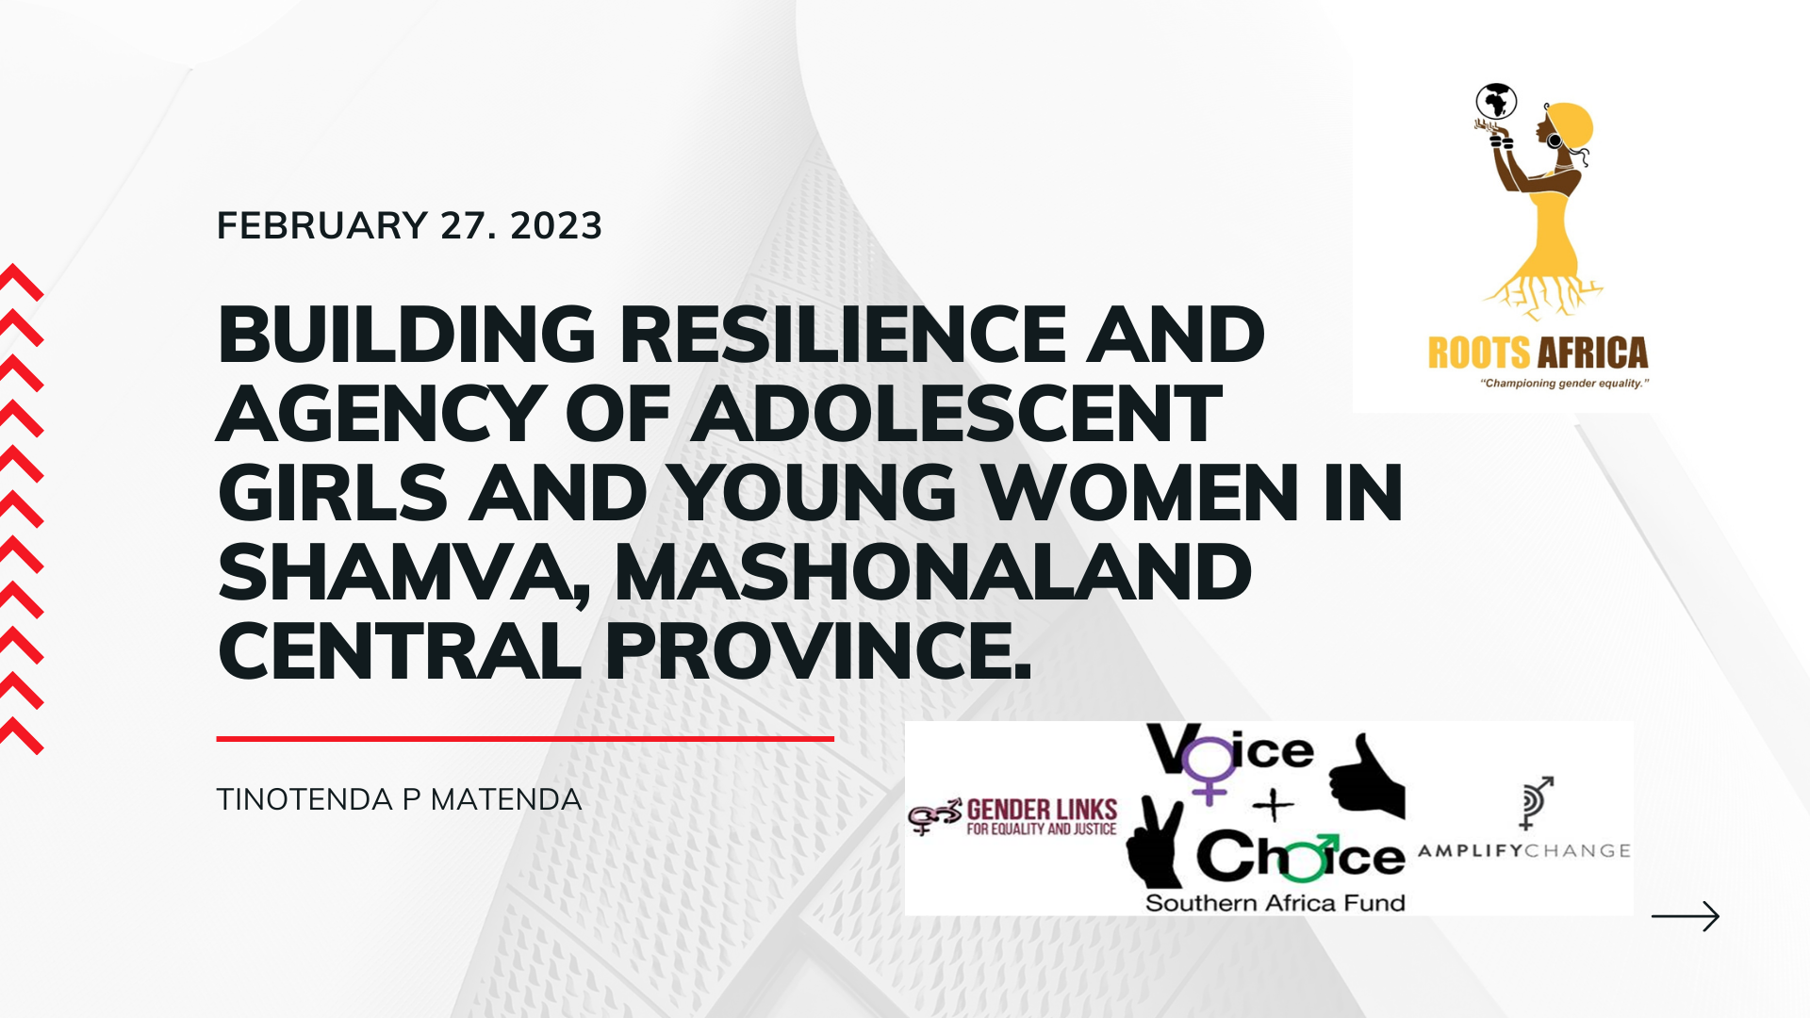
PROJECT TITLE
STORY OF CHANGE TITLE
MOBILE CLINICS BREAKING THE DIVIDE THRU INCREASED ACCESSIBILITY

Slide 5
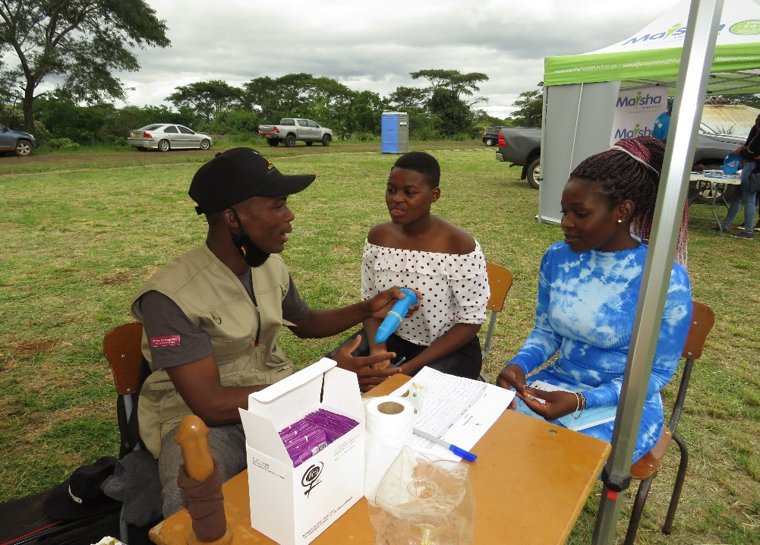
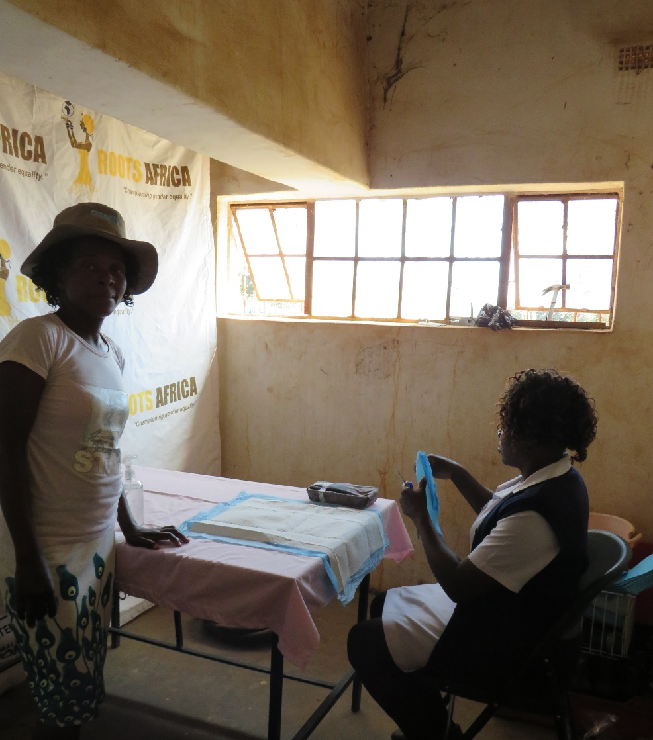
SYNOPSIS
In the rural mining communities of ward 19 and 20 in Shamva District women and girls face significant barriers in accessing essential SRH services as well as GBV prevention and response. Despite the high risk that the area poses because of artisanal miners. The closest clinic is in shamva town, which requires these women to incur transport expenses if they want to seeks services. As a result they neglect accessing SRH services. Most service providers do not favour these wards particularly ward 19 because of very bad road network.
The mobile clinics were conducted in partnership with local government, Ministry of Health, National Aids Council, Zimbabwe Republic Police Victim Friendly Unit (VFU), Zimbabwe Women Lawyers Association(ZWALA) , Ministry of Women Affairs and Department of Social Development
The Multi-stakeholder approach provided comprehensive services and bridged the gap of travelling distance and costs for communities as well as limited resources and poor road networks for services providers
Women’s Voice and Leadership Learning and Sharing Summit 2025

Slide 6
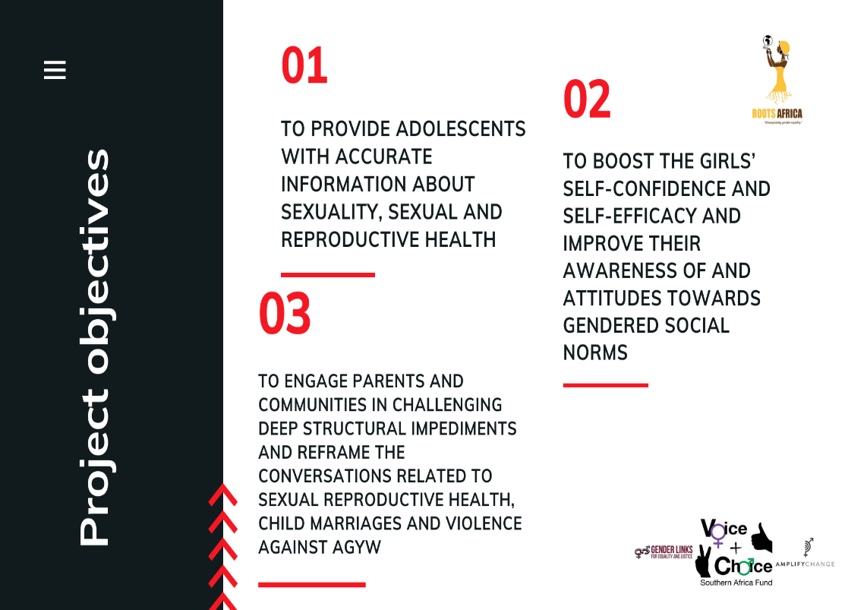

Slide 7
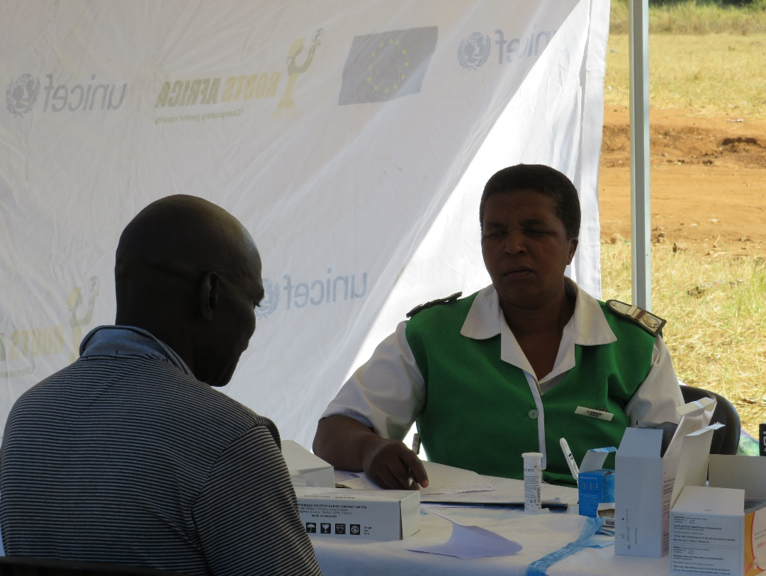
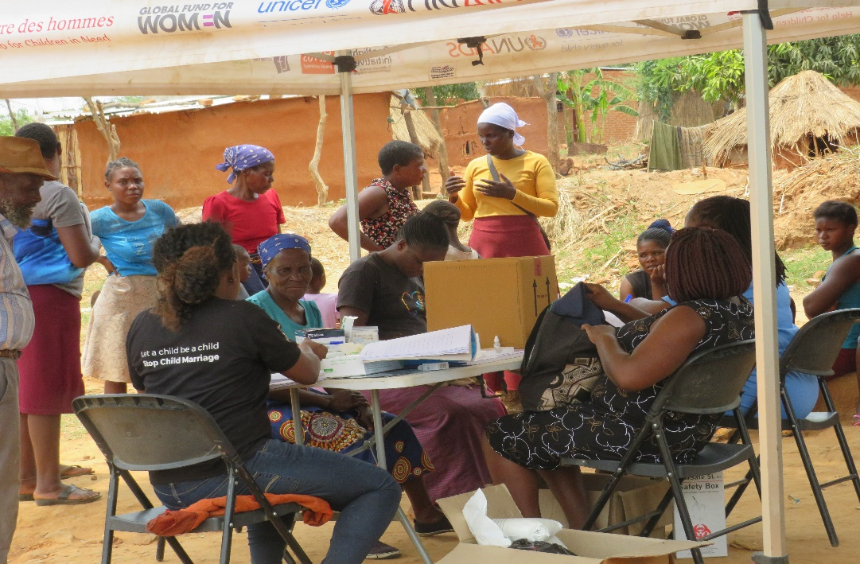
OBJECTIVES
The clinics contributed to the project objective of providing adolescents with accurate information about sexuality, sexual and reproductive health
The key outcome arrears included ,
Improved availability of comprehensive, age appropriate education, information and adolescent friendly SRH services
Increased availability of quality and timely health services for AYPs
Women’s Voice and Leadership Learning and Sharing Summit 2025

Slide 8
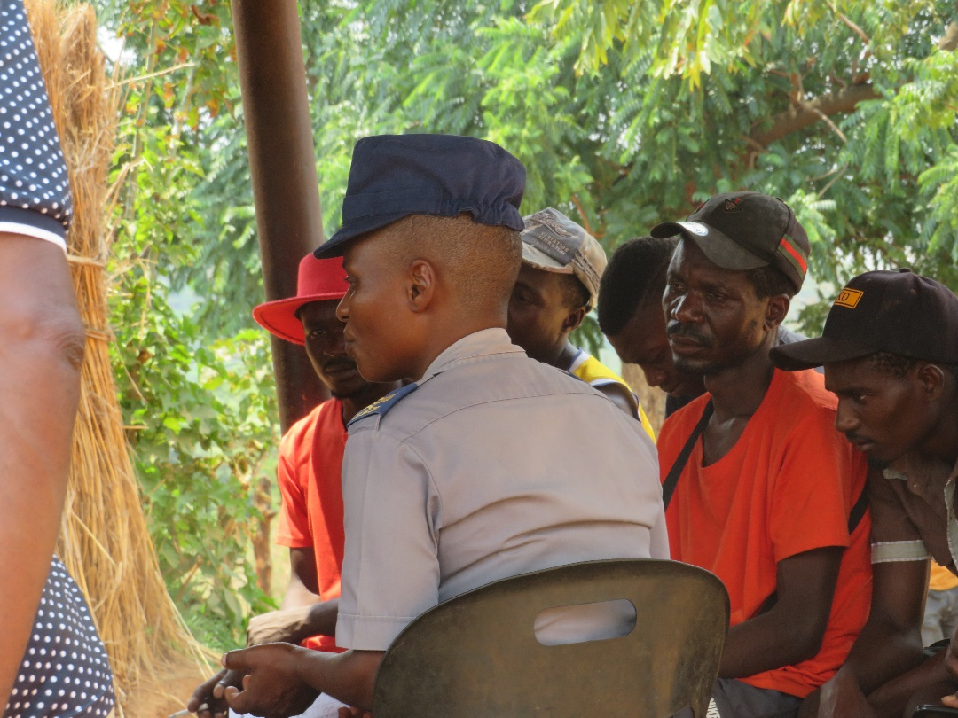
ACTIVITIES
The mobile clinics provided clinical , non clinical and legal services and information .
Cervical cancer Screening , HIV testing, Syphilis Testing, Family planning pills and jadelle , counselling , legal counsel
The evidence include Hospital Registers that the Ministry of Health Uses,
Activity reports from ROOTS Africa
Activity registers from ROOTS
Pictures, videos and testimonies from beneficiaries and stakeholders
Women’s Voice and Leadership Learning and Sharing Summit 2025

Slide 9
Contribution to change
Logistical support : the organisation was primarily responsible for providing the logistical support for stakeholder and communities. This included transport and meals for service providers. Where there was need, the organisation also provided transport to communities to attend the mobile clinics. Preparation and selection of venues , applying for police clearance was also done by the organisation.
Community mobilization : the organisation facilitated the mobilization of communities. This was done with close support from community leaders like councilors, chief Bushu, village health workers, Women Affairs ward coordinators amongst other key players. The organisation planned and coordinated the times and places for the clinics in liaison with local leadership
Stakeholder coordination : Another key contribution by the organisation was stakeholder coordination. The organisation ensured that all the key service providers were well and informed and available to offer services on selected days
Facilitation of information dissemination sessions : because of different ages, some minors could not access services, the organisation facilitated discussions to raise awareness about various topical SRH issues amongst the young and other community members
Women’s Voice and Leadership Learning and Sharing Summit 2025

Slide 10
Population Group this change most closely related to
Category | Women | Men | Total | % Women
Direct beneficiaries | 270 | 35 | 305 | 88.52%
Indirect beneficiaries (e.g. through other networks) | N/A | N/A | N/A | N/A
Online beneficiaries (e.g. website access, mailing lists, scholarly articles) | N/A | N/A | N/A | N/A
Total | 270 | 35 | 305
Women’s Voice and Leadership Learning and Sharing Summit 2025

Slide 11
Significance of change
Increased access to SRH services and information has enabled young people to make informed decision about their sexuality amongst other things, this involves choices to abstain or practice safe sex
Presence of lawyers and police officers from the VFU helped to raise awareness about the court and legal process on matters of GBV including rape, some people were hesitant to report cases as they blamed corruption on some incidences where it was not applicable. This was largely attributed to not understanding court process, thus by interacting with communities the VFU and ZWALA were able to raise awareness on legal processes as well as the law on sexual offences and abuse
Cancer screening contributes to earlier detection of cervical cancer which is one of the leading killer cancers in women. Thus through the screening process, women are able to live healthier lives
Access to family planning methods including condoms reduces unintended pregnancies, teen pregnancies as well as incidences of gender based violence caused by unplanned pregnancies
Women’s Voice and Leadership Learning and Sharing Summit 2025

Slide 12
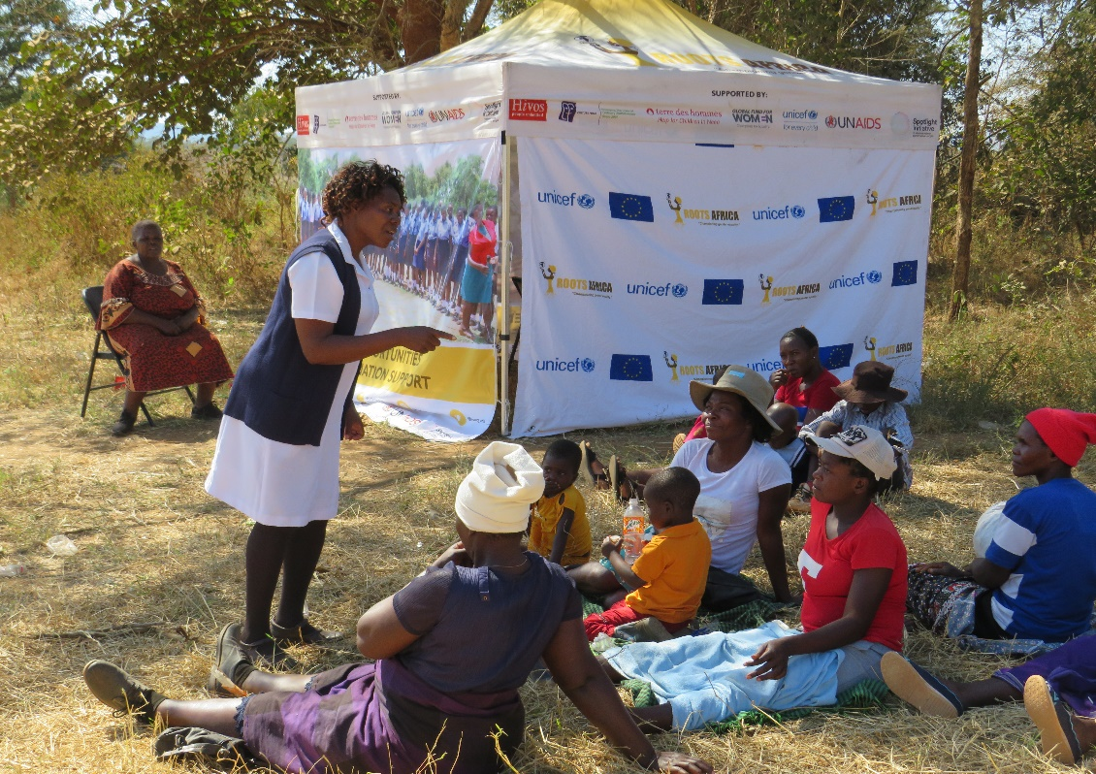
RESULTS
Through mobile clinics there has been a shift in attitudes and behaviours where people used to think that SRH services are for women only, though the figure was low, the project saw boys and men accessing SRH services
The mobile clinic increased access to SRH service with people accessing contraceptives and family planning methods
Cervical cancer screening being done in the community was a huge success from the project
Community awareness was raised through interactions with police and lawyers
While others also sought legal advice from the ZWALA lawyers
Women’s Voice and Leadership Learning and Sharing Summit 2025

Slide 13
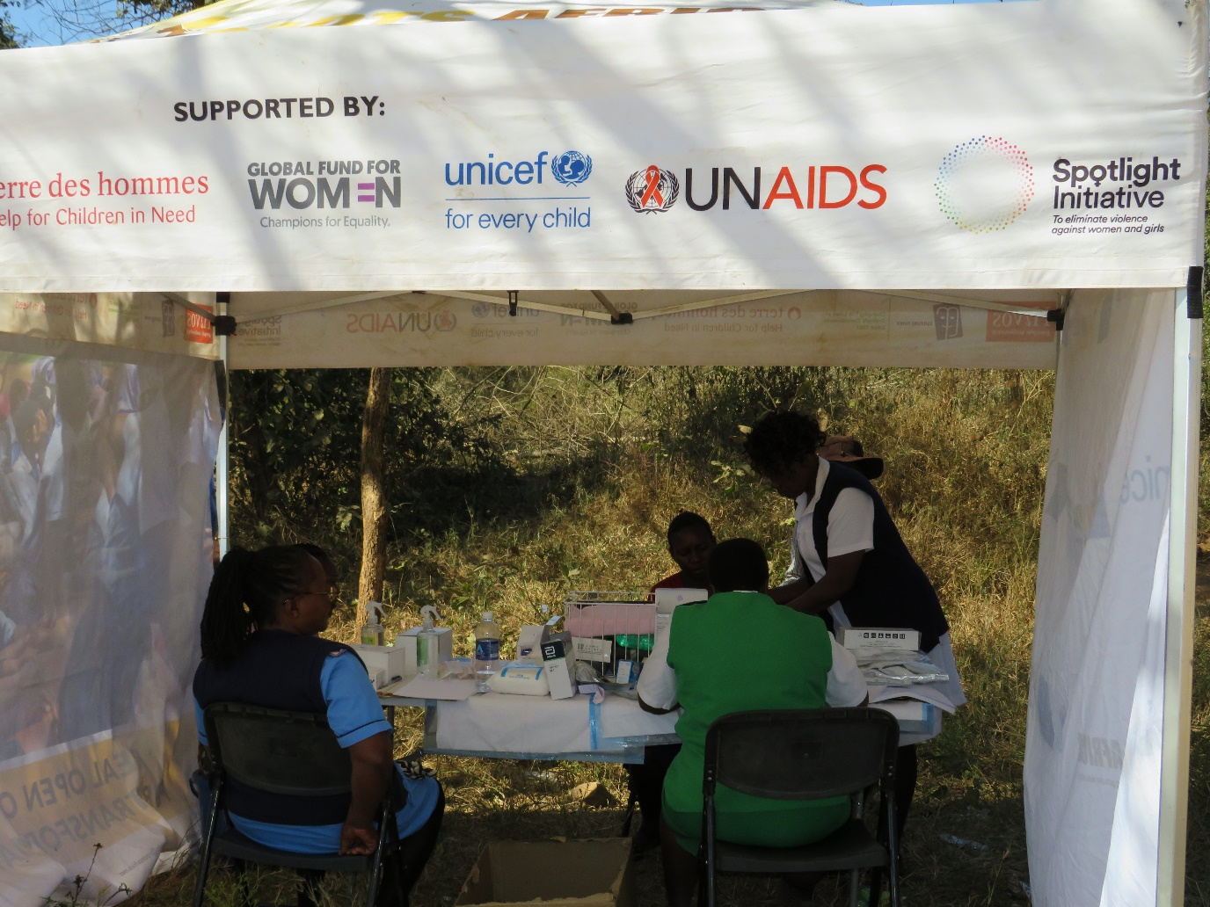
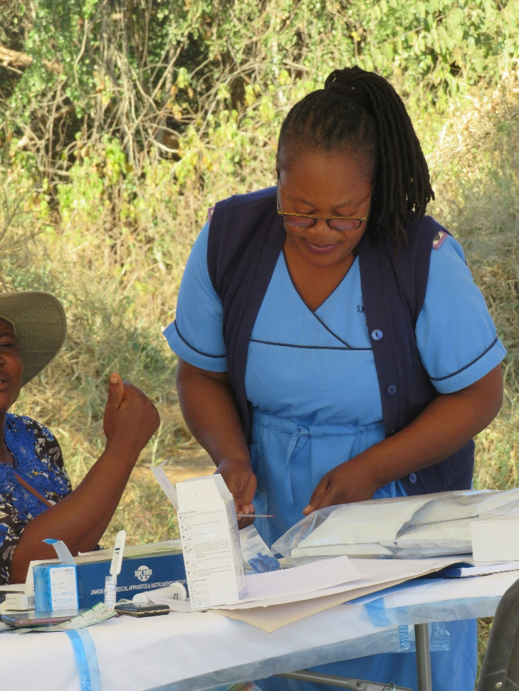

Slide 14
Evidence
The impact of this project has been measured primarily through activity registers, which beneficiaries fill in when they attend a mobile clinic
Secondly testimonies from beneficiaries of these projects, community leaders and service providers
Documentation by Activity reports compiled by ROOTS staff , including Monitoring and evaluation reports also hold evidence
Women’s Voice and Leadership Learning and Sharing Summit 2025

Slide 15
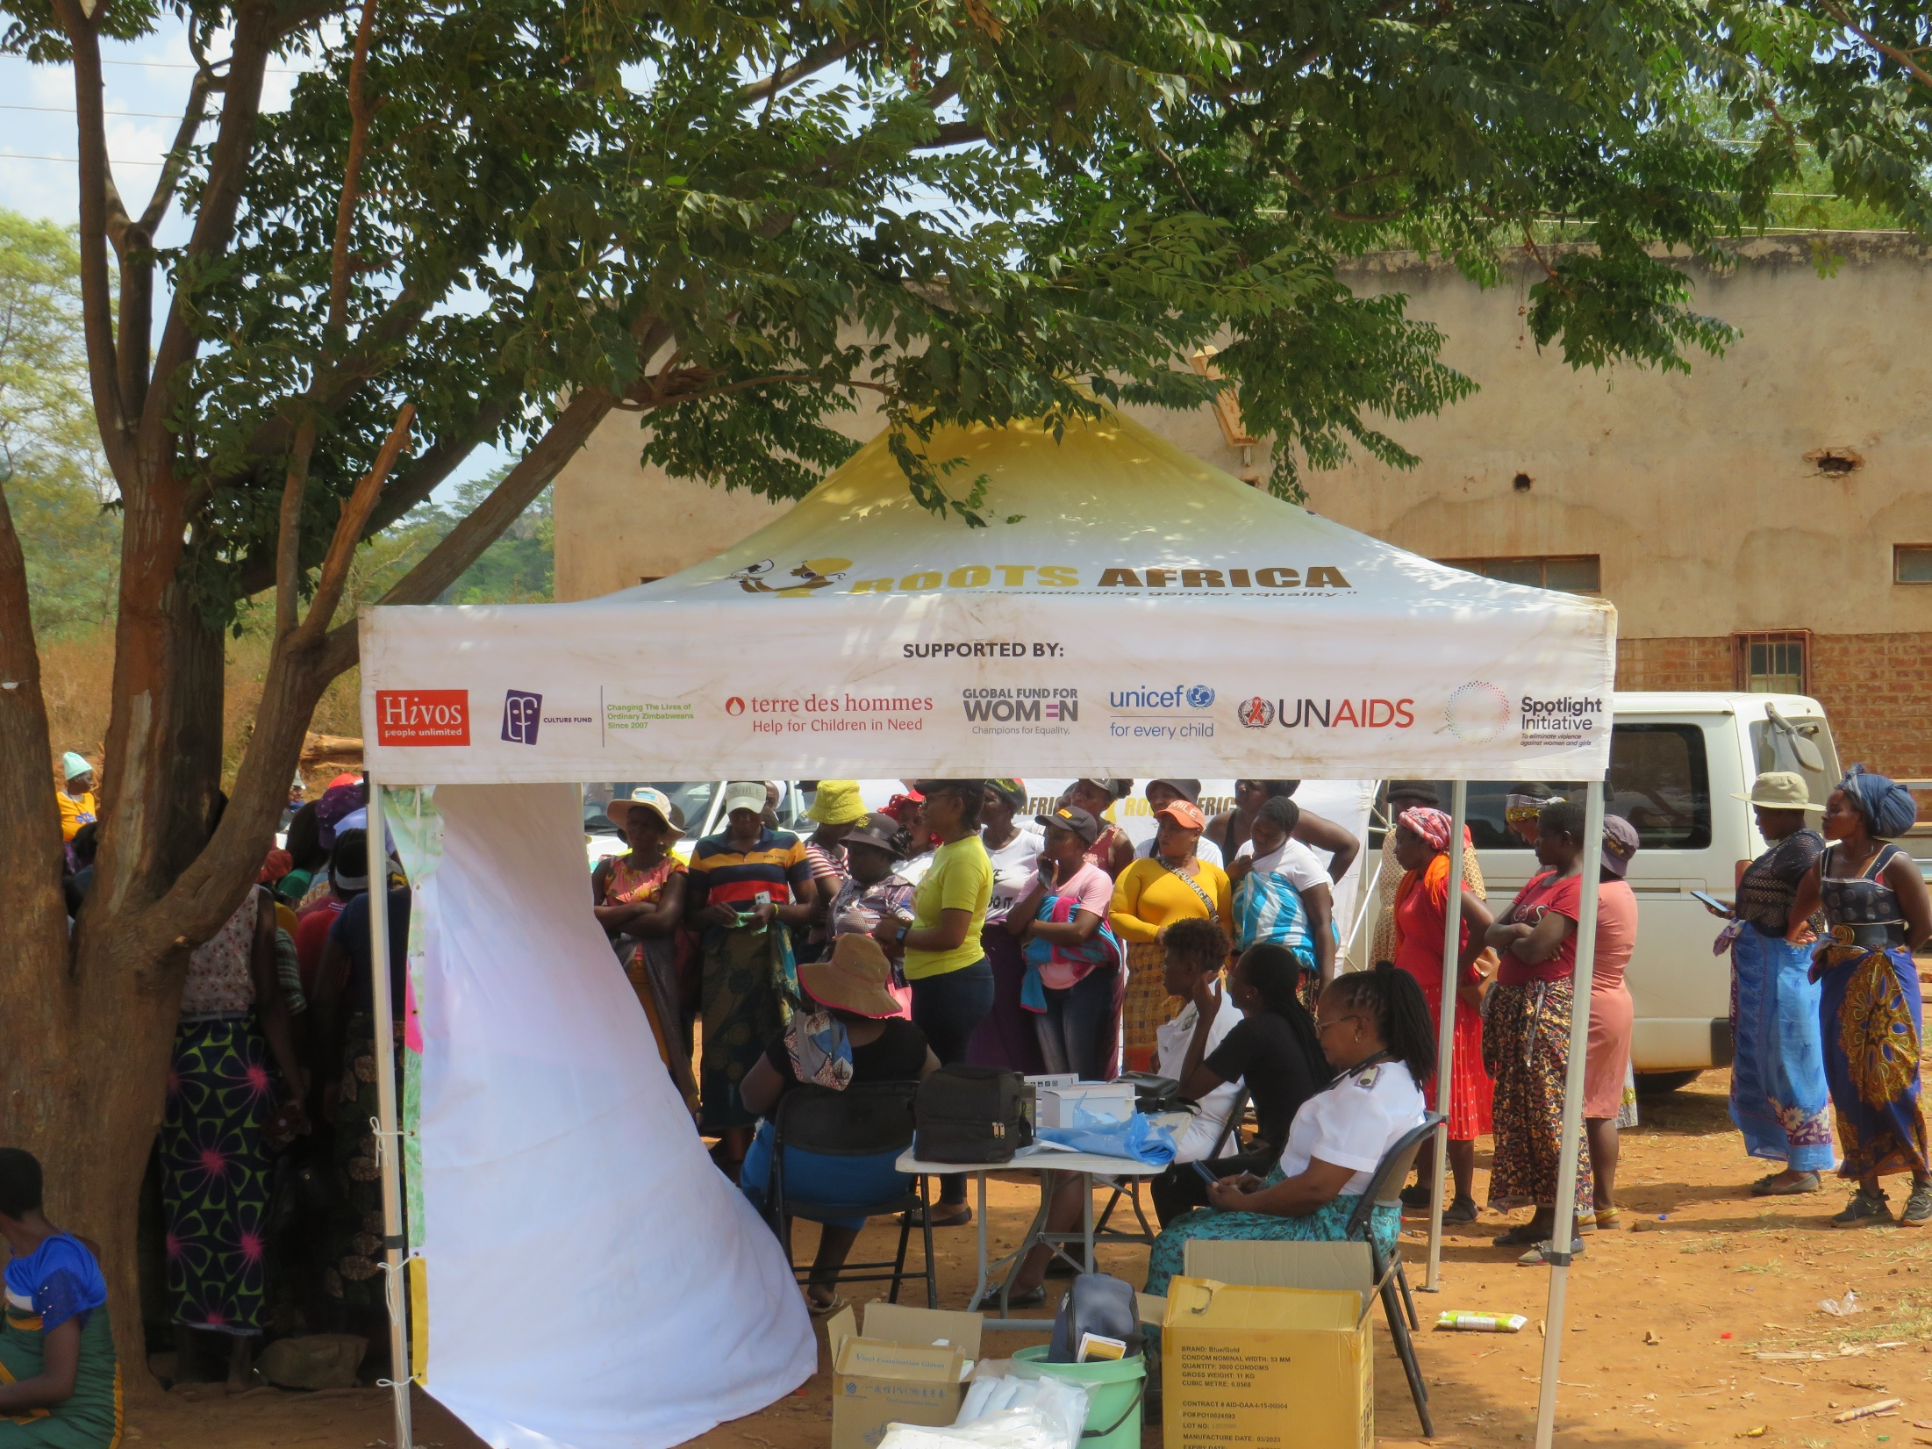

Slide 16
CHALLENGES AND LESSONS LEARNT
Inadequate infrastructure which is safe and private for cancer screening.to address this, the project used local schools and houses provided by local leader which strengthened community ownership
Poor road networks also posed a greater challenge especially when it rained, this challenge was addressed by utilizing central locations which would be easily accessible to communities
Lower number of cancer screening kits against the demand in communities
Competing commitments, going to mines versus accessing services, to overcome this we planned mobile clinics on local rest days where communities traditionally do not work as well as choosing locations that are close to the mines where community members will be working
Lower participation of boys and men due to social stigma sand stereotypes which portray seeking SRH services as a women’s thing. The service providers were encouraging women to take condoms on behalf of their spouses as well ass use self test kits
Women’s Voice and Leadership Learning and Sharing Summit 2025

Slide 17
CHALLENGES AND LESSONS LEARNT
Strength of multi stakeholder approach . The multi stakeholder approach provided a wide range of complimenting services. These benefitted not only the primary target AGYW but the greater community also benefited from legal expertise, police presence counselling by women affairs etc.
There is great value in establishing community ownership and collaborating with local leaders. Working with local leaders enabled the project to utilize local venues and get support to mobilise participants
There is wide unacceptance of the female condoms in communities . Female condoms are widely unaccepted for a number of reasons some of which are mythical . However key factors that lead to low uptake of female condoms include, the size is intimidating, and the process of putting on the condom is complex and unacceptable to many men.
Women’s Voice and Leadership Learning and Sharing Summit 2025

Slide 18
CHALLENGES AND LESSONS LEARNT
From the lessons, the organisation will continue to engage and advocate with key stakeholders to promote the universal health coverage policy by construction of more clinics in arrears like ward 19 and 20 of Shamva, which do not have clinics
To improve our programming , the organisation will ride on existing local initiatives such as Chisi to increase reach
The organisation will strengthen its partnership and collaboration with stakeholders and communities as this has proved to be a very impactful approach to project implimentation.
Women’s Voice and Leadership Learning and Sharing Summit 2025

Slide 19
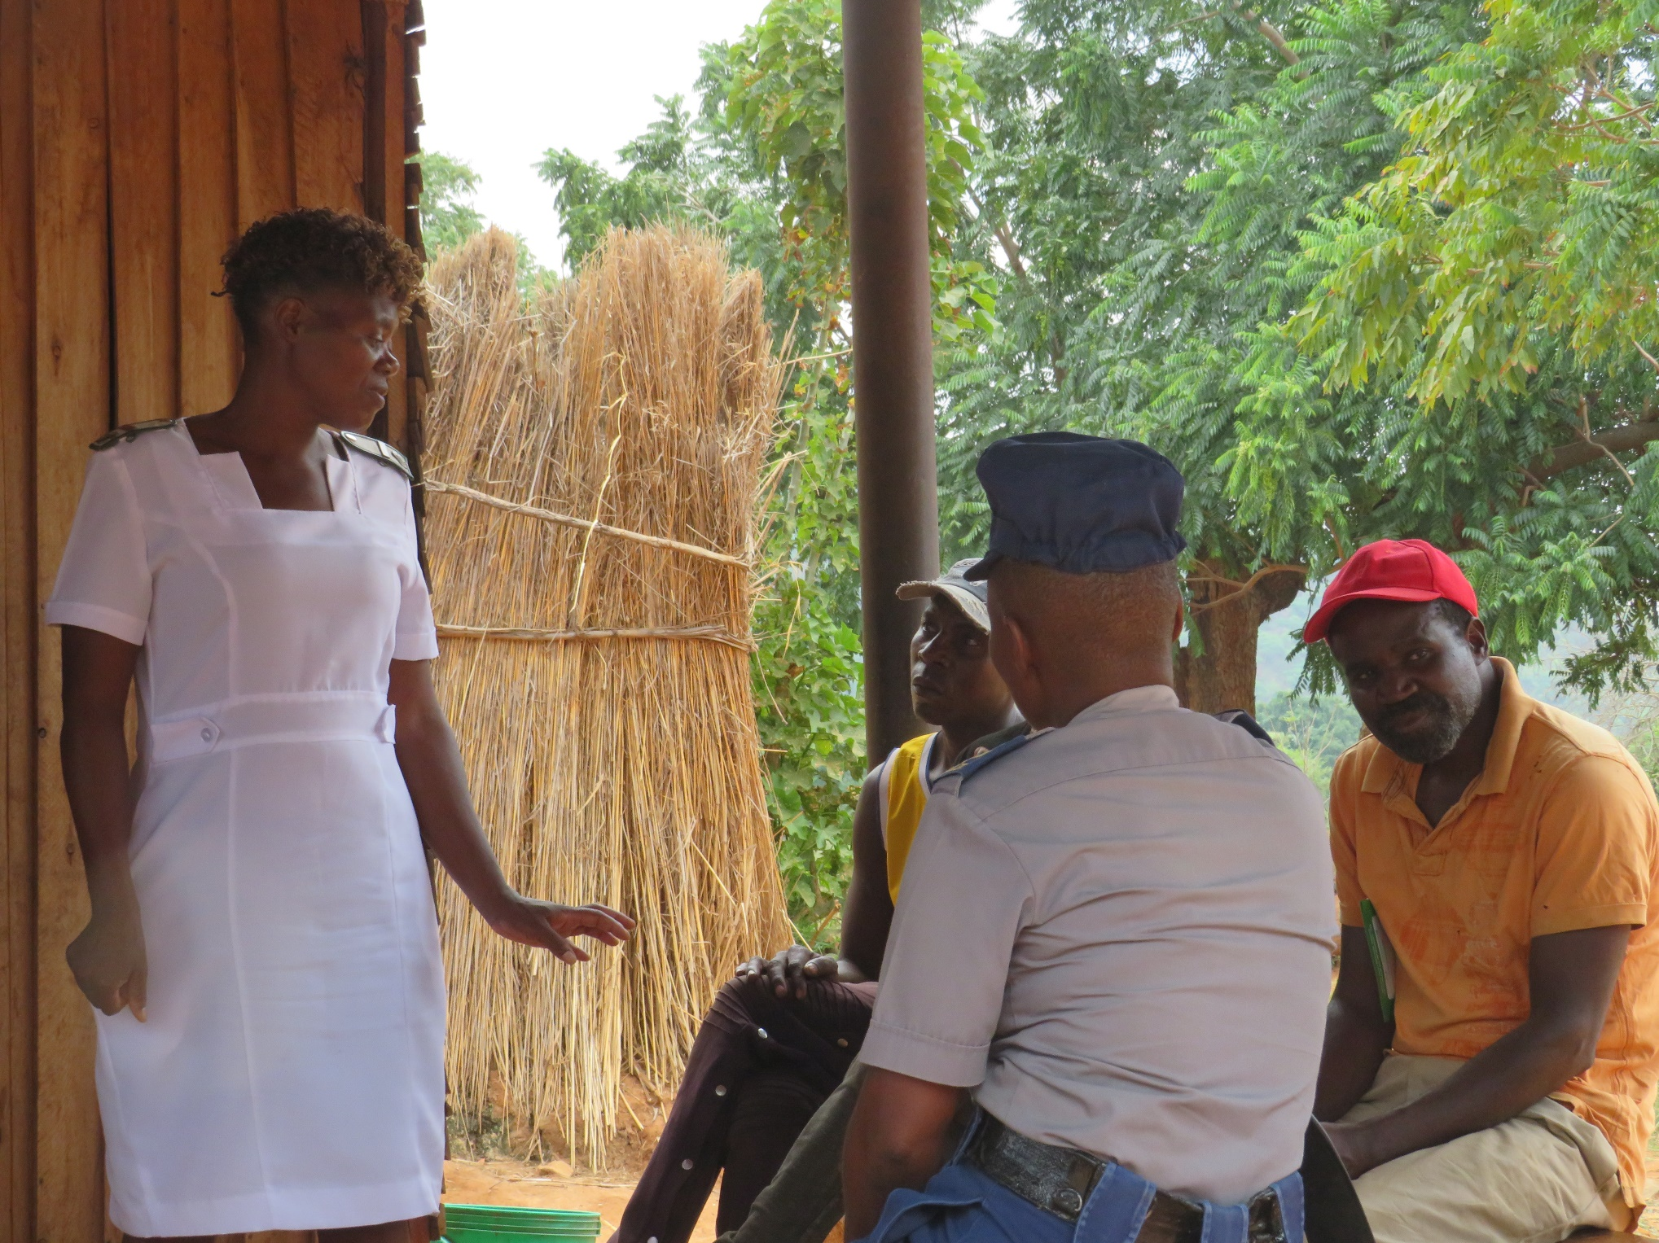

Slide 20
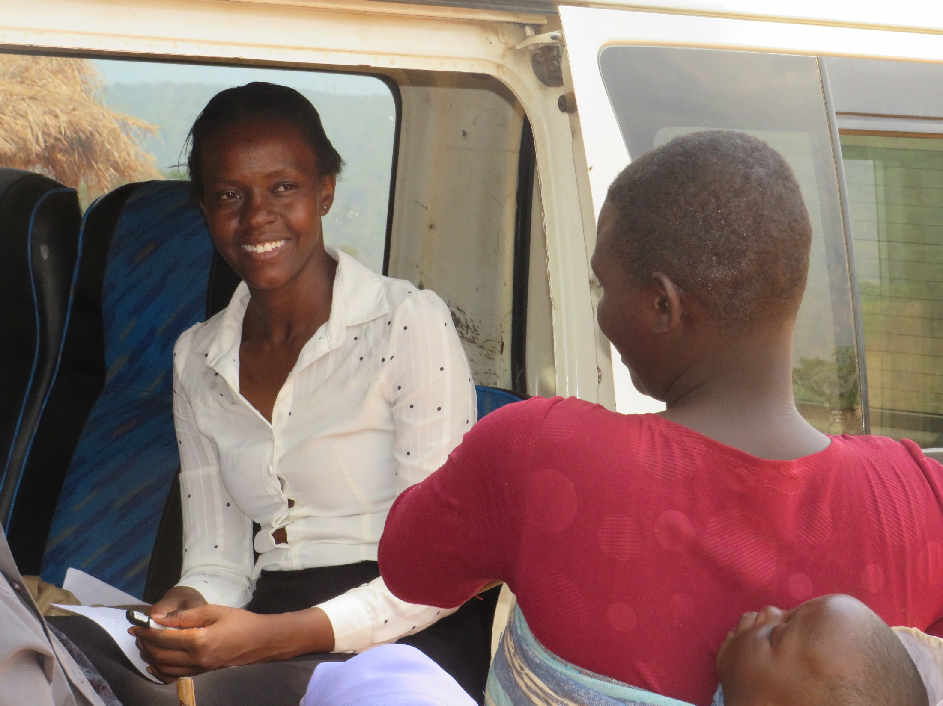

Slide 21


Slide 22
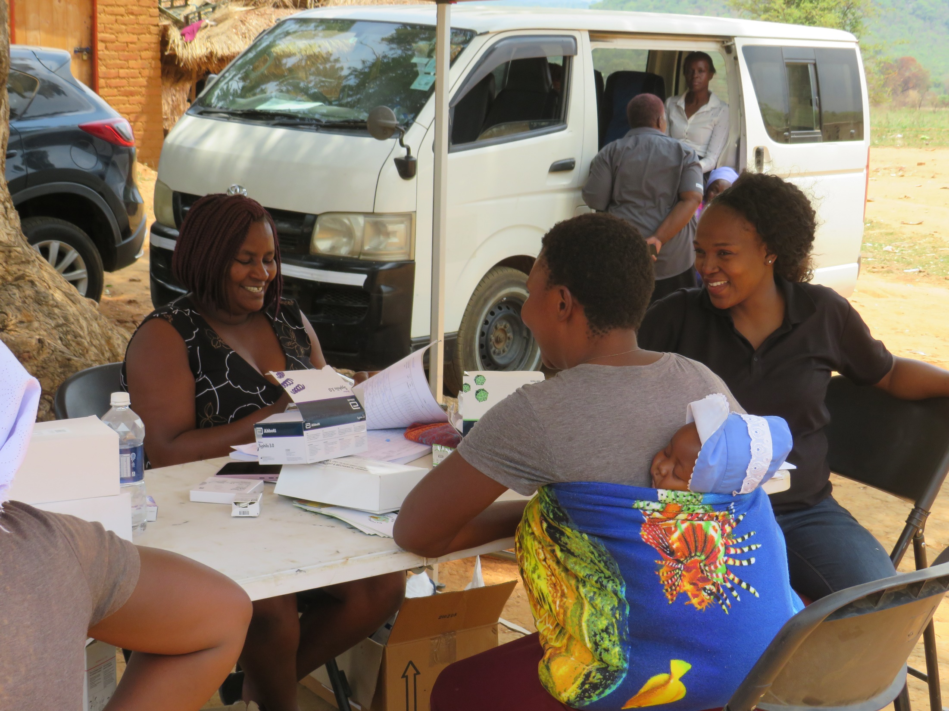

Slide 23
SUSTAINABILITY AND REPLICATION
Without direct investment into resources like mobile caravans it becomes difficult for the work to be sustained by the government without CSO interventions. Considering that the essence of the mobile clinic is its mobility
However documentation of the progress and results will ensure that other CSOs working in these wards are able to learn and build on our experiences
Community Health Workers, Village health workers and child care workers also gained knowledge and awareness from these mobile clinics. Though they can not offer such professional services, they are in a better position to refer and connect the communities with the police, lawyers and nurses. This is to be done utilizing other existing digital options such as toll free number that ROOTS
Utilizing social media platforms to share about the model enables its replication in other provinces, countries and regions
Sharing through reports at district, province levels and presentations at forums such as this summit is also a great opportunity for sustainability as it opens room for more funding and replication by other organisation learning from our experiences on the project
Women’s Voice and Leadership Learning and Sharing Summit 2025

Slide 24
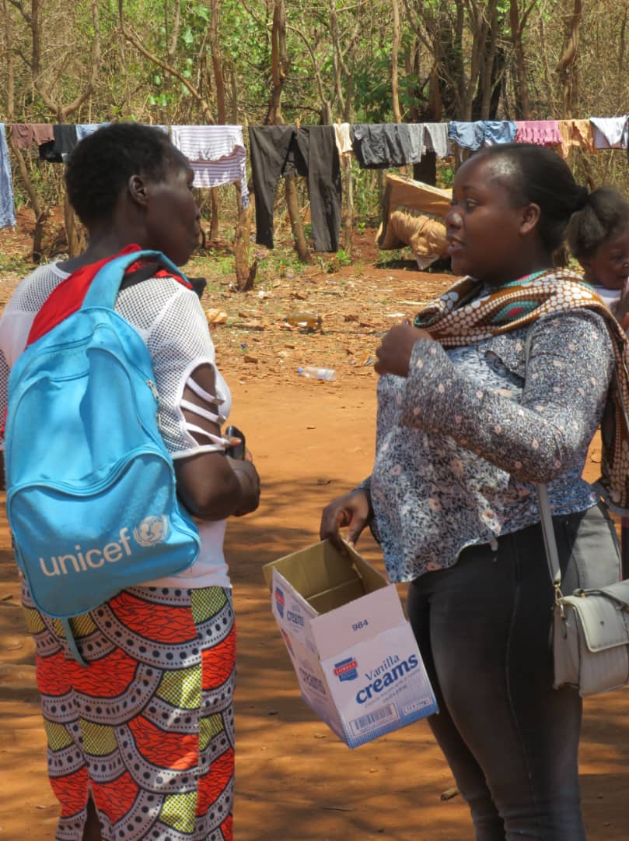
NEXT STEPS
Going forward the organisation's priority is on mobilization of resources both financial and non monetary resources that can enable continued implimentation of such a model within the district
As the organisation remains a key stakeholder in the district , it will advocate to ensure that other organisations coming into the district are given these wards to work in, as most of the times they are neglected because of poor road connections
Documentation and sharing of project impact
Women’s Voice and Leadership Learning and Sharing Summit 2025

Slide 25
