Slide 1



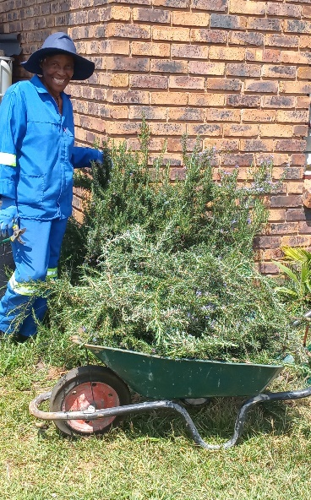
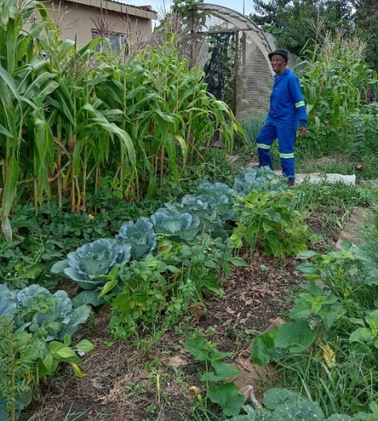
Promoting Gender-inclusive Local Economic Development In South Africa
ESTABLISHED ENTREPRENEUR
Business Name: Mampu Perfect Integration (Pty) Ltd
Participant Name: Puleng Sehloho
Council: Midvaal Local Municipality

Slide 2
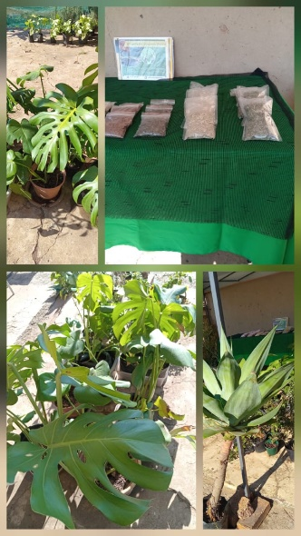
SUNRISE CAMPAIGN JOURNEY –IMPACT AND PERSONAL GROWTH
Personal Growth
Increased self-confidence and belief in my abilities.
Gained new knowledge and skills through training and mentorship.
2. Family Impact
* Improved relationships within my family as they see my commitment and growth.
*I have become a role model to my children and other women in the family.
3. Community Respect
I am now seen as a source of motivation and inspiration to others.
4. Income and lifestyle Improvements
Improved quality of life for myself and family.
Better financial planning and management.
5. Overall Impact of Sunrise Campaign
Encouraged me to uplift and inspire other women in my community.
Provided mentorship, training and support.

Slide 3
MY EXPERIENCE DURING SUNRISE CAMPAIGN
1. Overall Experience
* The Sunrise Campaign has been a life-changing journey for me. I am now unstoppable!
* I gained so much confidence and courage to pursue my goals and grow my business.
2. Key Lessons in Life Skills Training
Understanding my rights and the importance of self-worth and dignity.
Learning how to manage challenges and remain resilient.
developing better communication and decision making skills.
3. Key Lessons Entrepreneurship TrainingProgramme
The importance of customer care and marketing my products.
Learning how to plan for my business growth and sustainability.
4. Memorable Moments During the
The support and sisterhood among participants which made the journey meaningful.
Celebrating achievements and seeing the progress of other women.

Slide 4
5. Continued Impact
The support from mentors and fellow participants continues even after the training.
I remain motivated to succeed and inspire other women in the communities

Slide 5
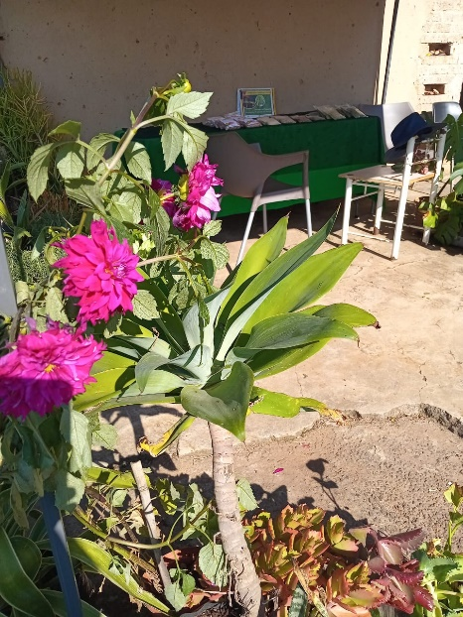
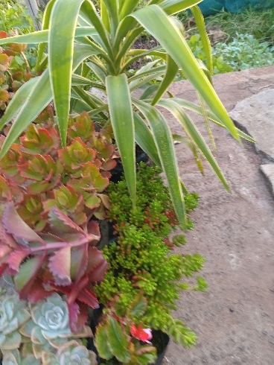
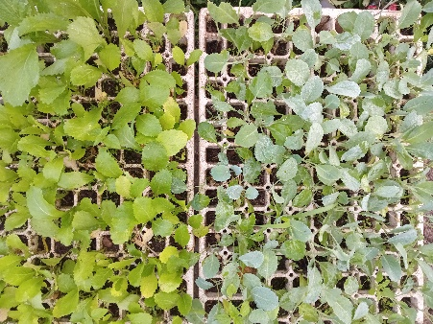
PLEASE DESCRIBE THE BUSINESS
My business name is: Mampu Perfect Integration (Pty) Ltd It is a registered company. We grow, sell and process fresh naturally grown (Organic) vegetables and herbs. The business is growing very well as we have opened nursery is boost
Achievements so far:
Securing seedling big orders from community projects its encouraging and confirmation that we are doing something right for customers trusting us.

Slide 6
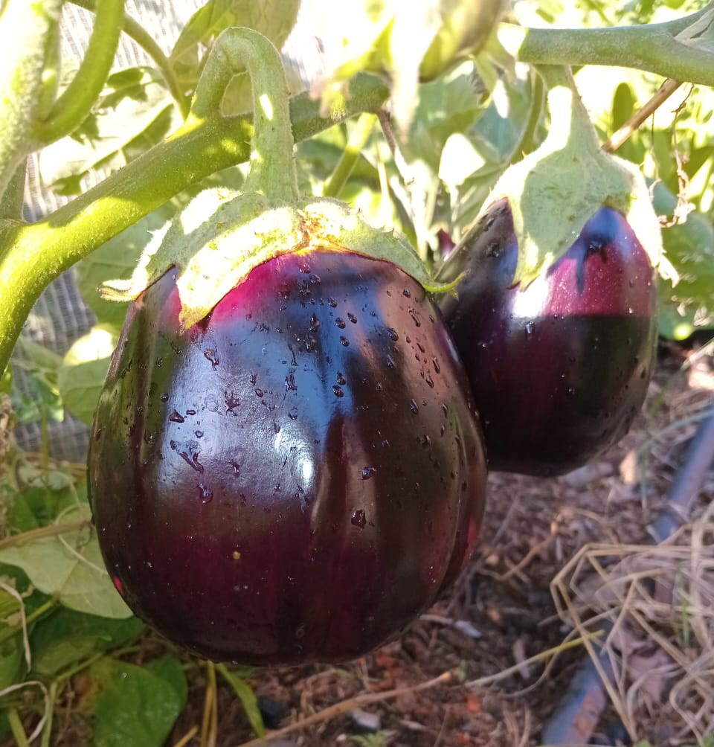
1. Product Quality
The products are of high quality and well made.
Products are fresh, tastier with quality packaging
2. Good Customer Service
Friendly and welcoming customer service
Customers feel valued and welcomed
3. Affordability
Prices are reasonable for community
We always put ourselves in the shoes of our communities.
4. Reliability
The business is consistent and reliable

Slide 7
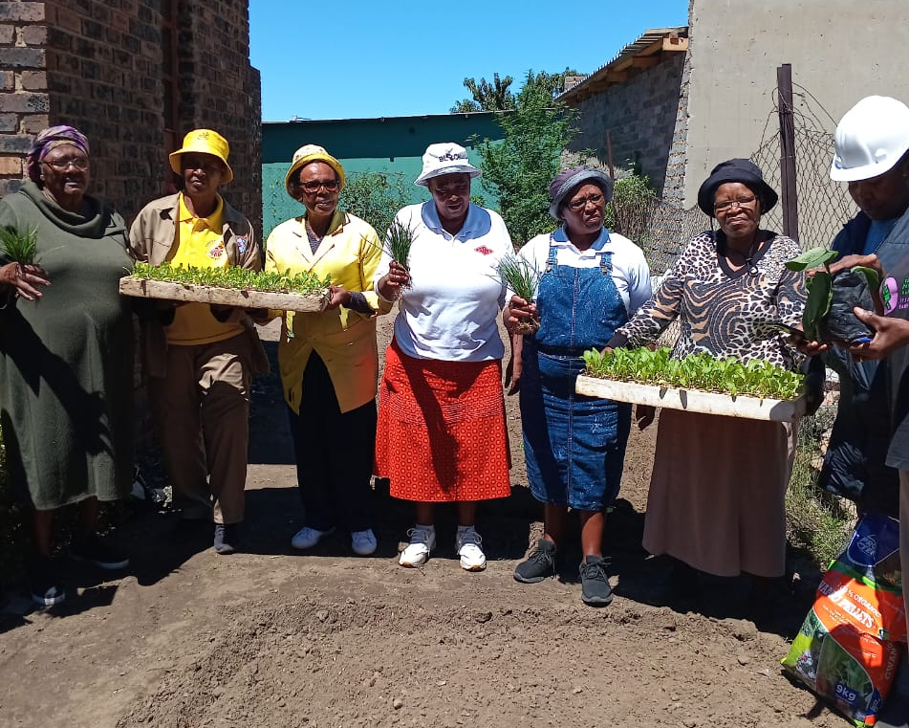
5. Community Impact
The business empowers community to learn and establish their own veggie gardens as part of skill transfer.
The business creates opportunities and inspires others
School kids connecting on WiFi doing their homework.
6. Customer Loyalty
Customers say they keep coming back because they are satisfied with our products.
Customers recommend the business to the neighbors and colleagues.
7. Personal Growth of the Entrepreneur
“I am so grateful, you’re selfless woman who has the interest of the community at heart. Every information or knowledge you shared to uplift the youth. I was part of 2025 Teacher’s Education assistant because of your WiFi “
“Puleng is a hard worker, she is prepared to do what it takes in order to make her dream to come true”
“Mama I thank you for giving an opportunity, I managed to save and I got my Code 14 Learners License”

Slide 8
CUSTOMER BASE AND COMPETION?
Target market
Local Communities
Social media - no boundaries.
What makes my business different from others
Affordable prices for high quality products.
New House brand products make us extremely different and attracting more customers
Relevant to market demands to current trends.
Convenient user friendly system for customers.
Enable us to reach customers around the country.
Competitors are everywhere but we just learned how to work smart with open minds and be flexible to adapt.

Slide 9
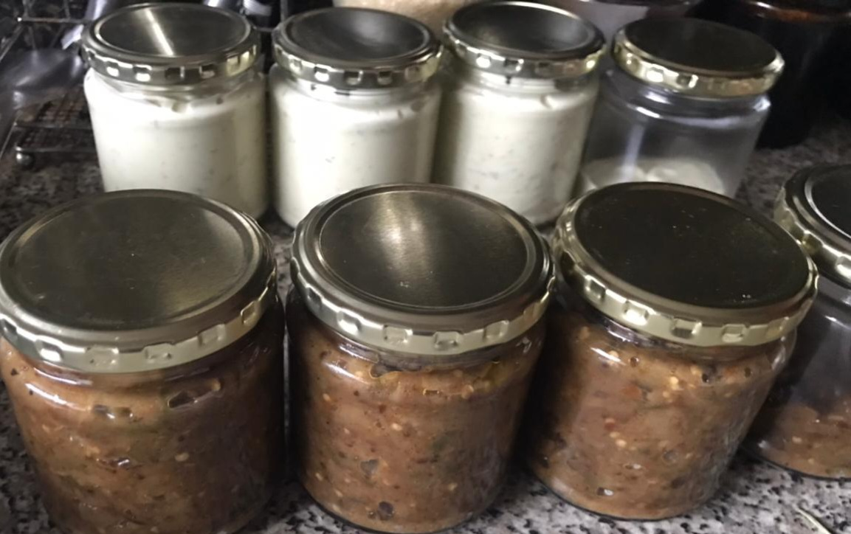
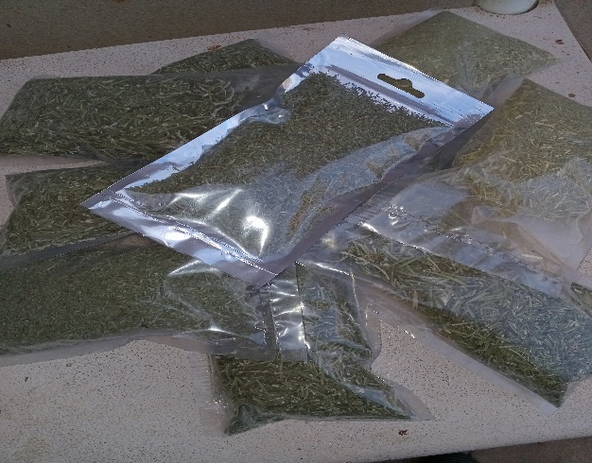
NEW PRODUCTS
New products range:
Green Beans Relish
Sweet Chilly Source
Brinjal Pickles
Garlic Mayo
Dried Herbs
Himalayan Salt (Pink Health salt)
Pure Honey
Healthy Snack Seeds
New products performance
Adding more value
Attracted new customers and increased sales
Marketing and advertising:
social media platforms

Slide 10
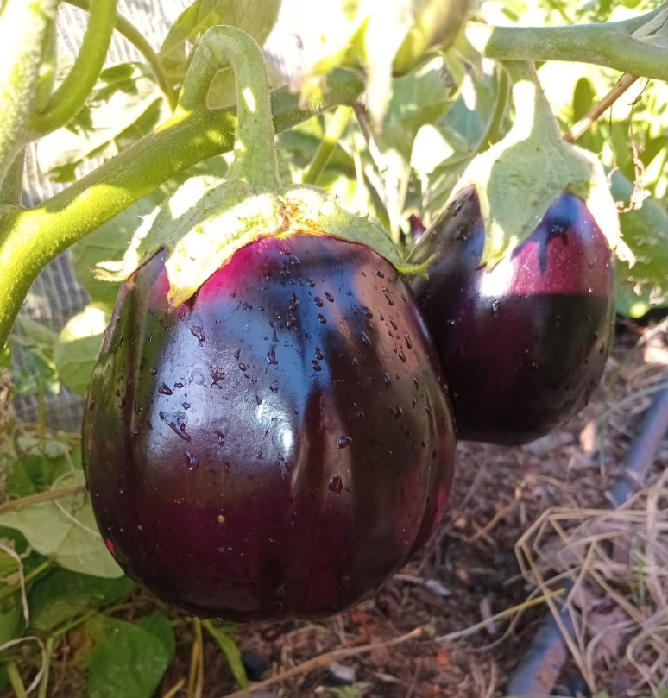
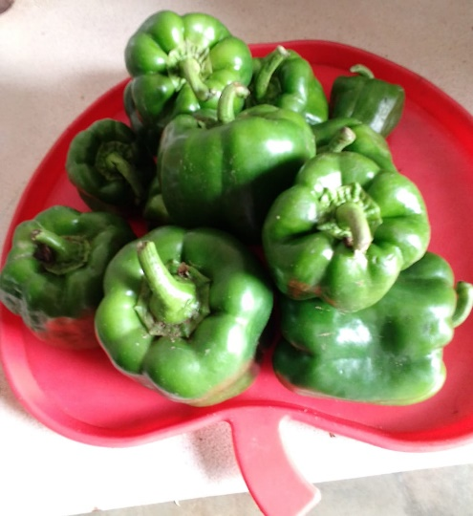
QUALITY AND PACKAGING
My customers highly value the quality of my products. More people in the society are becoming aware of the benefits of organic produce and the risks of buying vegetables that are not naturally grown. They are also increasingly looking for available herbs, as many are becoming more health conscious.
For packaging, I use clean, simple, and eco-friendly materials that keep the vegetables fresh and protect them during transport. This helps maintain the quality and appeal of the produce.

Slide 11
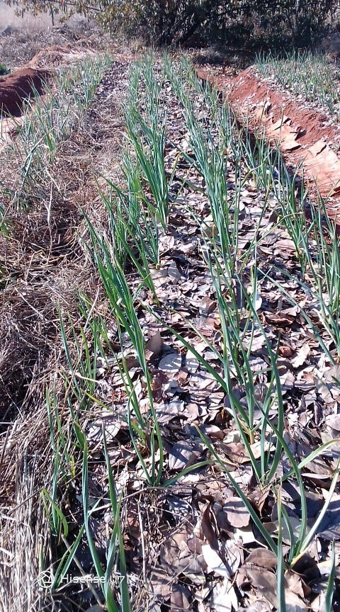
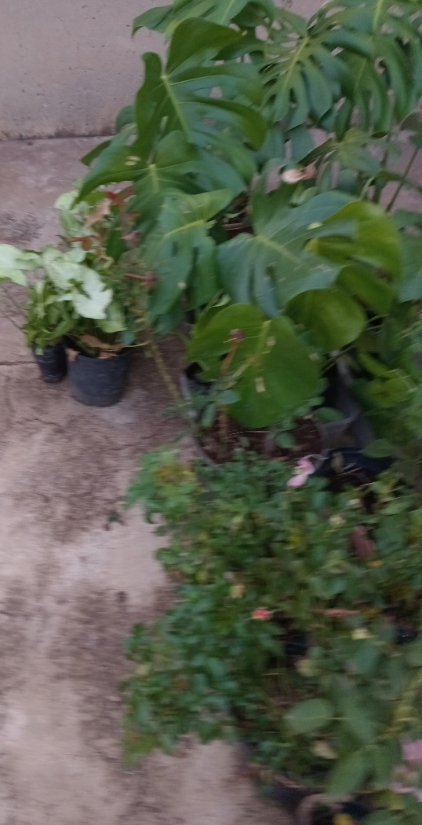
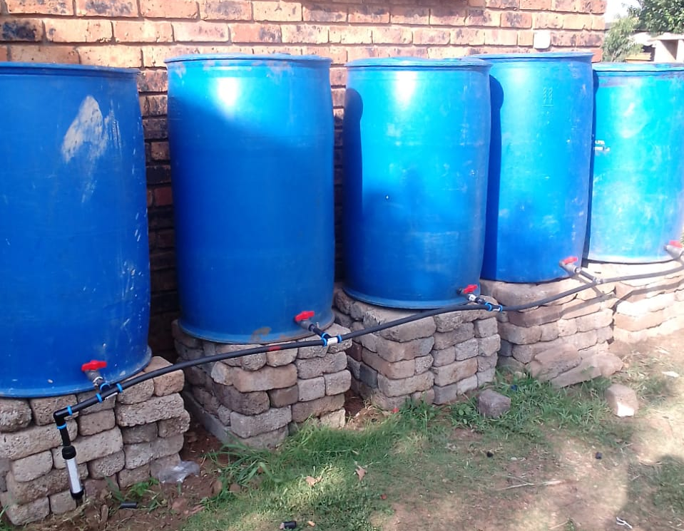
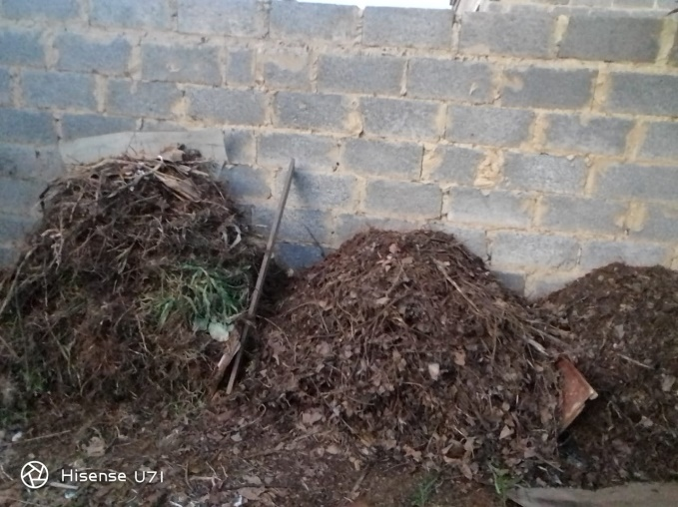
BUSINESS MANAGEMENT
I have 1 (one) employee and I manage the business myself.
Staff training is a key part of my business operations.
Pricing Strategy: 50% margin is used to keep my prices competitive to the market.
Reduce input costs to improve profit.

Slide 12
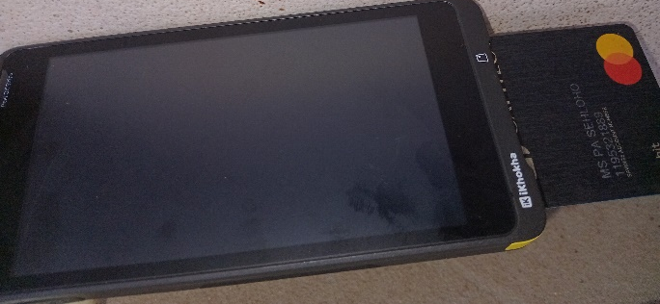
FINANCIAL MANAGEMENT
Investment on Speed Point Machine
We keep detailed records of all transactions,
Income and expenses.
Price List is regularly updated and available
The business is formally registered and has a bank account.

Slide 13
SAVINGS AND SELF SUFFICIENCY
Saving Club
Member of Itireleng savings group.
6 Business Ladies contributing R500 per month.
I have managed to save R3000
Have you managed to increase household income? Yes. Business growth has allowed for me to earn a salary from the business, thus increasing household income.

Slide 14
INCOME AND EXPENSES FOR THE BUSINESS FOR PAST THREE TO SIX MONTHS
EXPENSES
INCOME
Item | Amount |  | Item | Amount
Sales | R11 500 |  | Stock & Packaging | 3 132
Tenants Rentals | 15 600 |  | Electricity & Data | 1 800
 |  |  | Salaries | 6 000
 |  |  | Wages | 3 600
 |  |  | Transport | 2 500
Total | R27 100.00 |  | Total | R17032.00

Slide 15
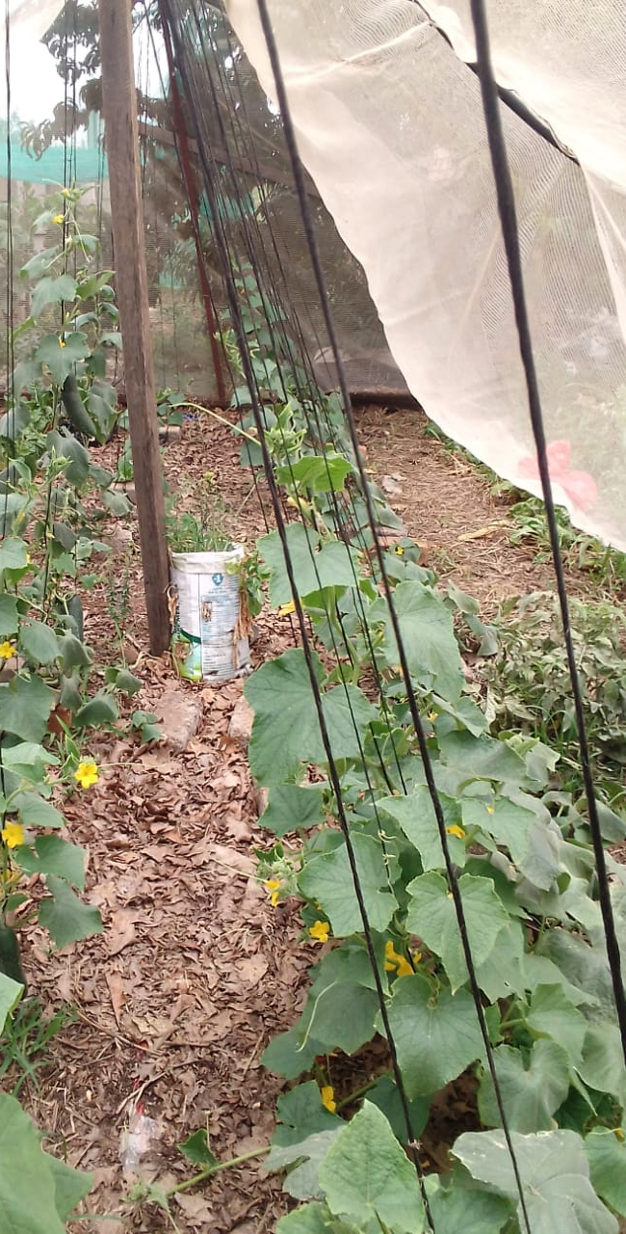
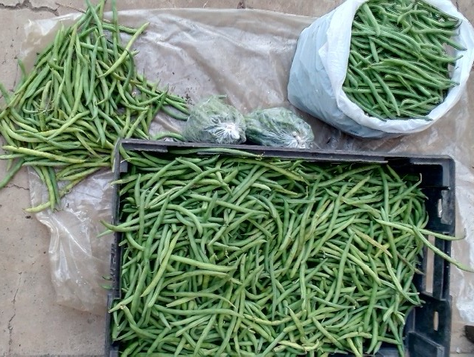
CHALLENGES
Limited space for larger scale planting.
Transport
How to manage?
I managed to get 2HA Plot Lease Agreement for crop planting.
Hire transport to suppliers and to market places.

Slide 16
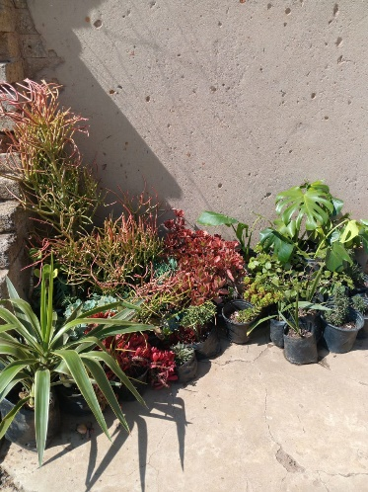
SUSTAINABILITY
Business Plan in place to ensure the long-term success
Connected to nature is our greatest advantage.
Nursery – Is a greater advantage for the business growth. By managing well duplication production
By using organic practices and eco-friendly methods.
Value added products - Processing

Slide 17
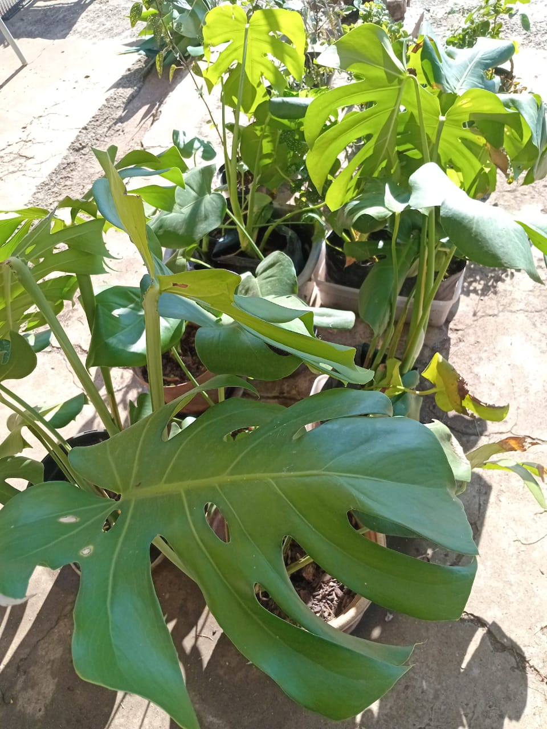
WHAT PLANS HAVE YOU MADE TO GROW YOUR BUSINESS IN THE NEXT 6 MONTHS?
To grow the business and meet increasing demand, I have the following expansion plans:
Lease 2-hectare plot specifically for vegetable production.
[Est. annual expense R36 000]
2 Wheel Tractor
Fencing: for crop production safety
Erect essential structures to support and protect production:
A greenhouse for starting seedlings. [Est. start-up of R30 000]
A nursery safe area for growing plants. [Est. start-up of R10 000]
Protective shelters to shield crops from harsh weather conditions.
Create employment opportunities by hiring additional workers for the increased workload.
Host workshops to share my knowledge and skills with others in the community, especially women and youth, as part of my commitment for skills development and empowerment.

Slide 18
Additional Information
Posters for Market exposure Website Design: To promote my business online and reach more customers.
Branded Promotional Materials: Such as banners and a branded gazebo, to improve visibility at markets, events, and community activities.
“Tough Times Never Last,
But Tough People Do!”
Robert H. Schuller

