Slide 1



PROMOTING GENDER-INCLUSIVEE LOCAL ECONOMIC DEVELOPMENT IN SOUTH AFRICA
ESTABLISHED ENTREPRENEURS
NAME OF THE BUSINESS
MATERENE CHEMICAL SUPPLIES
PARTICIPANT NAME: Pulane Moeketsane
COUNCIL: Midvaal
Please include photographs of the business!

Slide 2
MY EXPERIENCE DURING SUNRISE CAMPAIGN
Lessons from Life Skills and Entrepreneurship training and customer service.
I found my confidence again
My self-esteem is recovering
I can stand up for myself and I found my voice
I am now able to run my business better with the skills I leaned from Sunrise campaign training
Memorable moments (e.g. Group work and mentorship
Mentorship program was the most memorable,having someone that cares to help me with my business.
Computer skills training helped me a lot,I infact I made this presentation using the skills I got.

Slide 3
HOW MY LIFE HAS CHANGED
Personal growth (confidence, independance, safety)
I am more confident, more out going,and I put my safety first.
Family impact (children, relationships, community respect)
I'm a better Mother to my son.
I can now go to community events and not feel comfortable.
I believe I can do anything and succeed.
Income changes or lifestyle improvements
Earning money makes me financial independent ,
I can now take care of myself and my children,I can now go on outings with my son and buy him a birthday present after a long time.

Slide 4
PLEASE DESCRIBE THE BUSINESS
Name: Materene chemical supplies
Household cleaning supplies
Achievements so far Challenges still faced and how they’re managed
Managed to get a contract with 1 cleaning company,
Challenges getting more clients
Getting our business in the municipality data base

Slide 5
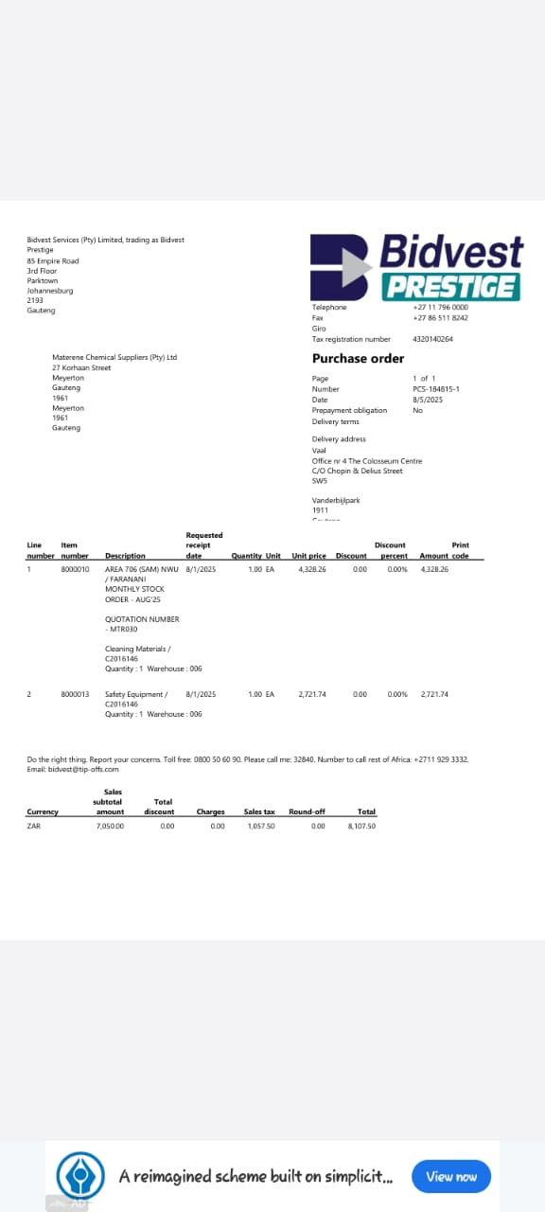
CUSTOMER BASE AND COMPETITION?
Evidence
Who are your customers?
Cleaning companies
Have you managed to get new customers?
No
How did you do this?
Still haven't managed to get any,most already have suppliers.
Who is your competition?
Big companies with experience.
How do you handle competition in your business?
Better prices,and offer other services like delivery to smaller companies.

Slide 6
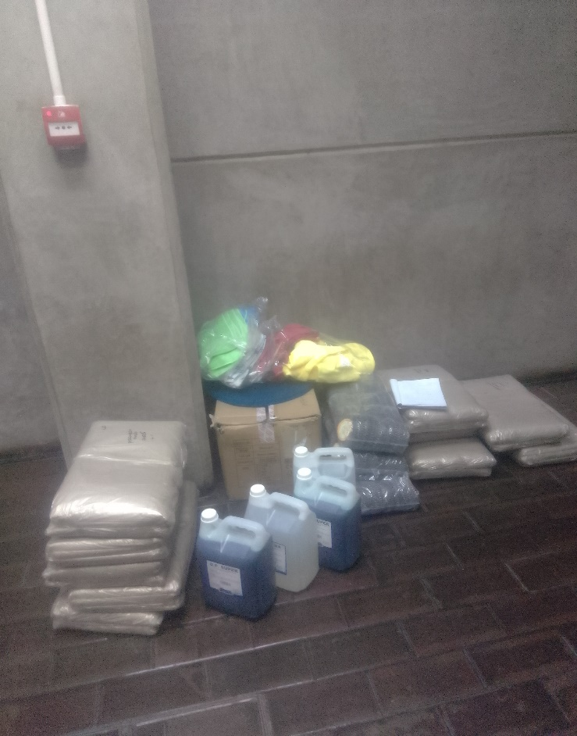
NEW PRODUCTS OR SERVICES?
Do you have any new business products or services?
Yes,we offer delivery services.
How do you advertise/market your products?
We send Marketing emails and price list to potential clients and also use word of mouth.
Evidence

Slide 7
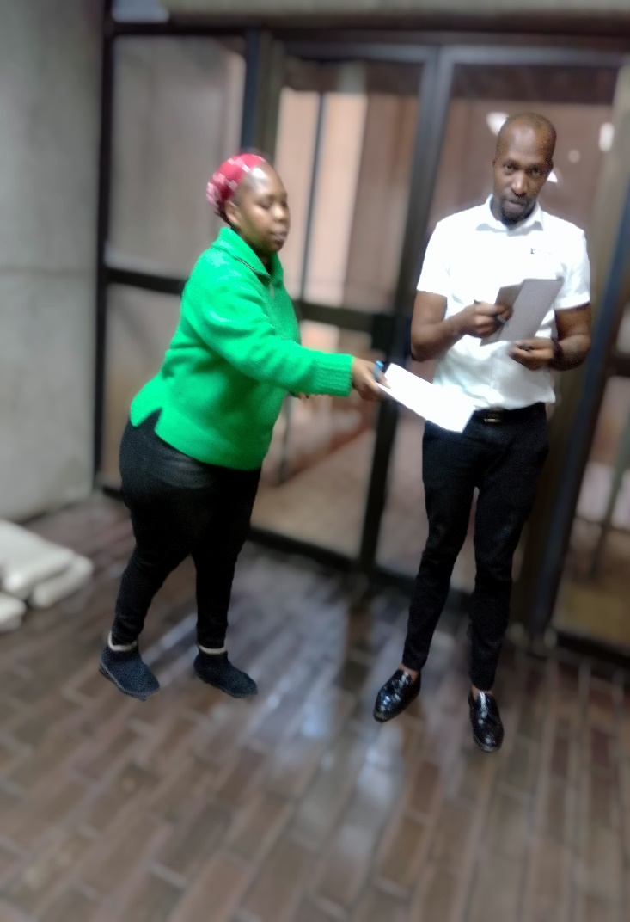
QUALITY AND PACKAGING
Are your customers happy with the quality of your products or services?
Yes
Our client renewed our contract for another year.
Do you have any branding available for your products?
Not yet but planning it's in the pipeline.hopefully next year.
Have you changed the packaging or marketing of your business to attract more customers?
Yes we have added free delivery to business in close areas.
Evidence

Slide 8
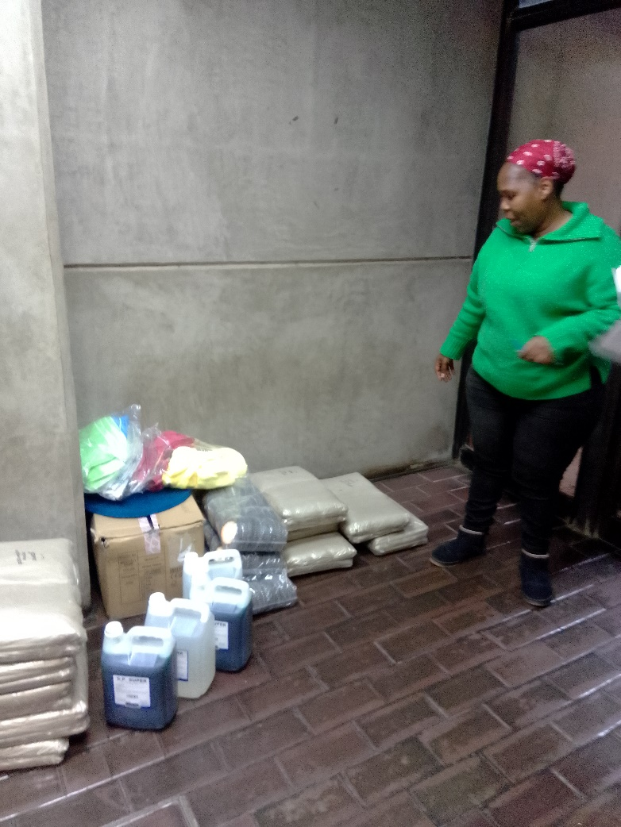
BUSINESS MANAGEMENT
Have you hired more staff?
No, we wanted to grow the business first
How do you manage your stock and check regularly?
We stock per order and deliver within 7 days.
Have you been able to price your products better so that you can earn a surplus from the business?
Yes,we now make more than 30% in profit.
Evidence

Slide 9
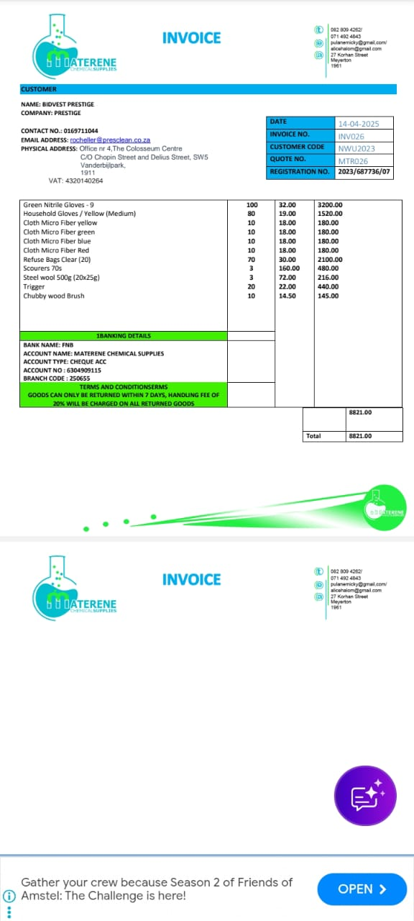
FINANCIAL MANAGEMENT
Do you have a record-keeping system in place?
Yes,we have an invoicing system and have an electronic filing system
If yes, how is it helping you to manage your business?
It helps with price tracking and keeps our records safe.
Do you have a bank account for your business?
Yes
Evidence

Slide 10
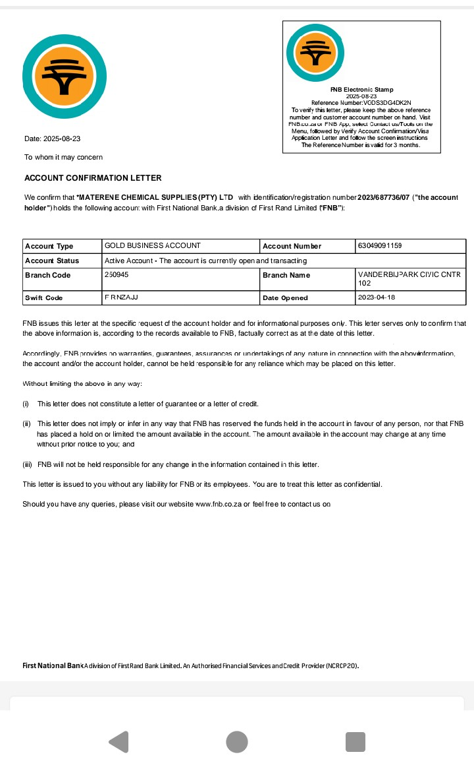
SAVINGS AND SELF SUFFICIENCY
Are you a member of a savings group?
Yes, rotation method.
Are you saving money? How much have you been able to save so far?
Yes
I will receive 5500 from stockvel.
Have you managed to increase household income?
Yes i have.
Evidence

Slide 11
INCOME AND EXPENSES FOR THE BUSINESS FOR PAST THREE TO SIX MONTHS
INCOME
EXPENSES
ITEMà | AMOUNT
Sales | 51000
TOTAL | 51000
ITEM | AMOUNT
Stock | 36000
Transportation | 3600
Savings | 3000
TOTAL | 42600

Slide 12
CHALLENGES
What challenges have you experienced in your business?
Big reputable businesses have the loyalty of cleaning companies.
How have you addressed these?
By offering better prices,good customer service and we offer free delivery to cleaning companies closeby.

Slide 13
SUSTAINABILITY
How will you sustain your business?
By growing our client base,securing contracts and offering other services.
What other sustainability measures are you putting in place for your business?
Maintain a good reputation by offering better service and deliver faster and effectively.

Slide 14
WHAT PLANS HAVE YOU MADE TO GROW YOUR BUSINESS IN THE NEXT 6 MONTHS?
Opening an online store.
Offering door to door delivery to all our customers.

Slide 15
ADDITIONAL INFORMATION?
What other changes have you experienced in your business?
There is a market for cleaning chemicals that are good quality and affordable and we want to bridge the gap between big manufacturers and resellers.
Do you have any additional information to share?
Yes,to improve myself I have done a nail technician course and in the process of opening my own nail bar,space and capital is a challenge but I am working very hard to open by March 2026.

