Slide 1
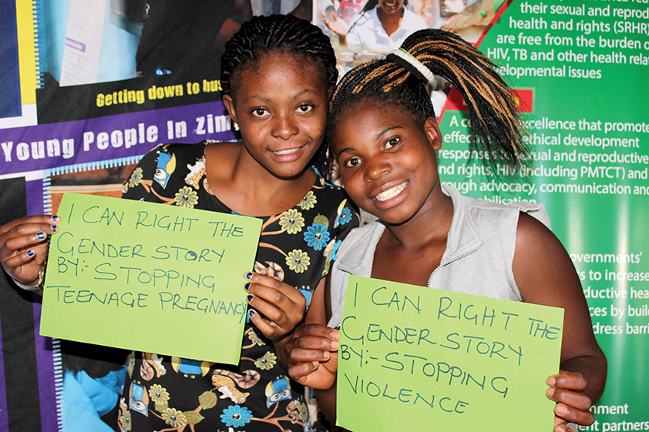
Regional Transforming Lives Programme (2018-2020)
Overview

Slide 2
PROGRAMME AT A GLANCE
TITLE: Transforming Lives – Transforming the Policy Environment for Accelerating Access to Sexual and Reproductive Health Rights (SRHR) by Adolescents and Young People, within an SDGs Framework, in Southern Africa, by 2020
TIMELINE: January 2018 - June 2021
COVERAGE: Regional: SADC region; and National: 6 implementing countries (Malawi, Lesotho, South Africa, Swaziland, Zambia and Zimbabwe), 10 collaborating countries (Angola, Botswana, DRC, Madagascar, Mauritius, Mozambique, Namibia, Seychelles, Comoros and Tanzania)
TARGETS & BENEFICIARIES: Beneficiaries: Adolescents and young people, particularly adolescent girls below 20 years of age; Primary target: Policy-makers from Ministries of Education, Health and Gender; Parliamentarians, Traditional and Religious leadership authorities & Youth-focused/led civil society organisations; and Secondary target: Regional Bodies (SADC Secretariat, SADC PF, AU) & CSO’s

Slide 3
GOALS
Impact Goal: Improved sexual and reproductive health outcomes among adolescents and young people, in Southern Africa, by 2020.
Programme Goal: Contributing towards a more conducive policy environment that enables positive SRH outcomes among adolescents and young women, in Southern Africa, by 2020.

Slide 4
OBJECTIVES
Strategic Objective 1 (SO1): Policy Development - Support the development of SADC Sexual gender-based violence (SGBV) Response Guidelines for Adolescents by Member States, by 2020
Strategic Objective 2 (SO2): Policy Advocacy - Advocate to SADC Member States to scale up prevention of unintended pregnancies and unsafe abortions among sexually active adolescents, in SADC by 2020
Strategic Objective 3 (SO3): Social Accountability Monitoring - Strengthen the capacity of regional youth organisations and networks in social accountability monitoring of the delivery of youth-friendly SRH Information and services in southern Africa, by 2020
Strategic Objective 4 (SO4): Evidence and Knowledge Sharing - Enhance knowledge sharing of working models and strategies, and innovations on SGBV, unintended pregnancies and unsafe abortions among adolescents and social accountability monitoring of youth-focused SRH services; within the region and across the broader sector, by 2020

Slide 5
SYNERGIES WITH GLOBAL, REGIONAL & NATIONAL PRIORITIES
Country Priorities
National
Development Plans
Health and related
Sector Policies
Regional Priorities
SADC Regional Indicative Development Strategic Plan (RIDSP)
SADC Protocol on Gender and Development
Global Commitments
SDG 3 on Health
and Well-being
SDG 5 on
Gender Equality
SADC Framework for Implementing CSW Resolution 60/2
SADC HIV, SRH, TB & Malaria Programmes Integration Strategy (2016-2020)
ASRH Strategies and Frameworks

Slide 6
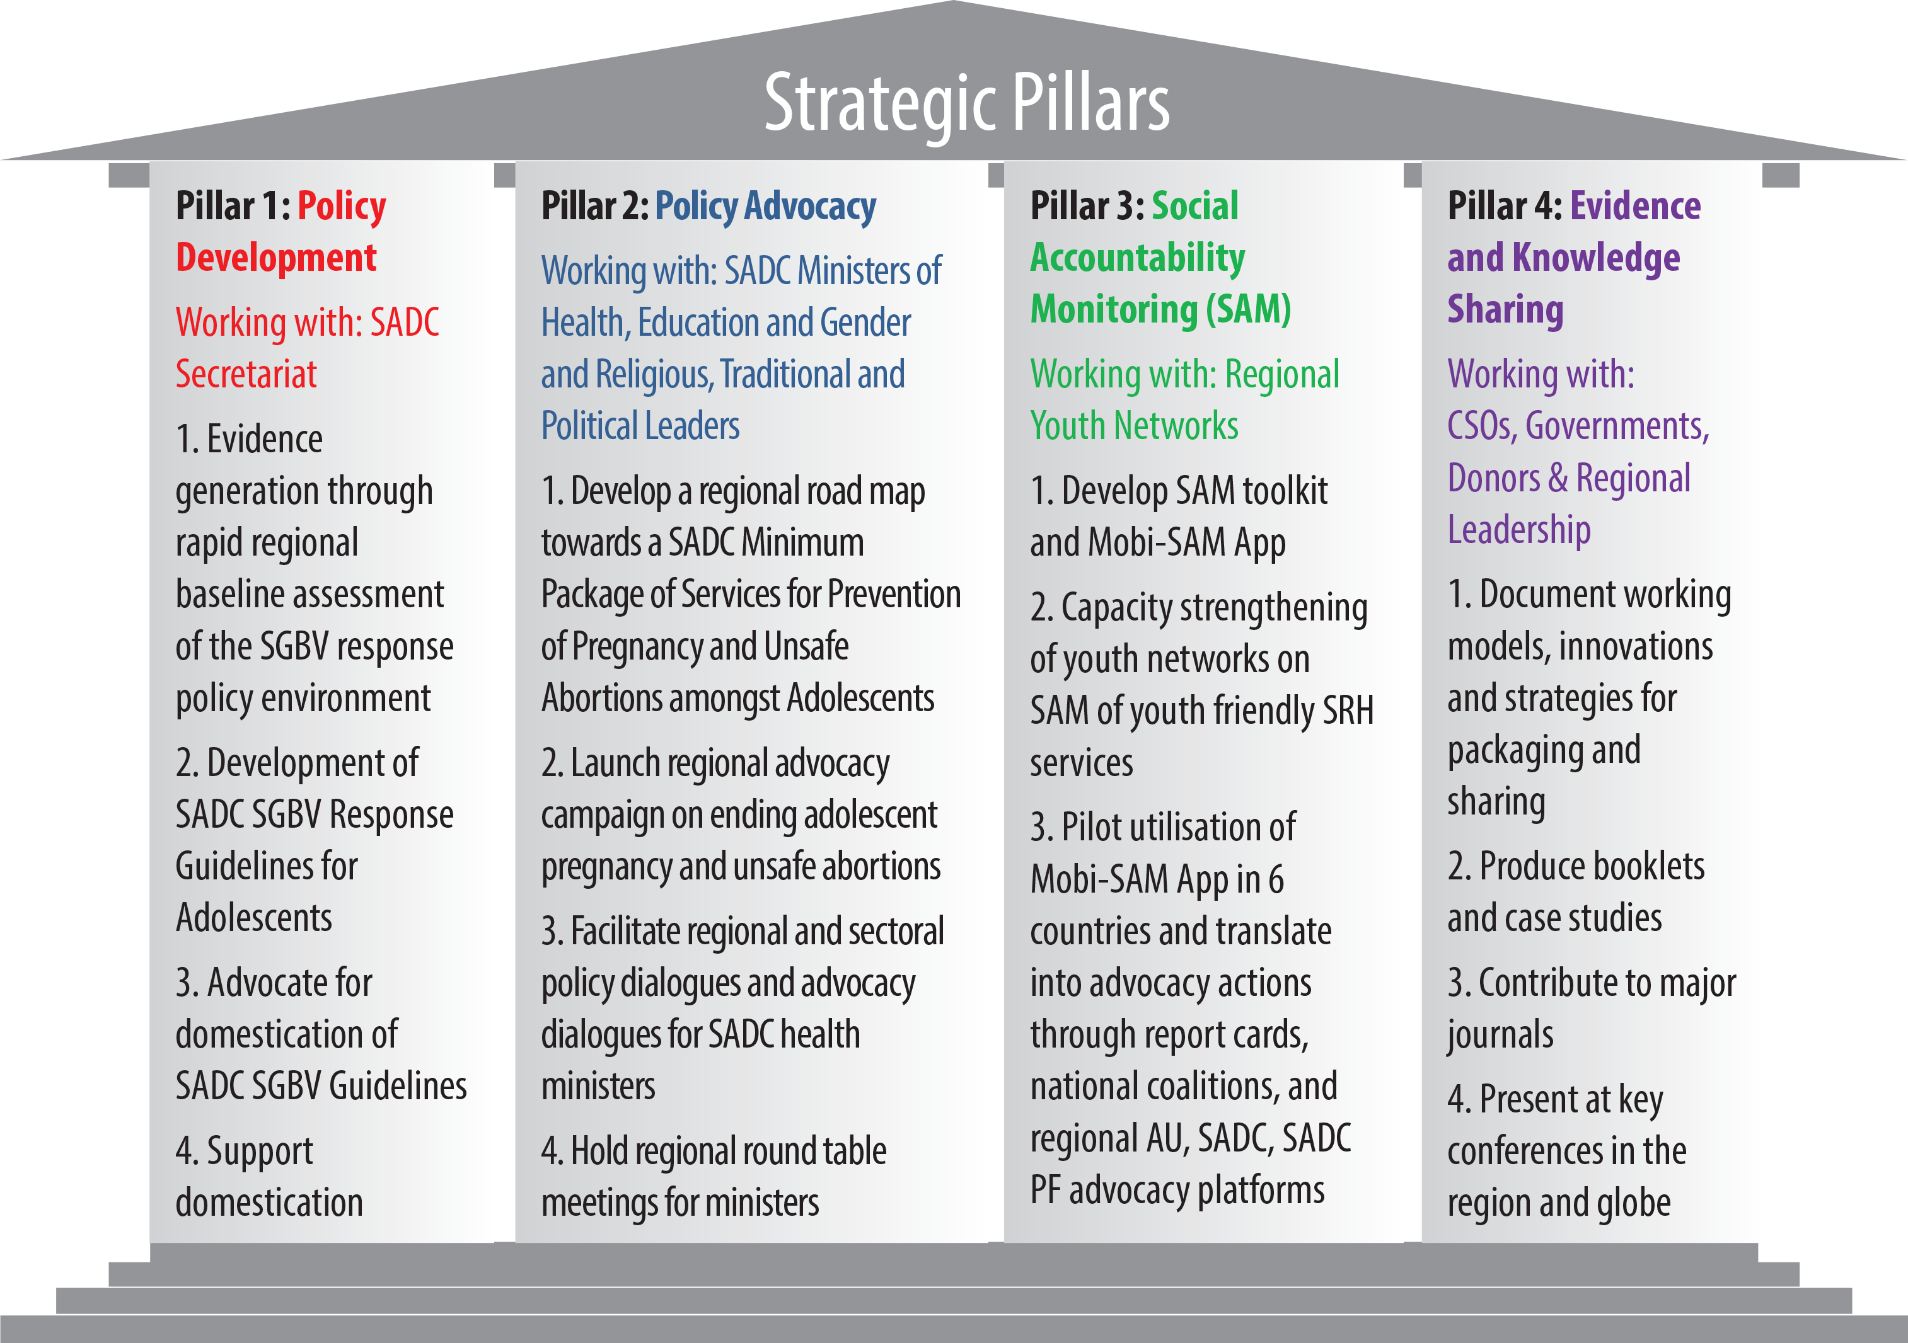
PROGRAMME PILLARS

Slide 7
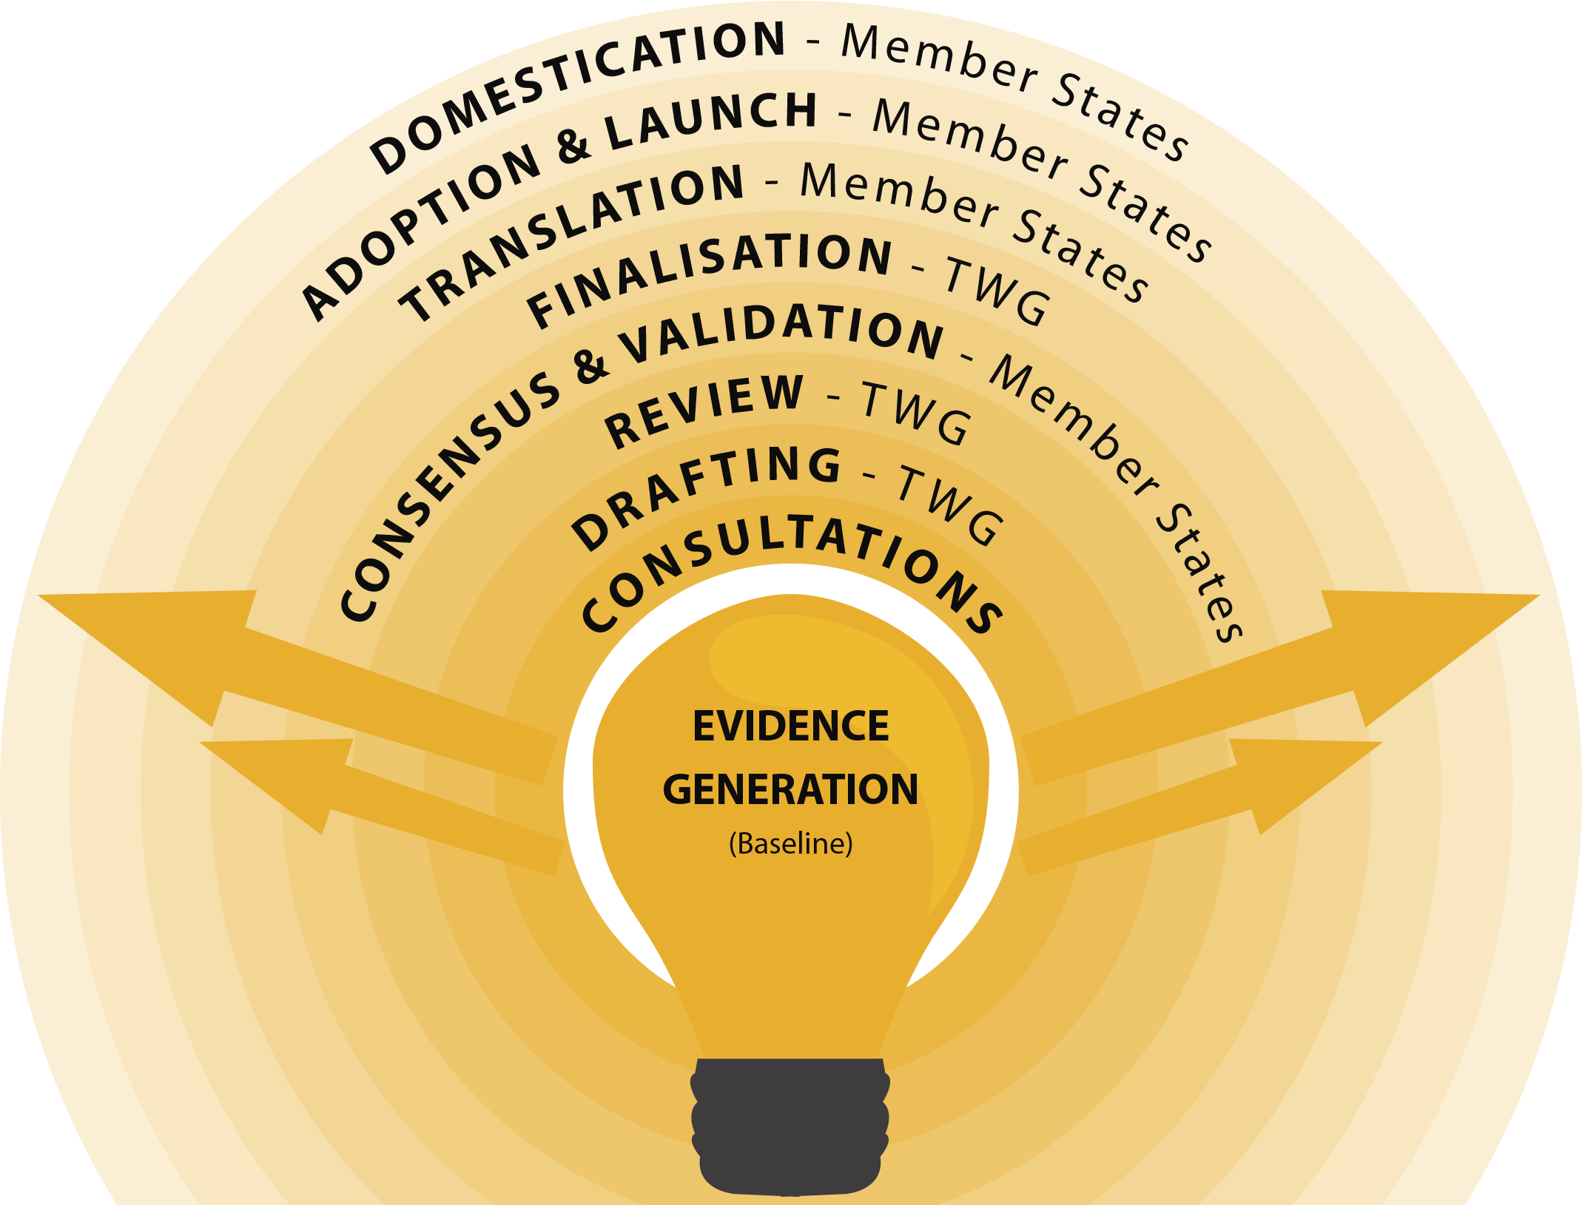
PILLAR 1: POLICY DEVELOPMENT

Slide 8
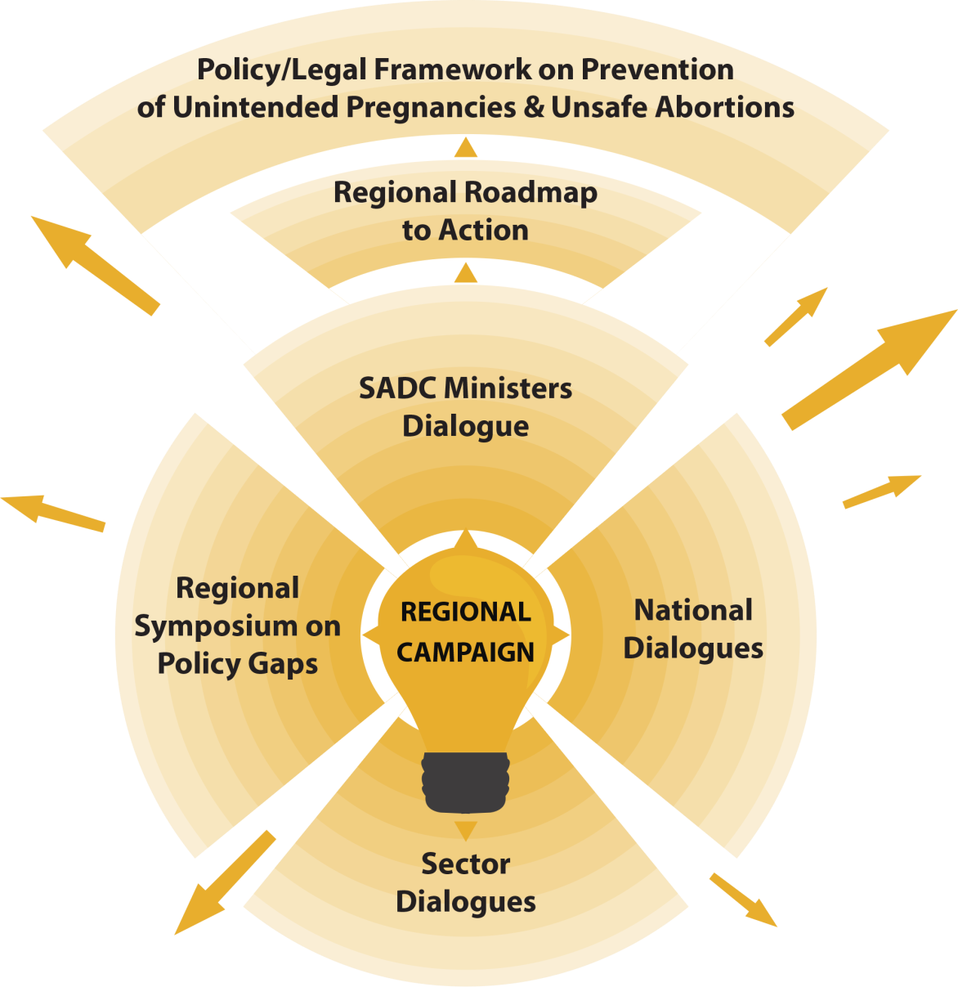
PILLAR 2: POLICY ADVOCACY

Slide 9







PILLAR 3 – SOCIAL ACCOUNTABILITY MONITORING
State/Duty-bearers Accountability in Delivery of Youth Friendly SRH Services
(SGBV, unintended teen pregnancy and unsafe abortions)
Learning and Reflection
Implementation Science Research
Social Accountability Advocacy
(Local, National & Regional Advocacy contributing to SO1 and SO2)
Identify Social accountability partnerships - Youth Networks, Service providers & Policy makers
Develop mobile technology and tools
Capacity strengthen on SAM on SRH for Youth networks/ CSOs
Pilot mobile technology and tools
Establish National Coalitions /synergise with existing structures of SAM on Youth SRH Services

Slide 10



PILLAR 4: EVIDENCE AND KNOWLEDGE SHARING
2. Package learning into appropriate formats for dissemination, such as booklets of models, case studies, journal articles and videos
1. Documentation of models, innovations and strategies on prevention of SGBV, unintended pregnancy and unsafe abortion
3. Organise knowledge sharing platforms for CSOs, ministries, policy-makers, donors, and youth groups

Slide 11
MONITORING & EVALUATION APPROACH
Sphere of Influence: Change in knowledge, behaviors, attitudes, relationships, partnerships and agendas
Sphere of Interest:
Policy and service delivery context; through a heightened political commitment lens
Sphere of Control: Advocacy tactics, activities and outputs
Baseline Values
Progress Markers Established
Evaluation
Evidence Generation & Learning
Programme Monitoring

Slide 12

Yes …..Young People Can Enjoy their SRHR !

Slide 13
Thank You… and looking forward to fruitful collaborations towards building a safer SADC for our young people!

