Slide 1


Voice and Choice Summit 2026-Organisational Development Fundraising & Sustainability Category
Cross subsidisation “ The Long Term Model”
Thabiso Ngcobo
Voice and Choice Summit 2026 \ Voice and Choice Summit 2026

Slide 2
Synopsis– brief overview what this is about
Name | Thabiso Ngcobo
Designation | Wellness practitioner
Organisation | Incema NPO
Country | South Africa
Category | Organisational Development Fundraising and Sustainability.
Summary | This presentation highlights Incema’s journey in strengthening organisational sustainability through diversified fundraising and development strategies. It outlines innovative approaches introduced between 2024 and 2025 to ensure long-term impact despite shrinking donor funding. The presentation focuses on cross-subsidisation, community fundraising initiatives, partnerships, volunteerism, and grant mobilisation.
Voice and Choice Summit 2026 \ Voice and Choice Summit 2026

Slide 3
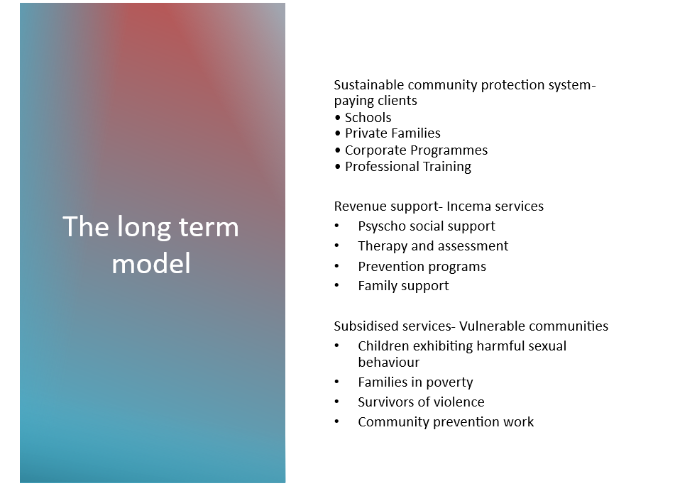

Incema Fundraining and Sustainability Concept
Voice and Choice Summit 2026 \ Voice and Choice Summit 2026

Slide 4
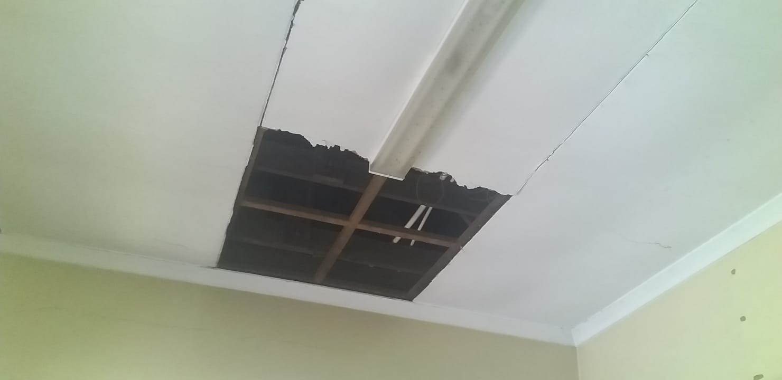
Background(problem, actions, change, evidence)
Before receiving support through the Women Voice and Leadership (WVL) Fund 1 & 2, Incema relied heavily on project-based grant funding. Limited resources made it difficult to sustain specialised services for vulnerable children and families. Operational challenges such as limited office infrastructure and unstable municipal support threatened service continuity.
Voice and Choice Summit 2026 \ Voice and Choice Summit 2026

Slide 5
Funds raised
Program/ Activity | Amount raised (please be clear what currency) | How you went about raising the funds
Scottsville Primary | R165,300 | We rendered specialised cross subsidisation services. ( Pilot)
Berg street primary | R5000 | We rendered psychosocial services
Hiking wellness and fundraising | R12700 | Ticket sales, donations & partnerships
Jumble sale | R3040 | Gathering and selling pre loved clothes
TOTAL | R184,040 | Incema was able to generate these outside of funding, this speaks to its sustainability efforts.
Voice and Choice Summit 2026 \ Voice and Choice Summit 2026

Slide 6
In kind funds raised
Source of in –kind funds | Amount (please be clear about currency) | How were you able to do this
Office space from Pietermaritzburg Magistrate Court | R3,500 x 12 = R42,000 ( PA) | GBV Hotspot- Court placement partnership
Office support from uMsunduzi Municipality | R3,500 x 12= R42,000 (PA) | We would occupy, safe guard and maintain their space in return for occupation rights
Psychologist placements through University of KwaZulu-Natal | R15,000 X12 = R180,000 (PA) | Partnerships formed between the institution and the organisation.
Intern and in-service trainees' placements from Durban University of Technology | R 21 000, X12 = R252,000 (PA) | MOU was created so that the relationship can be sustained.
Incema team | R120 000 pm ( R67 000 pm) Difference= R53,000 x 12= R636,000 (PA) | Stipends earnings instead of salaries
TOTAL | R96,000 PM R1,152,000 PA | All of the above save the organisation this total on monthly bases
Voice and Choice Summit 2026 \ Voice and Choice Summit 2026

Slide 7

Lessons learned
• Diversified funding sources strengthen sustainability
• Partnerships reduce operational costs
• Community engagement builds support
• Cross-subsidisation can sustain specialised services
Voice and Choice Summit 2026 \ Voice and Choice Summit 2026

Slide 8
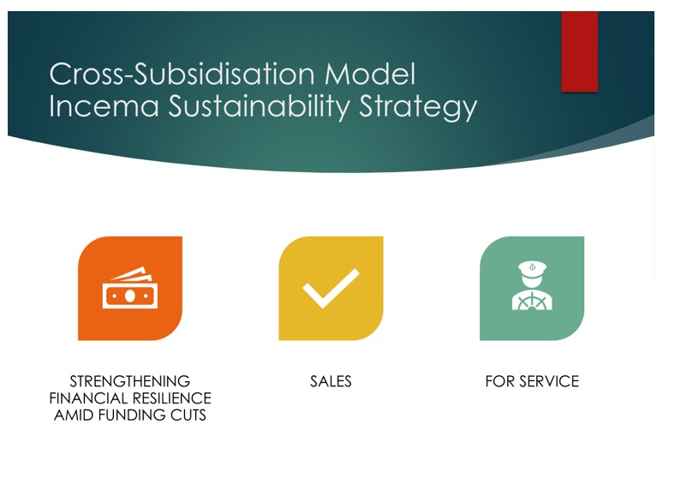
Sustainability
Incema introduced the 'Long Term Model', a cross-subsidisation approach where services are structured to allow those who can afford to contribute financially while ensuring free access for vulnerable communities. Revenue generated through structured service partnerships supports community services.
Voice and Choice Summit 2026 \ Voice and Choice Summit 2026

Slide 9
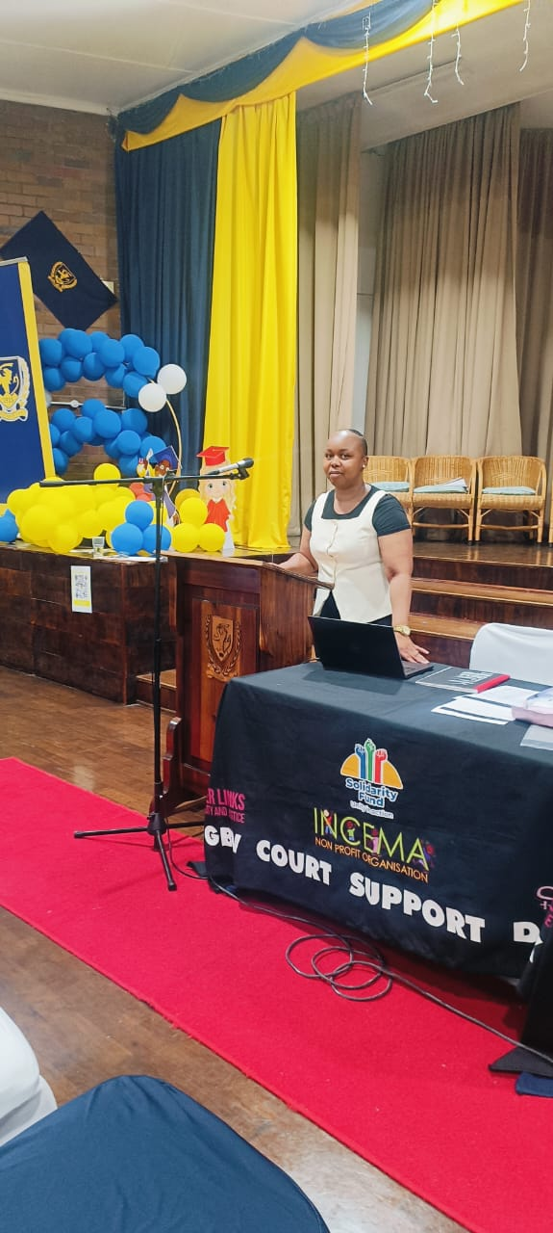
Sustainability
Pilot Project – Scottsville Primary School Programme
The Scottsville Primary School programme serves as a pilot for the cross-subsidisation model.
Psychosocial services
Professional training for educators
Prevention programmes for learners
Early reporting mechanisms for harmful sexual behaviour
Funds generated support psychosocial services for vulnerable children.
Program raised R165000 in two months
Voice and Choice Summit 2026 \ Voice and Choice Summit 2026

Slide 10
Next Steps
Future Sustainability Plans
• Secure a permanent organisational building
• Expand cross-subsidisation model to more institutions such as hospitals, Child and Youth Care Centre and schools
• Strengthen corporate partnerships
• Expand prevention programmes across the district
Voice and Choice Summit 2026 \ Voice and Choice Summit 2026

