Slide 1


Voice and Choice Summit 2026-Organisational Development Category
Your logo goes here
Namibia – MPower Community Trust: Strengthening Fundraising and Resource Mobilisation for Organisational Sustainability.
A compelling, short title that captures the essence of the Organisational Change starting with the country and organisation name e.g. South Africa – Women’s Action Network: strengthening governance and financial systems to sustain women’s rights work”
Please use your own photos to make your presentation unique.
Quotes and any other visuals make your presentation more engaging!
Voice and Choice Summit 2026 \ Voice and Choice Summit 2026

Slide 2
Synopsis– brief overview what this is about
Name | Inacia Pangelasius
Designation | Monitoring & Evaluation Manager
Organisation | Mpower Community Trust
Country | Namibia
Category | Organizational Development Category
Summary | This presentation showcases MPower Community Trust’s efforts to strengthen financial sustainability and organizational capacity while delivering its Safe Voices programme for LGBTIQ communities in Namibia. The organization introduced income-generating activities, formalized financial and HR systems, implemented key policies, and strengthened Board oversight and M&E practices. These changes improved transparency, accountability, and operational efficiency, reducing reliance on donor funding and enhancing long-term sustainability. The experience offers replicable lessons for other grantees seeking to institutionalize robust systems and deliver rights-based programmes effectively.
Voice and Choice Summit 2026 \ Voice and Choice Summit 2026

Slide 3
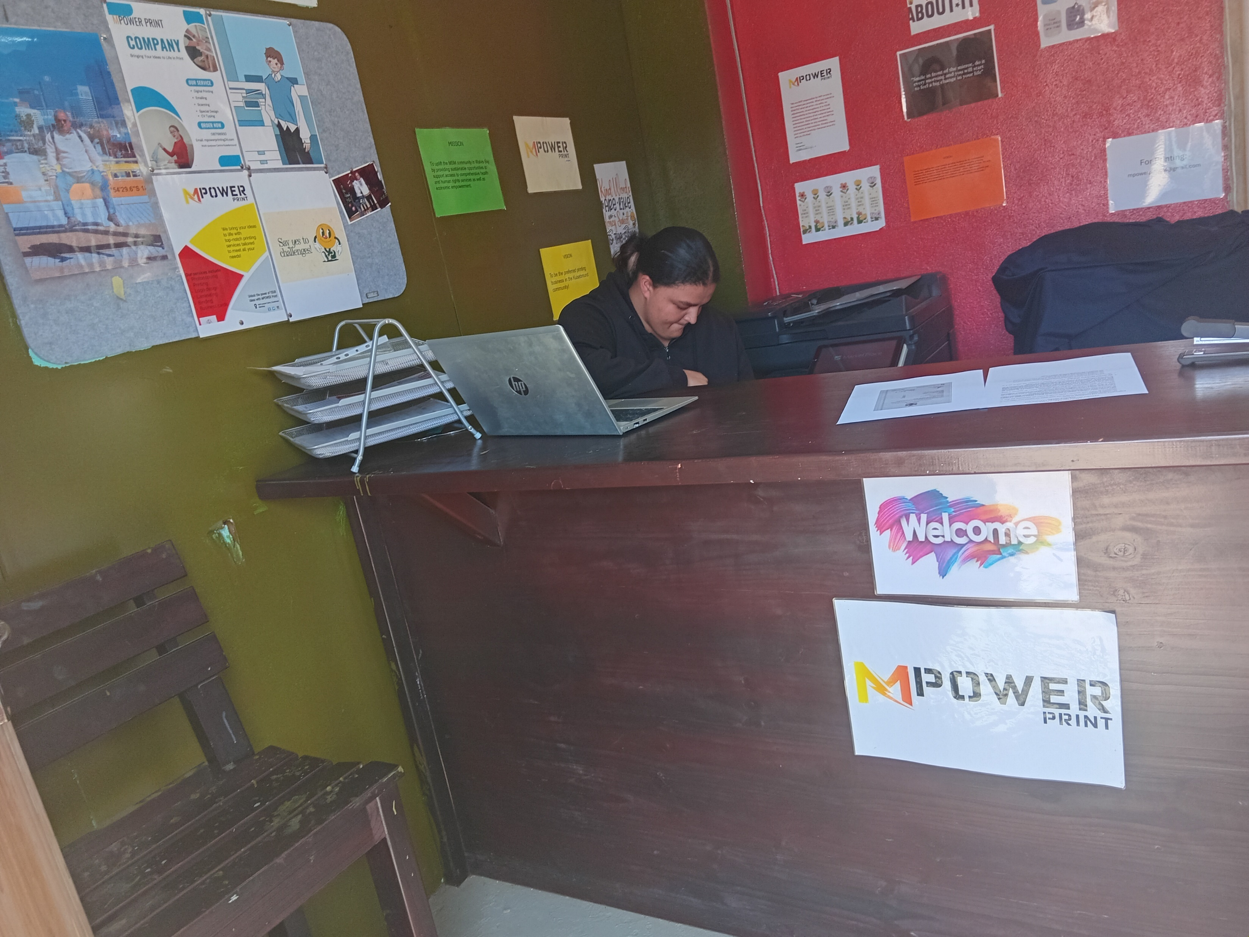
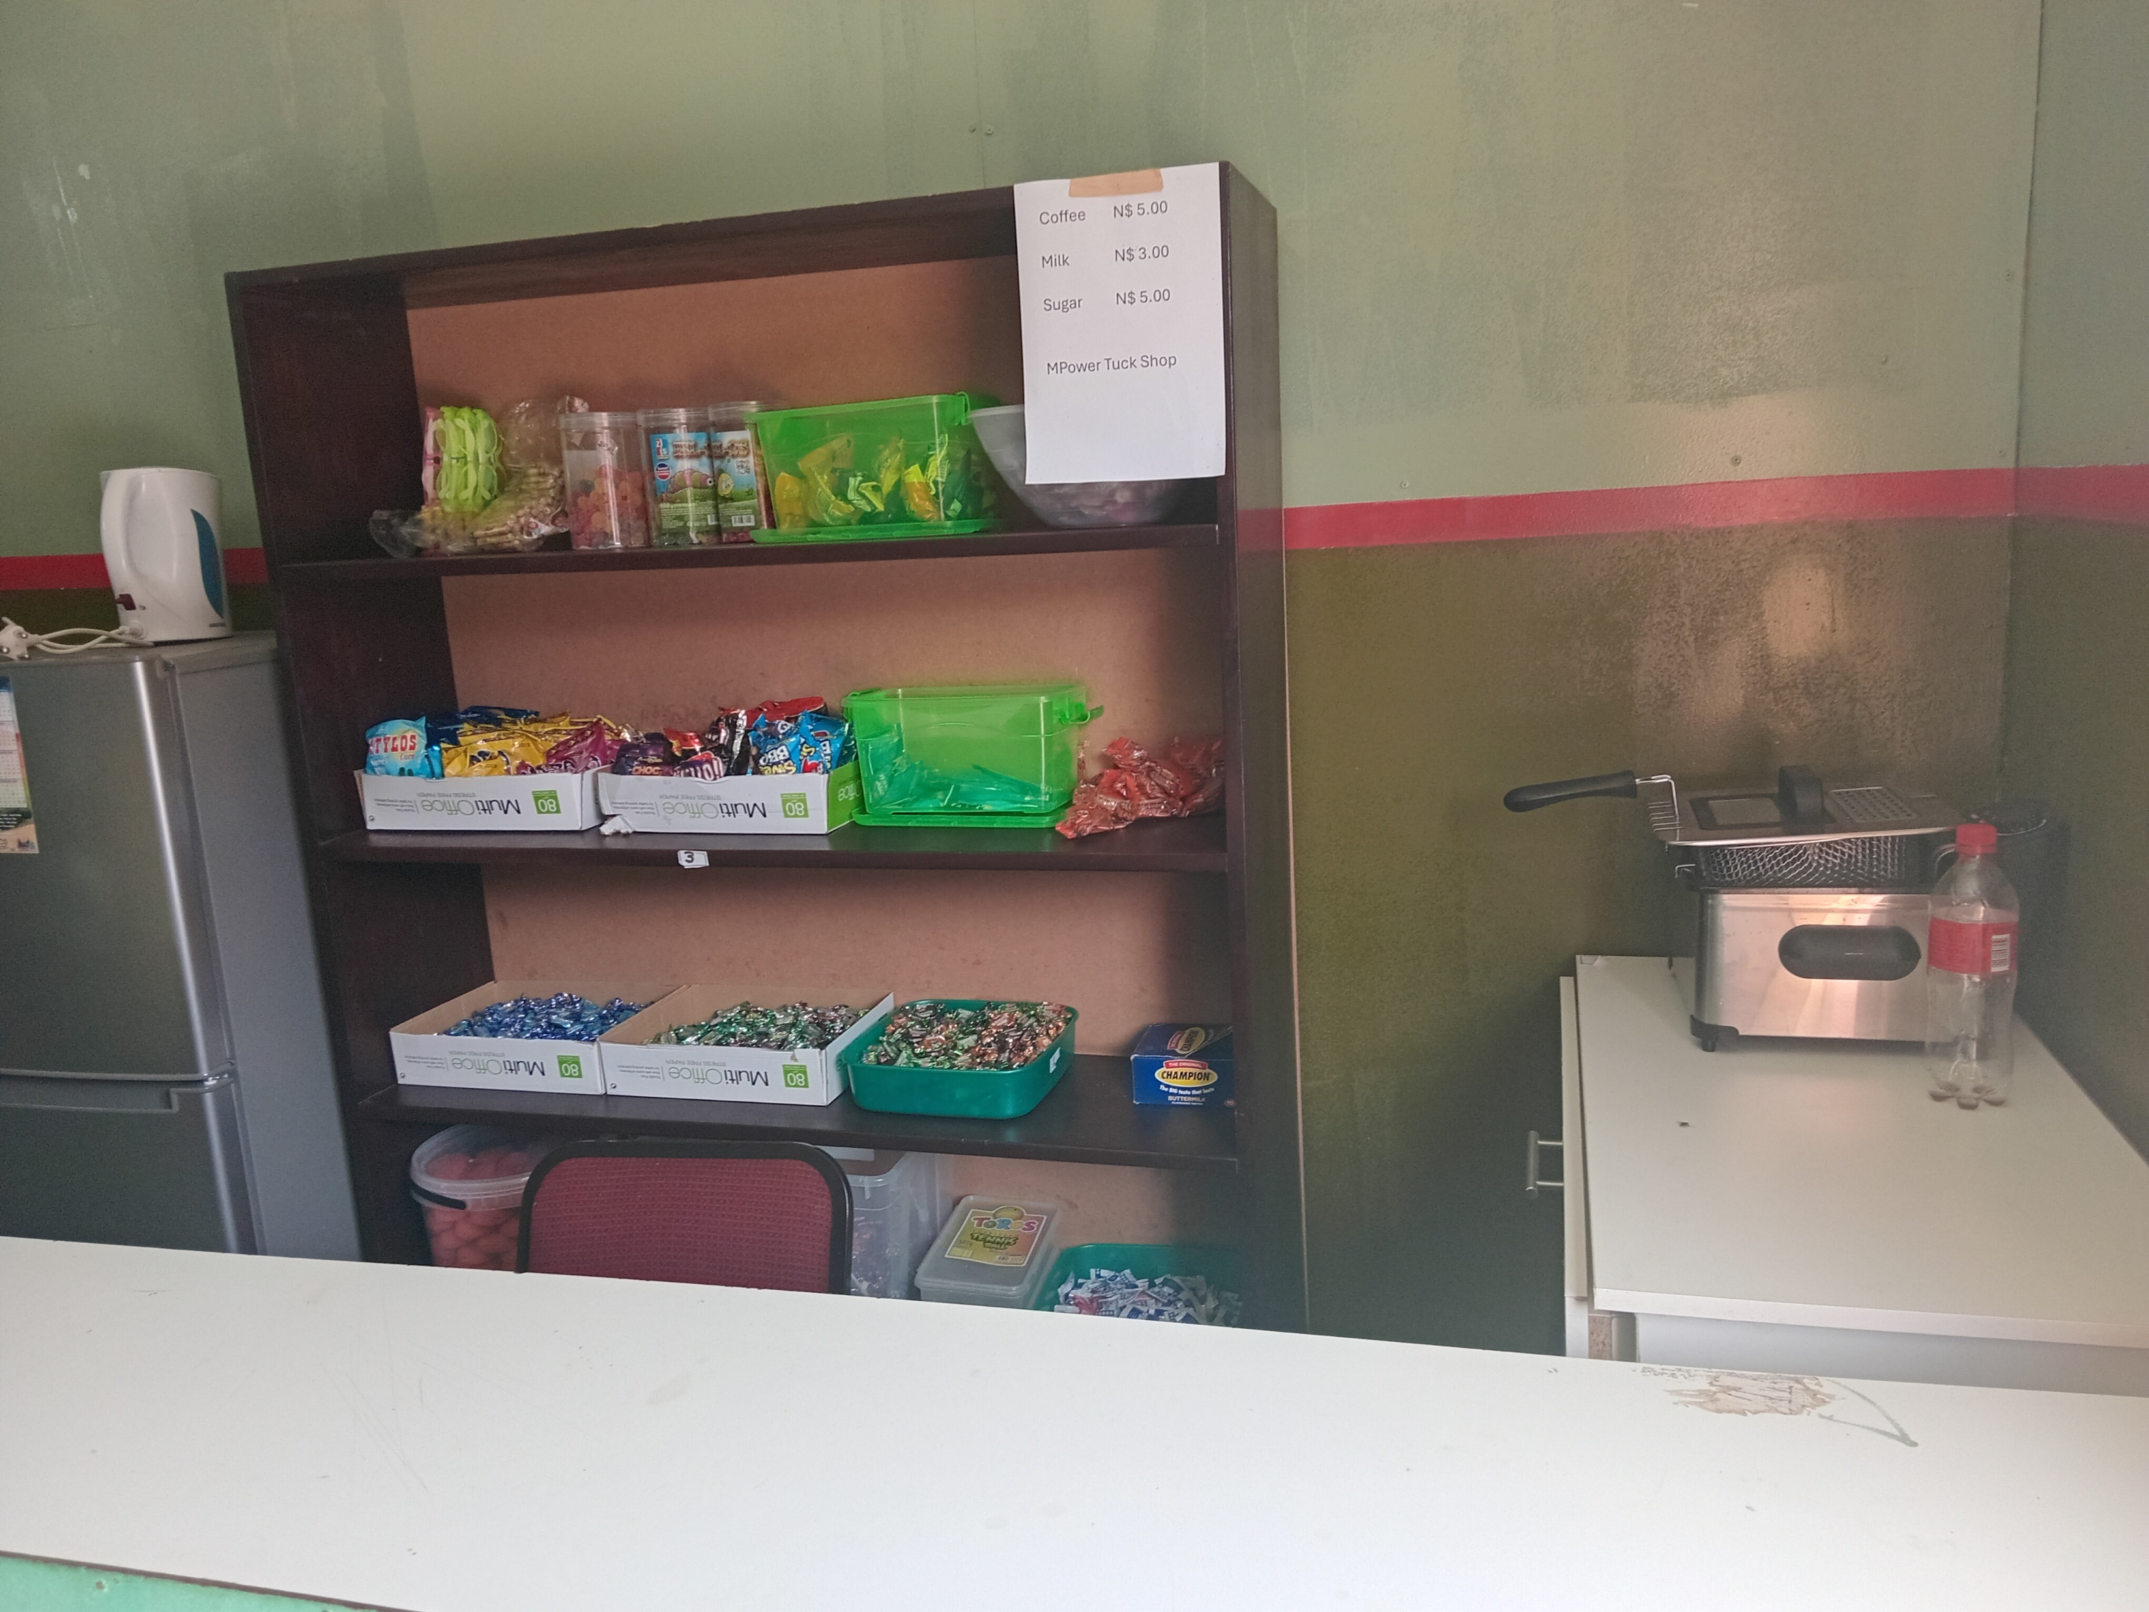
Background(problem, actions, change, evidence)
Problem:
Reliance on donor funding, manual financial systems, and limited fundraising constrained sustainability and organizational growth.
Action:
Introduced income-generating initiatives: a small printing shop and a kiosk.
Formalized financial and HR systems, developed key policies (finance, safeguarding, procurement, whistleblowing).
Change:
Initiated early fundraising strategies and diversified income streams for long-term sustainability.
Evidence: Include Photos or videos
Voice and Choice Summit 2026 \ Voice and Choice Summit 2026

Slide 4
ODS Baseline Scores- find yours!
RWVL ODS Baseline Report
Marang ODS Baseline Report
Overall Score
People and Leadership score | 8
Structures, Systems, and Processes Score | 7
Resilience, Care, and Security Score | 7
Finance and sustainability and social entrepreneurship Score | 6
Connections and Visibility Score | 6
Voice and Choice Summit 2026 \ Voice and Choice Summit 2026

Slide 5
Change
How did the change come about?
The change at MPower Community Trust came about as a response to the organisation’s need to strengthen financial sustainability, reduce reliance on donor funding, and support long-term growth while scaling the Safe Voices programme.
The Executive Director led the process, securing Board approval and strategic oversight, while finance and programme staff participated in setting up operational procedures, record-keeping systems, and managing day-to-day activities. Actions taken included introducing income-generating initiatives (a printing shop and kiosk) integrated into the financial framework, establishing a separate project bank account with dual signatories, formalizing financial and HR systems, developing key policies on finance, safeguarding, procurement, whistleblowing, and sexual harassment, training staff on procedures and internal controls, strengthening Board governance, and creating an offline M&E database to enable independent tracking, reporting, and organizational learning.
Evidence: Include Photos or videos
Voice and Choice Summit 2026 \ Voice and Choice Summit 2026

Slide 6
What has changed in the following areas since working with Gender Links.
 | Before due diligence | After due diligence
Financial system | There were already internal controls and standardized reporting. | Same systems were applied.
Separate bank account | The organization keep money into separate bank accounts. | A dedicated project bank account was opened, ensuring immediate financial segregation and accountability before donor funds were disbursed.
Two signatories to the account | The organization has always kept 2 Signatories to the account. | Same principles were followed.
Financial documentation | Financial records were standardized, complete, and filed, improving audit trails and accountability. | Financial records are now more standardized, complete, and systematically filed, improving audit trails and accountability
Monthly reconciliations and routines | Monthly financial reconciliations are conducted regularly, ensuring accurate tracking and timely reporting. | Monthly financial reconciliations are now conducted regularly, ensuring accurate tracking and timely reporting.
Fundraising and Sustainability | The organisation was in the process to diversify funding incomes. | Structured fundraising strategies and diversified income streams are being developed to reduce donor dependence and strengthen sustainability.
Voice and Choice Summit 2026 \ Voice and Choice Summit 2026

Slide 7
what has changed in the following areas since working with Gender Links.
 | Before due diligence | After due diligence
Safeguarding policy | There was no stipulated safeguarding policy. | A formal safeguarding policy was implemented to protect beneficiaries, staff, and stakeholders and ensure ethical programming.
Human resources policy | There was an HR policy that guides staff recruitment, management, and development, ensuring consistency and accountability. | A formal HR policy now guides staff recruitment, management, and development, ensuring consistency and accountability.
Finance policy | A comprehensive finance policy provides clear budgeting, expenditure, and compliance procedures, enhancing transparency. | A comprehensive finance policy provides clear budgeting, expenditure, and compliance procedures, enhancing transparency.
Procurement policy | Procurement processes were there and consistently applied across all projects for greater accountability. | Procurement processes are now standardized and consistently applied across all projects for greater accountability.
Board functionality | The Board operates with clear roles, meetings, and structured oversight for improved governance. | The Board’s operation still needs support with clear roles, regular meetings, and structured oversight for improved governance.
Anti-corruption/Fraud Policy | There was no fraud policy | The whistleblowing policy is operational, though its monitoring and implementation require further strengthening.
Sexual Harassment Policy | There is no stand alone policy for sexual harassment. | Sexual harassment procedures are included in the gender operations framework, with ongoing efforts to improve enforcement and awareness.
Monitoring and Evaluation Systems | Monitoring and Evaluation is guided by the donor requirements and operational SOPs. | An offline M&E database is being developed, to allow independent data management and enhanced organizational learning.
Fundraising and Sustainability | There were no fundraising strategies. | Structured fundraising strategies and diversified income streams are being developed to reduce donor dependence and strengthen sustainability.
Voice and Choice Summit 2026 \ Voice and Choice Summit 2026

Slide 8
Significance/ Impact
What is the significance of the change?
The changes significantly strengthened MPower Community Trust’s governance, financial accountability, and organisational sustainability. By introducing clear financial systems, key policies, stronger Board oversight, and an independent M&E database, the organisation improved transparency, compliance, and decision-making. As a result, MPower is now better positioned to manage donor funds responsibly, reduce operational risks, and deliver impactful, rights-based programmes for its beneficiaries.
Evidence: Include Photos or videos
Voice and Choice Summit 2026 \ Voice and Choice Summit 2026

Slide 9
Challenges & Lessons learnt
Challenges & mitigation
Limited financial systems and manual processes: Strengthened financial procedures, introduced standardized documentation, and conducted regular reconciliations.
High reliance on donor funding: Introduced income-generating initiatives (printing shop and kiosk) and began developing fundraising strategies.
Lack of formal policies: Developed and implemented key policies including finance, HR, safeguarding, and procurement.
Limited governance oversight: Strengthened Board functionality through clearer roles, regular meetings, and structured oversight.
Inconsistent data management: Began developing an offline M&E database to improve independent tracking and organizational learning.
What lessons have you learnt?
Strong internal systems and clear policies are essential for transparency, accountability, and donor confidence.
Diversifying income sources helps reduce dependence on a single donor and improves sustainability.
Staff orientation and capacity building are critical for successfully implementing new systems and procedures.
Effective Board oversight strengthens governance and strategic decision-making.
Investing in internal M&E systems supports evidence-based planning, learning, and programme improvement.
Voice and Choice Summit 2026 \ Voice and Choice Summit 2026

Slide 10
Sustainability
Institutionalizing key policies (finance, HR, safeguarding, procurement).
Maintaining regular financial controls such as reconciliations and dual-signatory approvals.
Strengthening Board oversight and staff capacity.
Using the M&E database for continuous learning and decision-making.
Expanding fundraising and income-generating initiatives.
Dedicated project bank accounts with dual signatories.
Clear organizational policies and standardized financial systems.
Regular financial reviews and documentation.
Staff capacity building and strong Board governance.
Internal M&E systems for better data management and learning.
Evidence: Include Photos or videos
Voice and Choice Summit 2026 \ Voice and Choice Summit 2026

Slide 11
Next Steps
What are your plans?
Strengthen and expand fundraising strategies to diversify funding sources.
Grow income-generating initiatives to support core organisational costs.
Continue strengthening internal systems, policies, and financial controls.
Fully implement and utilize the offline M&E database for improved data management and learning.
Build staff capacity and strengthen Board governance to support long-term organisational sustainability.
Voice and Choice Summit 2026 \ Voice and Choice Summit 2026

