Slide 1


Voice and Choice Summit 2026- Organisational Development Category
Your logo goes here
South Africa – Social Welfare In Tech: empowering GBV survivors through community dialogue and support
Women’s Action Network: strengthening governance and financial systems to sustain women’s rights work”
!
Voice and Choice Summit 2026 \ Voice and Choice Summit 2026

Slide 2
Presentation overview
Synopsis
Background
ODS Baseline Scores
Change/ What inspired our Change
What changed after GL’s intervention
Areas that changed
Significance/ Impact
Challenges And Lesson Learned
Sustainability
Next step - Where to from here

Slide 3
Synopsis– brief overview what this is about
Name | Tiny Baloyi
Designation | Programme Manager
Organisation | Social Welfare In Tech
Country | South Africa
Category | Organisational Development
Summary | Social Welfare In Tech is a community-focused organisation that works to prevent Gender-Based Violence and Femicide (GBVF) and promote positive behavioural change among young people. Through school-based programmes and community initiatives, the organisation provides education on violence prevention, healthy relationships, Sexual and Reproductive Health, and encourage focus on school progress without hindrance due to early pregnancy. By integrating social welfare services with innovative, informed approaches, Social Welfare In Tech empowers learners, families, and communities with the knowledge, skills, and support needed to build safer and more resilient environments.
Voice and Choice Summit 2026 \ Voice and Choice Summit 2026

Slide 4
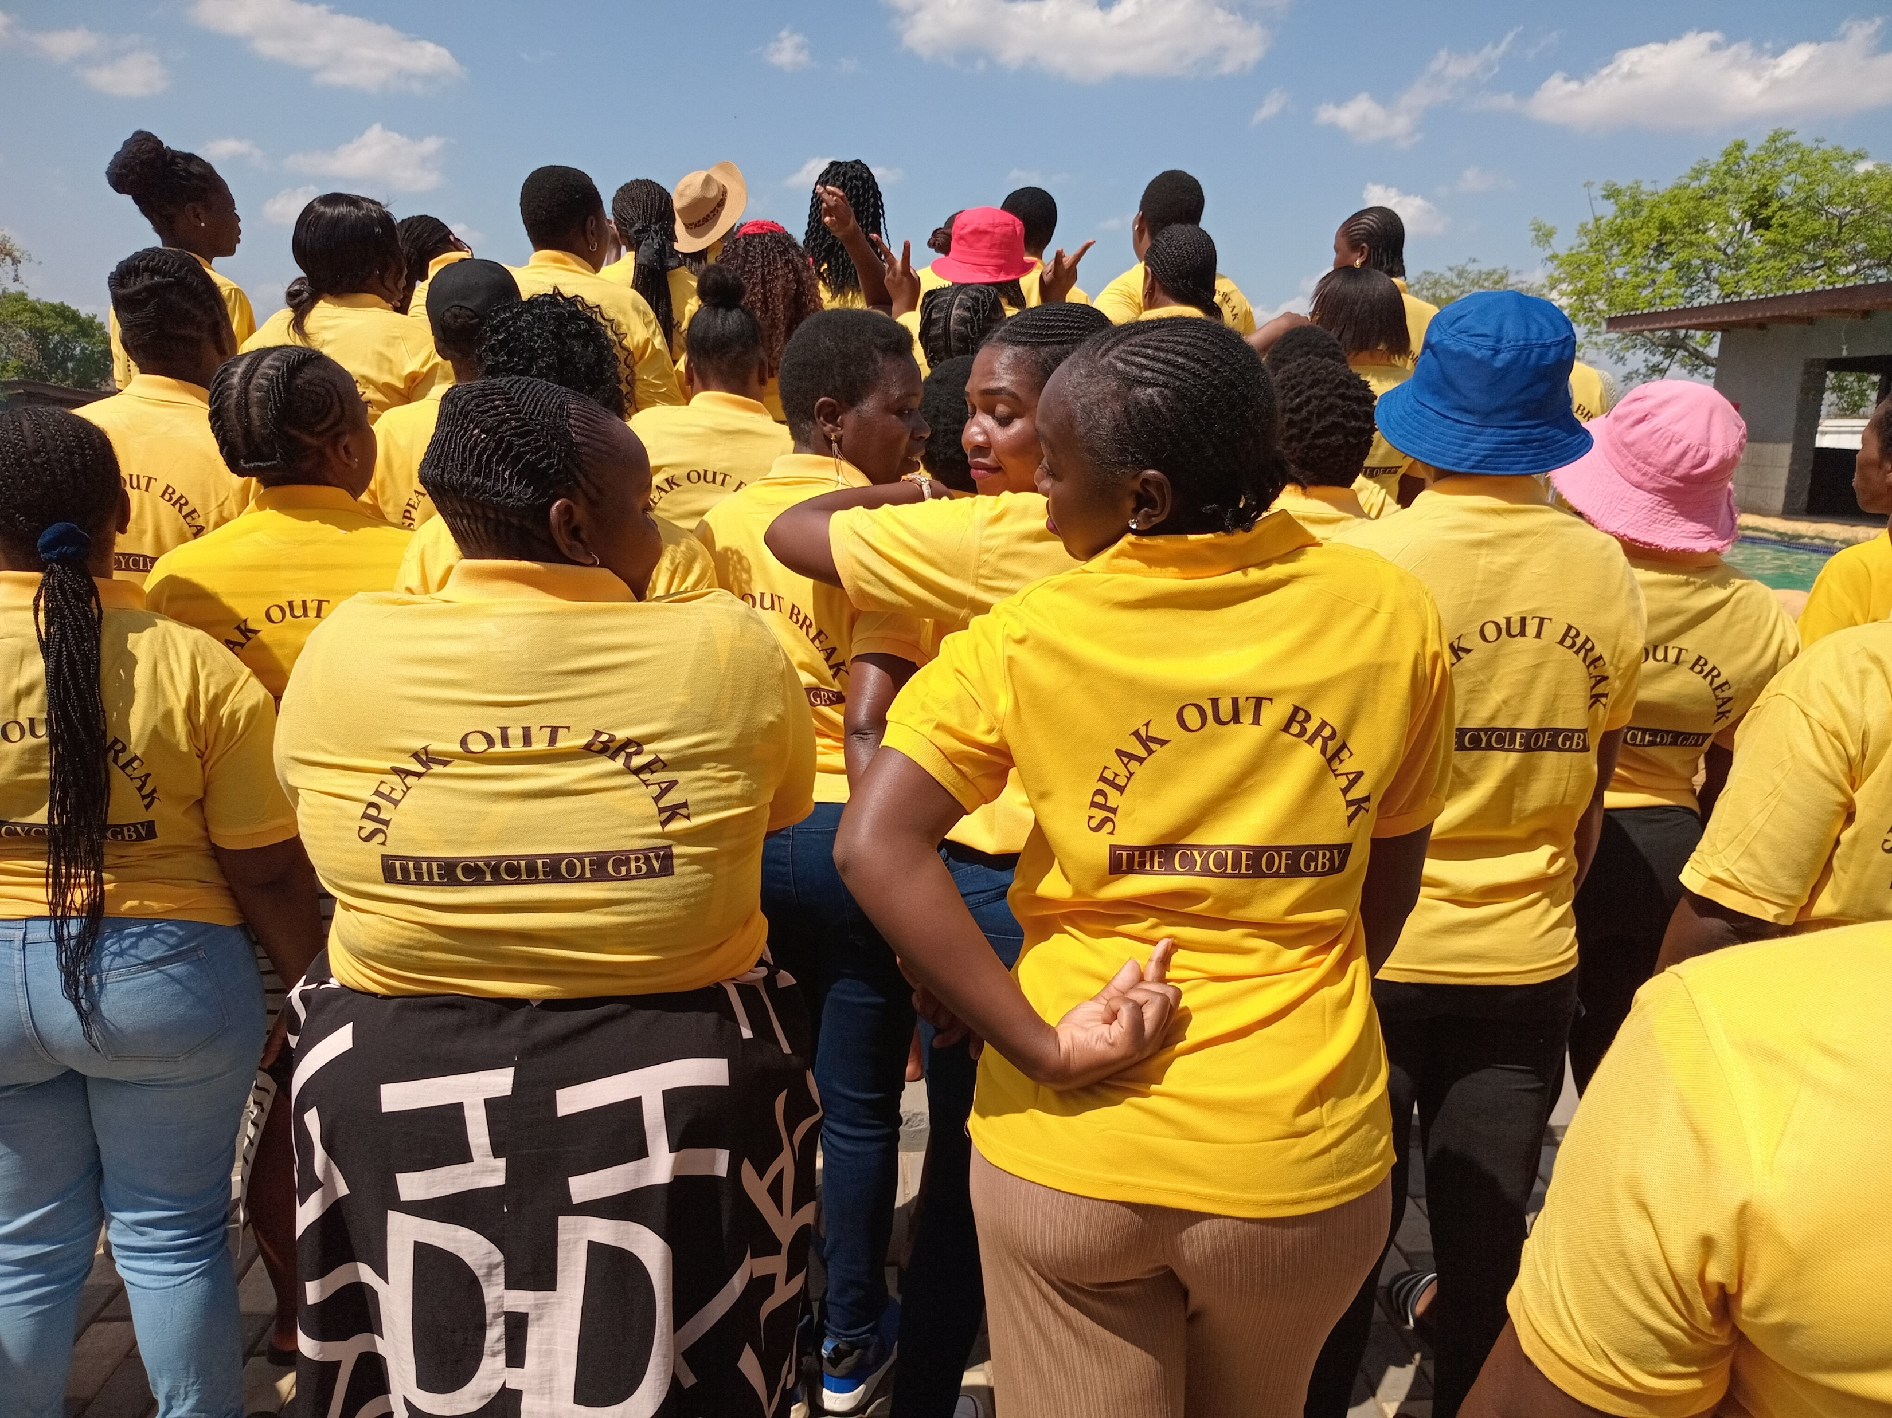

Background(problem, actions, change, evidence)
Social Welfare In Tech is a community-based organization in South Africa working to prevent gender-based violence (GBV) and strengthen mental-health support through community dialogue, advocacy, and survivor-centred services. The organization primarily serves women, girls, and vulnerable community members who face high levels of violence, stigma, and limited access to psychosocial support in under-resourced communities.
Before the organizational change process, Social Welfare In Tech operated with strong community commitment a formal governance structure, limited financial management systems, and little documented operational procedures due to working on personal staff equipment like a (Laptop) . These gaps constrained the organization's ability to scale programs, strengthen partnerships, and access sustainable funding. At the same time, communities continued to experience rising GBV cases, low awareness of mental-health services, and weak coordination between local stakeholders. This context highlighted the urgent need to strengthen internal organizational systems so that community prevention and response efforts could become more effective, accountable, and sustainable. Also, a call for a need to strengthen financial governance, improve accountability mechanisms, and build staff capacity to ensure sustainable and compliant program implementation.
The opportunity grant received from gender links assisted the organization to put systems in place, the organization managed to buy few tools of trade to advance its goal of implementing a GBVF program with the limited staff within it.
Voice and Choice Summit 2026 \ Voice and Choice Summit 2026

Slide 5
ODS Baseline Scores- find yours!
RWVL ODS Baseline Report
Social Welfare In Tech ODS Baseline Report
Overall Score | 750% 75%57
People and Leadership score | 50%
Structures, Systems, and Processes Score | 50%%
Resilience, Care, and Security Score | 70%
Finance and sustainability and social entrepreneurship Score | 55%
Connections and Visibility Score | 50%
Voice and Choice Summit 2026 \ Voice and Choice Summit 2026

Slide 6
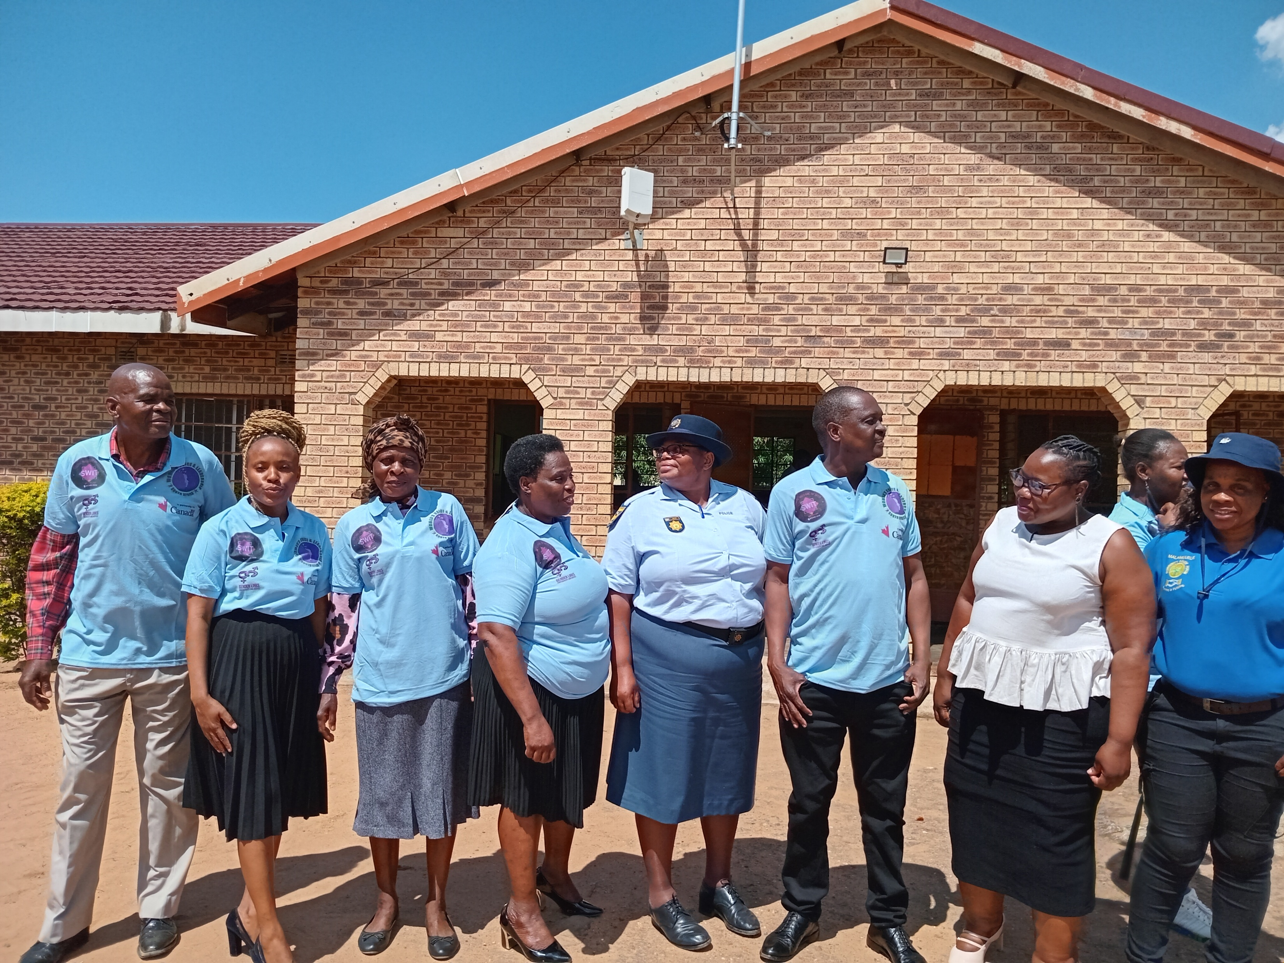
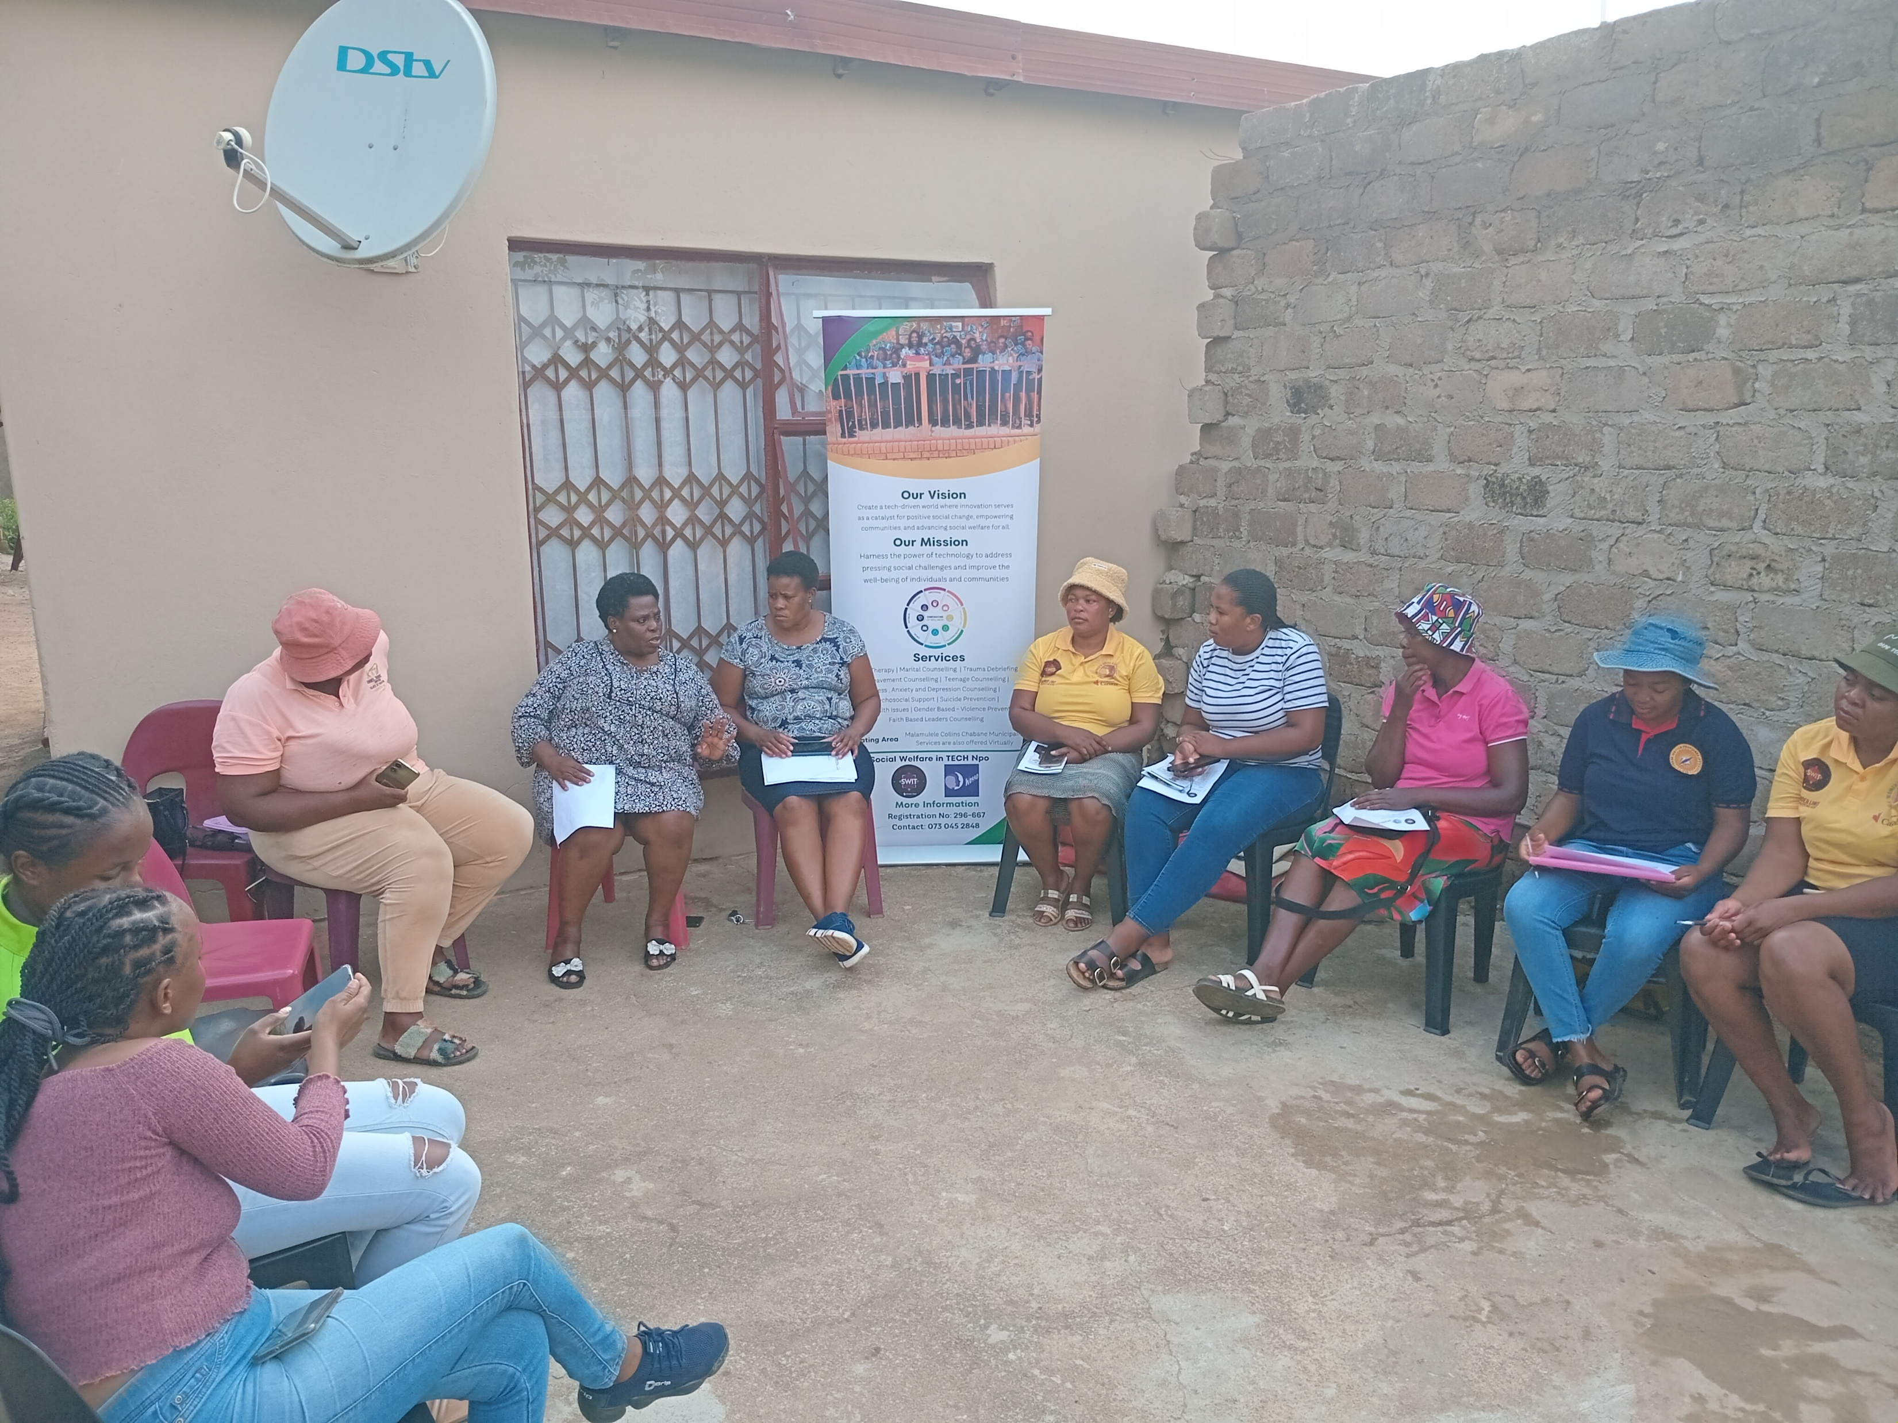
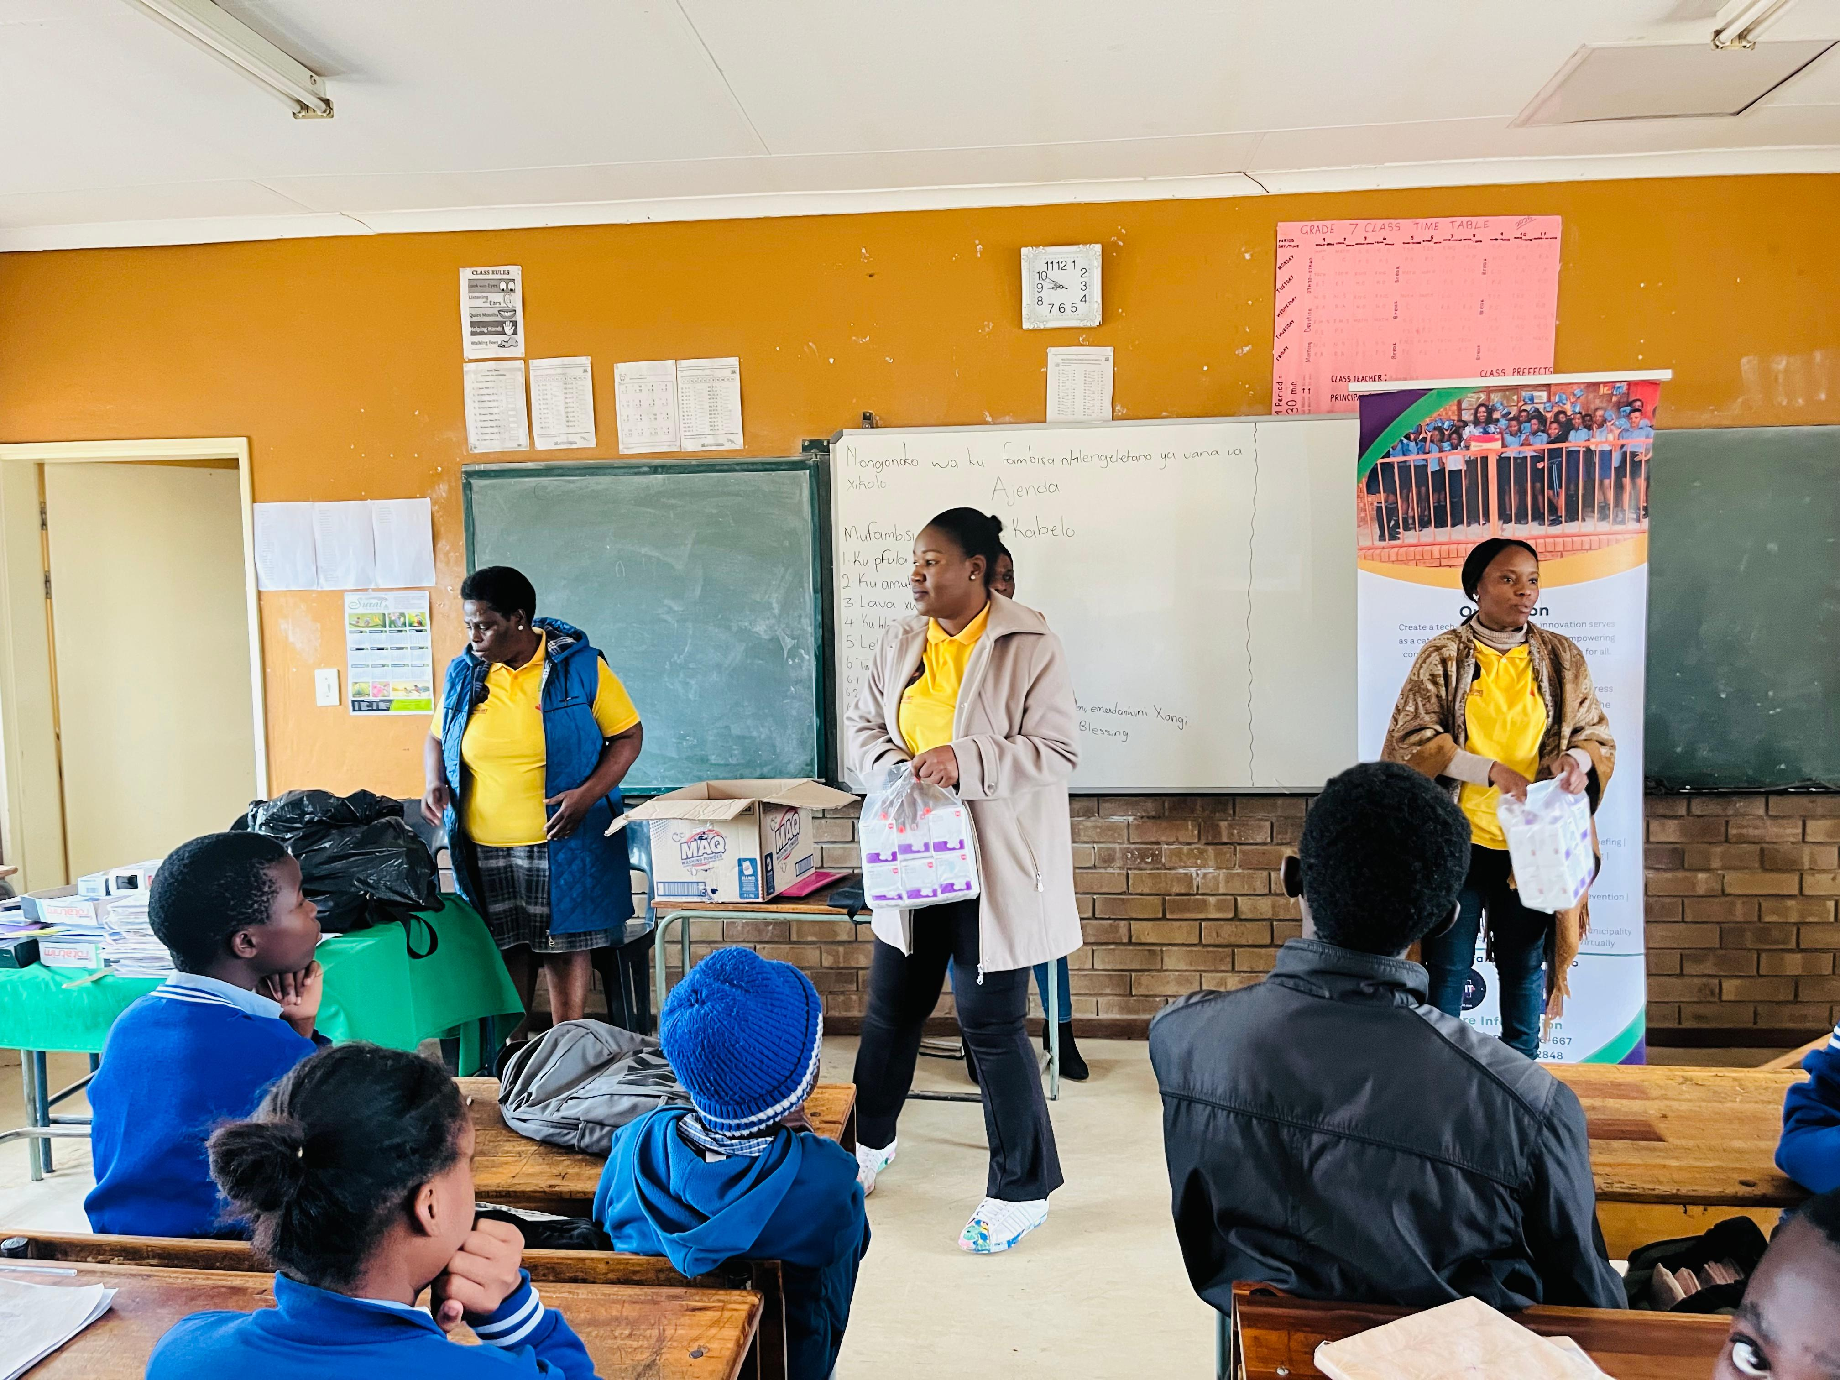
Change
The organizational change at Social Welfare In Tech came from a growing recognition that strong community impact requires equally strong internal governance, financial management, and operational systems. While the organization had built trust through GBV prevention dialogues, mental-health awareness, and survivor referrals as well as empowerment, limited formal structures, constrained sustainability, accountability, and access to long-term funding. This reflection supported by partner engagement and organizational self-assessment and benchmarking from other existing organizations initiated a deliberate process of strengthening systems.
Several targeted capacity-building meetings contributed to the change. These included governance and financial-management training, development of internal policies and procedures, improved budgeting and financial-tracking tools, and the establishment of clearer reporting and accountability mechanisms learned from Gender links orientation. The organization also strengthened program planning, monitoring and evaluation processes, and documentation practice.
To better measure community-level outcomes. In parallel, Social Welfare In Tech expanded partnerships with local stakeholders to align prevention, referral, and awareness efforts.
The change was led by the organization's leadership team, with active participation from staff, volunteers, community facilitators, and partner organizations. External technical support and mentorship received through the gender link site visit monitoring it further strengthened institutional learning and ensured that improvements aligned with good governance and compliance standards are followed. This collaborative approach fostered ownership across all levels of the organization.
To implement these changes organization-wide, Social Welfare In Tech formalized governance structures, introduced standard financial controls, strengthened internal communication and decision-making processes, and embedded monitoring and evaluation within program delivery. Staff and volunteers received orientation on new systems, ensuring consistent application across activities. As a result, the organization transitioned from informal, resource-limited operations toward a more structured, transparent, and sustainable institutional model capable of scaling community impact.
Voice and Choice Summit 2026 \ Voice and Choice Summit 2026

Slide 7
What has changed in the following areas since working with Gender Links.
 | Before due diligence | After due diligence
Financial system | Financial system was informal, with no clearly documented procedures or controls. | A clear financial system is in place, with written procedures, internal controls, and regular reviews.
Separate bank account | No separate bank account dedicated to project or organisational funds. | A separate bank account is used for project/organisational funds to ensure transparency and traceability.
Two signatories to the account | Payments could be authorised by one person, with weak or no dual‑signatory control. | At least two signatories are required for all payments, reducing the risk of misuse of funds.
Financial documentation | Financial documentation (invoices, receipts, vouchers) was incomplete or poorly filed. | Financial documentation is standardised and properly filed, supporting audits and donor reporting.
Monthly reconciliations and routines | Monthly reconciliations and basic financial routines were irregular or absent. | Monthly bank reconciliations and financial routines are done consistently and reviewed by management/board.
Fundraising and Sustainability | Fundraising was ad hoc, with limited strategy for long‑term sustainability. | A basic fundraising and sustainability plan exists, linking programmes to diverse funding sources.
Voice and Choice Summit 2026 \ Voice and Choice Summit 2026

Slide 8
what has changed in the following areas since working with Gender Links.
 | Before due diligence | After due diligence
Safeguarding policy | Safeguarding, HR, finance, and procurement policies were either not in place or not consistently applied. | Safeguarding, human resources, finance, and procurement policies are approved and implemented, guiding daily practice.
Human resources policy | Safeguarding, HR, finance, and procurement policies were either not in place or not consistently applied. | Safeguarding, human resources, finance, and procurement policies are approved and implemented, guiding daily practice.
Finance policy | Safeguarding, HR, finance, and procurement policies were either not in place or not consistently applied. | Safeguarding, human resources, finance, and procurement policies are approved and implemented, guiding daily practice.
Procurement policy | Safeguarding, HR, finance, and procurement policies were either not in place or not consistently applied. | Safeguarding, human resources, finance, and procurement policies are approved and implemented, guiding daily practice.
Board functionality | Board roles and responsibilities were unclear, with irregular meetings and weak oversight. | The board is functional, meets regularly, keeps minutes, and provides strategic and fiduciary oversight.
Anti-corruption/Fraud Policy | No explicit anti‑corruption/fraud or sexual harassment policies to guide prevention and response. | Anti‑corruption/fraud and sexual harassment policies are in place, with clear reporting and case‑handling procedures.
Sexual Harassment Policy | No explicit anti‑corruption/fraud or sexual harassment policies to guide prevention and response. | Anti‑corruption/fraud and sexual harassment policies are in place, with clear reporting and case‑handling procedures.
Monitoring and Evaluation Systems | Monitoring and Evaluation (M&E) systems were weak, with limited data for learning, accountability, or fundraising. | Monitoring and Evaluation systems track activities, outputs, and outcomes, generating evidence for learning, accountability, and future fundraising.
Fundraising and Sustainability |  | Still to be strengthened
Voice and Choice Summit 2026 \ Voice and Choice Summit 2026

Slide 9
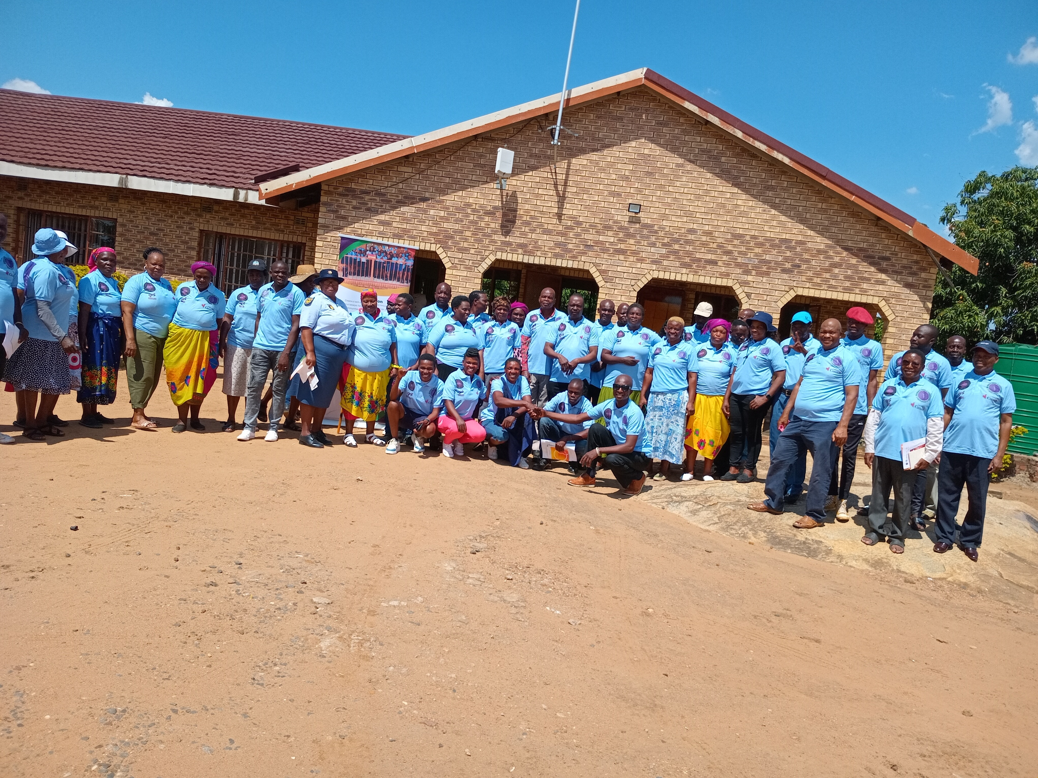
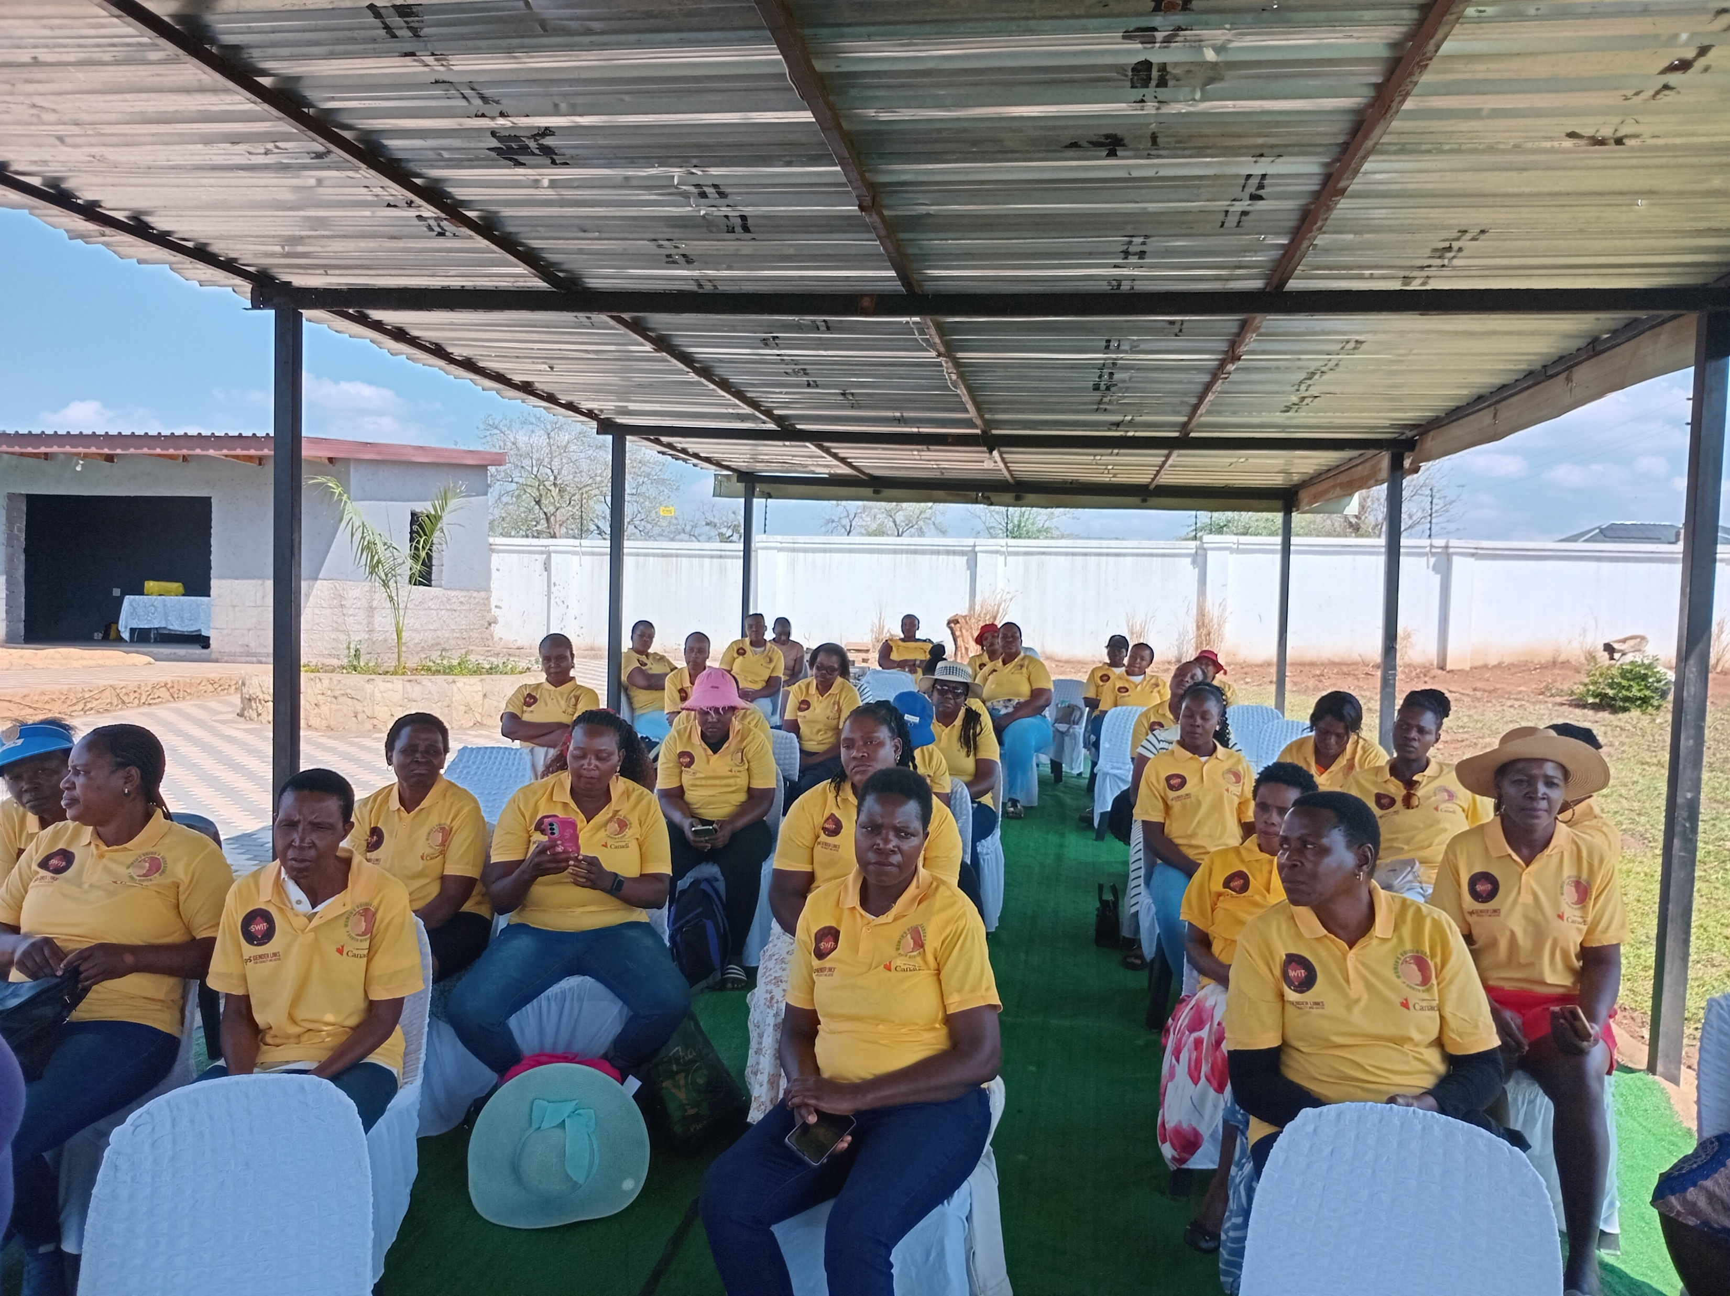
Significance/ Impact
The organizational change at Social Welfare In Tech marked a critical transition from informal, resource-constrained operations to a more structured, accountable, and sustainable institution capable of delivering consistent community impact awareness sessions. Strengthened governance, clearer financial management systems, and documented operational procedures significantly improved transparency, compliance, and organizational credibility. As a result, the organization is now better positioned to manage resources responsibly, meet donor reporting requirements, and pursue diversified funding opportunities that will support long-term programme continuity..
This change also enhanced programme quality and effectiveness. Improved planning, monitoring, and evaluation systems enabled Social Welfare In Tech to track outcomes more accurately, respond to community needs in a timely manner, and demonstrate measurable progress in GBV prevention and mental-health awareness. Stronger internal coordination and clearer roles increased efficiency in programme delivery and partnership engagement.
Most importantly, the strengthened organizational foundation translated into greater benefits for communities. Women, girls, and vulnerable groups now experience more reliable access to prevention information, referral pathways, and psychosocial support through programmes that are better managed and sustained. The organization's increased credibility has also strengthened collaboration with local stakeholders, contributing to a more coordinated community response to GBV and mental-health challenges.
Overall, the change has positioned Social Welfare In Tech as a more resilient, trusted, and impact-driven organization, capable of sustaining and scaling its mission to prevent GBV and promote mental wellbeing in underserved communities
Voice and Choice Summit 2026 \ Voice and Choice Summit 2026

Slide 10
Challenges & Lessons learnt
Challenges & mitigation
1,Limited formal governance and financial management systems. Developed clear governance structures, financial policies, and internal controls with staff orientation and leadership oversight
2, Manual financial tracking and weak reporting mechanisms due to lack of tools of trade for capturing and storing info. Introduced structured budgeting, financial tracking tools, and regular reporting processes
3. Limited monitoring, evaluation, and documentation of impact. Strengthened M&E frameworks, data collection, and outcome reporting across programmes
4. Capacity gaps among staff and volunteers on new systems. Conducted training, mentorship, and continuous capacity-building support.
5. Fragmented coordination with community stakeholders. Strengthened partnerships, referral pathways, and collaborative planning with local actors.
6. Resource constraints affecting programme scale and continuity. Prioritized diversified fundraising, partnership development, and improved compliance readiness.
What lessons have you learnt?
Strong internal systems are essential for accountability, credibility, and long-term sustainability
Transparent financial management improves donor confidence and resource mobilisation opportunities
Evidence-based programming enables learning, adaptation, and demonstration of measurable community impact
Organisational change requires ongoing learning and collective ownership, not once-off training
Collaboration enhances programme reach, efficiency, and sustainability of community responses to GBV and mental health
Financial sustainability depends on both strong systems and proactive resource mobilisation
Voice and Choice Summit 2026 \ Voice and Choice Summit 2026

Slide 11
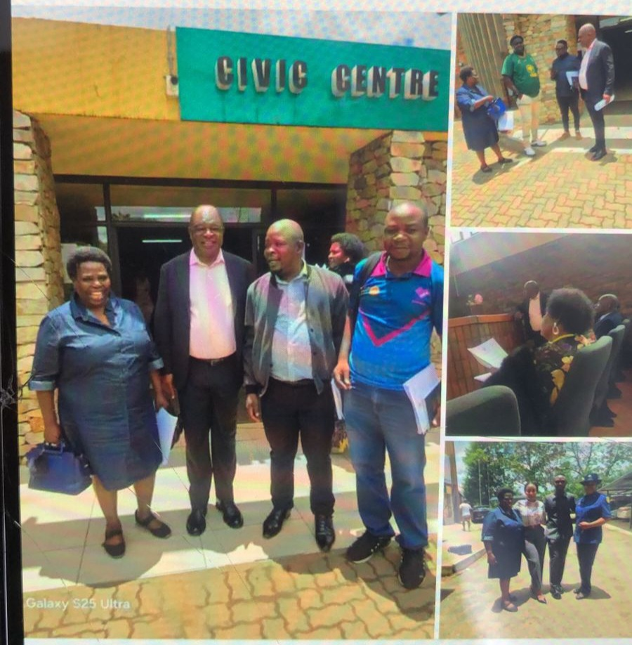
Sustainability
Social Welfare In Tech will sustain the organizational change by inserting strengthened governance, financial management, and monitoring systems into everyday operations rather than treating them as one-time improvements. Clear financial controls, documented policies, regular internal reviews, and transparent reporting processes are now integrated into programme implementation and leadership decision-making. Ongoing staff and volunteer orientation, mentorship, and capacity-building will ensure that institutional knowledge is retained and continuously strengthened. In addition, the organization is prioritizing diversified resource mobilization and strengthened partnerships to secure long-term financial stability and programme continuity.
The change is highly replicable for other grantees, especially community-based organizations operating with limited resources. Key transferable lessons include conducting an honest organizational self-assessment, investing in simple , but strong governance and financial systems, documenting procedures, and intentionally linking internal capacity strengthening to measurable community impact. Social Welfare In Tech’s experience demonstrates that sustainable social change is driven not only by effective programmes, but by resilient organizational foundations. By integrating meaningful community engagement with strengthened accountability and continuous learning systems, organizations can enhance credibility, attract sustainable funding, and scale their impact within their own contexts.
Voice and Choice Summit 2026 \ Voice and Choice Summit 2026

Slide 12
Next Steps
What are our plans?
Social Welfare In Tech plans to consolidate and expand the gains made. Key priorities include: embedding governance and financial systems into daily operations, scaling GBV prevention and mental-health programmes to new communities, maintaining staff and volunteer capacity-building, deepening stakeholder collaboration, diversifying funding, and documenting lessons for replication by other organisations.
These plans ensure that Social Welfare In Tech continues to deliver sustainable, community-driven impact, while serving as a model for other grantees seeking to strengthen governance, systems, and service delivery
Voice and Choice Summit 2026 \ Voice and Choice Summit 2026

Slide 13
THANK YOU

