Slide 1


Voice and Choice
Summit 2026-Organisational Development Category
Your logo goes here
Title/Name of the Story of Organisational Change
A compelling, short title that captures the essence of the Organisational Change starting with the country and organisation name e.g. South Africa – Women’s Action Network: strengthening governance and financial systems to sustain women’s rights work”
Please use your own photos to make your presentation unique.
Quotes and any other visuals make your presentation more engaging!
Voice and Choice Summit 2026 \ Voice and Choice Summit 2026

Slide 2
Synopsis– brief overview what this is about
Name | Nomsa Manzini
Designation | Grants Manager
Organisation | Forum for the Empowerment of Women
Country | South Africa
Category | Oorganisational Development
Summary | The Forum for the Empowerment of Women (FEW) is a Black feminist LBQ organisation based in South Africa that works to advance the rights, safety, and empowerment of lesbian, bisexual, queer, and gender non-conforming women. As one of the first responders to hate crimes in the country, FEW provides direct support to survivors, advocates for justice, and works to challenge violence and discrimination affecting LGBTQI+ communities. After taking over this legacy organisation, which had experienced several leadership transitions, FEW recognised an urgent need for Organisational Development to address gaps in governance, systems, and institutional memory. While our existence remains critical, especially in responding to hate crimes and sustaining flagship programmes such as Soweto Pride, which we have organised for the past 21 years, we realised that passion and history alone were not enough to sustain our impact. When we honestly asked ourselves whether we were truly organised as an organisation, the answer raised a red flag, revealing weaknesses in governance, operational processes, and overall organisational alignment. Organisational Development therefore became essential to strengthen our foundations, ensure long-term sustainability, and safeguard the vital role we play in our communities.
Voice and Choice Summit 2026 \ Voice and Choice Summit 2026

Slide 3
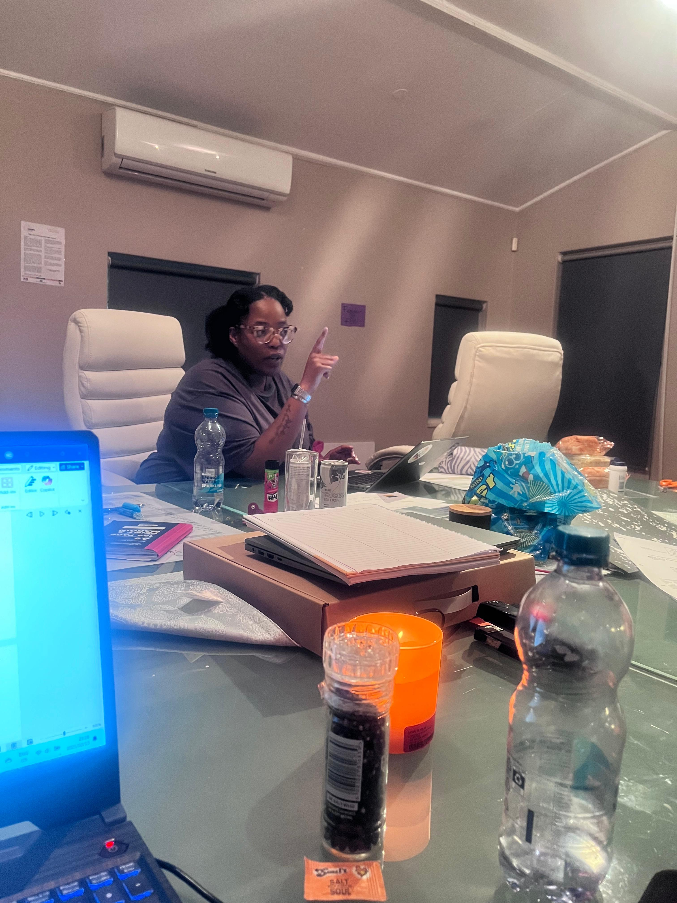
Background(problem, actions, change, evidence)
What organizational challenges do you face?
    Scaling with Funding Growth
    As funding increased, the organization faced growing institutional and operational pressures that required stronger systems and structures.
    Financial Management Capacity
    Limited availability of skilled finance personnel made it difficult to manage and administer larger funding portfolios effectively.
    Donor Fund Tracking
    Maintaining consistent tracking of funds per donor and ensuring alignment with the financial ledger has been challenging.
    Balancing Accountability and Feminist Principles
    Efforts to practice collective and feminist leadership sometimes complicated traditional accountability structures, affecting focus on the broader mission.
    Legacy Regulatory Issues
    Historical challenges, including previous de-registration with the Department of Social Development (DSD), continue to impact institutional credibility and processes.
    Tax Compliance Challenges
    Navigating regulatory and tax compliance requirements with SARS has required additional administrative capacity.
    Rebuilding Donor Relationships
    Ongoing restorative dialogues with donors are necessary to rebuild trust, transparency, and long-term partnerships.
Voice and Choice Summit 2026 \ Voice and Choice Summit 2026

Slide 4
ODS Baseline Scores- find yours!
RWVL ODS Baseline Report
Marang ODS Baseline Report
Overall Score
People and Leadership score | 65
Structures, Systems, and Processes Score | 70
Resilience, Care, and Security Score | 80
Finance and sustainability and social entrepreneurship Score | 65
Connections and Visibility Score | 95
Voice and Choice Summit 2026 \ Voice and Choice Summit 2026

Slide 5
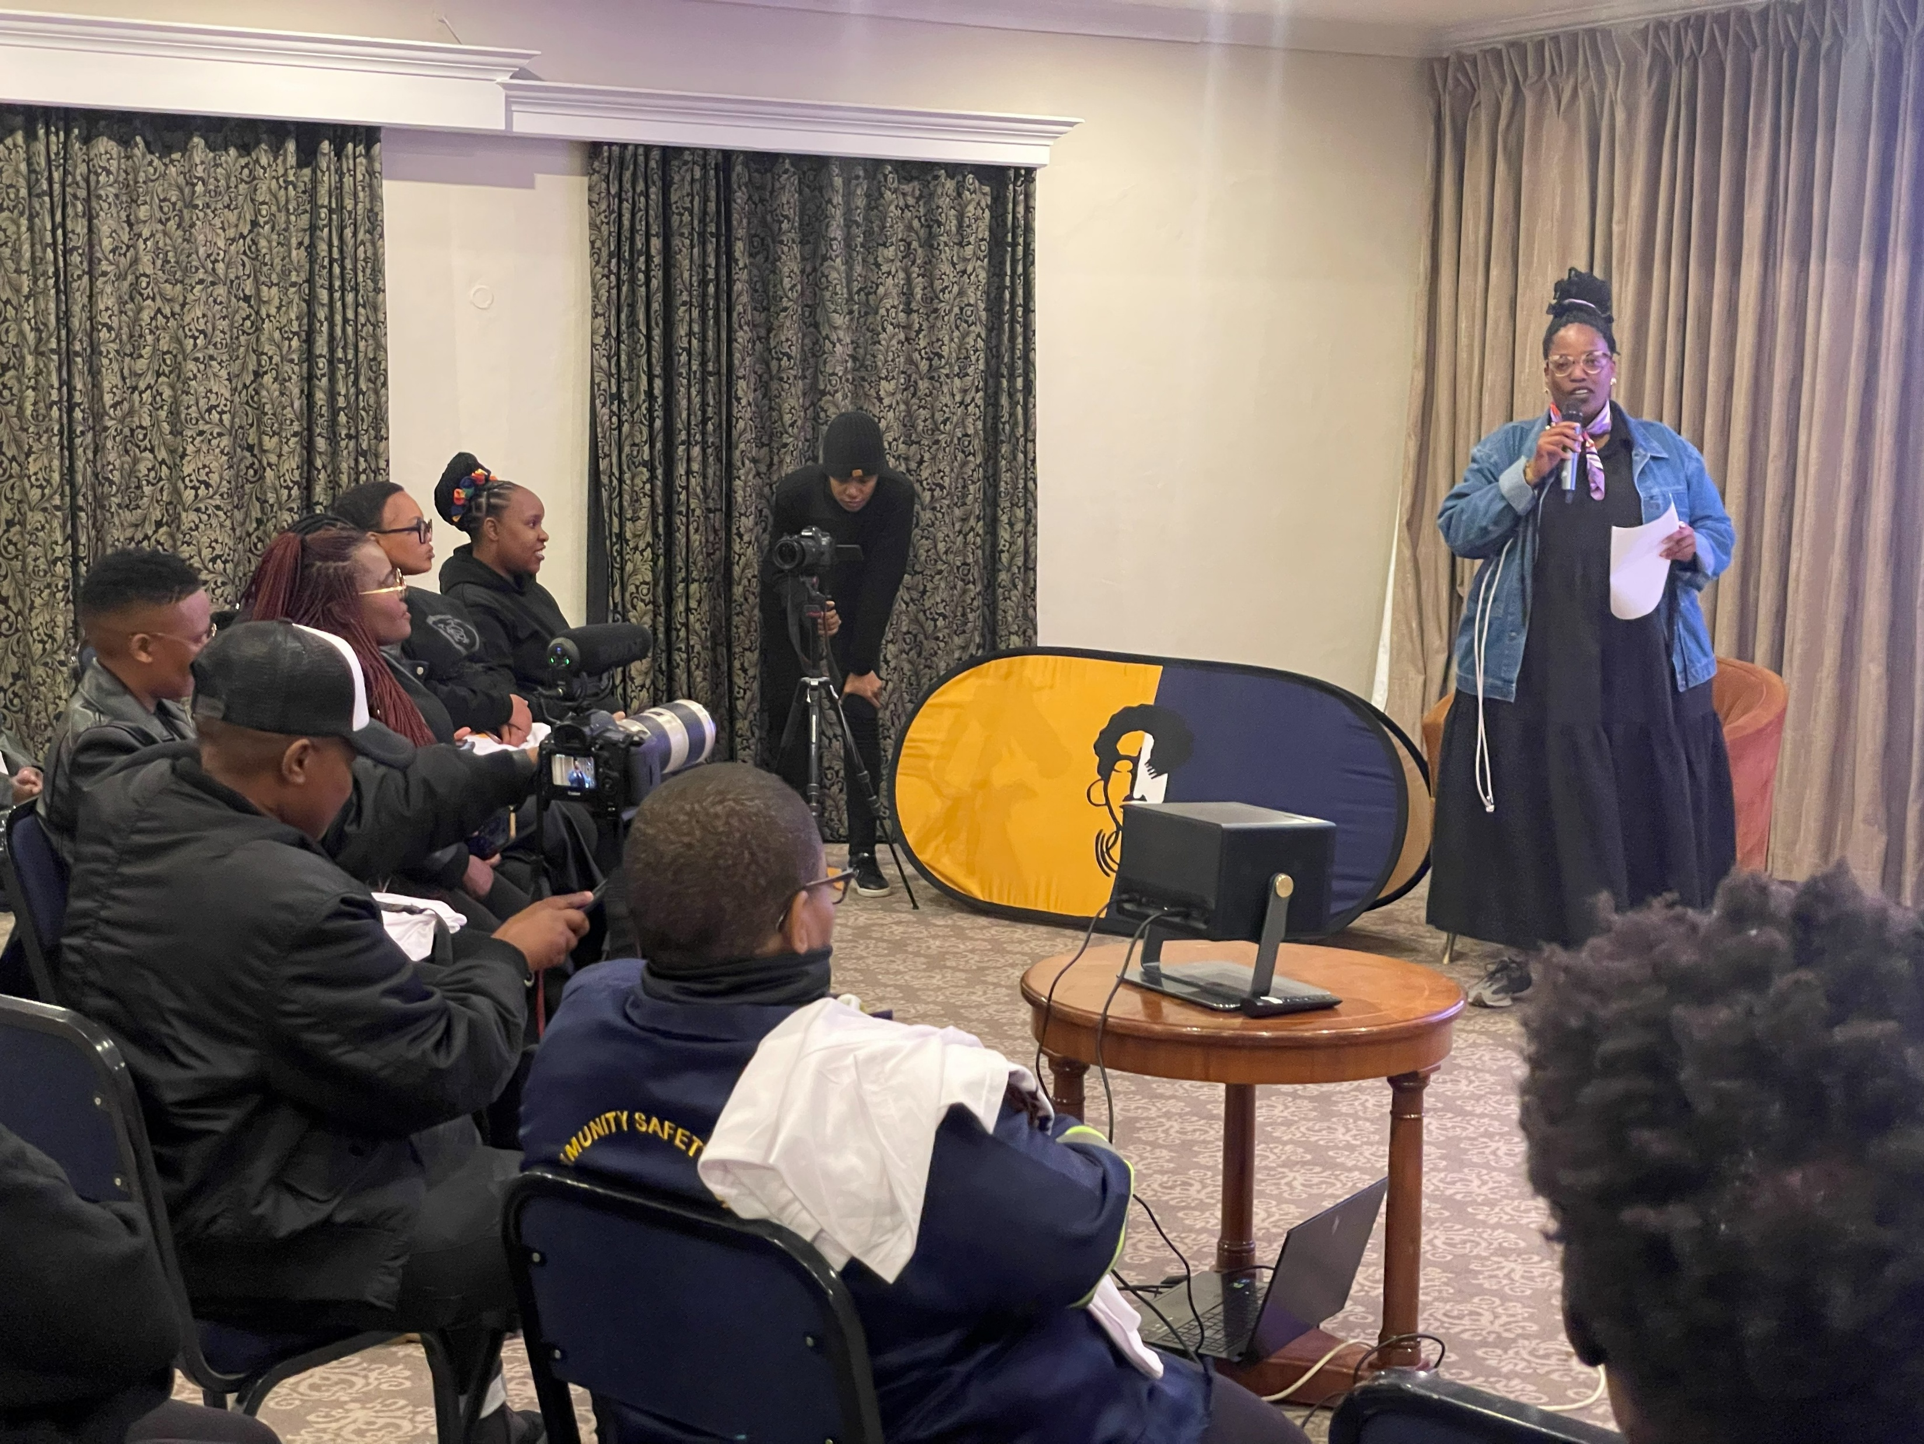
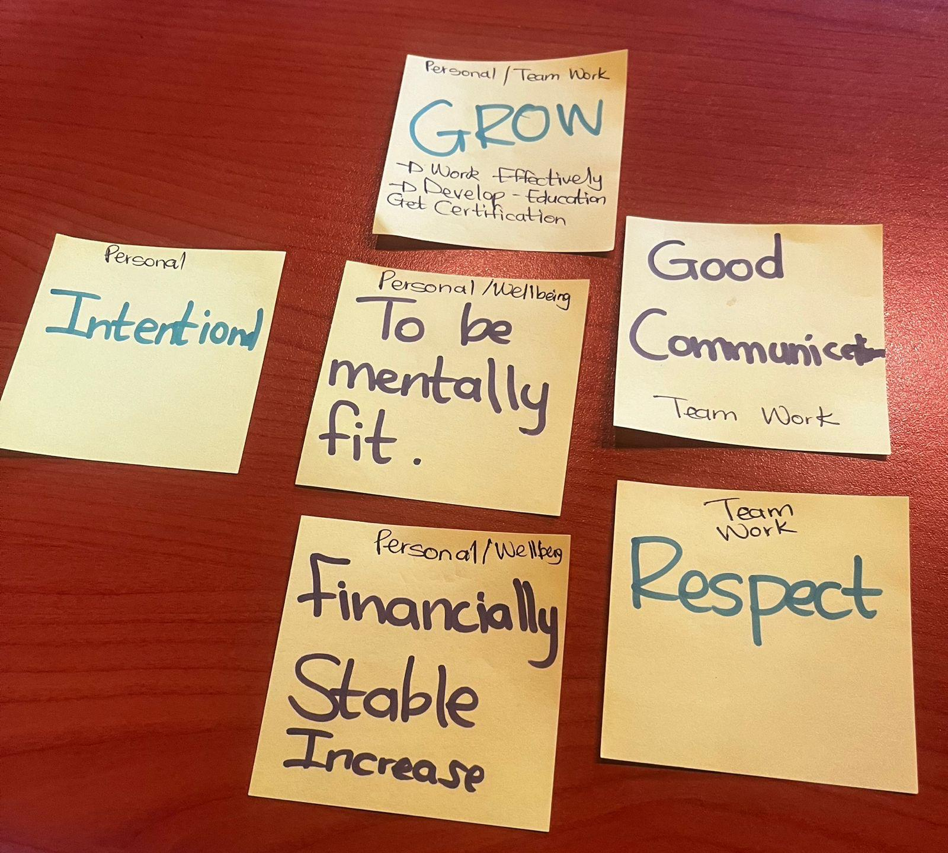
Change
Organisational Change Process
How the Change Came About
Close collaboration between Board and leadership to address structural challenges
Performance management system introduced with an HR consultant
Fundraising for team capacity strengthening
Internal mentorship programmes established
Staff retreat organised to rebuild morale and team spirit
Staff enrolled in mental wellbeing programmes
Organisational structure reviewed and redesigned for stronger compliance and systems
Key Actions to Implement Change
External organisational review to address structural gaps
Strategic realignment of organisational priorities
Focus on internal strengthening before external growth
Clear roles, reporting lines, and restructured teams
Leadership focused on governance and strategy, teams on implementation
Internal promotions, skills audit, and staff development plan
Improved Monitoring & Evaluation systems
Strengthened fundraising strategy with focus on core funding
Voice and Choice Summit 2026 \ Voice and Choice Summit 2026

Slide 6
What has changed in the following areas since working with Gender Links.
 | Before due diligence | After due diligence
Financial system | No Finance Tracking tools | Finance tracking tools 70% accurate
Separate bank account | No Separate bank account | Full functional Separate bank account
Two signatories to the account | 100% | 100%
Financial documentation | Filling system was not fully effective | Effective finance documentation on our SharePoint and with back up physical files
Monthly reconciliations and routines | Not done | Done but not with all donors we realised that Gender Links is more Prioritised based on the system used other lack the consistence still needs to be improved
Fundraising and Sustainability | Not doing well due to lack of trust from donor | For the first timer of fundraisers we did well in the first year from 3 donors to 12 Donors and what we need to improve on is core support and flexible funding We also restored our relationship with donors
Voice and Choice Summit 2026 \ Voice and Choice Summit 2026

Slide 7
what has changed in the following areas since working with Gender Links.
 | Before due diligence | After due diligence
Safeguarding policy | Not Available | Fully Developed and implemented
Human resources policy | Available but not implemented | Fully Developed and implemented
Finance policy | Available but not fully implemented | Fully Developed and implemented
Procurement policy | Available but not fully implemented | Fully Developed and implemented
Board functionality | Available but not fully engaged | Fully Developed and implemented
Anti-corruption/Fraud Policy | Not Available | Fully Developed and implemented
Sexual Harassment Policy | Not Available | Fully Developed and implemented
Monitoring and Evaluation Systems | Not Available | Fully Developed and implemented
Fundraising and Sustainability | Not Available | Fully Developed and implemented
Voice and Choice Summit 2026 \ Voice and Choice Summit 2026

Slide 8
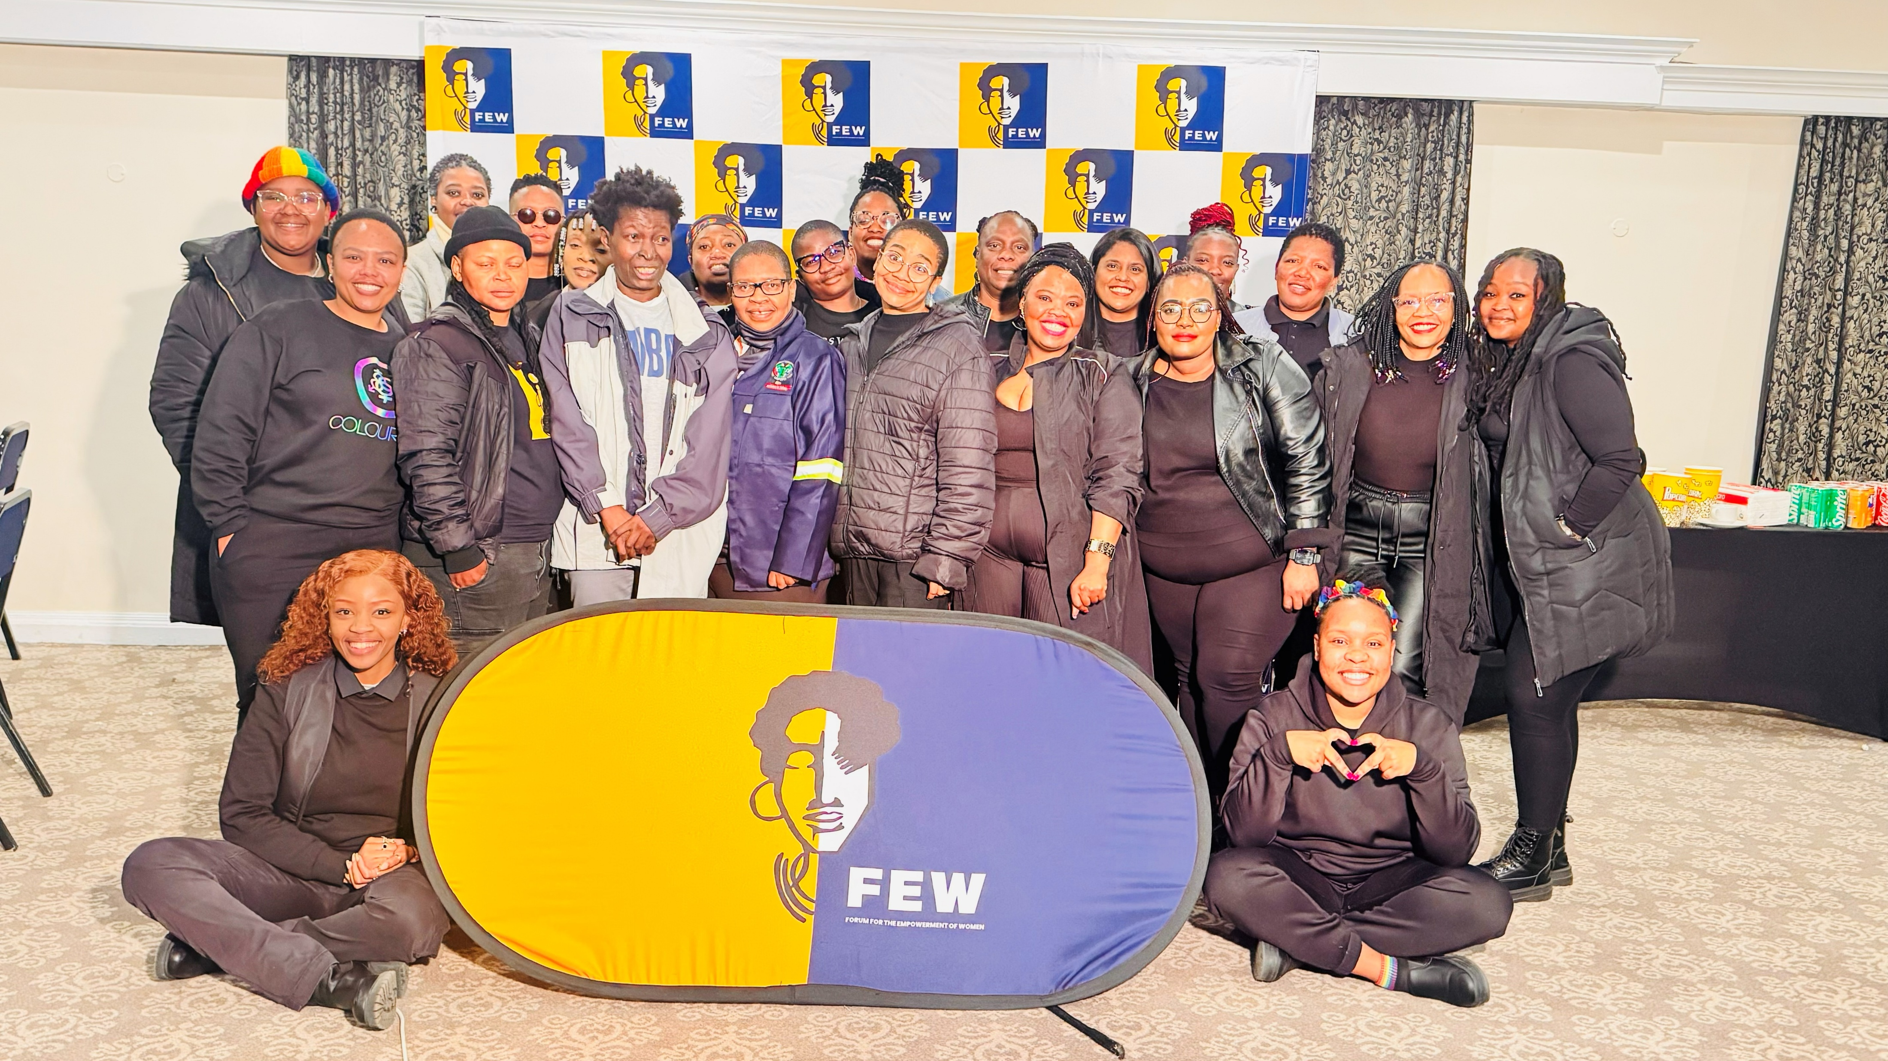
Significance/ Impact
  Significance of the Organisational Change
  Critical Turning Point: FEW is at a defining stage where strengthening internal systems will determine long-term stability and sustainability.
  Aligning Growth with Capacity: While the organisation has gained national and global recognition for responding to hate crimes, internal systems must evolve to match this expanding impact.
  Addressing Organisational Maturity: The change process responds to reaching a ceiling in organisational development, requiring stronger structures, leadership alignment, and operational clarity.
  Managing Internal Transitions: The process addresses change management, leadership transitions, and internal conflict, while reshaping organisational culture to support growth.
  Preventing Burnout and Fragmentation: Strengthening internal systems reduces risks of staff burnout, organisational instability, and operational fragmentation.
  Building Strong Foundations: Organisational development supports improved governance, healthier team dynamics, clearer accountability, and shared leadership ownership.
  Securing Long-Term Impact: These changes ensure FEW moves from survival to stability, and from stability to sustainable, transformative impact for the communities it serves.
  Protecting a Legacy: Strengthening the organisation ensures that FEW’s work and vision continue beyond individual leaders, securing its legacy as a Black feminist lesbian movement organisation.
https://www.instagram.com/p/DVYGvvrjbp4/?img_index=3&igsh=NzBrd3loNjUwMjAz
Voice and Choice Summit 2026 \ Voice and Choice Summit 2026

Slide 9
Challenges & Lessons learnt
Challenges & mitigation
FEW has identified critical structural gaps that must be addressed to ensure long-term sustainability and impact.
Strengthening governance by clearly defining roles and accountability between the Board and Secretariat is essential for effective oversight.
Improving financial management systems including cash flow forecasting and stronger financial controls, will safeguard resources and increase donor confidence.
Aligning programmes with mission-critical priorities will ensure strategic focus and measurable impact.
Developing a communications strategy and risk management protocol will help protect FEW’s reputation and strengthen its voice.
Clarifying the HR structure through updated job descriptions, clear reporting lines, and workload monitoring will reduce internal strain and improve organisational culture.
These steps are foundational investments to stabilise FEW, support sustainable growth, and strengthen service to communities.
What Lessons have you learnt
Growth without intentional structure is not sustainable.
Focusing on fewer priorities and delivering them with excellence is more effective than pursuing many initiatives at once.
Aligning daily work with FEW’s mission and long-term strategy is essential.
Sustainability depends not only on securing funding but on managing and using resources effectively.
Strong organisations rely on disciplined execution, strategic focus, and strong systems.
FEW is shifting from reactive growth to deliberate, sustainable transformation.
Voice and Choice Summit 2026 \ Voice and Choice Summit 2026

Slide 10
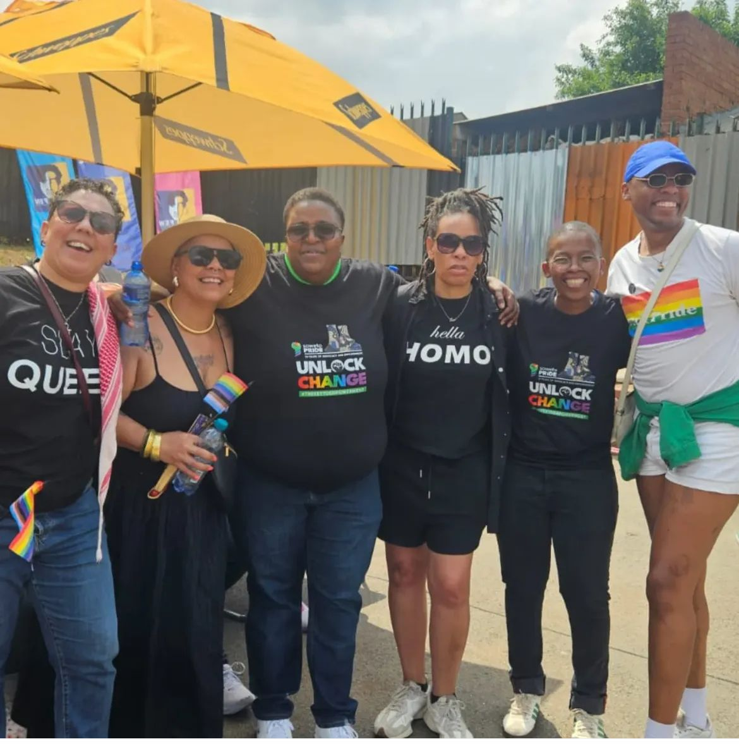
Sustainability
How will the change be sustained in your organisation
The sustainability of change within FEW will be anchored in three critical pillars:
Strong Board guidance, accountable management leadership, and committed staff engagement. Our Board will play a proactive governance role, providing strategic oversight, ensuring policy compliance, and safeguarding the long-term vision of the organisation.
Management will be held accountable for operational excellence, transparent decision-making, financial stewardship, and the consistent implementation of agreed systems and processes.
Equally important is the willingness and active participation of staff, whose commitment to cultural transformation, shared ownership, and disciplined execution will determine the success of these reforms.
What can be replicated by other grantees?
Sustainable change cannot rest on policy alone; it must be lived daily through responsible leadership, clear accountability, and collective buy-in. By aligning governance, management, and staff around a shared purpose and measurable standards, We can all ensure that organisational strengthening is not a temporary intervention, but a permanent shift toward stability, integrity, and long-term impact.
Voice and Choice Summit 2026 \ Voice and Choice Summit 2026

Slide 11
Next Steps
What are your plans?
Develop a robust fundraising strategy aligned with FEW’s organisational mission and long-term strategy.
Focus on implementing our own strategic priorities, not only acting as project implementers for others.
Strengthen organisational empowerment so FEW can remain relevant and responsive to community needs.
Continue the “cleaning the house” process, including restorative engagement with donors to rebuild trust and align expectations.
Maintain and strengthen the restructured finance unit to ensure strong budgeting, expenditure oversight, reporting and reconciliations.
Invest in strong internal systems, financial discipline and internal accountability to support long-term sustainability.
Strengthen governance and leadership structures, ensuring clear roles between the Board, Executive Director and staff.
Continue staff engagement through consultations, training and dialogue to build shared ownership of organisational reforms.
Sustain compliance with legal, financial and safeguarding standards, including anti-corruption and sexual harassment policies.
Use approved annual plans, budgets and monitoring frameworks to improve planning, reduce risk and demonstrate impact.
Continue investing in governance, accountability and learning partnerships to ensure long-term resilience and credibility with donors and communities.
“True transformation begins when an organisation chooses discipline over speed, systems over shortcuts, and purpose over pressure.”
Voice and Choice Summit 2026 \ Voice and Choice Summit 2026

