Slide 1



Voice and Choice
Summit 2026-Organisational Development Category
South Africa – Nyara Youth Development
Strengthening Governance and Systems to Sustain the LEAP Ladder Programme
Voice and Choice Summit 2026 \ Voice and Choice Summit 2026

Slide 2

Synopsis– brief overview what this is about
Name
Designation
Organisation
Country
Category
Summary
Verdra Brown
Operations Manager
Nyara Youth Development
South Africa
Organisational Development and Growth
Nyara Youth Development (NYD) runs the LEAP Ladder Aftercare Programme in Nyara Villages, supporting young people through tutoring, sport for development and psycho-social support in a safe environment.
Through the Women’s Voice and Leadership programme and the Organisational Development Scorecard process, NYD strengthened governance systems, financial management practices and organisational policies to improve accountability and sustainability.
Voice and Choice Summit 2026 \ Voice and Choice Summit 2026

Slide 3
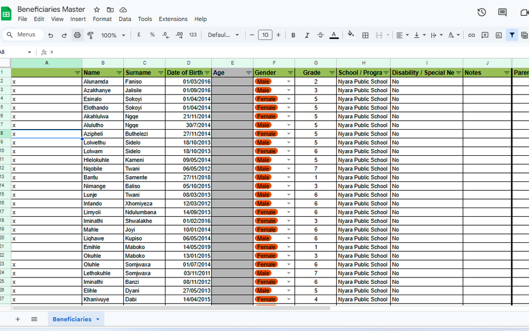
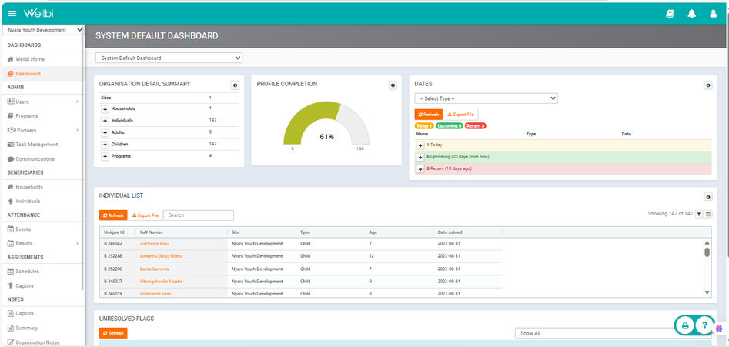
Background(problem, actions, change, evidence)
Evidence: Include Photos or videos
What organizational challenges do you face?
➞ Financial management systems were mostly informal with basic record keeping.
➞ Documentation and financial records were not centrally organised.
➞ Monitoring and evaluation systems were manual and paper-based.
➞ Key organisational policies such as HR, Finance and Procurement were not yet formalised.
➞ Digital infrastructure for monitoring and administration was limited.
➞ Governance structures existed but required stronger systems for oversight and accountability.
Before - Manual Excel tracking.
After - Wellbi digital system.
Voice and Choice Summit 2026 \ Voice and Choice Summit 2026

Slide 4
ODS Baseline Scores- find yours!
RWVL ODS Baseline Report Marang ODS Baseline Report
Overall Score
People and Leadership score
Structures, Systems, and Processes Score
Resilience, Care, and Security Score
Finance and sustainability and social entrepreneurship Score
Connections and Visibility Score
85%
88%
84%
83%
82%
90%
The ODS baseline assessment showed strong leadership and partnerships, while highlighting opportunities to strengthen organisational systems and financial sustainability.
Voice and Choice Summit 2026 \ Voice and Choice Summit 2026

Slide 5
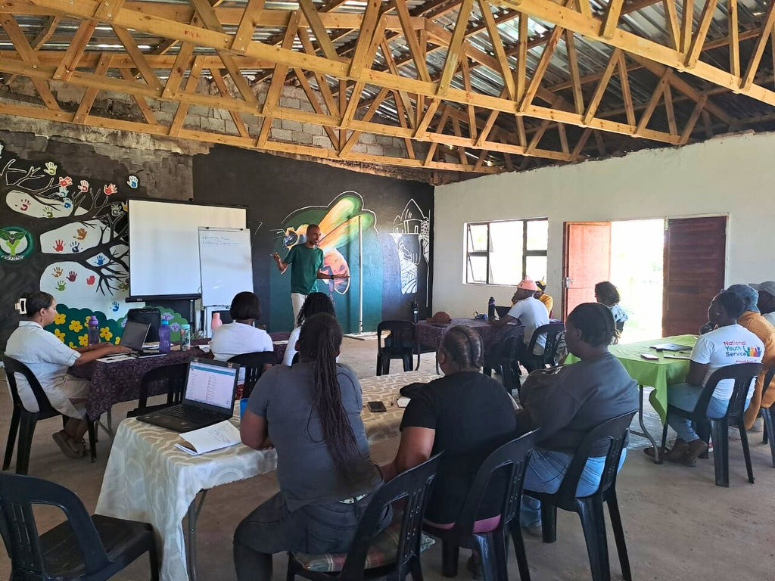
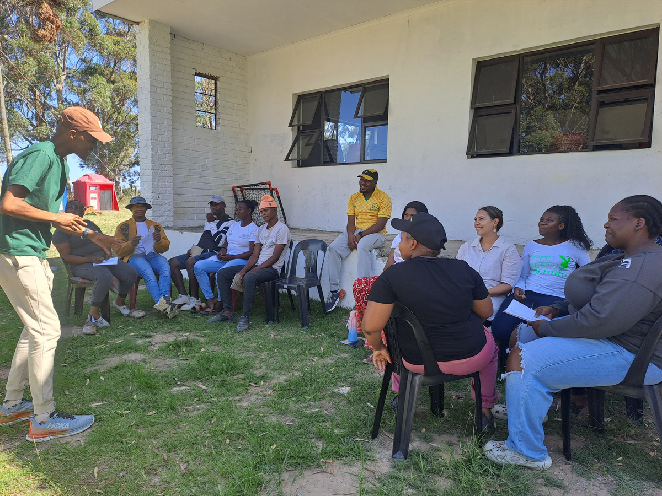
Change
How did the change come about?
  What actions were taken by the organisation to implement these changes across the organisation?
  Who led and participated in bringing about the change?
Evidence: M&E & photos / videos
➞ The Organisational Development Scorecard helped NYD review its internal systems.
➞ Leadership from Robyn Mafanya and Verdra Brown guided the strengthening of governance and organisational practices.
➞ The team worked together to strengthen policies and financial procedures.
➞ Policies including Safeguarding, HR, Finance and Procurement were strengthened and implemented.
➞ Digital tools were introduced to improve monitoring and documentation.
Team strategy and training session.
Voice and Choice Summit 2026 \ Voice and Choice Summit 2026

Slide 6
What has changed in the following areas since working with Gender Links.
 | Before due diligence | After due diligence
Financial system | Basic financial record keeping with limited internal structure. | Financial systems strengthened with clearer procedures and financial routines.
Separate bank account | Organisational banking systems existed but processes were less structured. | Financial management strengthened with clearer banking procedures.
Two signatories to the account | Signatory processes existed but were not always formalised. | Dual-signatory authorisation strengthened financial accountability.
Financial documentation | Financial records existed but were not systematically organised. | Improved documentation and structured record keeping.
Monthly reconciliations and routines | Financial routines were less structured. | Regular reconciliation routines implemented.
Fundraising and Sustainability | Funding relied mainly on project-based support. | Improved organisational systems strengthened sustainability planning.
Voice and Choice Summit 2026 \ Voice and Choice Summit 2026

Slide 7
What has changed in the following areas since working with Gender Links.
 | Before due diligence | After due diligence
Safeguarding policy | Basic safeguarding practices. | Strengthened safeguarding procedures.
Human resources policy | Staff management practices existed but were informal. | HR structures strengthened with clearer procedures.
Finance policy | Basic financial routines. | Formal finance policy implemented.
Procurement policy | Procurement handled informally. | Clear procurement procedures.
Board functionality | Board existed but governance systems were developing. | Board oversight strengthened with clearer governance practices.
Anti-corruption/Fraud Policy | Workplace conduct informal. | Fraud and anti-corruption policy.
Sexual Harassment Policy | Workplace conduct addressed informally. | Formal policy introduced to guide workplace conduct.
Monitoring and Evaluation Systems | Manual monitoring systems. | Wellbi digital monitoring system.
Voice and Choice Summit 2026 | Voice and Choice Summit 2026

Slide 8
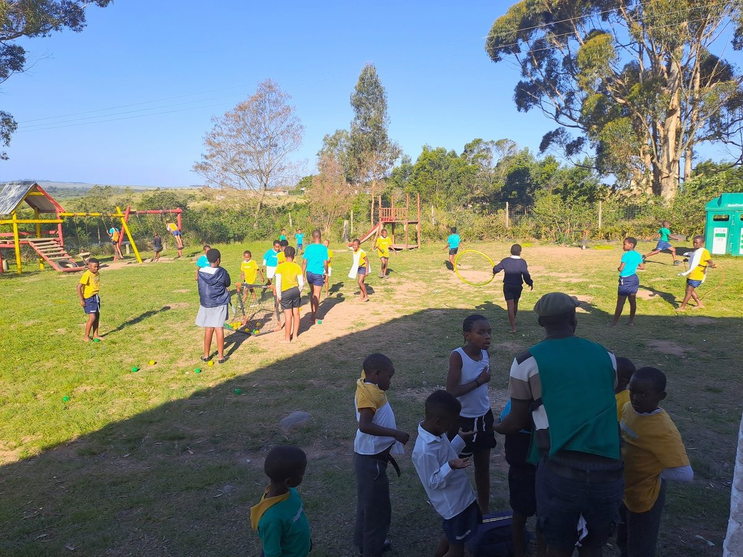
Significance / Impact
What is the significance of the change?
Evidence
  What difference this change has made to the organisation.
The LEAP Ladder programme continues to support children through structured aftercare activities
➞ Strengthening organisational systems improved governance and accountability.
➞ The LEAP Ladder programme continues to support children through structured aftercare activities.
➞ The Wellbi system supports improved monitoring of learner participation and progress.
➞ Strengthened financial systems improved transparency and reporting.
➞ Improved governance supports the long-term sustainability of the organisation.
https://drive.google.com/file/d/1ie62f5pQWJInshqTJsm4MQqIc-l4F5os/view?usp=drivesdk
Voice and Choice Summit 2026 \ Voice and Choice Summit 2026

Slide 9
Challenges & Lessons learnt
Challenges & mitigation
What lessons have you learnt?
➞ Introducing new governance systems required staff adjustment and training.
➞ Implementing digital monitoring tools required capacity building.
➞ Strengthening organisational systems while maintaining programme delivery required coordination.
➞ Strong organisational systems support programme sustainability.
➞ Digital monitoring improves accountability and reporting.
➞ Team participation is important when implementing organisational change.
Voice and Choice Summit 2026 \ Voice and Choice Summit 2026

Slide 10
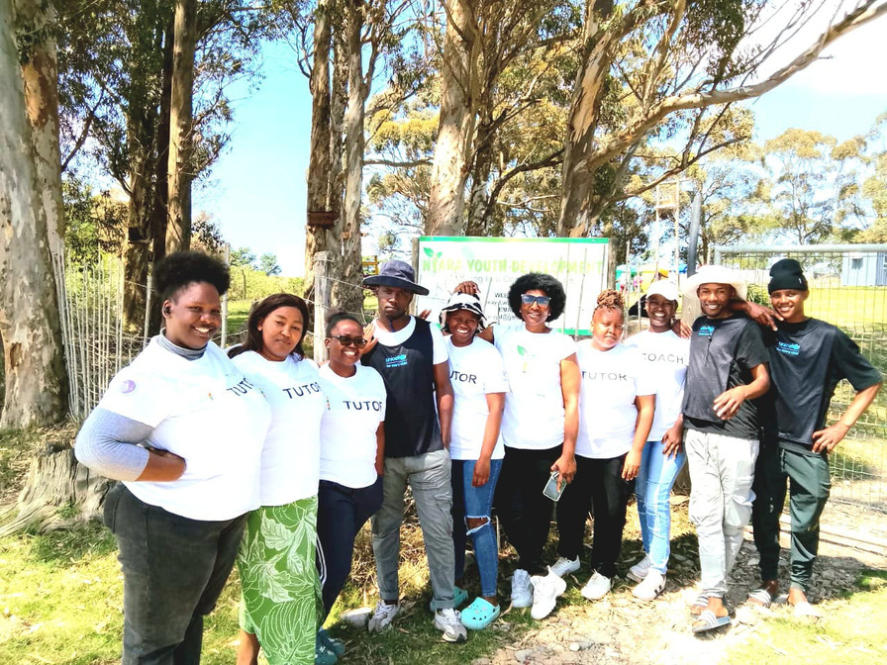
Sustainability
What can be replicated:
Strengthening governance through clear organisational policies, using digital monitoring systems to track programme impact, building partnerships with local stakeholders, and sharing learning between community organisations.
  How will the change be sustained in your organisation
  What can be replicated by other grantees?
➞ Governance systems embedded through Safeguarding, HR, Finance and Procurement policies.
➞ Monthly financial routines and dual-signatory processes strengthen accountability.
➞ Improved documentation systems support record keeping.
➞ The Wellbi system continues to support programme monitoring.
➞ Board oversight strengthens organisational governance.
Evidence: Include Photos or videos
Nyara tutors and staff supporting youth programmes.
Voice and Choice Summit 2026 \ Voice and Choice Summit 2026

Slide 11
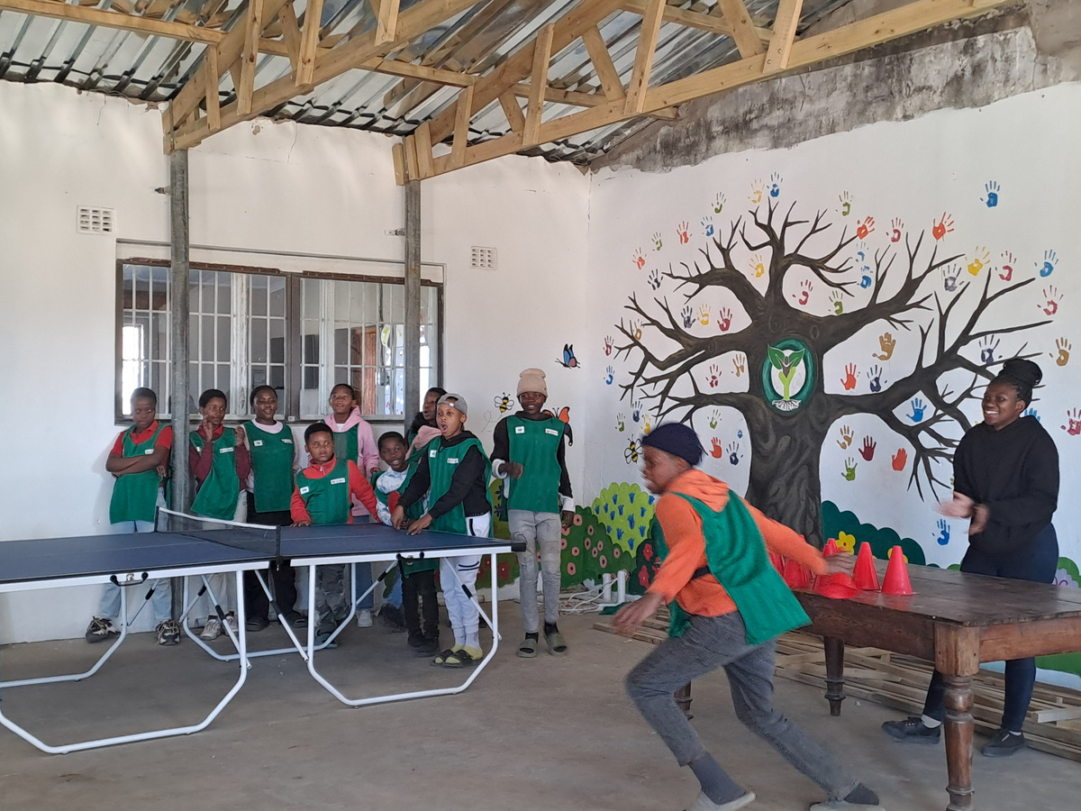
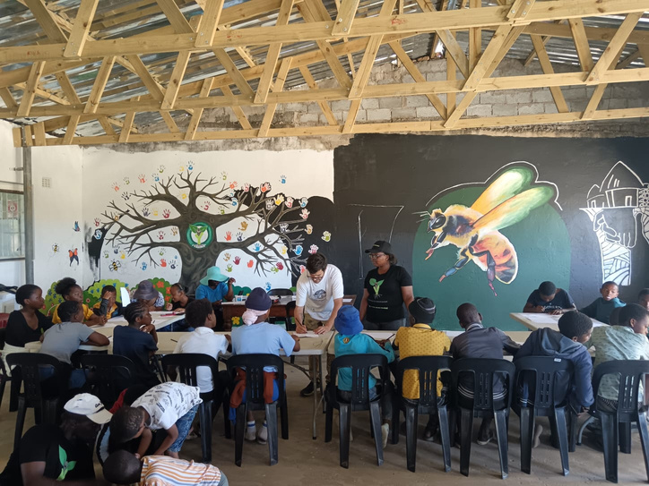
Next Steps
What are your plans?
Nyara Youth Development will continue strengthening its governance and organisational systems while expanding the LEAP Ladder Aftercare Programme to support more children and youth in the community. The organisation will continue using digital tools such as Wellbi to improve monitoring and reporting, strengthen partnerships with community stakeholders, and invest in staff development to support sustainable programme delivery and long-term impact.
Voice and Choice Summit 2026 \ Voice and Choice Summit 2026

