Slide 1


Voice and Choice
Summit 2026
Organisational Development Category
South Africa - Capricorn Ignited LGBTI:
Strengthening Visibility, Awareness and Dignity of LGBTIQ+ persons in a
traditional culture rooted Limpopo Province.
Voice and Choice Summit 2026 \ Voice and Choice Summit 2026

Slide 2

Synopsis
Name | Maburwana Lebo Monama
Designation | Managing Director
Organisation | Capricorn Ignited LGBTI
Country | South Africa
Category | Organizational Development and Growth
Summary | Information in understanding of Sexual and Reproductive Health and Rights and LGBTIQ+ is limited in villages. The demand has reached even further areas where we are unfortunately unable to reach due to logistics, where injection of the RWVL funding has assisted in achieving progress. Investing more on this project and strategizing in a way that will be cost effective for the organization will help us grow further in networking and administration processes.
Voice and Choice Summit 2026 \ Voice and Choice Summit 2026

Slide 3
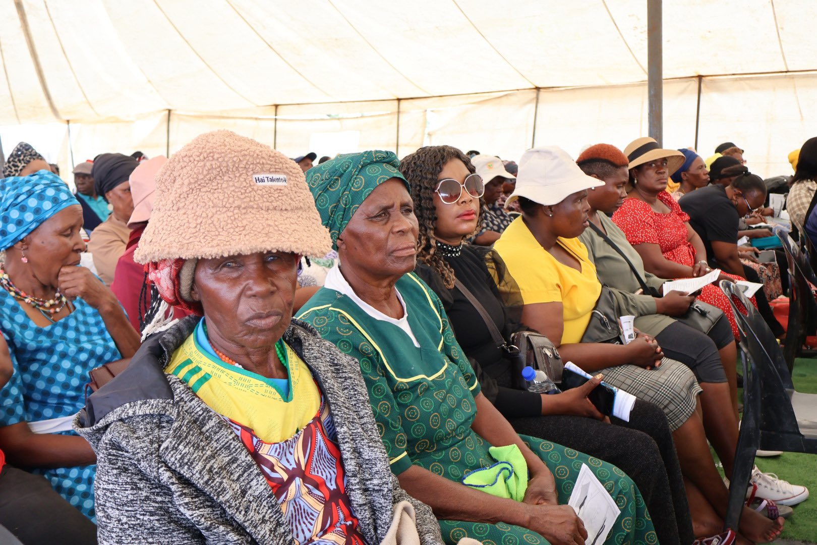
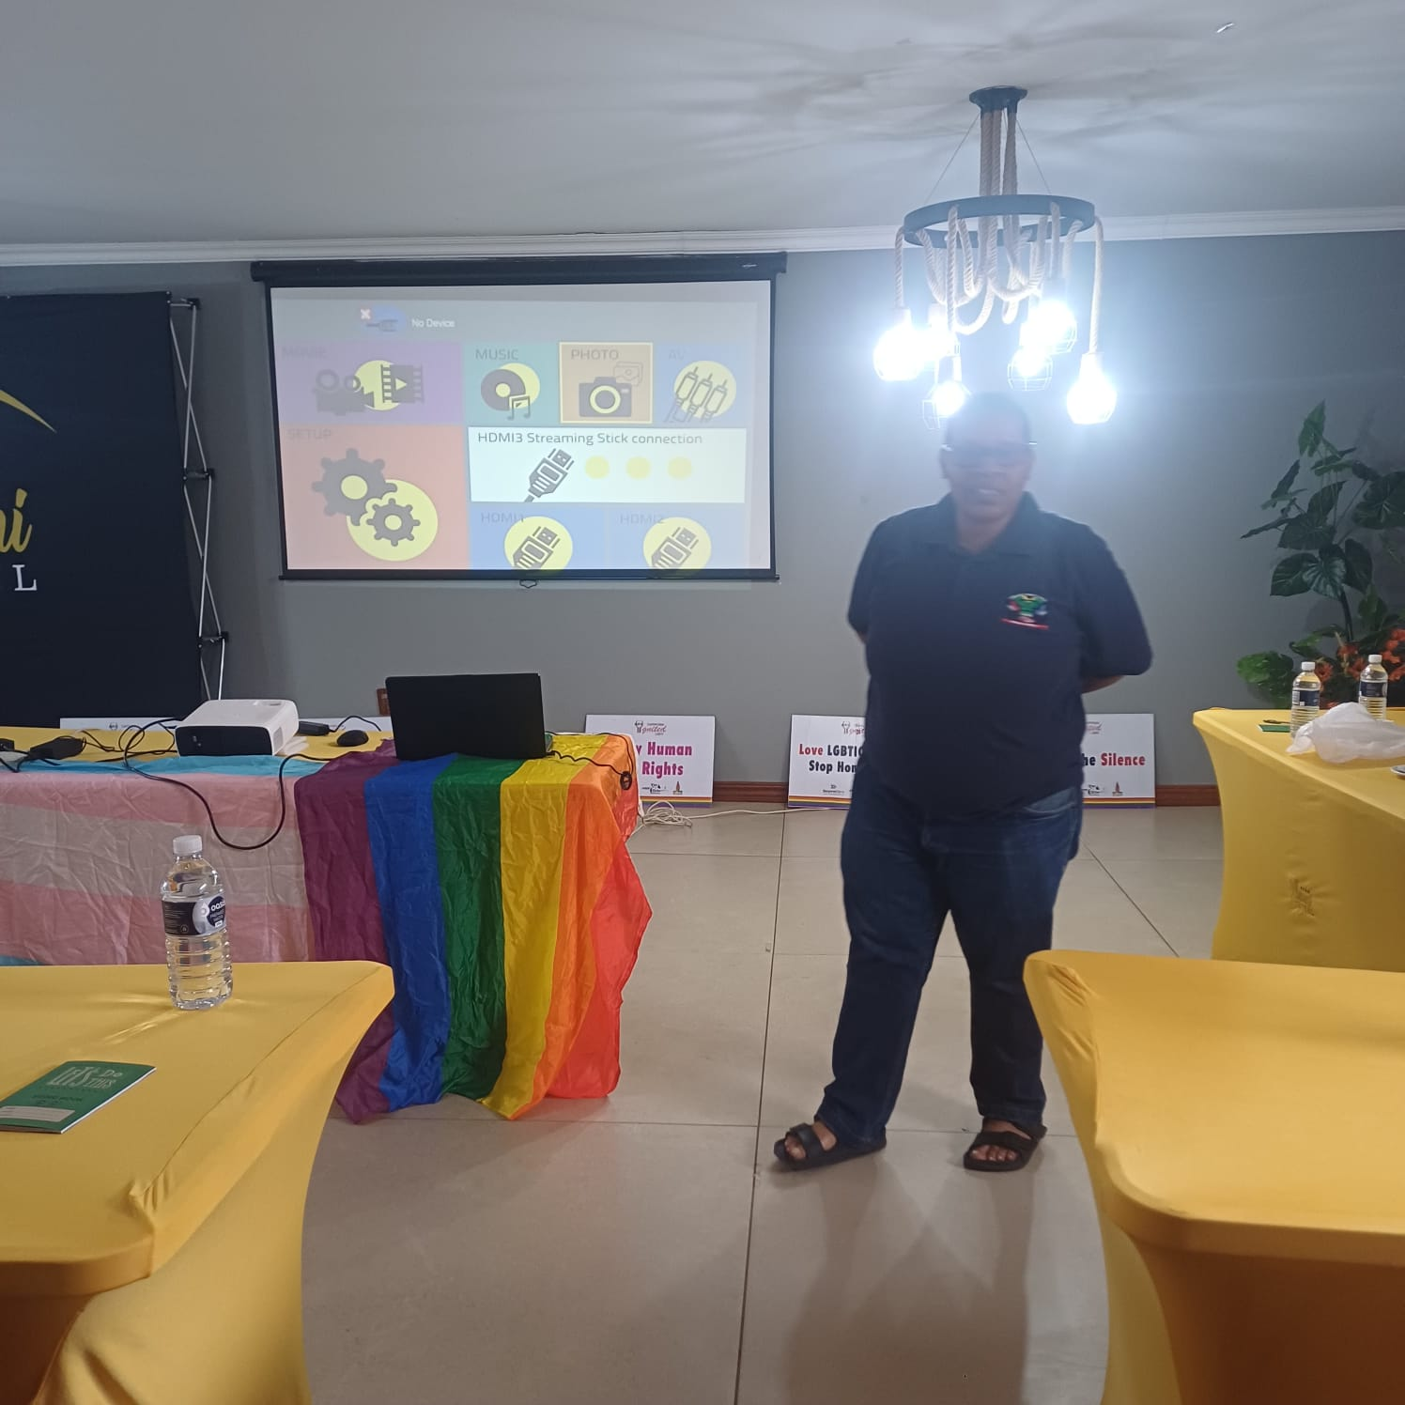
Background
When the SRHR Tsebo project started, through the voice and choice funding we focused mainly on areas around Polokwane and a few outside areas to pilot processes of reaching deep rural communities.
Balancing of activities and spreading them within municipalities proves to be a great way of reaching more people, as we have witnessed leaders from other organizations from deeper rural areas requesting assistance from our organization to come and do sensitization in their areas.
Voice and Choice Summit 2026 \ Voice and Choice Summit 2026

Slide 4
ODS Baseline Scores
RWVL ODS Baseline Report
Overall Score | 78
People and Leadership score | 82
Structures, Systems, and Processes Score | 79
Resilience, Care, and Security Score | 77
Finance and sustainability and social entrepreneurship Score | 74
Connections and Visibility Score | 79
Voice and Choice Summit 2026 \ Voice and Choice Summit 2026

Slide 5
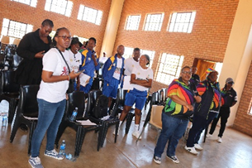
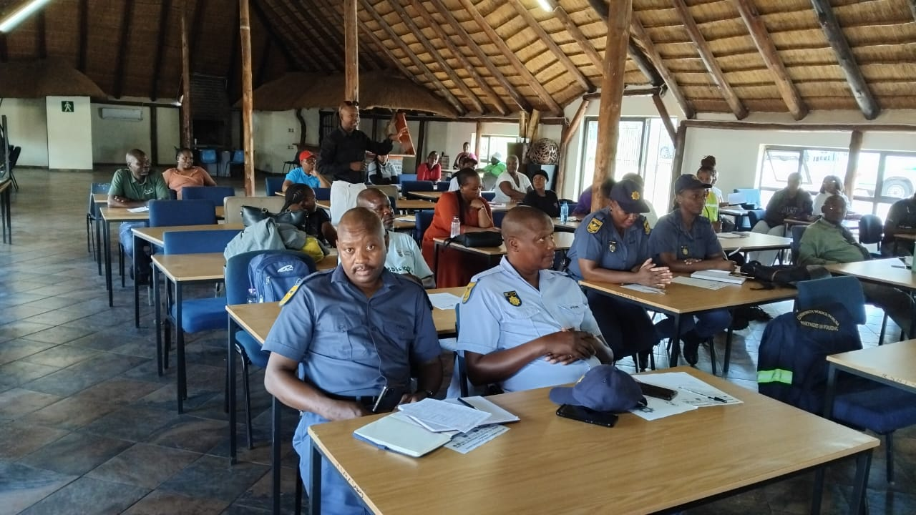
Change
How did the change come about?
The LGBTIQ+ Volunteers continue supporting our work even through limited funds.
Stigma and Discrimination against LGBTIQ+ continue to be high despite all the legislation and the constitution in place.
Strong Cultural and Religious morality beliefs are being triggered by our movements in deep rural areas, and those are the places we need to put more focus to break the barriers, by being more visible and create awareness.
We have managed to create Forums with few police stations, and covering all stations will have a great impact in the district and make it easier to reach other districts. When we reach those police stations, we also reach local clinics and schools within the area, and therefore able to sensitize various sectors collectively
More police and health care workers need to be sensitized in order to reduce secondary victimization and stigma and discrimination within facilities, where LGBTIQ+ people’s SRHR are mostly violated.
Voice and Choice Summit 2026 \ Voice and Choice Summit 2026

Slide 6
What has changed in the following areas since working with Gender Links.
 | Before due diligence | After due diligence
Financial system | Using Excel spreadsheets to compile reports. | Improvement in Procurement procedures. Multiple storage and backup options.
Separate bank account | Single Account | Able to open different bank accounts for projects
Financial documentation | We have 3 signatories to the account | Financial Management Policies in place and followed
Monthly reconciliations and routines | The system was not in order and affected our reporting criteria. | Redefined Systems to be efficient and cost-effective. Eg. Online
Voice and Choice Summit 2026 \ Voice and Choice Summit 2026

Slide 7
what has changed in the following areas since working with Gender Links.
 | Before due diligence | After due diligence
Safeguarding policy | The Policy is in place | Policy in place and followed
Human resources policy | The Policy is in place | Policy in place and followed
Finance policy | The Policy is in place | Policy in place and followed
Procurement policy | The Policy is in place | Policy in place and followed
Board functionality | The Board is in place | Meets online and physically
Anti-corruption/Fraud Policy | The Policy is in place | Policy in place and followed
Sexual Harassment Policy | The Policy is in place | Policy in place and followed
Monitoring and Evaluation Systems | Systems in place and open for further review and amendments | we continue to refine systems working on having more online systems to make us work effectively.
Voice and Choice Summit 2026 \ Voice and Choice Summit 2026

Slide 8
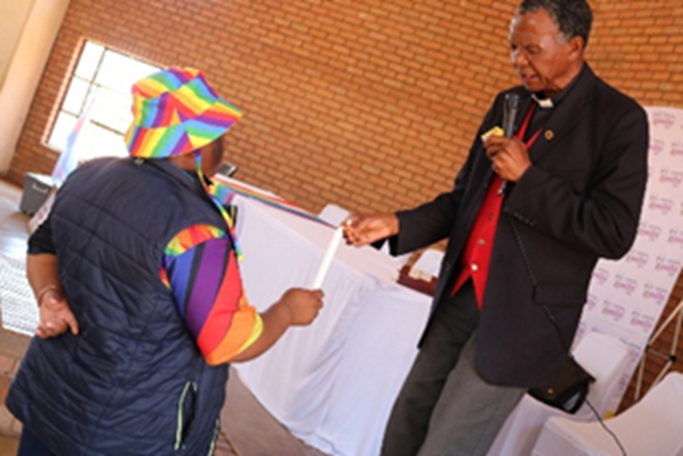
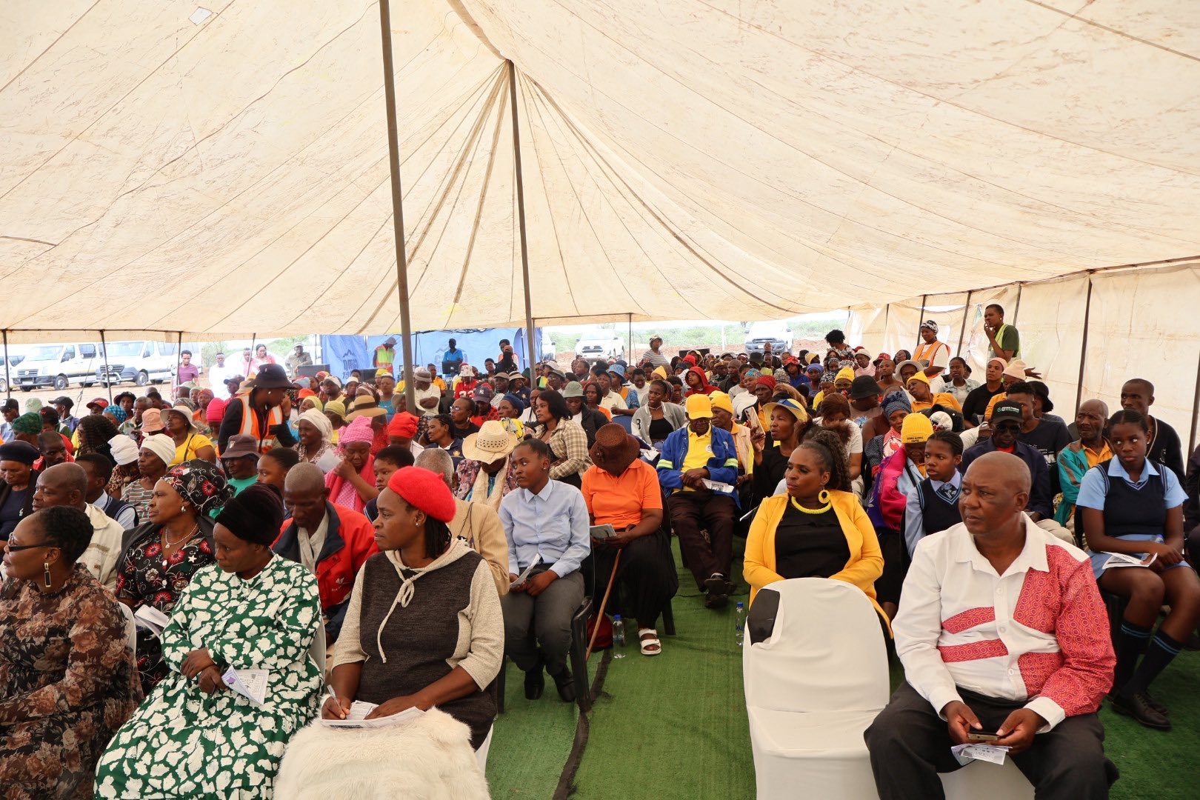
Significance/ Impact
What is the significance of the change?
Our Main aim is to create a safe space from hate and discrimination, where the LGBTIQ+ human rights are upheld through societal acceptance and legal protections across all settings (private and public sector).
In urban and city areas people understand easier because of more exposure, but when we go deeper into the rural villages, we need better approaches.
We are expanding further to deeper rural communities where most LGBTIQ+ who are in cities come from, so that they return home to sensitized communities instead of isolating themselves in cities to be able to live freely. We also use the multisectoral approach of collaborating with different stakeholders to address chain challenges faced by LGBTIQ+ people within our communities, working with specific stakeholders like the Faith Based Sector (Churches), Traditional Health Practitioners (maNgaka) and Traditional Authorities (Moshate) to address more issues using locally trusted stakeholders.
We participate in more online sessions and reach broader areas.
Voice and Choice Summit 2026 \ Voice and Choice Summit 2026

Slide 9
Challenges & Lessons learnt
Fundraising and Sustainability:
Limited staff and resource capacity are delaying our progress; people no longer want to volunteer and work with less compensation due to hardships of life and low employment rate in the country. Although people are supportive in participating at activities ensuring our visibility work is conducted, they are however not available for administrative purposes.
Lessons learnt:
We keep applying for funds, but we need to improve on creating income generating activities that can help sustain the organization.
Our partnership with stakeholders also helps in ensuring we are active in communities.
Voice and Choice Summit 2026 \ Voice and Choice Summit 2026

Slide 10
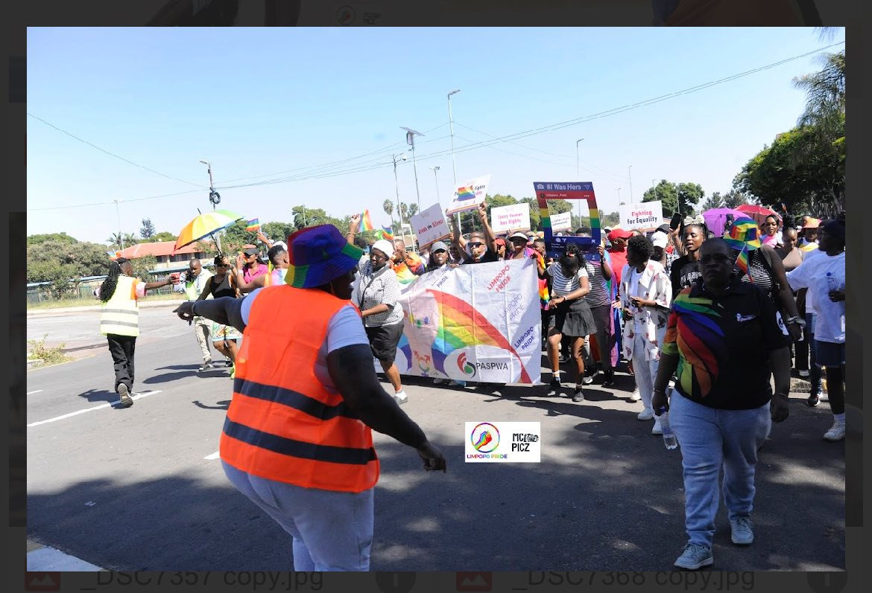
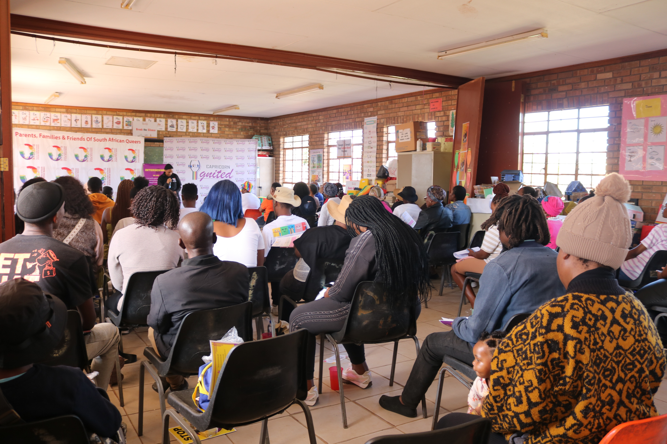
Sustainability
How will the change be sustained in our organization and What can be replicated by other grantees:
Strengthening partnerships with key stakeholders helps in sustaining the movement, as we address the following key areas through stakeholders:
1. SAPS - Stigma and Discrimination Reduction and Secondary victimization at police stations. To ensure the justice systems are fairly conducted against LGBTIQ+ people. We are establishing Local Organizing Committees together with local SAPS Social Crimes Units at stations. The SAPS SOP was drafted nationally with the sector.
2. Departments (Health, Community Safety and Social Development) - Intervention on challenges faced by LGBTIQ+ and young girls to access health services at facilities and receive psychosocial support, sensitization of health care and social welfare workers.
3. Municipalities - Broader access to all areas and being able to use municipal facilities to reach deep rural communities. Working closely with Municipalities and stakeholders from Forums assists us in accessing communities from locally based organizations.
4. Victim Empowerment Centres and Chapter 9 Institutions - Fair practices on process of justice system and ensuring that victims and survivors are legally protected.
5. Civil Society Organizations - Mobilization and support as key stakeholder in all activities conducted in communities. Reaching more people through collaborative work. We centralize some of the events in the local busy hubs of those communities to be able to gather people from surrounding villages and planning those activities in advance to monitor all challenges that may arise.
Voice and Choice Summit 2026 \ Voice and Choice Summit 2026

Slide 11
Next Steps
Our plans:
Secure more fundraising personnel and training to improve our finances.
Create different Podcast and Video messages clips for more online content.
Encourage more LGBTIQ+ organizations for Collective Collaborations or Merging to strengthen LGBTIQ+ Advocacy and avoid scattered funding and resources.
Loving Ourselves First, Accepted by the Rest!
Re a Leboga. (Thank You)
Voice and Choice Summit 2026 \ Voice and Choice Summit 2026

