Slide 1



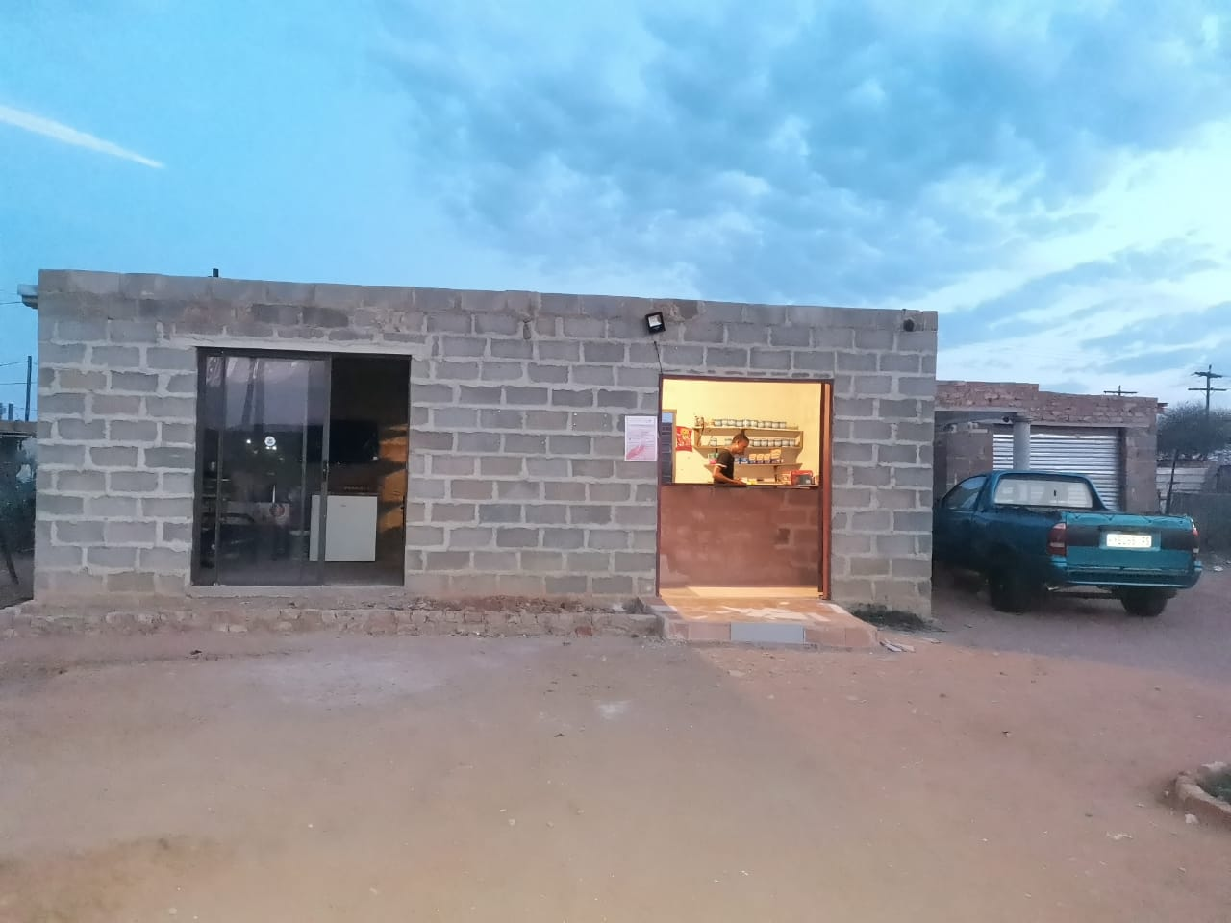
PROMOTING GENDER-INCLUSIVE LOCAL ECONOMIC DEVELOPMENT IN SOUTH AFRICA
ESTABLISHED ENTREPRENEURS
NAME OF THE BUSINESS: HILLSIDE TUCK SHOP AND RESTURANT
PARTICIPANT NAME: OLGA DIEKETSENG MORWENG
COUNCIL: PHOKWANE MUNICIPALITY

Slide 2
MY EXPERIENCE DURING SUNRISE CAMPAIGN
Informed on Gender based violence
The impact of gender based violence
The importance of reporting cases
How cultural believes and practices contributes to GBV
Vulnerability/risks of being dependant on the perpetrator
Self esteem and Self confidence
Human rights and violation thereof
How to write a business plan
Managing finances and cash flow (Income and expenditure)
The strategies of attracting and keeping customers happy
Financial support to grow my existing business

Slide 3
HOW MY LIFE HAS CHANGED
Informed on GBV
Informed on human rights
Self esteem and confidence
Reduced vulnerability to abuse
Improved business management
Gained more customers
Business Profit
Popular business
Household income
Improved relationship with partner and Children
Respect in the community

Slide 4
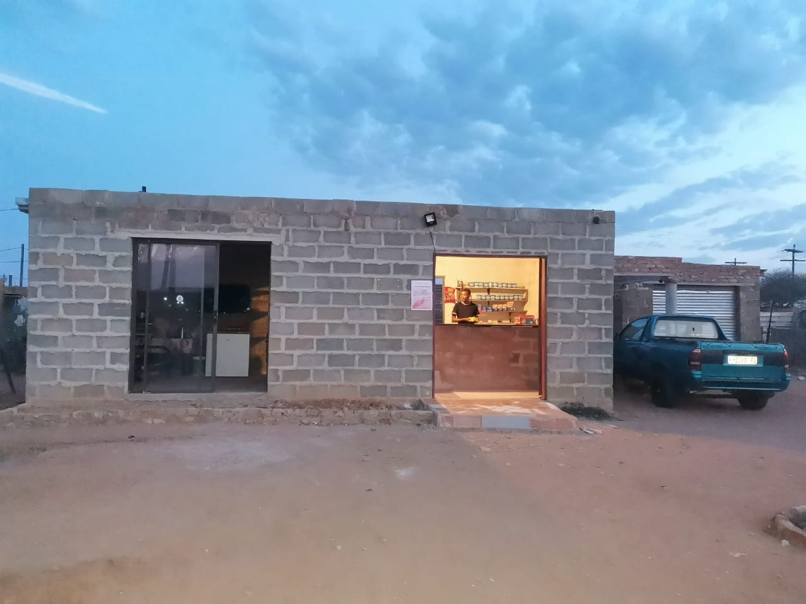
PLEASE DESCRIBE THE BUSINESS
The name of our business is Hillside tuckshop and resturant
Retail business selling basic household goods which includes food and non food products.
We operate from our own premises (not rented)
The business is situated in the community, the customers are my family, friends, neighbours and the community at large.
The business is currently being run by the immediate family.
It was registered in 2024 (After gender links training)

Slide 5
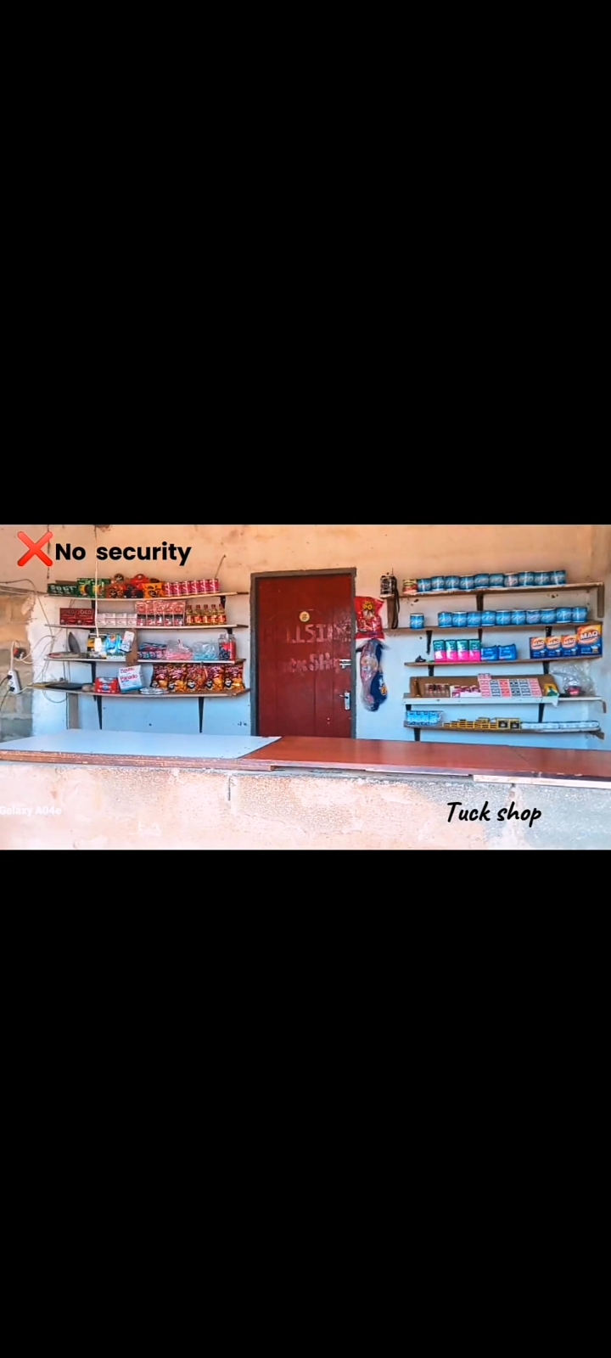
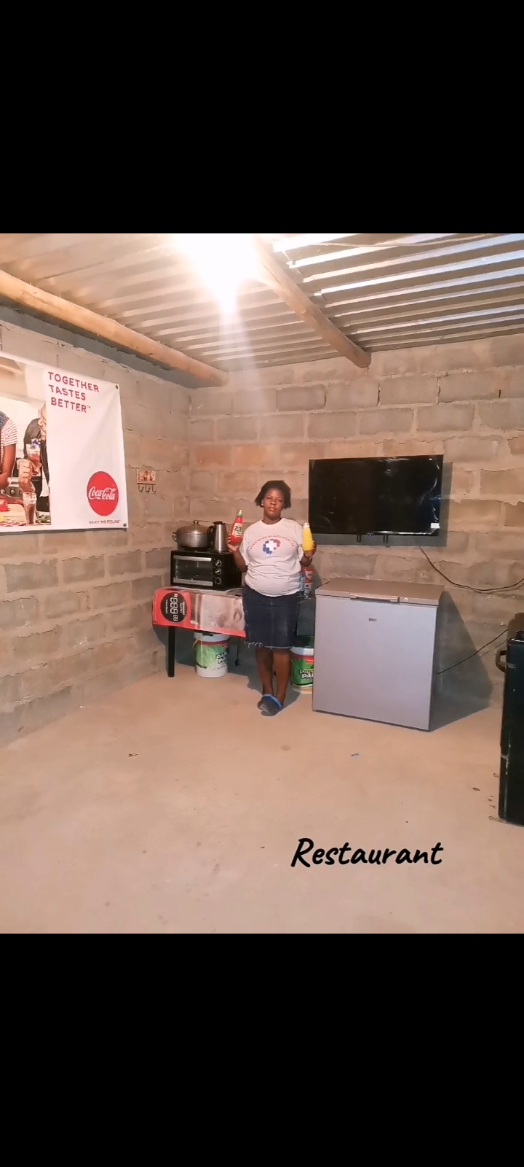
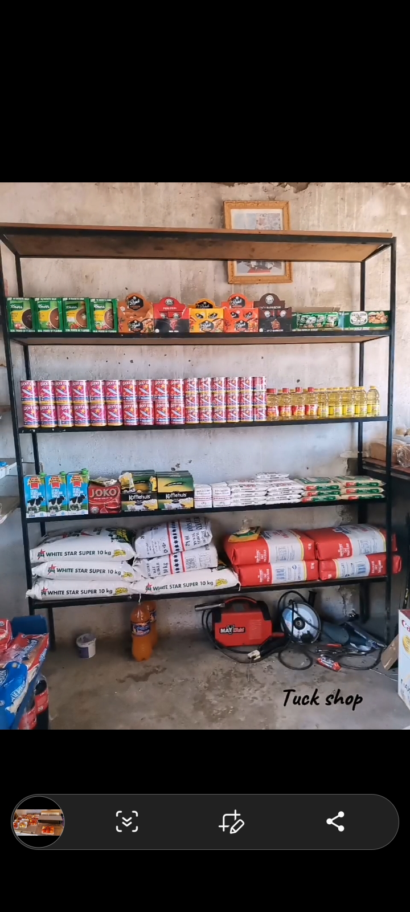
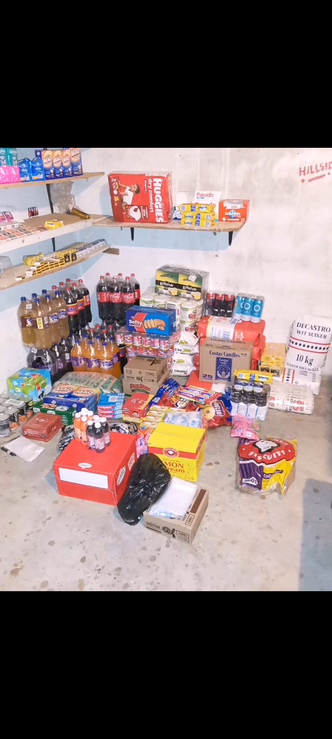
CUSTOMER BASE AND COMPETITION?
Who are your customers?
the community , adults youth and children
Have you increased the number of customers since starting the LED Programme? Yes or No
Yes
How did you do this?
By increasing the stock
Getting other services to increase customers i.e the games for kids and airtime and electricity machine
Who is your competition?
local tuck shops (2)
How do you handle competition in your business?
By trying at all times to have what the customers need and to sell at reasonable prices
by ensuring that the food is safe and fresh

Slide 6
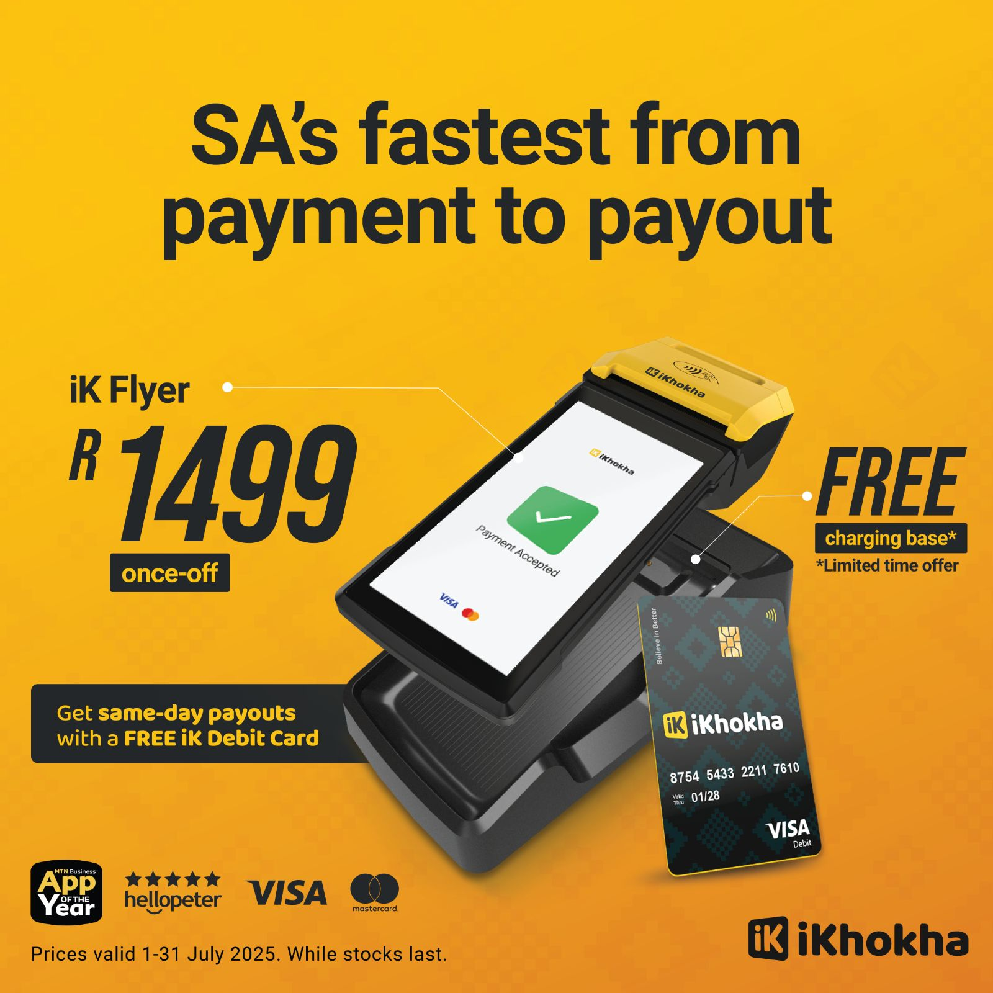
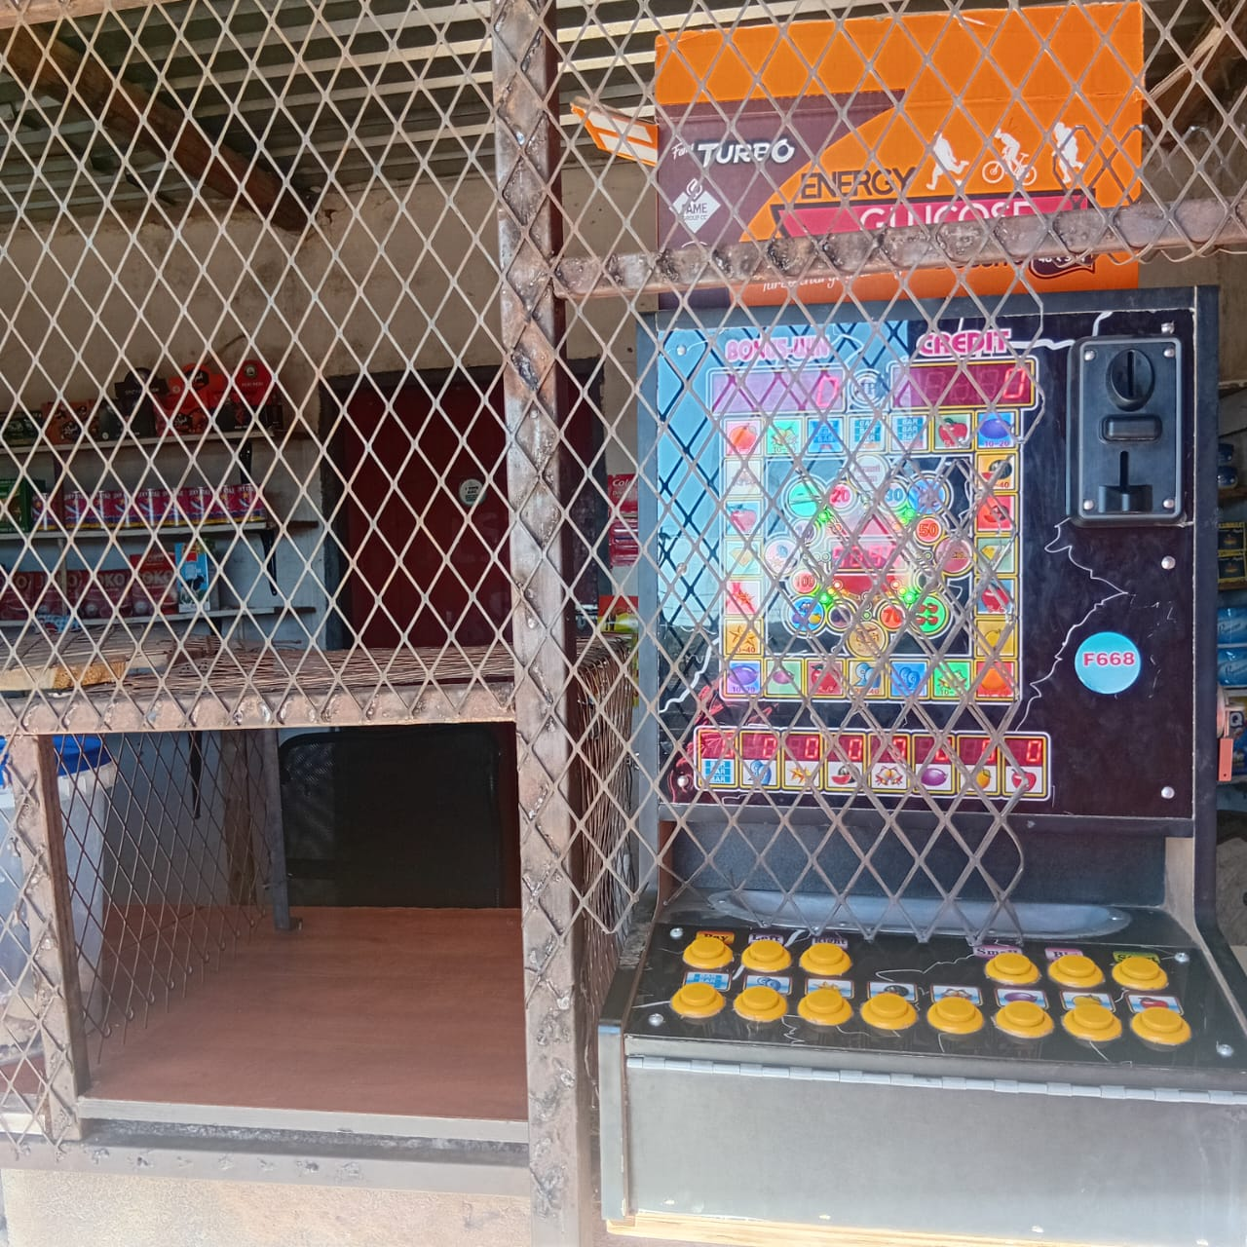
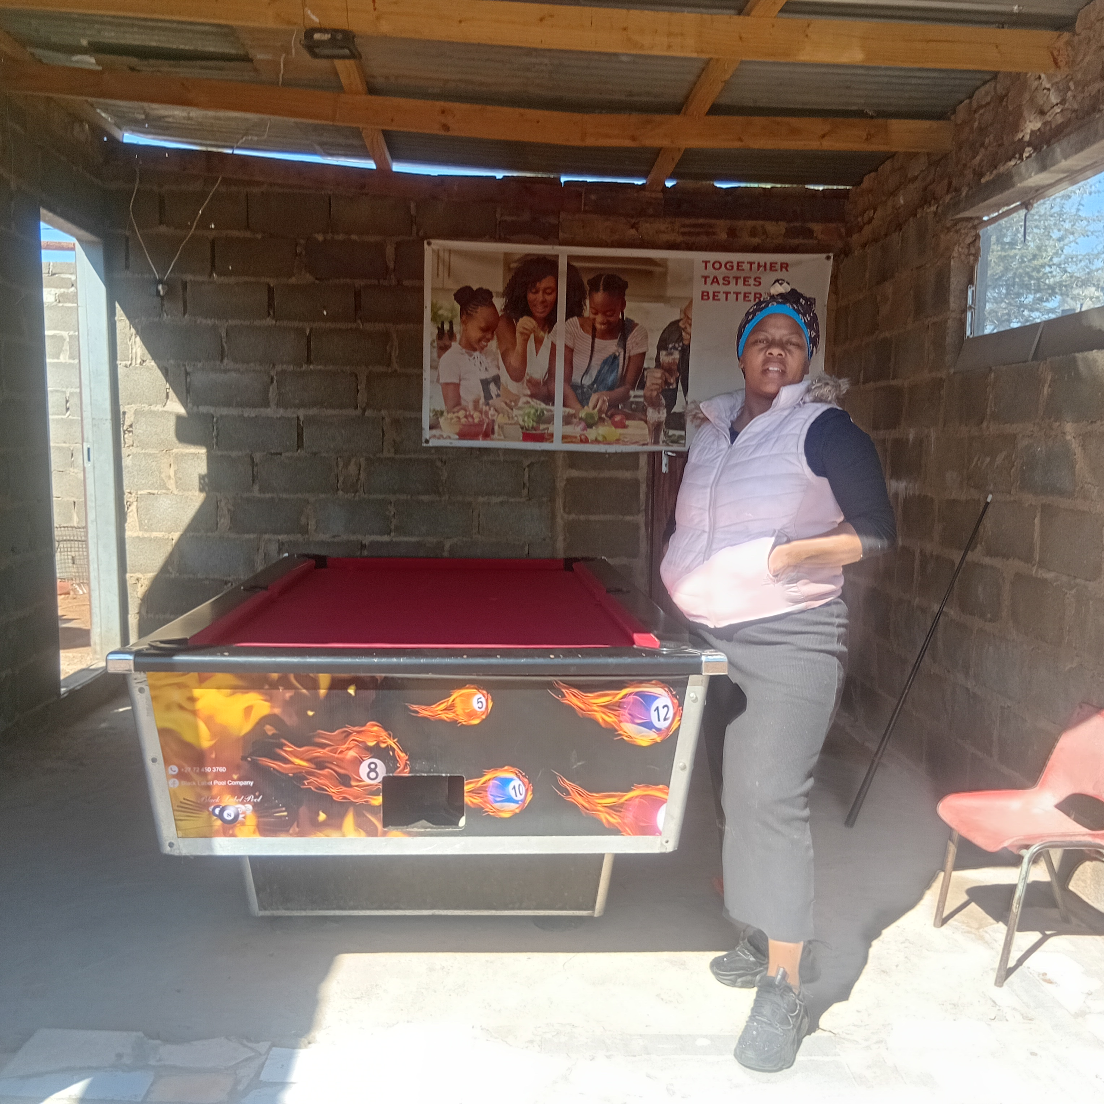
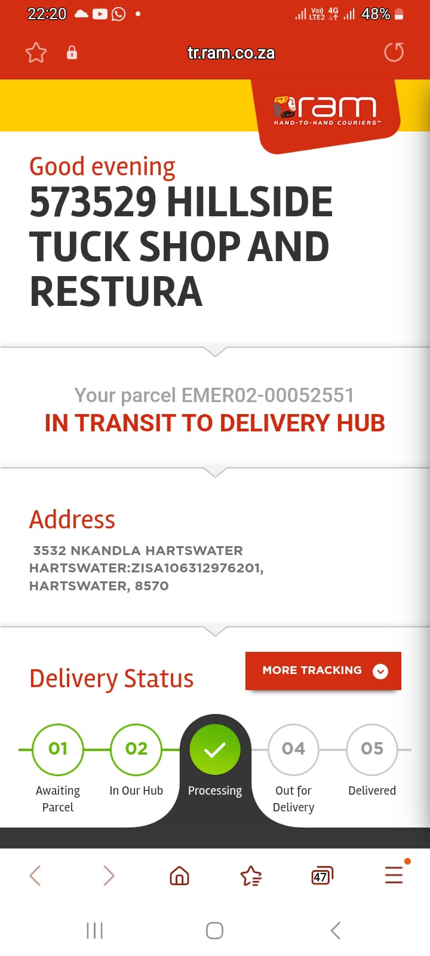
NEW PRODUCTS OR SERVICES?
Do you have any new business products or services?
Yes
What new products are in the business?
Game shop
Table pool
Ikhokha machine (Airtime, electricity, DSTV payment, Swipping and cash back services)
How are they performing compared to your initial products?
Attracting more customers
Increasing sales
How do you advertise/market your products?
Social media
Word of mouth

Slide 7
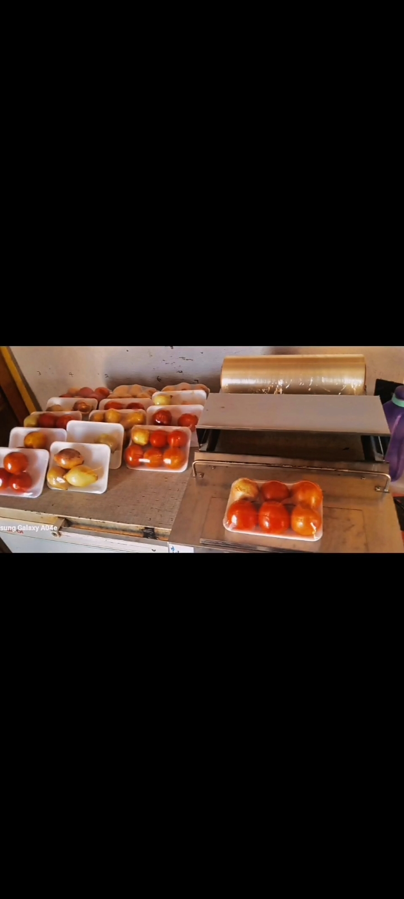
QUALITY AND PACKAGING
Are your customers happy with the quality of your products or services?
Yes
If you have answered yes please give more information.
More customers
Happy customers
Do you have any branding available for your products? Explain
I am my own brand
Have you changed the packaging or marketing of your business to attract more customers? Please explain.
Yes, I am using packaging to keep the food fresh and safe
Evidence

Slide 8
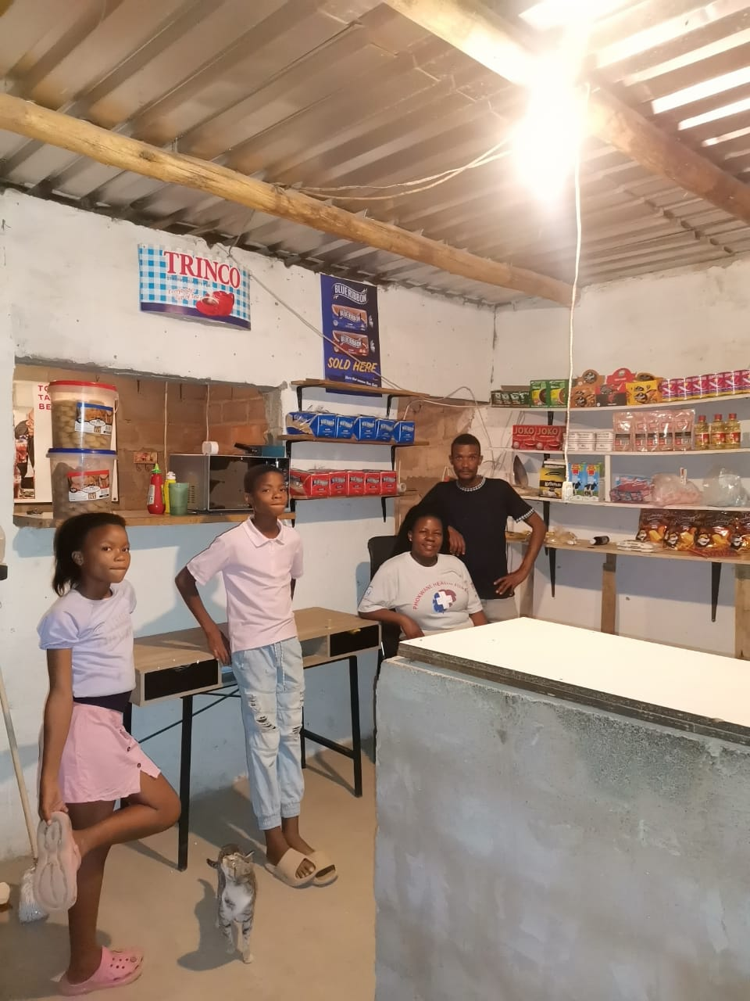
BUSINESS MANAGEMENT
Have you hired more staff? How many full-time and how many part-time?
Currently it is only me and my Partner working in the shop.
How do you manage your stock and check regularly? Please explain.
Gender links tought me how to do stock sheet and cash flow.
Have you been able to price your products better so that you can earn a surplus from the business? Please explain.
Yes, I compare the prices with my competitors and compare to the buying price in order to get the right prices and profit.

Slide 9
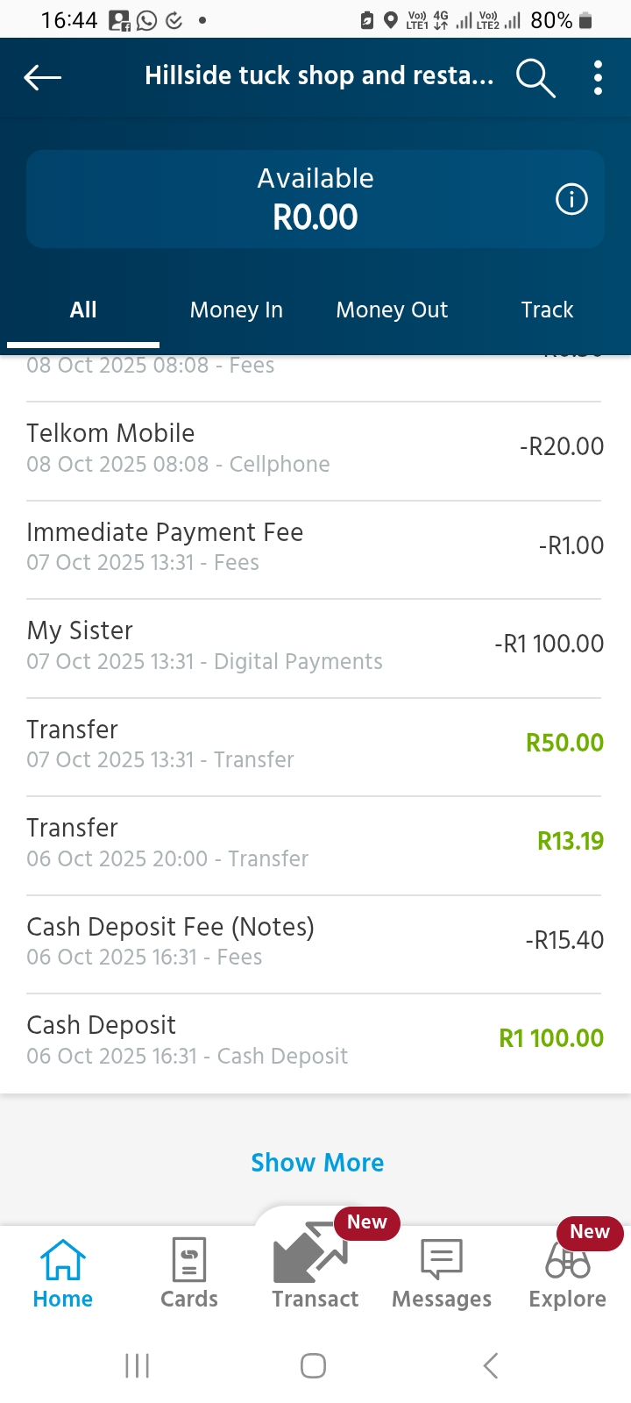
FINANCIAL MANAGEMENT
Do you have a record-keeping system in place? Explain.
Yes, we record income and expenditure
If yes, how is it helping you to manage your business?
I am able to see the profit made as well as the available stock.
Do you have a bank account for your business?
Yes

Slide 10
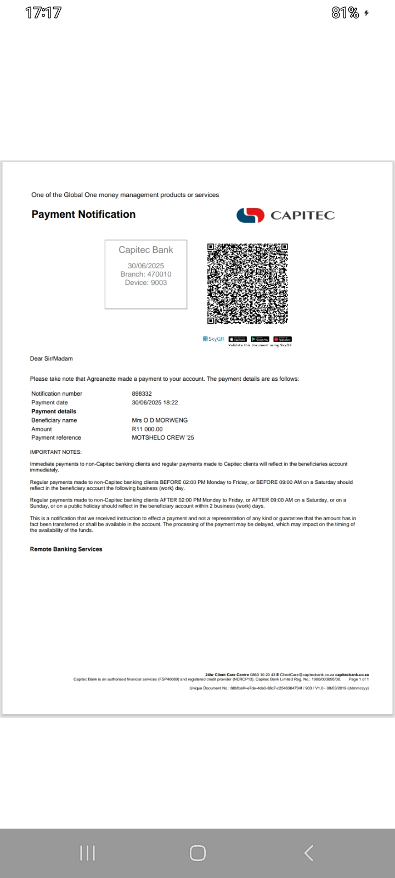
SAVINGS AND SELF SUFFICIENCY
Are you a member of a savings group?
Yes
Are you saving money? How much have you been able to save so far?
Yes, We save R1000 a month,we are 12 members ,once a month we give one member R11 000
Have you managed to increase household income?
Yes.

Slide 11
INCOME AND EXPENSES FOR THE BUSINESS FOR PAST THREE TO SIX MONTHS
INCOME
EXPENSES
ITEM | AMOUNT
Business | R15 000.00
Motshelo(stockvel group) | R11 000.00
TOTAL | R26 000.00
ITEM | AMOUNT
Stock for the shop | R9 000.00
Transport | R600
Airtime electricity | R600 R1 200.00
Salary | R6 000.00
TOTAL | R17 400.00

Slide 12
CHALLENGES
What challenges have you experienced in your business?
No bulk stock
limited stock items
Lack of financial support
How have you addressed these?
Company registration
Funding application
Game machine and a table pool (More customers & rental income)

Slide 13
SUSTAINABILITY
How will you sustain your business?
Outsource funding
Equipments for the resturant
More stock more customers
Savings group
What other sustainability measures are you putting in place for your business?
Needs analysis
Job creation for home deliveries

Slide 14
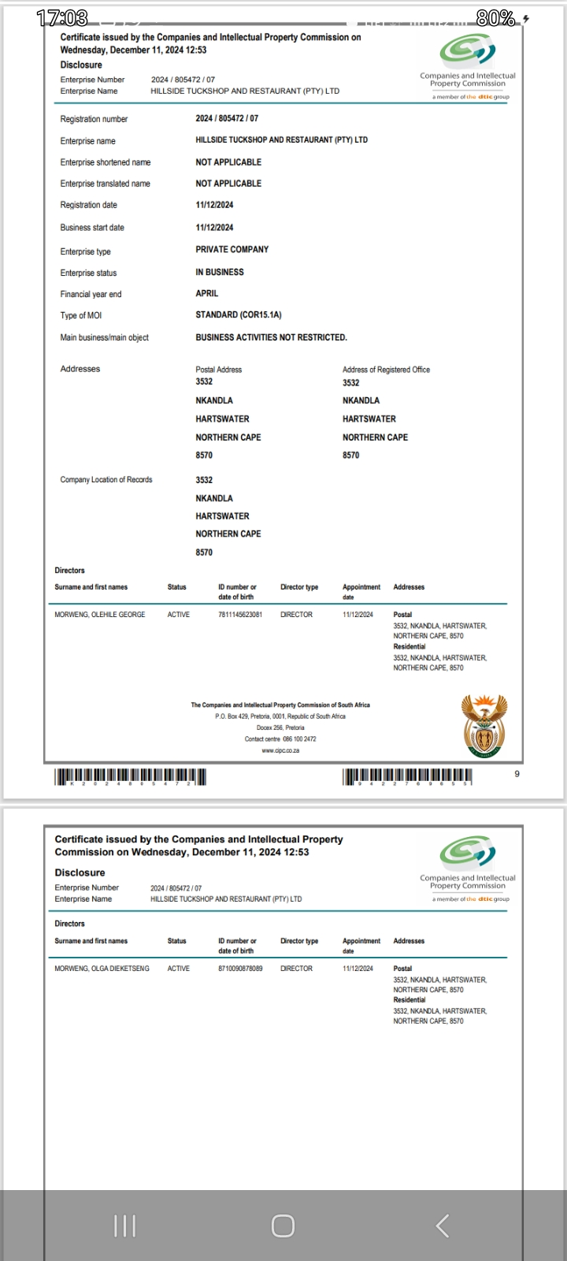
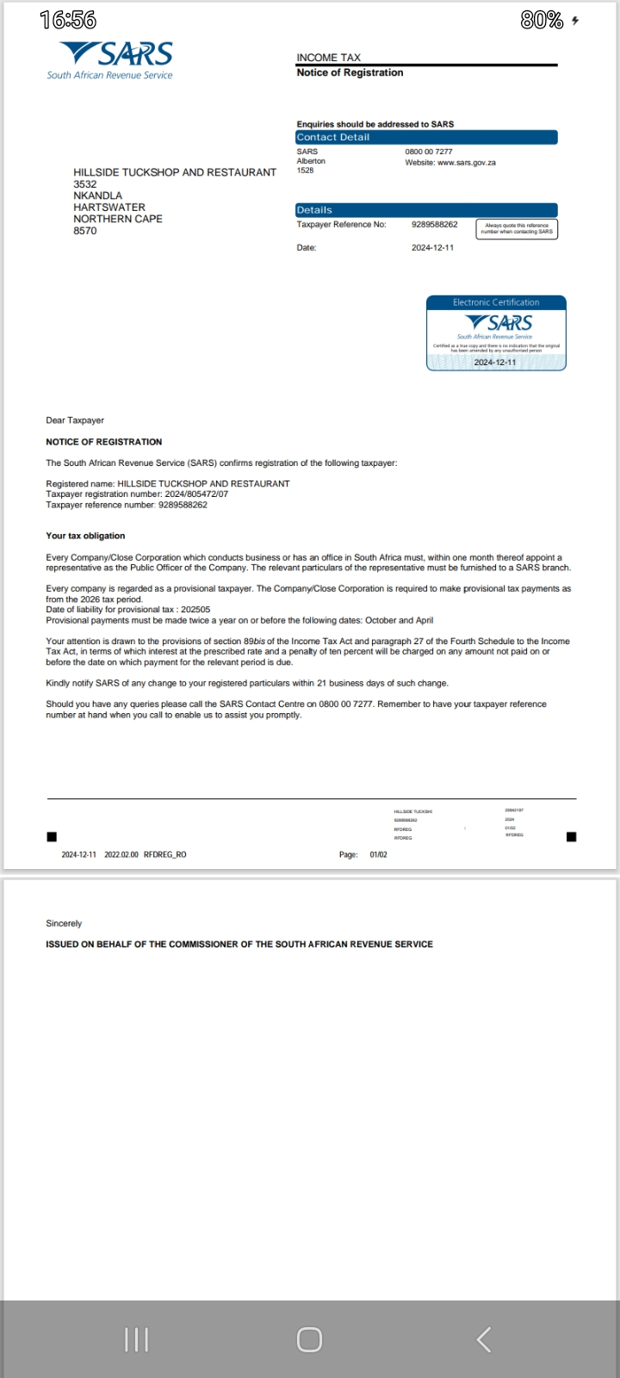
WHAT PLANS HAVE YOU MADE TO GROW YOUR BUSINESS IN THE NEXT 6 MONTHS?
Company registration
Needs analysis
Apply for small business funding

Slide 15
ADDITIONAL INFORMATION?
What other changes have you experienced in your business? Explain.
The busineess is now registered and have applied for funding for small businesses.
Do you have any additional information to share?
Opportunity (Training and empowerment)
Phokwane municipality (opportunity)
Gender links (Training)
Sunrise campaign (resources)
Mentor ( Advise and support)

Slide 16
