Slide 1
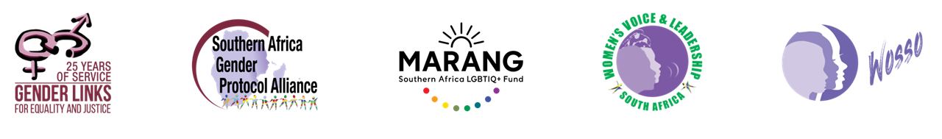

Voice and Choice Summit 2026-Story of Change Category
Your logo goes here
Knowledge Could Have Changed Everything
Knowledge Gives Teenage Mothers a Second Chance at Education
(Cameroon, Bamenda, 25 February 2026 and Ngala Nadege
Voice and Choice Summit 2026 \ Voice and Choice Summit 2026

Slide 2
Background
Briefly describe the context or problem the project set out to address.
What were the key objectives of the project?
What was the situation before the project?
Who is the organisation behind the project?
Where are you based / Where is the project being implemented?
Who was most affected by the problem and how?
What issue(s) did the project address?
In many schools in Cameroon, girls who become pregnant are often forced to drop out or are quietly pushed out of the education system due to stigma, discrimination, and lack of clear implementation of policies supporting their return to school. Before now, adolescent dropout of school was mostly linked to poverty, peer pressure, early marriages, rape etc however, our field researched showed that lack of knowledge on sexual health was the leading factor of the rapid rise of teenage pregnancies in schools in my community. I am a living proof of this system.
Key Objectives of the Project: Advocate for second-chance education for teenage mothers. Promote Sexual and Reproductive Health and Rights (SRHR) education to prevent unintended teenage pregnancies. Engage schools, teachers, and communities to support re-entry and retention of pregnant learners and young mothers in school. Encourage implementation of existing education policies protecting pregnant learners.
Situation Before the Project: Many adolescent girls were sent home from school once pregnancy was discovered. Fear, stigma, lack of SRHR knowledge, and absence of psychosocial support left many girls without the opportunity to continue their education.
Organization Behind the Project: Lifein Association Cameroon (LIA) leads the initiative under Project Second Chance Education: SRHRs for Teenage Mothers.
Location: The project is implemented in Bamenda, North West Region of Cameroon, an area already affected by conflict and educational disruption.
Most Affected: Adolescent girls and teenage mothers, many of whom lose access to education and future opportunities.
Issues Addressed: Teenage pregnancy, school exclusion, lack of SRHR knowledge, stigma against pregnant students, and weak implementation of policies supporting girls’ education.
Voice and Choice Summit 2026 \ Voice and Choice Summit 2026

Slide 3
Change
How did the change come about?
• What activities or actions brought about the change?
• Who led and participated in bringing about the change.
The change began from my own lived experience. As a teenage mother who was sent out of school due to pregnancy, I understood the deep stigma, silence, and lack of support that many girls face. This experience motivated me to transform my personal pain into advocacy for second chance education and Sexual and Reproductive Health and Rights (SRHR) for adolescent girls.
Key Activities and Actions: onducting school-based surveys and data collection to understand the realities of teenage pregnancy and school dropout among girls. Holding dialogues with teachers, school administrators, and counselors on supporting pregnant learners and teenage mothers.
Running social media advocacy campaigns to raise awareness about girls’ rights to education after pregnancy.
Promoting conversations on policy implementation in schools, especially the ministerial decision allowing girls to continue education after pregnancy.
Creating safe spaces for girls to share experiences and receive guidance.
Leadership and Participation: The initiative is led by Ngala Nadege, founder of Lifein Association Cameroon (LIA), with support from volunteers, teachers, school counselors, community members, and young girls who have become advocates for change within their schools and communities.
Voice and Choice Summit 2026 \ Voice and Choice Summit 2026

Slide 4

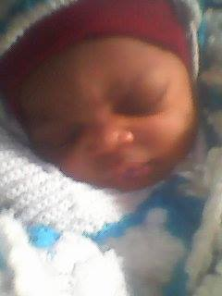
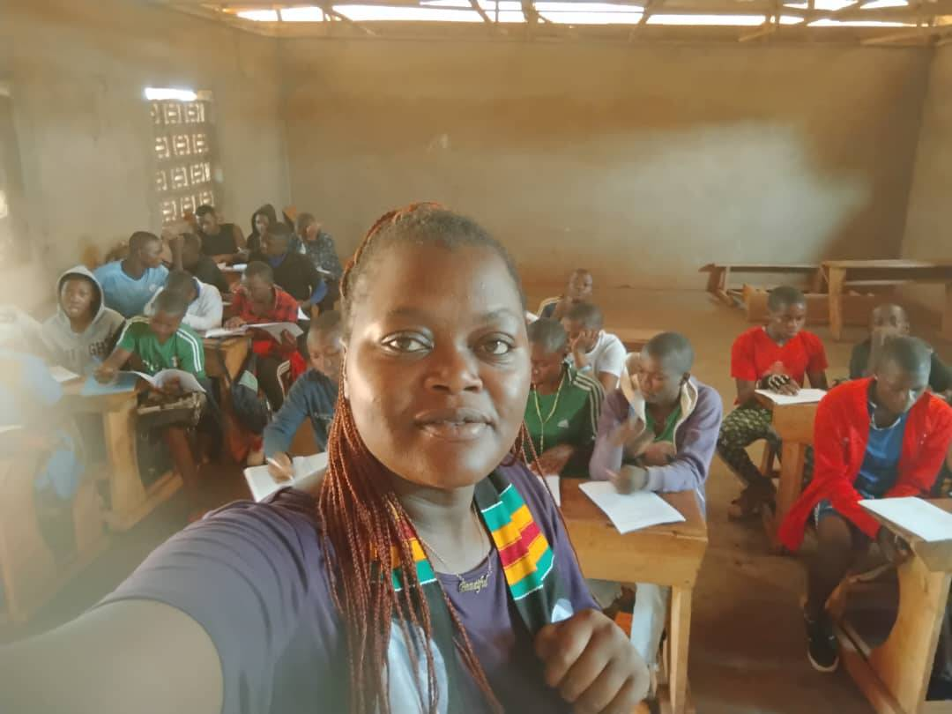
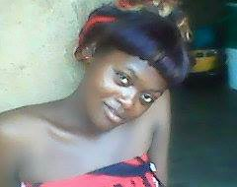
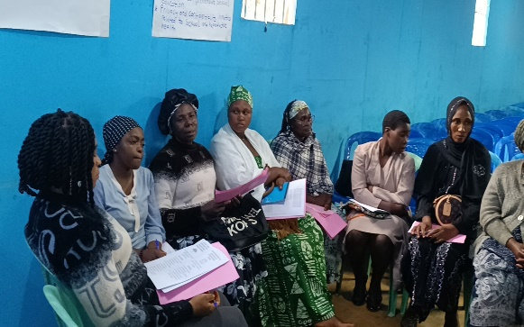
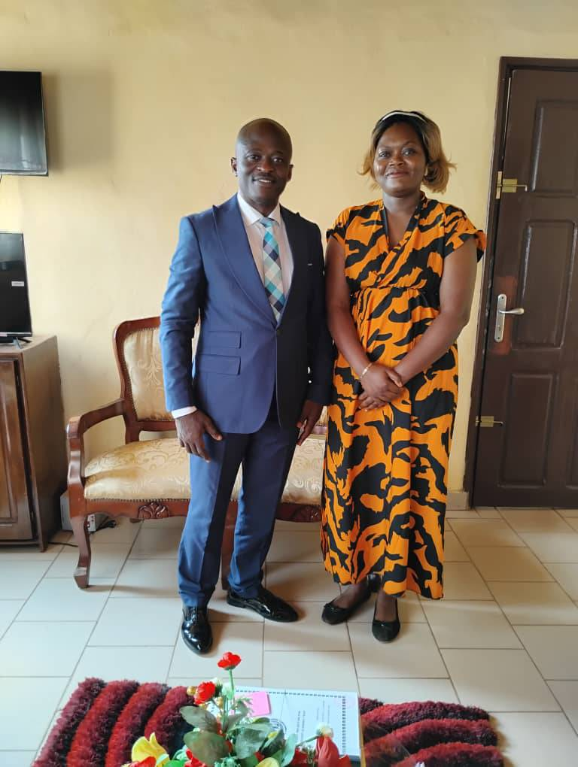
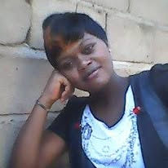
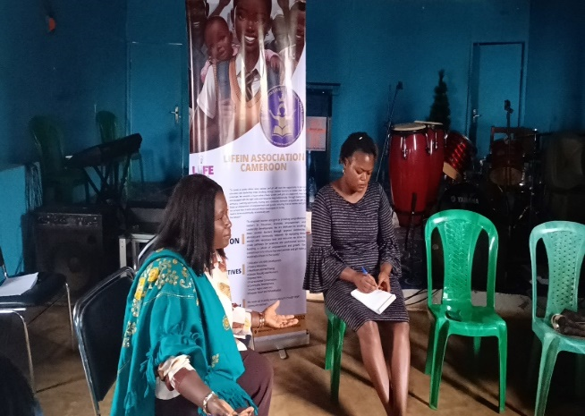
Pictures
These are pictures of me when I gave birth, held a survey, a FGDs to collect data and get an insight on what students, community women think or know about sexual health

Slide 5
The change
Describe the change that has occurred?
• Describe what the change was, when and where it happened
• Was the change positive or negative?
• Who benefited, and in what way?
• What is the situation now?
The project “Second Chance Education and Sexual and Reproductive Health Rights (SRHR) for Teenage Mothers” has started to create positive change in Bamenda 1sub Division, North West Region of Cameroon. Before the project began, many teenage girls who became pregnant were forced to leave school and had little or no knowledge about sexual and reproductive health. Stigma, discrimination, and lack of support prevented many young mothers from returning to school Since the implementation of the project in 2024, awareness sessions, school engagements, surveys, and community discussions have helped young girls and teenage mothers better understand their sexual and reproductive health rights and the importance of education. The change has been positive, as many girls now feel more confident speaking about SRHR, seeking information, and expressing their desire to continue their education after pregnancy.
Teenage mothers, adolescent girls, and even teachers have benefited from the project through increased awareness, dialogue, and support for second-chance education. Some schools and community members are beginning to recognize that pregnancy should not mean the end of a girl’s education.
Today, there is growing awareness and conversation around SRHR and second-chance education in the community especially in schools While challenges remain and a lot still to be done, the project has opened space for change, giving hope to girls who once believed their dreams had ended. Recently, the regional delegate of secondary education solicited our opinion on a recent data collection method especially on girls dropout.
Voice and Choice Summit 2026 \ Voice and Choice Summit 2026
Voice and Choice Summit 2026 \ Voice and Choice Summit 2026

Slide 6
Significance of Change
Please provide further information on what this change means for the movement and its goals
What effect this change may have on the next steps in this area of work.
Evidence: Include Photos or videos
This change is significant for the broader movement advocating for girls’ education and Sexual and Reproductive Health Rights (SRHR) in Cameroon. For many years, teenage pregnancy has led to stigma, discrimination, and the exclusion of young mothers from the education system. By creating awareness and encouraging dialogue on second-chance education and SRHR, the project contributes to shifting attitudes within schools and communities. It helps people recognize that teenage mothers still deserve the opportunity to continue their education and rebuild their futures.
The change also strengthens the movement’s goal of promoting inclusive education and gender equality, ensuring that no girl is denied education because of pregnancy. By empowering young girls with knowledge about SRHR, the project helps them make informed decisions about their health and future.
This progress also lays the foundation for the next phase of the work. The insights gathered from school surveys, awareness sessions, and community engagement will support stronger advocacy with education authorities and policymakers to ensure better implementation of policies that allow teenage mothers to return to school, build a robust psychosocial support system in school.
In-service training of teachers in the field of sexual health has been seen as a necessity as teachers need to know how to accommodate pregnancy hormones in class
Ultimately, the change builds momentum for scaling up the initiative, expanding awareness programs, strengthening support systems for teenage mothers, and advocating for long-term policy implementation that protects girls’ right to education.
Voice and Choice Summit 2026 \ Voice and Choice Summit 2026

Slide 7
Sustainability
What sustainability measures were put in place for the work?
How do you intend to sustain the work or scale up?
Evidence: Include Photos or videos
To ensure sustainability, the project focused on building knowledge, partnerships, and community ownership. Awareness sessions and discussions on Sexual and Reproductive Health Rights (SRHR) and second-chance education were conducted with students, teachers, and community members so that the knowledge shared continues to spread even after the project activities end.
Teachers and school authorities were encouraged to become allies in supporting teenage mothers to remain in or return to school.
Club creation in school which will serve as ambassadors of the program. These clubs will be monitored, empowered, and motivated to ensure continuity.
The project also collected data through surveys and focus group discussions in schools. This data will serve as an evidence base for continued advocacy with education authorities and policymakers to strengthen the implementation of policies that support teenage mothers’ right to education.
Partnerships with schools and community stakeholders are another key sustainability measure. These relationships will allow ongoing engagement, mentorship, and awareness activities for girls who may be at risk of dropping out due to pregnancy.
In the future, the work will be scaled up by expanding SRHR education programs to more schools and communities, strengthening collaboration with civil society organizations, and using digital platforms and social media to reach a wider audience. The long-term goal is to create a stronger support system that ensures teenage mothers can access education, health information, and opportunities to rebuild their futures.
Voice and Choice Summit 2026 \ Voice and Choice Summit 2026

Slide 8
Beneficiaries
Number of;
Female – Direct beneficiaries
Male – Direct beneficiaries
Female – Indirect beneficiaries (e.g. through other networks)
Male – Indirect beneficiaries (e.g. through other networks)
Female – Online beneficiaries (e.g. website access, mailing lists, scholarly articles)
Male – Online beneficiaries (e.g. website access, mailing lists, scholarly articles)
Evidence: Include Photos or videos
Female – Direct beneficiaries: 120 (Teenage mothers, girls who attended SRHR awareness sessions, focus groups, and discussions in schools.)
Male – Direct beneficiaries: 40 (Male students and teachers who participated in discussions and awareness sessions on SRHR and girls’ education.)
Female – Indirect beneficiaries (e.g. through other networks): 300 (Girls who received information through peers, teachers, and school networks.)
Male – Indirect beneficiaries (e.g. through other networks): 120 (Male students, parents, and community members reached through discussions and school awareness activities.)
Female – Online beneficiaries (e.g. Social media): 800
Male – Online beneficiaries (e.g. social media): 350
These include people reached through social media advocacy, shared posts, and online discussions about SRHR and second chance education
Voice and Choice Summit 2026 \ Voice and Choice Summit 2026

Slide 9
Challenges & Lessons learnt
Challenges & mitigation
While progress has been made, several challenges affect the expansion of the project:
Limited financial resources remain a major obstacle, restricting the scale of outreach activities, research, and advocacy work.
Lack of collaboration from some school authorities who are reluctant to share information related to adolescent pregnancy. In some cases, schools tend to conceal or underreport cases of teenage pregnancy(``school reputation``), making it difficult to obtain accurate data and fully understand the scope of the issue.
The absence of structured data systems within schools and education offices makes monitoring and evaluation challenging.
Despite these challenges, the project remains committed to advocating for education, dignity, and equal opportunities for pregnant adolescents and teenage mothers. By strengthening collaboration, improving awareness, and promoting better data systems, the initiative hopes to create a more supportive and inclusive educational environment.
What lessons have you learnt?
Lived Experience as a Powerful Advocacy Tool My own journey as a teenage mother who was sent out of school gave me credibility and urgency to your advocacy. Sometimes I cry as some stories resonate deeply with me. This Lived experience has transform a personal struggle into a tool for social change.
Education and SRHR knowledge are vital and lack of information is a major driver of teenage pregnancies. Empowering girls with knowledge about their bodies, rights, and reproductive health can prevent early pregnancies.
One lesson I have learnt is that adolescent pregnancy is not a community affair, it is a national concern and should be handled with caution.
Community and Family support are critical Mothers, fathers, and community leaders significantly influence teenage girls’ decisions. Some mothers want to support but lack the knowledge or resources. So I strongly think that Advocacy must engage families and communities, not just the girls themselves.
Policies alone are not enough even when laws allow pregnant girls to remain in school, implementation gaps persist. Some schools still expel or stigmatize teenage mothers, especially in Private schools. So, advocacy must address both policy and practice, ensuring rules translate into action in every educational sector.
Voice and Choice Summit 2026 \ Voice and Choice Summit 2026

Slide 10
Next Steps
What are your plans?
The Project Second Chance Education: SRHRs for Teenage Mothers is a three-year advocacy initiative currently in its second year. The next phase of the project will focus on strengthening policy implementation, improving access to Sexual and Reproductive Health and Rights (SRHR) information, and building systems that support pregnant adolescents and teenage mothers to remain and return in school.
One of the key observations from field engagement is the lack of reliable data on adolescent pregnancy in schools. During school visits and community interactions, it became evident that many schools do not keep structured records on pregnant students or teenage mothers. Similarly, there is limited consolidated data available at the Divisional Delegations of Secondary and Basic Education. This lack of data makes it difficult to understand the full scale of the problem, design effective interventions, and advocate for evidence-based policy implementation.
As a long-term vision, the project intends to advocate for and eventually contribute to the development of a data management and tracking system that can be used by schools to record and monitor cases of adolescent pregnancy, school dropout, and reintegration of teenage mothers. Such a system would help education authorities, schools, and advocacy organizations make informed decisions and develop targeted support programs for affected girls and help Ministries bring out the right policies that support girls education and eliminate gender discrimination.
Short-Term Plans
In the short term, the project aims to:
Continue school and community awareness campaigns on SRHR to address misinformation and prevent early pregnancies.
Conduct focus group discussions with students, parents, teachers, and school counsellors to better understand the challenges faced by pregnant adolescents.
Strengthen dialogue with school authorities and education officials to encourage the implementation of the ministerial circular allowing pregnant girls to continue their education.
Promote the importance of proper data collection within schools regarding adolescent pregnancy and school reintegration.
Build partnerships with local organizations, educators, and community leaders to support teenage mothers.
Voice and Choice Summit 2026 \ Voice and Choice Summit 2026

