Slide 1

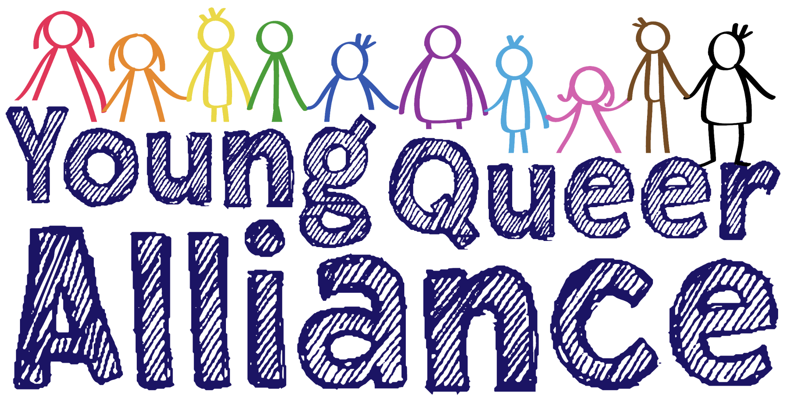
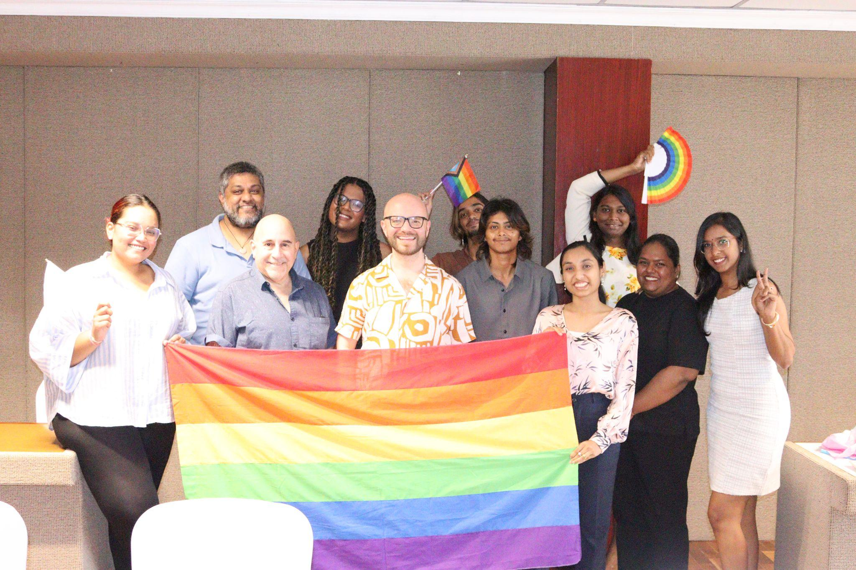
Voice and Choice
Summit 2026
Leadership Category
Mauritius: Young leaders transforming LGBTQIA+ inclusion through community-driven services
Voice and Choice Summit 2026 \ Voice and Choice Summit 2026

Slide 2
Synopsis– brief overview what this is about
Name | Najeebah Nabeebaccus
Designation | Community Empowerment Officer
Organisation | Young Queer Alliance
Country | Mauritius
Category | Leadership
Summary | The Young Queer Alliance (YQA) has emerged as a youth-led movement creating spaces where LGBTQIA+ individuals can access support, become empowered, and advocate for equal rights. The organisation has adopted a collaborative/shared leadership style across various levels in the organisation to advance its 2022 - 2027 Strategic Plan. The Strategic Plan, was developed using community participation and co-creation and resulted in 5 Strategic Objectives: • Mobilising and empowering the LGBTQIA+ community • Promoting acceptance and celebrating diversity • Advocating for legal and policy reforms • Building strong partnerships • Strengthening organisational sustainability As one of the leaders of the organisation, I work collaboratively with team members to advance the strategic objectives, by focusing on community empowerment through service delivery, community mobilisation, grassroots outreach and working in partnership, My work helps in transforming challenges into opportunities for leadership and social change.
Voice and Choice Summit 2026 \ Voice and Choice Summit 2026

Slide 3
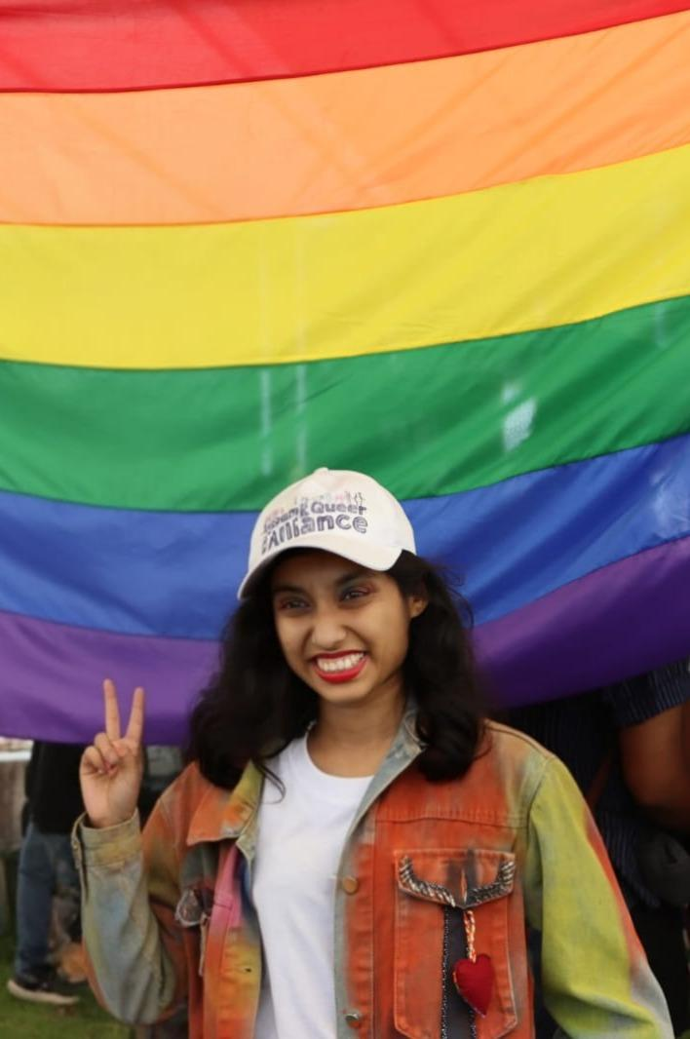
Background
My name is Najeebah, I am 30 years old, Mauritian, and I identify as genderfluid and pansexual. My journey with the LGBTQIA+ community began during my university years, when I conducted research on coming out experiences of LGBT+ young adults in Mauritius. During that time, I also engaged in online activism through my Instagram platform This Rainbow Sheep, where I shared awareness content and amplified the work of community organisations.
My connection with the Young Queer Alliance (YQA) started in 2018. At first, I reached out as a student researcher and later collaborated with the organisation professionally while working in the field of social work. In 2021, I joined YQA as a beneficiary, participating in safe spaces, community discussions and advocacy campaigns that support LGBTQIA+ individuals in Mauritius.
In 2024, I joined YQA as a Community Empowerment Officer. Today, my role focuses on strengthening the wellbeing and resilience of LGBTQIA+ community members by coordinating support services, organising safe spaces, and providing psychosocial support. I work closely with beneficiaries to assess their needs, develop personalised support plans, provide counselling, and connect them with relevant services.
Through this role, I also help maintain community engagement by creating digital content and strengthening connections between LGBTQIA+ individuals and supportive networks. My work contributes to YQA’s broader mission of empowering LGBTQIA+ people to become leaders of change and to build a safer, more inclusive society in Mauritius.
Voice and Choice Summit 2026 \ Voice and Choice Summit 2026

Slide 4
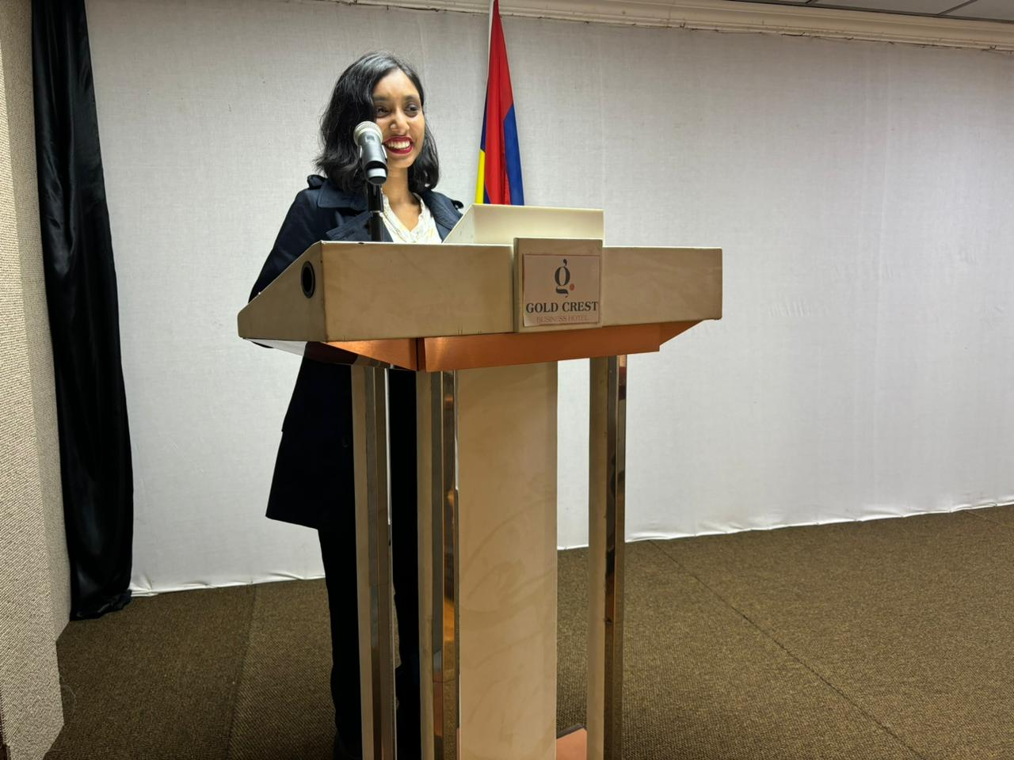
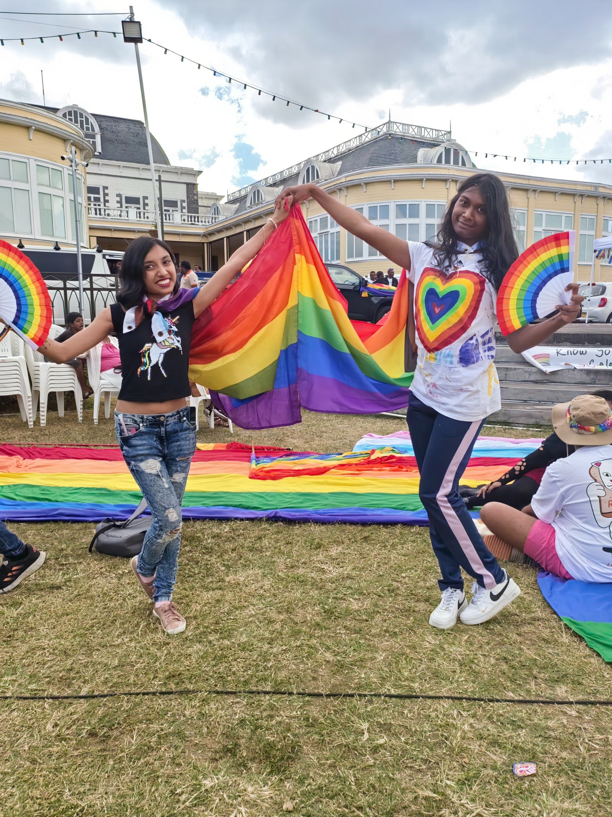
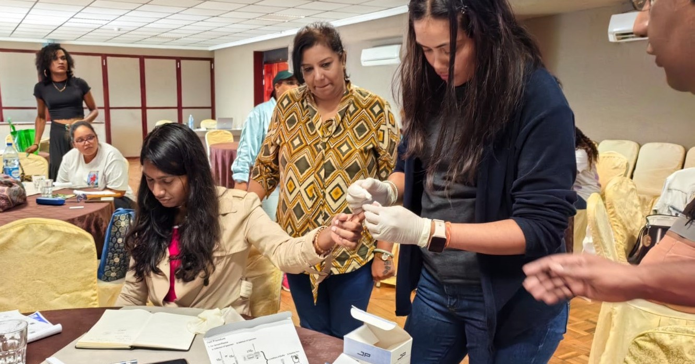
Background
Situation Before Change: A Climate of Fear and Silence
Pride events disrupted by queerphobia and misinformation
LGBTQIA+ youth afraid to speak openly about their identity
Online harassment, insults, and death threats
Limited public education about sexual diversity
Many queer people living in isolation and fear
Issues Being Addressed:
Social stigma and discrimination
Limited safe spaces for queer youth
Mental health challenges and isolation
High vulnerability to HIV/STIs among MSM and transgender communities
Conflict between sexual identity and religious beliefs
Lack of representation and visibility
What makes me unique: From Silence to Leadership
Genderfluid and pansexual activist from Mauritius
Formerly closeted → now openly advocating for LGBTQIA+ rights
Combines psychology background with community empowerment
Builds safe spaces for marginalized queer youth
Advocates while navigating religious and cultural barriers
Supports over 100 individuals in personal and identity journeys
Voice and Choice Summit 2026 \ Voice and Choice Summit 2026

Slide 5
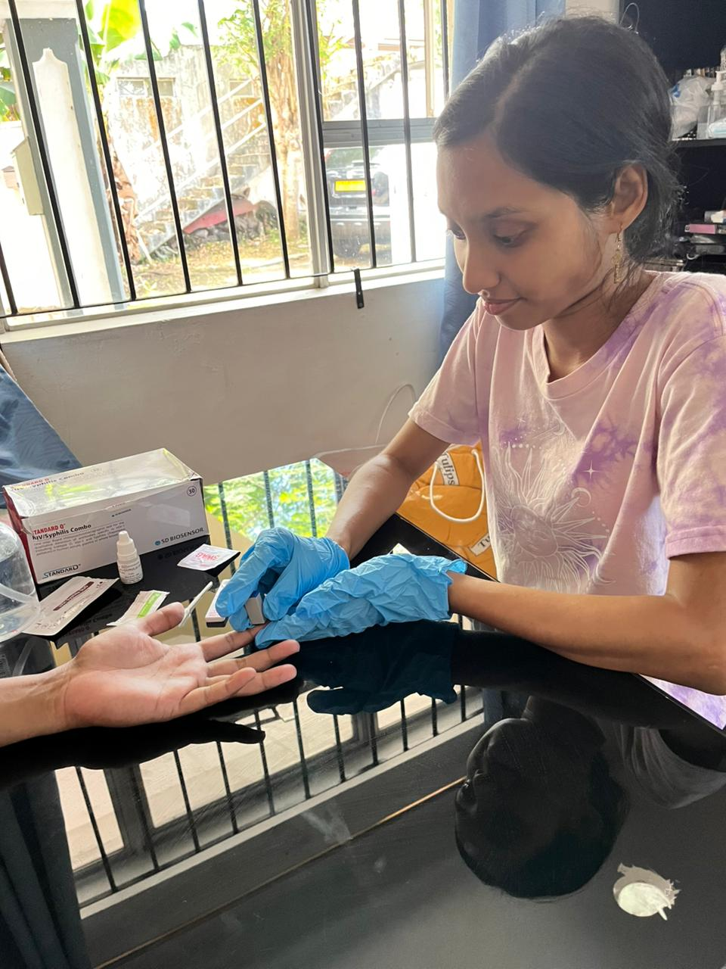
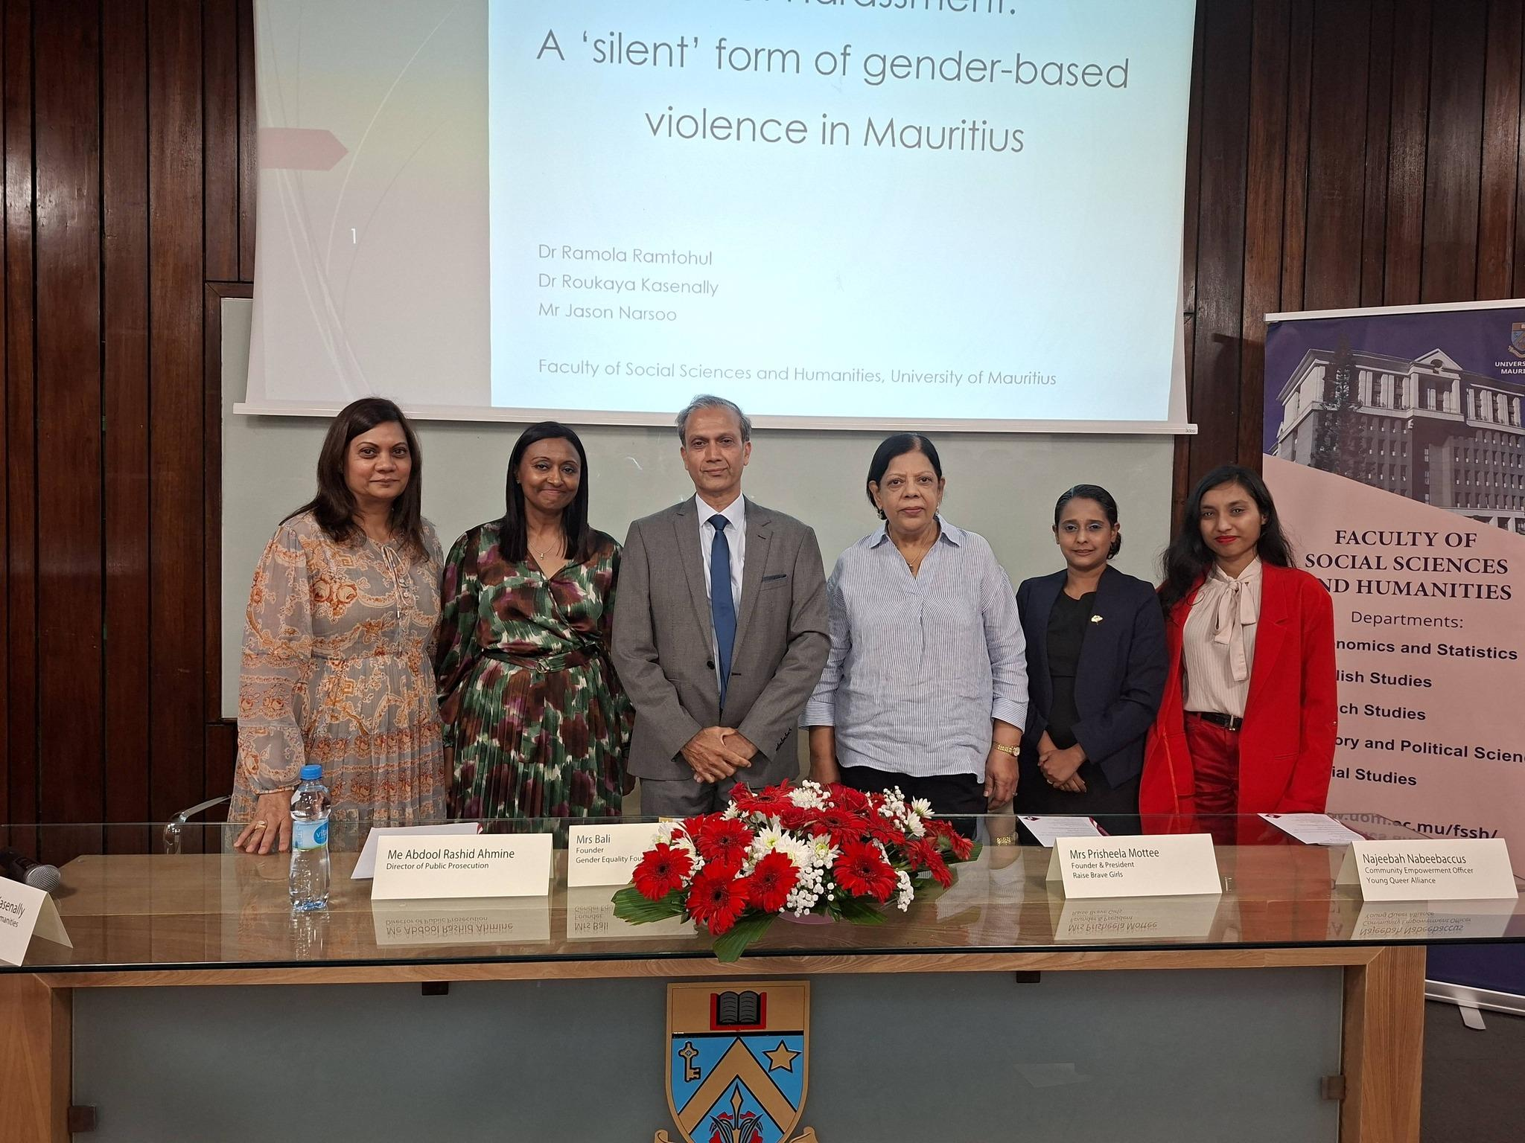
Change
The change at the Young Queer Alliance has been driven through collective leadership, where staff, volunteers, the Board, and community members work together to strengthen services and advocacy for LGBTQIA+ people in Mauritius.
Since joining YQA as Community Empowerment Officer in 2024, I have contributed to expanding the organisation’s outreach and community engagement. Together with my colleagues and leadership team, we have supported a significant growth in community participation, with more than 400 new beneficiaries joining YQA and over 200 new cases managed.
Through community support and empowerment initiatives, I have personally accompanied more than 100 individuals in their wellbeing and personal identity journeys, helping them access safe spaces, counselling, and community support. I have also conducted HIV testing for more than 200 people within the MSM and transgender communities, who face higher risks and barriers to healthcare in Mauritius.
Our collective work has strengthened YQA’s impact through:
• Community empowerment: regular safe spaces and events attended by more than 30 participants each time, creating belonging and peer support.
• Leadership development: supporting queer entrepreneurs and community members to participate in public panels, consultations and advocacy spaces.
• Advocacy and partnerships: expanding collaborations with international organisations working toward marriage equality and legal recognition for LGBTQIA+ people.
• Policy engagement: contributing to governmental workshops and dialogues on social inclusion and the needs of vulnerable LGBTQIA+ households.
• Visibility and awareness: increased media coverage highlighting LGBTQIA+ issues and YQA’s work.
I also helped strengthen internal systems by making beneficiary databases and monitoring tools more inclusive, recognising diverse identities such as non-binary and pansexual individuals so that people feel accurately represented and understood.
To better engage younger generations, we introduced more interactive community activities—including games, icebreakers, cultural events, and discussions that explore the intersection of queer identity, faith, and culture.
Through this collective effort, individuals who once felt isolated or fearful are now finding the confidence to live authentically, participate in public conversations, and build supportive communities.
Voice and Choice Summit 2026 \ Voice and Choice Summit 2026

Slide 6

Change
Voice and Choice Summit 2026 \ Voice and Choice Summit 2026

Slide 7
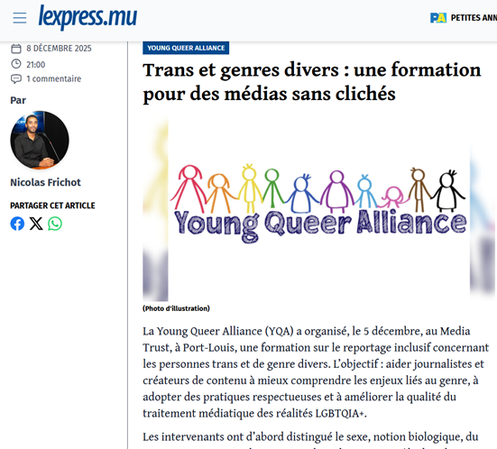
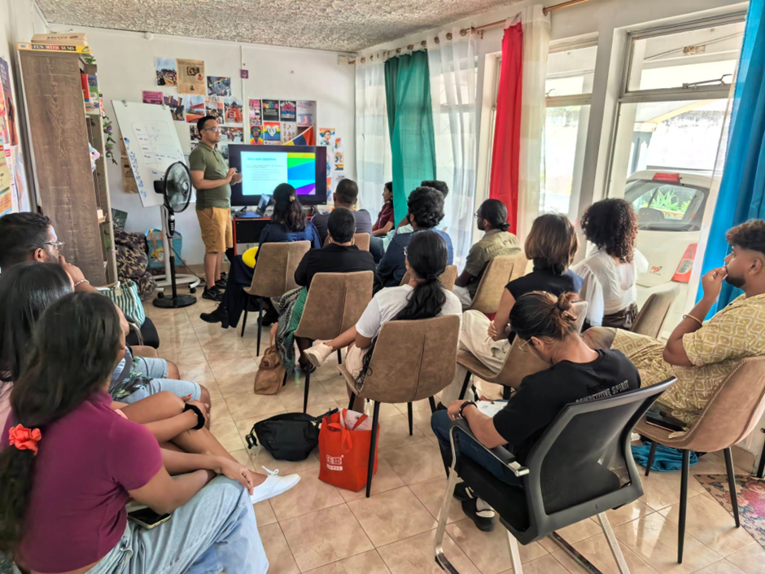
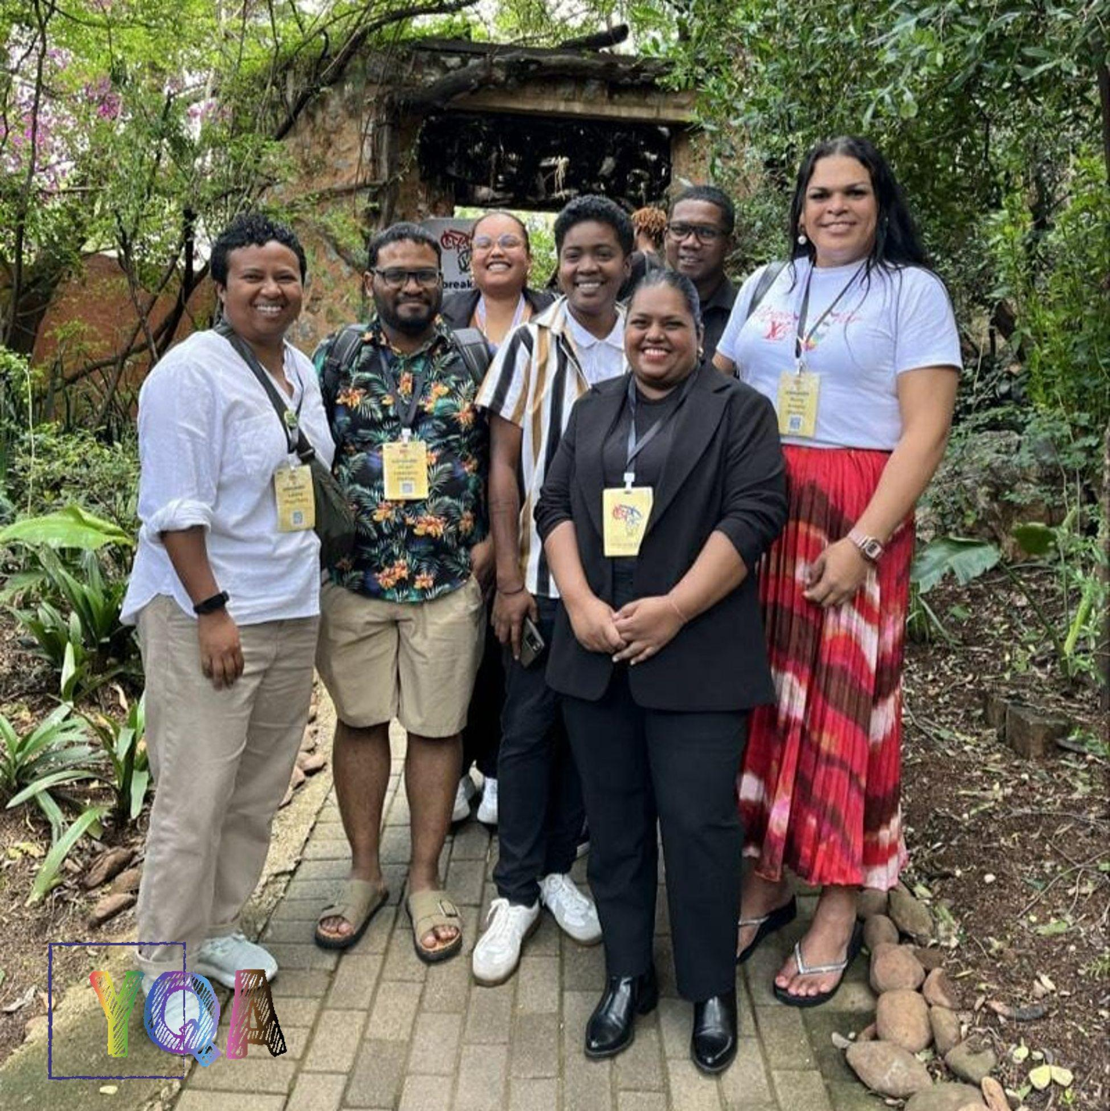
Impact
The Change We Are Seeing
YQA’s leadership has created change at multiple levels: community, Mauritius, and international.
Community Impact
Overall increase in engagement and participation of LGBTQIA+ people in YQA programs and safe spaces, with particularly significant visibility of trans, gender-diverse, and elderly beneficiaries
Greater awareness of rights, available services such as counselling, case management, hosting of safe spaces, HIV Testing and Information sharing on coming-out, Trans Issues and LGBTQIA+ Rights, and support networks among LGBTQIA+ community members through trainings, workshops, and guidance, fostering confidence, empowerment, and the ability to advocate for themselves and others
Strengthened engagement and active participation through social media and community initiatives, with beneficiaries more connected, actively creating and sharing content, raising awareness, and contributing to community solidarity and acceptance
National Impact
Engagement with government, policymakers, and stakeholders to advocate for inclusive intersectional policies in workplaces, families, and healthcare, including producing the first-ever video interview highlighting the lived experiences of an intersex person
Strengthened collaboration with local NGOs, fostering mutual engagement and creating pathways for queer beneficiaries to access services, while increasing public awareness through intersectional approaches
Increased media visibility and coverage of LGBTQIA+ issues, strengthening public awareness and societal acceptance
International Impact
Active participation in UN human rights mechanisms, contributing to global discussions on LGBTQIA+ rights and inclusion
Collaboration with international organisations, including TIHA, Avocats Sans Frontières, Freedom To Marry Golbal and several African LGBTQIA+ organisations, sharing Mauritius’ experiences and best practices while learning from regional and global initiatives
Voice and Choice Summit 2026 \ Voice and Choice Summit 2026

Slide 8
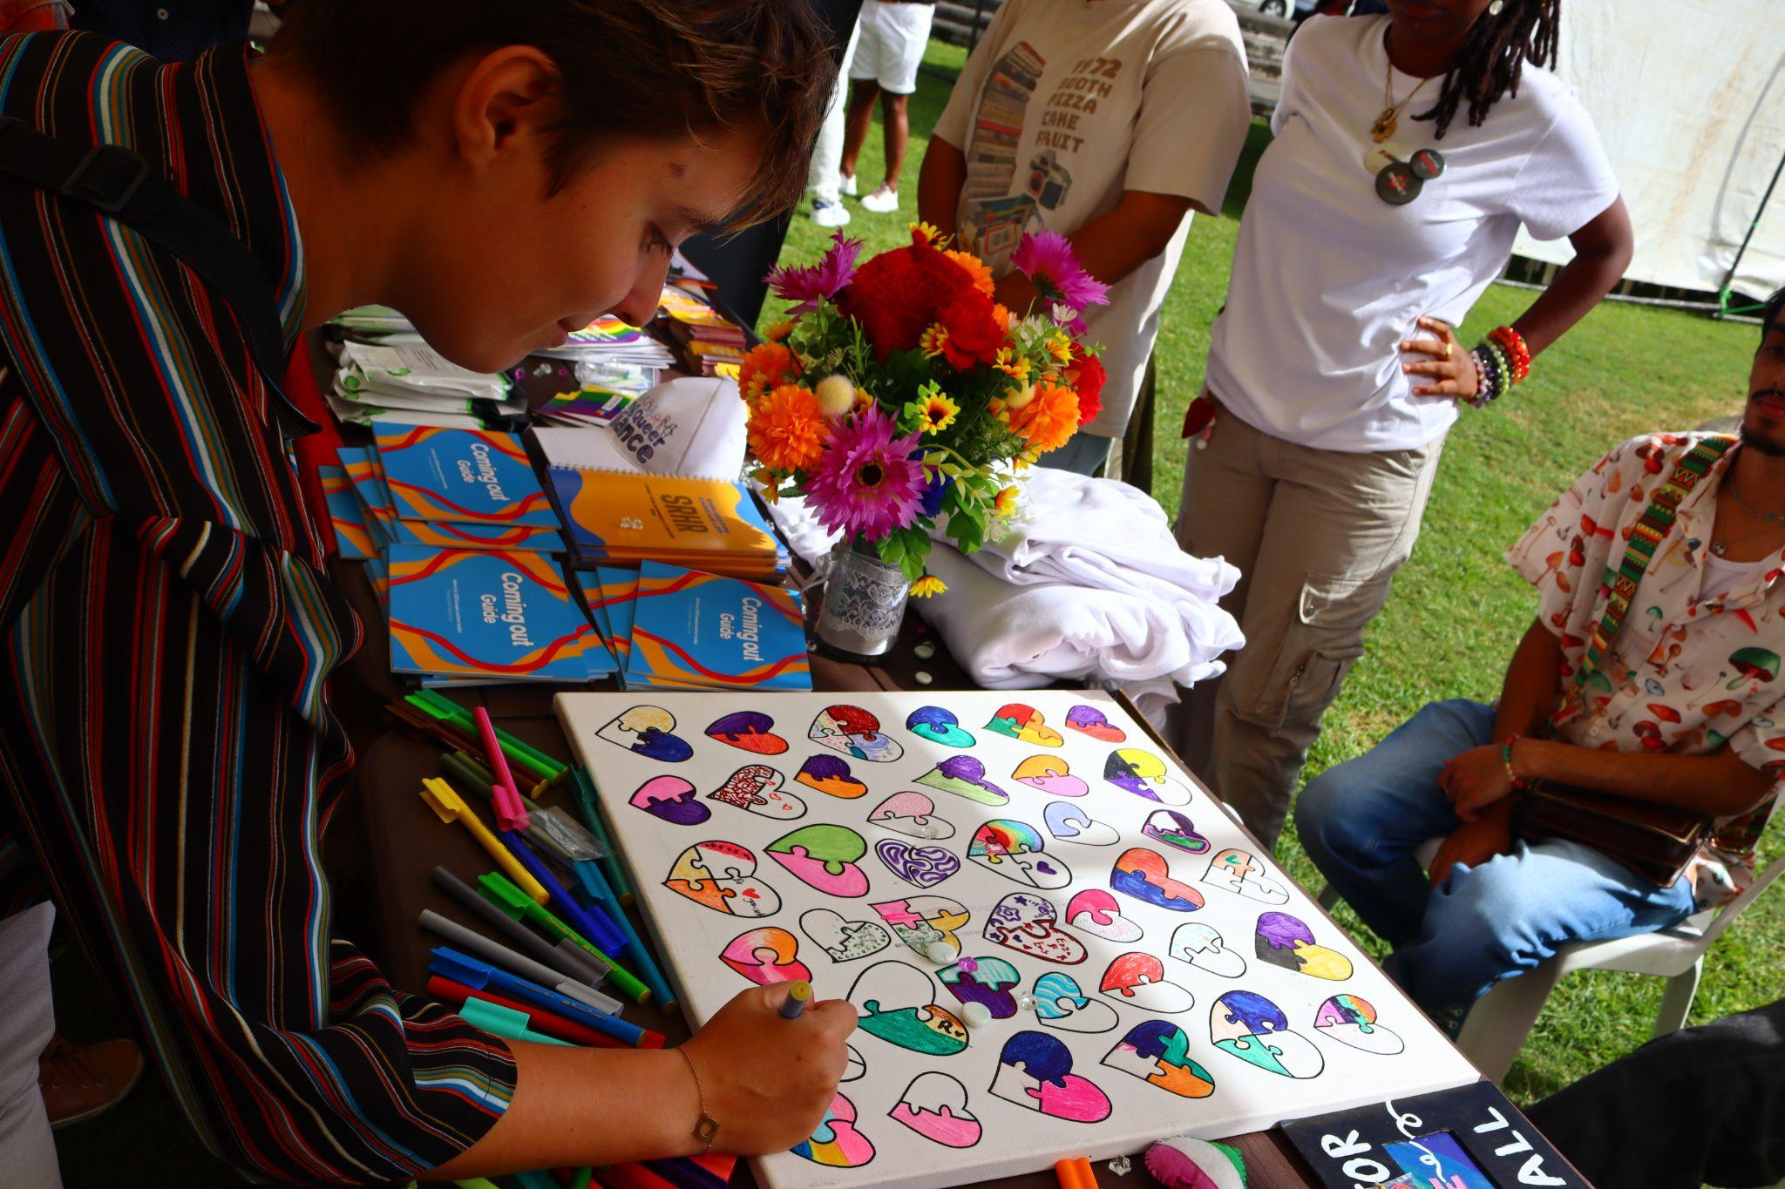
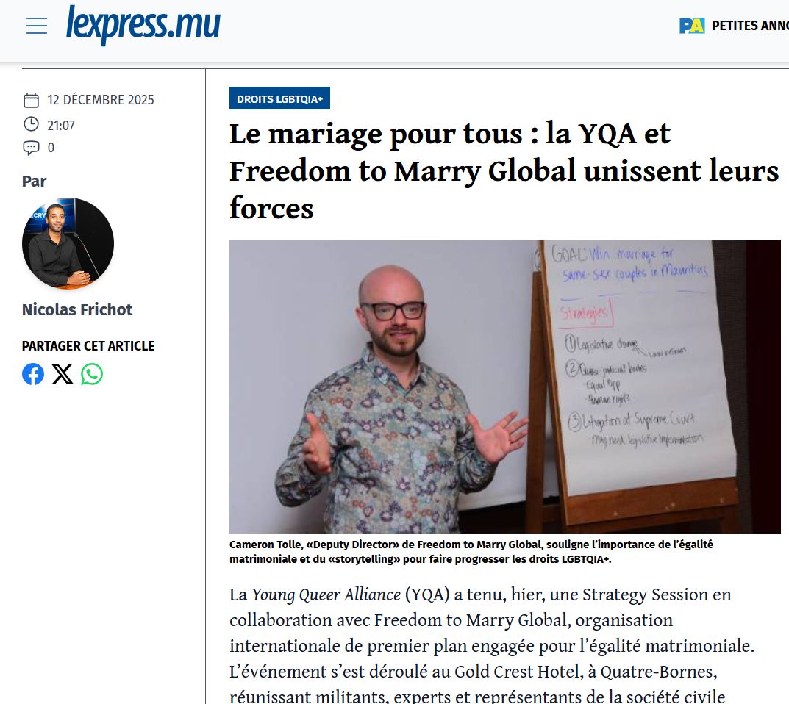
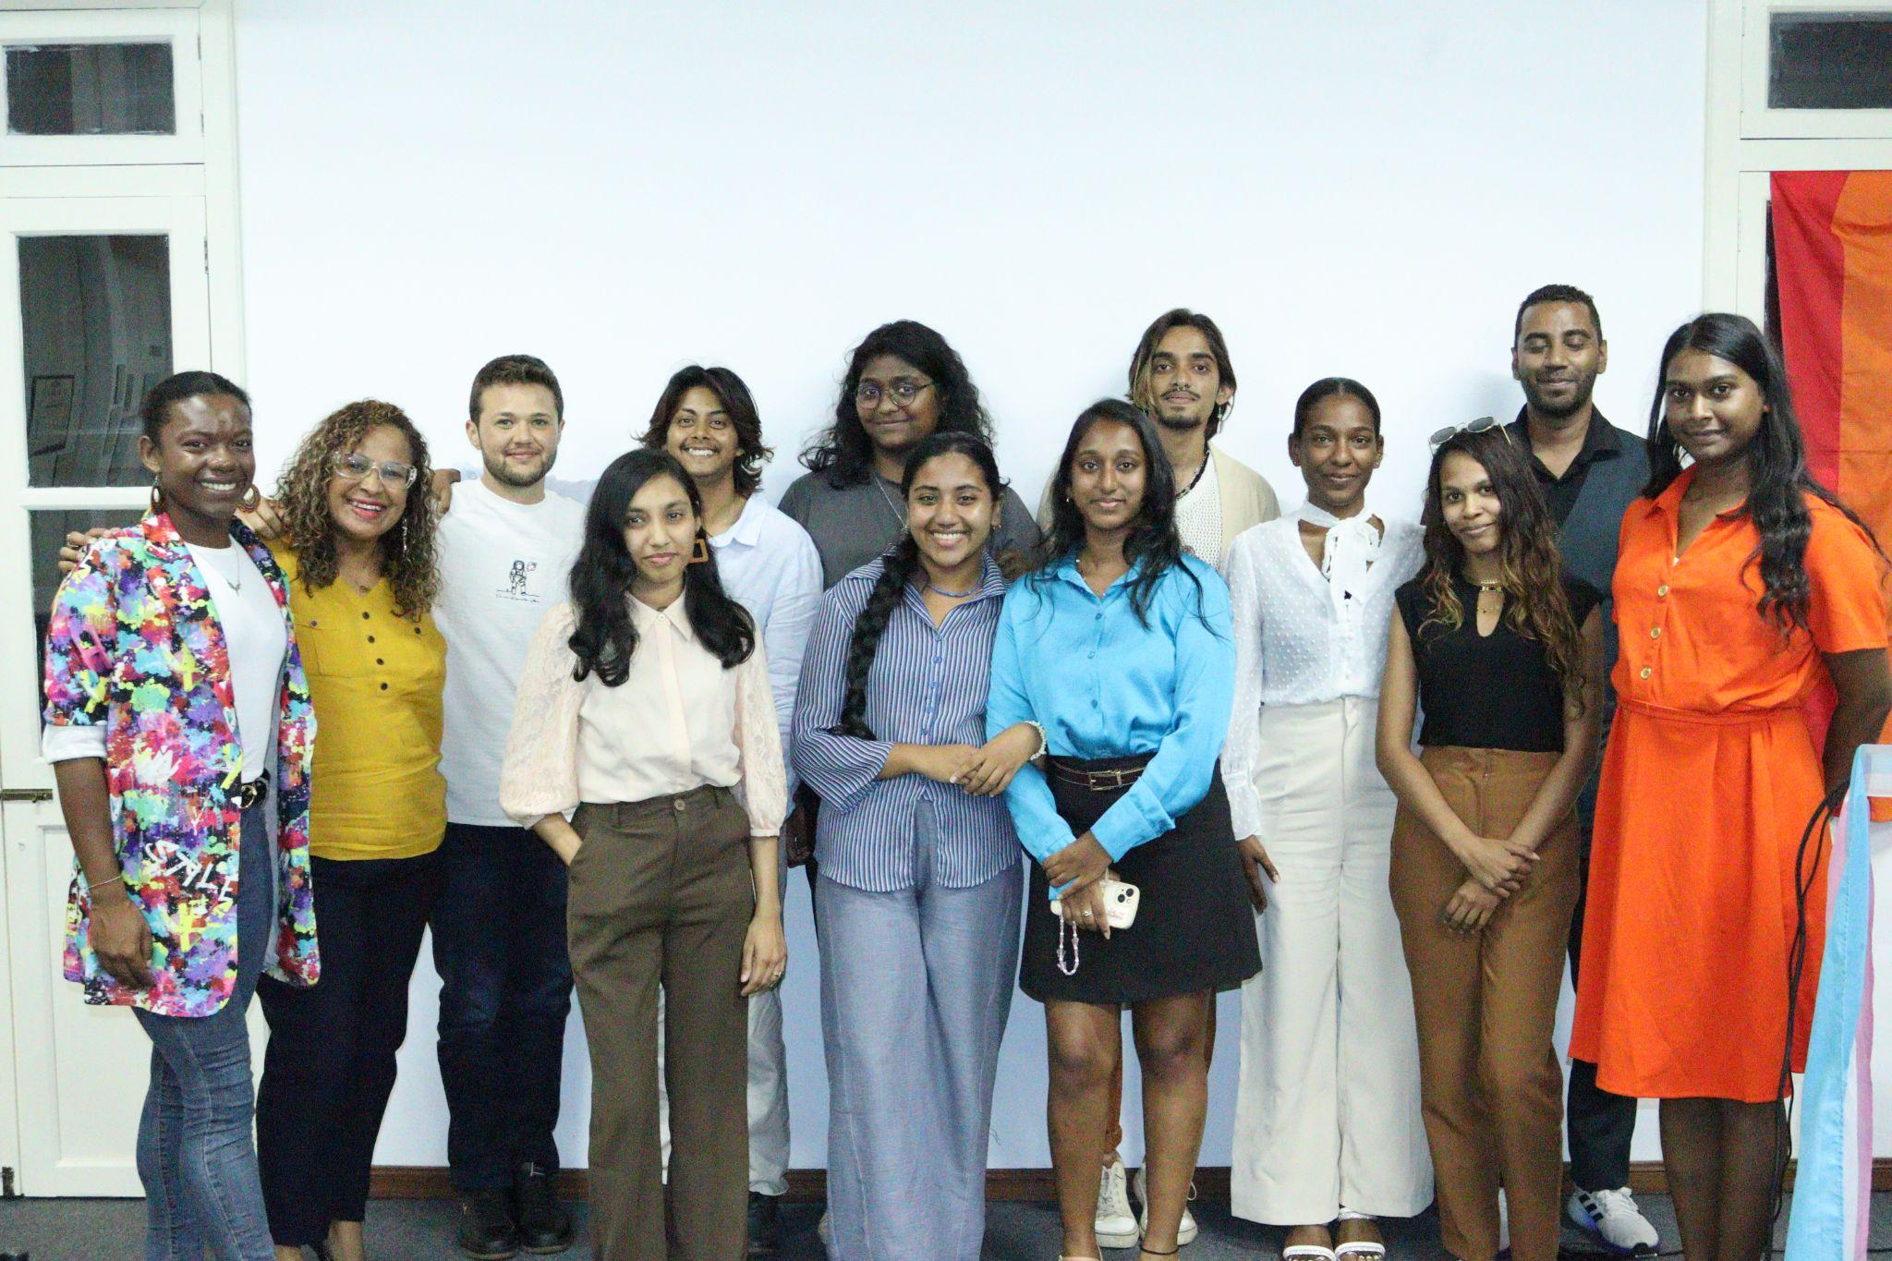
Impact
Who benefits
LGBTQIA+ individuals and families – Improved access to rights, resources, and safe spaces; increased visibility and social acceptance; support for mental health, well-being, and resilience.
Youth leaders and activists – Enhanced leadership skills, advocacy capacity, and networks; opportunities to influence policy and drive social change.
Civil society organisations – Strengthened organisational capacity, collaboration opportunities, and access to research and best practices for inclusive programming.
Mauritian society as a whole – Broader social awareness, reduced discrimination, promotion of human rights, and a more inclusive and equitable society.
Evidence of change includes
Community participation in activities and trainings – Higher engagement in workshops, mentorship programs, and advocacy initiatives; measurable improvements in knowledge, skills, and confidence.
Research publications and policy briefs – Data-driven insights informing policy, advocacy, and programming; increased visibility of marginalized communities’ needs and experiences.
Media coverage and public dialogue – Stories, interviews, and campaigns that shape public perceptions, reduce stigma, and stimulate discussions on equality and inclusion.
Strengthened partnerships with institutions – Collaborative initiatives with government bodies, regional and international organisations, and academic institutions to advance legal, social, and cultural change.
Policy and legal influence – Contributions to reforms, guidelines, or recommendations that promote LGBTQIA+ rights and protect vulnerable populations.
Capacity building and sustainability – Long-term empowerment of individuals and organisations to continue advocacy, mentorship, and community support independently.
Voice and Choice Summit 2026 \ Voice and Choice Summit 2026

Slide 9
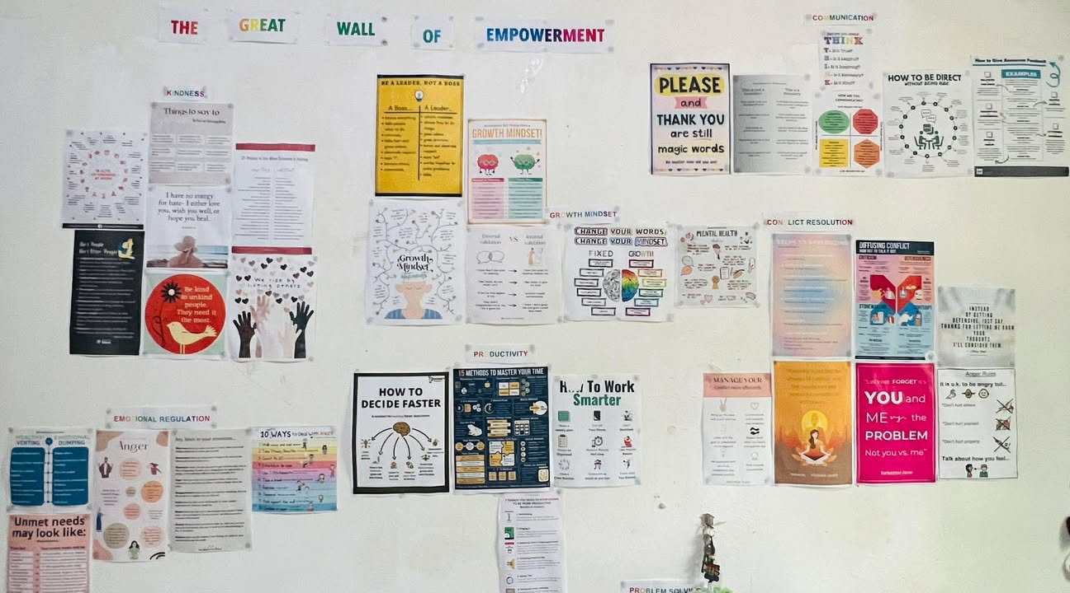
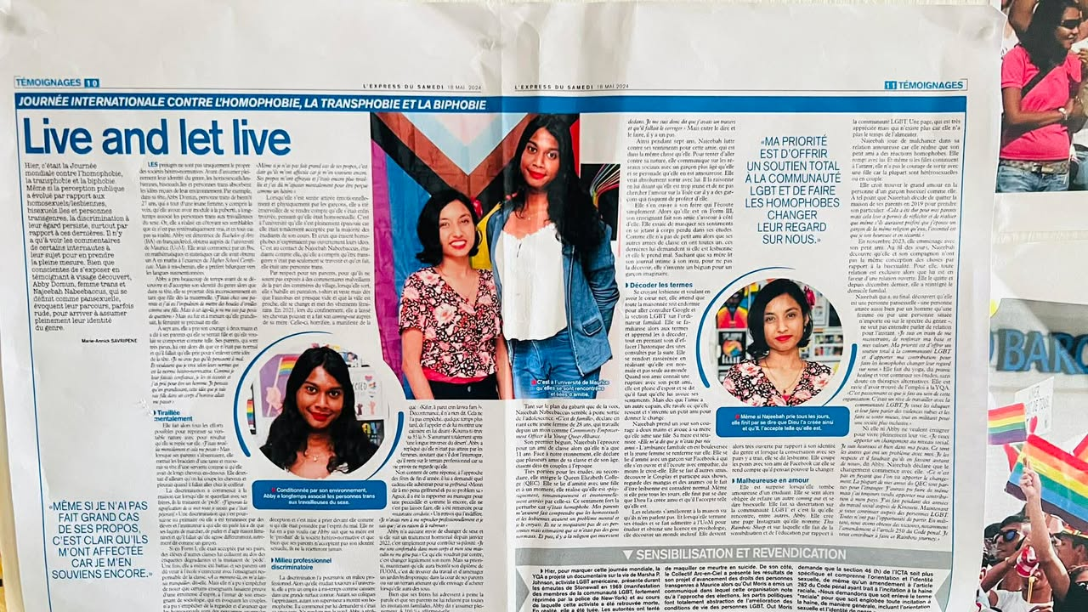
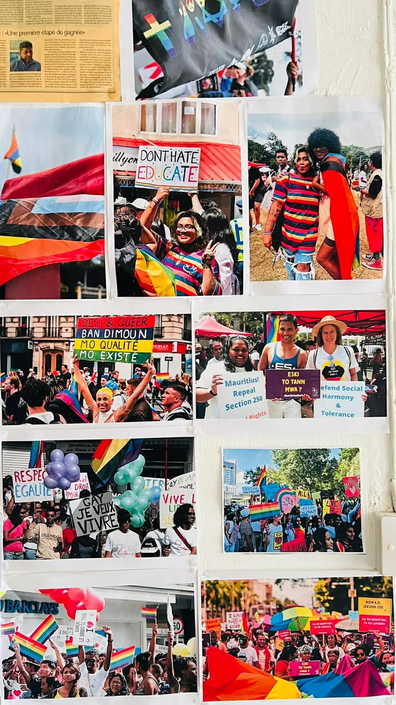
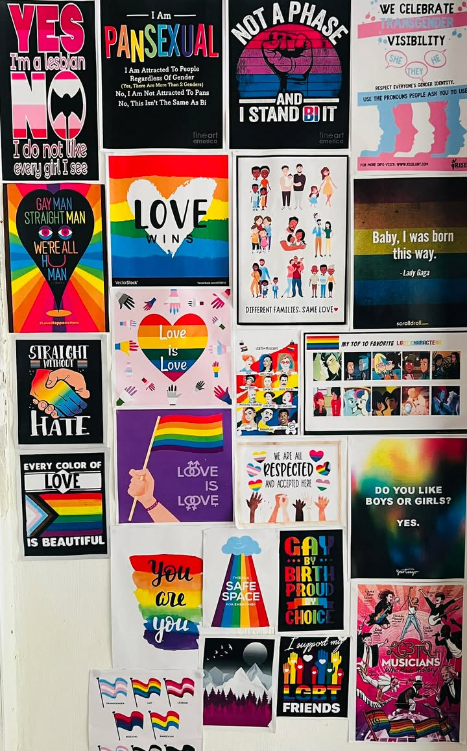
Recognition
Recognition of Leadership
My leadership journey has been recognised through community visibility, storytelling, and collective appreciation.
Even before joining the Young Queer Alliance as a staff member, I chose to publicly share my story by participating in Nou La, one of the first documentaries highlighting LGBTQIA+ voices in Mauritius. Participating in this project was an important act of visibility and courage. By sharing my personal journey, I contributed to breaking silence around LGBTQIA+ experiences and helping others feel less alone.
My advocacy and community work have also been recognised through press articles and media coverage, where I have spoken about LGBTQIA+ issues, social inclusion, and the importance of safe spaces for queer people.
Recognition also comes from within the community and the organisation itself. At YQA, leadership is collaborative, and my work is affirmed through the trust and support of my colleagues and the board. As a team player, I contribute to planning activities, coordinating initiatives, and fostering a positive work environment.
Simple gestures of appreciation within our team—such as encouraging messages in the office, collaborative planning sessions, and shared celebration of successes—reflect the collective leadership culture that drives our work forward.
Ultimately, the greatest recognition comes from the community: seeing individuals who once lived in fear now finding their voice, participating in public conversations, and embracing their identity with pride.
Voice and Choice Summit 2026 \ Voice and Choice Summit 2026

Slide 10

Recognition - Nou La Video
Voice and Choice Summit 2026 \ Voice and Choice Summit 2026

Slide 11
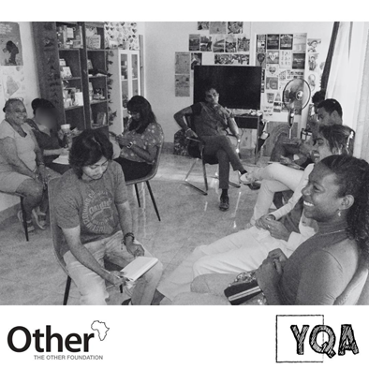
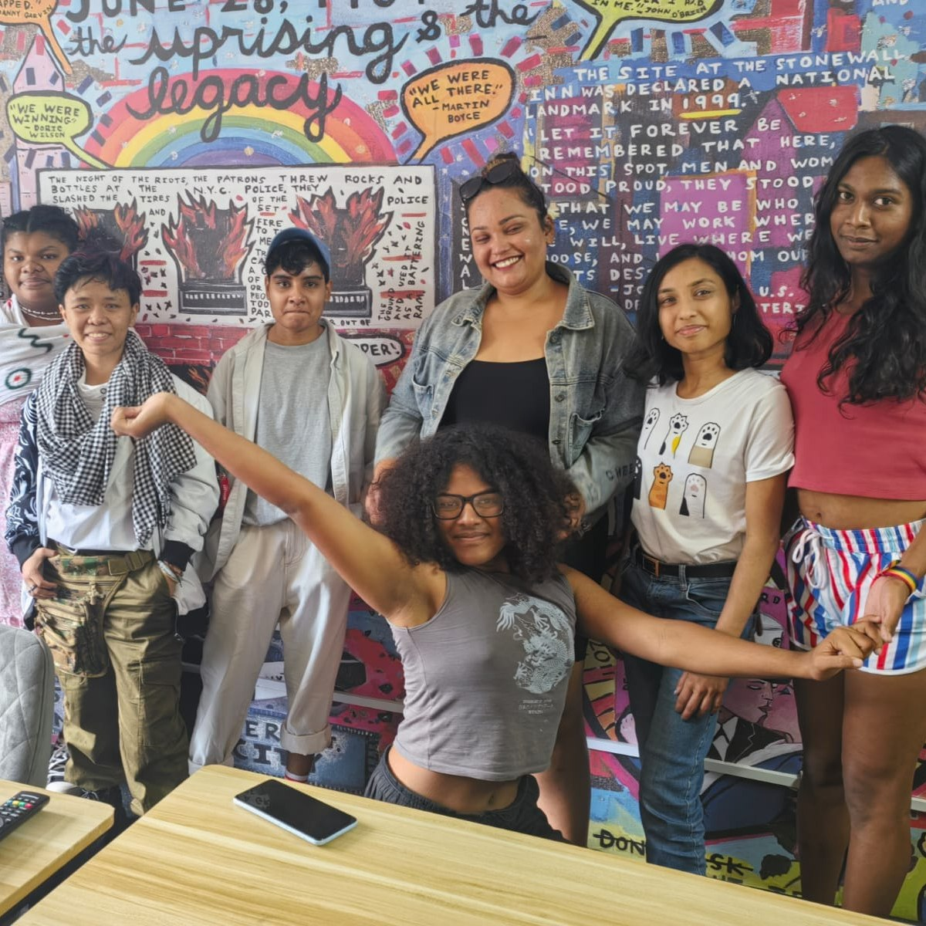
Challenges & Lessons learnt
Challenges, Lessons, and Mitigation Strategies in LGBTQIA+ Advocacy
1. Personal and Cultural Challenges
Challenge: Coming from conservative or religious family backgrounds can create contradictions between personal life and advocacy work.
Lesson Learned: Empathy, patience, and culturally sensitive approaches are critical when engaging communities.
Mitigation: Shared leadership allows team members to support one another, distribute advocacy responsibilities, and navigate sensitive conversations with communities effectively.
2. Lack of Medical Transition Protocols for Trans People
Challenge: Absence of clear national guidelines creates confusion for trans individuals seeking healthcare.
Lesson Learned: NGOs play a key role in providing guidance and advocating for inclusive healthcare policies.
Mitigation: Through partnerships and collective expertise, service delivery teams develop interim guidelines, train healthcare providers, and ensure community members access informed support.
3. No Legal Recognition for Trans People
Challenge: Barriers with official IDs and accessing services due to lack of legal recognition.
Lesson Learned: Continuous advocacy and engagement with policymakers are essential to achieve inclusive laws.
Mitigation: Collaborative outreach, shared leadership, and strategic partnerships help navigate bureaucratic systems, create awareness campaigns, and support community members in accessing services.
.
Voice and Choice Summit 2026 \ Voice and Choice Summit 2026

Slide 12
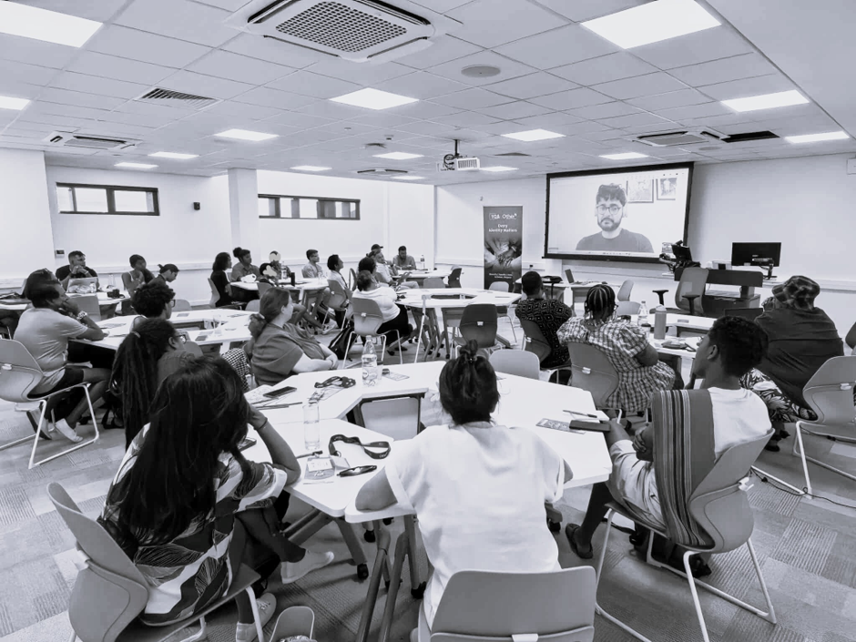
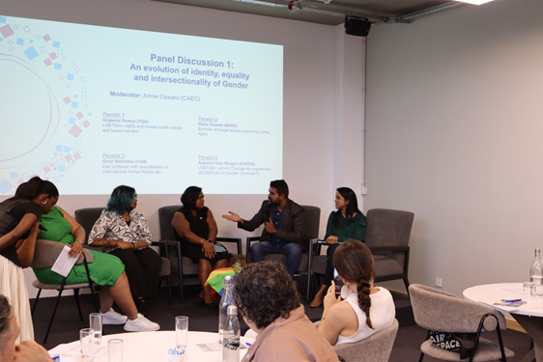
4. Discrimination Toward Intersex People
Challenge: Institutions and professionals sometimes undermine the dignity of intersex individuals.
Lesson Learned: Sensitisation and education of stakeholders are necessary to promote respectful practices.
Mitigation: Grassroots outreach, workshops, and joint trainings with stakeholders, guided by shared leadership, reinforce inclusive language and respectful practices.
5. Low Public Awareness of Intersex Issues
Challenge: Intersex topics remain largely invisible.
Lesson Learned: Integrating intersex awareness into broader SOGIESC advocacy increases visibility and understanding.
Mitigation: Coordinated community mobilisation, public campaigns, and partnerships with media and civil society organisations help raise awareness, amplify voices, and reduce stigma
Role of Shared Leadership:
Promotes collaborative decision-making and distributes responsibilities among team members.
Ensures continuity and collective problem-solving when facing resistance or cultural sensitivities.
Strengthens partnerships with local communities, institutions, and other NGOs, enabling a more resilient and effective advocacy approach.
Voice and Choice Summit 2026 \ Voice and Choice Summit 2026
Voice and Choice Summit 2026 \ Voice and Choice Summit 2026

Slide 13
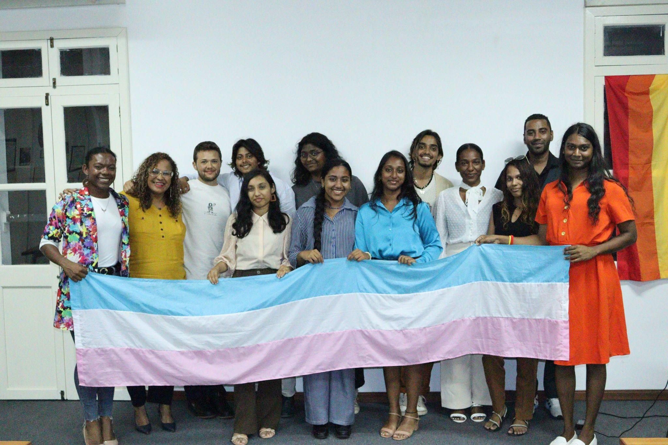
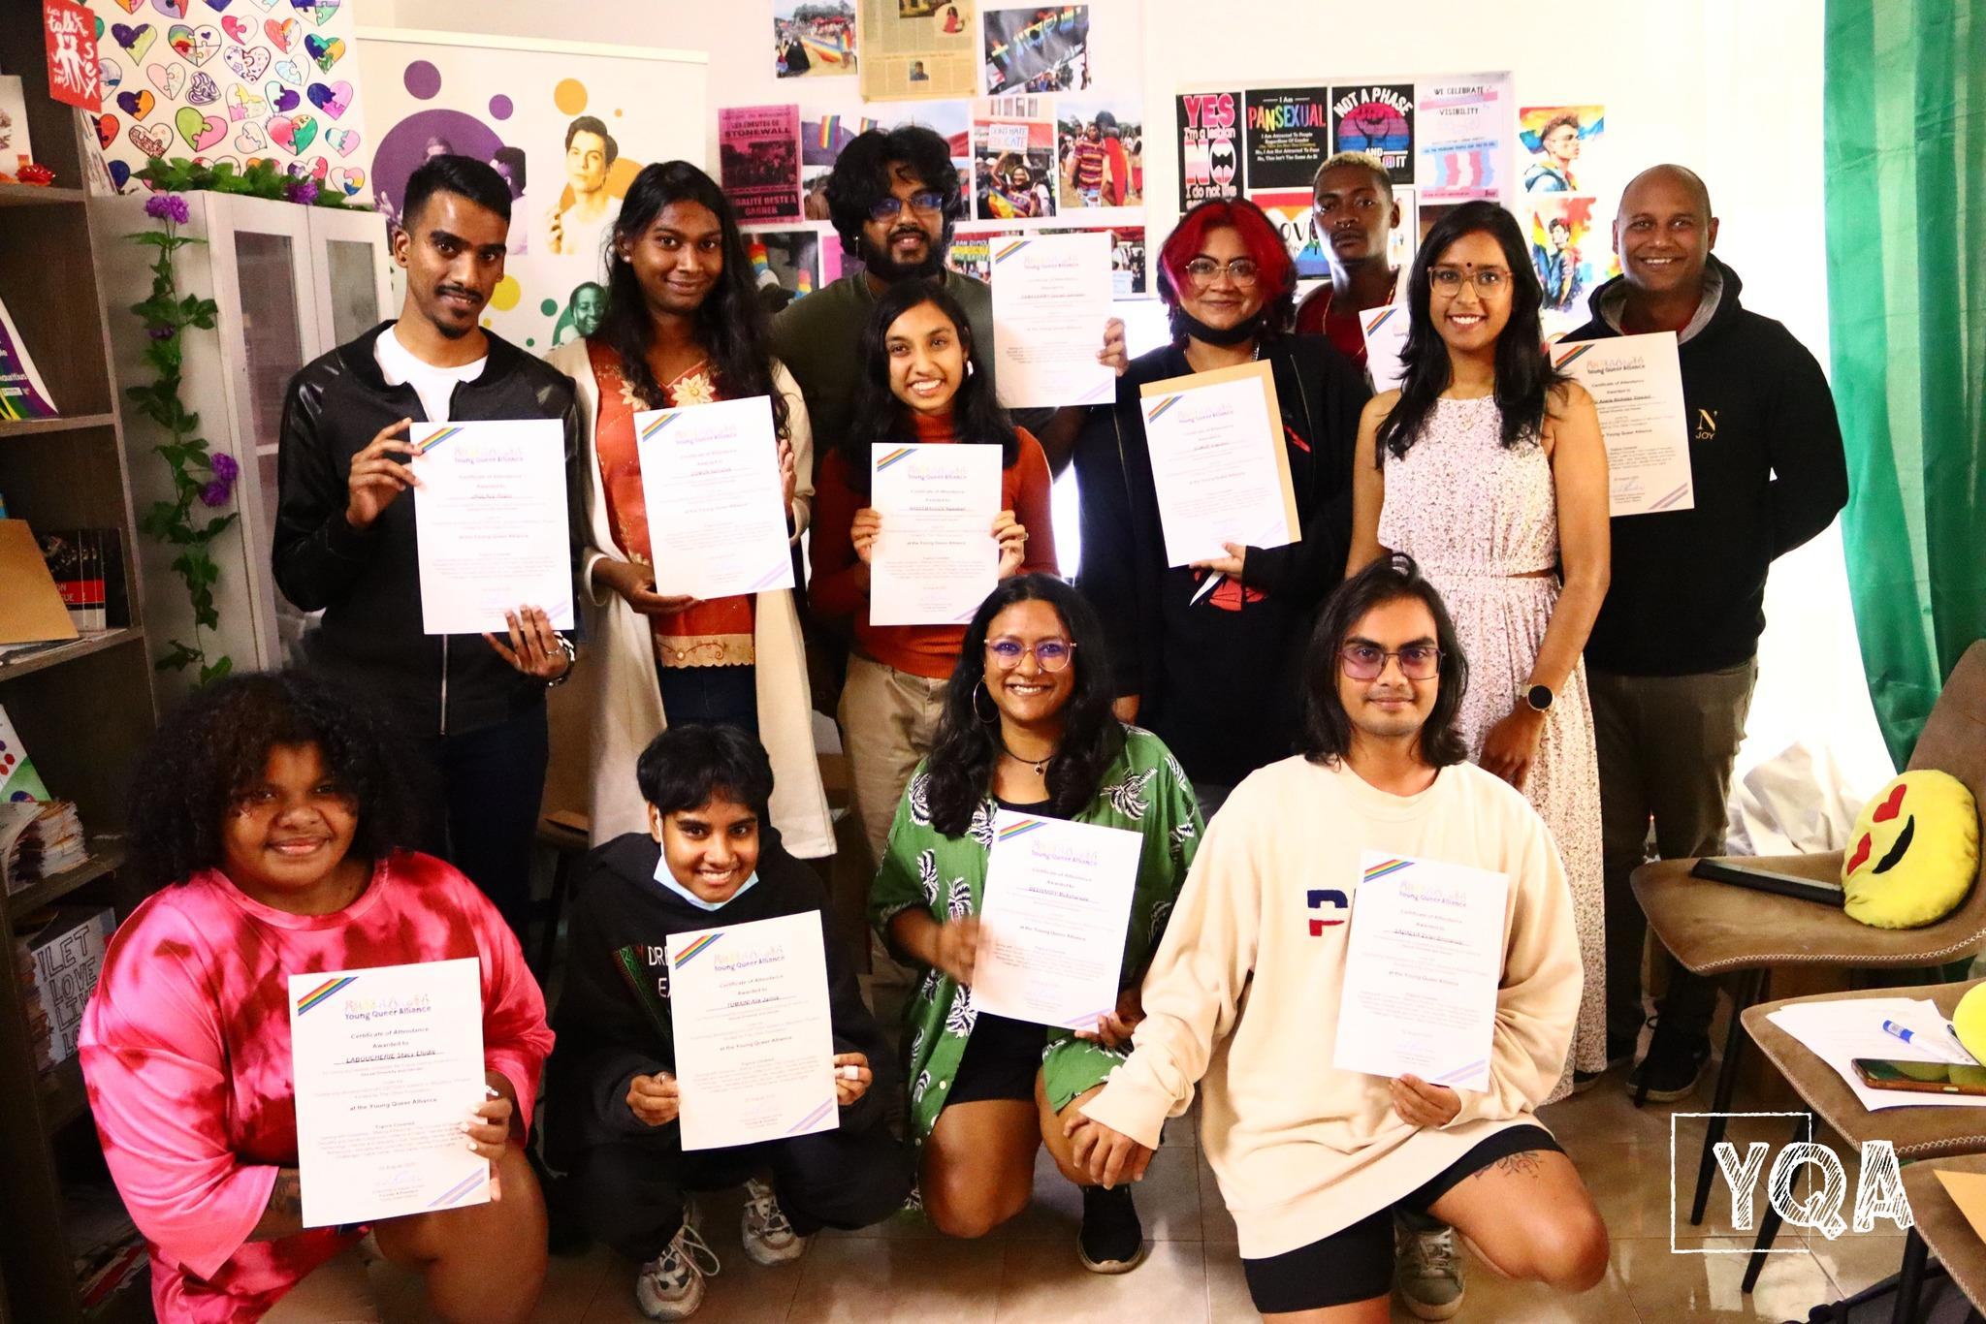
Sustainability
Sustainability Strategy
Develop a long-term fundraising strategy
Strengthen organisational systems and HR processes
Expand partnerships with allies and institutions
Train new activists and community leaders
Capacity Building & Collective Leadership
Training and skills development for members and volunteers
Promoting shared leadership within YQA
Encouraging participatory decision-making
YQA Core Values
Diversity – Valuing differences
Equality – Promoting equal rights
Inclusion – Creating spaces where everyone belongs
Activism – Encouraging social change
Respect – Ensuring dignity and accountability
Partnerships for Impact
Collaboration with civil society and community partners
Advancing human rights, inclusion, and LGBTQIA+ wellbeing in Mauritius
Voice and Choice Summit 2026 \ Voice and Choice Summit 2026

Slide 14
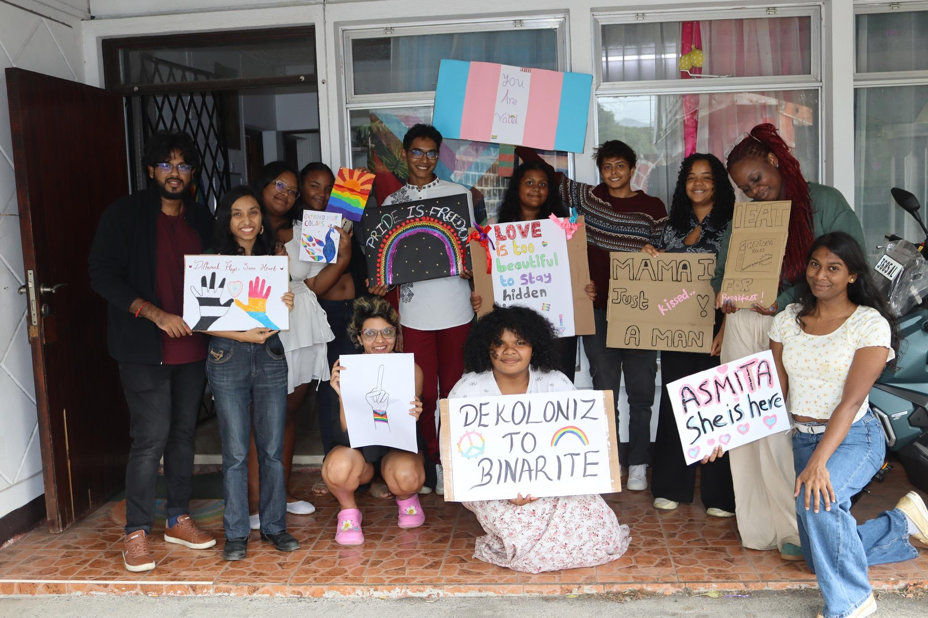
Next Steps
One key step for growth and replicability is to move from person-centred leadership to community-centred leadership. While many initiatives may currently work through my involvement, the goal is to ensure that the knowledge, values, and approaches are shared, documented, and transferable so others can lead and replicate them.
My plan is to strengthen collaboration with stakeholders and partners, by sharing good practices and involving them more actively in activities. This helps ensure that the values and approaches we promote are not unique to YQA but can be integrated into the work of other organisations and institutions.
We have already seen an example of this with the concept of “safe space.” What started as YQA being recognised as a safe space has gradually evolved into the community itself asking for safe spaces in other settings, showing that the idea has expanded beyond the organisation.
Moving forward, I also want to focus on developing more community leaders and peer educators, so that more people are equipped to facilitate discussions, organise activities, and advocate within their own spaces. This will allow the work to grow organically, reach more communities, and remain sustainable over time.
Voice and Choice Summit 2026 \ Voice and Choice Summit 2026

