Slide 1



Promoting Gender-inclusive Local Economic Development
In South Africa
ESTABLISHED ENTREPRENEUR
Business Name: ND Snacks and Clothing (PTY) LTD
Participant Name: Ntaoleng Eliza Duba
Council: Midvaal Local Municipality

Slide 2
MY EXPERIENCE DURING SUNRISE CAMPAIGN
Understanding Gender and Equality: On the first day of my training with the Sunrise Campaign, the facilitator spoke about the difference between sex and gender. Growing up, many of us were taught that certain types of work are only for boys, and others only for girls. But through this training, I came to realise that children should be treated equally, regardless of whether they are boys or girls. We all have the same potential, and we must raise the next generation with fairness and respect.
Gender-Based Violence (GBV): Through the training, I learned that gender-based violence is any harmful act directed at someone based on their gender — including physical, sexual, or psychological abuse, especially towards women. I came to understand that many women face GBV, often in silence. But what gave me hope was learning that, with the right knowledge and support, women can begin to heal and rebuild their lives. The Sunrise Campaign helped me see that recovery is possible, and that we must speak up and support one another.

Slide 3
HOW MY LIFE HAS CHANGED
Personal Growth: In the beginning, I struggled with patience when it came to business. If I saw someone else selling the same product as me, I would often feel discouraged and stop. But now, I no longer give up. I have started regaining the confidence I had lost, little by little, every day. Through my business journey, I have grown into an independent woman who can stand for herself and face challenges with strength.
Gained new knowledge and skills through training and mentorship.
Family Impact: The skills and knowledge I gained from entrepreneurship have allowed me to empower my family as well. There has been a positive change in our home — less conflict and more peace, compared to how things were before I joined the Sunrise Campaign. This business has not only brought growth to me but also healing within my family.
I have become a role model to my children.
My family now respects and support my work.

Slide 4
Community respects: Community members recognize my hard work and determination.
People approach me for advice and encouragement even my competitors.
Income Changes / Lifestyle Improvements: My income has improved a lot. I am now able to buy some things with cash, which was not possible before. My lifestyle has also changed — I have a daily routine, I wake up in the morning, prepare for the day, and go to work in my business with purpose and discipline.
Better financial planning and management.
My experience during sunrise campaigns: Sunrise campaign changed my life a lot.
The program helped me to believe that I’m capable of creating a better future for my self.
Entrepreneurship training: I have to start and manage business effectively
The importance of marketing and costomercare.
Memorable moments during the programmed: They encourage us to register our business mentors.
Support from each other made the journey to be meaningful.
Group work was good.
Business visits and feedbacks sessions that helped to improve our business.
Celebrating of other women in the program.

Slide 5
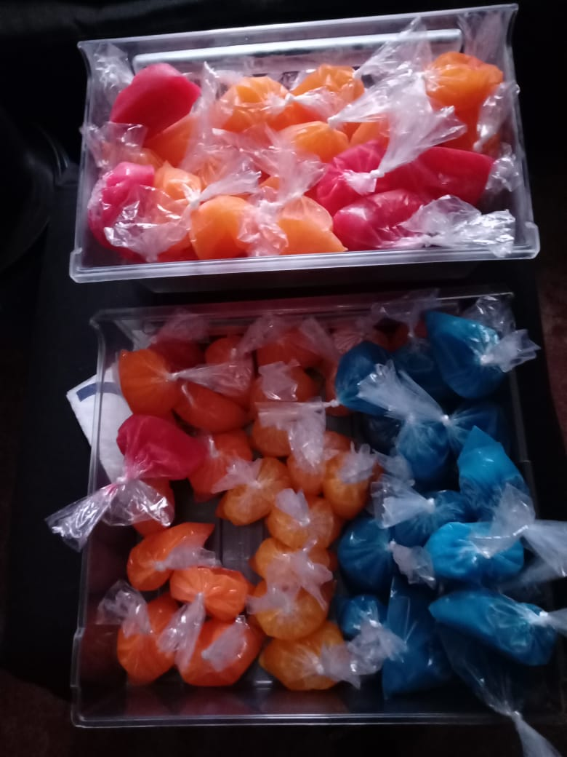
PLEASE DESCRIBE THE BUSINESS
I have a part time employee who was selling avon. It is seasonal only busy at a certain times of the year.
Products are lollipops most of my costumers are leName of my business is ND SNACKS’ N CLOTHING.
arners and community members.
I added avon products as well
For avon orders are delivered on time
Customers knows they can trust the service

Slide 6
Quality and packaging: quality my products are clean and nicely packed.
The products sugar last long and meet the expectation.
Business management: stock recording.
I write down the quantity of the stock received and the quality sold.
Checking stock weekly
Avon stock I buy according to what the costumers has order.

Slide 7
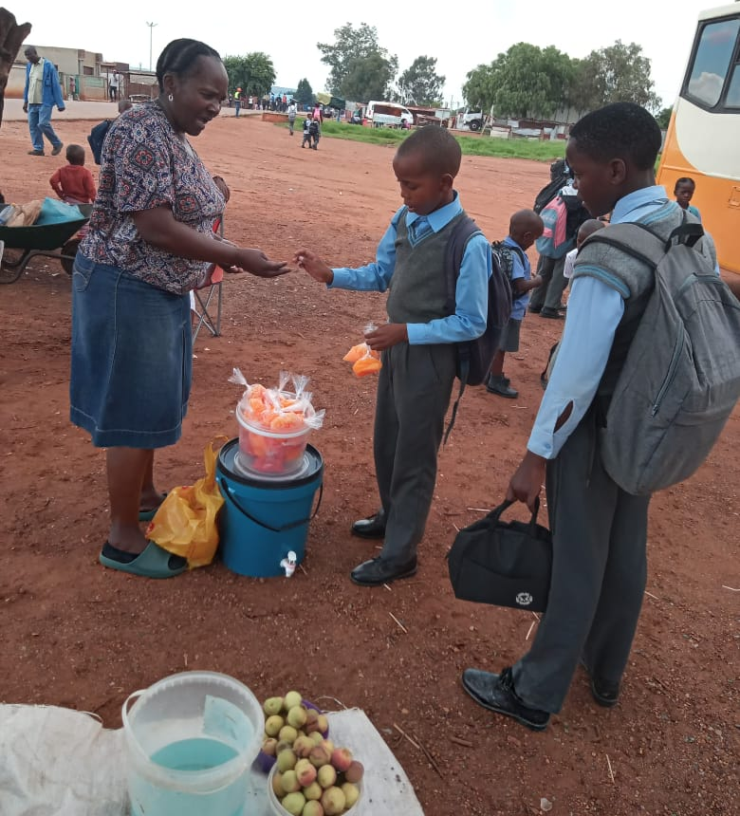
CUSTOMER BASE AND COMPETION?
My customers are scholars and other community members.
I have increased my customer based by introducing new flavours.
Yes, there is competition in my field, but by applying customer care principles, I have managed to build relationships this my customers.
.
Evidence

Slide 8
Customer base and competion
new flavors helped me to beat competion
New products or services: how do you advertise
Yes Is there competion in my field, but by applying costumer care principle , I have manage to build relationships with my costumers.

Slide 9
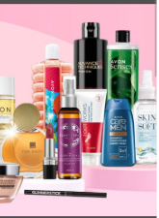
NEW PRODUCTS OR SERVICES?
How do you advertise/market your products?
  I advertise my business through social media and boards.
  Through word of mouth, flayers, catalogues. I use transparent container so that costumer will able to see my products.

Slide 10
QUALITY AND PACKAGING
My customers are happy with my products.
My lollipops are soft and enjoyable, while my competitors product leaves much to be desired
I do not have any branding.
My products are clean and nicely packed.
The sugar products last longer and meet expectation
For Avon products the plastic I use for packaging have Avon brand

Slide 11
BUSINESS MANAGEMENT
I have not hired any staff.
I restock on a monthly basis, always checking my sales against my inventory.
I use the below formula to ensure that I have a good profit margin:
cost + profit = selling price
I write down the quality of stock received and the quality sold.
Avon stock I buy according to what the costumers have ordered. I have a part-time employee who was selling Avon for me.

Slide 12
FINANCIAL MANAGEMENT
I have a record keeping system in place, it helps me track my expenses and income.
I have a business account.

Slide 13
SAVINGS AND SELF SUFFICIENCY
I am part of a savings group (stokvel). We are a group of 4 ladies, each contributing R200.
I have been able to save R3000 so far.
I have not been able to increase my household income as yet.
Not saved from last year September.
I’m left with R1800 from my previous savings.

Slide 14
INCOME AND EXPENSES FOR THE BUSINESS FOR PAST THREE TO SIX MONTHS
INCOME
EXPENSES
ITEM | AMOUNT
Sales | R21 000.00
TOTAL | R21 000.00
ITEM | AMOUNT
Salaries | R4 200.00
Transport | R2400.00
Stock | R4 200.00
Electricity Staff salary | R2 100.00 R600
TOTAL | R11 340.00

Slide 15
CHALLENGES
I do not have enough customers visiting my store.
I have increased marketing and offer new products to attract more customers?
When learners were no going to school because of no transport.
Lack of capital to expand the business.
Difficulty to reach costumers from big events.
Sometimes competion from other business
Electricity
Solutions: saves a position of every sales for emergencies or future growth.
Listen to costumers feedback to improve products.
Use social media or word of mouth to reach more customers.

Slide 16
SUSTAINABILITY
By keeping my costumers happy so that they may return.
Rewarding loyal costumers with small gifts and samples
I will sustain my business by monitoring my finances regularly and reviewing financial statements to ensure profitability and make adjustments as needed.
Other sustainability measures I am putting in place include building customer loyalty and maintaining quality control.
Six months grow your business: target new costumers at work places or nearby towns.
Expand products by introducing new products.
Marketing by using catalogues, flayers to attracts attention.
Plan to attend training to learn new techniques for production and costumers service.

Slide 17
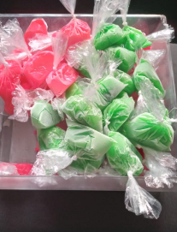
WHAT PLANS HAVE YOU MADE TO GROW YOUR BUSINESS IN THE NEXT 6 MONTHS?
Expand product line, introduce new flavours and shapes or seasonal lollipops t attract new customers.
Partner with local spaza shop.
To showcase my products at local events.
Evidence

Slide 18
ADDITIONAL INFORMATION?
I would like to thank Sunrise campaign, my mentor, municipality of facilitator Mme Naledi for the love she has for women and believing in us that our lives will never be the same after all the trainings we got. Thanks to my costumers for their support and trust. I am so proud of my business journey so far and I am committed to grow it further to serve my family and my costumers even better.

