Slide 1








Logo goes here
LEARNING
AND SHARING
SUMMIT 2025
South Africa, Johannesburg, 18 February 2025,
Presenter: Tinashe Rubaba
tinashe@ncpd.org.za
Women’s Voice and Leadership Learning and Sharing Summit 2025

Slide 2
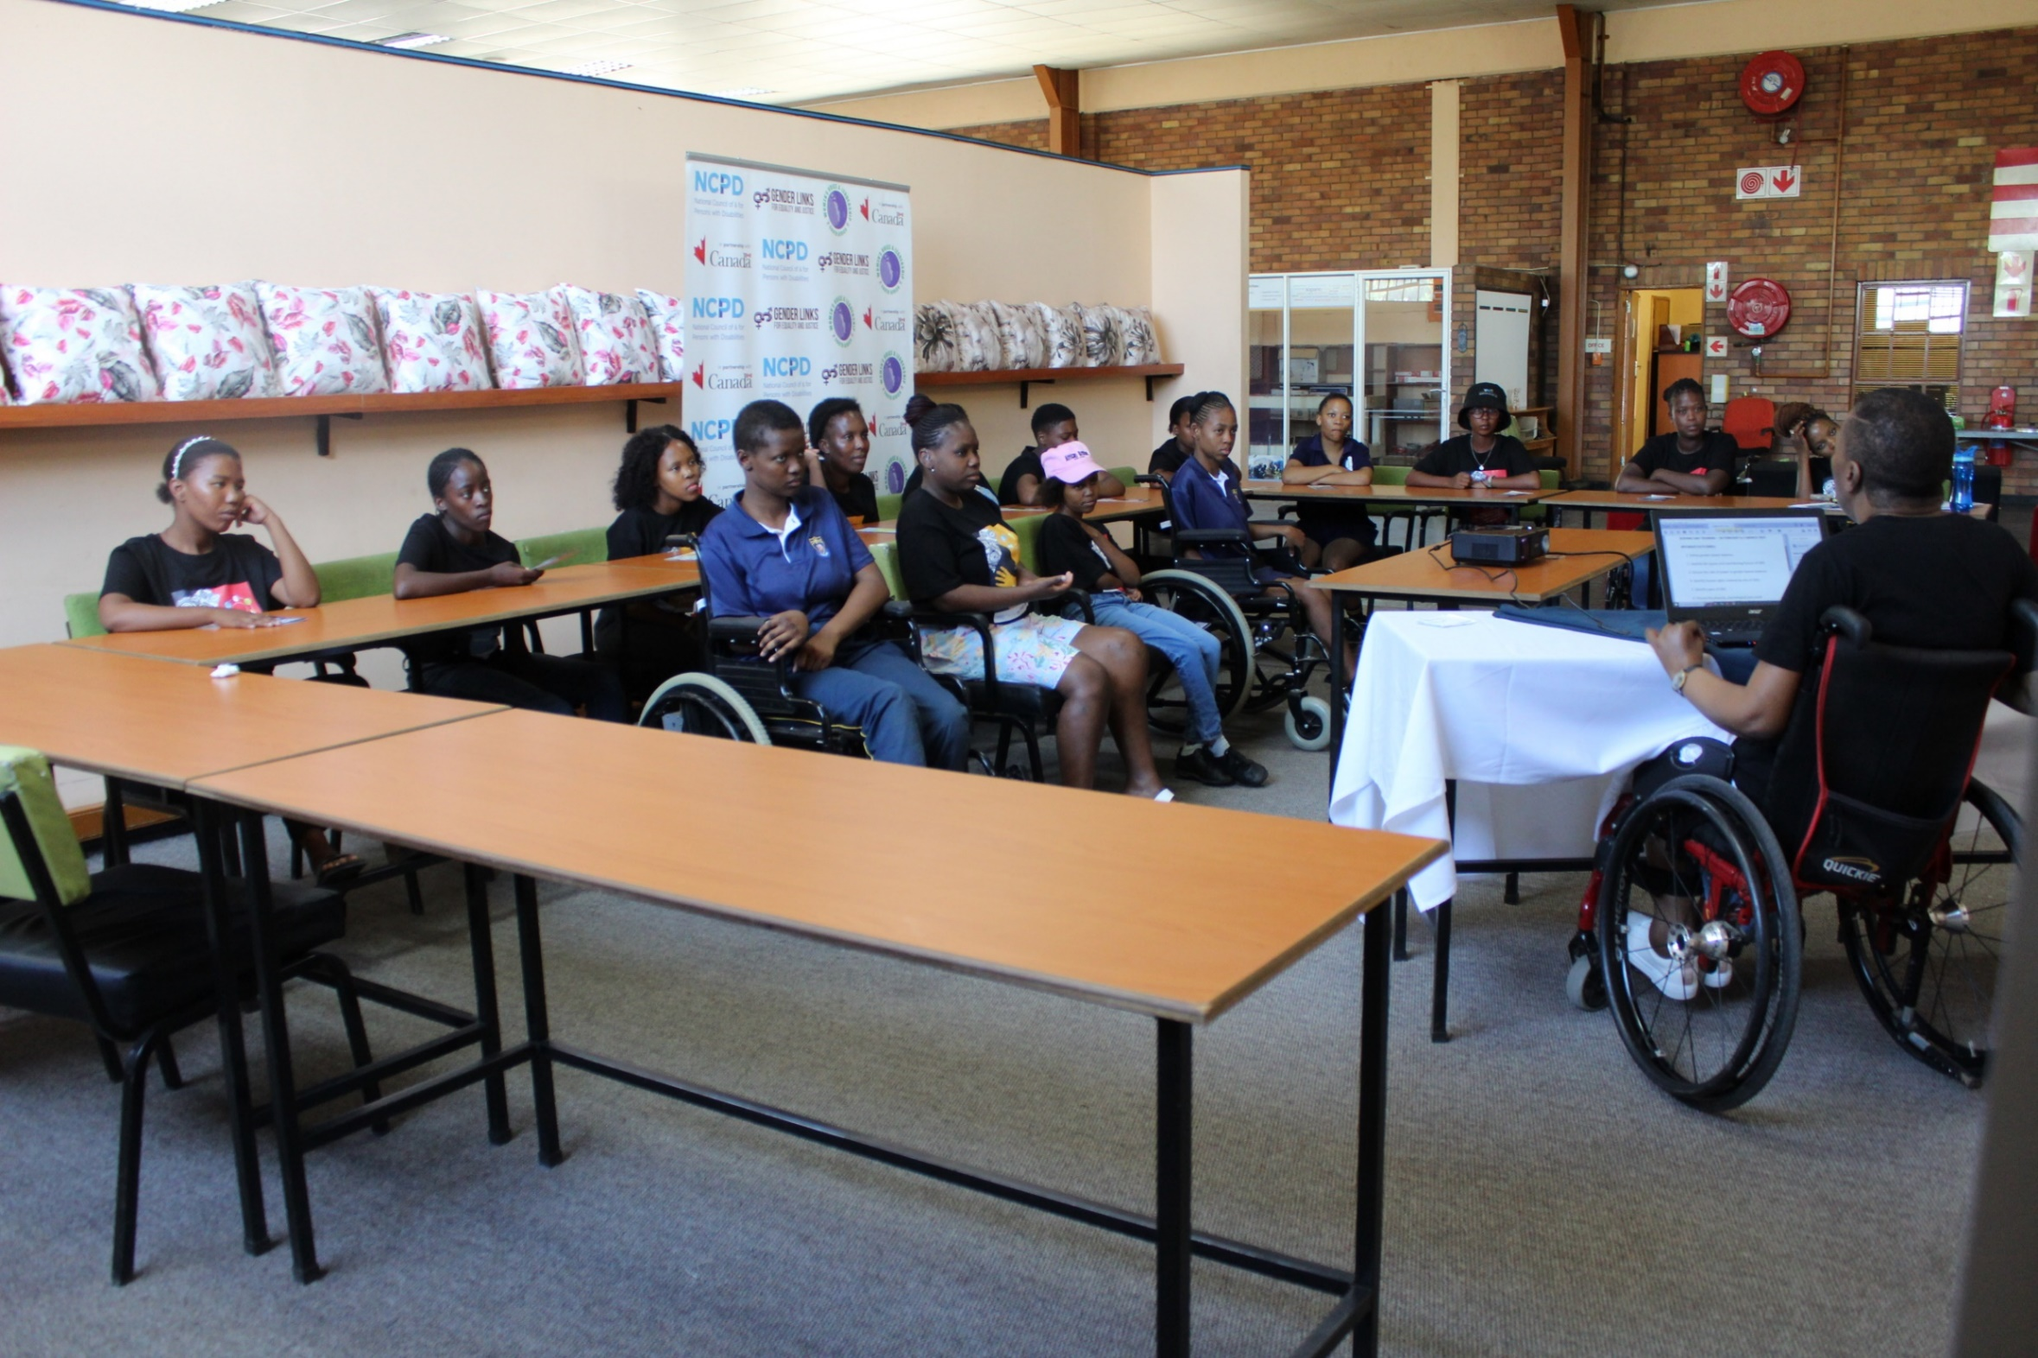
Summary
Throughout history, disabled women have often been the forgotten sisters of equality movements. Wins for gender equality and women’s rights are rarely shared or enjoyed by disabled women in South Africa. The same applies to progress in the fight against GBV.
Our project, Enabled Womxn Arise, aims to bridge the disability and development gap for disabled women and girls. It does this by fostering their enjoyment of existing gains within women’s empowerment, feminist, and GBV movements.
The project promotes disability-inclusive programming and facilitates collaboration between women-focused CBOs, disabled women, and their organizations—creating opportunities for learning, cross-pollination of ideas, and the adaptation of proven inclusive models.
Add photo or video
Voice and Choice Learning and Sharing Summit 2025

Slide 3
Initiatives and strategies
Contribution to building stronger and inclusive movements
The project brings the forgotten sisters of South Africa into the fold of women’s movements, ensuring that they are fully included in the fight for gender equality and women's rights.
By embedding disability inclusion into feminist and women-focused initiatives, it strengthens their impact and reach.
Through fostering a network of disability-responsive organizations, the initiative builds a more inclusive, intersectional, and united movement for all women.
Strategies to strengthen collaboration and solidarity
Bridge Gaps Between Movements – Facilitate partnerships between feminist, women-led, and disability rights organizations to ensure disability inclusion becomes a standard practice in gender justice efforts.
Capacity Building – Provides DET , DIP GBV Workshops to women-focused organizations, fostering a shared understanding and commitment to inclusion. Conducts Gender sensitization to DPOs
Collective Advocacy – opens itself up to and facilitates platforms for joint advocacy, amplifying the voices of disabled women and ensuring their priorities are reflected in broader feminist and GBV movements.
Cross-Movement Learning – Organize knowledge-sharing sessions where feminist and DPOs exchange best practices, innovative strategies, and inclusive models.
Technical Support - Links women focused CBOs to disabled persons, translates CBO resources to accessible formats, documents good practices for continuous learning
Voice and Choice Learning and Sharing Summit 2025

Slide 4


Governance & Resource Allocation
Ensuring Active participation and decision-making
Participating CBOs and DPOs will automatically become members of what will become a Disability-Responsive GBV Network. Members on a voluntary basis will take up roles within the steering committee and workstreams of the network to jointly give direction.
Distribution of Resources for equity and sustainability
NCPD through EWA will bear facilitation and organizing costs.
Needs based resource allocation-to prioritise CBOs requiring the most help. Joint learning physical events will only be conducted in Johannesburg, a hybrid approach will be used to cater for CBOs outside Gauteng.
Voice and Choice Learning and Sharing Summit 2025

Slide 5


Governance & Resource Allocation continued…
Disability –Responsive Budgeting: Network activities will teach members to motivate for funding to promote disability inclusion in programmes.
Technical Support: NCPD will provide technical support network members.
Resource Pooling: Members will bring in their networks and resources where needed to support jointly agreed collaborative actions
Voice and Choice Learning and Sharing Summit 2025

Slide 6
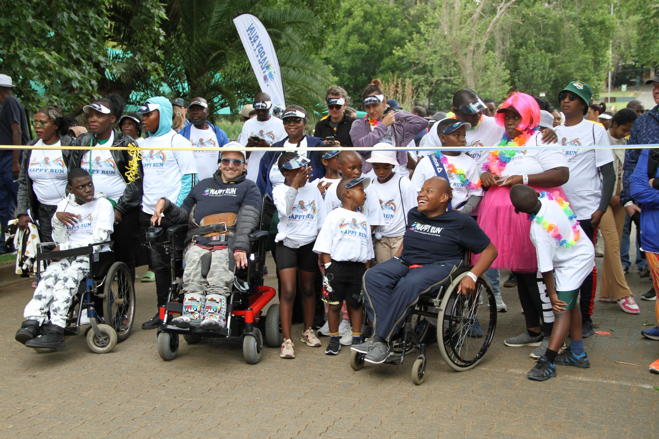
Inclusive Leadership & Coordination
Leveraging expertise and diverse connections to strengthen advocacy efforts
Strategic Partnerships – We will be open to establishing collaborations with key stakeholders, in 2025 will leverage on the G20 , C 20 and D 20 to reach stakeholders and amplify the network’s reach and influence. These partnerships will ensure that the network is well-supported and aligned with broader advocacy movements.
Connecting Across Movements – Facilitate connections between DPOs and CBOs, ensuring both movements are integrated and that insights from each can strengthen the overall advocacy efforts.
Utilizing Community and Grassroots Networks – Leverage existing relationships within local communities, and our vast disability network to drive advocacy on the ground while ensuring amplification of voices jointly with network participants.
Voice and Choice Learning and Sharing Summit 2025

Slide 7
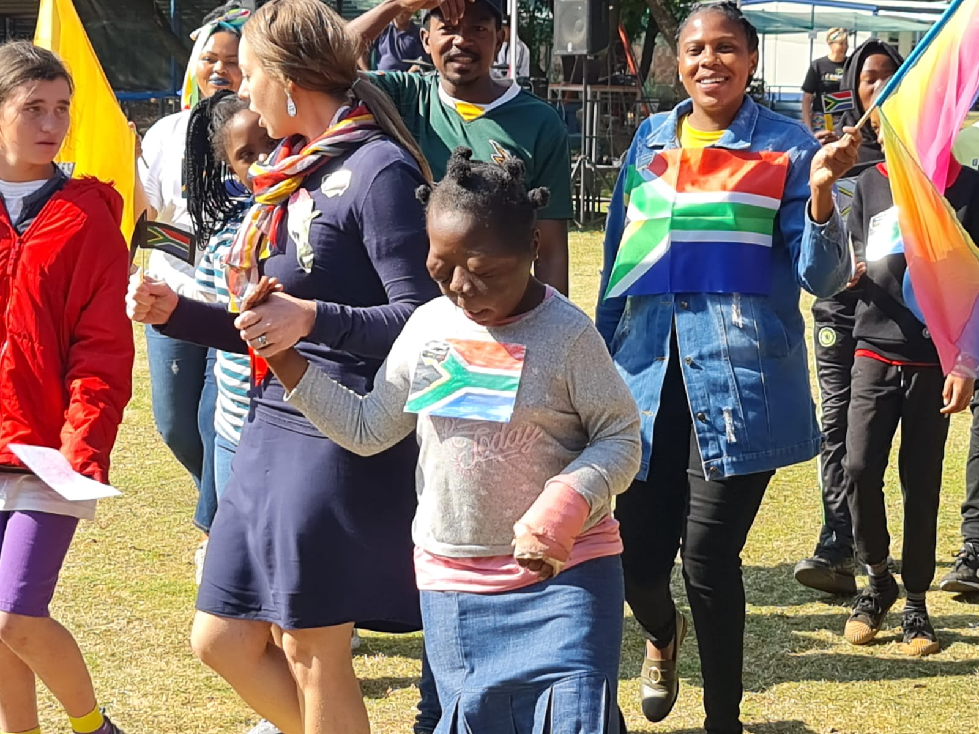
Inclusive Leadership & Coordination continued …
Campaign Coordination Strategies:
NCPD will be the convener, and will invite DPOs and CBOs to take voluntary roles in the steering committee
Jointly develop Disability and Gender Advocacy Plans – these will integrate the priorities of both disability and gender justice movements, ensuring alignment and maximizing impact.
Shared Campaign Calendars – Coordinate timing and focus for campaigns, avoiding overlap and ensuring
Reciprocal Social Media Engagement for Amplified Campaign Impact: Organizations will engage in reciprocal messaging by tagging each other, sharing social media platforms and links, and following one another to collectively build followings and amplify campaign messages.
Voice and Choice Learning and Sharing Summit 2025

Slide 8
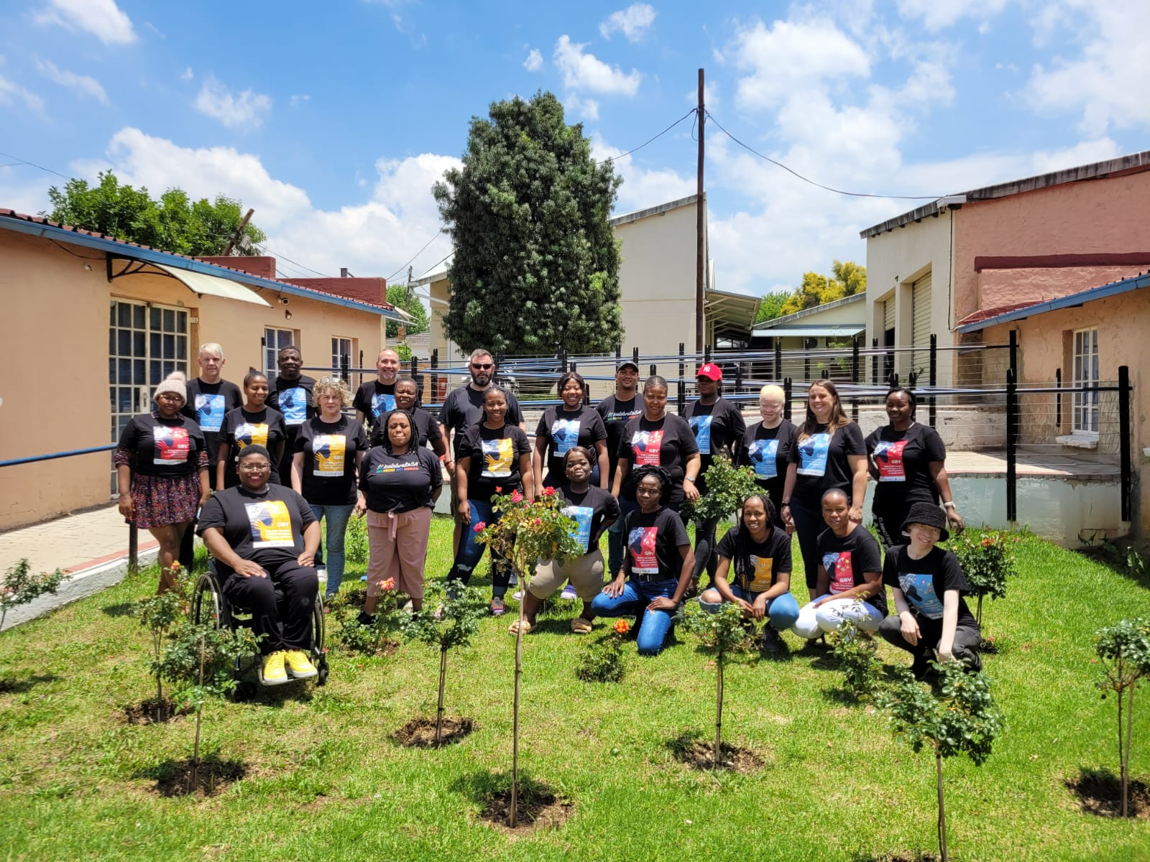
Connecting & Community-Building
Approaches to build and sustain relationships within the advocacy community
Cultivate Cross-Sector Collaboration – Joint learning workshops will bring together DPOs, women-focused CBOs, and advocacy groups to align priorities and share expertise
Establish Ongoing Engagement Mechanisms – Organize regular meetings, networking events, and working groups to maintain momentum and strengthen
Leverage Digital Communication
Develop Joint Advocacy Campaigns
Voice and Choice Learning and Sharing Summit 2025

Slide 9
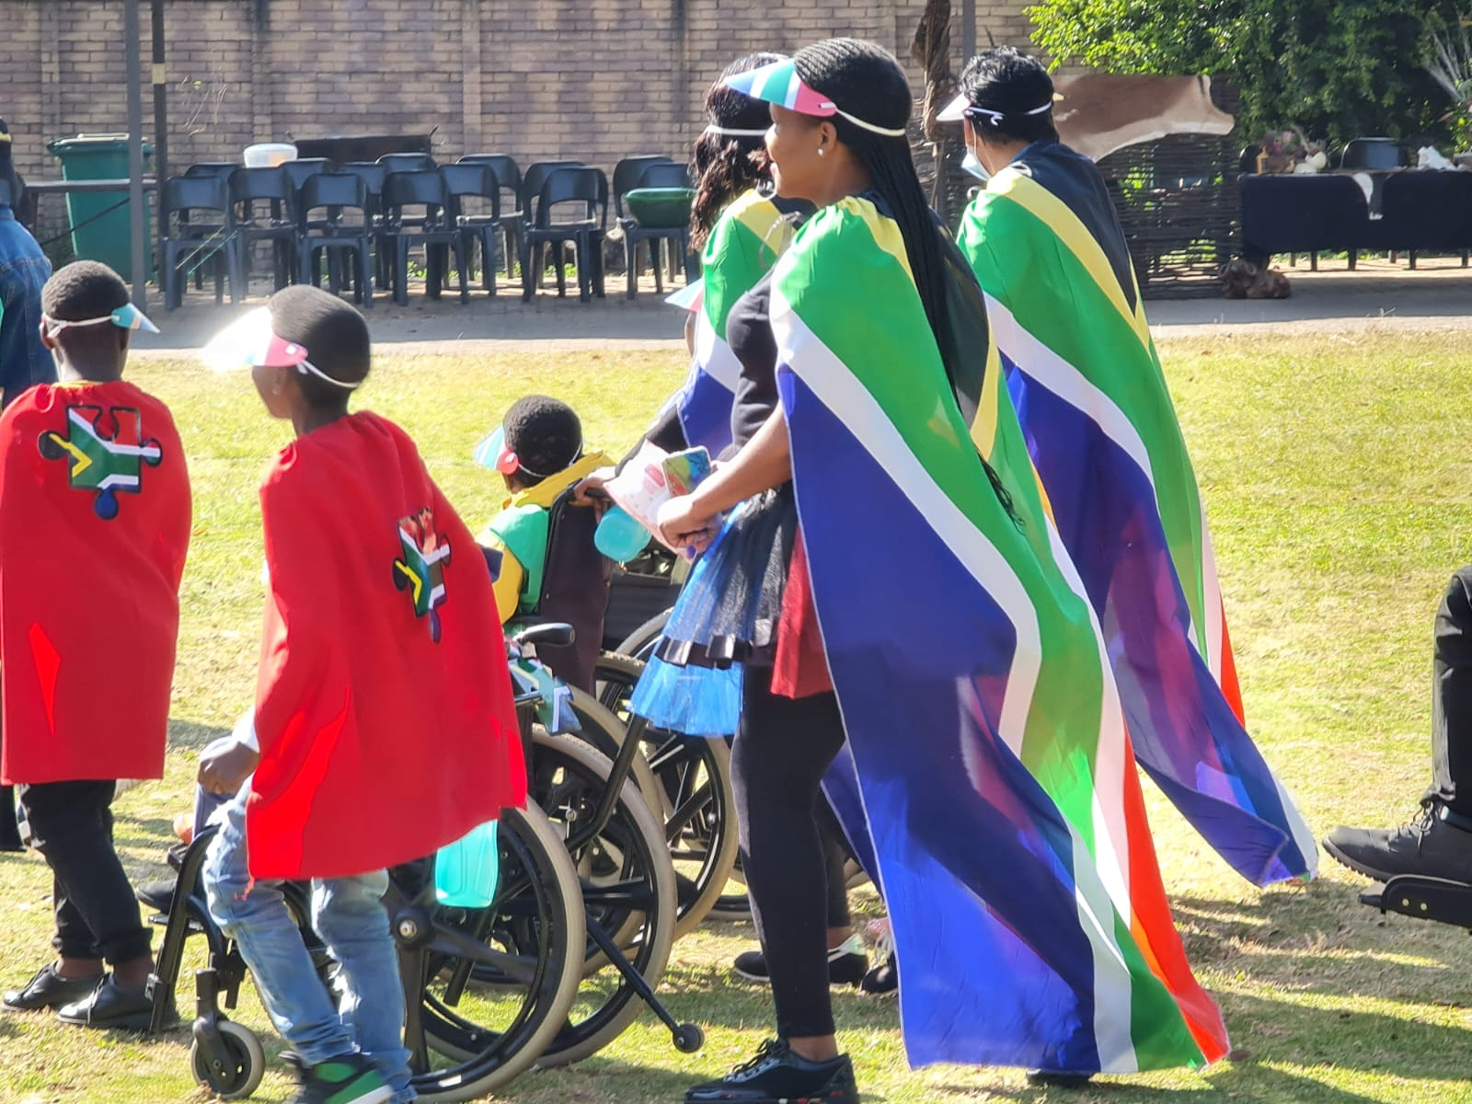
Connecting & Community-Building continued …
Facilitating mentoring, convening, and peer exchanges among professional advocates and emerging leaders
Workshops as Peer-Learning Platforms
Cross-Organizational Knowledge Sharing
Technical Support for Accessibility
Activist Grooming-
Informal Peer Support Networks
Voice and Choice Learning and Sharing Summit 2025

Slide 10
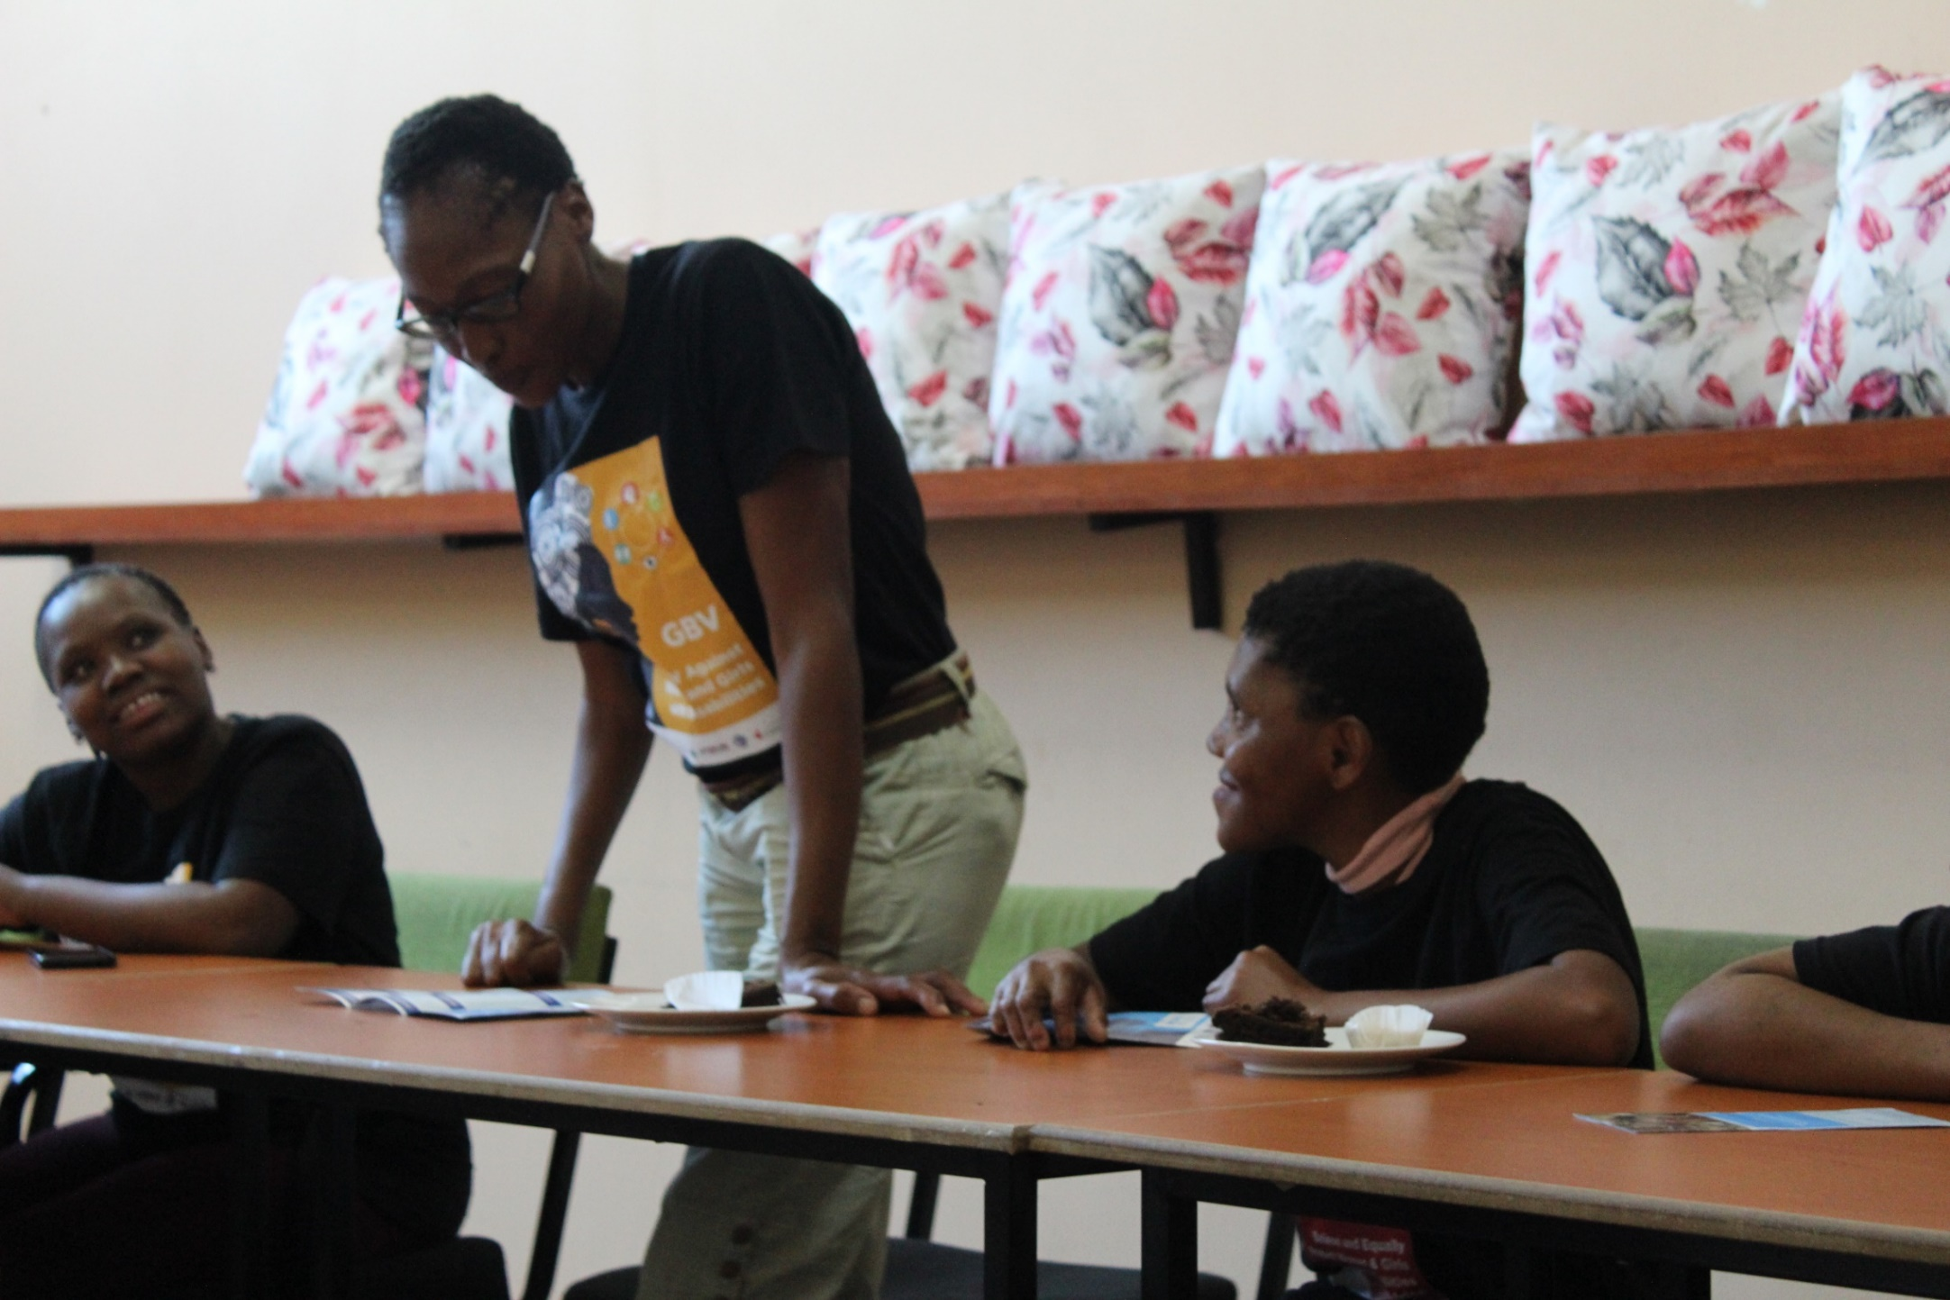
Linking & Learning
Fostering a culture of continuous learning and best practice sharing
All DIP-GBV, DET, Gender sensitization and Joint Learning sessions will build in slots for story telling and reflection to allow organisations to reflect, assess and adapt
Lived experiences: Systematic sharing of lived experiences of disabled women to allow members to reflect and ideate effective inclusion mechanisms
Voice and Choice Learning and Sharing Summit 2025

Slide 11
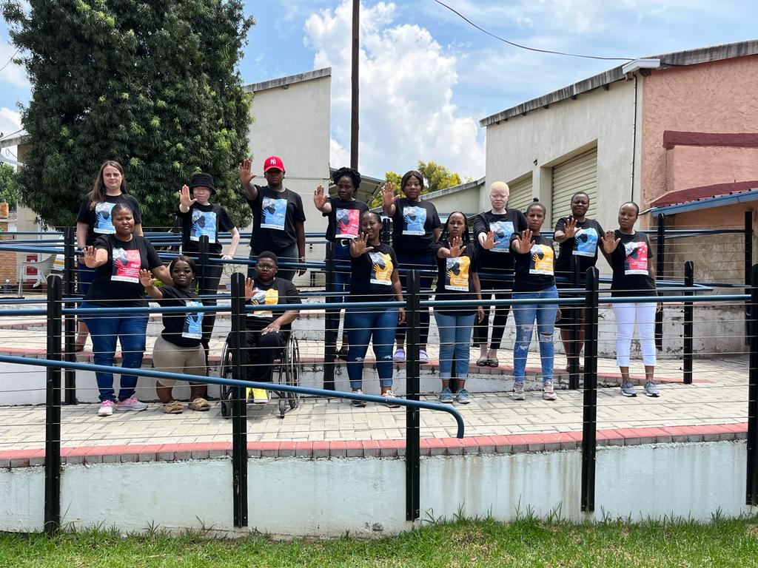
Linking & Learning continued …
Mechanisms to document and share lessons learned
Shared resource drives: Use google drives, SharePoint etc. to share resources
Embed links to the NCPD Website to upload videos, documents and updates
Feedback Loops, systematic feedback after major engagements
Member Interviews, Beneficiary Interviews to harvest stories and feedback
Voice and Choice Learning and Sharing Summit 2025

Slide 12
NEXT STEPS
Key priorities moving forward
Accessible Formats Initiative: Translation of CBO ‘Key Service Information’ to Accessible Formats to raise awareness of their programs and services to persons with disabilities who may benefit from this work
CBOs and DPOs Mobilisation: We have already started reaching out to CBOs, through the accessible format initiative, those who participate will automatically become network members .
Develop network structure :Encourage CBOs and DPOs to voluntarily take roles that align with their work and programmes
Organizing Initial Capacity Building Roll out Plan: Schedule the first round of DIP-GBV, DET, Gender Sensitization workshops and Joint Learning workshops
Develop Campaign Framework: Develop Key messages framework jointly, share activity calendars aligned with the network's goals.
Train, and link Disability GBV peer Educators with CBOs in the network, create pathways to link Disability-GBV Peer educators to CBOs to strengthen CBO disability inclusion.
Establish Monitoring, Evaluation, Accountability and Learning (MEAL) strategy
Women’s Voice and Leadership Learning and Sharing Summit 2025

Slide 13
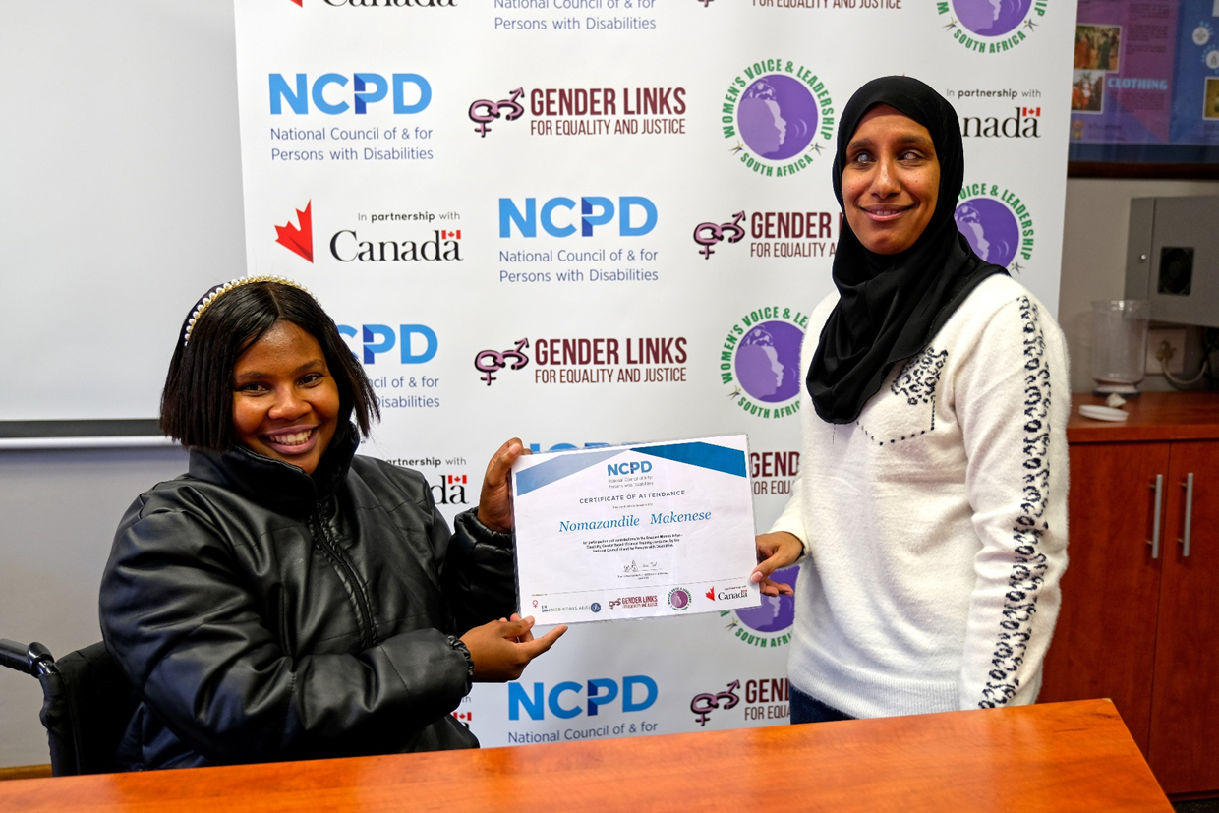
Thank You!
tinashe@ncpd.org.za

