Slide 1







Logo goes here
LEARNING
AND SHARING
SUMMIT 2025
Inside out 360, Stronger and Bolder
(Zimbabwe, Mt Hampden, 4 March and Opportunity Makanga)
Women’s Voice and Leadership Learning and Sharing Summit 2025

Slide 2
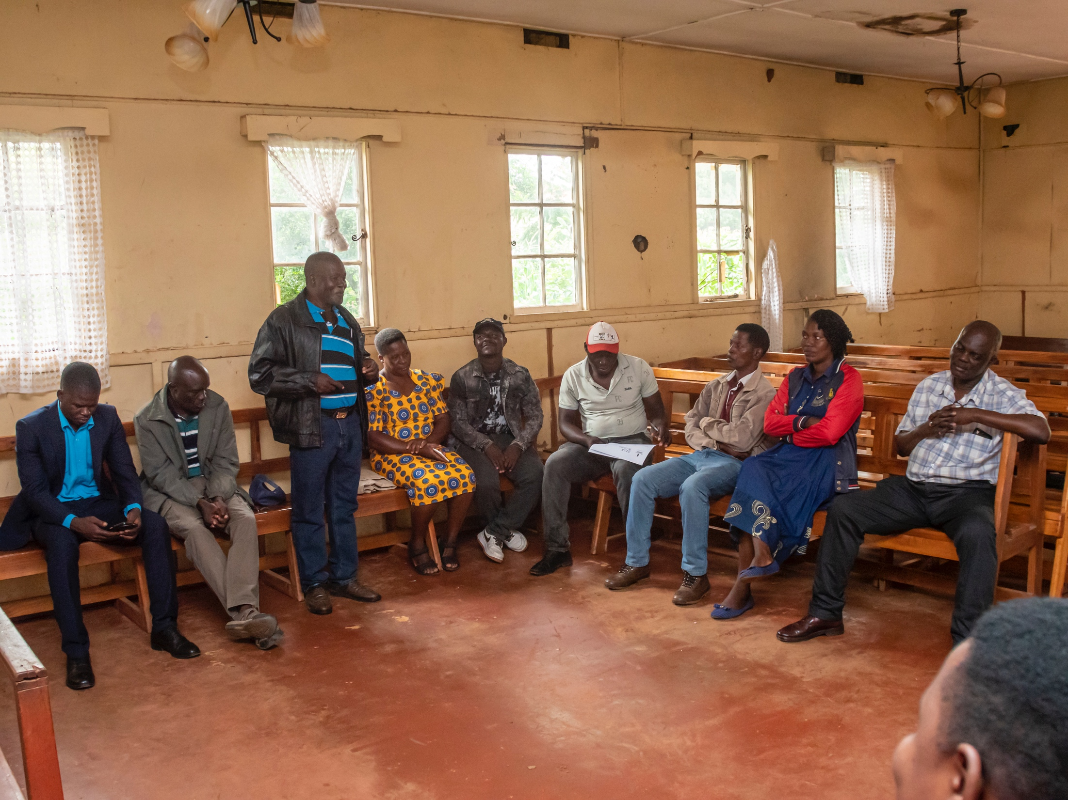
SYNOPSIS
Increased knowledge
Improved attitudes towards sex, relationships, and gender.
Delayed sexual debut and reduced risk of unintended pregnancies and STIs.
Increased confidence and self-esteem.
Photo
Women’s Voice and Leadership Learning and Sharing Summit 2025

Slide 3
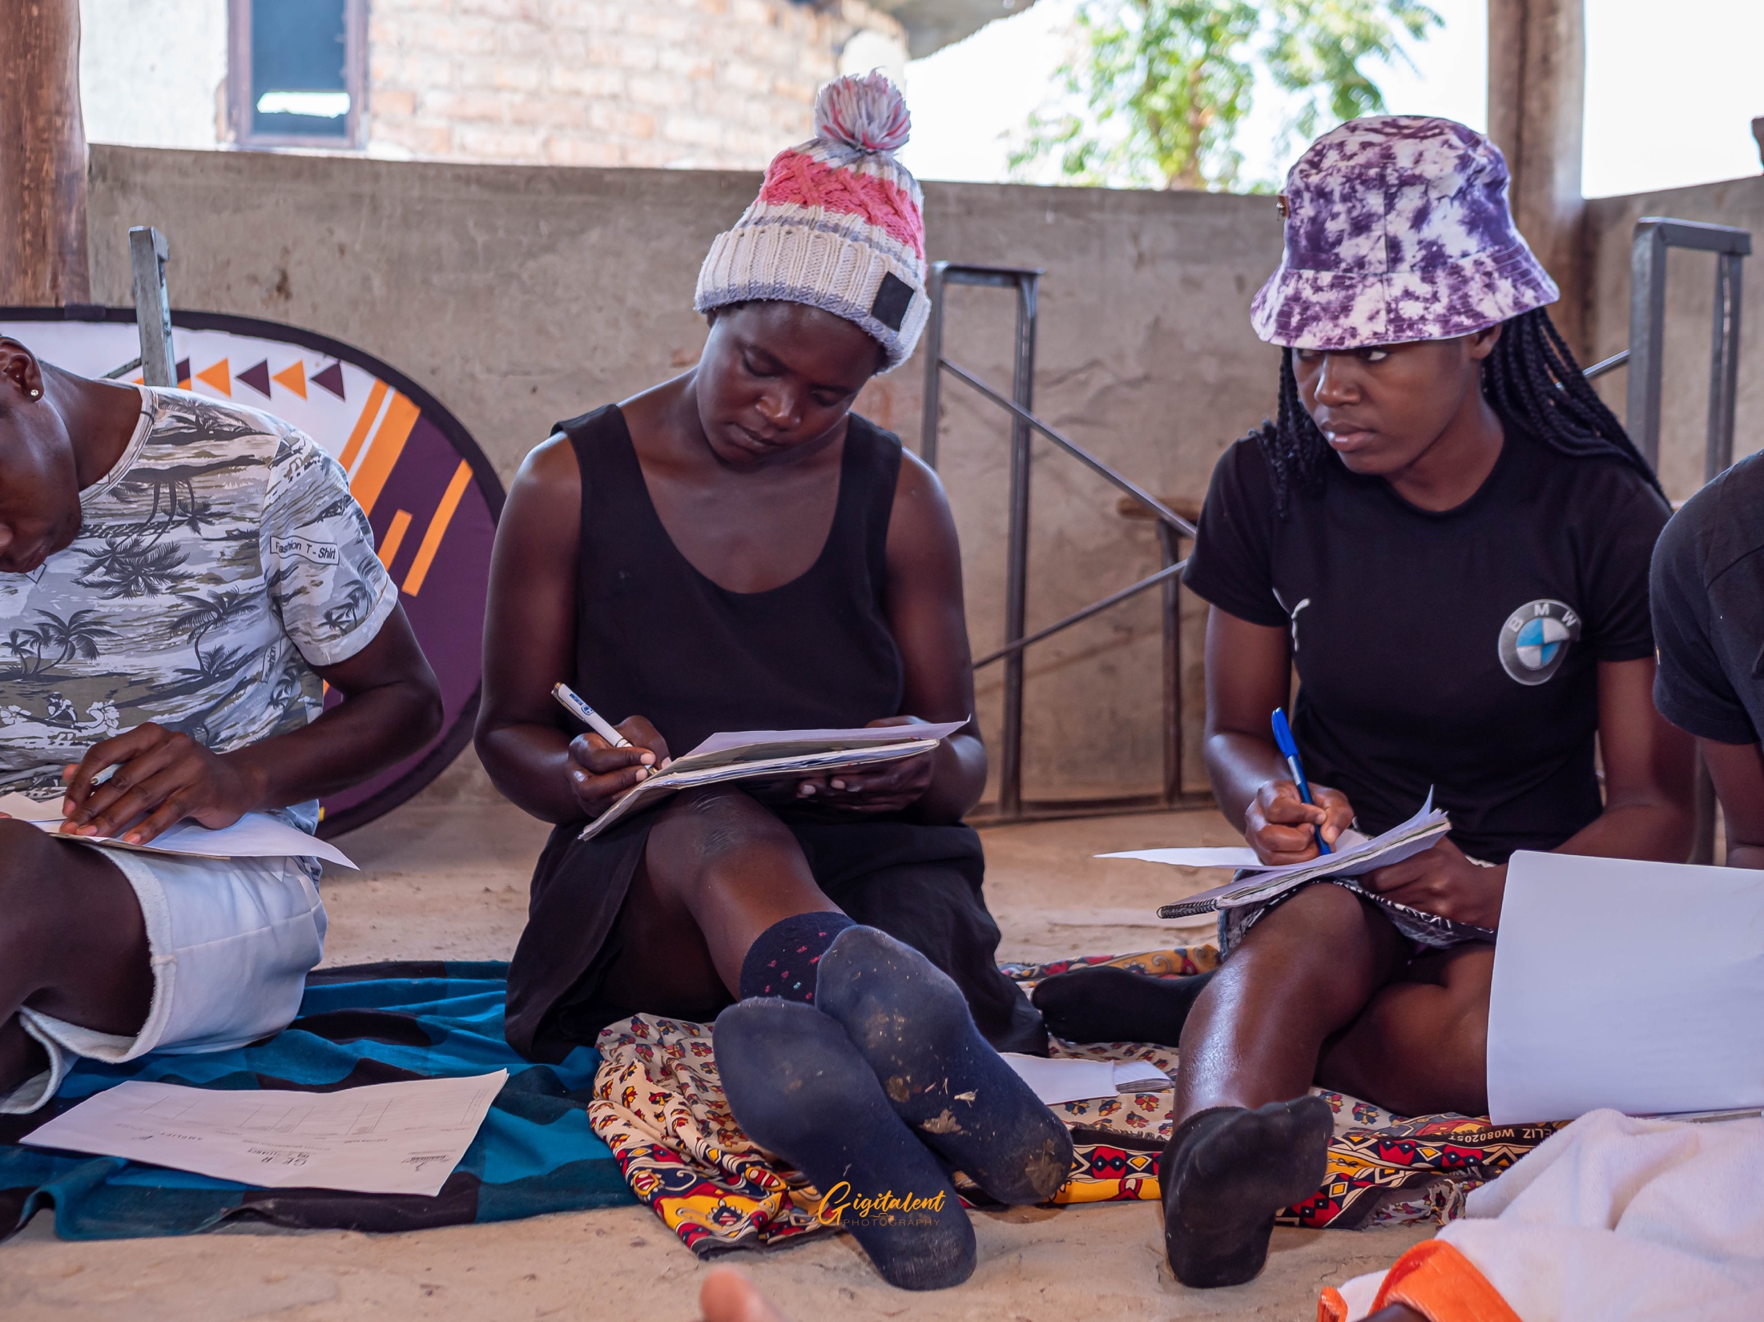
OBJECTIVES
What did the process/ project set out to do?
Reduce HIV and other STIs
Prevent early and unintended pregnancies
Address gender based violence
Empower young people
Create supportive environments
Improve overall well being
Photo
Women’s Voice and Leadership Learning and Sharing Summit 2025

Slide 4
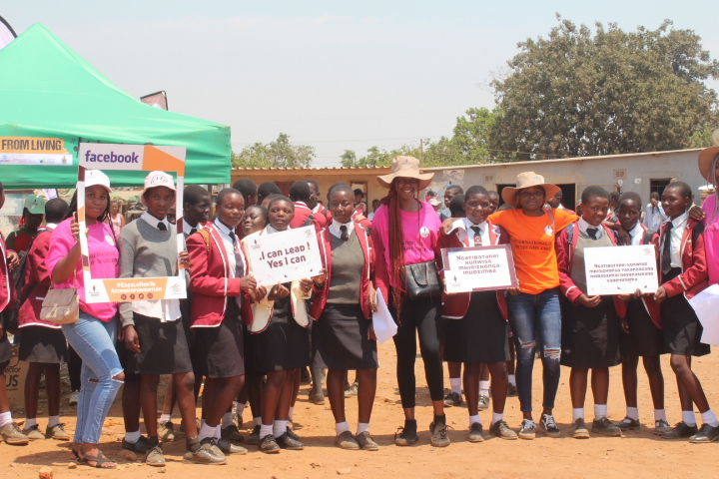
ACTIVITIES
What evidence or means of verification do you have for this change?
Workshops
Community dialogues
Intergenerational engagements
Creative expression- art, music
Video and photography
Photo
Women’s Voice and Leadership Learning and Sharing Summit 2025

Slide 5
Contribution to change
What contribution did your organisation make to this change?
Training of teachers and healthcare providers on CSE
Training of community champions
Development of age appropriate CSE materials
Establishment of school based CSE clubs
Community outreach and engagement
Women’s Voice and Leadership Learning and Sharing Summit 2025

Slide 6
Population Group this change most closely related to
Category | Women | Men | Total | % Women
Direct beneficiaries | 3100 | 150 | 3250 | 95.3%
Indirect beneficiaries (e.g. through other networks) | 850 | 320 | 1170 | 72.6%
Online beneficiaries (e.g. website access, mailing lists, scholarly articles) | 20000 | 18000 | 38000 | 52.6 %
Total | 23950 | 18470 | 42420 | 56.4%
Women’s Voice and Leadership Learning and Sharing Summit 2025

Slide 7
Significance of change
What is the significance of the change?
Promoting healthy relationships
Prevention of HIV and other STls,
Reduction in early and unintended pregnancies
Empowering young people to make informed decisions about their lives.
Women’s Voice and Leadership Learning and Sharing Summit 2025

Slide 8
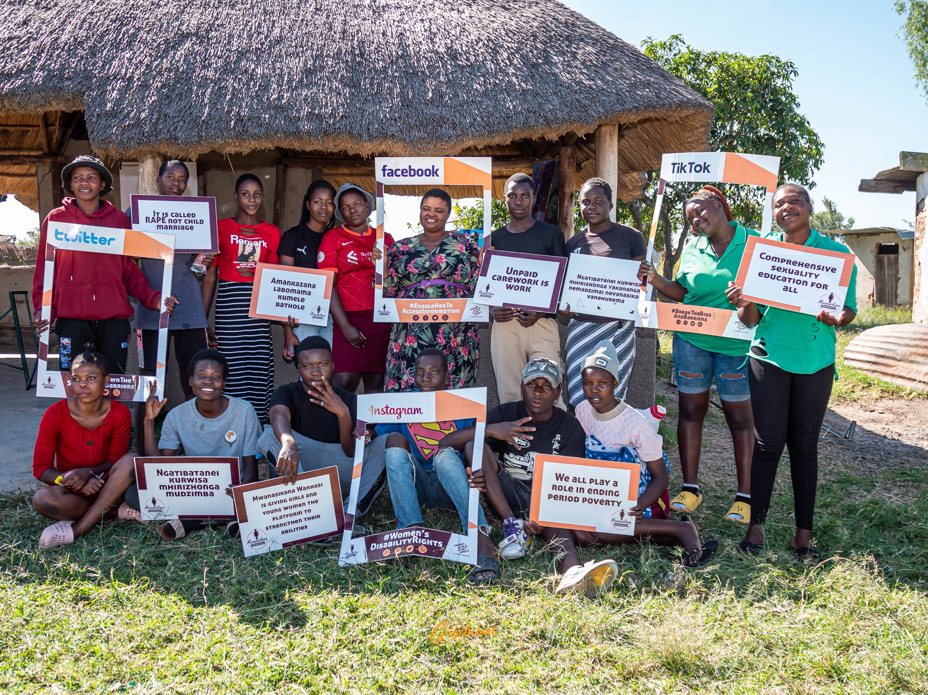
RESULTS
Please share some of your results for example
Increased knowledge
Delayed sexual debut
Improved contraceptive use and reduced unintended pregnancies
Reduced Gender Based Violence
Improved Menstrual Hygiene
Include evidence here – photos/clippings
Women’s Voice and Leadership Learning and Sharing Summit 2025

Slide 9
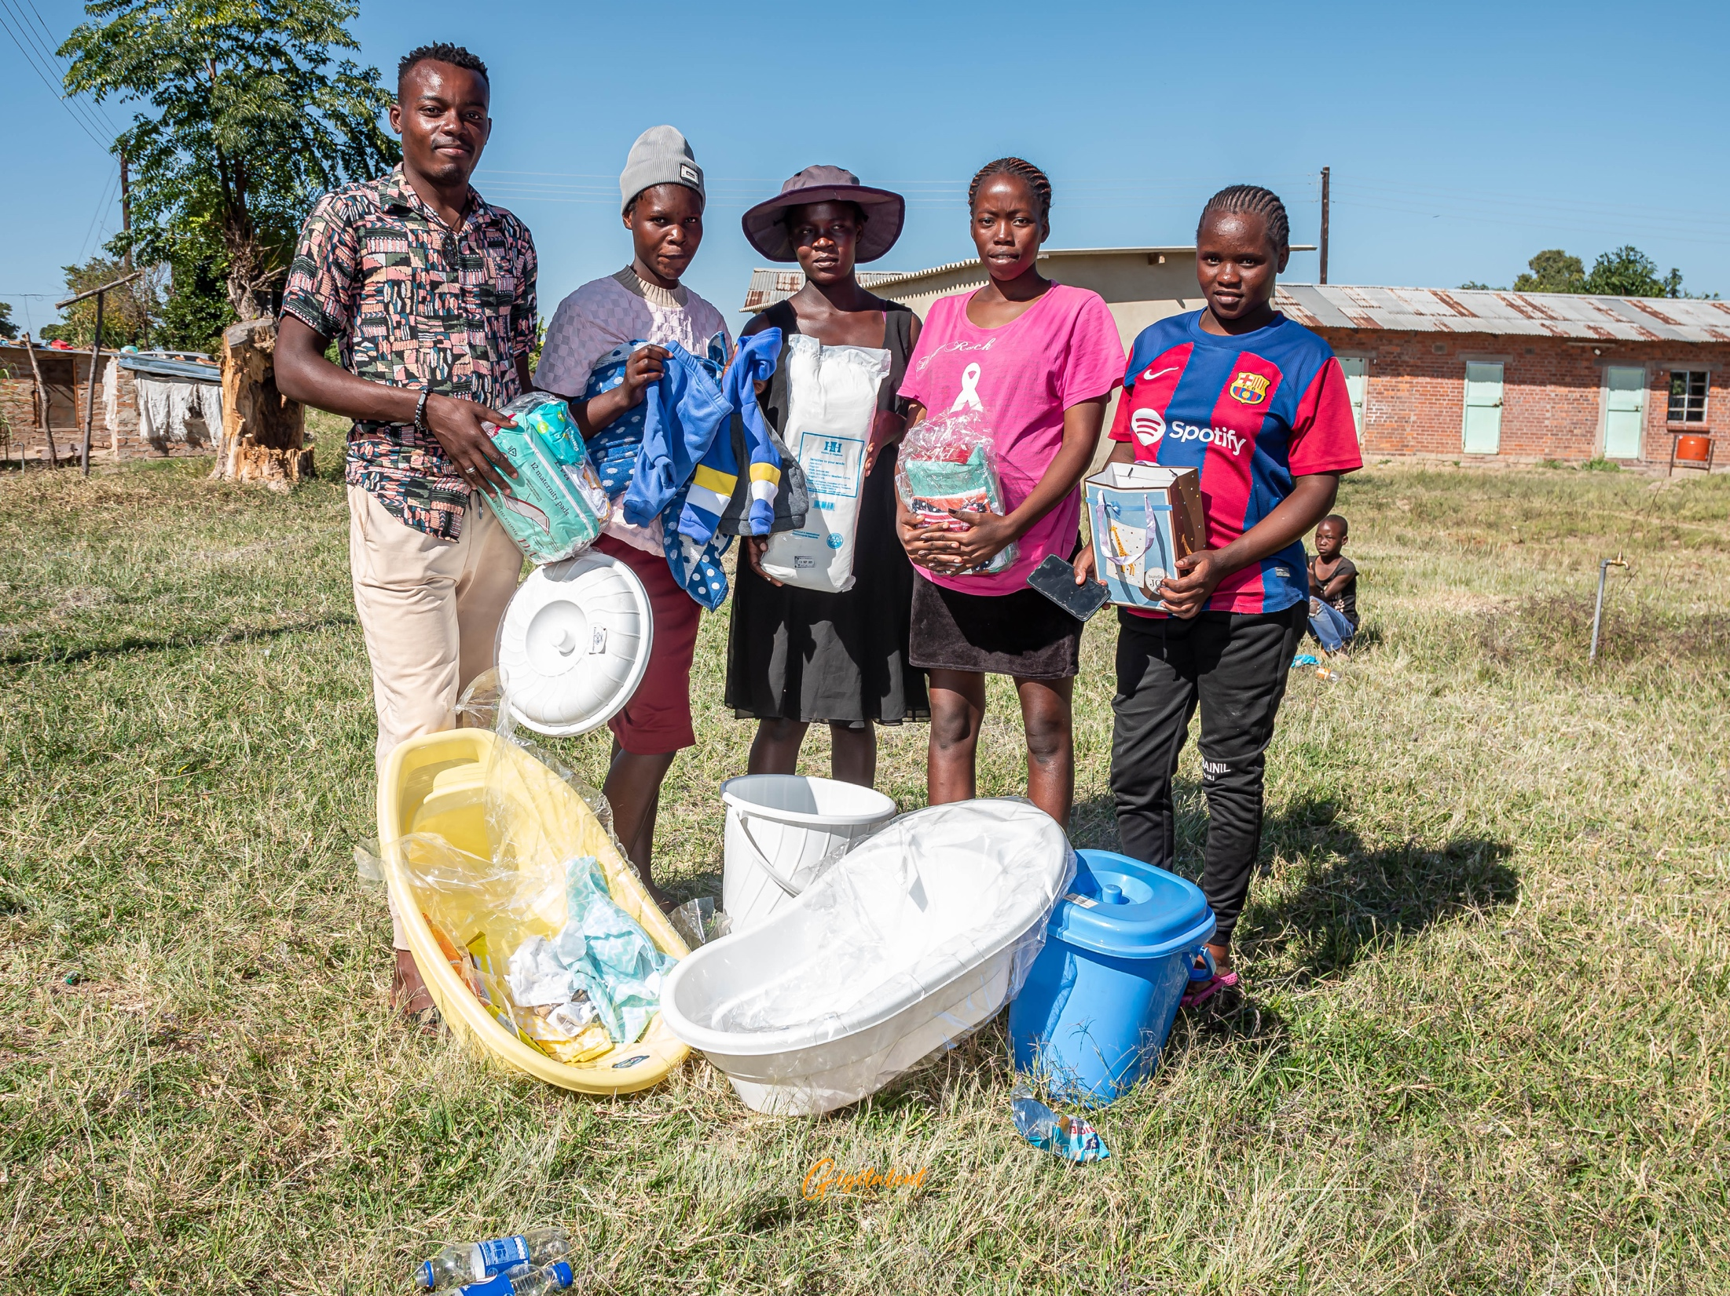
Evidence
What evidence / means of verification
Pictures
Vidoes
Reports
Testimonials
Include evidence here – photos/clippings
Women’s Voice and Leadership Learning and Sharing Summit 2025

Slide 10
CHALLENGES AND LESSONS LEARNT
What have been the main challenges? How have these challenges been overcome?
Social and Cultural Challenges-Resistance, Stigma and Gender and social norms
Policy and legislative challenges- lack of supportive policies
Implementation challenges- limited resources, difficulty in engaging parents and men
Women’s Voice and Leadership Learning and Sharing Summit 2025

Slide 11
CHALLENGES AND LESSONS LEARNT
What lessons have been learned?
Engaging community from the onset
Capacity building of peer educators
Fostering partnerships
Providing ongoing support
Women’s Voice and Leadership Learning and Sharing Summit 2025

Slide 12
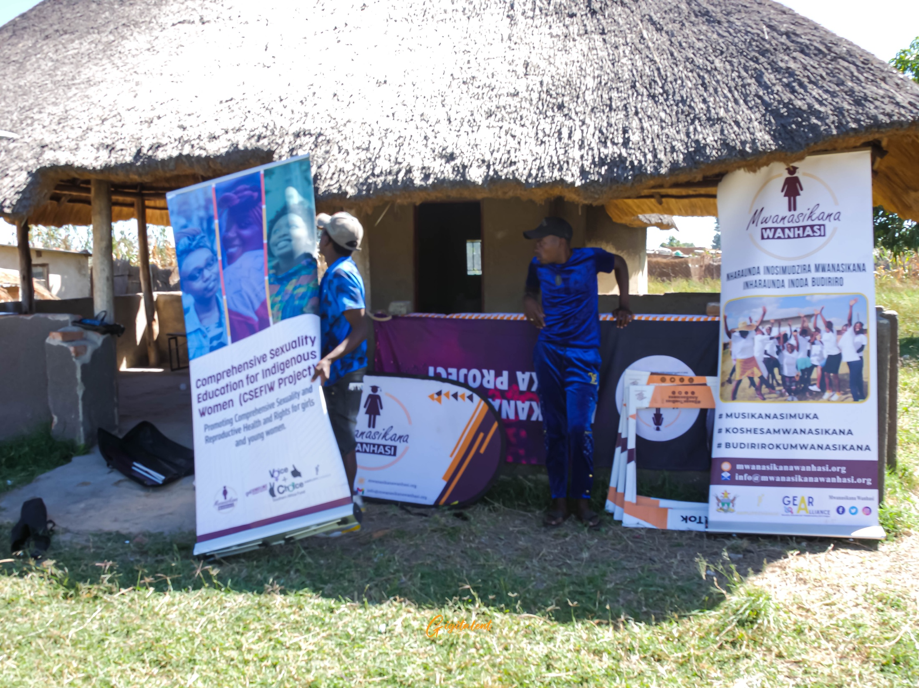
CHALLENGES AND LESSONS LEARNT
How will the lessons learned be applied?
Continued engagement
Women’s Voice and Leadership Learning and Sharing Summit 2025

Slide 13
SUSTAINABILITY AND REPLICATION
Community Engagement and Ownership- training of SRHR Community Champions
Establish a community-led committee- Gender Desk
Build community capacity- trainings, distribution of tools
Foster community partnerships: Collaborate with local organizations, schools, and healthcare providers to ensure the project's continuity. E.g NorthCot
Collaborating with health care workers- local clinic
Establish Monitoring and Evaluation System
Women’s Voice and Leadership Learning and Sharing Summit 2025

Slide 14
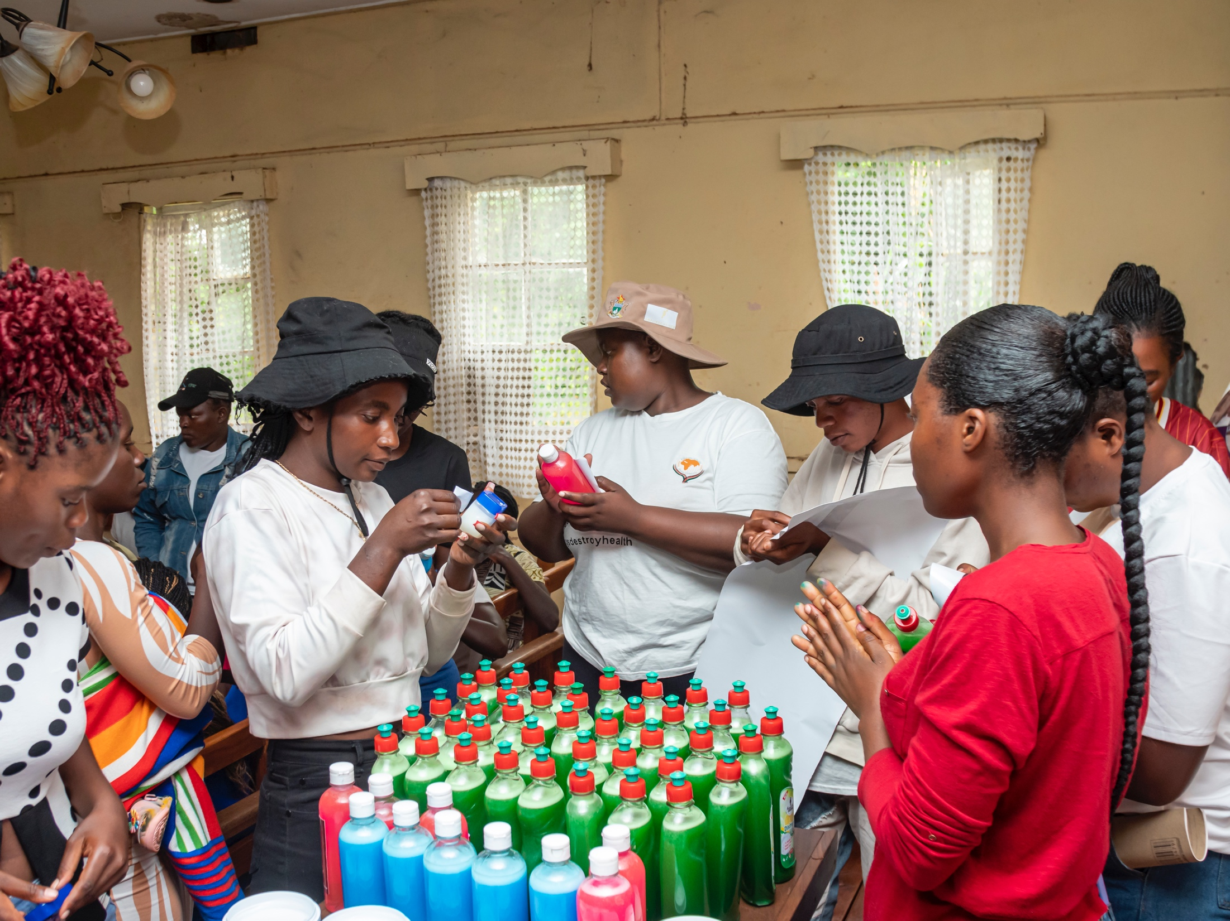
NEXT STEPS
What are the key priorities going forward?
Resource mobilization for further engagements
Life skills training
Include evidence here – photos/clippings
Women’s Voice and Leadership Learning and Sharing Summit 2025

