Slide 1







Logo goes here
LEARNING
AND SHARING
SUMMIT 2025
Amplifying Youth Voices: Social Media for SRHR Activism
(Zimbabwe, Mt Hampden, 4 March 2025 and Opportunity Makanga)
Women’s Voice and Leadership Learning and Sharing Summit 2025

Slide 2
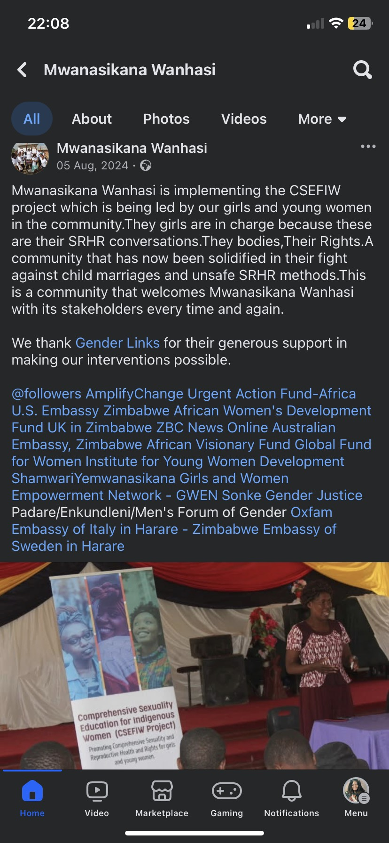
Achieved/planned objective
Increased awareness and engagement- sparking conversations on SRHR
Improved knowledge and attitudes
Behavioural change advocacy
Project visibility
Photo/clippings
Women’s Voice and Leadership Learning and Sharing Summit 2025

Slide 3
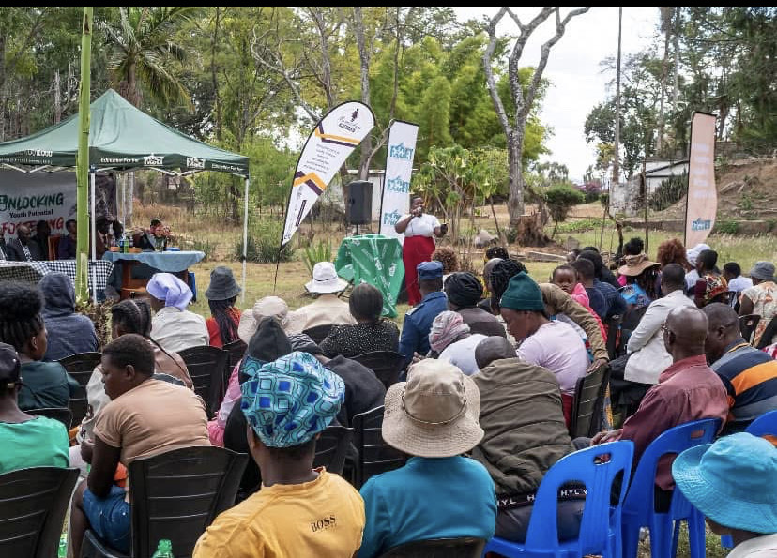
PARTNERS AND NETWORKS
Did you work with other VCSA grantees? Who?
Roots
Photo/clippings
Women’s Voice and Leadership Learning and Sharing Summit 2025

Slide 4
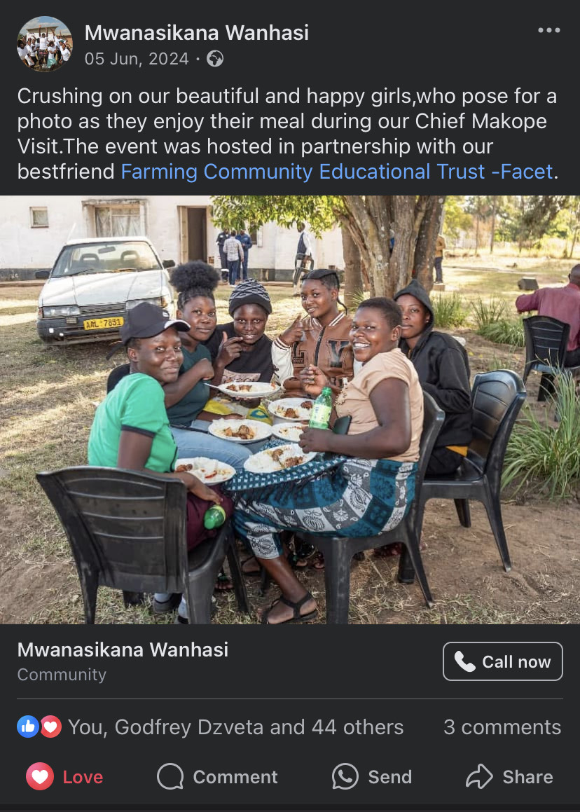
Did you work with other partners on your visibility other than VCSA grantees? Who?
Facet
World Life Changers
Youth Empowerment for Transformation Trust (YETT)
SAYWHAT
ZCLDN
Young voices
Photo/clippings
Women’s Voice and Leadership Learning and Sharing Summit 2025

Slide 5
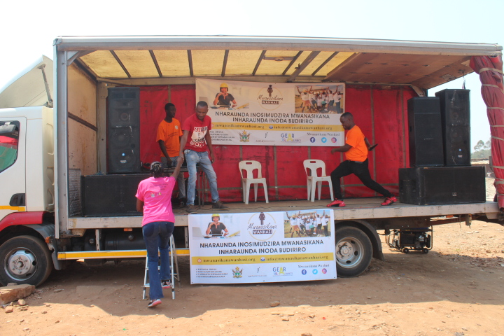
Did you build networks/ alliances through your social media activities? Who?
KFM Consultancy
World Life Changers
Young Voices
Abmatech Marketing
Goodhope Ministries
For Youths By Youths
Femme Voice
Photo/clippings
Women’s Voice and Leadership Learning and Sharing Summit 2025

Slide 6
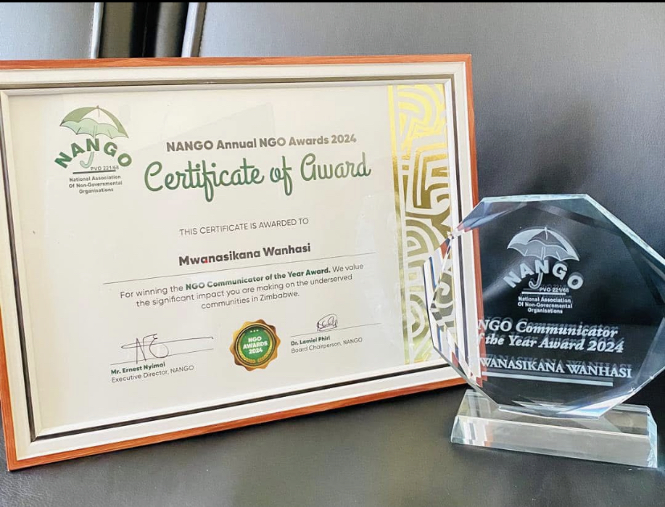
IMPACT
What has been your social media impact?
NGO Communicator of the Year Award
Information dissemination
Social media dialogues
Photo/clippings
Women’s Voice and Leadership Learning and Sharing Summit 2025

Slide 7
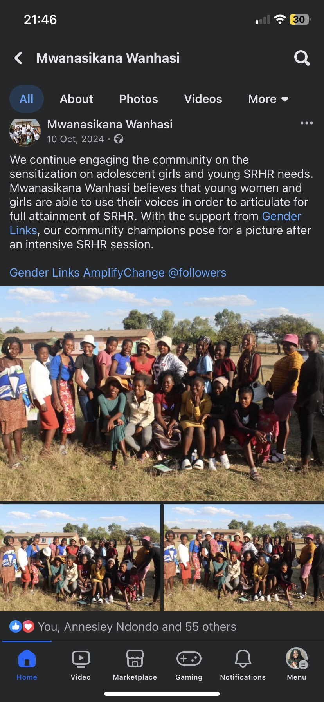
Followers | Before VCSA | Current
Facebook | 19100 | 21734
Twitter | 5134 | 7500
Tik-Tok | 120 | 127
YouTube | 9 | 20
Instagram | 930 | 1240
Please provide a concrete example of your post
https://www.facebook.com/share/p/1DiYvhNRau/?mibextid=wwXIfr
Women’s Voice and Leadership Learning and Sharing Summit 2025

Slide 8
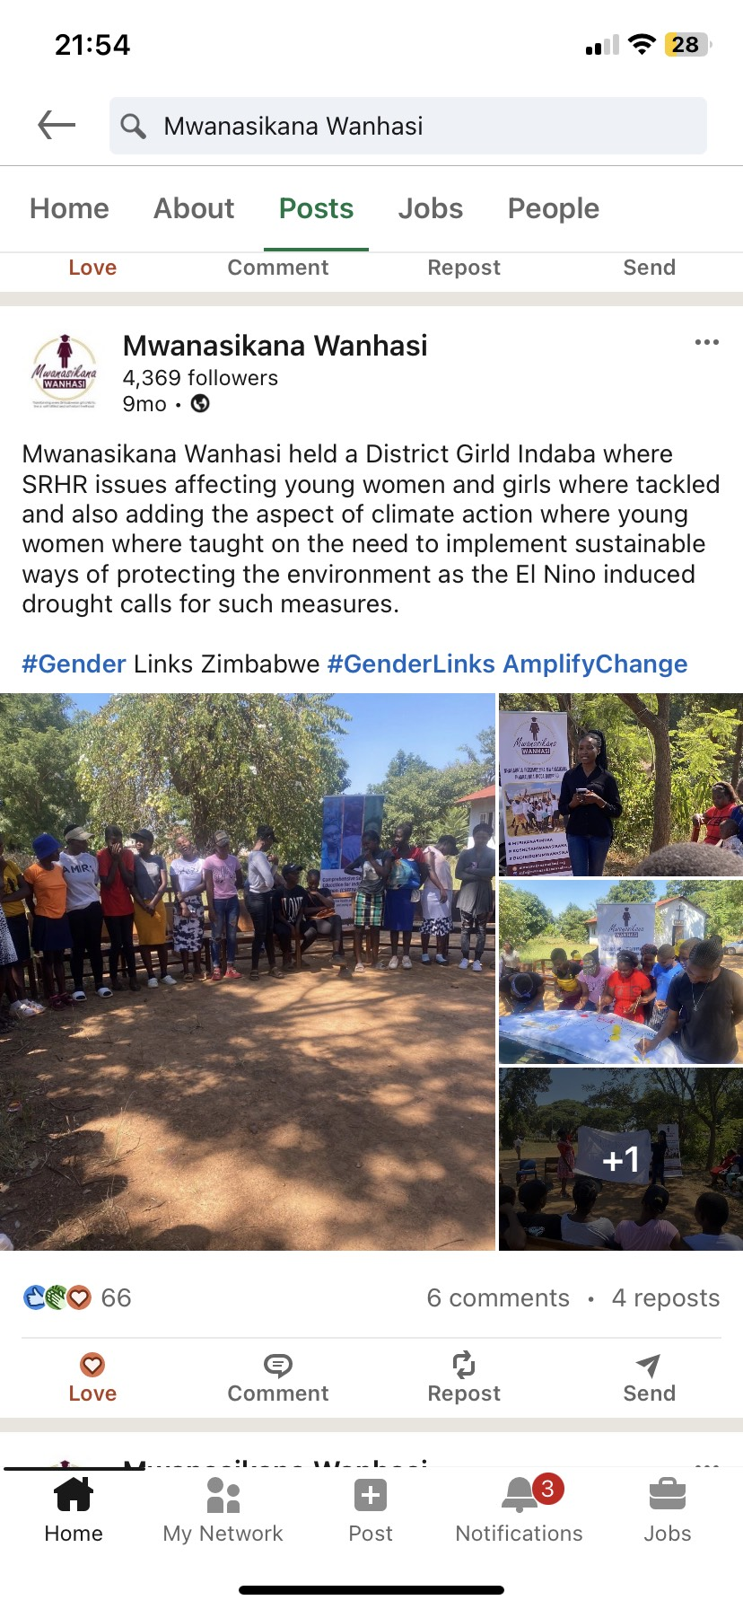
Likes | Before VCSA | Current
Facebook | 50000 | 125000
Twitter | 1500 | 2700
Tik-Tok | 0 | 0
YouTube | 5 | 9
Instagram | 1500 | 2543
https://www.linkedin.com/posts/mwanasikana-wanhasi_gender-genderlinks-activity-7189637626398654465-djAo?utm_source=share&utm_medium=member_ios&rcm=ACoAADe7QkYBLgQ3zyu2xxNrZs8KywsWZZ4VV5w
Women’s Voice and Leadership Learning and Sharing Summit 2025

Slide 9
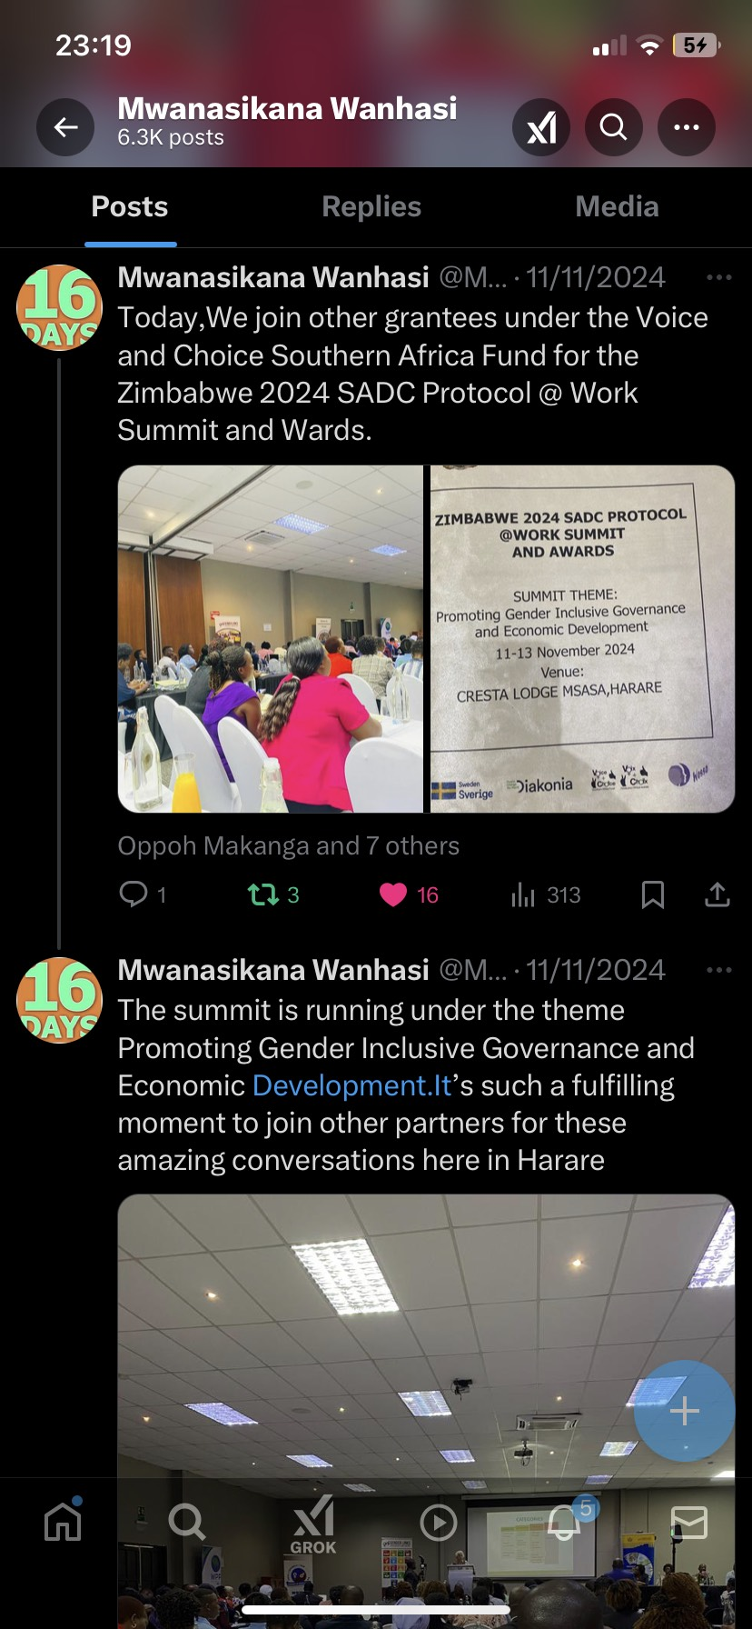
Impressions | Before VCSA | Current
Facebook | 50000 | 120000
Twitter | 400 | 1200
Tik-Tok | 0 | 0
YouTube | 120 | 415
Instagram | 1200 | 4300
https://www.facebook.com/share/p/14toVhkBh7/?mibextid=wwXIfr
Women’s Voice and Leadership Learning and Sharing Summit 2025

Slide 10
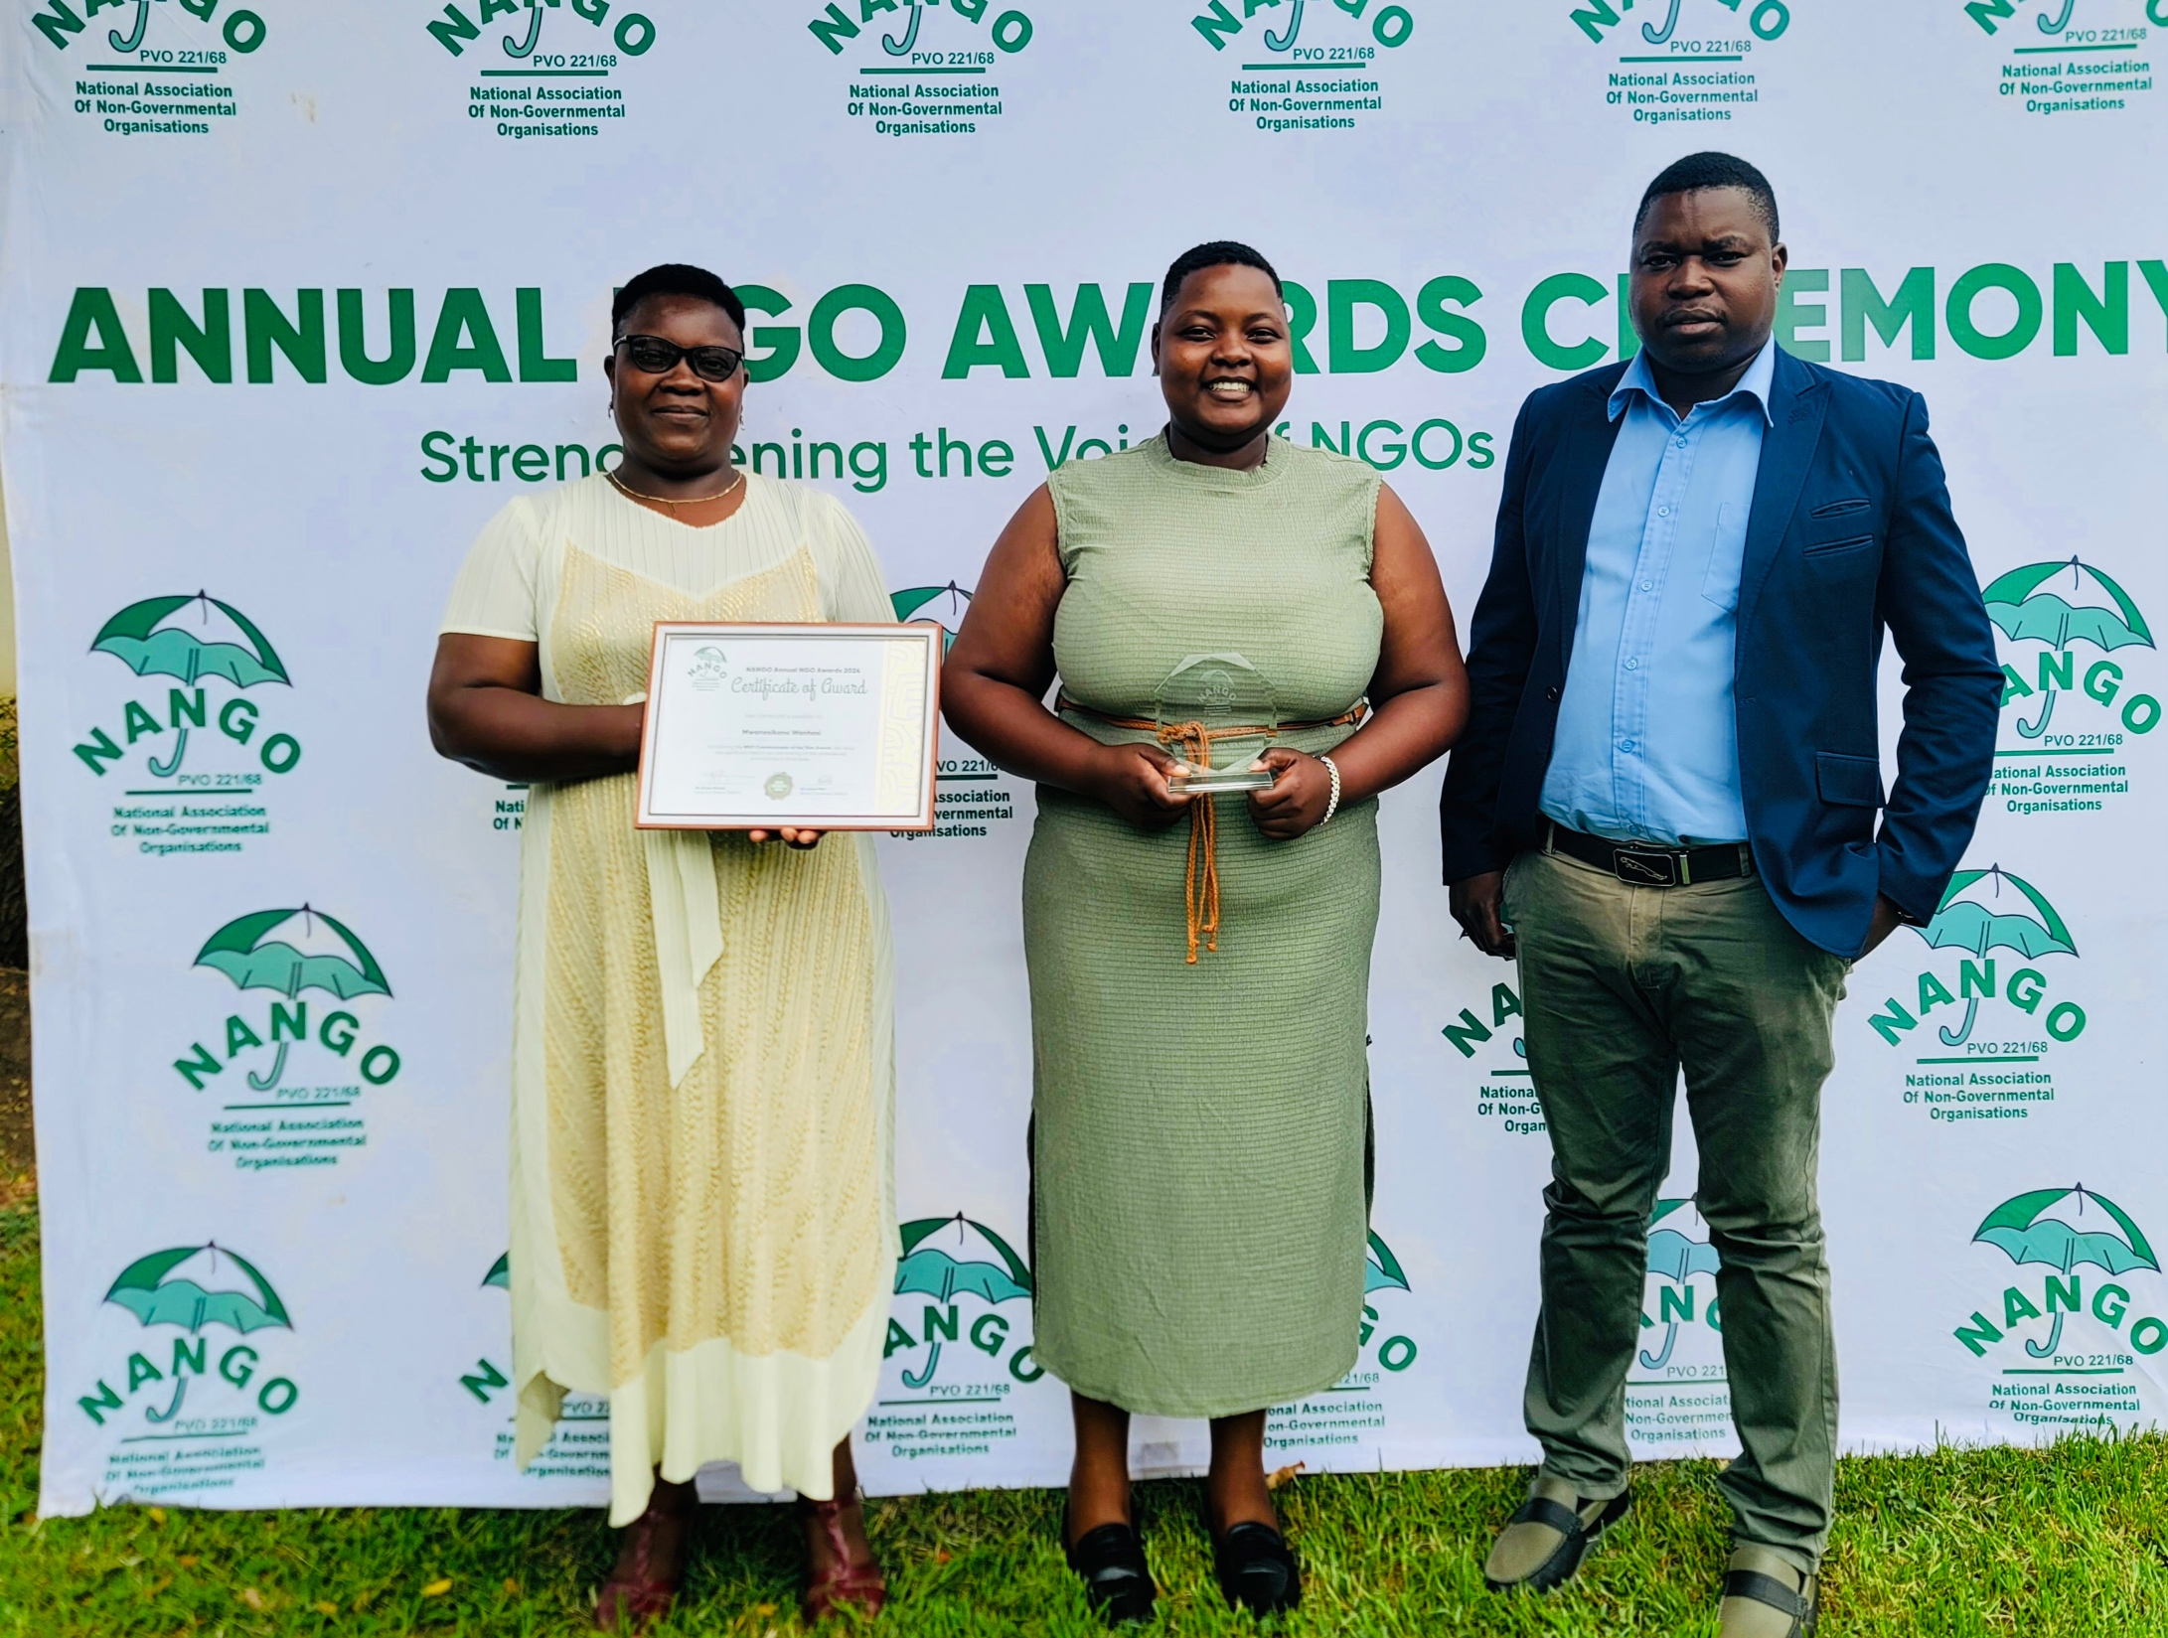
ADDITIONAL EVIDENCE
Evidence of your good practice
High engagements rates e,g likes, shares
Increased followers
Comments and conversations
High reach- people seeing posts
Increased impressions
Viral posts
Include evidence here – Video/photos/clippings
Women’s Voice and Leadership Learning and Sharing Summit 2025

Slide 11
CHALLENGES AND LESSONS LEARNT
What have been the main challenges? How have these challenges been overcome?
What lessons have been learned?
How will the lessons learned be applied?
Content consistency- whilst waiting for funds
Algorithm changes
Limited budget- allocating sufficient resources to support social media
Backlash- negative/offensive comments
Women’s Voice and Leadership Learning and Sharing Summit 2025

Slide 12
NEXT STEPS
What are the key priorities going forward?
Develop content calendar
Create engaging content
Respond to comments and messages
Use branding guidelines- using logos
Partner with influencers
Allocate sufficient budget
Women’s Voice and Leadership Learning and Sharing Summit 2025

