Slide 1

Voice and Choice Summit 2026
Story of Change Category
Dr. Afrikanah Book Club by Mercy Judy Wanjiru
(Kenya)
2nd March 2026
Voice and Choice Summit 2026 \ Voice and Choice Summit 2026

Slide 2
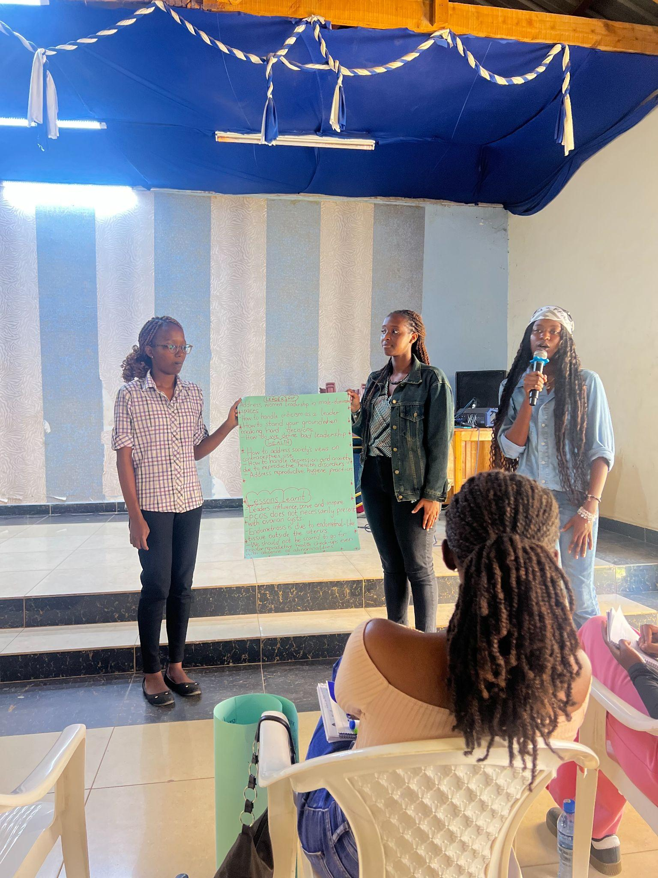
Background
The Problem
Girls and young women often lack safe spaces to discuss leadership, mental health, menstrual health, and SRHR, leading to silence, misinformation, and limited leadership opportunities.
Who Was Affected
The project focused on secondary school and university students who lacked access to rights-based information, mentorship, and open dialogue on issues affecting their lives.
Where & By Whom
Implemented in Nairobi by Dr. Afrikanah Book Club, with Phase 1 at Kenyatta Girls Secondary School and Phase 2 in university and community spaces.
Project Goal
To create safe feminist learning spaces using storytelling, literature, and dialogue to strengthen young women’s knowledge, confidence, and leadership.
Voice and Choice Summit 2026 \ Voice and Choice Summit 2026

Slide 3

How the Change Came About
Creating Safe Dialogue Spaces
The project created participatory spaces where girls and young women could openly discuss leadership, mental health, menstrual health, and SRHR through storytelling and facilitated dialogue.
Key Activities
Book club discussions using women-authored literature, interactive workshops, mentorship sessions with Kenyan women leaders and authors, and participatory group discussions.
Two Implementation Phases
Phase One: School-based leadership discussions with students at Kenyatta Girls Secondary School.
Phase Two: Expanded engagement with university students and young women in community spaces in Nairobi.
Who Led the Change
Mercy Judy Wanjiru through Dr. Afrikanah Book Club, with support from volunteers, partner authors, and active participation from students.
Voice and Choice Summit 2026 \ Voice and Choice Summit 2026

Slide 4
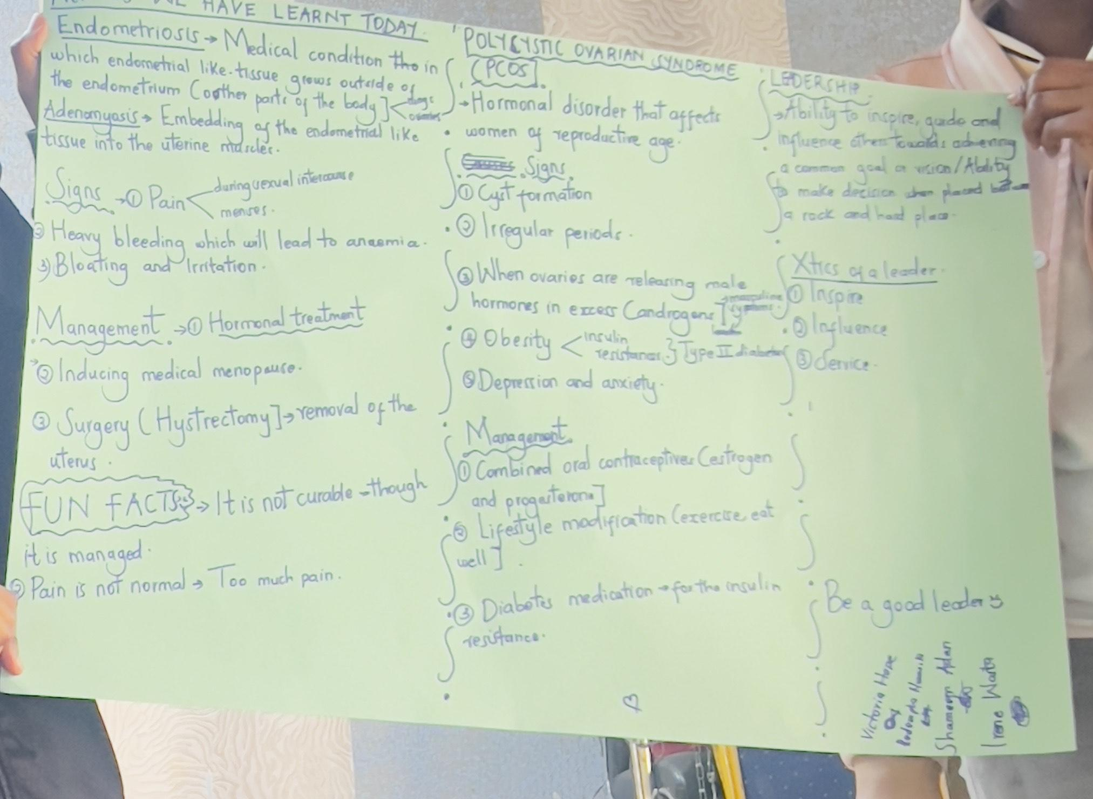
The change
Shift in Engagement
The project led to a shift from silence and limited dialogue to active participation and open conversations among the participants
Positive Change in Confidence & Participation
The change was largely positive, with participants moving from passive learning to confidently discussing women’s leadership, mental health, menstrual health, and SRHR.
Who Benefited
Secondary school girls gained early exposure to leadership and confidence-building discussions.
University students and young women in communities engaged in deeper conversations on mental health, SRHR, menstrual disorders, and intimate partner violence, supported through mentorship from women authors and practitioners.
Current Situation
Participants now show greater openness, knowledge, and confidence in discussing previously stigmatized topics, with continued engagement through Dr. Afrikanah Book Club and growing interest in future sessions on leadership, mental health, and SRHR.
Voice and Choice Summit 2026 \ Voice and Choice Summit 2026

Slide 5
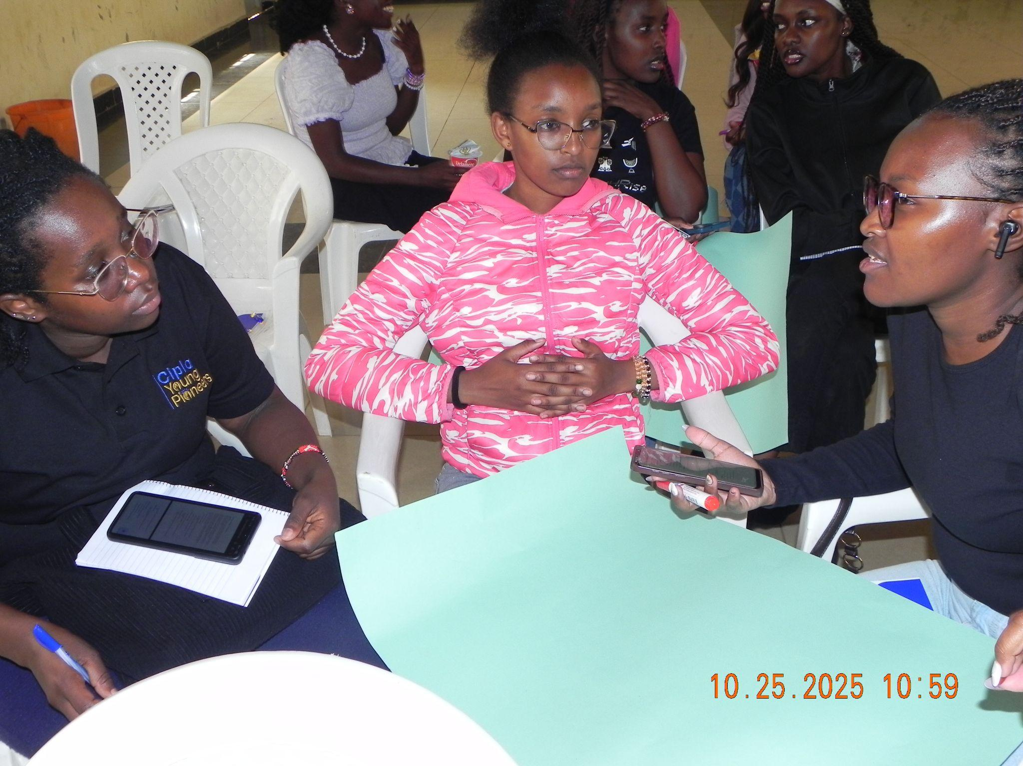
Significance of Change
Strengthens the feminist movement
Creates safe spaces for girls and young women to exercise voice, choice, and agency on leadership, mental health, and SRHR.
Shows effective tools for movement-building
Demonstrates how storytelling and feminist literature can spark dialogue and leadership development.
Centers young women as leaders
Participants moved from passive learning to actively shaping conversations and identifying priority issues.
Guides next steps
Expand the model to more schools and communities, strengthen systems for programming and volunteers, and increase visibility to amplify young women’s voices.
Voice and Choice Summit 2026 \ Voice and Choice Summit 2026

Slide 6
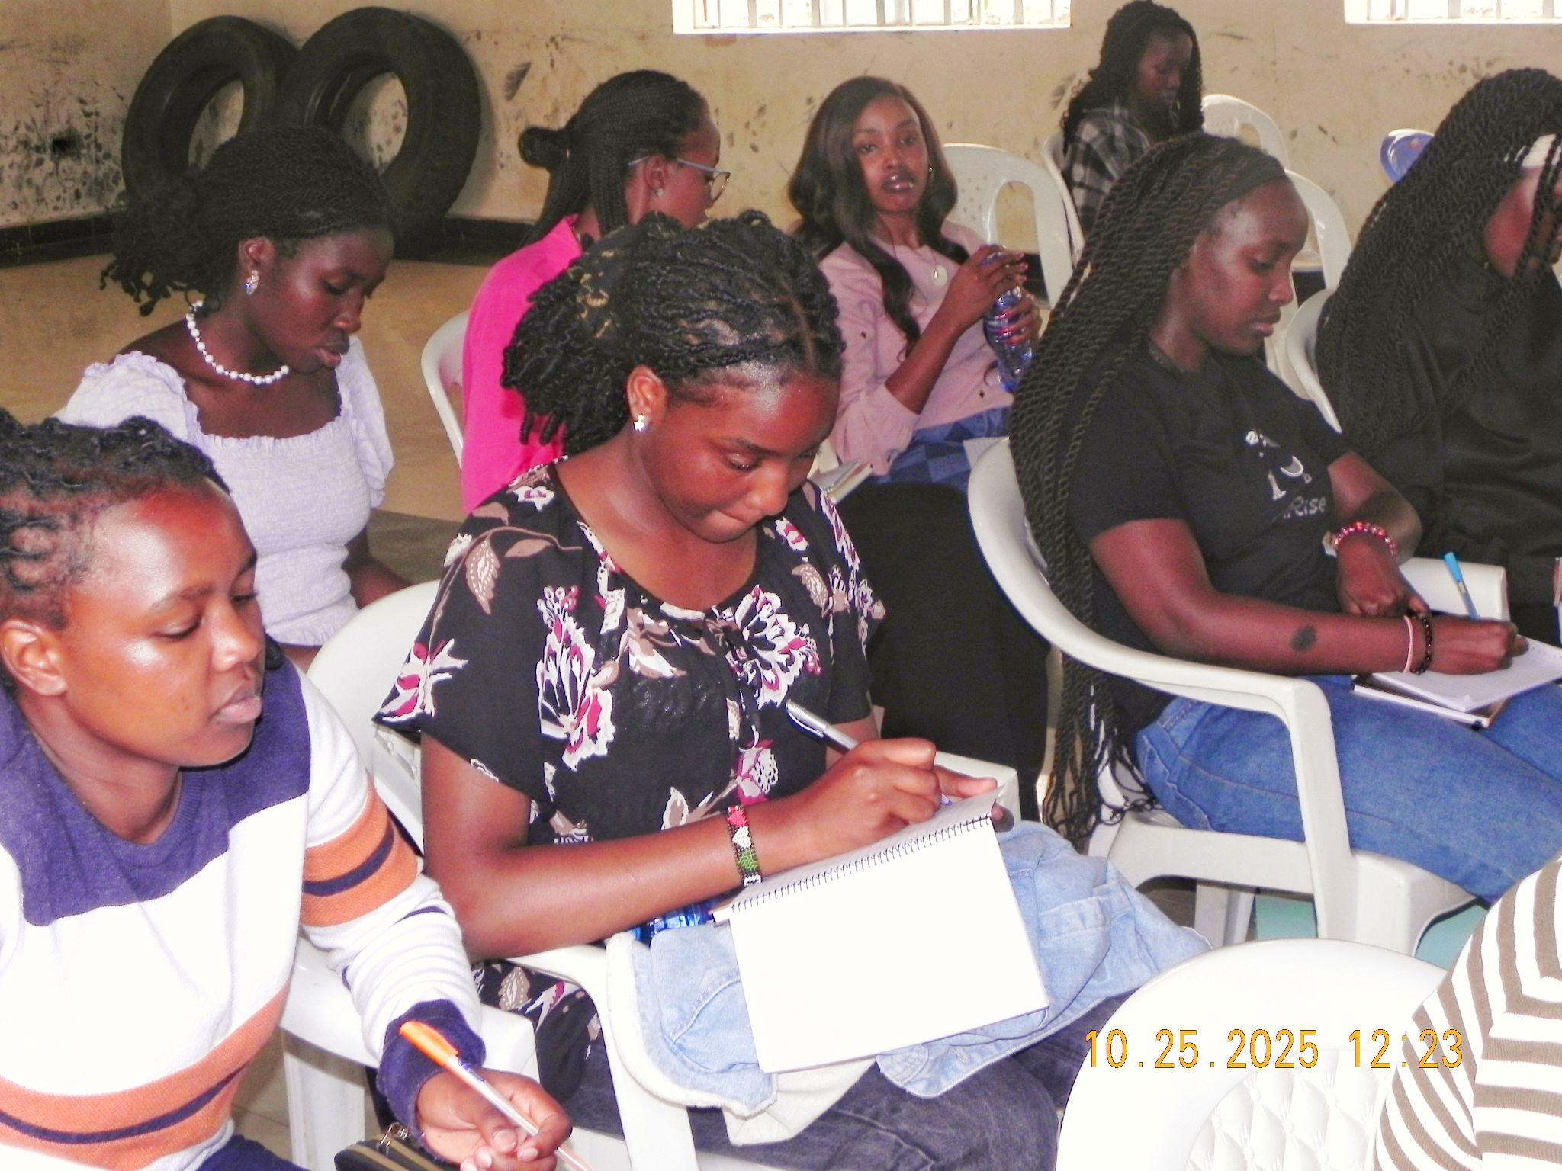
Sustainability
Institutional strengthening
Formal registration of Dr. Afrikanah Book Club.
Sustainable systems
Clear structures for programming, volunteer engagement, and leadership succession to ensure continuity.
Peer-led model
Participants are trained to facilitate sessions and mentor others, sustaining the initiative beyond the original project lead.
Scaling and partnerships
Expand to more schools and communities while strengthening collaborations with feminist networks.
Voice and Choice Summit 2026 \ Voice and Choice Summit 2026

Slide 7
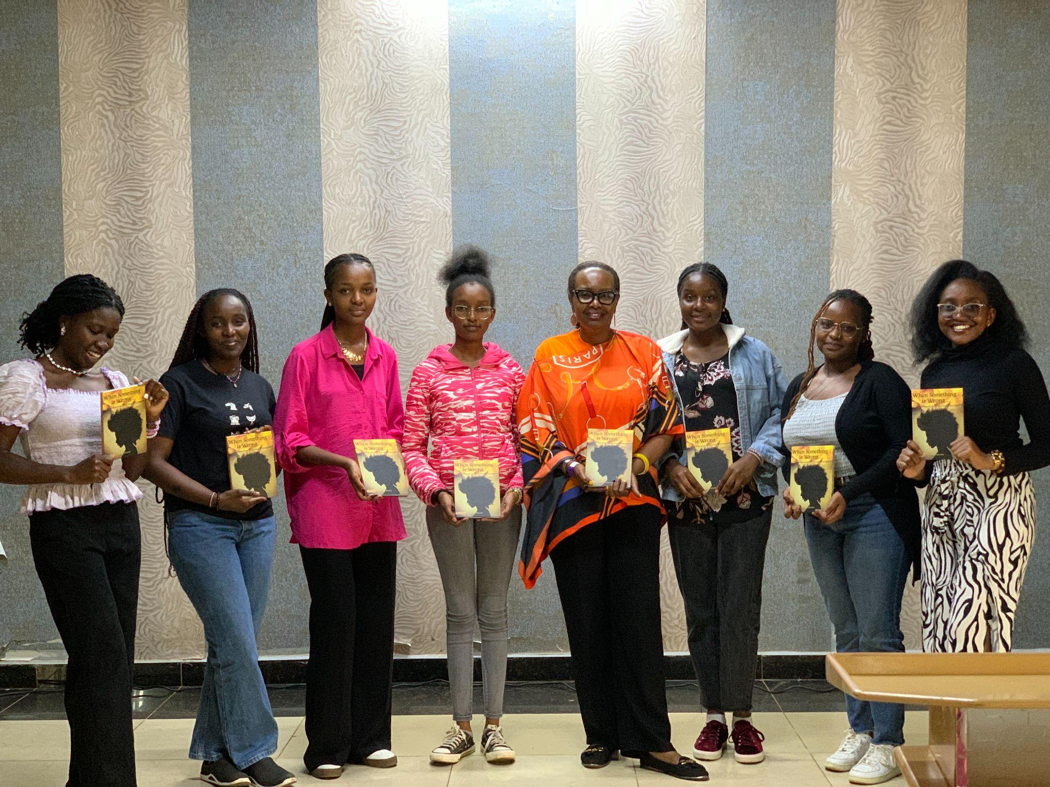
Beneficiaries
Number of;
Female – 43 Direct beneficiaries
Female – 15 Indirect beneficiaries
Female – 200 Online beneficiaries
Voice and Choice Summit 2026 \ Voice and Choice Summit 2026

Slide 8
Challenges & Lessons learnt
Challenges & mitigation
Institutional resistance
Secondary school was hesitant to host discussions on feminism and SRHR.
Mitigation: Shifted to community and university spaces and framed discussions around leadership and wellbeing.
Stigma around sensitive topics
Topics like mental health and SRHR were initially difficult for participants to discuss.
Mitigation: Used storytelling and literature to create safer entry points for dialogue.
What lessons have you learnt?
Safe spaces matter
2. Storytelling is powerful
3. Young women should lead the conversation
4. Flexibility is key
Voice and Choice Summit 2026 \ Voice and Choice Summit 2026

Slide 9
Next Steps
Formalize the initiative
Strengthen leadership
Train participants to facilitate sessions, mentor peers, and take on leadership roles.
Increase visibility and partnerships
Improve documentation through social media and a website, and collaborate with feminist networks.
Voice and Choice Summit 2026 \ Voice and Choice Summit 2026

