Slide 1

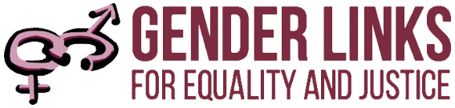
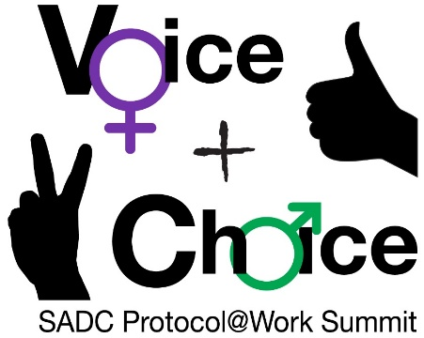
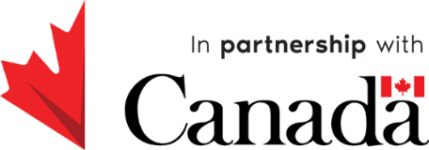
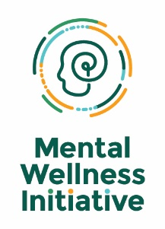
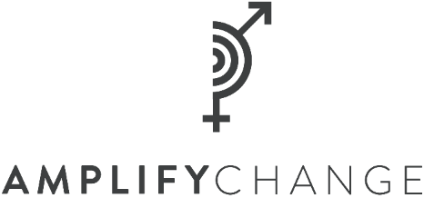
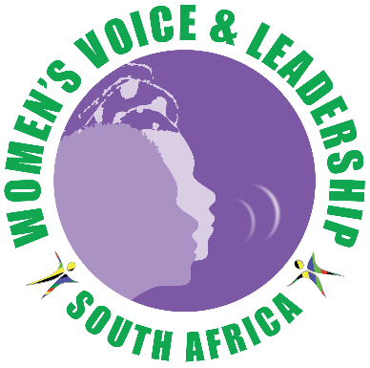
LEARNING AND SHARING
SUMMIT 2025
RWVL Drivers of Change
Collective Healing: Building a Movement for Change
South Africa, Johannesburg, March 2025
Presented by Segametsi Ditlhale
Women’s Voice and Leadership Learning and Sharing Summit 2025

Slide 2
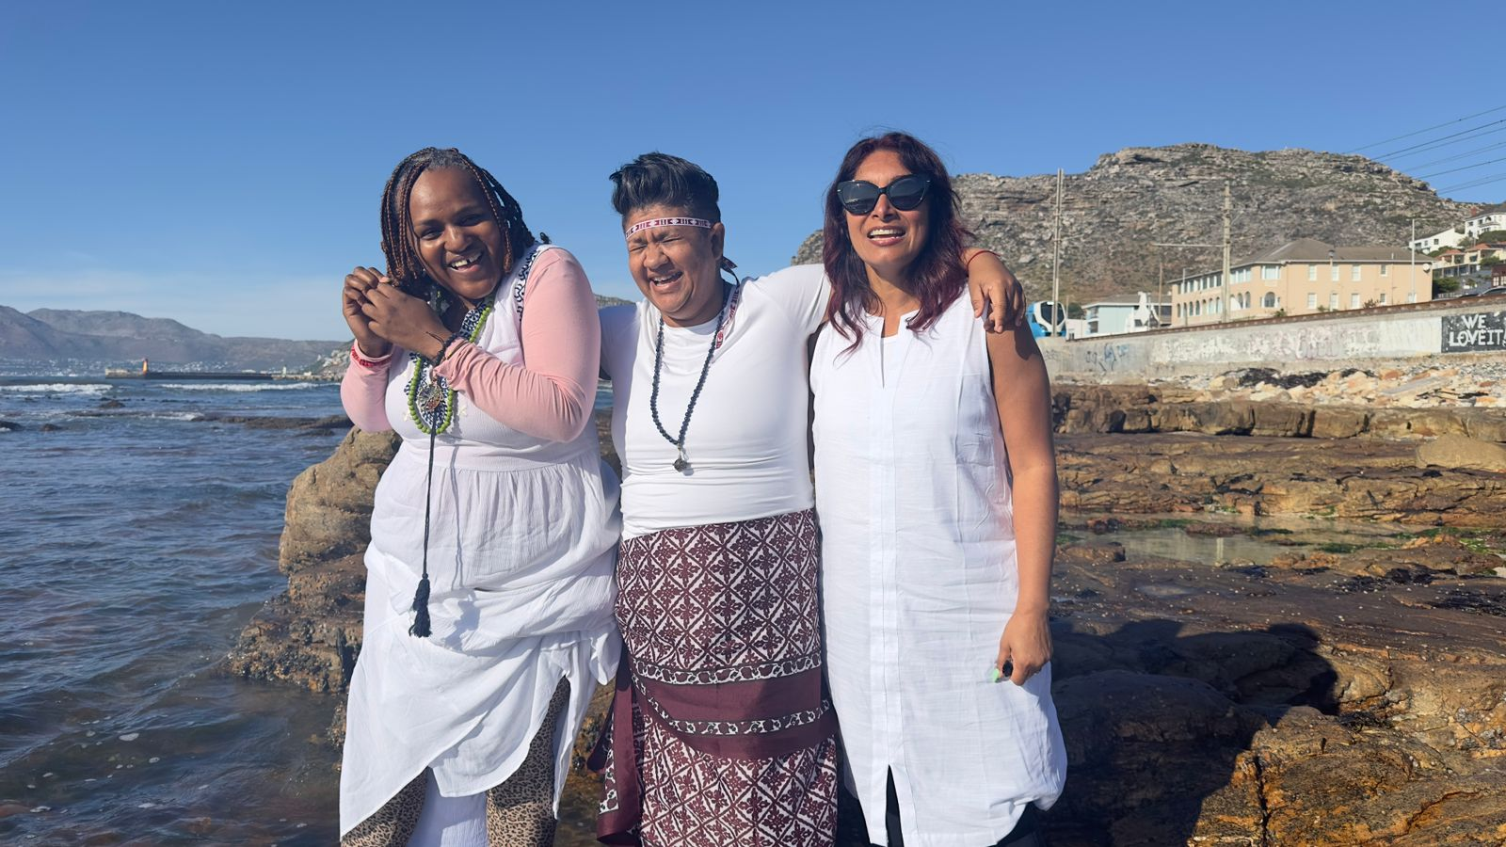
Who is this leader?
Who I Am
  My name is Segametsi Ditlhale, the middle child of eight siblings—a nurturer by nature and a healer by calling. I am a trauma and GBV survivor.
Where I Am From
  I am from NW - Debrak village, currently I am based in Douglasdale. Our office is based in Randburg.
This is me, with one of our healing facilitators and the CEO of MWI.
We make an amazing team!
Women’s Voice and Leadership Learning and Sharing Summit 2025

Slide 3
Who is this leader?
What I Do
I am a trauma practitioner who facilitates deep healing and transformation. My work focuses on helping individuals—especially GBV survivors—release trauma and reclaim their wholeness. Through my programs, I teach various trauma healing modalities, blending science, energy healing, and holistic wellness to support profound emotional and psychological recovery.
What Makes Me Unique
I don’t just do this work—I live it. As a GBV survivor, I chose to turn my wounds into a source of light for others. But my healing mission doesn’t stop with survivors. I work with perpetrators as well, because I believe that no one is born causing harm—hurt people hurt others.
I believe true healing means breaking the cycle at its root, allowing both survivors and perpetrators to find peace. I embody deep, unconditional love, creating safe spaces where even the most wounded souls can begin their journey to healing so that we can build a thriving society.
Women’s Voice and Leadership Learning and Sharing Summit 2025

Slide 4
What drives you?
Vision
To create a trauma-informed society where healing is accessible to all, fostering emotional resilience, well-being, and community transformation.
Objectives
  Empower CBOs with trauma healing and mental wellness tools.
  Integrate energy healing and somatic therapies into community support programs.
  Build a strong network for collective impact in driving social change.
Commitment to Gender Equality
As a trauma practitioner and energy healer, I am committed to breaking cycles of trauma by promoting safe, inclusive spaces for both men and women. Through healing, empowerment, and education, we create a society where everyone thrives.
Include photos or videos
Women’s Voice and Leadership Learning and Sharing Summit 2025

Slide 5
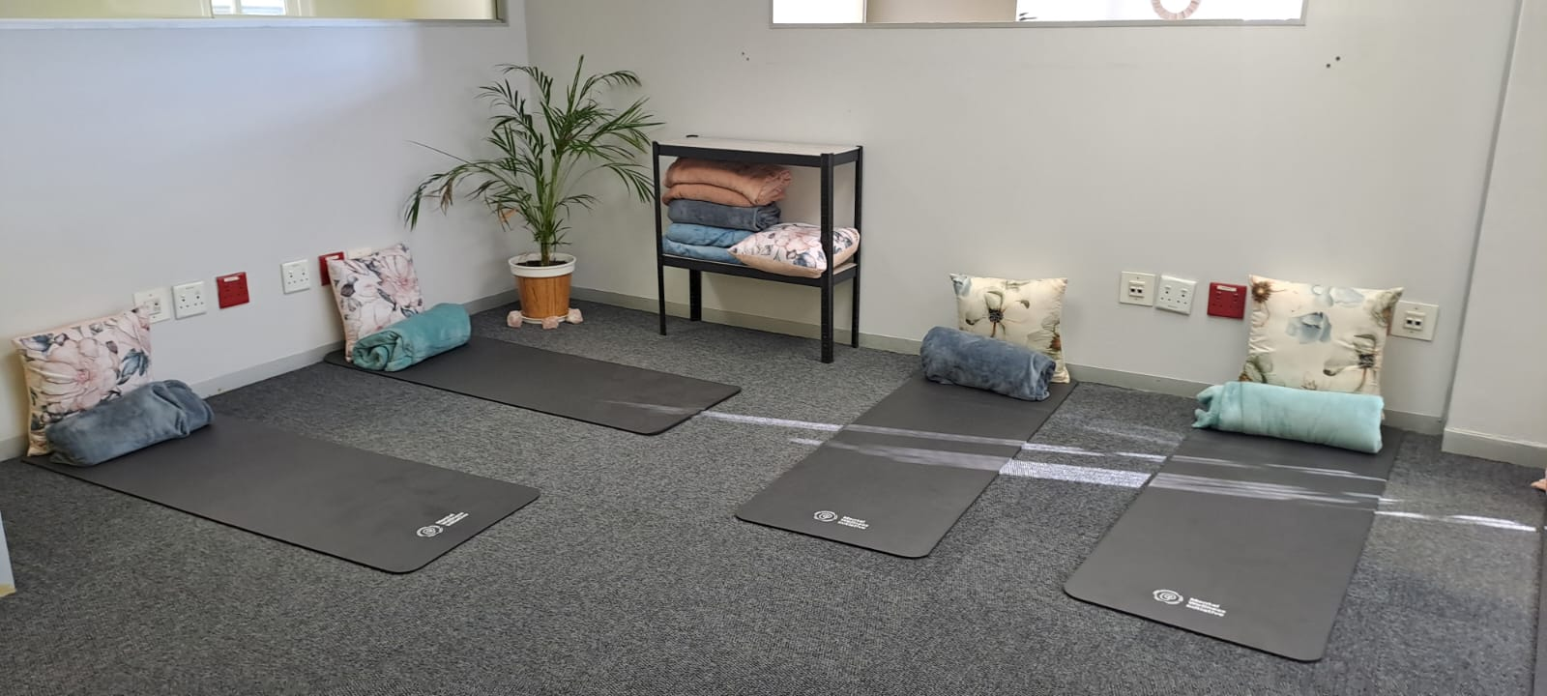
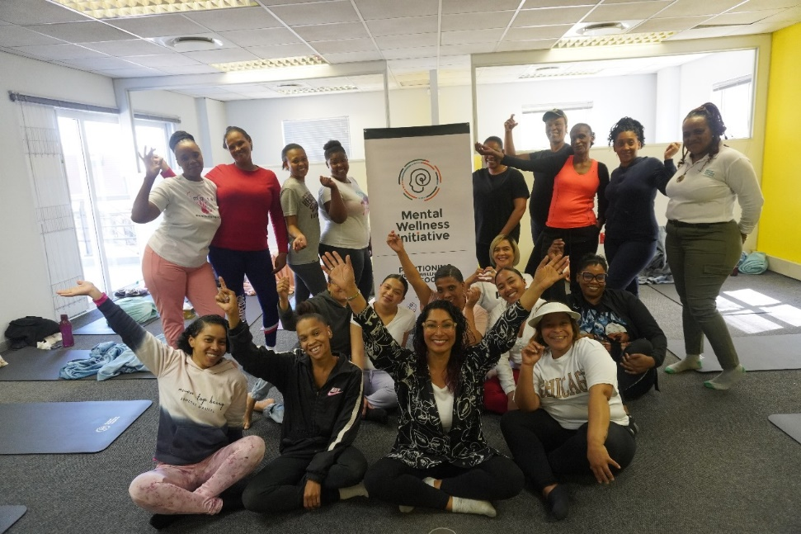
What do you do?
  I oversee, implement, and drive our trauma-focused programs and community engagement work, creating safe spaces for deep healing and transformation. Through the GBV Survivor Program, I support survivors in reclaiming their power by providing trauma healing modalities that address the emotional and psychological wounds of abuse.
  I also lead the Ex-Offender Reintegration Program, where I offer psychosocial support to former inmates as they navigate their journey back into society. I believe true rehabilitation comes from healing the root causes of trauma, and my work focuses on guiding both survivors and ex-offenders toward self-awareness, accountability, and emotional restoration.
A healing session with GBV responders in our JHB group therapy room
Women’s Voice and Leadership Learning and Sharing Summit 2025

Slide 6
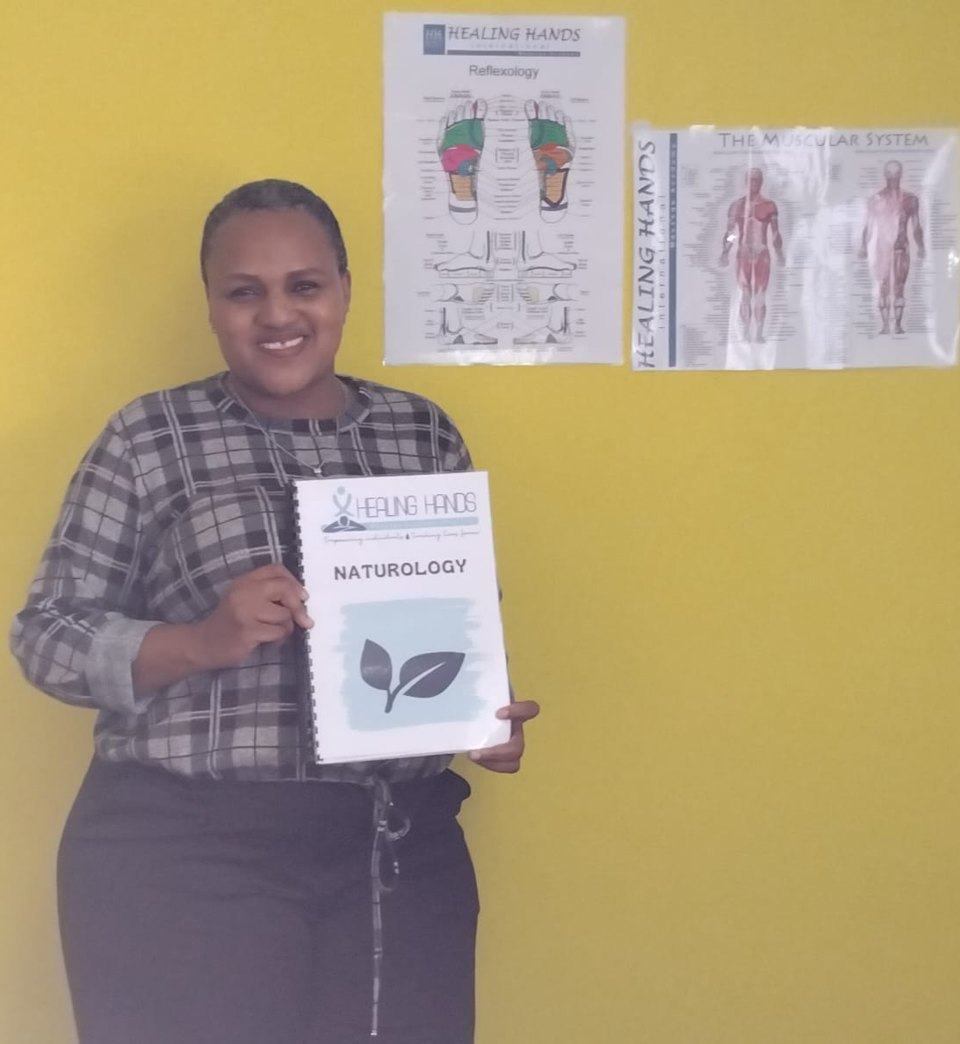
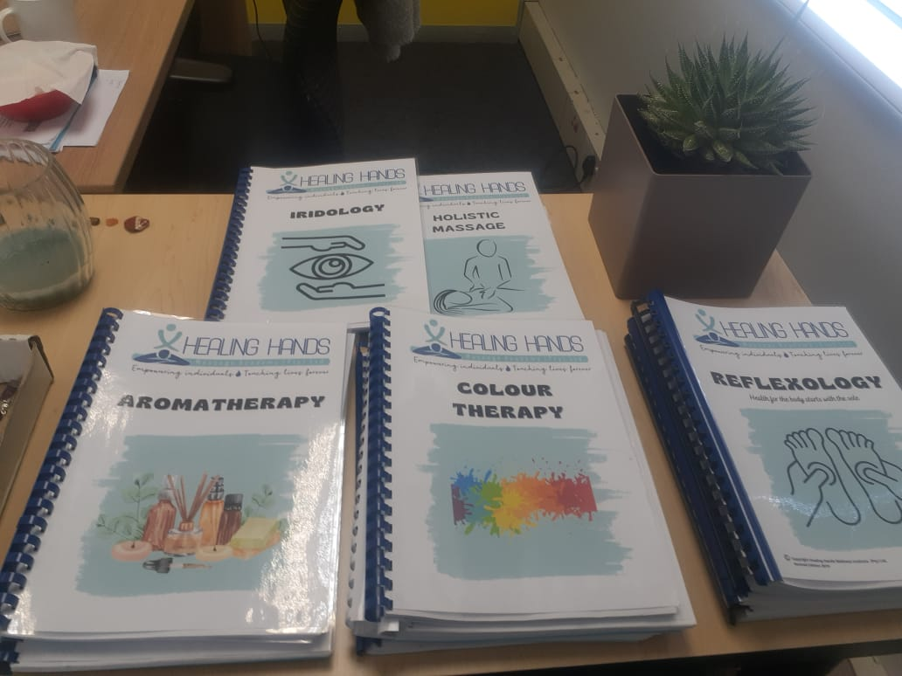
Change at the individual level
Working with GL presents an opportunity to deepen my understanding of trauma and healing, particularly in diverse contexts where healing is needed most. I strive to continuously expand my knowledge of wounding, recovery, and the nuanced paths to transformation.
As a trained trauma interventionist and complementary therapist, my work is rooted in lifelong learning. Engaging with GL will not only refine my skill set but also challenge and expand my perspectives, allowing me to grow both personally and professionally—ultimately enhancing the impact of my healing work in communities.
This is part of my workspace at the office. I am always a student, learning about more ways to enable and facilitate healing. GL allows me to apply this learning to communities and individuals who cannot access help.
Women’s Voice and Leadership Learning and Sharing Summit 2025

Slide 7
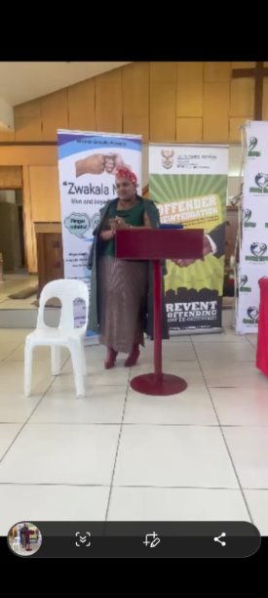
Achievements at community level
We aim to engage 20 CBOs in our healing programs and 90 CBOs in a destigmatization campaign that will shift societal perceptions around trauma and healing.
The heart of our work lies in the belief that true healing has the power to transform. When individuals heal, over time, they break free from the cycles of violence and abuse. Our goal is to ignite a movement that positions healing as a critical GBVF prevention strategy—showing that when people heal, the cycle of harm is disrupted.
Our innovative approach focuses on working with CBOs themselves first, empowering them to heal before teaching them how to guide others through their healing process. By strengthening the CBOs from within, we ensure they are equipped to create lasting, transformative change in their communities.
Part of my presentation at an ex-offenders integration programme
Women’s Voice and Leadership Learning and Sharing Summit 2025

Slide 8
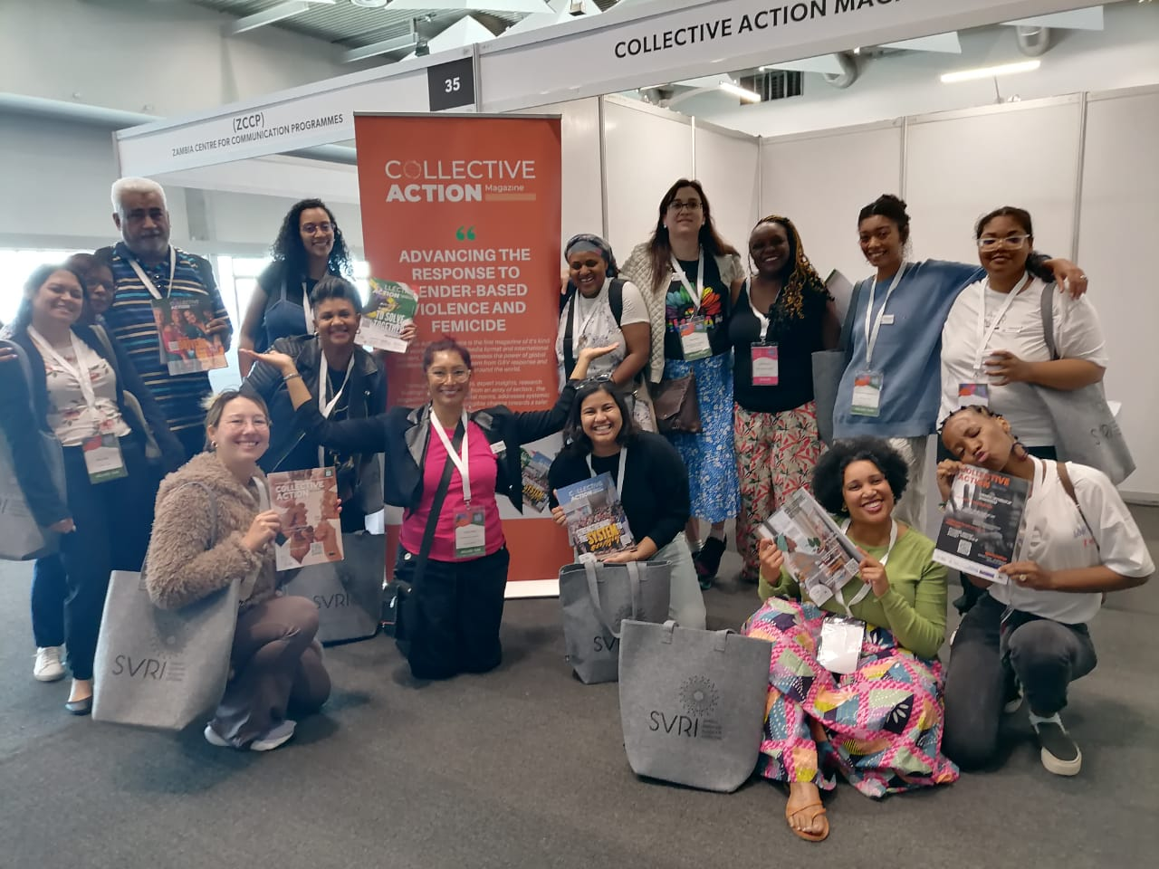
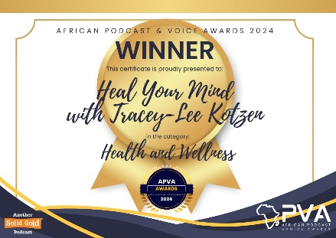
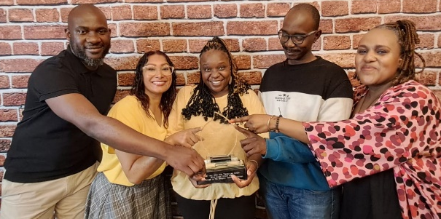
Achievements at societal level
There is still a significant gap in the focus on mental health and emotional wellness, particularly when it comes to understanding the critical role trauma plays in overall well-being. In the work I am leading, we are challenging misconceptions and stigma surrounding mental health, using innovative messaging and methodology to create a cultural shift towards trauma-informed healing.
We have already expanded our reach into global arenas, further solidifying our impact on a broader scale. In addition, we were honored to be appointed to manage and facilitate the wellness center at the SVRI International Forum 2024 in Cape Town, providing a dedicated space for mental wellness and healing during this event.
MWI assembled and lead the team of wellness professionals for the global SVRI Forum 2024
We are currently the title holders of the best health and wellness podcast on the continent
Women’s Voice and Leadership Learning and Sharing Summit 2025

Slide 9
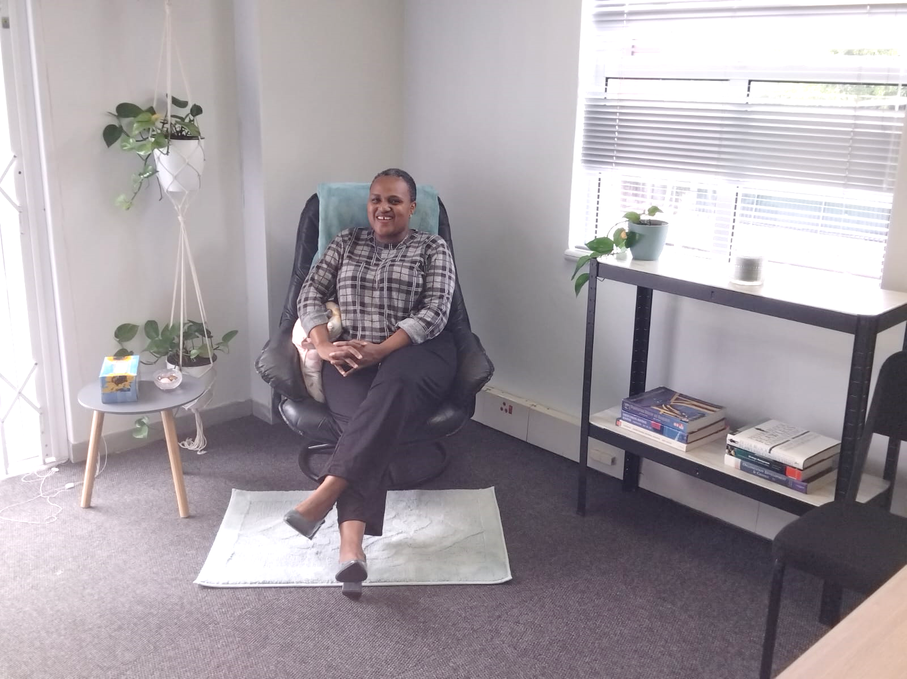
Leadership qualities
I am deeply passionate about both personal and collective healing, and this passion fuels everything I do. My leadership is anchored in perseverance, courage, and compassion.
I am committed to making healing tools accessible to individuals and communities, particularly those who would not otherwise have access, ensuring they receive these resources at ZERO cost.
In addition, I strive to shift organizational policies to prioritize mental wellness, believing that structural change is key to fostering long-term healing. My leadership is grounded in the values of empathy, integrity, and a deep respect for the human experience—ensuring that every person I work with feels seen, heard, and valued.
Me, in our client consultation room. My leadership is not about authority, but about serving others with humility, compassion, and a fierce belief in the power of healing to change lives and society.
Women’s Voice and Leadership Learning and Sharing Summit 2025

Slide 10
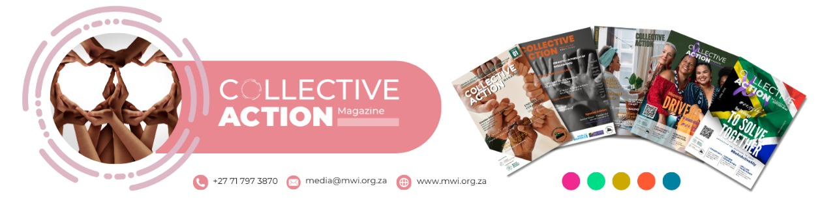
Contribution to gender equality
Through the programs and initiatives I lead, I strive to empower survivors, support gender-inclusive healing, and work towards the dismantling of harmful gender norms that perpetuate violence.
A key part of my contribution to gender equality is our publication of the Collective Action Magazine, a world-first initiative aimed at advancing the global response to gender-based violence. This publication serves as a platform to share innovative approaches, success stories, and resources that support women’s rights and gender equity on a global scale. As we continue to publish and grow this magazine, we are not only raising awareness but also actively contributing to the global movement for gender justice.
Additionally, I am dedicated to ensuring that mental wellness programs for both men and women address gender-specific needs, supporting healing without reinforcing gendered stereotypes.
Our magazine has over
78 359 readers worldwide
Women’s Voice and Leadership Learning and Sharing Summit 2025

Slide 11
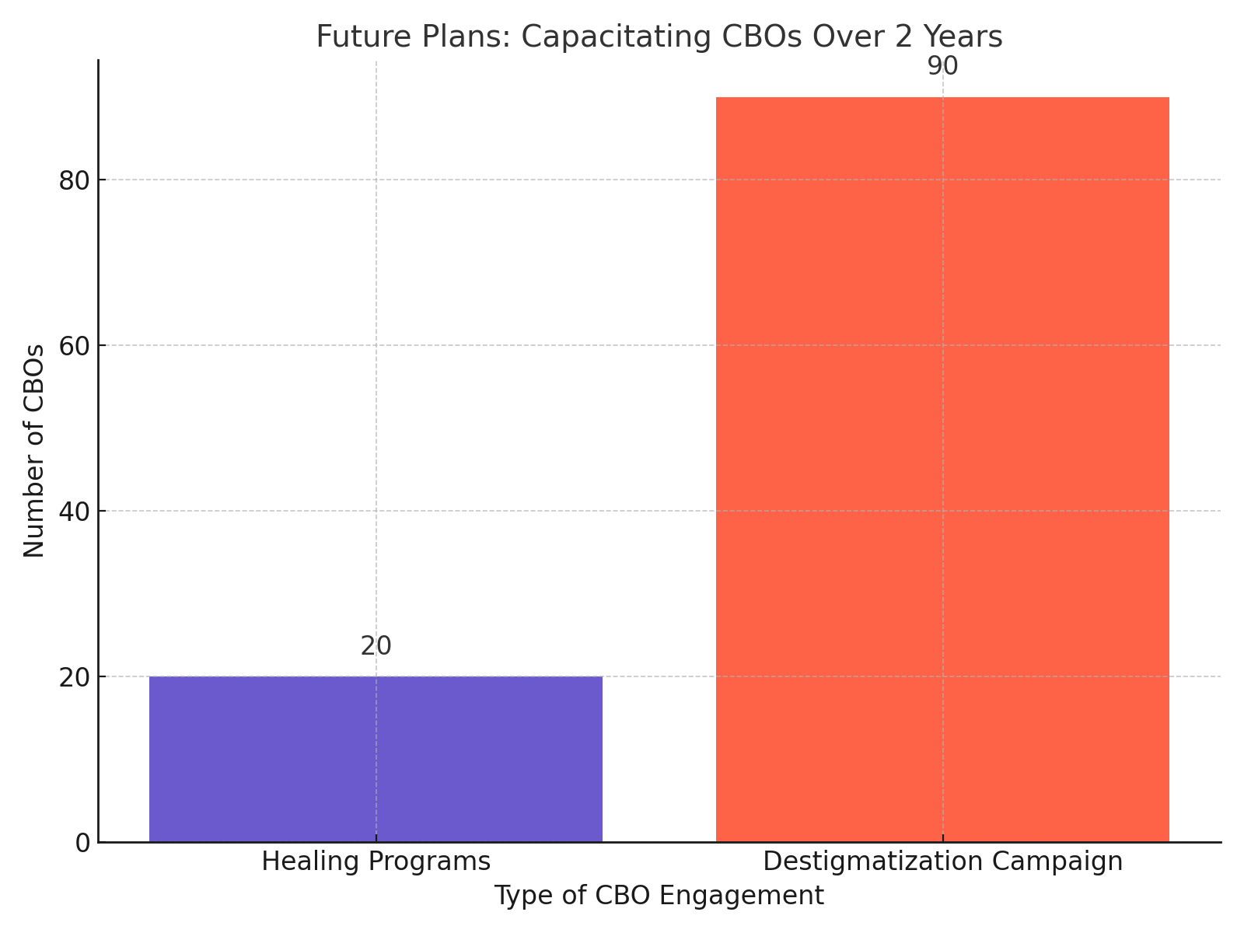
Next steps
Our future plans are centered around empowering community-based organizations (CBOs) to become active agents of healing and change within their communities. Over the next two years, we aim to capacitate 20 CBOs in trauma healing programs These programs will provide CBOs with the knowledge and tools to offer transformative healing experiences to survivors, helping to create healthier, more resilient communities.
Additionally, we plan to engage and support 90 CBOs through a destigmatization campaign, which will challenge harmful societal norms and perceptions surrounding mental health and trauma healing.
Women’s Voice and Leadership Learning and Sharing Summit 2025

