Slide 1

Voice and Choice Summit 2026-Organisational Development Finance & Compliance Category
Your logo goes here
Title
Please use your own photos to make your presentation unique.
Quotes and any other visuals make your presentation more engaging!
Voice and Choice Summit 2026 \ Voice and Choice Summit 2026

Slide 2
Synopsis– brief overview what this is about
Name | Elvis “Foxy” Hochobeb
Designation | Finance Manager
Organisation | MPower Community Trust
Country | Namibia
Category | Organisational Development – Finance & Compliance
Summary
Voice and Choice Summit 2026 \ Voice and Choice Summit 2026

Slide 3
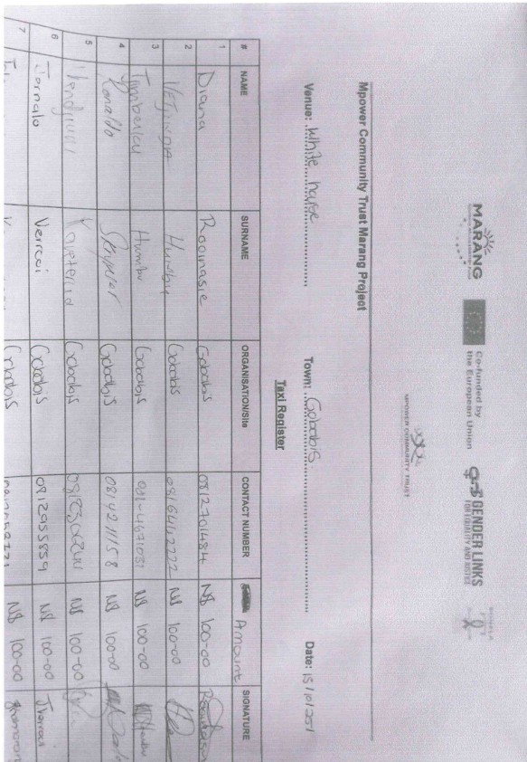
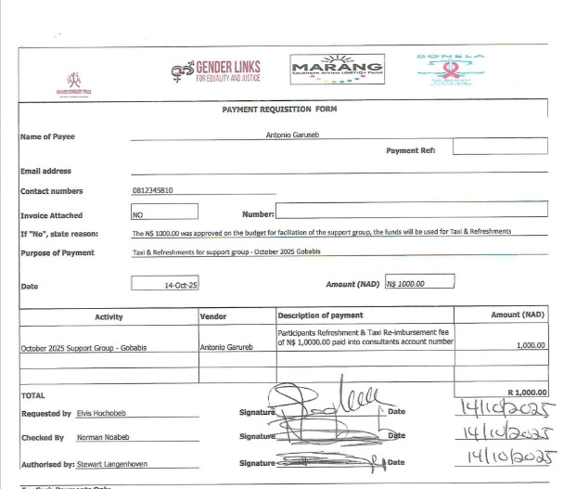
Background(problem, actions, change, evidence)
The project focused Strengthening governance, financial management, and compliance systems to improve accountability and transparency.
Before - supporting documents were often submitted late and not centrally stored, making monitoring and reporting difficult.
Introduced clearer compliance processes, centralised document storage, and consistent use of QuickBooks to strengthen financial controls
Voice and Choice Summit 2026 \ Voice and Choice Summit 2026

Slide 4
Background(problem, actions, change, evidence)
What actions have you taken to address the problem?
What actions were taken by the organisation to implement these changes across the organisation?
Evidence: Include Photos or videos
Voice and Choice Summit 2026 \ Voice and Choice Summit 2026

Slide 5
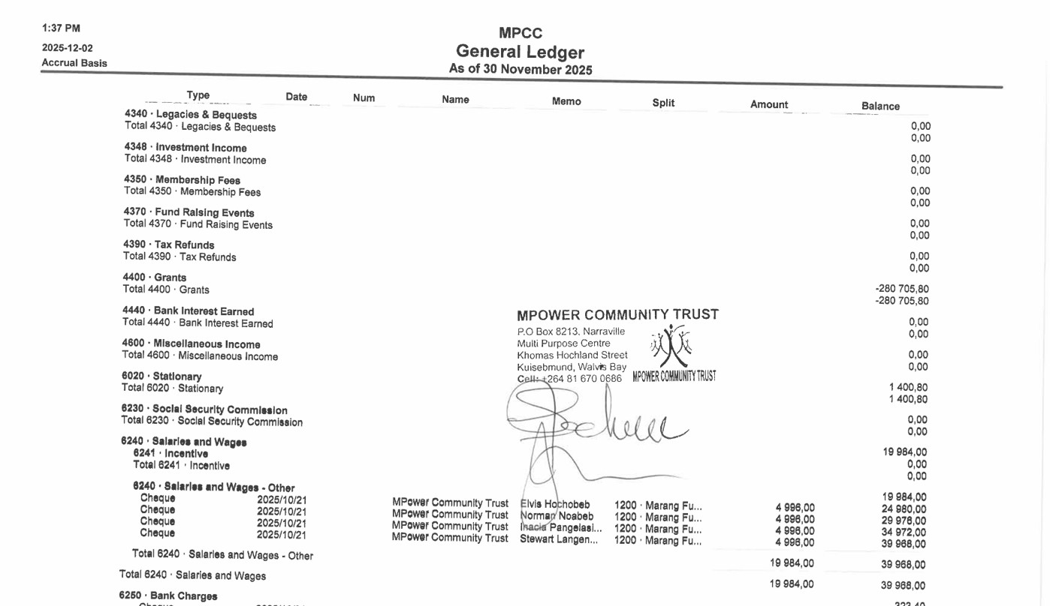
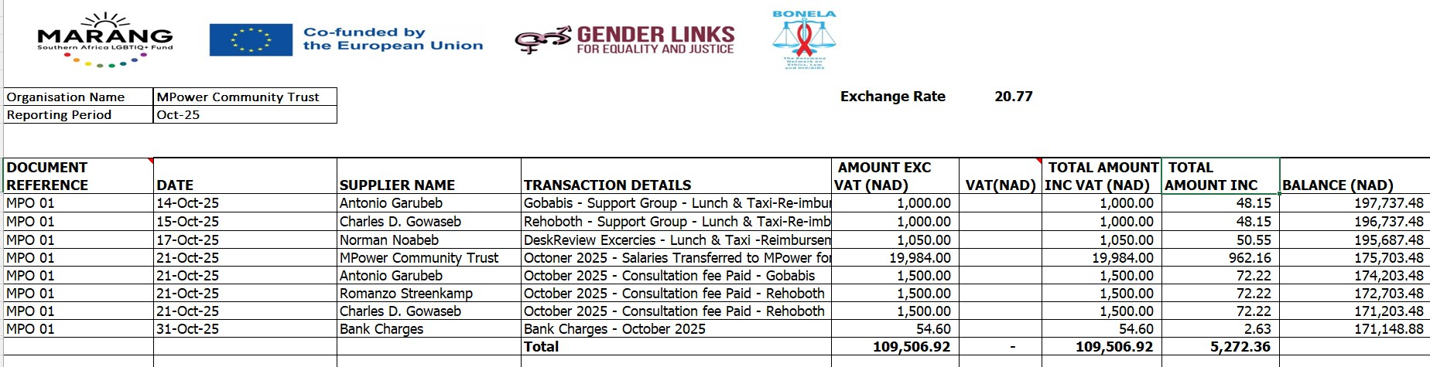
Finance Systems
Financial Systems in Use
QuickBooks – for core accounting and financial management
Excel – for report compilation and analysis
Voice and Choice Summit 2026 \ Voice and Choice Summit 2026

Slide 6
Compliance Status
 | Before due diligence | After due diligence
Financial system | QuickBooks and Excel financial reporting | MPower adopted the GL due diligence process to strengthen existing systems.
Separate bank account | MPower consistently used separate bank accounts for all implementing projects and donors. | MPower adopted the GL due diligence process to strengthen existing systems.
Two signatories to the account | Yes - Documented segregation of duties with multiple authorised signatories. | MPower adopted the GL due diligence process to strengthen existing systems.
Financial documentation | Documented policies, procedures, and operational manuals in place prior to the due diligence process. | MPower adopted the GL due diligence process to strengthen existing systems.
Monthly reconciliations and routines | Yes – managed through QuickBooks and supported by documented procedures and processes. | MPower adopted the GL due diligence process to strengthen existing systems.
Safeguarding policy | No – Mpower does not currently have a standalone safeguarding policy in place. | Requires GL to assist with safeguarding policy
Human resources policy | Yes - Ddocumented policies in place prior to the due diligence process. | MPower adopted the GL due diligence process to strengthen existing policies
Finance policy | Yes - Ddocumented policies in place prior to the due diligence process. | MPower adopted the GL due diligence process to strengthen existing policies
Procurement policy | Yes - Ddocumented policies in place prior to the due diligence process. | MPower adopted the GL due diligence process to strengthen existing policies
Board functionality | We operates with a functional Board of Members | MPower adopted the GL due diligence process to strengthen existing policies
Anti-corruption/Fraud Policy | Yes - Wwhistle-blower policy in place. | We will benefit from stand alone – antifraud Policy
Sexual Harassment Policy | Included in the HR Policy | We will benefit from a dedicated Sexual Harassment policy.
Monitoring and Evaluation Systems | MPower has moderate experience in this area | MPower will benefit from capacity building in this area, which was also documents ODS
Fundraising and Sustainability
Voice and Choice Summit 2026 \ Voice and Choice Summit 2026

Slide 7
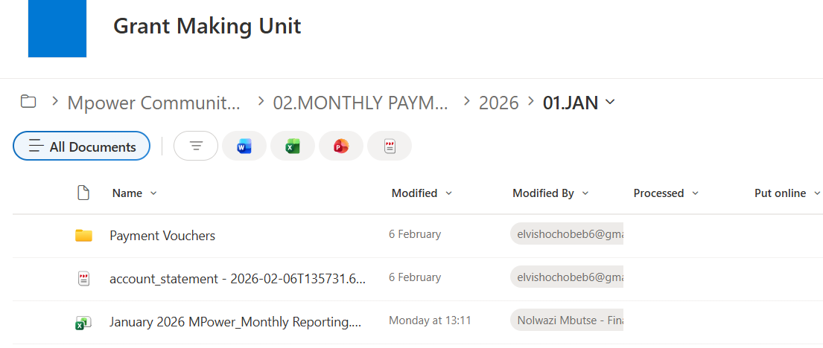
Financial filing
Financial filing is up to date through January 2026; February 2026 reports were not yet due at the time of this presentation.
Voice and Choice Summit 2026 \ Voice and Choice Summit 2026

Slide 8
Challenges & Lessons learnt
Challenges & Mitigation
Late submission of supporting documents – mitigated by couriering documents immediately after activities.
Delays in payments due to unavailable signatories – mitigated through proper planning.
Single QuickBooks license limiting timely updates – mitigated through scheduling and planning.
Difficulty convening full-time board members – mitigated by advanced planning of meetings.
Lessons Learned
Timely submission of documents requires proactive logistics.
Planning ahead ensures payments and approvals are not delayed.
Resource limitations, like a single QuickBooks license, need careful scheduling.
Board engagement improves with advance planning of meetings.
Voice and Choice Summit 2026 \ Voice and Choice Summit 2026

Slide 9
Next Steps
Plans
Submit the first bi-annual report due on 31 March 2026, to access the next disbursement for ongoing activities.
Finalise and utilise our database platform to document cases effectively.
Prepare for MPower’s first Pride event in June in Rehoboth.
RoundTable discussion with community and stakeholders (December) .
Voice and Choice Summit 2026 \ Voice and Choice Summit 2026

