Slide 1


Voice and Choice
Summit 2026-Marang Media LGBTIQ Category
Your logo goes here
Lack of Workplace Reforms Impede Economic Inclusion for Queer Persons
Voice and Choice Summit 2026 \ Voice and Choice Summit 2026

Slide 2
Name | Setho Poloko Mongatane
Designation | Assistant Programs Manager, Broadcast Journalist
Organisation | Gabz-FM
Country | Botswana
Category | Marang Fund Media Engagement
Summary | The story explores how economic exclusion continues to affect queer people in Botswana despite two landmark court victories: the 2016 registration case and the 2019 decriminalisation ruling. Asking the question, do court rulings translate to lived experiences?
Voice and Choice Summit 2026 \ Voice and Choice Summit 2026

Slide 3
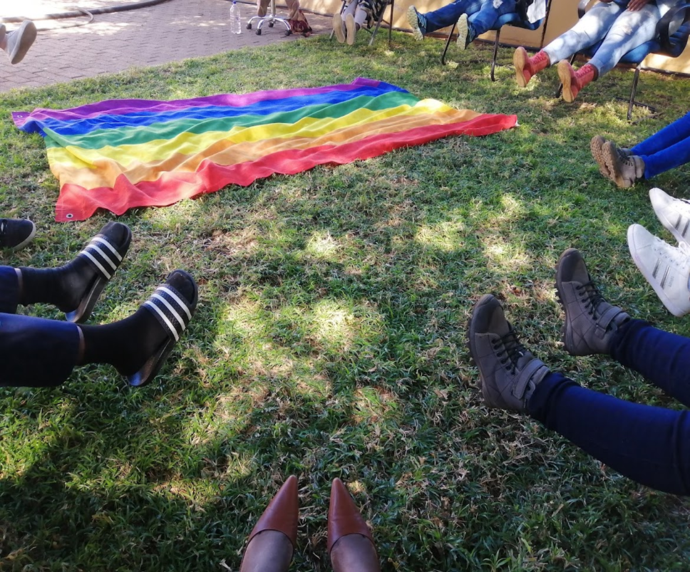
Background
Exclusion through legislature, religion and cultural norms shaped attitudes of people in Botswana
Legalization of queer organisations, same sex conduct has not always been a magic wand.
The story intended to investigate that though socio-political rights had been asserted, has the economical exclusion caused by discrimination also eliminated.
Could the people who are now living and loving openly get employed openly?
To test this one must look at employment opportunities, advancement in employment, presence of financial products matching those for heterosexual couple, products such as mortgages, insurance, medical aid etc.
To see if being queer doesn’t require more money to exist in Botswana, what is referred to as; Queer or Pink Tax.
Voice and Choice Summit 2026 \ Voice and Choice Summit 2026

Slide 4
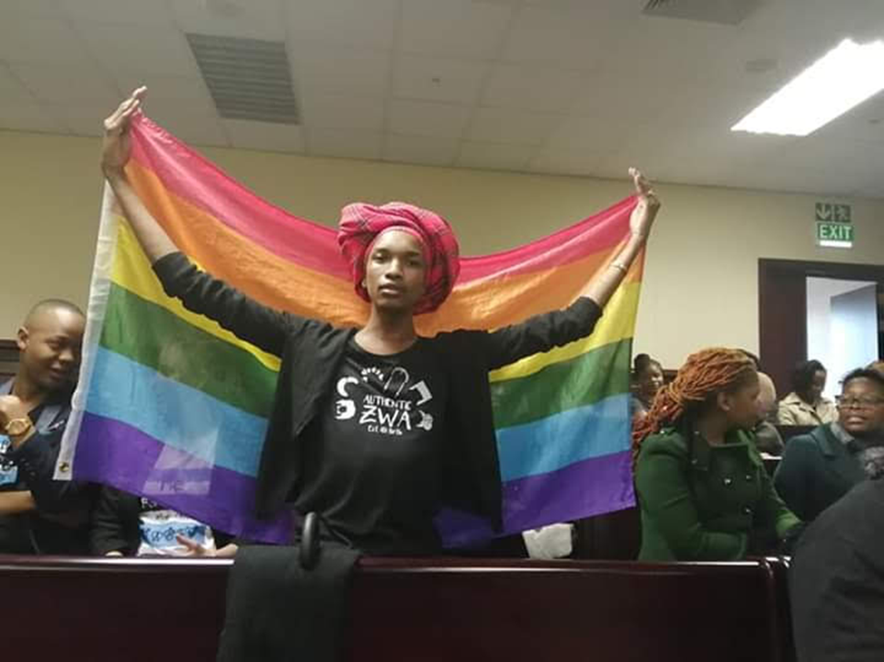
Background
In the spirit of nothing for us without us, the investigation sort to firstly get queer persons to share their lived experiences, - personal stories on access to employment, financial assistance, land acquisition. Further more pink or queer tax was also explored as an economic barrier
Representatives of Queer community, advocacy bodies such as LEGABIBO, Banana Emoji Club, to find out if any programing exists that aims to bridge the economic gap.
Statistics Botswana - if indeed economic statistic are kept and if so, what do they indicate, from employment, to income brackets, to land/asset ownership
Financial Institutions- since queer person are excluded from marriage, are there alternative products for life partnerships and other coupling alternatives.
Decriminalization Victory 2019. Depicts that the personal is political, that justice must be felt in everyday, at individual level
Voice and Choice Summit 2026 \ Voice and Choice Summit 2026

Slide 5
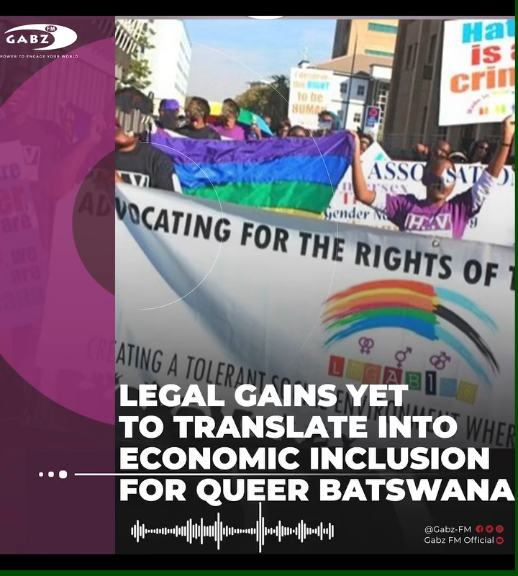
Synopsis – The Media Contribution (LGBTIQ Focus)
Radio & Online story (Facebook)
LEGAL GAINS YET TO TRANSLATE INTO ECONOMIC INCLUSION FOR QUEER BATSWANA
Despite landmark legal victories in Botswana, members of the queer community say economic inclusion remains limited.
Botswana recognized LEGABIBO in 2016 and decriminalized consensual same-sex conduct in 2019.
However, community members say these gains have not translated into financial security.
Voice and Choice Summit 2026 \ Voice and Choice Summit 2026

Slide 6

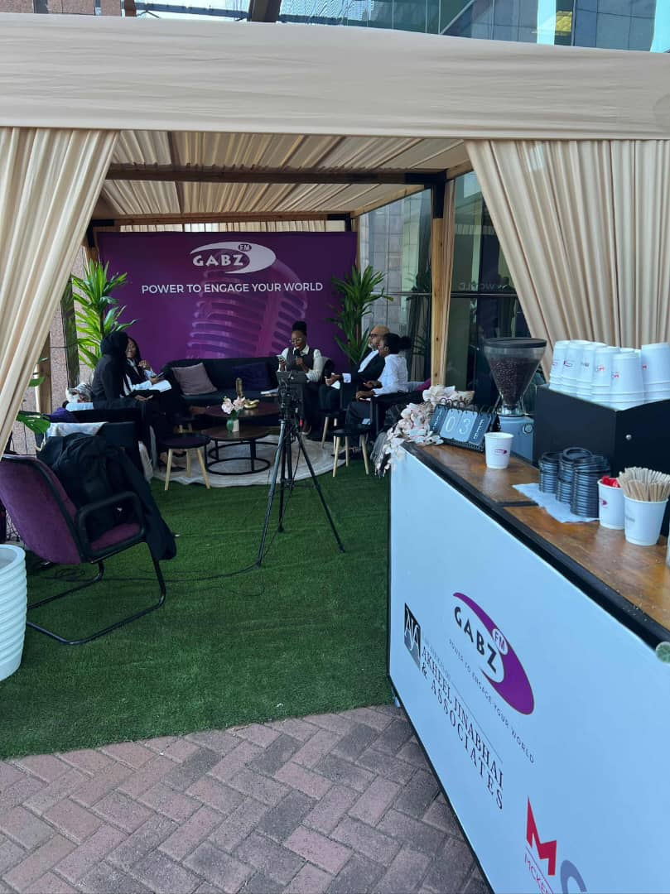
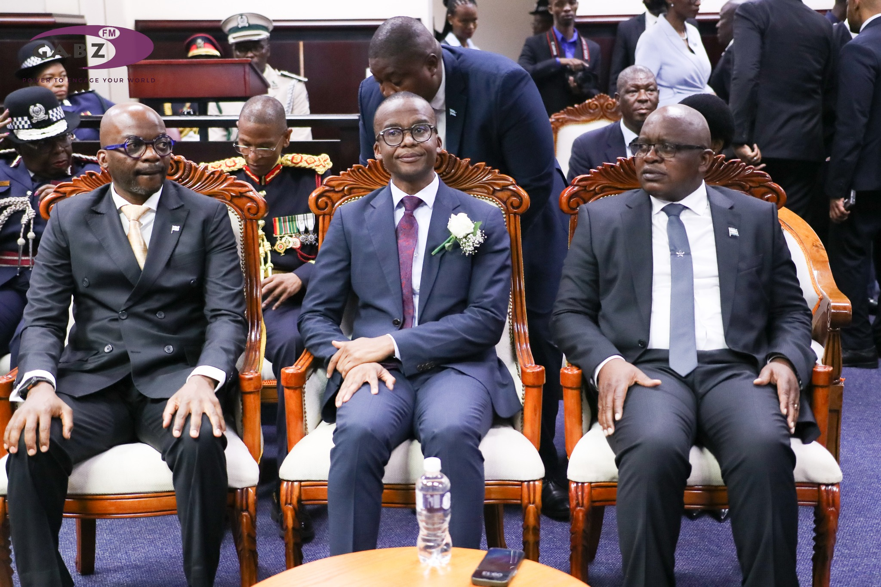
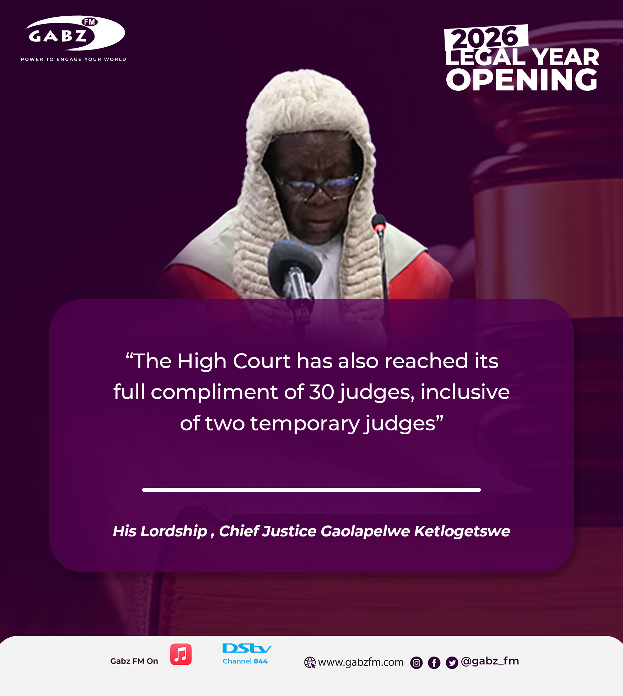
Synopsis – The Media Contribution (LGBTIQ Focus)
The Primary audience for this was;
The Public; to see if institutions are efficient and can provide our vision 2036, prosperity for all
Advocacy community; to see where the gaps are and create targeted programing
The Business Community; to provide inclusive employment spaces
Judicature; this was aired on the day of the legal 2026 year opening where the theme “The Court as a Public Service” to see if indeed the court and its judgement were serving lived justice. GabzF-m was broadcasting live from the High Court, centering the conversation
The legislature: (lead by Speaker, present at Legal Year Opening; to follow up set Jurisprudence with practical statutes to ensure inclusion
To ensure ethical coverage;
firstly the voices of queer persons and their advocacy bodies were ensured to lead the story to reflect real lived experiences, these where however kept anonymous for protection
Secondly, the story was read across 3 bulletins to ensure high reach and loaded on Facebook the day following legal year to continue the conversation
Hateful comments on Facebook were removed but those that were divergent but sparking discourse were allowed.
Though the business community failed to give their side, this was represented in the story to indicate balance
Voice and Choice Summit 2026 \ Voice and Choice Summit 2026

Slide 7
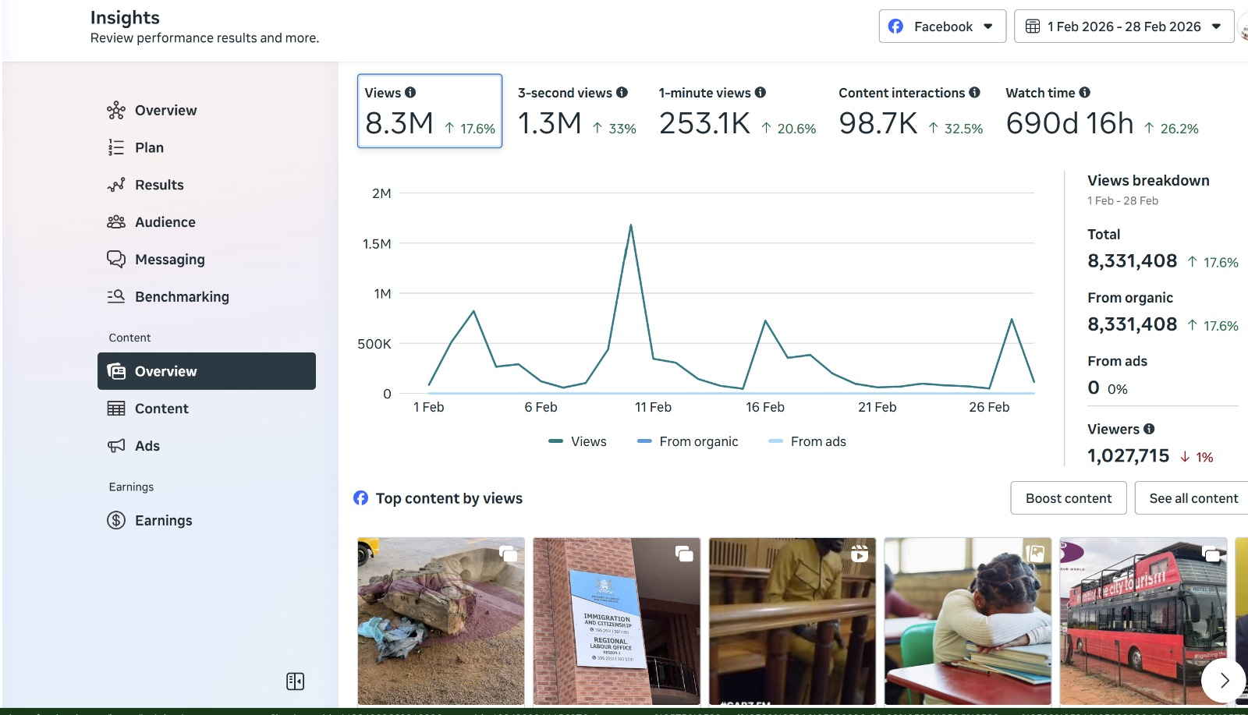
Change
• Radio Story ran for 3 bulletins that was also posted on our online platforms e.g. Facebook, 800k views on the day loaded.
1.6k people watched the video to the end
The central message was that 10 years on after registration case and 5 years on after decriminalisation case there is still not much tangible evidence that lived experiences have been affected by the decriminalization court gains when it comes to economic inclusion.
It also included multiple stakeholders to show that solutions need us all
Facebook Statistics for GabzFm FB Page February 2026.
Voice and Choice Summit 2026 \ Voice and Choice Summit 2026

Slide 8
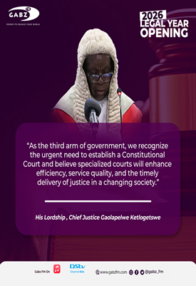
Change
Queer rights discourse have been mostly centred around political and social rights. The story was intended to show how being free should be extended to having means.
To the everyday citizen was given perspective on the difficulties/barriers to economic inclusion of queer persons. This is intended to inform for better engagement when speaking to public policy development. There is also been conversation currently áround the establishment of a Constitutional Court. Will this be the platform to assert queer rights? what does the constitution say about these rights currently, how does it affect everyone including queer person
It gave light to the intersectionalities of safety or lack therefore leads to queer tax, because if its not a safe space, i cant walk, I have to take a taxi. If I cant be treated with respect at a public clinic, I have to pay for a doctor, I cant go to a concert and not pay VIP, when already, employment and advancing in the workplace is already challenged. So the pocket is also affected by hate, not just my right to be.
Voice and Choice Summit 2026 \ Voice and Choice Summit 2026

Slide 9
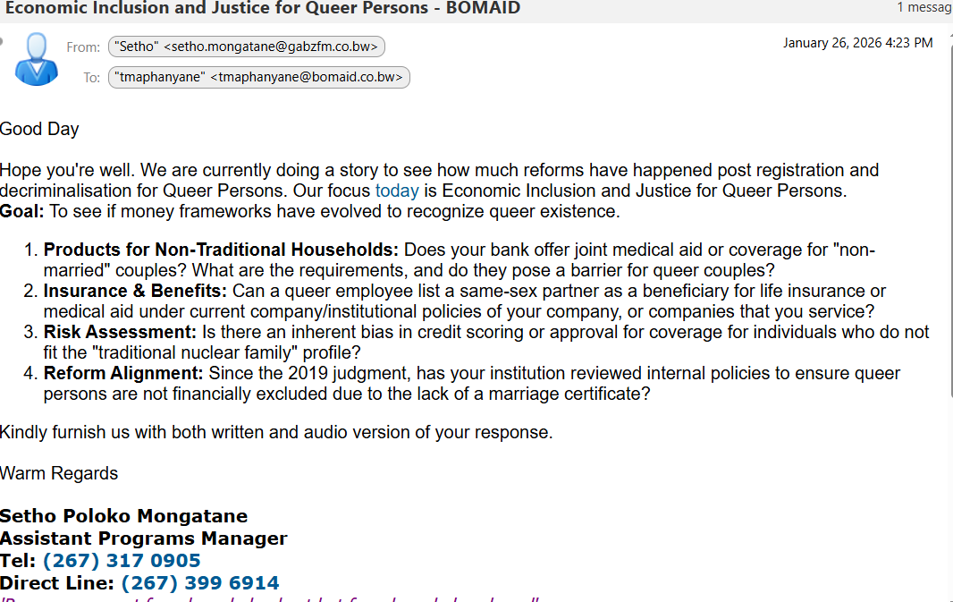
The change/ Impact
Awareness raising that court judgment should impact lived experiences, that is how justice is delivered
Strengthening accountability, is the constitution that asserts lack of discrimination practiced in the republic, without knowledge, the public cannot question
Our interview with Statistics Botswana also specifically showed that no data has yet been collected in relations to queer persons, and even the already existing data only recognised two genders and was not nuanced for non binary. The agency spoke to us on how this could be done and who to follow up with for there to be a policy change, they also said they would recommend to their supervisors that data must incorporate queer persons.
Without getting data and focusing on what the interpretations of that is? We therefore intend on interviewing ministers of relevant portfolios on what their plans are?
Critical Reflection: Though the business community gave us the run around and have not yet responded to our questionnaire, this has sensitized them to audit their employee benefits to see if they are inclusive
Change was Positive
An Example of the Questionnaire sent to Businesses
Voice and Choice Summit 2026 \ Voice and Choice Summit 2026

Slide 10
How do you score yourself?
 | 1-10
The story explicitly centres LGBTIQ communities, rights, lived realities, or meaningfully mainstreams sexual orientation, gender identity and expression, and sex characteristics (LGBTIQSC). | 9
The story meaningfully includes and fairly represents diverse LGBTIQ voices and lived experiences, giving appropriate weight to those most affected by the issue. | 8
The story reflects perspectives from both decision-makers and LGBTIQ people directly affected, clearly illustrating power dynamics and differential impact. | 9
All sources and subjects in the story are represented with dignity, respect, and agency, avoiding sensationalism, misrepresentation, or harm. | 10
The story challenges harmful stereotypes, stigma, and discrimination related to sexual orientation, gender identity and expression, and sex characteristics, and affirms diversity. | 9
Voice and Choice Summit 2026 \ Voice and Choice Summit 2026

Slide 11
How do you score yourself?
 | 1-10
The story contributes to informed public dialogue on LGBTIQ issues, rights, and social justice through education, advocacy, or critical reflection. | 10
Where data or statistics are used, they are accurate, contextualised, and appropriately disaggregated, or the limitations and gaps in available data are clearly acknowledged. | 7
The story takes a clear human right–based approach grounded in equality, non-discrimination, bodily autonomy, and dignity. | 9
The story demonstrates strong attention to privacy, safety, and security, including risk mitigation for participants and communities in restrictive or hostile environments. | 6
The story offers fresh, original, or under-represented perspectives on LGBTIQ issues and demonstrates editorial courage without exposing individuals or communities to undue risks. | 9
Voice and Choice Summit 2026 \ Voice and Choice Summit 2026

Slide 12
Challenges & Lessons learnt
Challenges & Mitigations
Business community failure to response made a key stakeholders side not represented. Escalated to business collectives to get data though them , will be represented as the story grows
Lots of feedback from Queer community but because of radio story it had to be compressed, so not all was aired. Organising a radio show with all stakeholders to give longer and allow for all voices to be represented
Statistics Botswana not collecting data was limiting to the story because only lived and anecdotal evidence was used, numerical data would have added weight to the story. In the future a poll or survey might be necessary to substitute government data
Without sensitizations, decision makers will continue to make products and take decisions from a Heteronormative gaze, It’s important to constantly write stories with a gender balance and inclusive eye.
Court Judgements are a piece of paper if they’re not enforced, justice is denied.
Voice and Choice Summit 2026 \ Voice and Choice Summit 2026

Slide 13
Sustainability
•Part 2 of the story has already been developed and questionnaires have been sent out to Government accounting officers to sensitize them on the findings of the story and finding out what
• An opportunity also exists (Part 3) where the story can be expanded to target different groups, queer women, queer men, gender non-conforming, trans-persons as well as gender diverse persons to look at how different economic challenges only affect one group versus the other. E.g, we have seen the pay parity statistics around men and women, how does this translate to queer persons. How does gender mismatched documents affect employment and access to services for trans persons. Is gender affirmation available with other free public services, if not, what is the financial burden for trans-persons to transition, why is it not provided public as a health service?
Voice and Choice Summit 2026 \ Voice and Choice Summit 2026

Slide 14
Next Steps
The part of the story has already been pitched and approved by the Editor and Marang team, Questionnaires have been submitted.
This part 2 is intended to hold Ministry of Labour & Home Affairs accountable in finding out what structural solutions they have put in place to allow for economic inclusion of queer persons. As the custodians of labour laws and policy, identity registration, they are better placed ensure employers offer equal opportunity for all the people of Botswana.
Additionally, an invitation has been passed to Unions to also give their perspective on what can be done to make Botswana workplaces inclusive, and to share what they have done in terms of advocacy to ensure said inclusion.
Since Banks and Medical Aids have failed to respond to our enquiries, the same questionnaires have been escalated to Non Bank Financial Regulatory Authority& Business Botswana for comment.
Voice and Choice Summit 2026 \ Voice and Choice Summit 2026

