Slide 1


Voice and Choice Summit 2026
Marang Media LGBTIQ Category
From Data to Dignity: Reframing Equal Rights in Mauritius
Nicolas FRICHOT (MAURITIUS) - L’express (print)
Voice and Choice Summit 2026 \ Voice and Choice Summit 2026

Slide 2
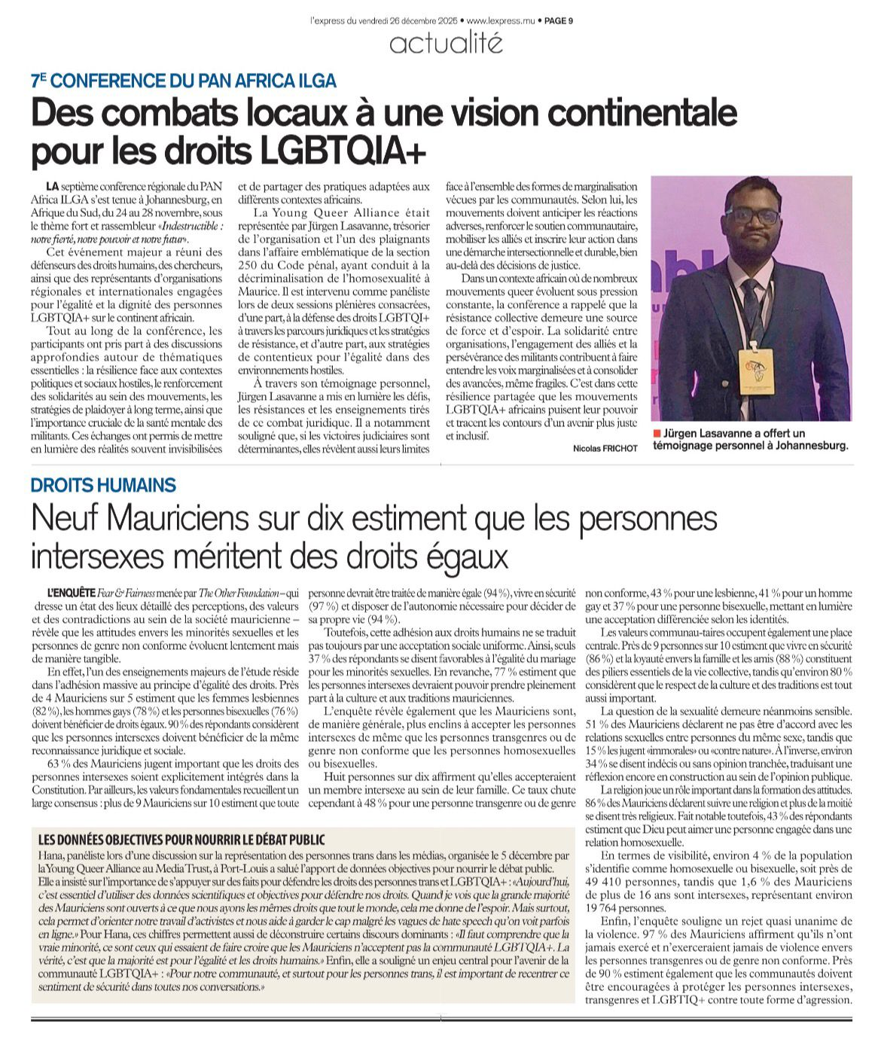

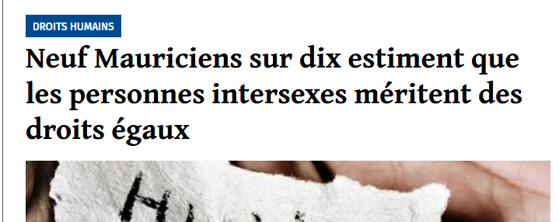

Synopsis
9 out of 10 Mauritians
support equal rights
for intersex people
Name | Nicolas FRICHOT
Designation | Journalist
Organisation | L’express
Country | Mauritius
Category | Media (print)
https://lexpress.mu/s/neuf-mauriciens-sur-dix-estiment-que-les-personnes-intersexes-meritent-des-droits-egaux-552827
Summary | A data-driven national feature showing that nine in ten Mauritians support equal rights for intersex people – reshaping the public debate around facts, safety, and human rights.
Voice and Choice Summit 2026 \ Voice and Choice Summit 2026

Slide 3
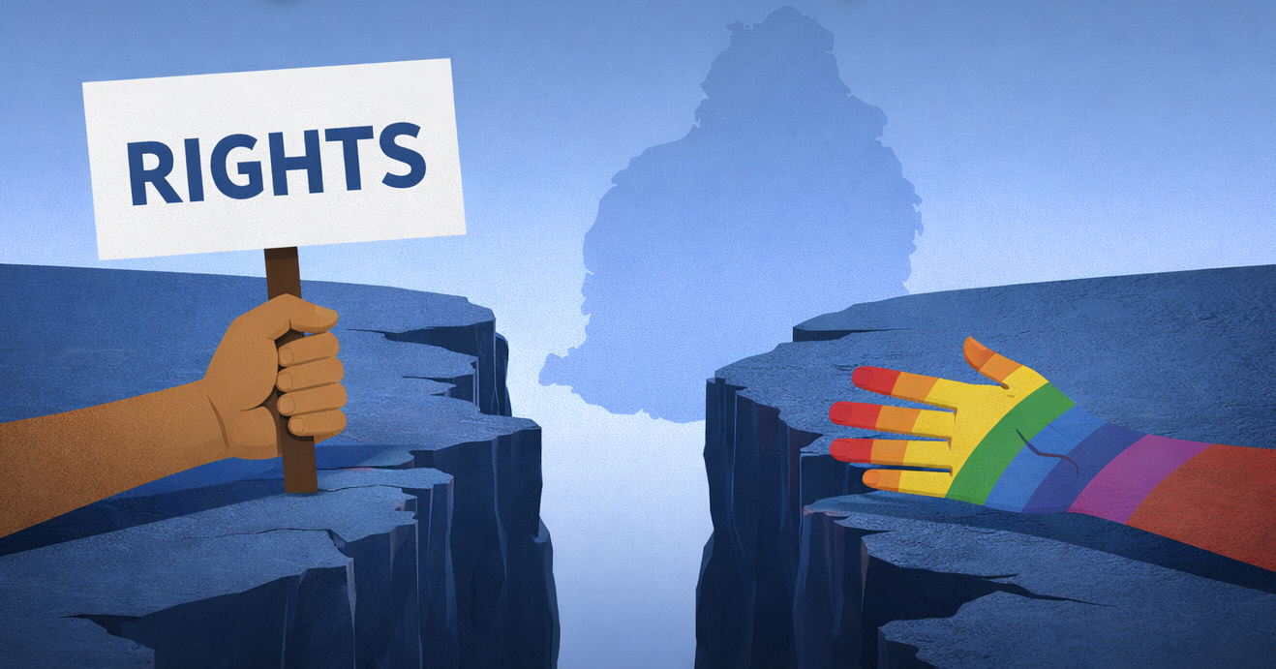
Background
Rights vs. Acceptance: The Gap
Although nine out of ten Mauritians support equal rights for intersex people, acceptance is still fragmented – especially around marriage, sexuality, and social life.
My work addressed the gap between rights and acceptance, using verified data to counter misinformation and ground the national debate in facts, equality, and human rights.
Voice and Choice Summit 2026 \ Voice and Choice Summit 2026

Slide 4
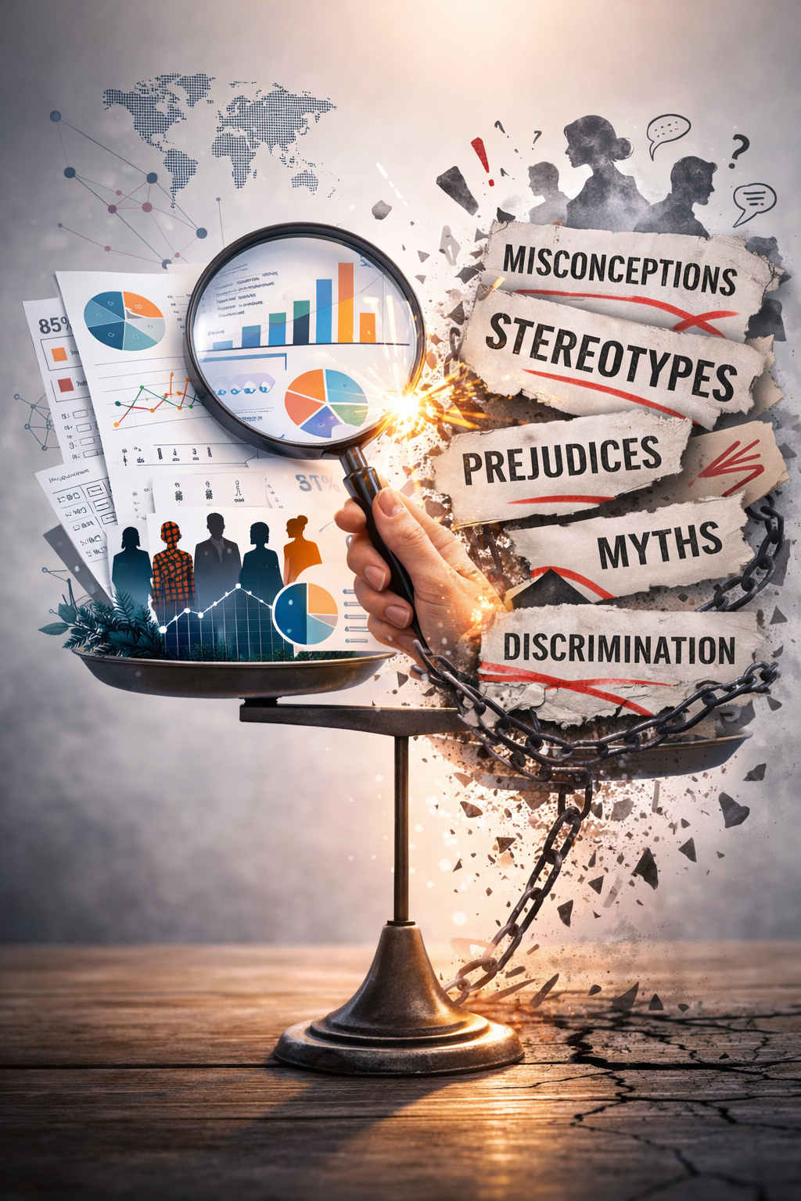
Background
Countering Stereotypes with Data
What actions were taken?
The article translated rigorous national survey data into a simple, clear, and impactful story, combined with lived testimony. It challenged dominant misconceptions and harmful stereotypes using verified evidence.
What change happened?
The debate shifted from perception to evidence. It strengthened the credibility and visibility of intersex and LGBTQIA+ rights, equipped advocates and decision-makers with solid data, and elevated the quality of public discourse.
Voice and Choice Summit 2026 \ Voice and Choice Summit 2026

Slide 5
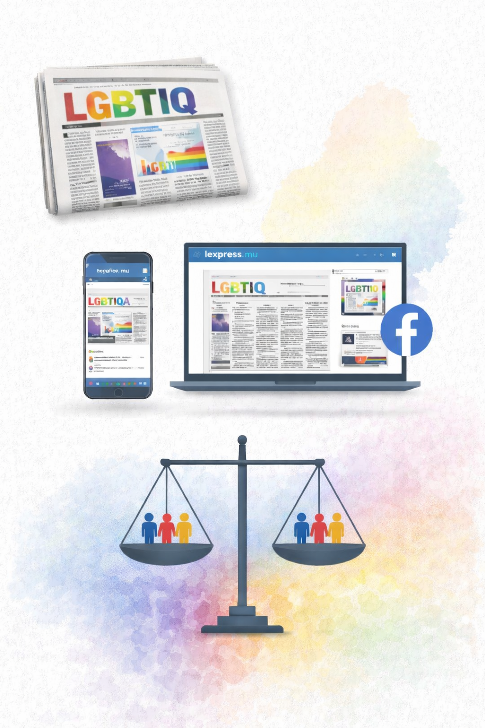
Synopsis
Media Format and Central Narrative
Type of media work produced:
A print in-depth feature article published in national newspaper, featured on a full page dedicated to LGBTIQ issues. The story was also published online and shared on l’express.mu Facebook page to reach a wider audience.
Central message/narrative:
The central message was that while most Mauritians support equal rights – especially for intersex people – social acceptance remains uneven. The article framed LGBTIQ issues as a matter of equal human rights and equal consideration under the law.
Voice and Choice Summit 2026 \ Voice and Choice Summit 2026

Slide 6
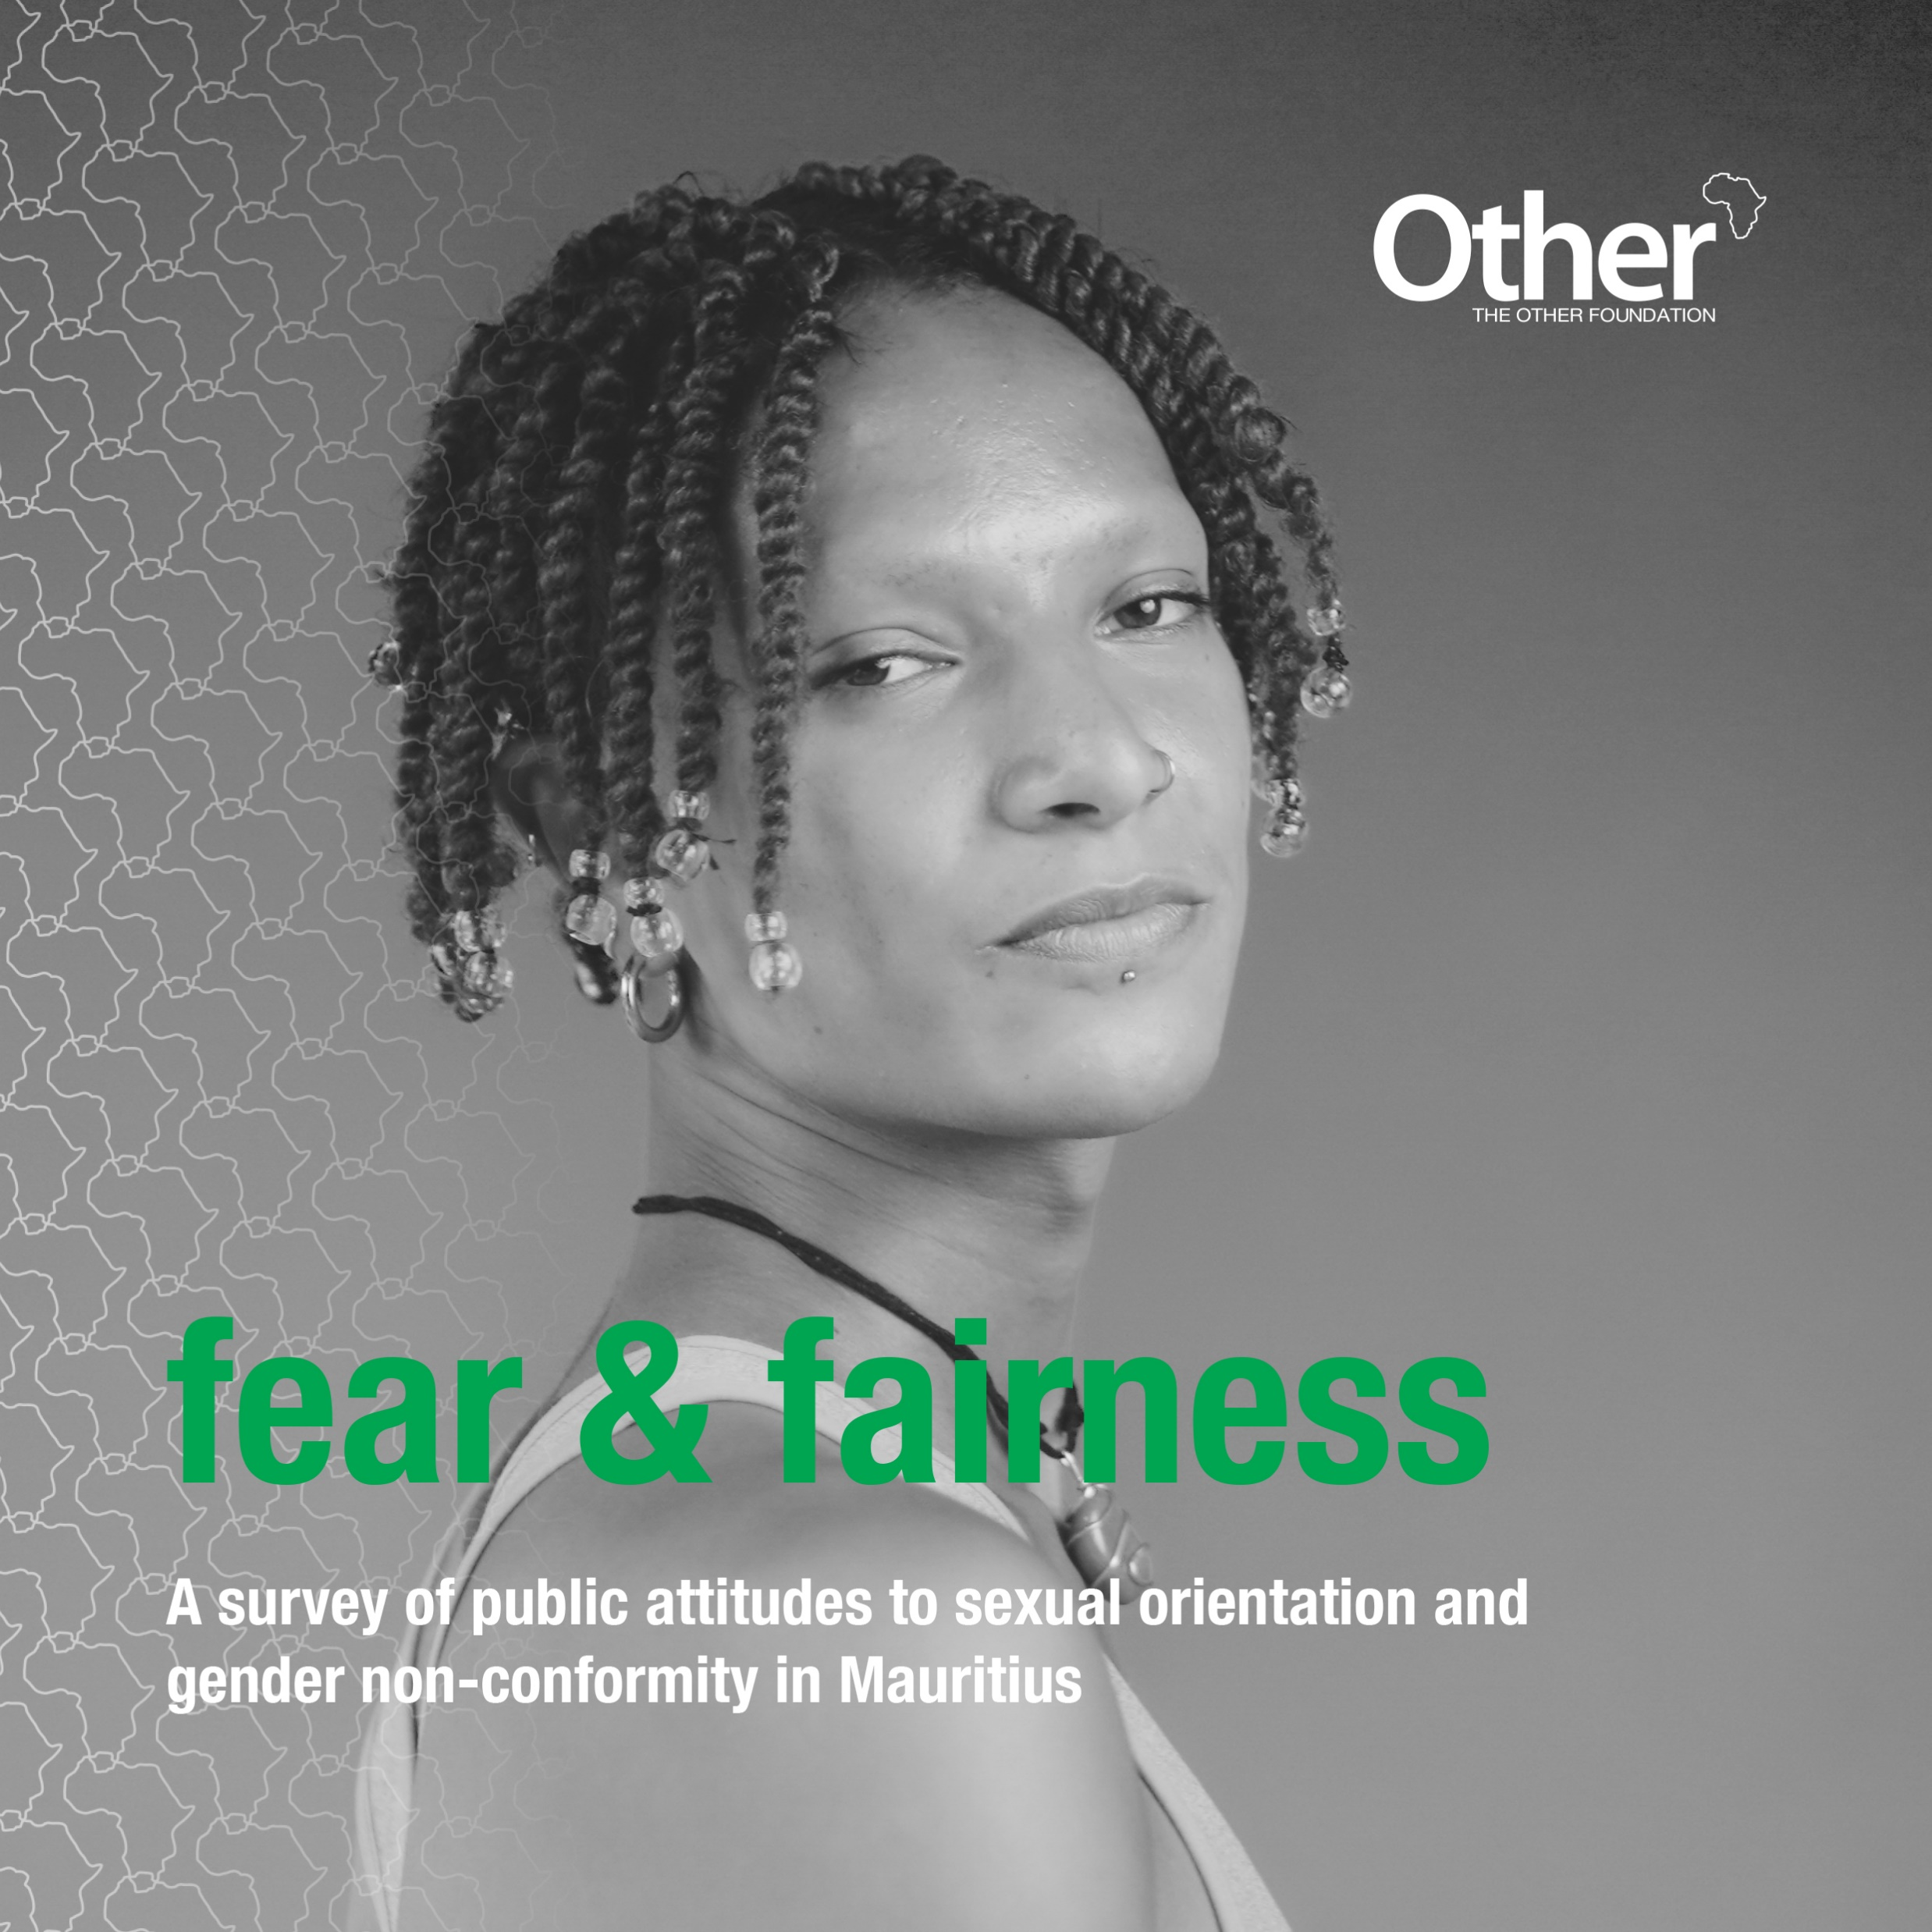
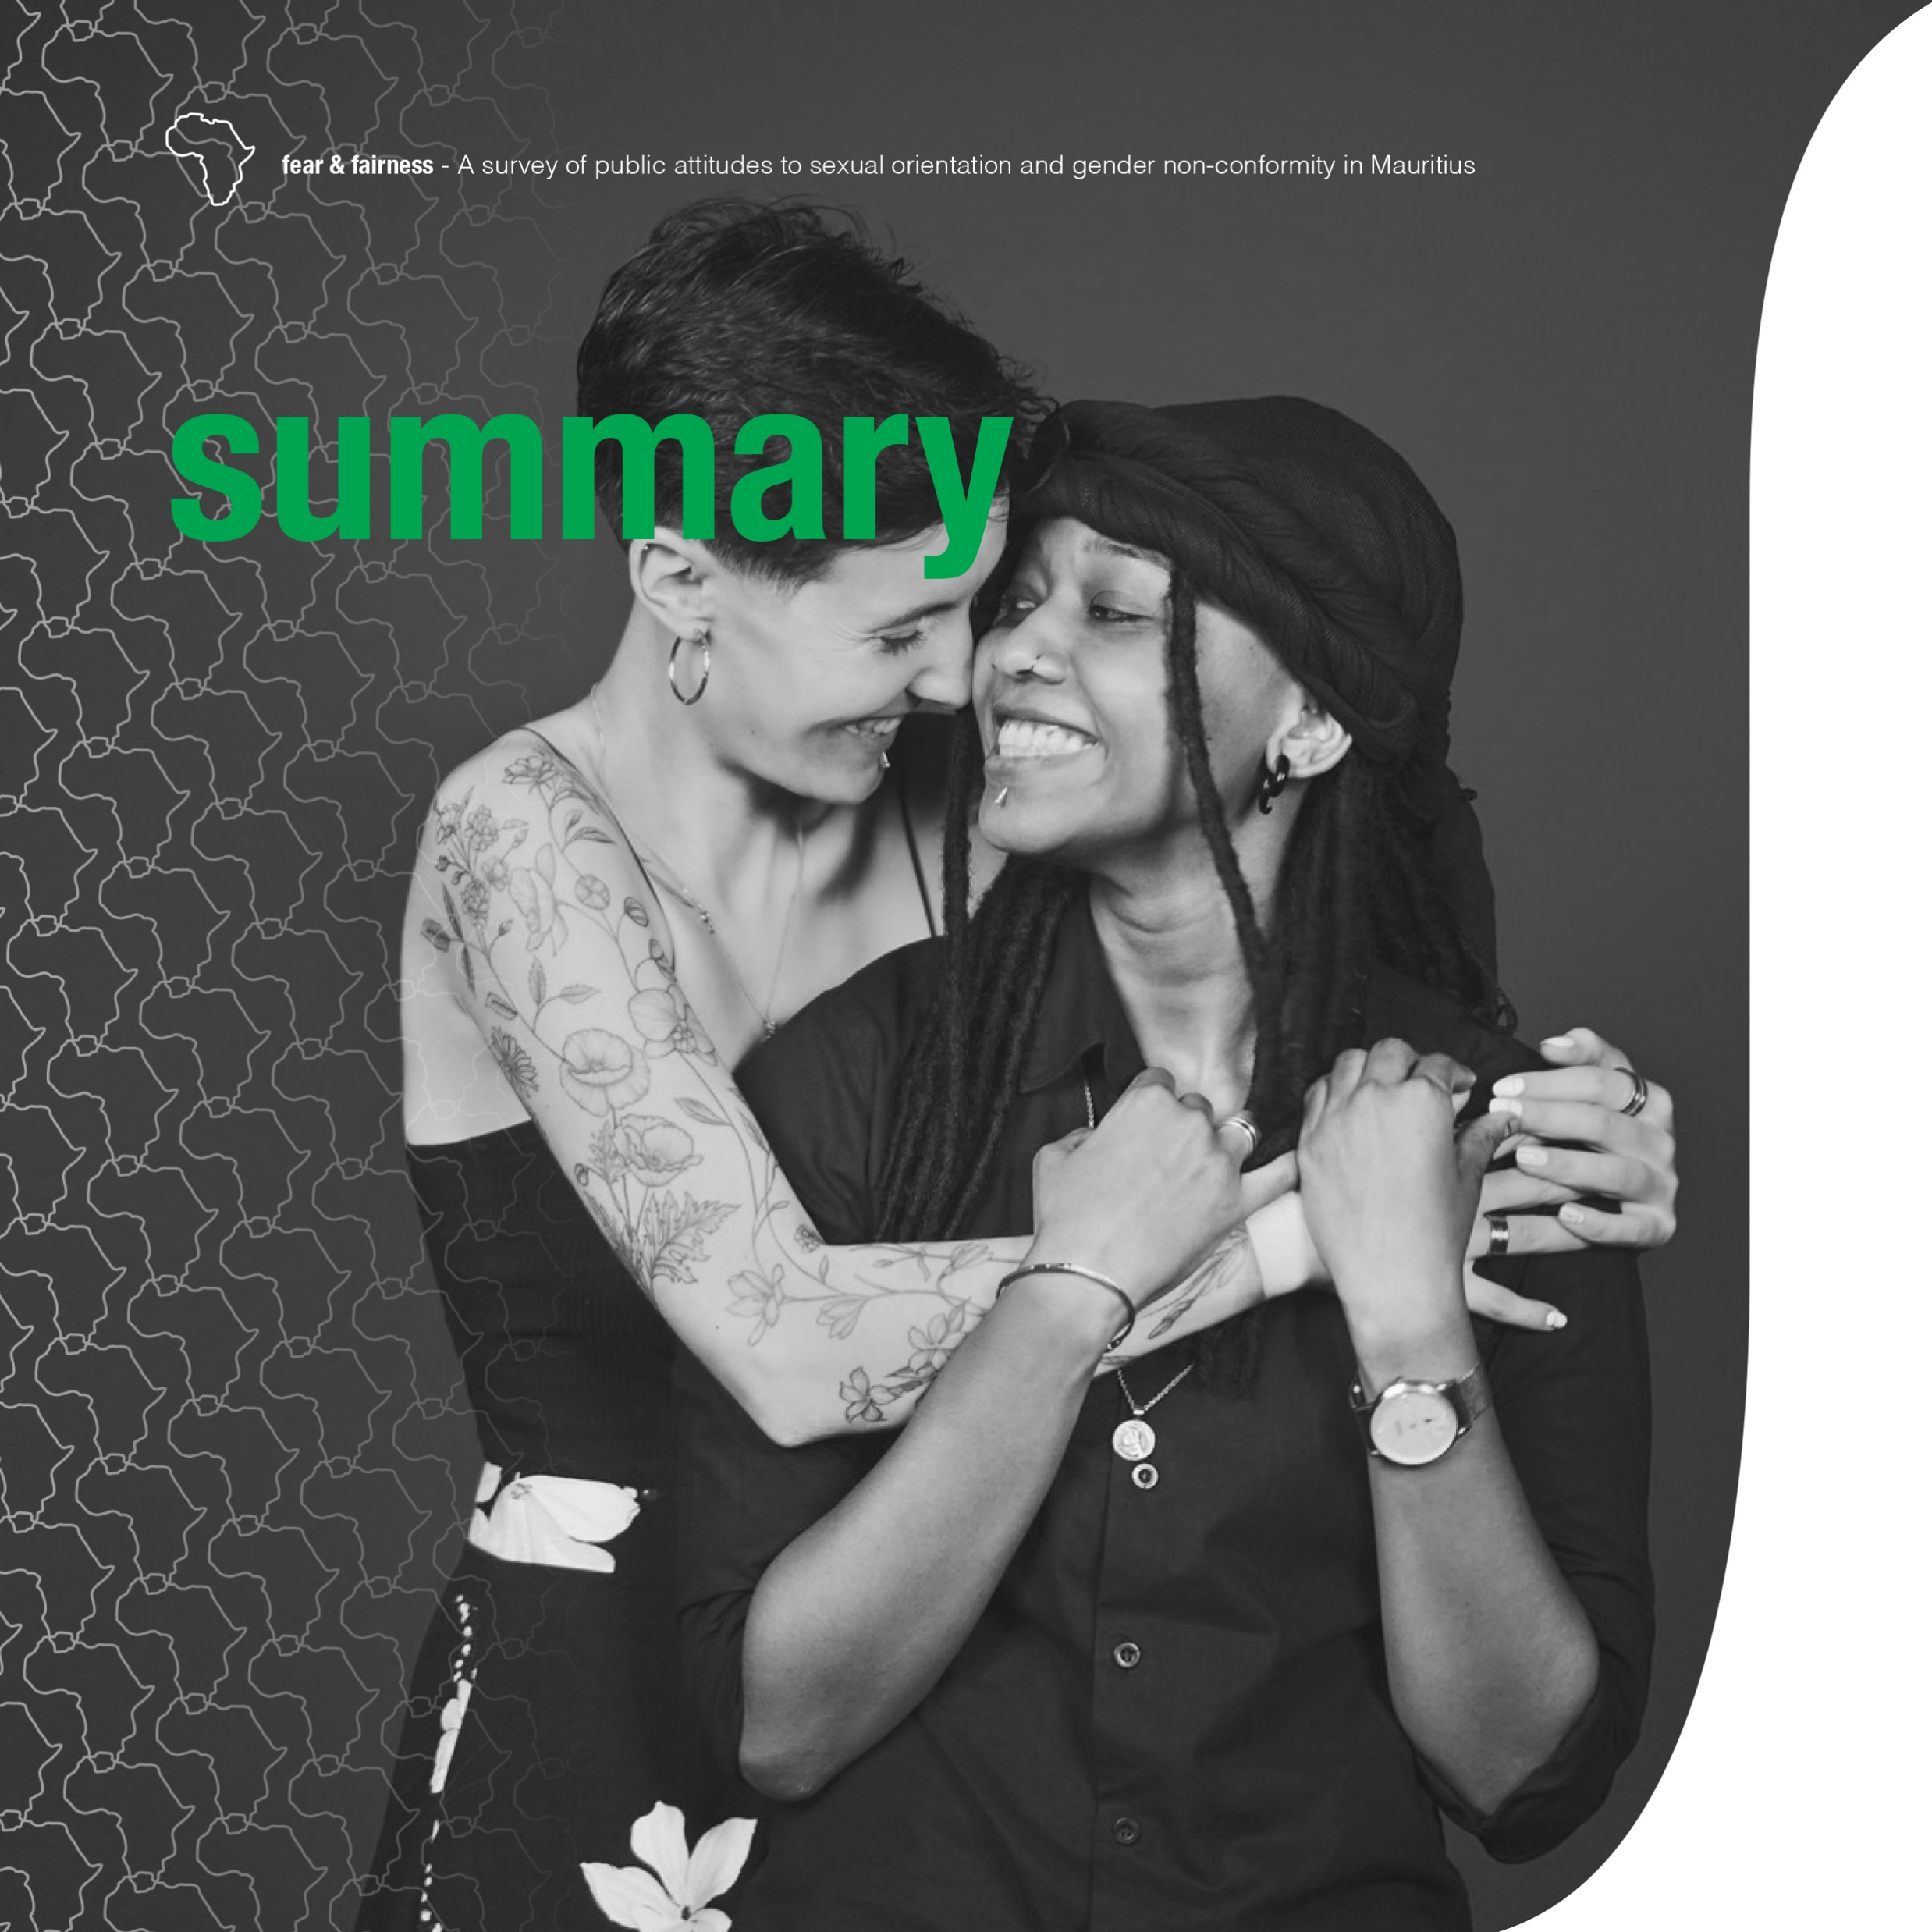
Synopsis
Reaching the Mainstream, Reporting Responsibly
Primary audience:
The general public in Mauritius, including opinion leaders, educators, and decision-makers who influence public discourse and social attitudes.
What made the coverage distinctive/responsible?
The coverage reframed the LGBTIQ debate from a perceived niche issue to a matter of universal human rights. It also brought intersex realities to the forefront.
The narrative integrated credible data and lived experience while prioritizing dignity, consent, and non-sensational reporting.
Voice and Choice Summit 2026 \ Voice and Choice Summit 2026

Slide 7

Change
From Publication to Public Debate
How did the article contribute to change?
The article generated over 100 comments on l’express Facebook page, sparking active public debate and encouraging readers to engage directly with the data on LGBTIQ rights
What role did the media work play?
The article brought the conversation into the mainstream. By publishing it in a national newspaper and online, it made discussion of intersex and LGBTIQ rights part of everyday public debate.
Voice and Choice Summit 2026 \ Voice and Choice Summit 2026

Slide 8
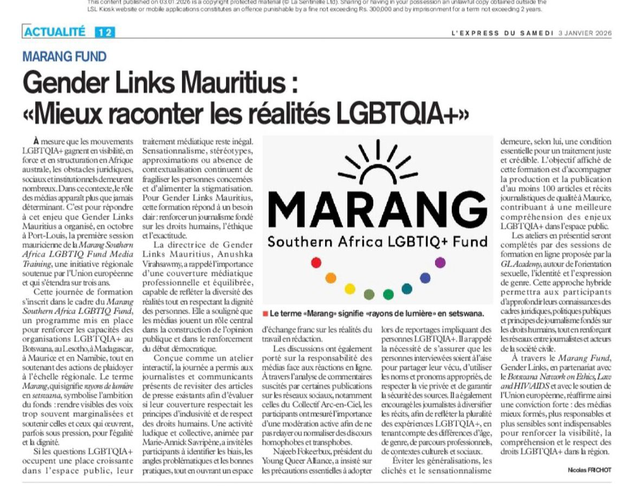
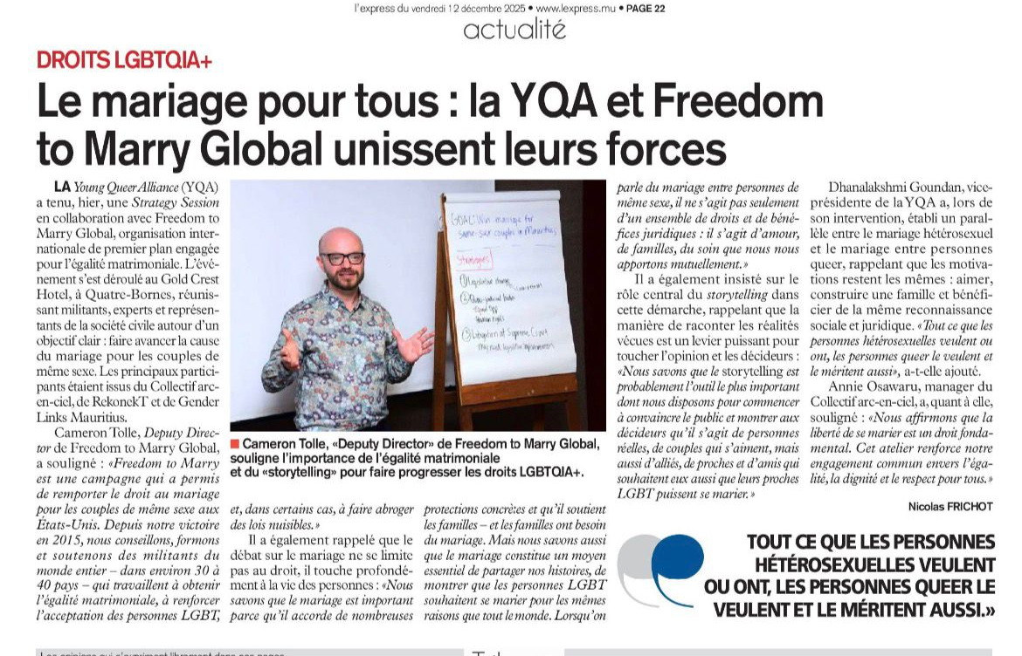
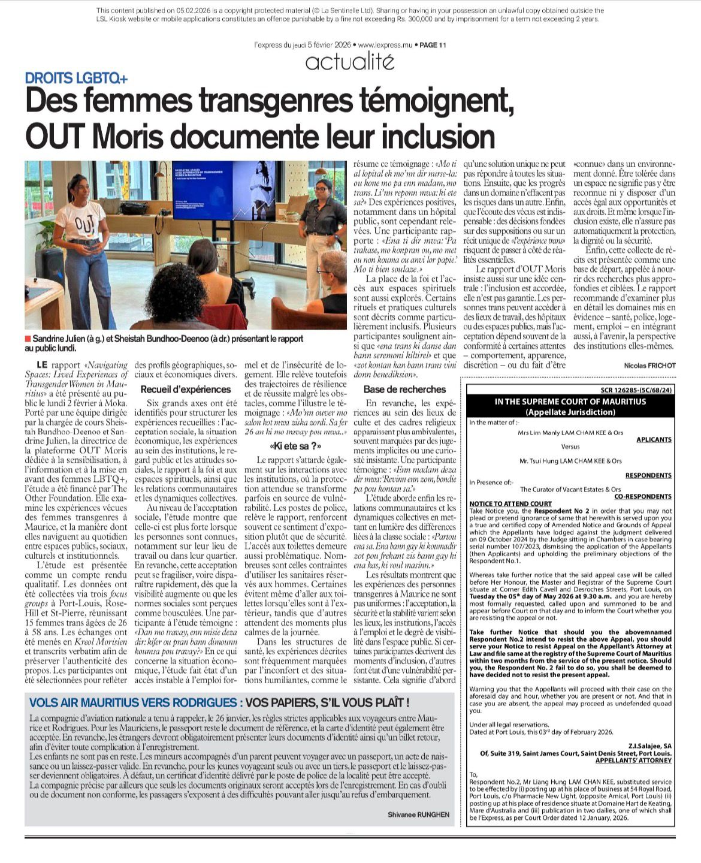
Change
Countering Stereotypes with Data
What specific actions contributed to awareness or change?
The article was part of a sustained weekly series on LGBTIQ issues, reinforcing awareness over time rather than treating the topic as a one-off story. This editorial continuity consolidated visibility and positioned intersex and LGBTIQ rights as an ongoing public concern.
https://lexpress.mu/s/gender-links-mauritius-mieux-raconter-les-realites-lgbtqia-553049
How do you know it influenced the conversation?
The qualitative responses reflected meaningful engagement. One reader responded to a negative remark by stating: “You’re talking about around 10 percent of the population — babies who are naturally born with two sex characteristics, and whose future is decided for them so they can be ‘normal,’ without being asked.”
https://lexpress.mu/s/le-mariage-pour-tous-la-yqa-et-freedom-to-marry-global-unissent-leurs-forces-552456
https://lexpress.mu/s/des-femmes-transgenres-temoignent-out-moris-documente-leur-inclusion-554081
Voice and Choice Summit 2026 \ Voice and Choice Summit 2026

Slide 9
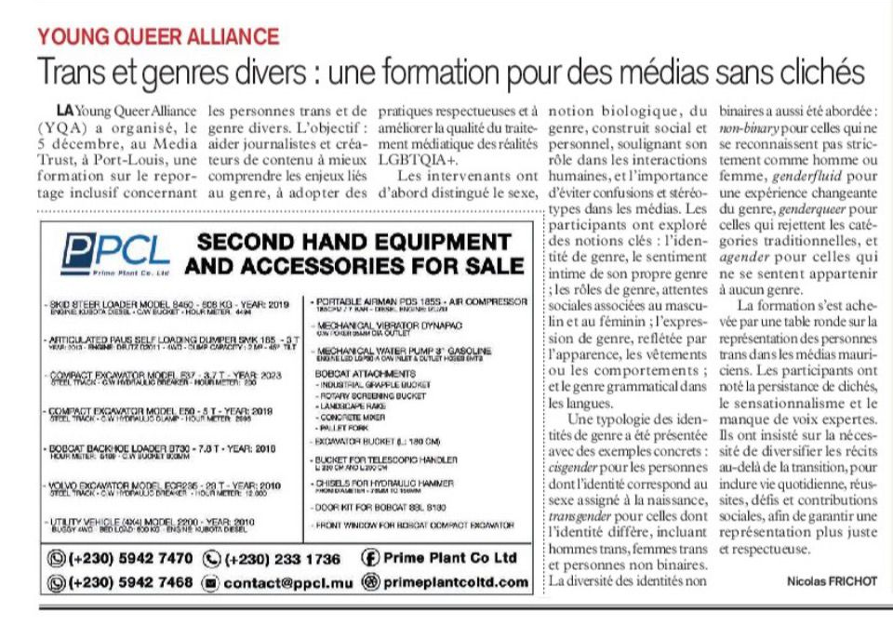
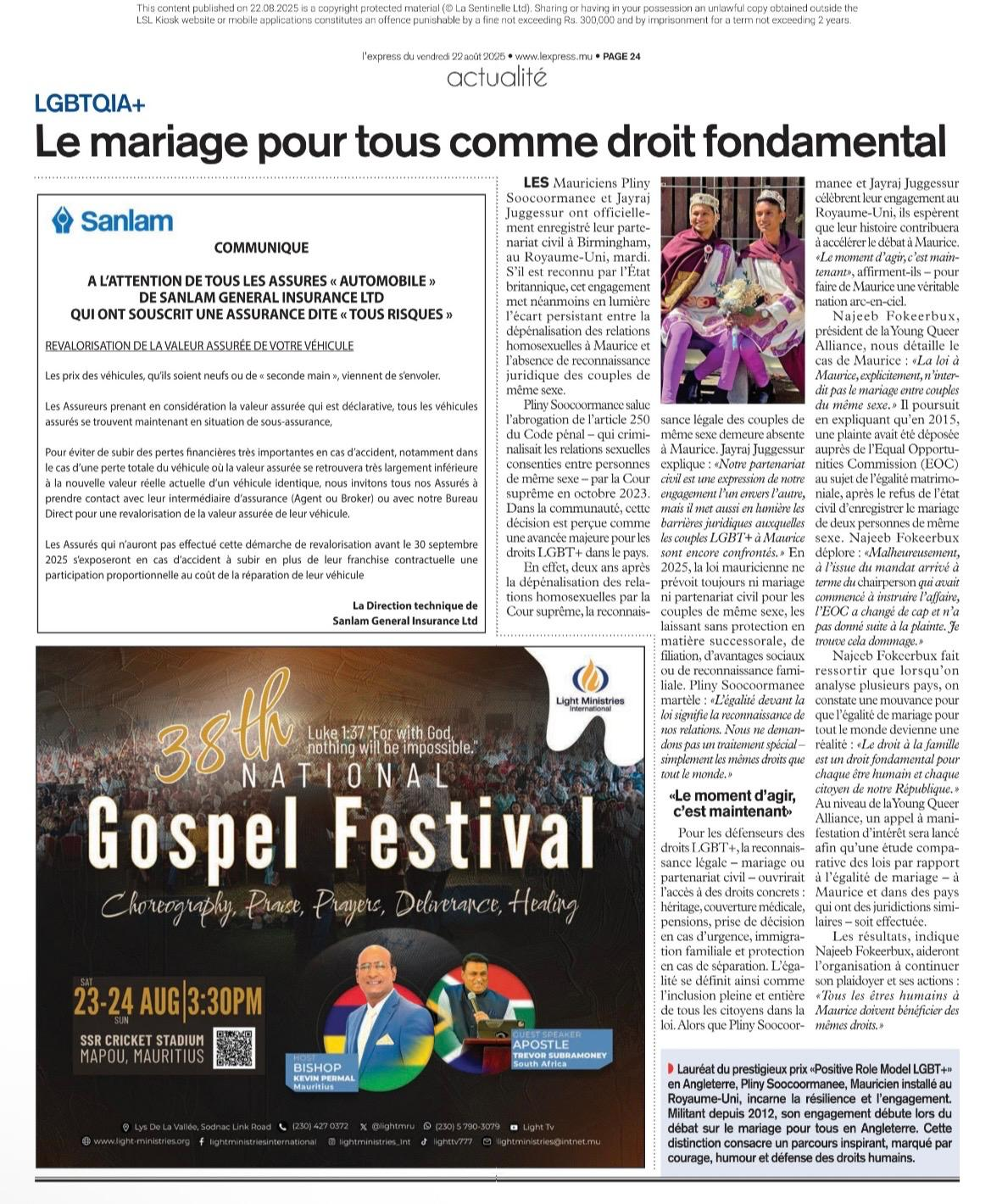
Impact
Advancing Equal Rights for LGBTIQ Communities in Public Discourse
Describe the change/impact:
The coverage helped normalize discussion of intersex and LGBTIQ rights within mainstream media.
Who benefited and how?
LGBTIQ communities – particularly intersex individuals – benefited from increased visibility framed within human rights rather than stigma.
https://lexpress.mu/s/trans-et-genres-divers-une-formation-pour-des-medias-sans-cliches-552301
Was the change positive or negative?
The overall impact was positive. While the coverage also revealed persistent resistance and negative reactions, it elevated the quality of public discourse and expanded space for informed, rights-based conversation.
https://lexpress.mu/s/droits-lgbt-pliny-et-jayraj-deux-mauriciens-se-marient-548524
Voice and Choice Summit 2026 \ Voice and Choice Summit 2026

Slide 10
How do you score yourself?
Self-evaluation
 | 1-10
The story explicitly centres LGBTIQ communities, rights, lived realities, or meaningfully mainstreams sexual orientation, gender identity and expression, and sex characteristics (LGBTIQSC). | 7
The story meaningfully includes and fairly represents diverse LGBTIQ voices and lived experiences, giving appropriate weight to those most affected by the issue. | 8
The story reflects perspectives from both decision-makers and LGBTIQ people directly affected, clearly illustrating power dynamics and differential impact. | 7
All sources and subjects in the story are represented with dignity, respect, and agency, avoiding sensationalism, misrepresentation, or harm. | 10
The story challenges harmful stereotypes, stigma, and discrimination related to sexual orientation, gender identity and expression, and sex characteristics, and affirms diversity. | 10
Voice and Choice Summit 2026 \ Voice and Choice Summit 2026

Slide 11
How do you score yourself?
Self-evaluation
 | 1-10
The story contributes to informed public dialogue on LGBTIQ issues, rights, and social justice through education, advocacy, or critical reflection. | 9
Where data or statistics are used, they are accurate, contextualised, and appropriately disaggregated, or the limitations and gaps in available data are clearly acknowledged. | 10
The story takes a clear human right–based approach grounded in equality, non-discrimination, bodily autonomy, and dignity. | 10
The story demonstrates strong attention to privacy, safety, and security, including risk mitigation for participants and communities in restrictive or hostile environments. | 10
The story offers fresh, original, or under-represented perspectives on LGBTIQ issues and demonstrates editorial courage without exposing individuals or communities to undue risks. | 9
Voice and Choice Summit 2026 \ Voice and Choice Summit 2026

Slide 12
Challenges & Lessons Learnt
Challenge & Mitigation
Challenge: Online backlash and potential abuse in social media comments.
Mitigation: Maintained balanced moderation, safeguarding freedom of expression while preventing harmful or discriminatory content.
Challenge: Limited public understanding of intersex realities.
Mitigation: Developed a forward-looking editorial plan including follow-up interviews, video reports, expert input, lived testimonies, and engagement with relevant authorities to deepen public understanding in future coverage.
What lessons have you learnt?
I learned that sustained coverage – rather than one-off reporting – is essential to normalize sensitive issues and build lasting public awareness.
I also learned that framing LGBTIQ issues within universal human rights principles broadens engagement and makes the conversation more inclusive and less polarized.
Voice and Choice Summit 2026 \ Voice and Choice Summit 2026

Slide 13
Sustainability
Are there plans to continue reporting?
Yes. Future coverage will focus on intersex realities, diversity in the workplace, coverage of LGBTIQ events, and giving voice to LGBTIQ community members beyond identity-specific topics.
How might this work inspire or enable further action?
By increasing presence and visibility, and amplifying authentic voices, the work will help normalize inclusion and strengthen momentum for gender equality nationwide.
Voice and Choice Summit 2026 \ Voice and Choice Summit 2026

Slide 14
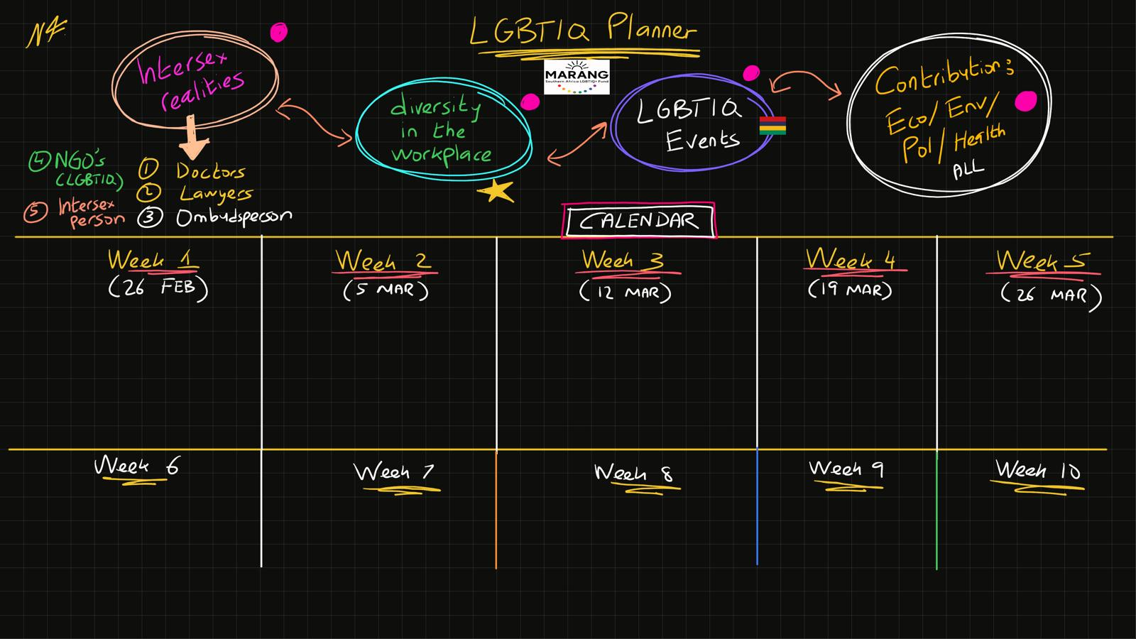
Next Steps
Voice and Choice Summit 2026 \ Voice and Choice Summit 2026

