Slide 1



Lesotho's First Transgender
Political Candidate Sparks Hope for Inclusive Leadership
Marang Media LGBTIQ Category

Slide 2
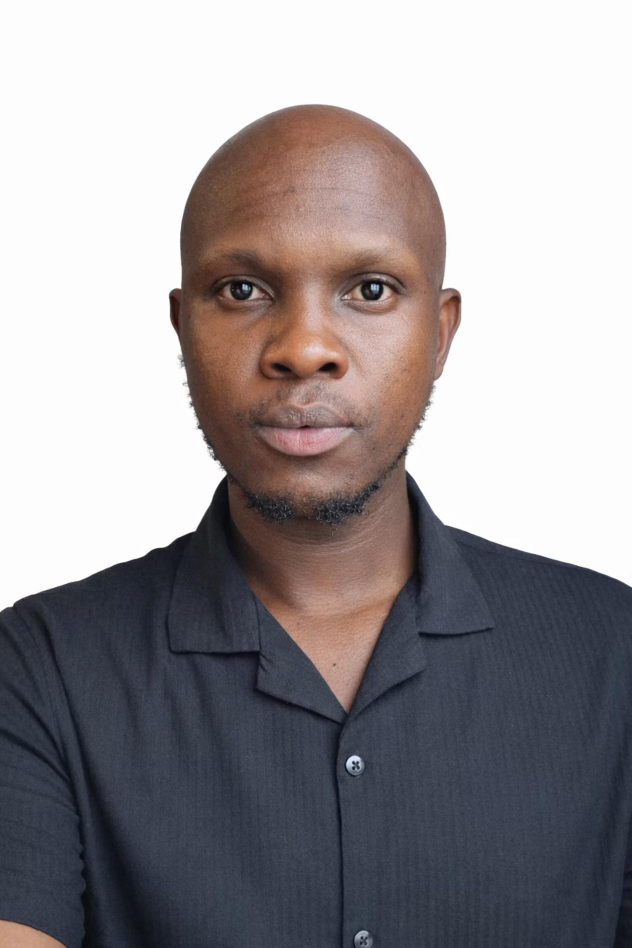
Synopsis: An Overview
Name
RETHABILE MOHONO
Organisation
Public Eye Newspaper
Designation
Journalist
Country
Lesotho
This is the story of the first openly transgender man to run in the primary elections in Lesotho, a landmark event challenging traditional political landscapes.
Voice and Choice Summit 2026 \ Voice and Choice Summit 2026

Slide 3
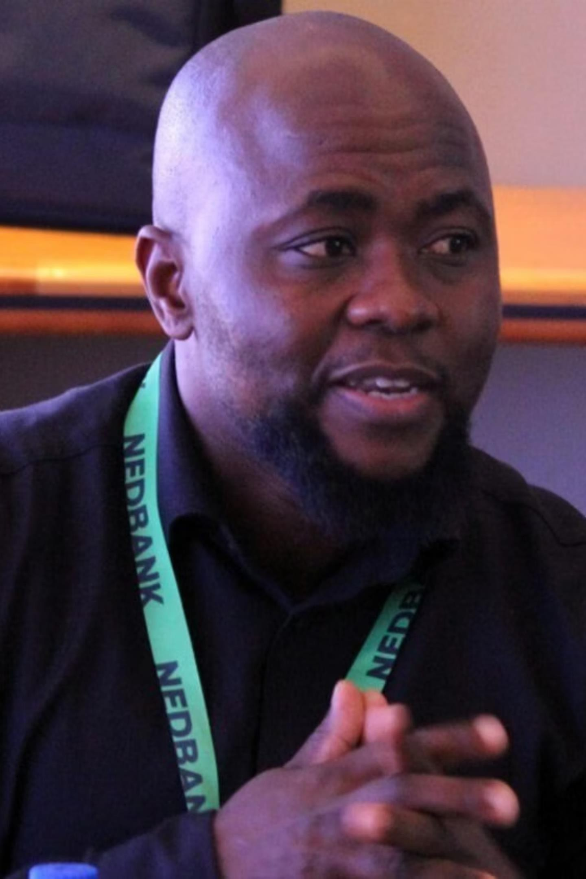
Background: Paving the Way for Inclusion
Lesotho's political system has historically excluded openly LGBTIQ+
individuals, particularly transgender people.
Representation of LGBTIQ+ communities within political parties remains severely limited.
Sheriff Mothopeng became the first openly transgender man nominated under the ruling Revolution for Prosperity (RFP), exposing major gaps in political inclusion and safety.
His candidacy faced significant challenges, including transphobia, sexism, internal party resistance, and threats, underscoring the systemic barriers.
My reporting highlighted both this historic milestone and the deeply entrenched systemic barriers preventing full LGBTIQ+ political participation in the nation.
Voice and Choice Summit 2026 \ Voice and Choice Summit 2026

Slide 4

Action & Impact: Driving Change
Addressing the Problem
My work aimed to tackle the exclusion of LGBTIQ+ persons from political leadership and combat the stigma that limits their participation. Before this, Lesotho had never seen an openly transgender candidate.
The Change My Intervention Brought
Inspired More Open Discussion
Within communities about running for
office.
Contributed to Shifting the Narrative
From LGBTIQ+ people as "outsiders" to legitimate political actors.
Sparked Wider Public
Conversations
About LGBTIQ+ representation in politics.
Strengthened Advocacy Calls
For inclusive political party policies.
Voice and Choice Summit 2026 \ Voice and Choice Summit 2026

Slide 5

Media Contribution: Amplifying LGBTIQ+ Voices
My story, published on the Public Eye website and Facebook page, centered on a critical message:
Representation is Essential
LGBTIQ+ people belong in political leadership and decision-making spaces. True democracy demands their presence, not just symbolic gestures.
Capable & Qualified Leaders
Transgender individuals are capable, qualified, and electable leaders whose contributions enrich governance.
Confronting Discrimination
Political participation must not be limited by gender identity or sexual orientation. Discrimination and institutional resistance must be openly confronted.
Leaders from Within
LGBTIQ+ communities are not only advocates from the outside but are ready to shape policy from within, strengthening democracy.
Voice and Choice Summit 2026 \ Voice and Choice Summit 2026

Slide 6

Responsible Reporting: Reaching Key Audiences
Primary Audience
Distinctive & Responsible Approach
General public and voters in
Lesotho
Political parties and policymakers
LGBTIQ+ community members considering political participation
Civil society and human rights organizations
Youth and marginalized groups
seeking representation
Framed the story as a critical democracy and governance issue.
Centered Sheriff's voice and agency, avoiding victim narratives.
Ensured informed consent for
personal and sensitive experiences.
Avoided sensationalizing
transphobia or threats.
Balanced reporting with advocacy voices and political context.
Prioritized safety, dignity, and appropriate language.
Highlighted systemic barriers over
individual discrimination.
Voice and Choice Summit 2026 \ Voice and Choice Summit 2026

Slide 7
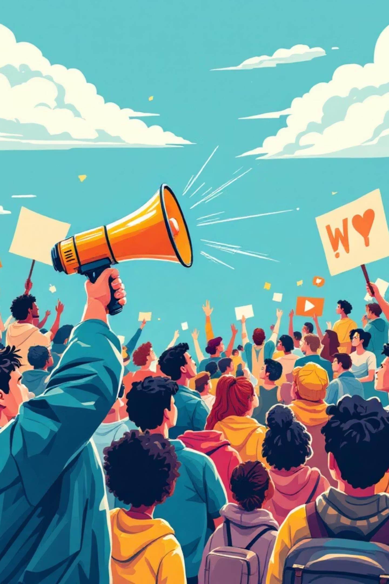
Catalyzing Change: The Article's Impact
How My Article Contributed to Change
My Media Work's Role
Brought mainstream visibility to a marginalized milestone.
Created a public record of both progress and prejudice.
Sparked discussion on social
media and within civil society.
Encouraged broader debate on representation beyond existing quotas.
Helped position LGBTIQ+ political participation as a legitimate democratic issue.
Documented a historic first for transgender political participation in Lesotho.
Elevated LGBTIQ+ political representation to a national conversation.
Challenged the narrative limiting LGBTIQ+ individuals to advocacy roles.
Exposed discrimination and institutional barriers within political structures.
Reinforced calls for inclusive policies and safeguards in political parties.
Voice and Choice Summit 2026 \ Voice and Choice Summit 2026

Slide 8

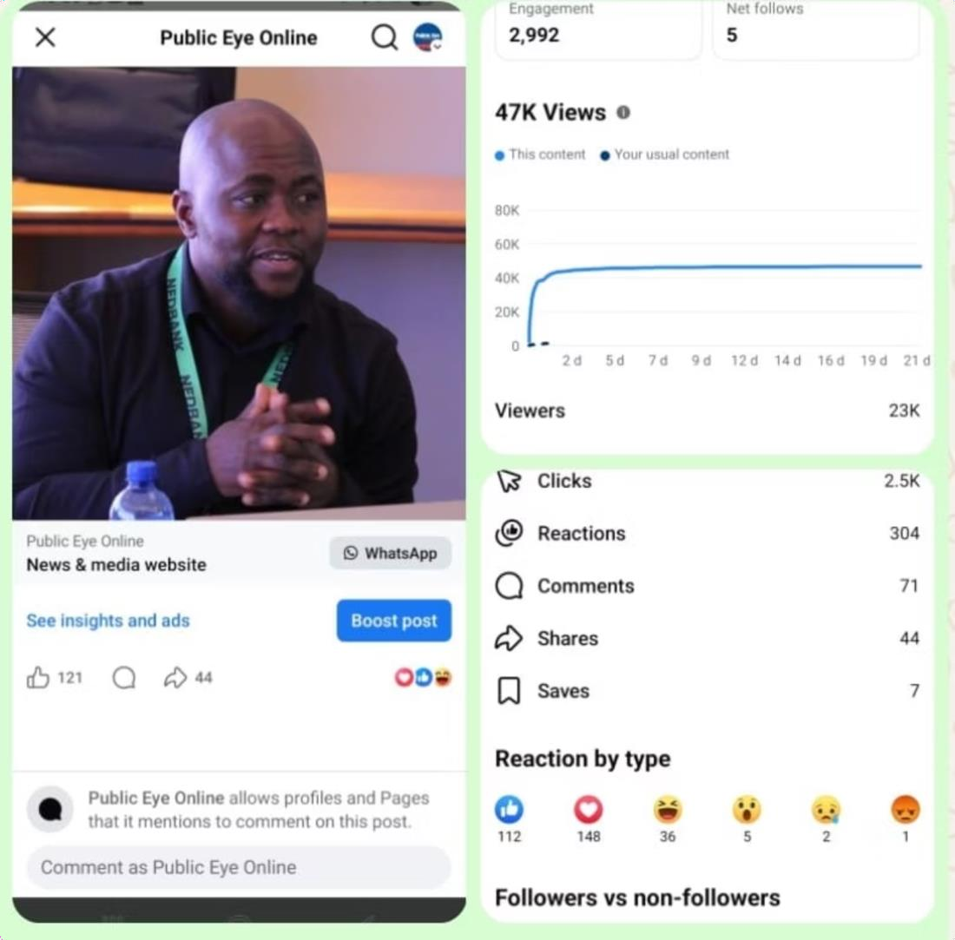
Measuring Influence: Actions and Awareness
Specific Actions That Fostered Awareness and Change
Evidence of Influenced Conversation
Conducted an in-depth feature interview detailing Sheriff's historic candidacy and lived experiences.
Investigated and reported on the
discrimination, transphobia, and
internal political resistance he faced.
Included diverse voices from LGBTIQ+ advocacy groups to contextualize systemic barriers and offer solutions.
The story generated significant public discussion on social media platforms and within civil society spaces.
Advocacy organizations actively
referenced the coverage in their
ongoing conversations about political inclusion and human rights.
The article successfully elevated LGBTIQ+ political participation into mainstream debate, moving it beyond niche activism.
Community members publicly described Sheriff's candidacy as both historic and deeply empowering, acknowledging its profound significance.
Voice and Choice Summit 2026 \ Voice and Choice Summit 2026

Slide 9
The Transformative Impact of Coverage
Visibility
Increased visibility of transgender and LGBTIQ+ communities in political discourse.
Media Contribution
Highlighted challenges like transphobia, sexism, and exclusion while showcasing the importance of representation.
Beneficiaries
Transgender and LGBTIQ+ communities are inspired to engage in leadership; public and political institutions are exposed to equitable democratic practices.
Nature of Change
Positive – promoted inclusion, representation, and civic participation.
Evidence
Rising interest in political participation, mentorship programs, community recognition, and national dialogue on diversity in leadership.
Voice and Choice Summit 2026 \ Voice and Choice Summit 2026

Slide 10





Self-Assessment: A Commitment to Inclusive Journalism
10
The story explicitly centers LGBTIQ communities, rights, lived realities, or meaningfully mainstreams sexual orientation, gender identity and expression, and sex characteristics (LGBTIQSC).
10
The story meaningfully includes and fairly represents diverse LGBTIQ voices and lived experiences, giving appropriate weight to those most affected by the issue.
9
The story reflects perspectives from both decision-makers and LGBTIQ people directly affected, clearly illustrating power dynamics and differential impact.
10
All sources and subjects in the story are represented with dignity, respect, and agency, avoiding sensationalism, misrepresentation, or harm.
10
The story challenges harmful stereotypes, stigma, and discrimination related to sexual orientation, gender identity and expression, and sex characteristics, and affirms diversity.
Voice and Choice Summit 2026 \ Voice and Choice Summit 2026

Slide 11

How do you score yourself?
Evaluate your impact on LGBTIQ+ reporting.
10/10: Informed Public Dialogue
Your story contributes to an informed public dialogue on LGBTIQ+ issues, rights, and social justice through education, advocacy, or critical reflection.
9/10: Accurate & Contextualized Data
Where data or statistics are used, they are accurate, contextualized, and appropriately disaggregated, or the limitations and gaps in available data are clearly acknowledged.
10/10: Human Rights-Based Approach
The story takes a clear human rights-based approach grounded in equality, non- discrimination, bodily autonomy, and dignity.
9/10: Privacy, Safety & Security
The story demonstrates strong attention to privacy, safety, and security, including risk mitigation for participants and communities in restrictive or hostile environments.
10/10: Fresh & Original Perspectives
The story offers fresh, original, or under- represented perspectives on LGBTIQ+ issues and demonstrates editorial courage without exposing individuals or communities to undue risks.
Voice and Choice Summit 2026 \ Voice and Choice Summit 2026

Slide 12

Navigating Challenges in LGBTIQ+ Reporting
Potential Backlash
Reporting on LGBTIQ+ issues often invites criticism or negative reactions from
certain segments of society.
Cultural Resistance
Deeply ingrained cultural norms and beliefs can create resistance to stories
promoting LGBTIQ+ rights and acceptance.
What lessons have you learnt?
Courageous journalism shapes democracy by fostering understanding and driving social change, even in the face of adversity. Embracing ethical practices and a human rights lens is crucial.
Voice and Choice Summit 2026 \ Voice and Choice Summit 2026

Slide 13

Commitment to Sustainability in Reporting
I am deeply committed to ongoing reporting on LGBTIQ+ issues, a dedication that spans a significant portion of my career. My sustained focus on human rights stories has not only fueled my own work but has also inspired and guided younger journalists under my mentorship.
Dedicated Sections for Inclusivity
Specialized sections for people with disabilities
Comprehensive coverage for the LGBTIQ+
community
This sustained effort aims to build a legacy of responsible and impactful journalism, fostering a new generation of reporters passionate about social justice.
Voice and Choice Summit 2026 \ Voice and Choice Summit 2026

Slide 14

Future Plans: Expanding Our Impact
What are your plans for advancing inclusive journalism?
Continue Reporting on Inclusive Governance
Dedicated coverage to ensure transparency and accountability in policies affecting marginalized communities.
Launch Independent Digital Platform
Create a dedicated online space for in-depth stories, analyses, and community engagement.
Amplify Marginalized Voices Nationally
Focus on elevating the narratives of LGBTIQ+ individuals and people with disabilities across the country.
Voice and Choice Summit 2026 \ Voice and Choice Summit 2026

