Slide 1







LEARNING
AND SHARING
SUMMIT 2025
Story of Change Template
(Lesotho, Maseru, 05/03/2025- I am Seithati Moleko)
Women’s Voice and Leadership Learning and Sharing Summit 2025

Slide 2
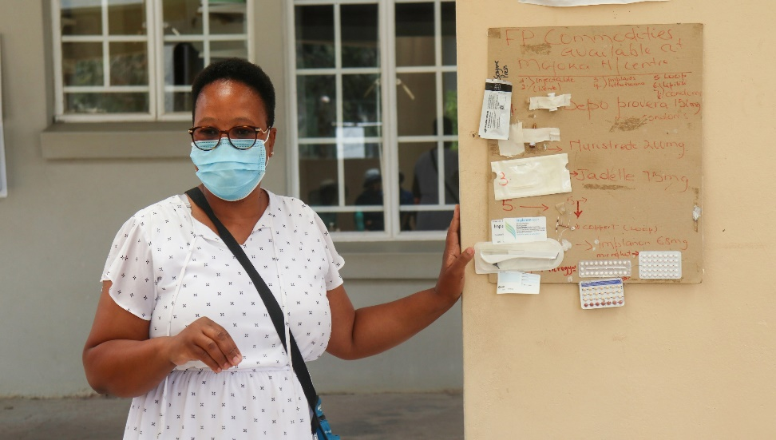
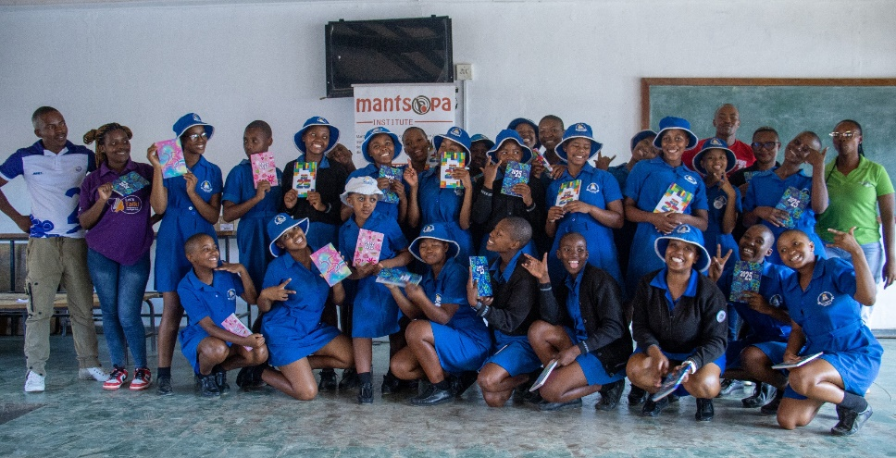
SYNOPSIS
The change that has occurred.
Since the launch of the ASRHR Advocacy Program by Mantsopa Institute powered by Gender Links in January 2023, significant improvements in SRH outcomes have been observed in Maseru, Ha Mofoka, Morija, and Matsieng. Through Gender Links and Mantsopa Institute’s interventions, awareness of SRH rights has increased, leading to greater condom and contraceptive use, improved healthcare-seeking behavior, and a decline in adolescent pregnancies. At Mofoka Health Centre: SRH service uptake rose by 939% in 2023, with 291 re-visits. In 2024, new visits dropped by 32%, but engagement remained high with 101 re-visits. Teenage Pregnancy Trends:2022: 47 cases2023: Increased to 67, but 76.1% were repeat pregnancies.2024: Declined to 57, with 56.1% being first-time pregnancies. While repeat pregnancies have decreased, continued efforts are needed to prevent initial adolescent pregnancies.
Women’s Voice and Leadership Learning and Sharing Summit 2025

Slide 3
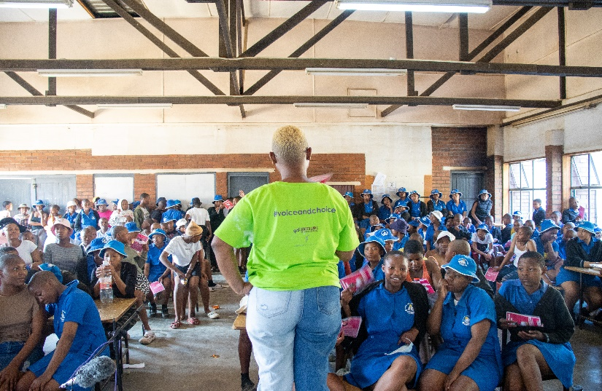
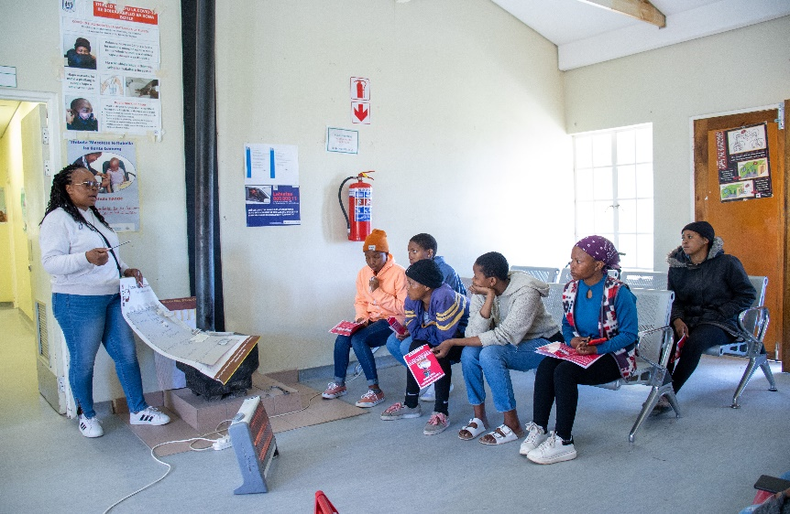
OBJECTIVES
The project set out to:
Objective 1: Education of SRHR
Objective 2: Increased Access to Services
Objective 3: Creating an enabling environment
Women’s Voice and Leadership Learning and Sharing Summit 2025
Notes:
Improve sexual and reproductive health (SRH) outcomes for (AGYW) in Maseru, Ha Mofoka, Morija, and Matsieng.
Raise awareness of SRHR to empower AGYW with knowledge and decision-making skills.
Improve access to youth-friendly SRH services by working with healthcare providers to create a more supportive environment.
Reduce adolescent pregnancy rates through education on contraception, abstinence, and safer sex practices.
Enhance healthcare-seeking behavior by encouraging AGYW to utilize available SRH services.
Addressing repeat pregnancies among adolescent mothers by promoting continued contraceptive use and reproductive health education.

Slide 4
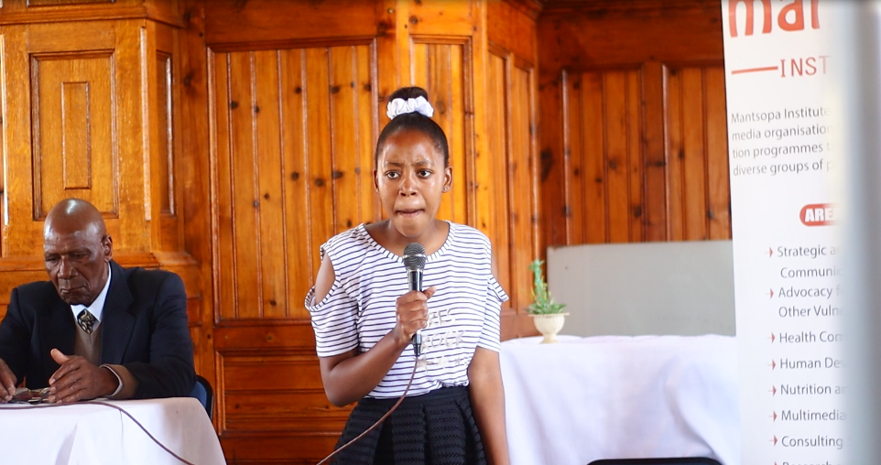
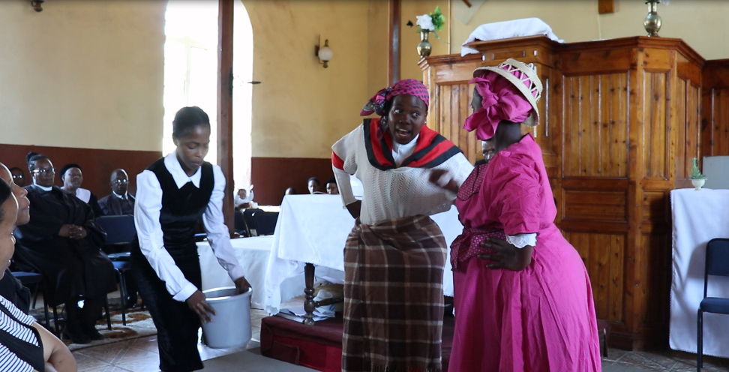
ACTIVITIES
Evidence/means of verification for this change?
Health Facility Data records from Mofoka Health Centre showing an increase in SRH service and decline in teenage pregnancy
Monitoring & Evaluation Report
Community and Stakeholder Feedback
Testimonies from health workers, adolescent girls, young women
Outreach and Engagement reports
Documentation of school and community outreach events, including session attendance, discussion topics, and feedback from participants.
Women’s Voice and Leadership Learning and Sharing Summit 2025

Slide 5
Contribution to change
What contribution did your organization make to this change?
Involved Parents and Community Leaders
Partnered with Health Facilities and Schools to conduct Outreaches
Residency Theatres- To convey messages through drama and poetry
Teen clubs both in and out of schools
Developed IEC Material
Women’s Voice and Leadership Learning and Sharing Summit 2025
Notes:
1.Engaged with local community leaders, parents, and health facilities to promote youth-friendly services.
Conducted outreaches in schools 2. Facilitated sensitization for health workers to provide non-judgmental and supportive care for AGYW in communities.
Partnered with Mofoka Health Centre, Matsieng Health Centre, and Scott Hospital to improve adolescent-friendly healthcare services. 3. Referred AGYW to local clinics for contraceptives, STI screening, and pregnancy prevention services.
Created safe spaces (teen clubs and peer-led sessions) for AGYW to discuss SRHR issues freely. 4. Promoted contraceptive use, abstinence, and decision-making skills through structured peer education through IEC Material
Addressed repeat pregnancies by ensuring AGYW continued accessing family planning services.

Slide 6
Population Group this change most closely related to
Category | Women | Men | Total | % Women
Direct beneficiaries | 1377 | 0 | 1377
Indirect beneficiaries (e.g. through other networks) | - | - | -
Online beneficiaries (e.g. website access, mailing lists, scholarly articles) | 375 | 0 | 375
Total | 1752 | 0 | 1752
Women’s Voice and Leadership Learning and Sharing Summit 2025

Slide 7
Significance of change
What is the significance of the change?
The Change made demonstrates the effectiveness of the SRHR advocacy program, but the work is far from over.
Women’s Voice and Leadership Learning and Sharing Summit 2025

Slide 8
RESULTS
For example:
Include evidence here – photos/clippings
Year | New AGYW Visits | Revisits | Total Teenage Pregnancies | Gravida 2 | First-Time Pregnancies
2022 | N/A | 47 | N/A | N/A | N/A
2023 | 28 | 291 | 67 | 51 | 16
2024 | 19(32% drop) | 101 | 57(14.9% drop) | 25 | 32
Women’s Voice and Leadership Learning and Sharing Summit 2025

Slide 9
Evidence
We have documented a comprehensive story(video) that provides evidence supporting these findings and outcomes.
Include evidence here – photos/clippings
A video to be played at the summit
Women’s Voice and Leadership Learning and Sharing Summit 2025

Slide 10
CHALLENGES AND LESSONS LEARNT
Parental Engagement Barriers
Health Workers’ Monetary Expectations
Resistance of AGYW to visit Health Facilities
Rude Health workers
Change Agent Transitions
Women’s Voice and Leadership Learning and Sharing Summit 2025
Notes:
Many parents remain unapproachable regarding sexuality, contraception, and reproductive health.
2. Some health professionals expected additional compensation for outreach participation.
Budget constraints led to delays in securing medical personnel for outreach activities.
3. Resignations due to education, personal reasons, or better job opportunities created gaps.
Constant recruitment and training slowed momentum in teen club development.
Separate sensitization sessions had limited impact on parent-adolescent communication.

Slide 11
LESSONS LEARNT
Enhancing Adolescent-Friendly Services
Strategic Relocation of Teen Clubs
Parental Engagement Through Joint Sessions
Strengthening Partnerships with Healthcare Providers
Sustaining Change Agents
Women’s Voice and Leadership Learning and Sharing Summit 2025
Notes:
1. Worked closely with healthcare providers to improve service delivery.
Advocacy efforts led to more supportive and non-judgmental care for adolescents.
2. Moved clubs to high schools for consistency and accessibility.
Integrated SRHR education into school activities to ensure sustained participation.
3. Introduced sessions where parents and adolescents discussed sensitive topics together.
Encouraged open dialogue, fostering better understanding and support.
4. Negotiated commitments based on professional development and recognition.
Emphasized the long-term benefits of adolescent health to secure provider involvement.
5. Developed a structured recruitment and training plan for continuity.
Provided practical exposure e.g., Malethola Nts’asa attended an outreach before taking on her role.
Strengthened retention through capacity-building opportunities.

Slide 12
CHALLENGES AND LESSONS LEARNT
How will the lessons learned be applied?
The easiest way to reach a child is through their parents, but the most effective way is through their teacher...
Why not train the parents and guardians, as well as teachers on SRHR?
Women’s Voice and Leadership Learning and Sharing Summit 2025
Notes:
Teachers spend a considerable time with children in a structured learning environment, which gives them valuable insight into a child’s behavior, strengths and weaknesses.

Slide 13
SUSTAINABILITY AND REPLICATION
Institutionalizing SRHR Education
Strengthening Community Engagement
Capacity Building & Retention of Change Agents
Women’s Voice and Leadership Learning and Sharing Summit 2025
Notes:
1. Include SRHR education into school curriculums and extracurricular activities to ensure continuous education.
Strengthen partnerships with the Ministry of Education and local schools for long-term integration. 2. Train and empower local champions, including teachers, community leaders, and parents, to continue SRHR advocacy.
Establish peer-led programs where adolescents educate and support each other. 3. Offer continuous training and mentorship for change agents to keep them motivated and well-equipped.
Provide professional development opportunities and linkages to SRHR organizations for career growth.

Slide 14
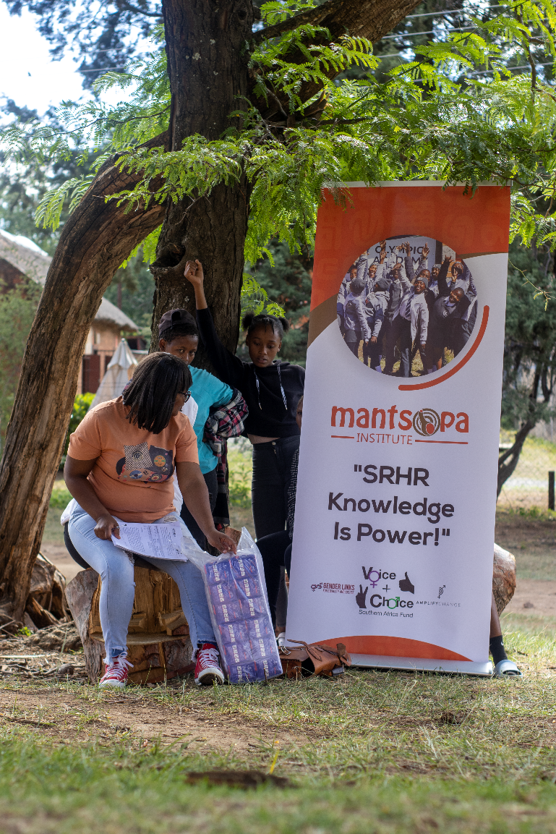
NEXT STEPS
What are the key priorities going forward?
Future efforts should focus on preventing first-time pregnancies, STI and HIV/AIDS, and in maintaining high engagement in SRH services,
Expanding outreach efforts
Opening more teen clubs to ensure that no adolescent is left behind.
Women’s Voice and Leadership Learning and Sharing Summit 2025

