Slide 1


Voice and Choice
Summit 2026-Story of Change Category
South Africa: Food Security as a Tool to Address GBVF
Presenter: Farida Myburgh, Programmes Manager
Organisation: Masimanyane Women’s Rights International
Voice and Choice Summit 2026 \ Voice and Choice Summit 2026

Slide 2
Synopsis– brief overview what this is about
Name | Farida Myburgh
Designation | Programmes Manager
Organisation | Masimanyane Women’s Rights International
Country | South Africa
Category | Stories of Change -Best Practices
Summary | Food gardens empower young women’s clubs in Buffalo City, Eastern Cape by providing food security, income generation, and independence from abusive relationships. • Supports NSP GBVF Pillar 5: Economic Power.
Voice and Choice Summit 2026 \ Voice and Choice Summit 2026

Slide 3
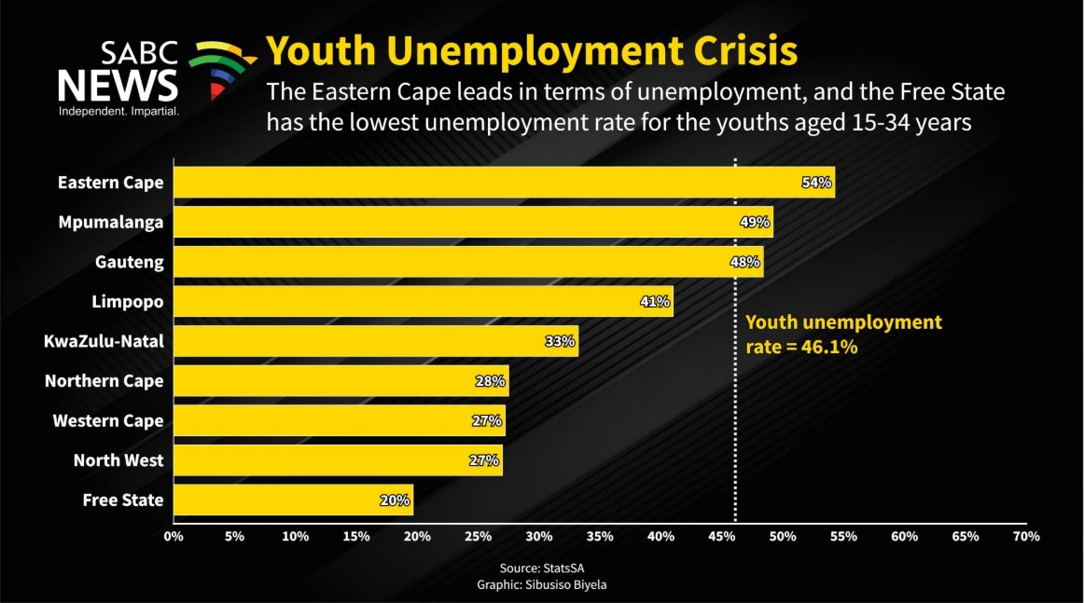
Background(problem , actions, change, evidence )
Give some background. Briefly describe the context or problem.
What was the specific issue, gap, or challenge addressed?
Problem: High unemployment increases GBV vulnerability.
What actions have you taken to address the problem?
Action: Establishing food gardens in 6 clubs.
What change has happened because of your interventions?
Access to food, income, and solidarity
Voice and Choice Summit 2026 \ Voice and Choice Summit 2026
Notes:
“Unemployment leaves many young women dependent on abusive partners or families. By creating food gardens, we provide both nutrition and income opportunities, reducing vulnerability to GBV.”

Slide 4
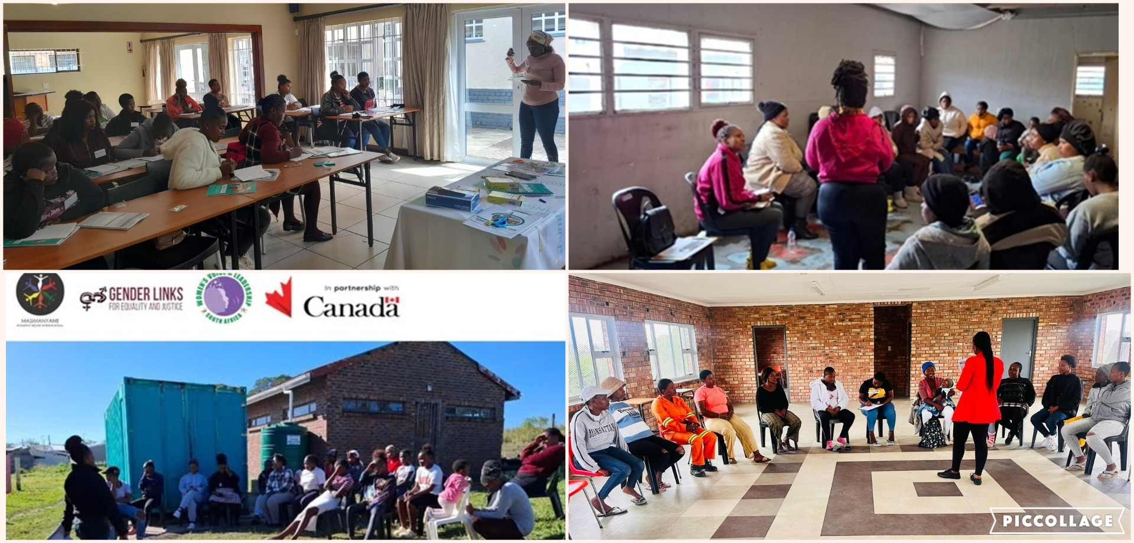
Background
MWRI trained young women on GBV in 10 communities and through discussions in the safe spaces, identified financial dependence and unemployment as reasons why they remain in abusive relationships. The food security project to address GBV was the result from these engagements.
Key Objectives of the Food Gardens Project
Reduce unemployment and poverty among young women
Provide opportunities for income generation and self‑sufficiency.
Improve food security and nutrition
Ensure access to fresh vegetables for healthier meals.
Promote independence and reduce GBV vulnerability
Enable women to earn income, lessening reliance on abusive relationships.
Strengthen community solidarity and support networks
Build teamwork, peer support, and collective resilience through shared gardens.
Empower young women through skills development
Enhance knowledge of gardening, climate impacts, and sustainable practices.
Ensure sustainability and expansion
Reinvest income into seedlings, expand gardens, and partner with institutions for training and climate‑smart agriculture.
Voice and Choice Summit 2026 \ Voice and Choice Summit 2026

Slide 5
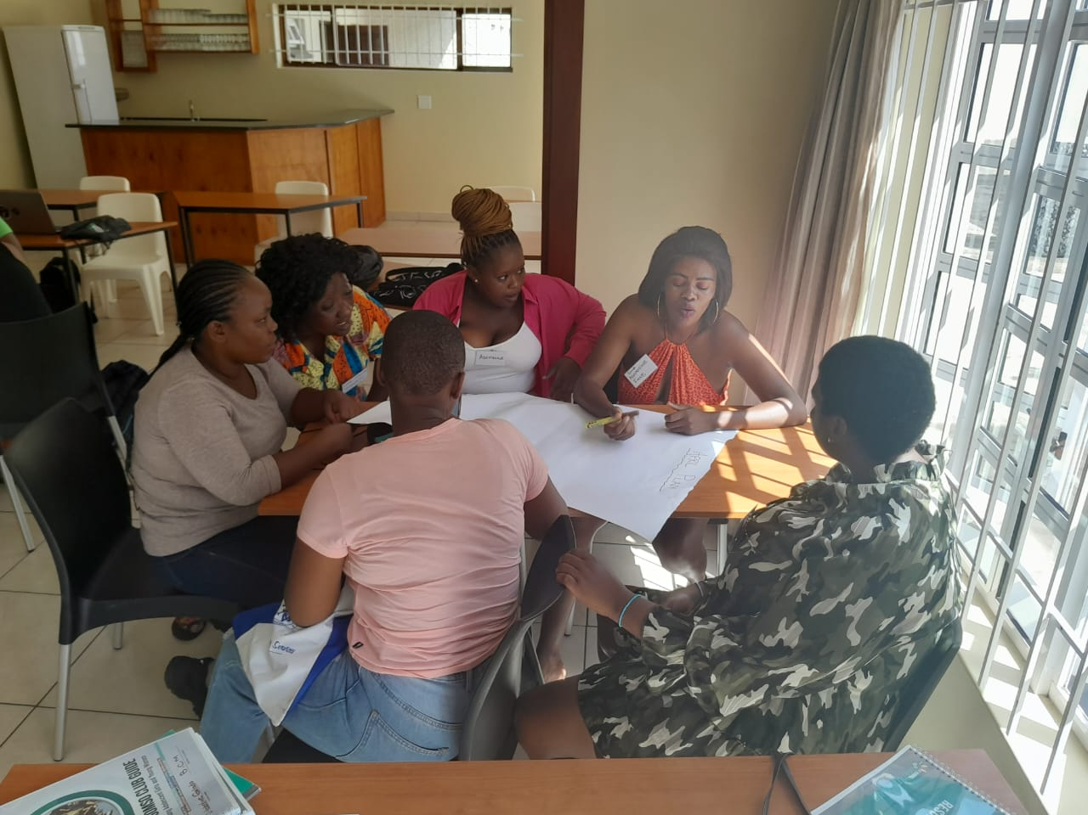
Context
MWRI is based in East London .The project was implemented in Buffalo City Metropolitan Municipality, Eastern Cape, South Africa.
Who was most affected by the problem and how?
In discussions with young women during the GBV trainings, many revealed that food insecurity and poverty often trap them in abusive relationships. They often escape their abusers but return because they are financially dependent.
What issue(s) did the project address?
Economic vulnerability linked to GBVF
Voice and Choice Summit 2026 \ Voice and Choice Summit 2026
Notes:
“This project is based in Eastern Cape, where unemployment among young women is high. Food insecurity and poverty often trap women in abusive relationships. Our gardens directly address this.”

Slide 6
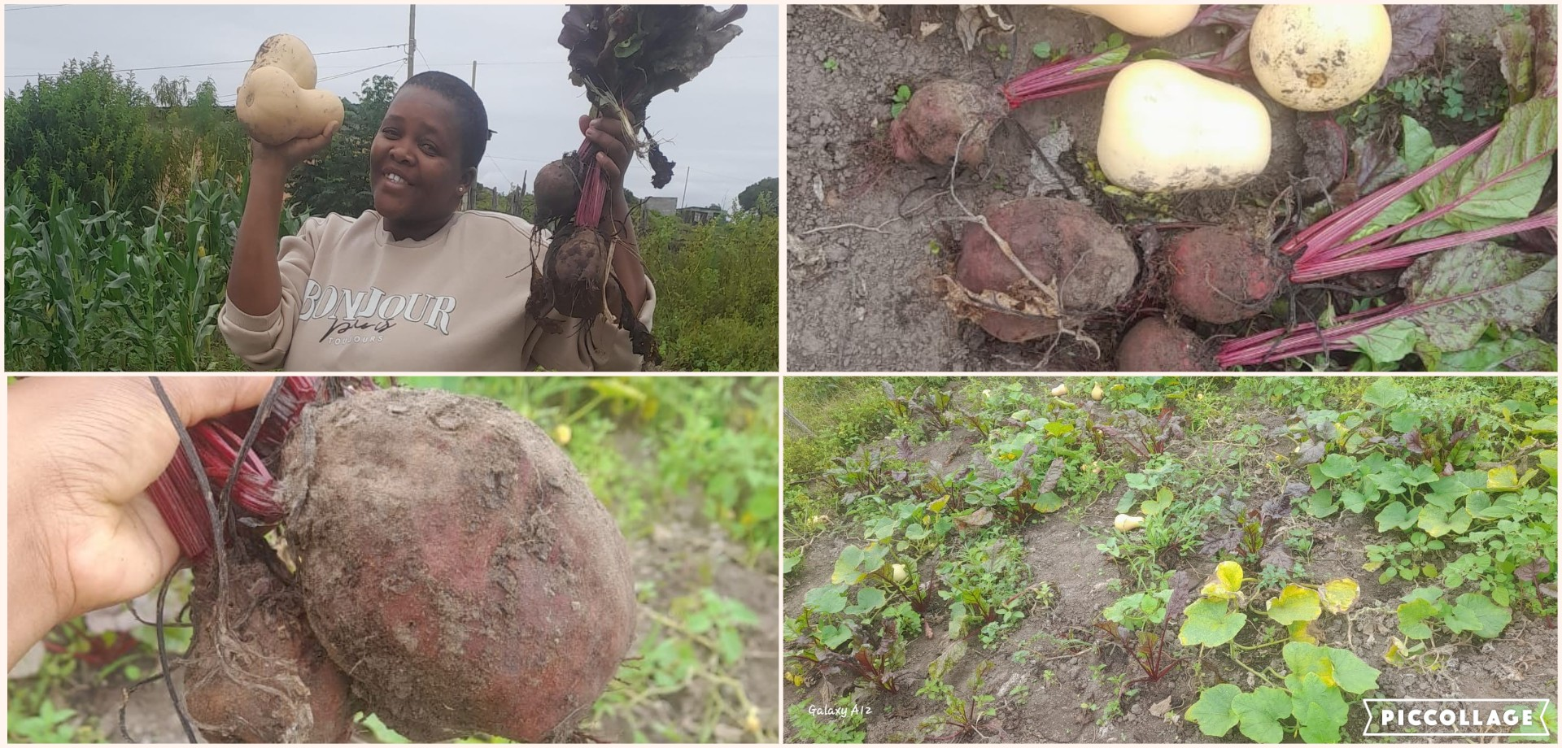
Actions
How did the change come about?
• What activities or actions brought about the change?
Clearing land for gardens.
• Planting diverse crops.
• Sharing produce with families.
• Selling vegetables for income.
• Who led and participated in bringing about the change.
Masimanyane trained the club leaders who were trained on square metre gardens and they trained their club members
Voice and Choice Summit 2026 \ Voice and Choice Summit 2026
Notes:
“The clubs cleared community land, planted crops like spinach, cabbage, and carrots, and began sharing produce with families. Selling vegetables generates income, reducing dependency on abusive relationships.”

Slide 7
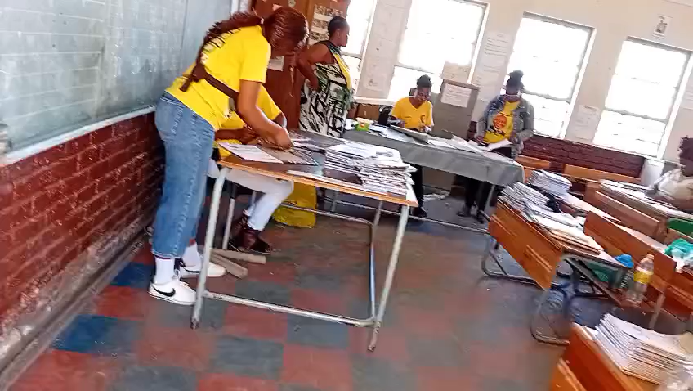
The change – impact
• Reduced poverty and food insecurity.
• Improved mental health and peer support.
• Financial independence reduces GBV risk.
• Community solidarity through soup kitchens, book covering and homework clubs
Voice and Choice Summit 2026 \ Voice and Choice Summit 2026
Notes:
“The impact has been powerful. Women report better mental health, stronger peer support, and financial independence. Some clubs even run soup kitchens, feeding children and families in need.”

Slide 8
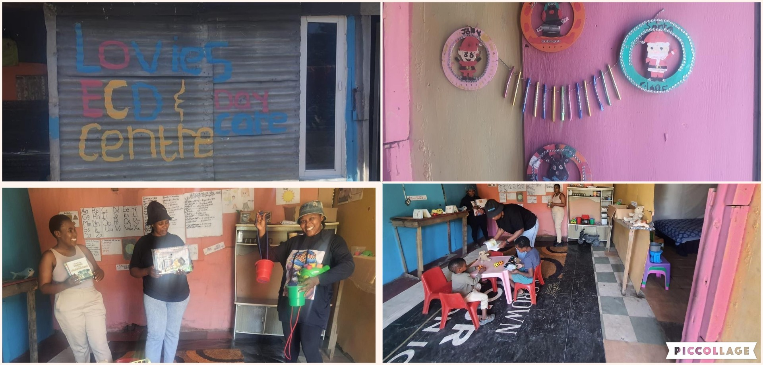
Significance of the Change
Builds resilience against poverty-driven GBV.
Promotes women’s rights and empowerment.
Best practice model linking food security to GBVF prevention.
Strengthens economic power (NSP Pillar 5).
Helen Hambani started a day care centre in Mntsintsi. This initiative demonstrates the development of this young woman’s leadership and is directly related to the impact of the training and support they receive through the food security project. Masimanyane has facilitated donations of furniture and books to the ECD
Voice and Choice Summit 2026 \ Voice and Choice Summit 2026
Notes:
“This initiative is a best practice model. It shows how food security can strengthen economic power, reduce GBV vulnerability, and promote women’s rights.”

Slide 9
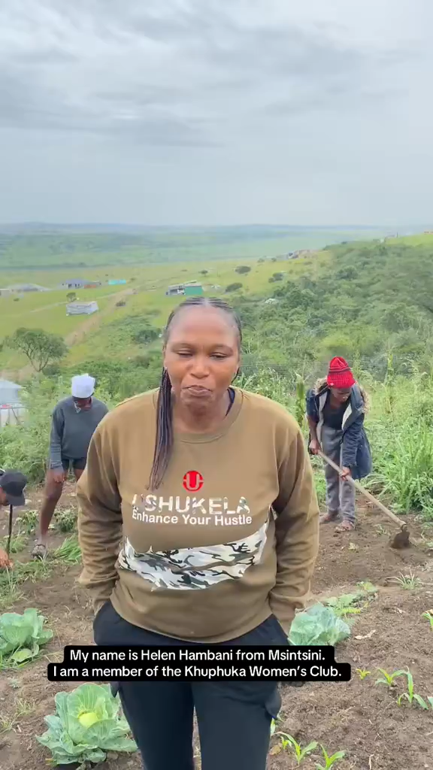
Significance of the Change
Best practice model linking food security to GBVF prevention.
Strengthens economic power (NSP Pillar 5).
Builds resilience against poverty-driven GBV.
Promotes women’s rights and empowerment.
Voice and Choice Summit 2026 \ Voice and Choice Summit 2026
Notes:
“This initiative is a best practice model. It shows how food security can strengthen economic power, reduce GBV vulnerability, and promote women’s rights.”

Slide 10
Beneficiaries
 | Number of participants
Female – Direct beneficiaries | 160 (club members)+ 30 girls
Male – Direct beneficiaries | 85 + 20 boys
Female – Indirect beneficiaries (e.g. through other networks) | 45
Male – Indirect beneficiaries (e.g. through other networks) | 25
Female – Online beneficiaries (e.g. website access, mailing lists, scholarly articles) | -
Male – Online beneficiaries (e.g. website access, mailing lists, scholarly articles) | -
Total | 365
Indirect: Families and community members.
Community impact: Soup kitchens, donations.
Voice and Choice Summit 2026 \ Voice and Choice Summit 2026
Notes:
“Directly, 72 young women benefit. Indirectly, their families and communities gain access to food and support. Soup kitchens and donations extend the impact even further.”

Slide 11
Challenges & Lessons learnt
Challenges & mitigation
Climate change and environmental disasters such as floods and gail force winds affected the food gardens
Mitigation
Regular monitoring and timeous support for the food gardens assist the clubs. These were factored into the team’s plans
There is a need to look at protective measures for the gardens
What lessons have you learnt?
Need for refresher training due to attrition in clubs when members get job opportunities
Climate change affects yields of crops.
Key Lesson: Collective action builds resilience and reduces vulnerability.
Voice and Choice Summit 2026 \ Voice and Choice Summit 2026
Notes:
“Challenges include the need for refresher training and climate change impacts. But the key lesson is that collective action builds resilience and reduces GBV vulnerability.”

Slide 12
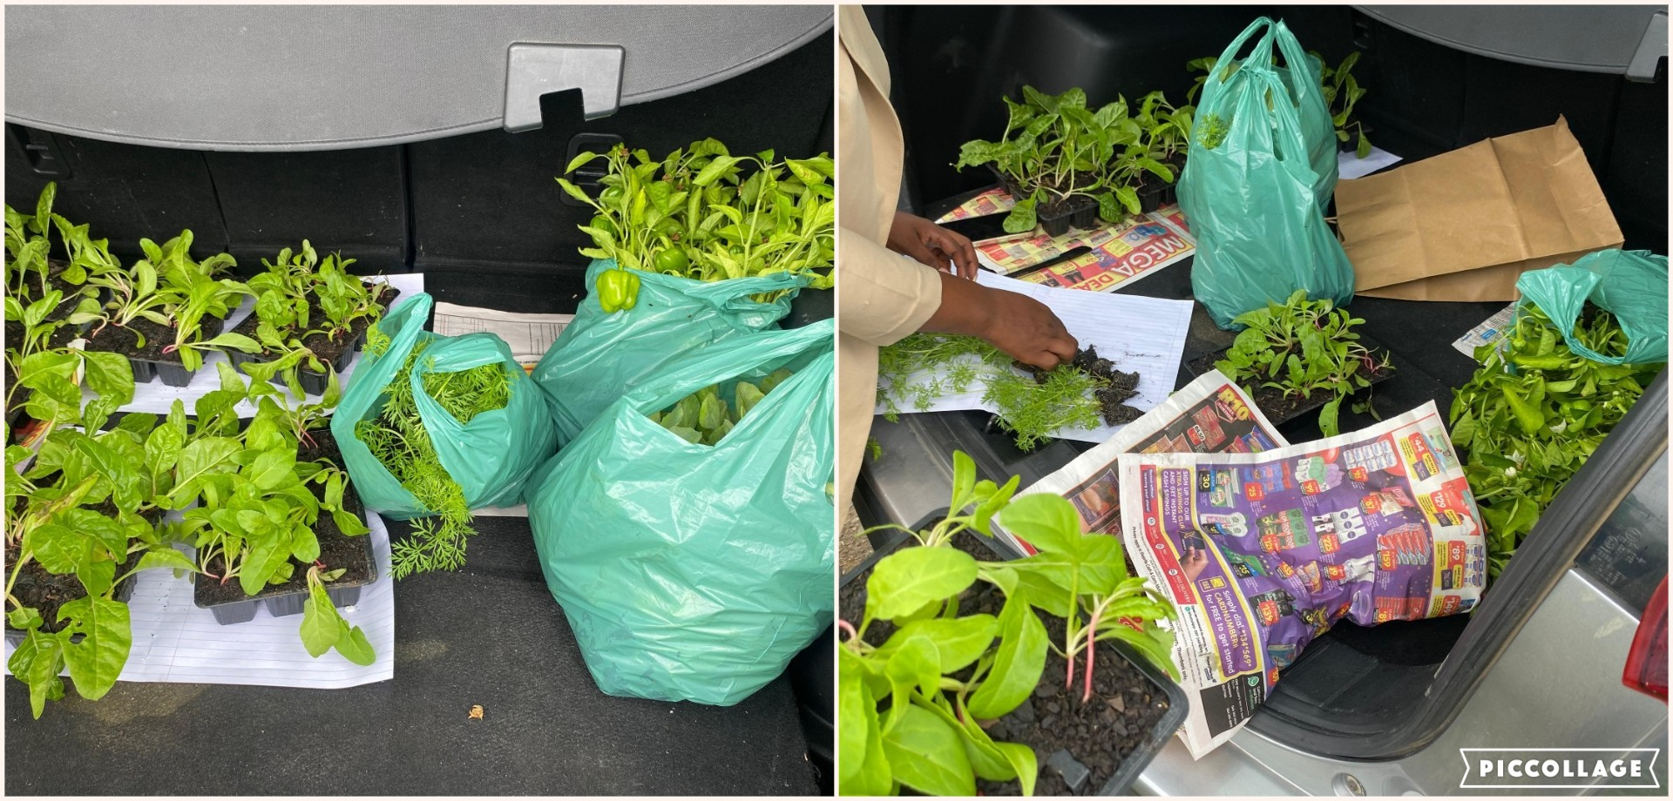
Sustainability
What sustainability measures were put in place for the work?
Partnerships have been developed with government departments.
Addressing unemployment by linking young women to job opportunities within partnerships
• Income reinvested into seedlings.
Club leaders have been trained on running meetings, keeping records and following up on decisions taken within the club
How do you intend to sustain the work or scale up?
• Plans to scale up and integrate climate-smart agriculture
Voice and Choice Summit 2026 \ Voice and Choice Summit 2026
Notes:
“Sustainability is ensured through partnerships and reinvestment of income into seedlings. We plan to expand gardens and integrate climate-smart agriculture.”

Slide 13
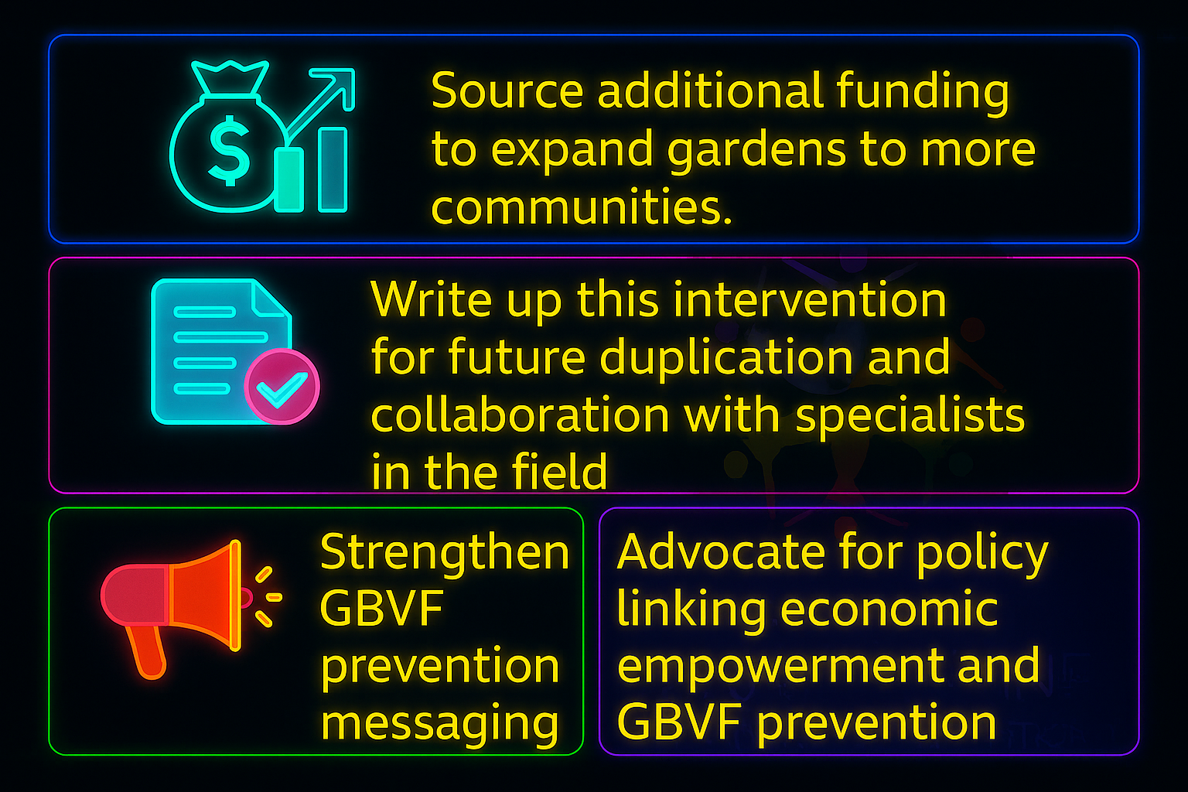
Next Steps
Voice and Choice Summit 2026 \ Voice and Choice Summit 2026
Notes:
Our next steps include expanding gardens, strengthening GBVF prevention messaging, and advocating for policies that link economic empowerment to GBVF prevention.”

Slide 14


Voice and Choice Summit 2026 \ Voice and Choice Summit 2026
Notes:
Our next steps include expanding gardens, strengthening GBVF prevention messaging, and advocating for policies that link economic empowerment to GBVF prevention.”

