Slide 1
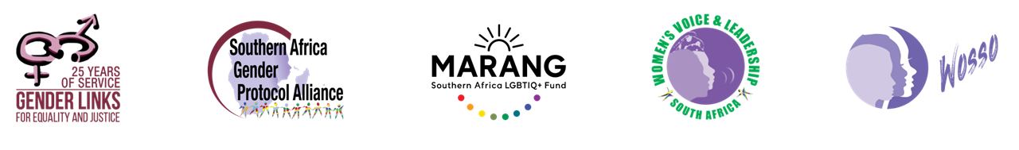
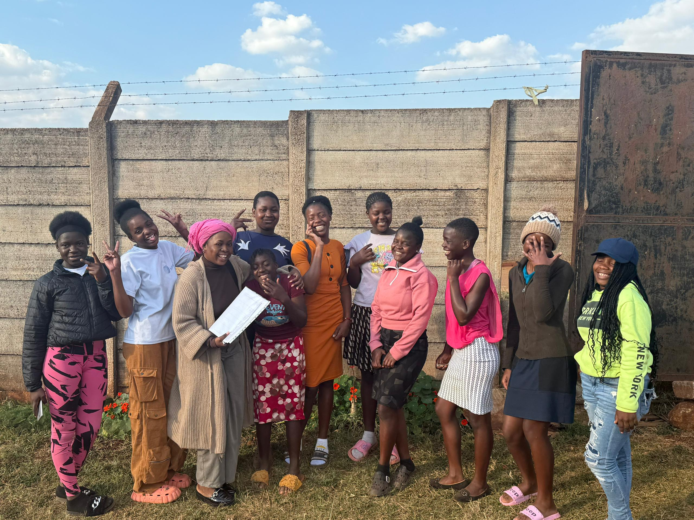
Safepath Zimbabwe - Guiding Girls Towards a Secure Future
Hatcliffe, Harare, Zimbabwe
4th March 2026
Presented by Lynet Tinoza
Voice and Choice Summit 2026 \ Voice and Choice Summit 2026

Slide 2
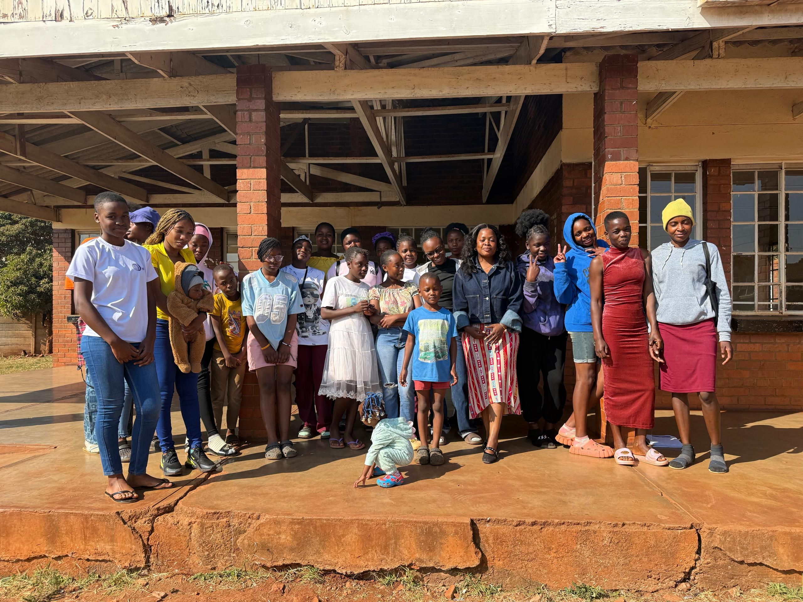
Background
Zimbabwe has one of the highest adolescent pregnancy rates globally, with a teenage pregnancy rate of 108 per 1,000 girls and a 2023 adolescent pregnancy prevalence rate of 23.7%, according to United Nations Population Fund (UNFPA), UNESCO and UNICEF.
SafePath Zimbabwe – Guiding Girls Towards a Secure Future was established to respond to the high prevalence of early and unintended teenage pregnancies, limited access to SRHR information and harmful gender norms affecting adolescent girls and young women in marginalized urban communities
The problem disproportionately affected adolescent girls and young women aged 13–24, many of whom lacked access to accurate SRHR information, safe spaces for dialogue and supportive family or community structures. As a result, many girls faced increased vulnerability to early pregnancy, school dropout, stigma and gender-based violence
The project addressed interconnected issues including inadequate SRHR knowledge, weak community accountability in adolescent pregnancy prevention, limited girl’s participation in decision-making and restrictive gender norms
Adolescent pregnancy is not only a health issue, it affects girl’s education, economic opportunities, mental well-being and long-term empowerment
Voice and Choice Summit 2026 \ Voice and Choice Summit 2026

Slide 3
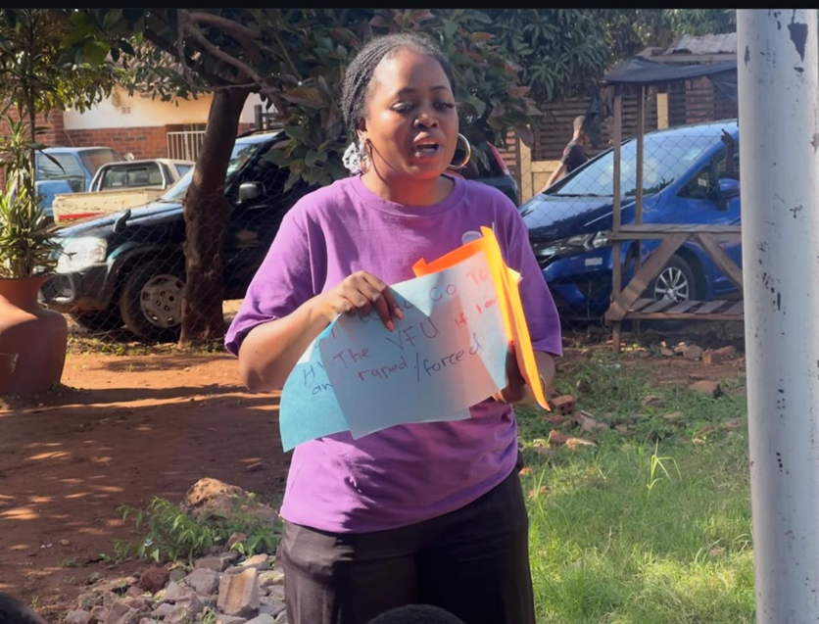
Background
Objectives of Safepath were:
To increase access to accurate and comprehensive SRHR information among adolescent girls and young women
To create a safe, community-based platform where girls can openly discuss sexuality, rights and healthy relationships
To strengthen girl’s autonomy, confidence and decision-making capacity in relation to their health and wellbeing
To reduce early and unintended pregnancies through knowledge and behavioural change
To amplify youth voices in advocating for supportive SRHR policies and community support systems
Safepath was an advocacy plan/project that was supported by WOSSO and led by Lynet Tinoza, it was implemented in the high-density suburb of Hatcliffe, Harare, Zimbabwe
Voice and Choice Summit 2026 \ Voice and Choice Summit 2026

Slide 4
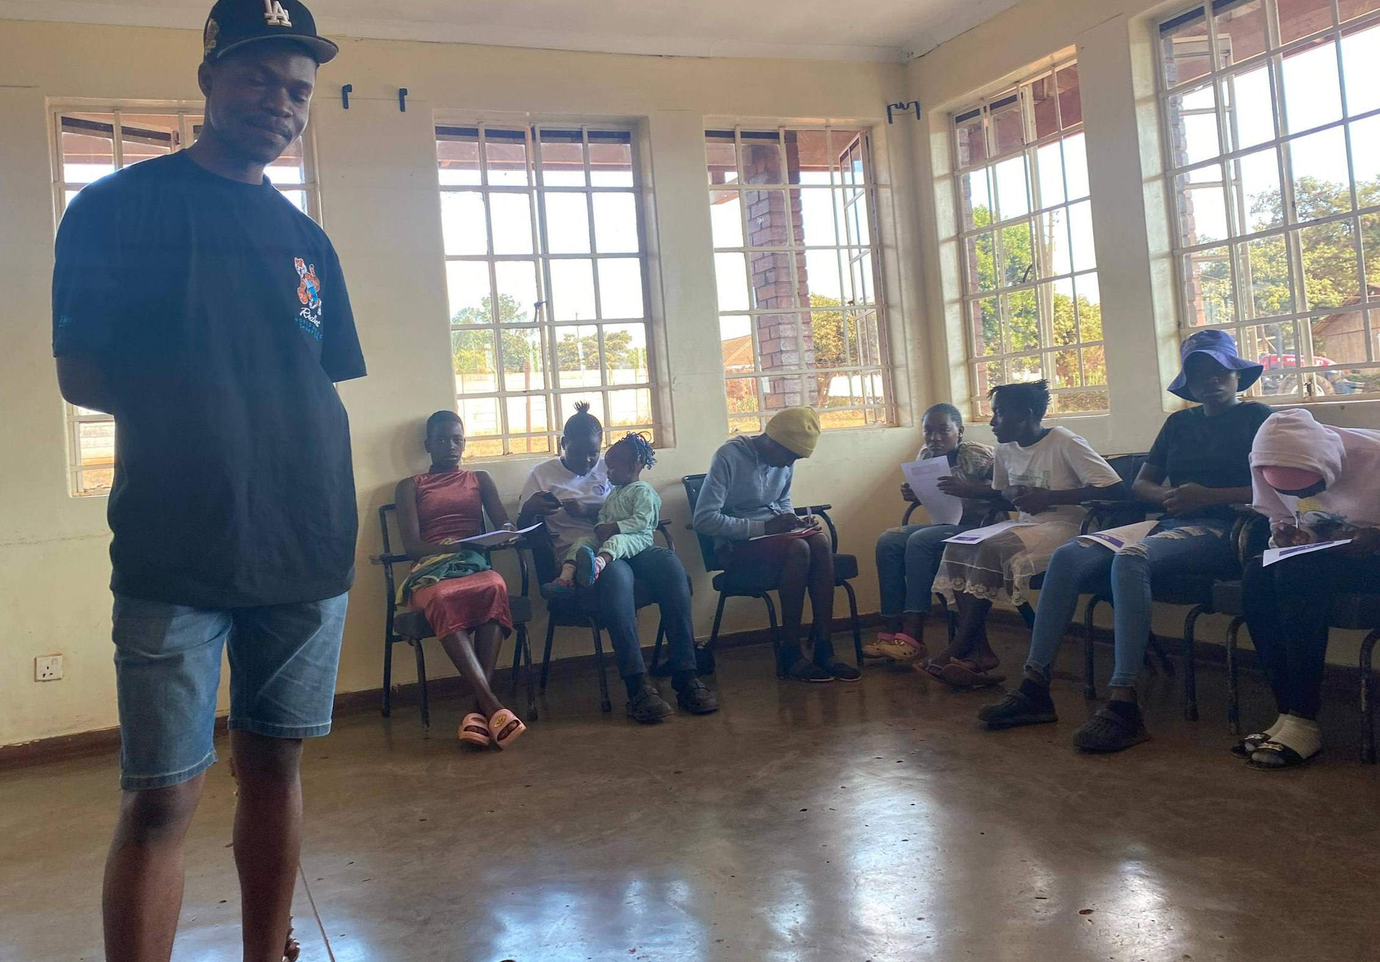
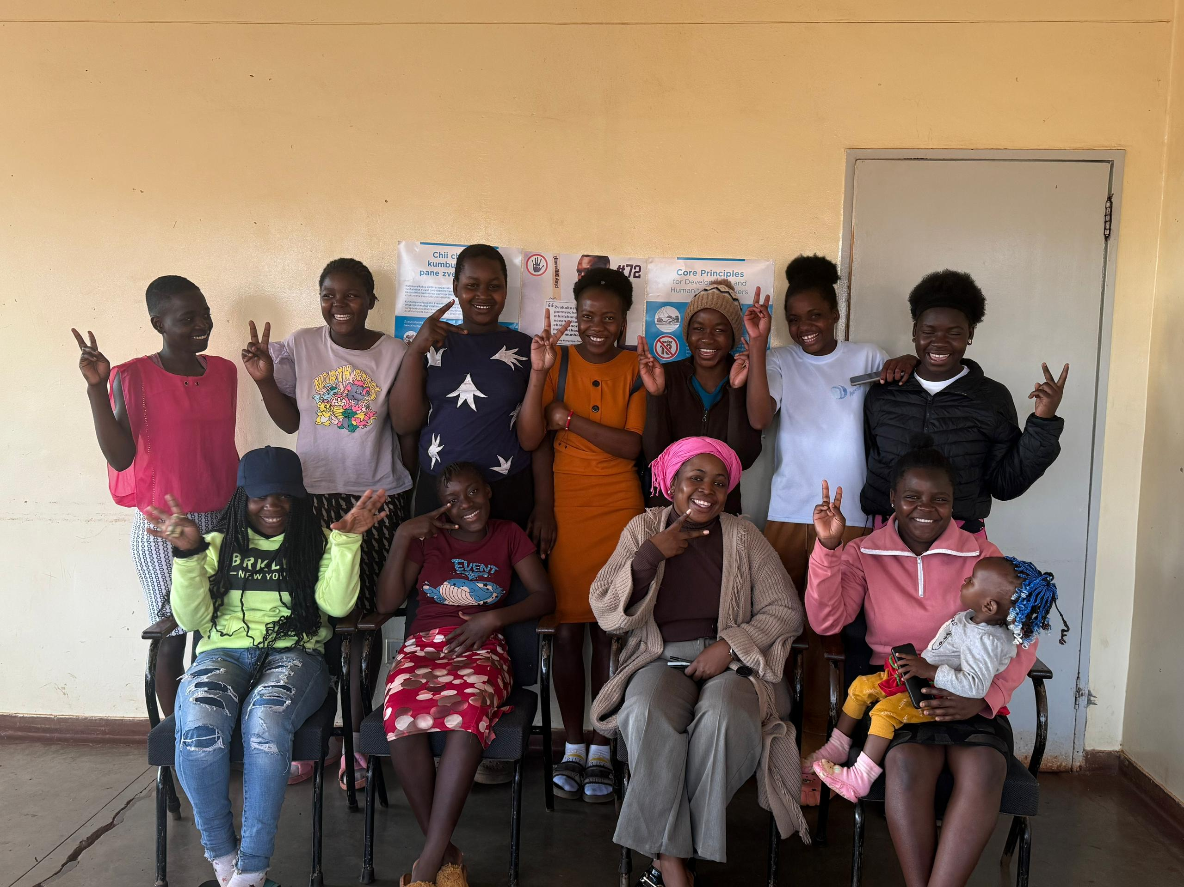
Background
There was a clear gap between national SRHR policies and what girls in Hatcliff were actually experiencing on the ground
Voice and Choice Summit 2026 \ Voice and Choice Summit 2026

Slide 5
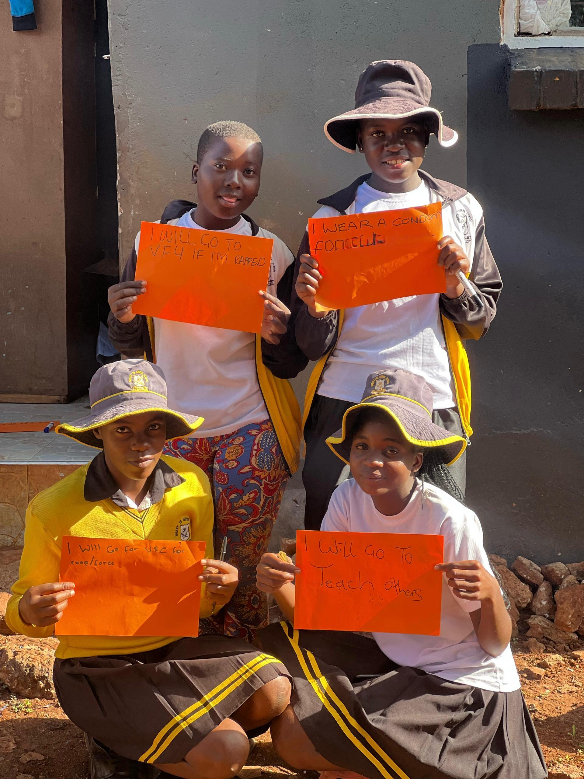
The change
The change came about through the intentional creation of a safe, community based platform for AGYW to access comprehensive Sexual and Reproductive Health and Rights information
We recognised that early and unitended teenage pregnancies are strongly linked to lack of knowledge, silence around sexuality and limited youth friendly spaces. Thus the advocacy focused on addressing these root causes at community level
The change was driven by the following key activities:
Establishment of safe dialogue spaces for adolescent girls Interactive SRHR education sessions on contraceptives, consent, healthy relationships and bodily autonomy
Peer learning and mentorship circles
Confidence-building and leadership development activities
Community engagement conversations to reduce stigma around SRHR discussions
Encouraging girls to understand both their rights and responsibilities in making informed reproductive health decisions
Voice and Choice Summit 2026 \ Voice and Choice Summit 2026

Slide 6
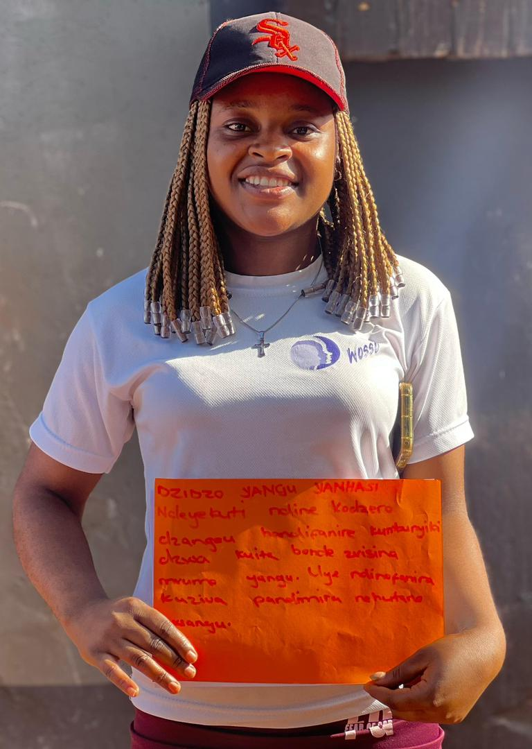
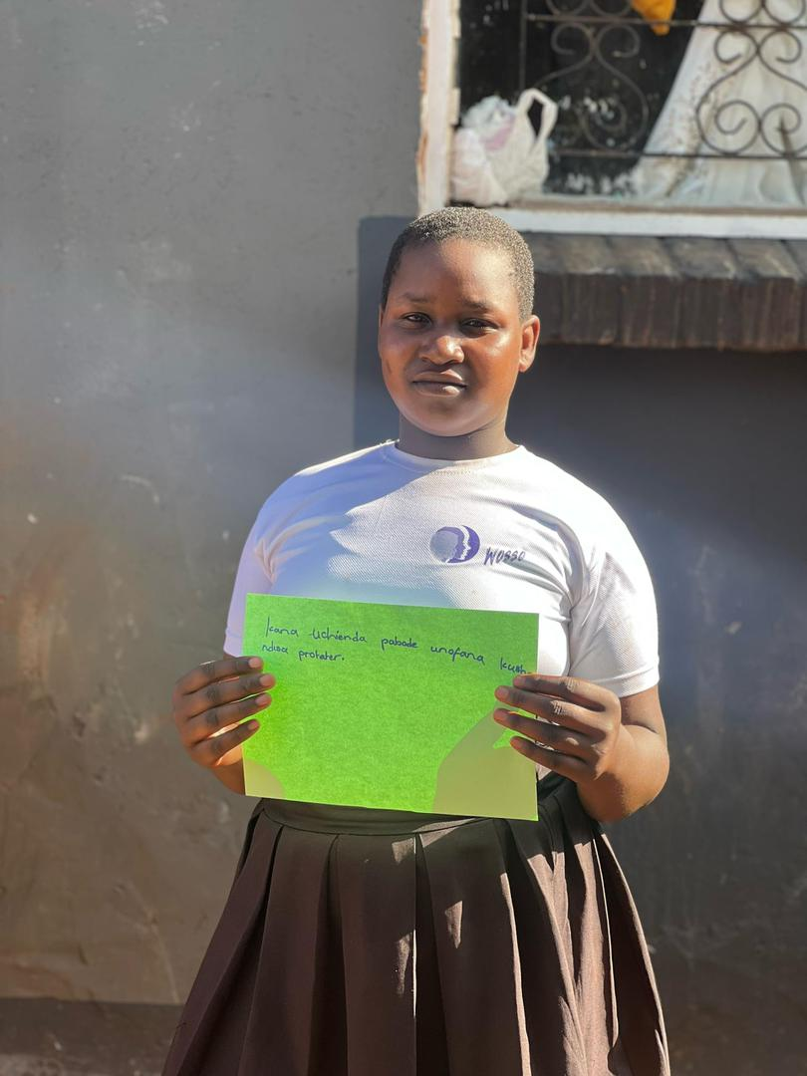
The Change
Participants included:
Adolescent girls and young women from Hatcliffe
Peer mentors
Community stakeholders engaged during sensitization efforts
Other NGO representatives operating in the community (SAfAIDS, REPSSI, Mwanasikana waNhasi)
“Before SafePath, we were told that talking about SRHR is disrespectful and that girls should just keep quiet. Now we understand that knowing our rights is not wrong. Even when people say we are being ‘spoiled,’ we support each other and continue speaking up for our health and our futures.”
— Adolescent girl, SafePath participant, Hatcliffe
Voice and Choice Summit 2026 \ Voice and Choice Summit 2026

Slide 7
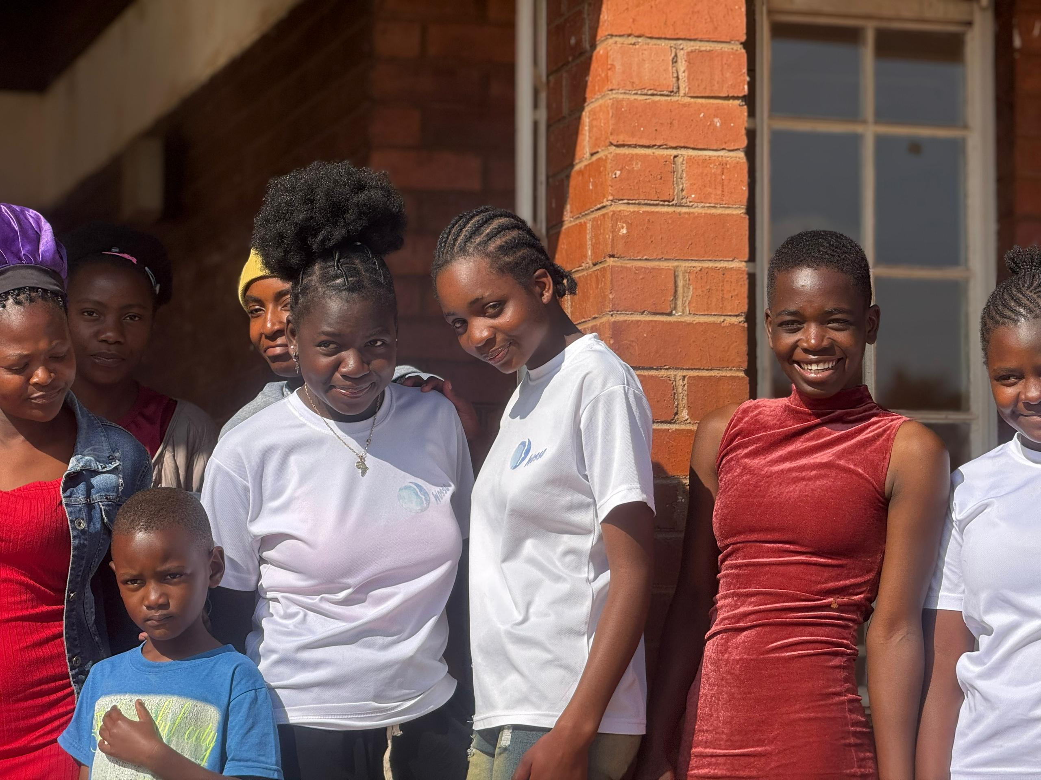
The change
The change was overwhelmingly positive.
By the end of the advocacy Project:
Girls demonstrated increased SRHR knowledge
Participants reported greater confidence in making informed decisions
There was improved openness in discussing sexual health issues
Girls expressed stronger understanding of consent and healthy relationships
The shift was particularly visible in the way participants began asking informed questions, challenging myths and supporting peers with correct information within the community
The primary beneficiaries were adolescent girls and young women in Hatcliffe aged between 13 -24.
Voice and Choice Summit 2026 \ Voice and Choice Summit 2026

Slide 8
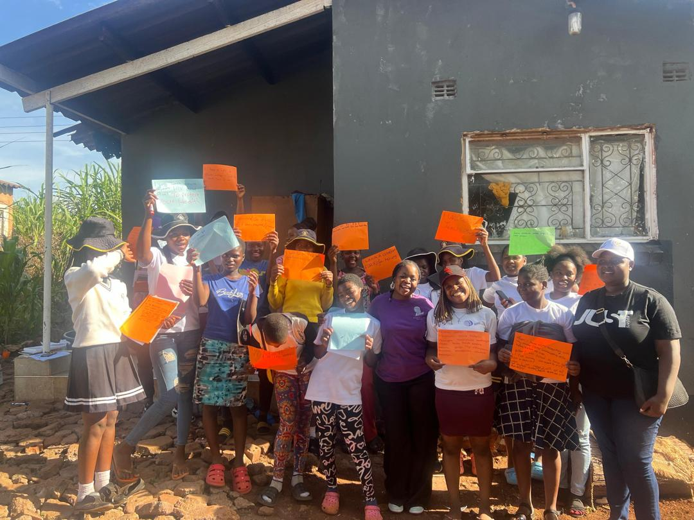
The change
The situation has shifted from silence and misinformation to increased awareness and dialogue
There is now:
A functioning safe space for SRHR engagement
Improved confidence among participating girls and young women to make informed SRHR decisions
Greater peer-to-peer sharing of accurate SRHR information
Increased recognition of the importance of comprehensive sexuality education at community level
While adolescent pregnancy remains a national challenge, SafePath Zimbabwe has contributed to a localized shift in knowledge, attitudes and empowerment in Hatcliffe which demonstrates that community led, youth-centered interventions can drive meaningful change
Voice and Choice Summit 2026 \ Voice and Choice Summit 2026

Slide 9
Significance of Change
The change brought about through SafePath Zimbabwe is significant because it contributes directly to strengthening girl’s agency, voice and informed choice which are core pillars of the broader gender equality and SRHR movement.
By increasing access to accurate SRHR information and creating safe spaces for dialogue, the project helped shift adolescent girls from being passive recipients of information to active rights-holders who are better equipped to make decisions about their bodies and futures.
For the movement, this change demonstrates that:
Community-led, youth-centered interventions are effective.
Girls are not passive beneficiaries they are capable advocates and change agents
Silence and stigma around sexuality can be dismantled through safe dialogue
Preventing adolescent pregnancy requires empowerment, not restriction
At a time when SRHR faces backlash and misinformation in many spaces, the project contributes to safeguarding gains in bodily autonomy and reproductive rights by grounding advocacy in community engagement and lived realities
Voice and Choice Summit 2026 \ Voice and Choice Summit 2026

Slide 10
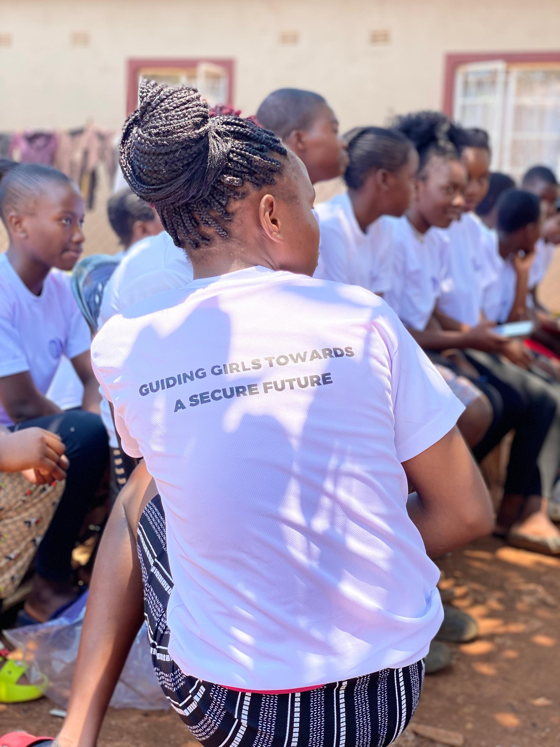
Significance of Change
Going forward:
The impact of this change creates a foundation for scaling and deepening the SRHR advocacy in several key ways:
Strengthening Advocacy for Comprehensive Sexuality Education
Scaling the Safe Space Model
Engagement with parents, community leaders and service providers to ensure sustainability and reduced resistance to SRHR education
Enhancing Youth Leadership
Advancing adolescent girl’s sexual and reproductive health is central to achieving gender justice and sustainable development
Voice and Choice Summit 2026 \ Voice and Choice Summit 2026

Slide 11
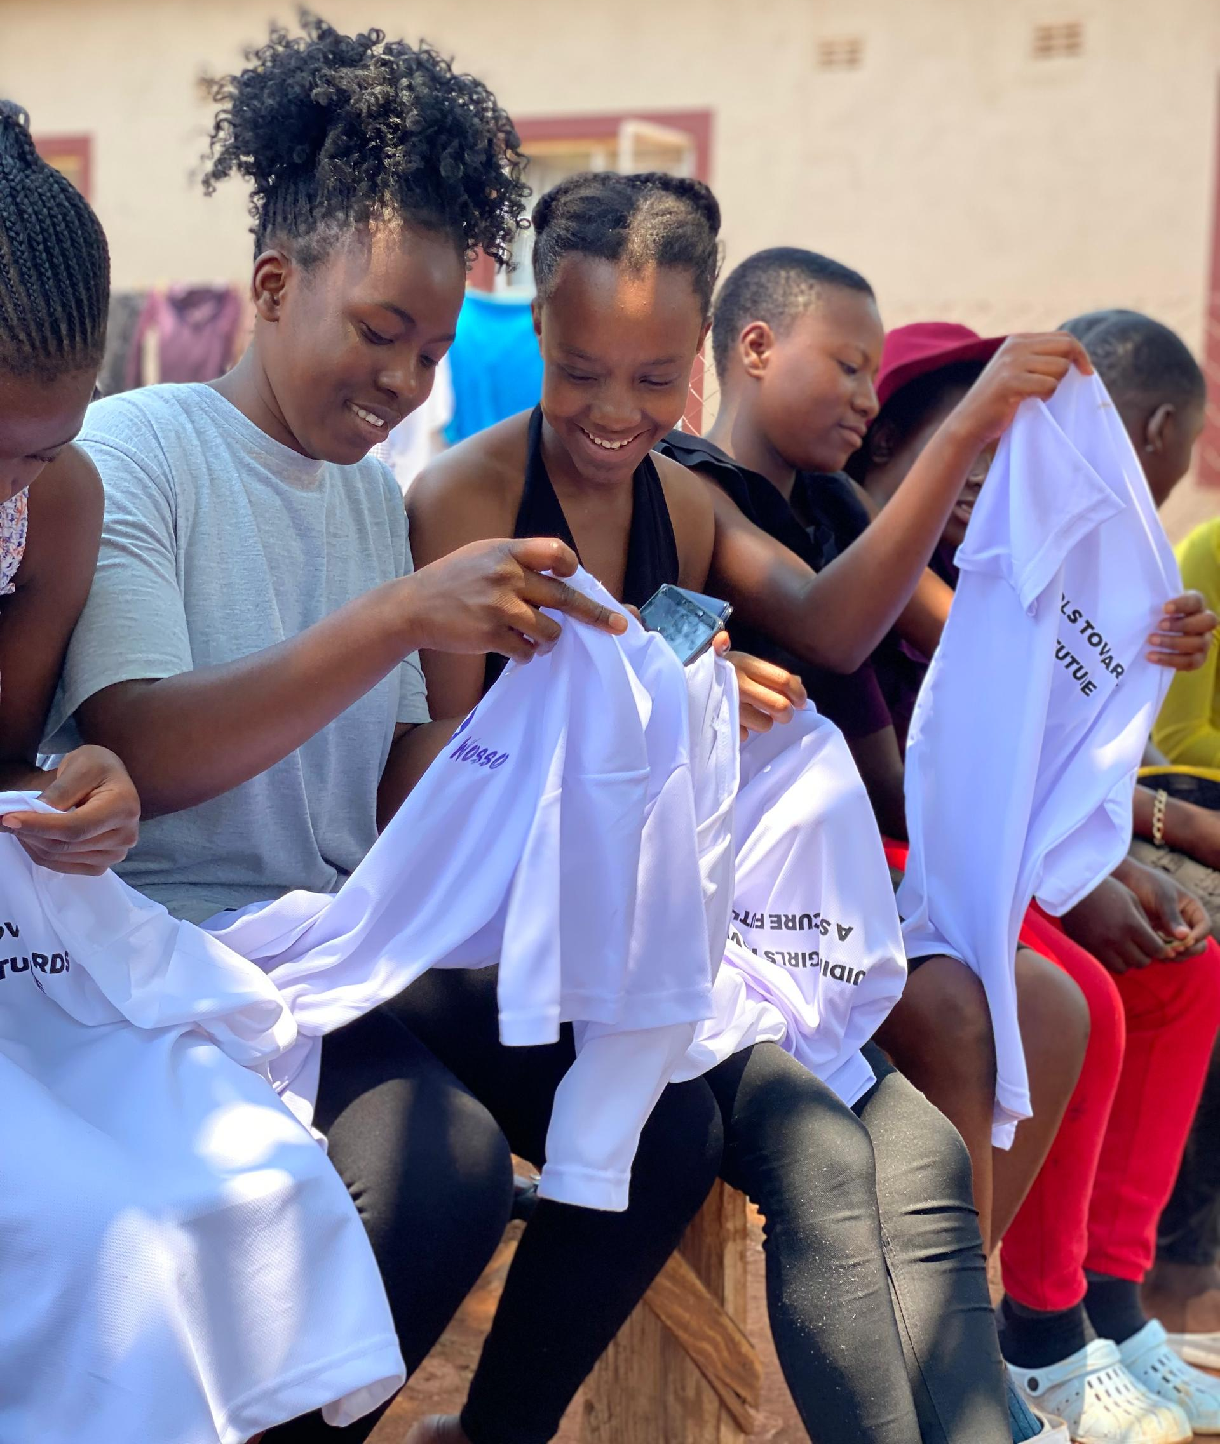
Sustainability
The change will be sustained by strengthening peer-led structures among AGYW, enabling them to continue sharing SRHR information, mentoring one another and providing ongoing peer support beyond the project period. By building the confidence and leadership capacity of girls, SafePath Zimbabwe promoted ownership of knowledge and ensured that learning is not dependent solely on external facilitation
To support scale-up, the project will continue to document key lessons, tools and participatory approaches used during implementation, creating simple models that can be adapted in other communities facing similar challenges. Strengthened partnerships with local schools, community leaders, health service providers and youth-focused organisations will help extend the project’s reach and embed its approach within existing community structures.
Voice and Choice Summit 2026 \ Voice and Choice Summit 2026

Slide 12
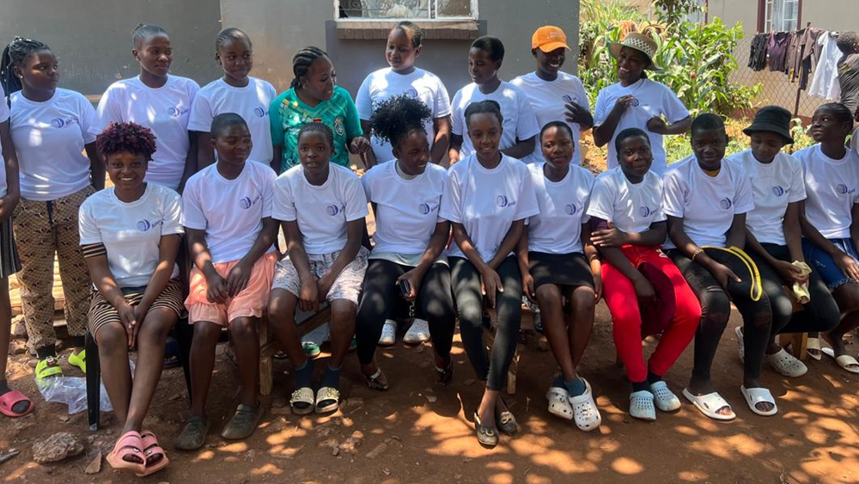
Beneficiaries
Number of;
Female – 35
Male – 8
Female – 12
Male – 2
“I used to think consent meant you cannot say no once you are in a relationship. Through the sessions, I learned that consent must be clear and can be withdrawn at any time. I now feel confident to say no and to protect myself.”
— Young woman, SafePath participant
Voice and Choice Summit 2026 \ Voice and Choice Summit 2026

Slide 13
Challenges & Lessons learnt
Challenges
Backlash and resistance from some parents and gurdians however the linking and learning sessions with fellow WOSSO Fellows played a critical role in strengthening the implementation of SafePath Zimbabwe advocacy plan and resisting backlash, through these sessions, I was exposed to diverse, feminist-led advocacy strategies being applied by fellows working in different country and community contexts
Lessons learnt
Locally grounded, small-scale initiatives can still influence meaningful social change when strategically designed
Story-based advocacy is critical particularly using personal narratives and community testimonies to humanize data and strengthen engagement with community leaders in HIV/SRHR issues
Voice and Choice Summit 2026 \ Voice and Choice Summit 2026

Slide 14
Next Steps
Continuous engagement of the cohort of young leaders and applications for other sources of funding to organise more sessions and events
This year the initiative plans to introduce digital engagement platforms (WhatsApp groups, online resource sharing, youth-friendly content) to reach girls who could not attend physical sessions and to counter SRHR misinformation online
It will also continue to build strategic partnerships with health service providers, schools and youth-focused organisations to ensure improved access to youth-friendly SRHR services and referral pathways
Voice and Choice Summit 2026 \ Voice and Choice Summit 2026

