Slide 1
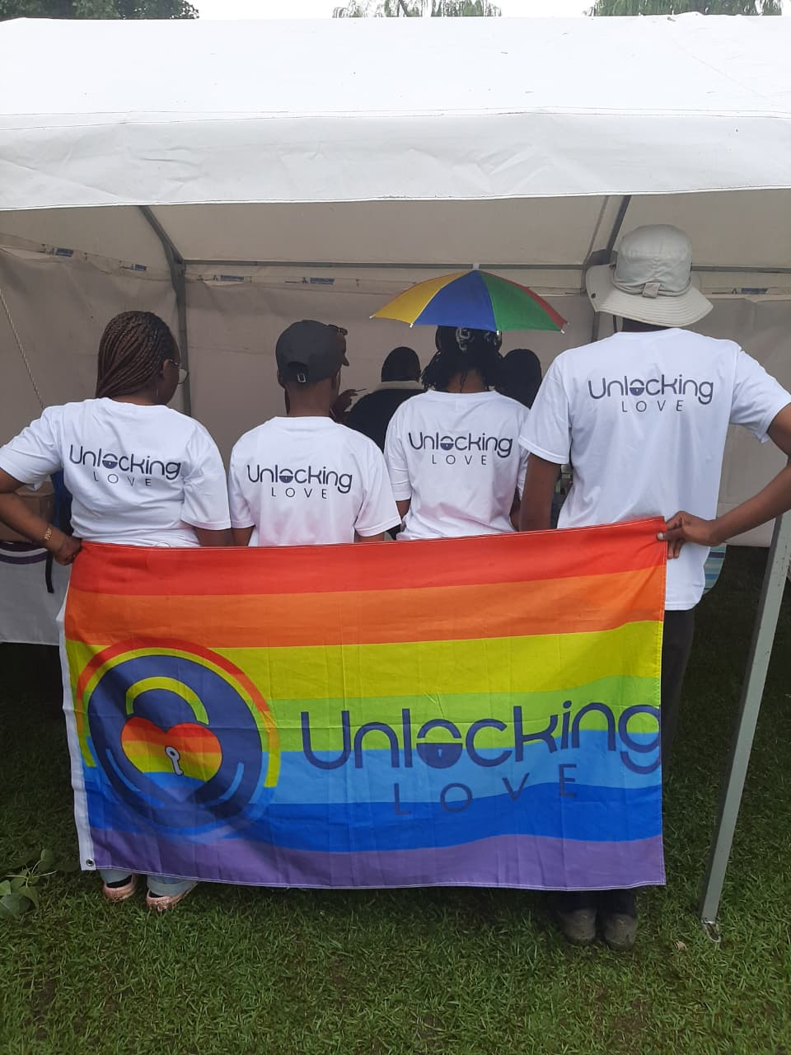


Voice and Choice
Summit 2026-Story of Change Category
Your logo goes here
Lesotho: Love, UNLOCKED—Queer Storytelling Challenging Gender Norms and Exclusion
Maseru, Lesotho
By Unlocking Love Foundation
Presenter : Irene Nchephe
Voice and Choice Summit 2026 \ Voice and Choice Summit 2026

Slide 2
Synopsis– brief overview what this is about
Name | Lesotho: Love, UNLOCKED—Queer Storytelling Challenging Gender Norms and Exclusion
Designation | A Queer-Centred Storytelling & Gender Norm Change Initiative
Organisation | Unlocking Love Foundation
Country | Lesotho
Category | Stories of Change
Summary | Love, UNLOCKED is a queer-led storytelling initiative that challenges harmful gender norms and advances inclusion for LGBTIQ+ communities in Lesotho. Through trauma-informed video conversations, the project amplifies affirming narratives of queer love and belonging, countering stigma and invisibility. By shifting public discourse and generating advocacy content, Love, UNLOCKED contributes to long-term social norm change, improved wellbeing, and stronger gender justice movements.
Voice and Choice Summit 2026 \ Voice and Choice Summit 2026

Slide 3
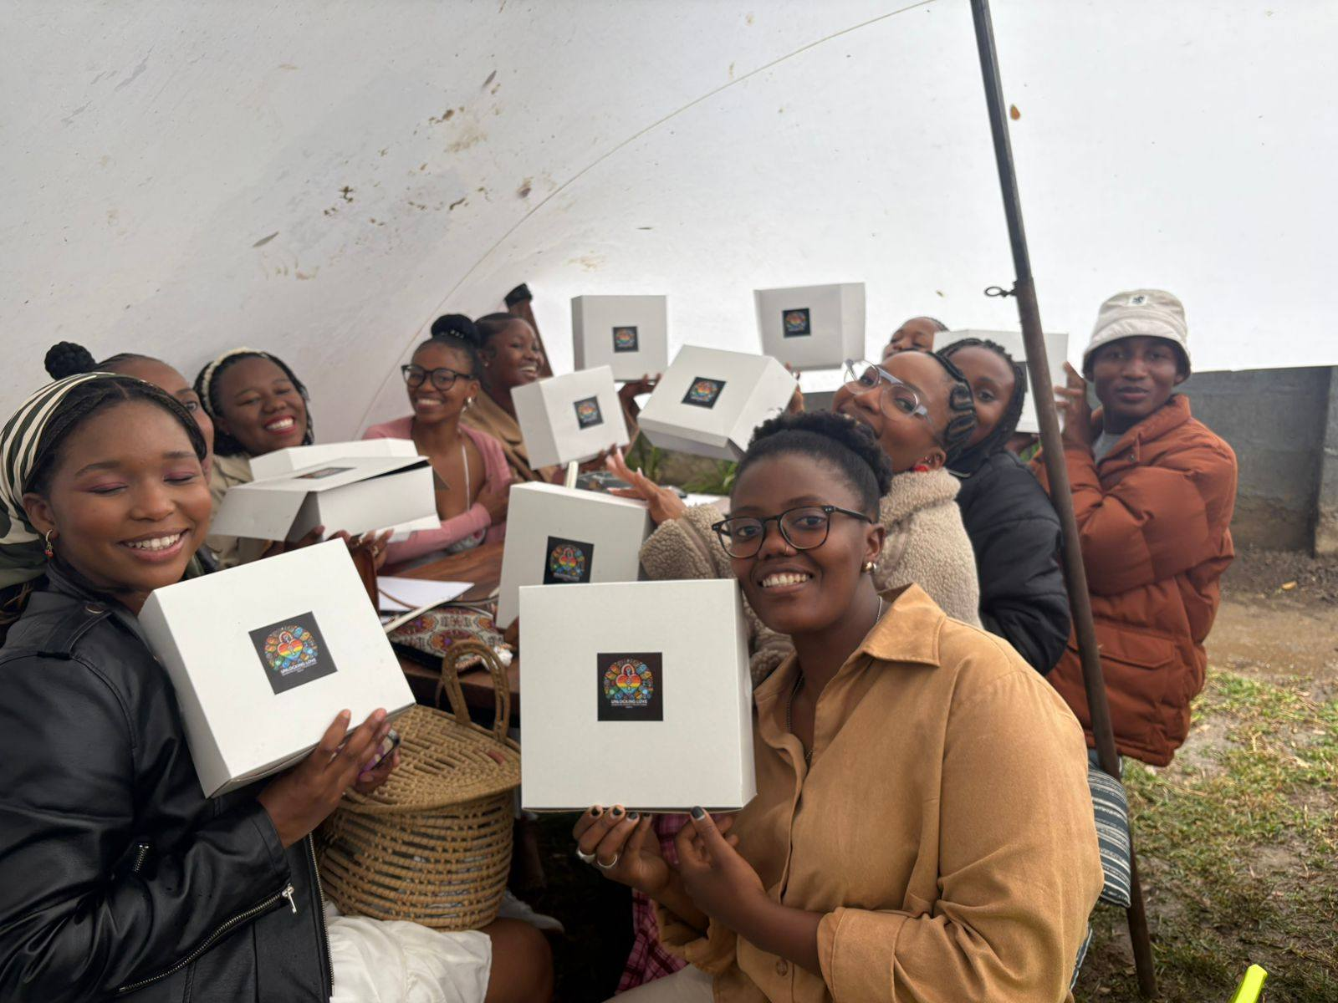
Background(problem, actions, change, evidence)
Background
In Lesotho, dominant social norms define love through heteronormative and cisnormative frameworks.
Queer relationships are often invisible, stigmatised, or framed through narratives of struggle and controversy.
This exclusion contributes to discrimination, isolation, and negative mental wellbeing outcomes for LGBTIQ+ individuals.
Voice and Choice Summit 2026 \ Voice and Choice Summit 2026

Slide 4
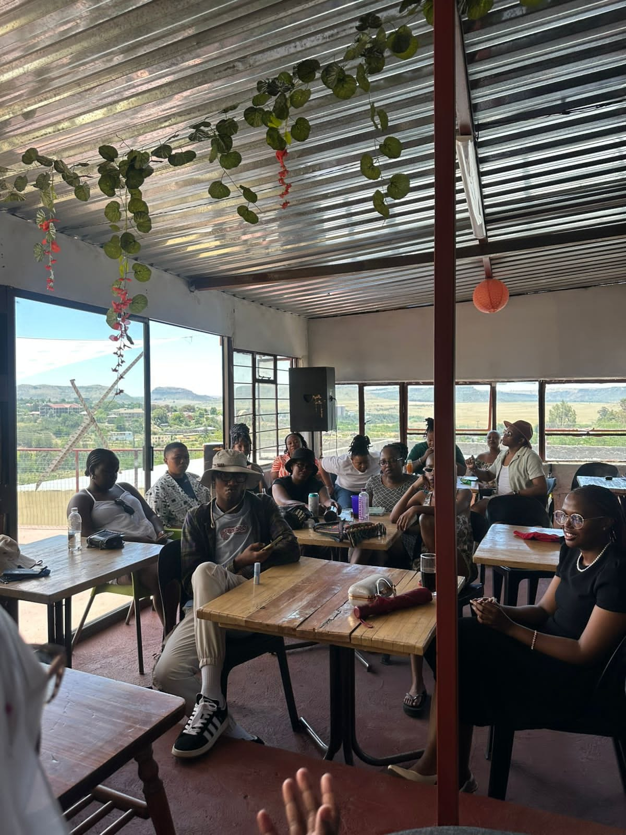
Background(problem, actions, change, evidence)
Specific Gap Addressed
Lack of affirming, locally grounded narratives of queer love and belonging.
Limited platforms for queer people to define love on their own terms.
Actions Taken
Launched Love, UNLOCKED, a trauma-informed storytelling initiative.
Facilitated paired video conversations between queer partners, friends, and chosen families.
Created safe spaces for guided reflection, vulnerability, and authentic expression.
Voice and Choice Summit 2026 \ Voice and Choice Summit 2026

Slide 5
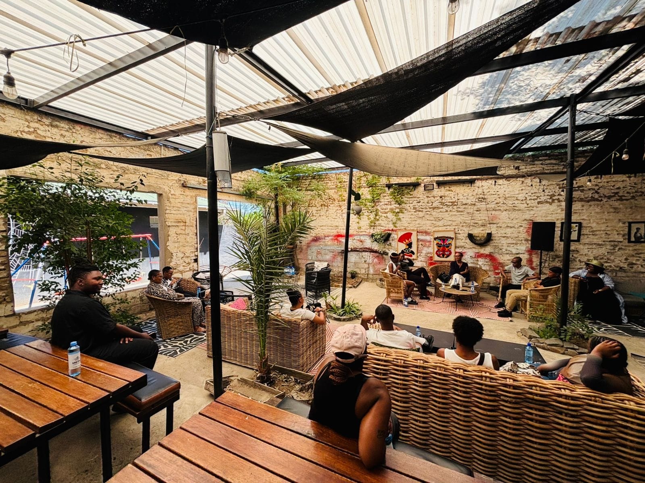
Background(problem, actions, change, evidence)
Emerging Change
Increased affirmation and visibility for participants.
Creation of advocacy content to shift public discourse.
Expected long-term contribution to gender norm change and inclusion.
Voice and Choice Summit 2026 \ Voice and Choice Summit 2026

Slide 6
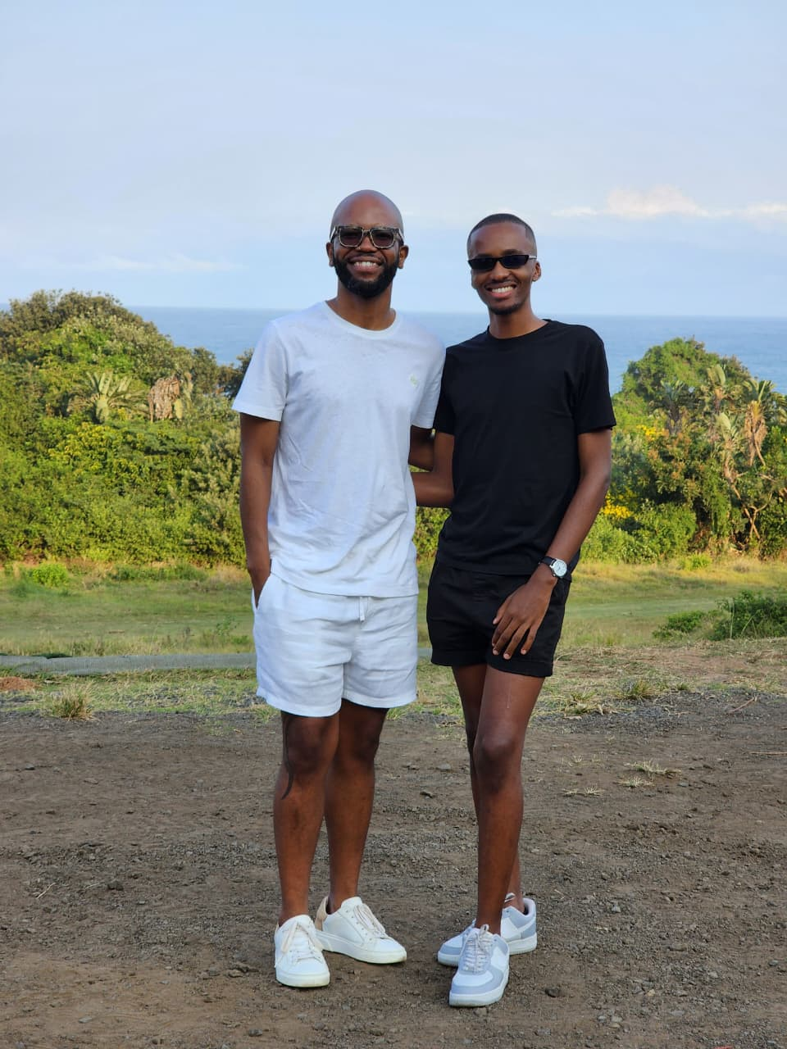
Background
Context / Problem
In Lesotho, dominant cultural and social norms define love and relationships through heterosexual and cisgender frameworks.
Queer relationships are often invisible, misunderstood, or associated with stigma and controversy.
The lack of positive representation contributes to social exclusion, internalised stigma, and negative mental wellbeing among LGBTIQ+ individuals.
Voice and Choice Summit 2026 \ Voice and Choice Summit 2026

Slide 7
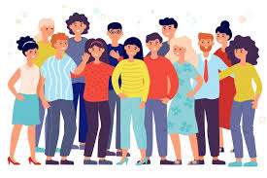
Background
Situation Before the Project
Limited safe platforms for queer individuals to openly express love and vulnerability.
Public narratives rarely reflected affirming, local stories of queer care, intimacy, and chosen family.
Gender norms remained largely unchallenged in community discourse.
Voice and Choice Summit 2026 \ Voice and Choice Summit 2026

Slide 8
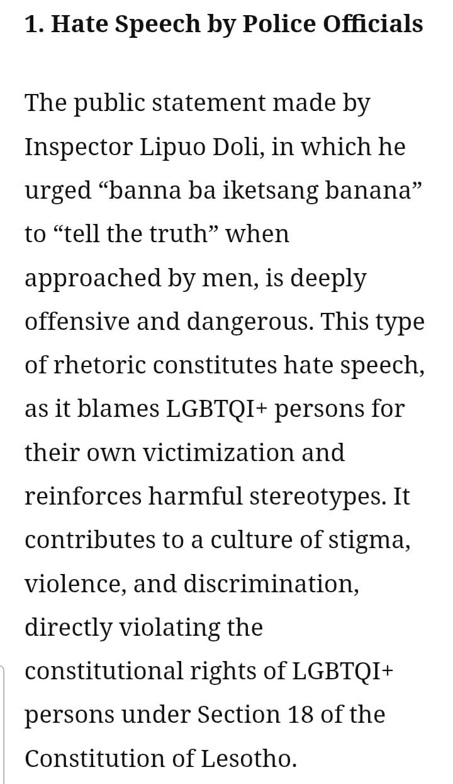
Background
Key Objectives of the Project
Challenge harmful gender norms and heteronormative definitions of love.
Amplify authentic, affirming queer narratives.
Promote visibility, dignity, and mental wellbeing.
Generate advocacy content to support long-term inclusion and social norm change.
STATEMENT TO THE COMMISSIONER OF POLICE: CONCERN REGARDING HATE SPEECH, MISINFORMATION, AND INVESTIGATIVE INTEGRITY IN THE MURDER CASE OF KABELO SESELI : Written By The People’s Matrix 2025
Voice and Choice Summit 2026 \ Voice and Choice Summit 2026

Slide 9
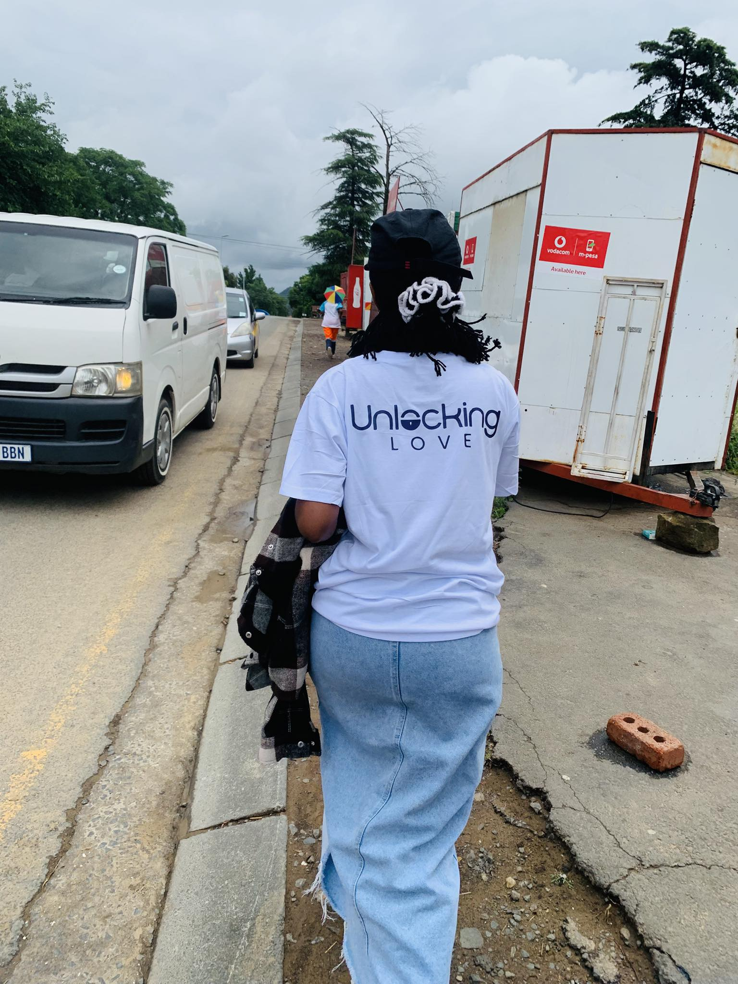
Background
Organisation Behind the Project
Love, UNLOCKED is led by Unlocking Love, a queer-led organisation based in Lesotho working to advance dignity, equality, and wellbeing for LGBTIQ+ communities through advocacy and creative engagement.
Voice and Choice Summit 2026 \ Voice and Choice Summit 2026

Slide 10
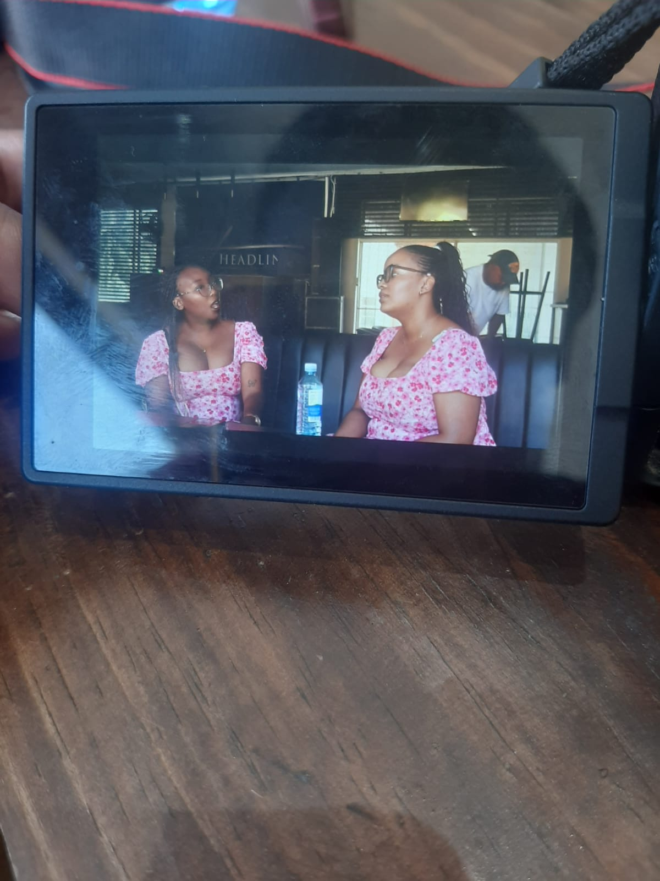
Actions
How Did the Change Come About?
Activities & Actions
Designed and launched a structured, trauma-informed storytelling initiative.
Facilitated paired video conversations between queer partners, friends, and chosen families.
Used guided prompts, mutual questioning, and shared activities to encourage authentic expression.
Prioritised consent, safety, and participant control over their narratives.
Leadership & Participation
Led by Unlocking Love, a queer-led organisation based in Lesotho.
LGBTIQ+ individuals participated as storytellers and co-creators.
Community members contributed to shaping messaging and visibility approaches.
Voice and Choice Summit 2026 \ Voice and Choice Summit 2026

Slide 11
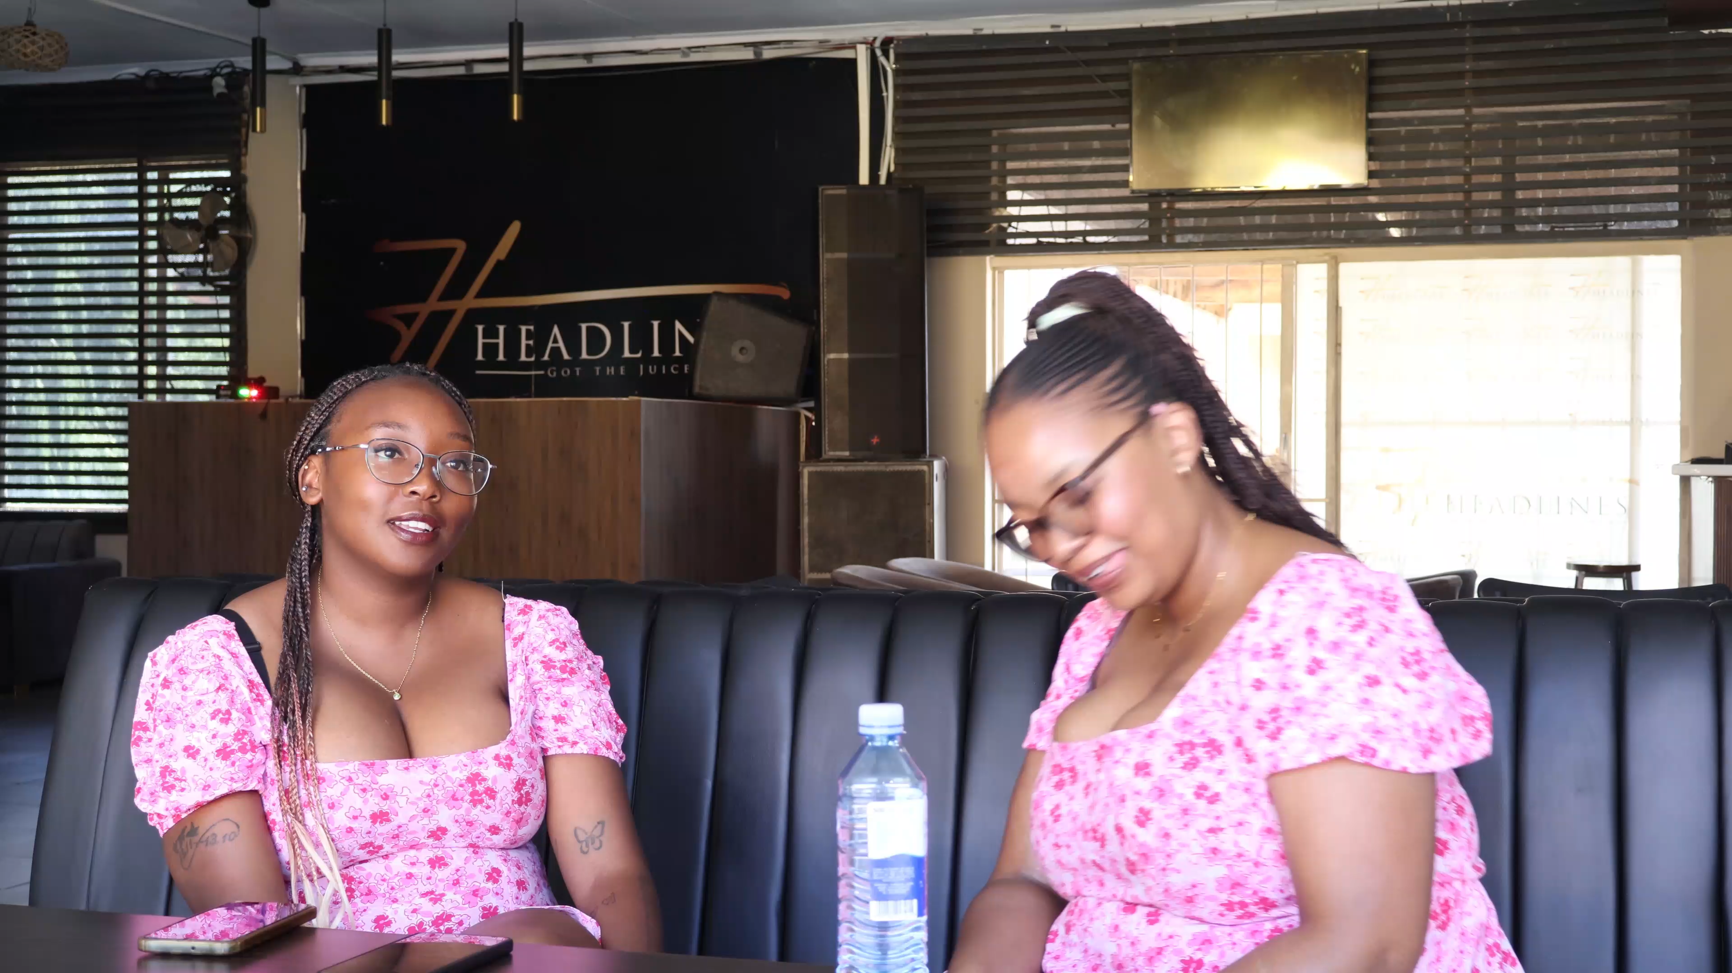
Context
Location, Target Group & Issues Addressed
Based in: Lesotho
Project implemented in: Lesotho, with relevance to broader Southern African contexts
Most affected: LGBTIQ+ individuals, particularly queer women and gender-diverse persons, who experience stigma, invisibility, discrimination, and limited safe spaces to express love and identity.
Issues addressed:
  Harmful gender norms and heteronormative definitions of love
  Social exclusion and lack of positive queer representation
  Stigma impacting mental wellbeing and community belonging
Love, UNLOCKED responds by creating affirming storytelling spaces that centre queer voices, visibility, and dignity.
Voice and Choice Summit 2026 \ Voice and Choice Summit 2026

Slide 12
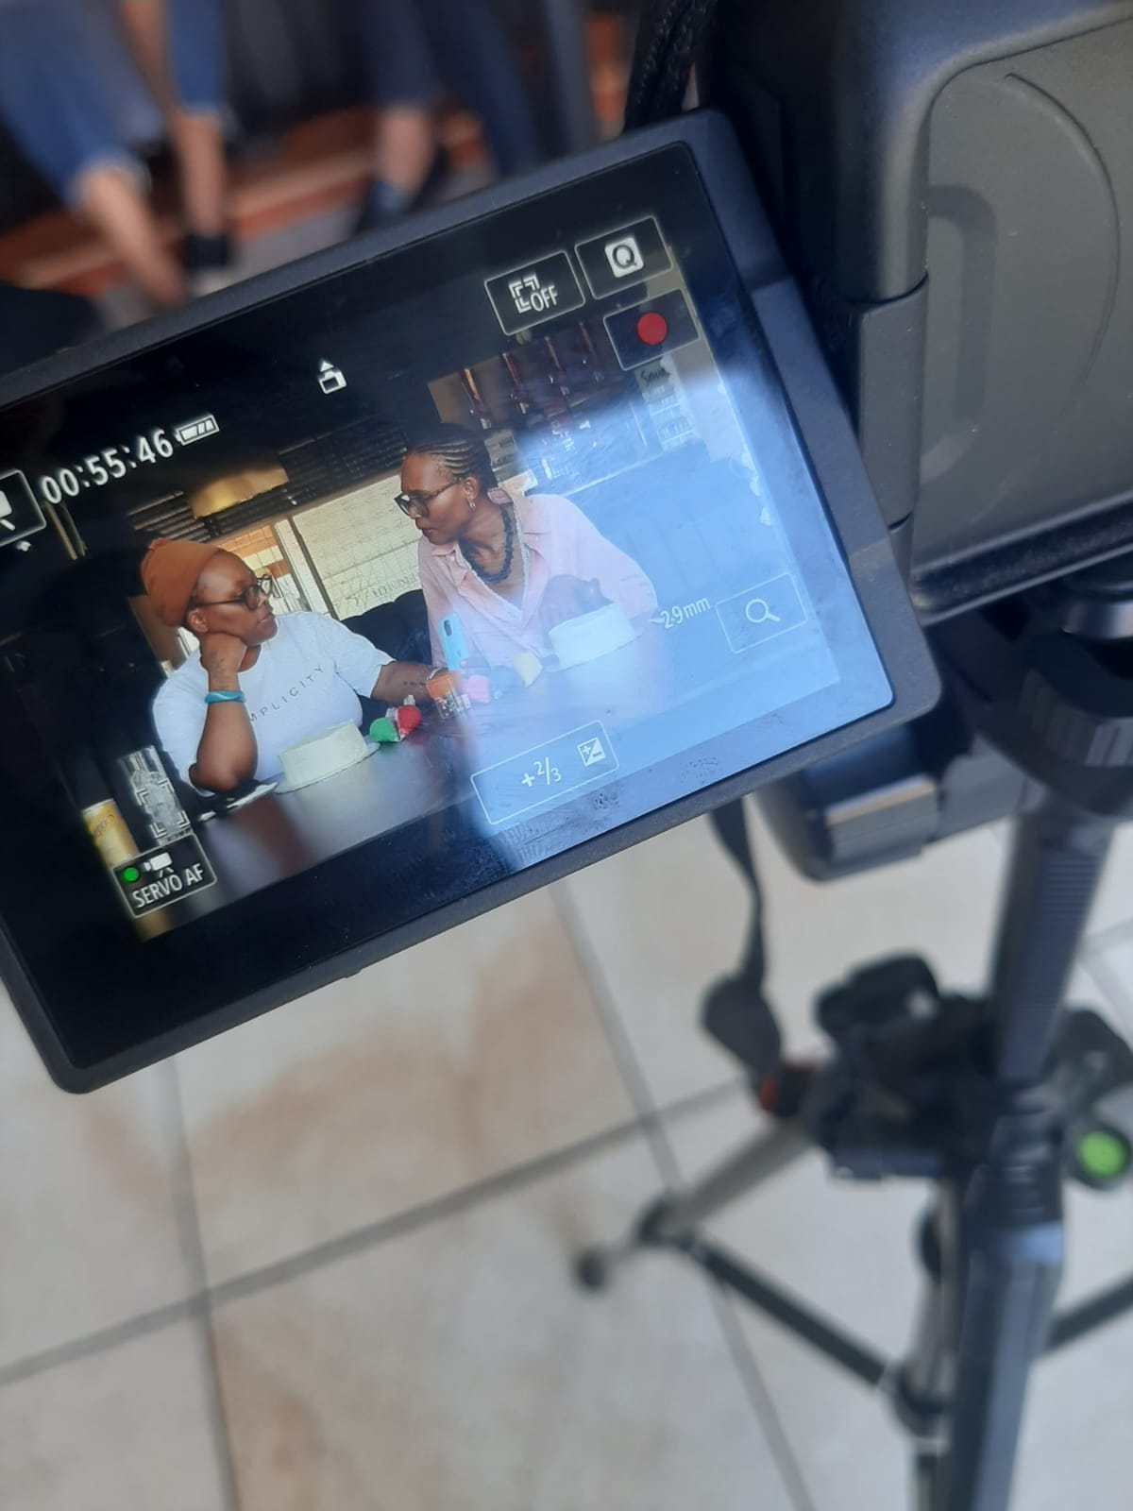
The change – impact
The Change
What changed: Increased visibility and affirmation of queer love narratives through structured storytelling.
When & where: Ongoing during the implementation of Love, UNLOCKED in Lesotho.
Nature of change: Positive shifting narratives from stigma and invisibility to dignity, care, and belonging.
Who benefited:
  LGBTIQ+ participants gained validation, emotional safety, and confidence in sharing their stories.
  Broader audiences benefit from exposure to humanising, locally grounded queer narratives.
Situation now:
  Queer individuals have a safe platform to define love on their own terms.
  Advocacy content is being developed to influence dialogue and contribute to longer-term gender norm change.
Voice and Choice Summit 2026 \ Voice and Choice Summit 2026

Slide 13
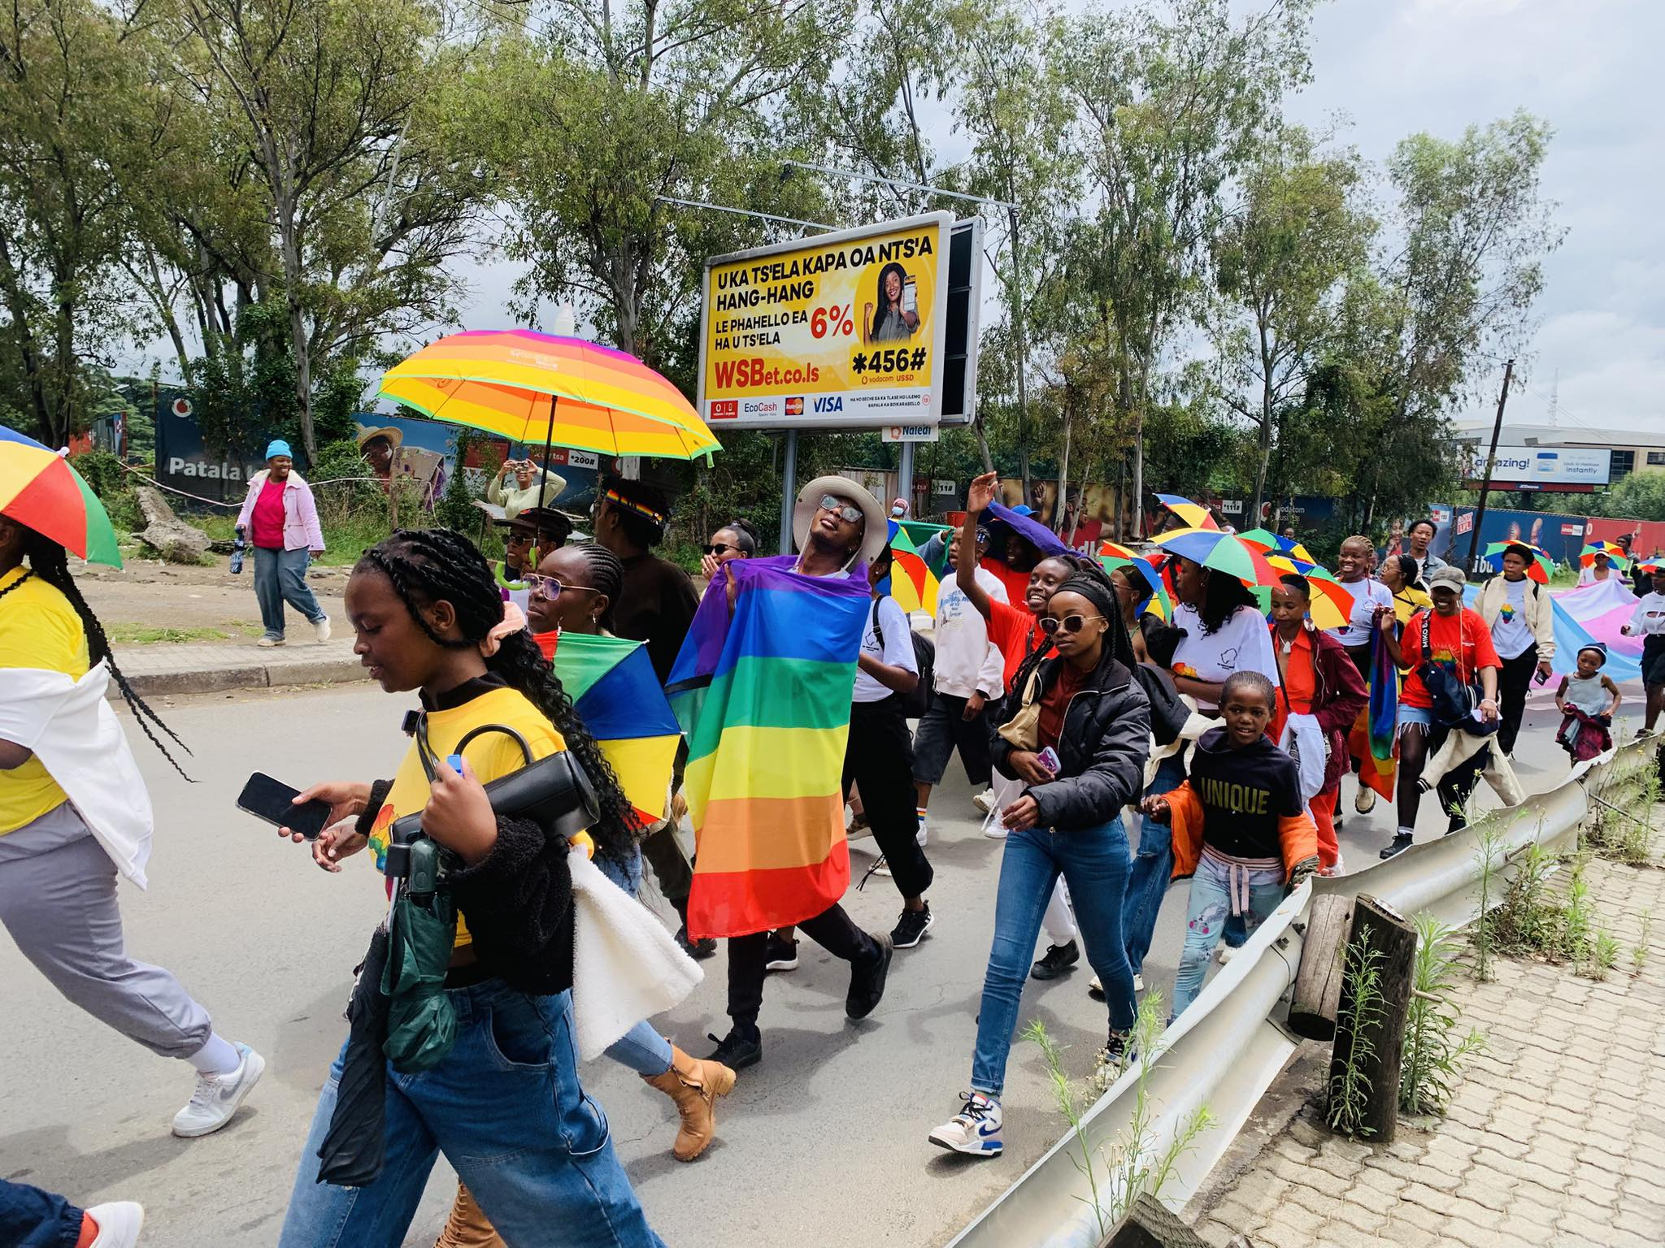
Significance of the Change
Significance for the Movement & Next Steps
Expands gender justice work beyond protection and risk to include dignity, joy, and belonging.
Strengthens the LGBTIQ+ movement by centring community-led narratives and lived experience.
Provides locally grounded advocacy content to influence public discourse and institutional engagement.
Challenges harmful gender norms at a cultural level, addressing root causes of exclusion and violence.
Effect on Next Steps
Integrate storytelling into broader advocacy and community dialogue initiatives.
Scale digital dissemination to reach wider audiences across Lesotho and the region.
Use content to support partnerships, policy engagement, and movement-building efforts.
Position creative storytelling as a sustainable tool for long-term social norm change.
Photo Cred : Queer Worx 2025
Voice and Choice Summit 2026 \ Voice and Choice Summit 2026

Slide 14
Beneficiaries
 | Number of participants
Female – Direct beneficiaries | 7
Male – Direct beneficiaries | 1
Female – Indirect beneficiaries (e.g. through other networks) | n/a
Male – Indirect beneficiaries (e.g. through other networks) | n/a
Female – Online beneficiaries (e.g. website access, mailing lists, scholarly articles) | n/a
Male – Online beneficiaries (e.g. website access, mailing lists, scholarly articles) | n/a
Total | 8
Voice and Choice Summit 2026 \ Voice and Choice Summit 2026

Slide 15
Challenges & Lessons learnt
Challenges & Mitigation
Key Challenges
Stigma and safety concerns for participants sharing personal stories.
Risk of online backlash or negative public reactions.
Limited financial and technical resources during implementation.
Emotional vulnerability associated with storytelling.
Mitigation Measures
Trauma-informed approach with informed consent and participant control over visibility.
Option for anonymity or limited disclosure.
Pre-interviews and emotional safety checks before filming.
Clear community guidelines for online engagement.
Phased implementation aligned with available resources.
Lessons Learned
Storytelling is a powerful and cost-effective tool for challenging harmful gender norms.
Safety, consent, and emotional preparedness must be prioritised in community-led storytelling.
Queer narratives resonate more deeply when they centre dignity, joy, and authenticity not only struggle.
Early community engagement strengthens trust and participation.
Organisational systems (governance, finance, safeguarding) must grow alongside programme innovation.
Gradual, phased implementation improves quality and sustainability.
Voice and Choice Summit 2026 \ Voice and Choice Summit 2026

Slide 16
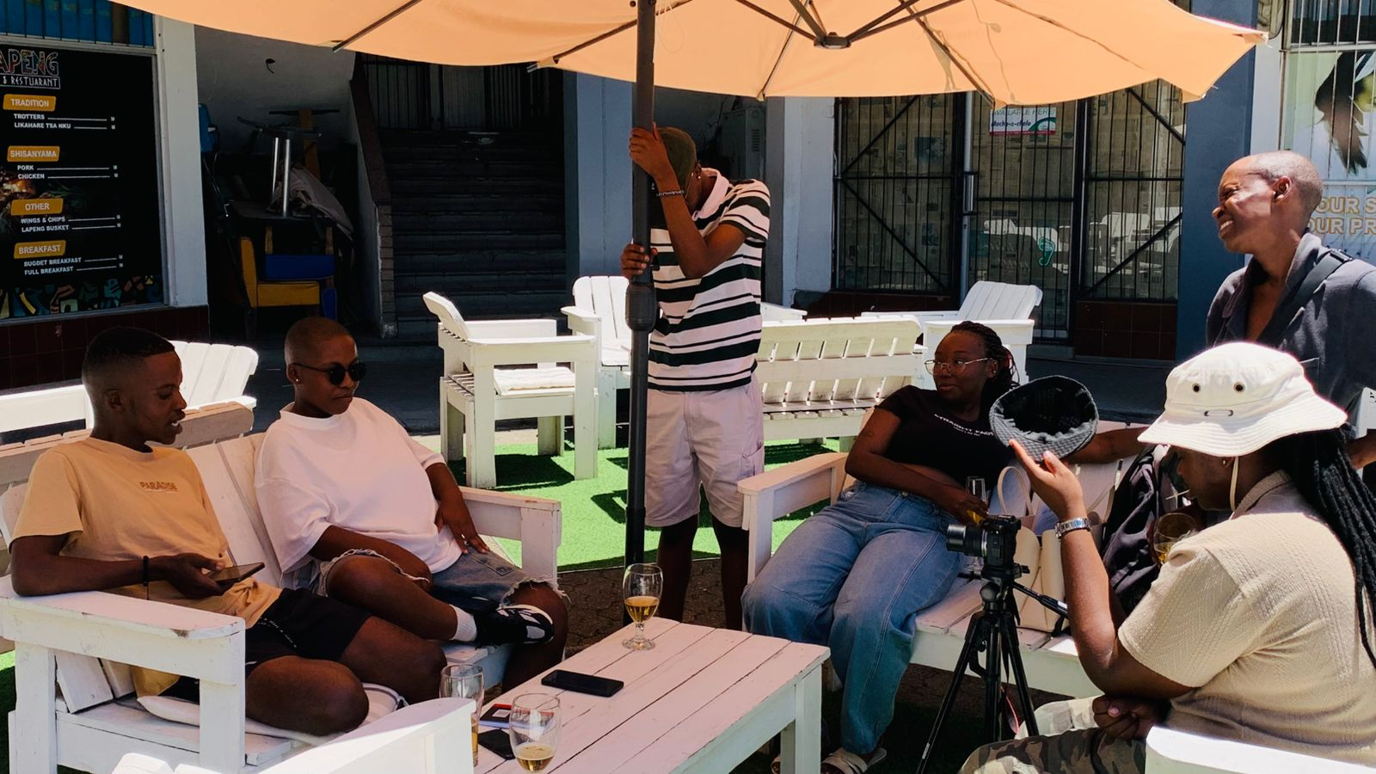
Sustainability
Sustainability & Scale
Sustainability Measures
Integrated Love, UNLOCKED into Unlocking Love’s broader advocacy and storytelling strategy.
Developed reusable digital content (videos, clips, quotes) for ongoing campaigns and dialogues.
Built community ownership by positioning participants as co-creators, not subjects.
Strengthening governance and financial systems to support long-term programme continuity.
Sustaining & Scaling Up
Expand digital dissemination to reach wider audiences locally and regionally.
Use content in workshops, community dialogues, and institutional engagements.
Develop partnerships with feminist and LGBTIQ+ networks for cross-platform amplification.
Replicate the storytelling model with new participants and themes (e.g., youth, trans voices, rural communities).
Voice and Choice Summit 2026 \ Voice and Choice Summit 2026

Slide 17
Next Steps
Our Plans
Complete production and release of the Love, UNLOCKED video series.
Launch a targeted digital campaign to maximise reach and engagement.
Host community dialogues and screenings to deepen discussion around gender norms and inclusion.
Strengthen partnerships with feminist, youth, and LGBTIQ+ networks for wider impact.
Develop themed editions (e.g., youth voices, trans narratives, rural communities).
Integrate storytelling into ongoing advocacy, policy engagement, and movement-building efforts.
Continue strengthening governance and financial systems to support sustainable growth.
Voice and Choice Summit 2026 \ Voice and Choice Summit 2026

