Slide 1







Logo goes here
LEARNING
AND SHARING
SUMMIT 2025
Drivers of Change Template
(South Africa, Life Savers Foundation, 20 February 2025 and Makuya Thivhowali)
!
Women’s Voice and Leadership Learning and Sharing Summit 2025

Slide 2
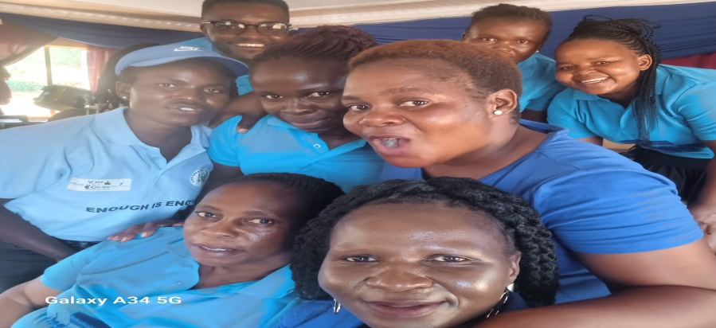
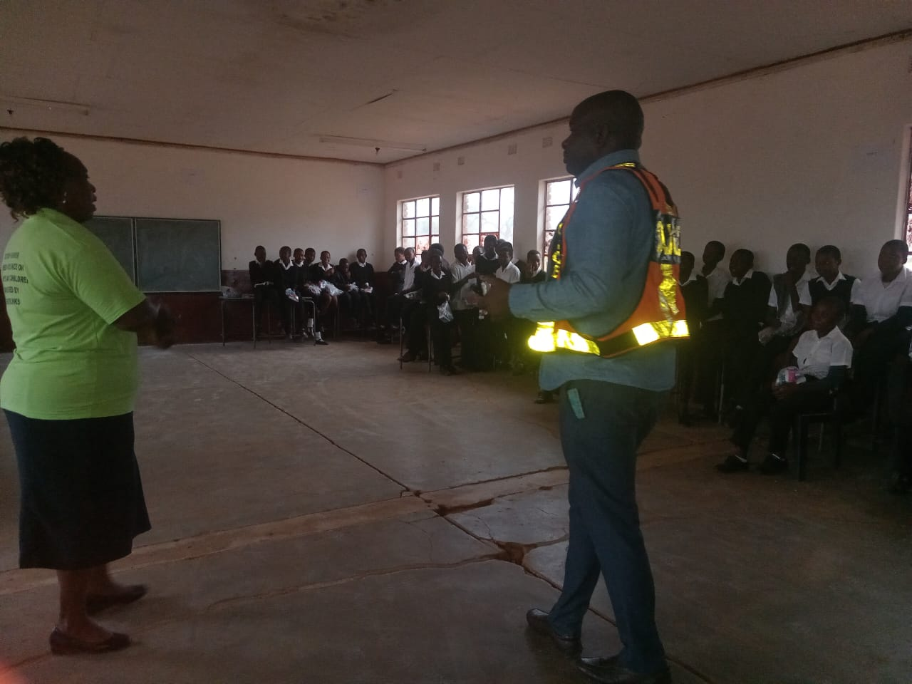
Who is this leader?
My name is Makuya Thivhowali, I am human rights activist, advocate practitioner with a specialization in GBV and gender equality. I have strong knowledge and skills and expertise to work with GBV survivors and also people who are affected by HIV and poverty, I am from a diverse and vibrant community called HA-MAKUYA village at the organisation called Life Savers Foundation, where I was raised with strong values of social justice, equality and compassion. What I do , I advocate for polies, laws and programs that promote gender equality and prevent GBV, what makes me unique is my passion and commitment, my deep passion to GBV drive my work and inspire me to make a positive impact.
Women’s Voice and Leadership Learning and Sharing Summit 2025

Slide 3
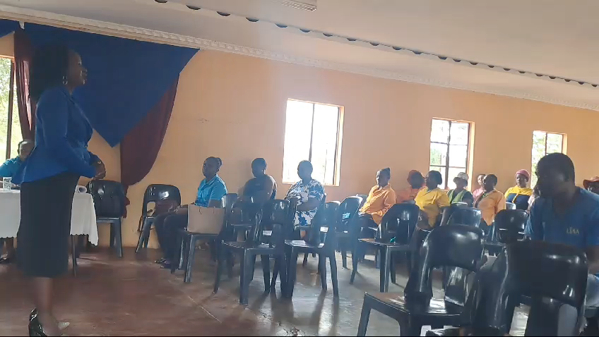
What drives you?
DETAIL
Our vision is to encourage zero tolerance towards GBV,inclduing sexual assault, furthermore our vision is to empower those who are affected by HIV and poverty, My commitment to gender equality is unwavering and unrelenting. I believe that every individual, regardless of their gender deserves to be treated with dignity and respect. And to have equal access to opportunities, resources and rights.as a passionate advocate for gender equality I am dedicated to address and prevent GBV and providing support and services to survivors.
Women’s Voice and Leadership Learning and Sharing Summit 2025

Slide 4
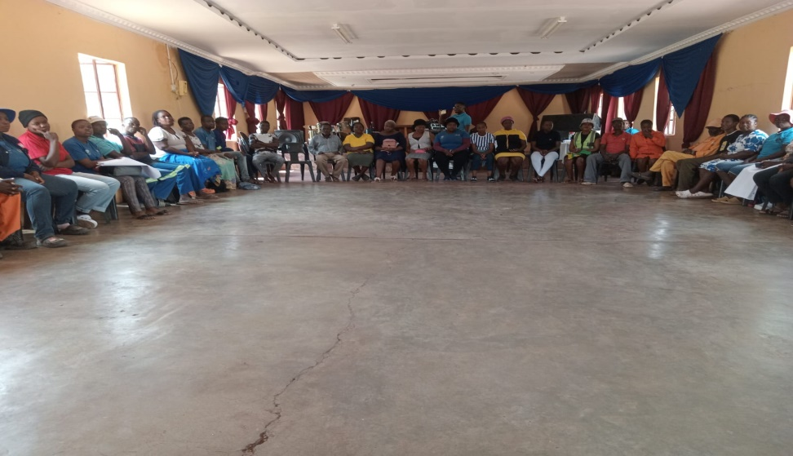
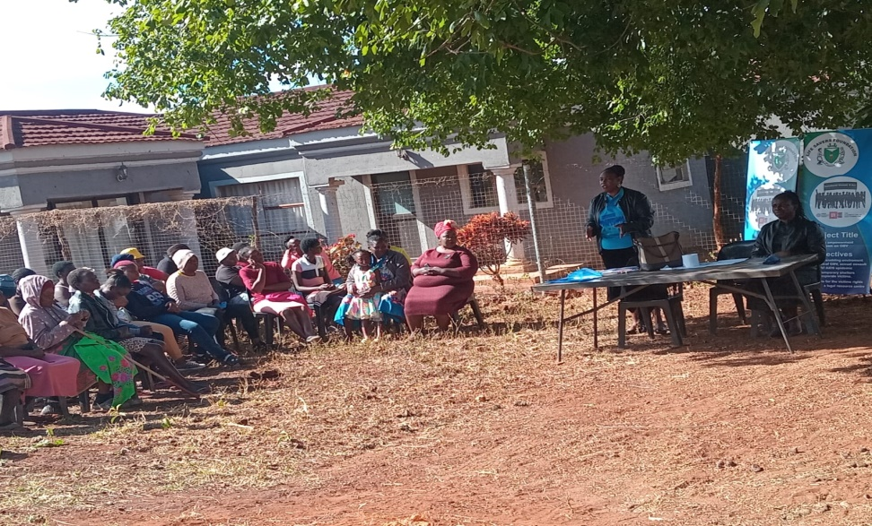
What do you do?
i am dedicated professional with a strong passion for promoting gender equality and preventing gender based violence, my work involves a ranger of activities including advocacy, I advocate for policies and laws that promote gender equality and prevent GBV. I work with government and civil society groups to push for changes that benefit women and girls. I design and implement programs that address GBV and promote gender equality. These programs may include training, education and community outreach activities. I work with communities to raise awareness about GBV and gender equality issues. This include organizing events to promote social change .
Women’s Voice and Leadership Learning and Sharing Summit 2025

Slide 5
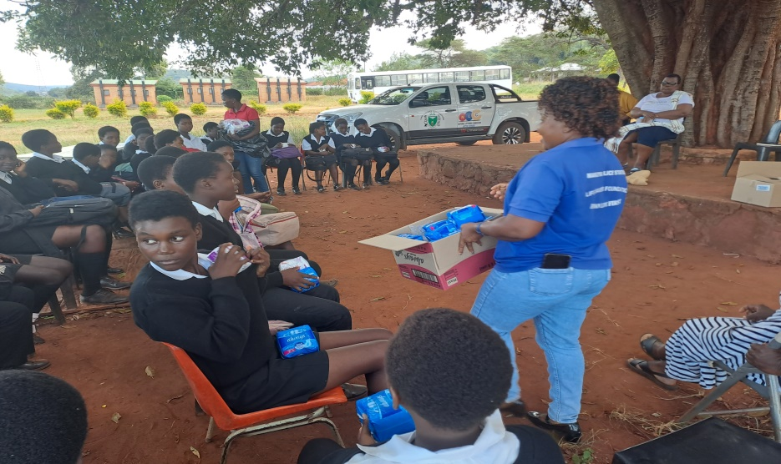
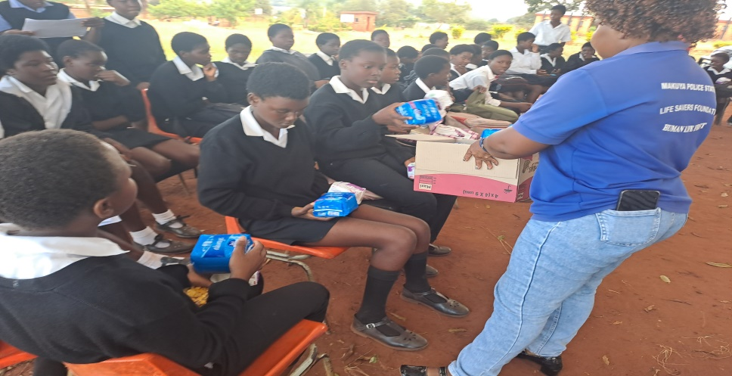
Personal achievements
As a dedicated and passionate individual, I have achieved numerous personal and professional milestones that I am proud to share, here are some of my most notable personal achievements, establishing a successful career in gender equality and GBV prevention, I have worked tirelessly to build a career that aligns with my values and passions and I am proud to have made a meaningful impact in the lives. I have designed and implemented numerous programs and polies that have improved the lives of women and girls including programs to prevent GBV promote woman's economic empowerment and support survivors of GBV
Women’s Voice and Leadership Learning and Sharing Summit 2025

Slide 6
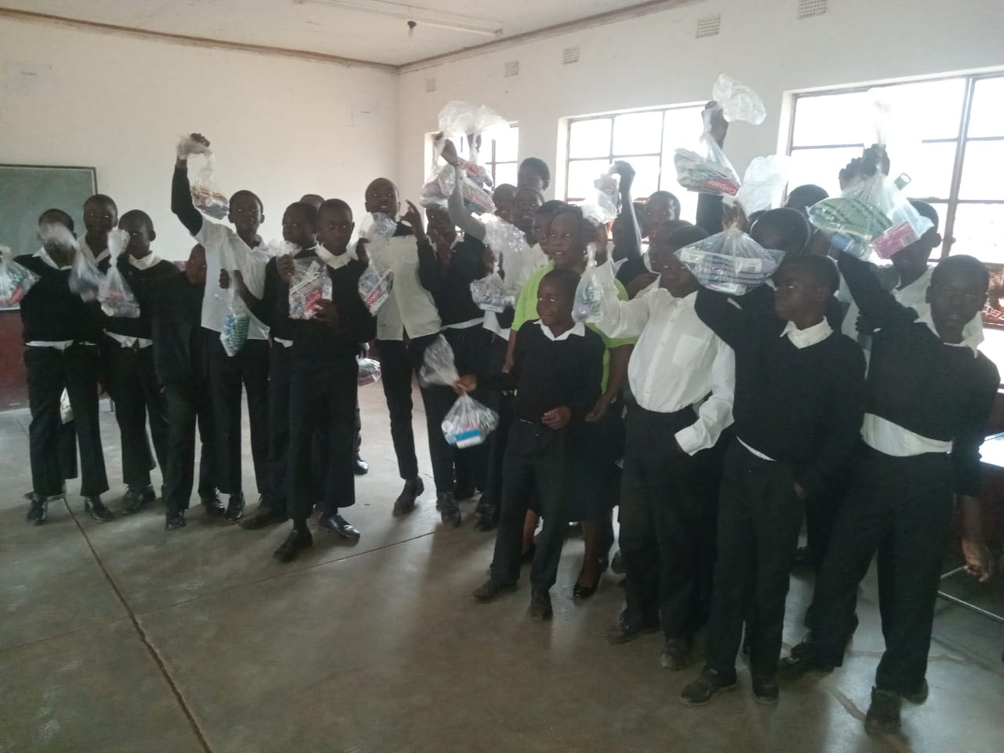
Change at the individual level
The beneficiary has learned how to effectively communicate GBV related issue through various media channels, also gained knowledge about the causes, consequences and prevention of GBV. The beneficiary also developed a strong commitment to promoting social justice and human right, particularly for marginalized groups. Also developed open minded and flexible attitude, including being willing to listen to and learn.
Women’s Voice and Leadership Learning and Sharing Summit 2025

Slide 7
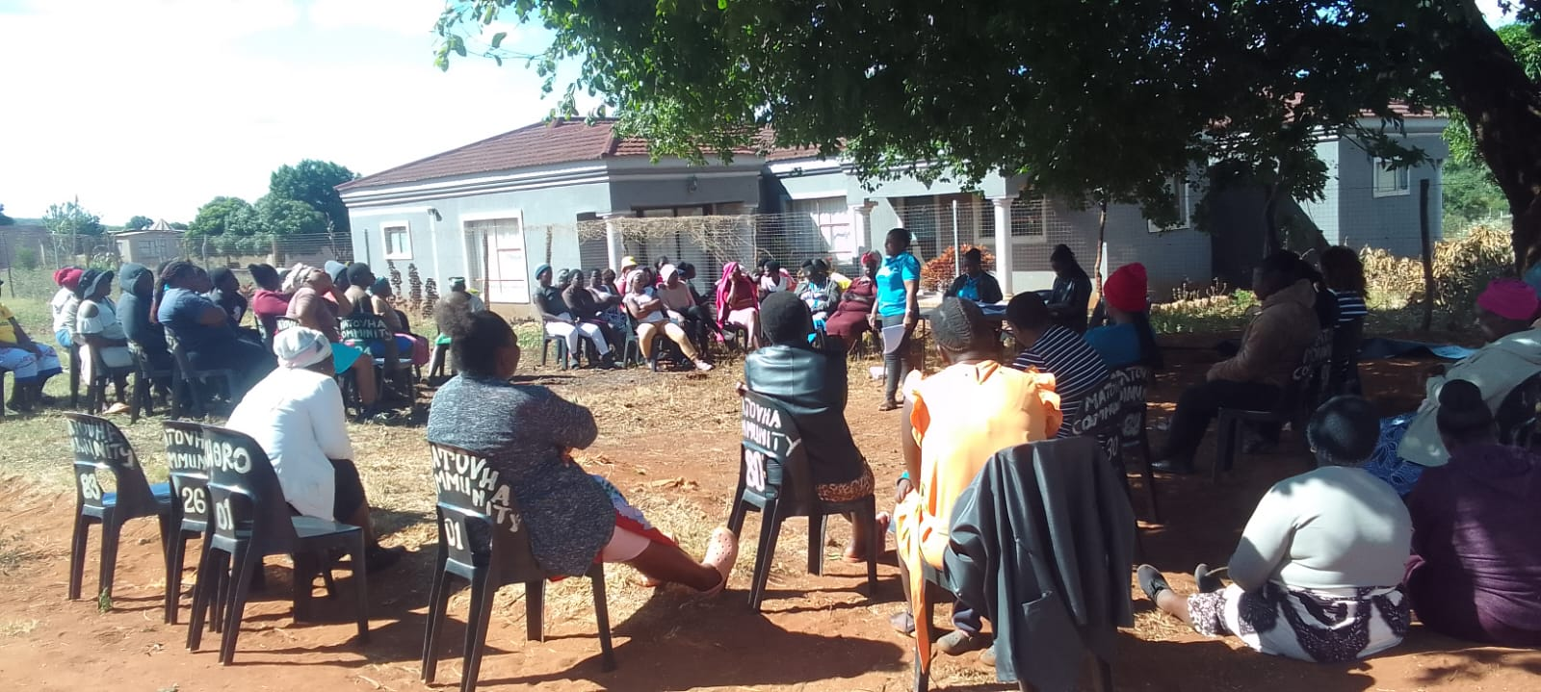
Achievements at community level
greatest achievements at community level is dialoque of community members, including traditional leaders, community health workers and police officer on GBV prevention and response. This helped to increase awareness and understanding of GBV and has improved the response to GBV cases. Support for GBV survivors, I have provided support to survivors of GBV including counselling ,accomodation, and economic empowerment .this has helped to improve the lives of survivors and has enabled them to build rebuild their live.
Women’s Voice and Leadership Learning and Sharing Summit 2025

Slide 8
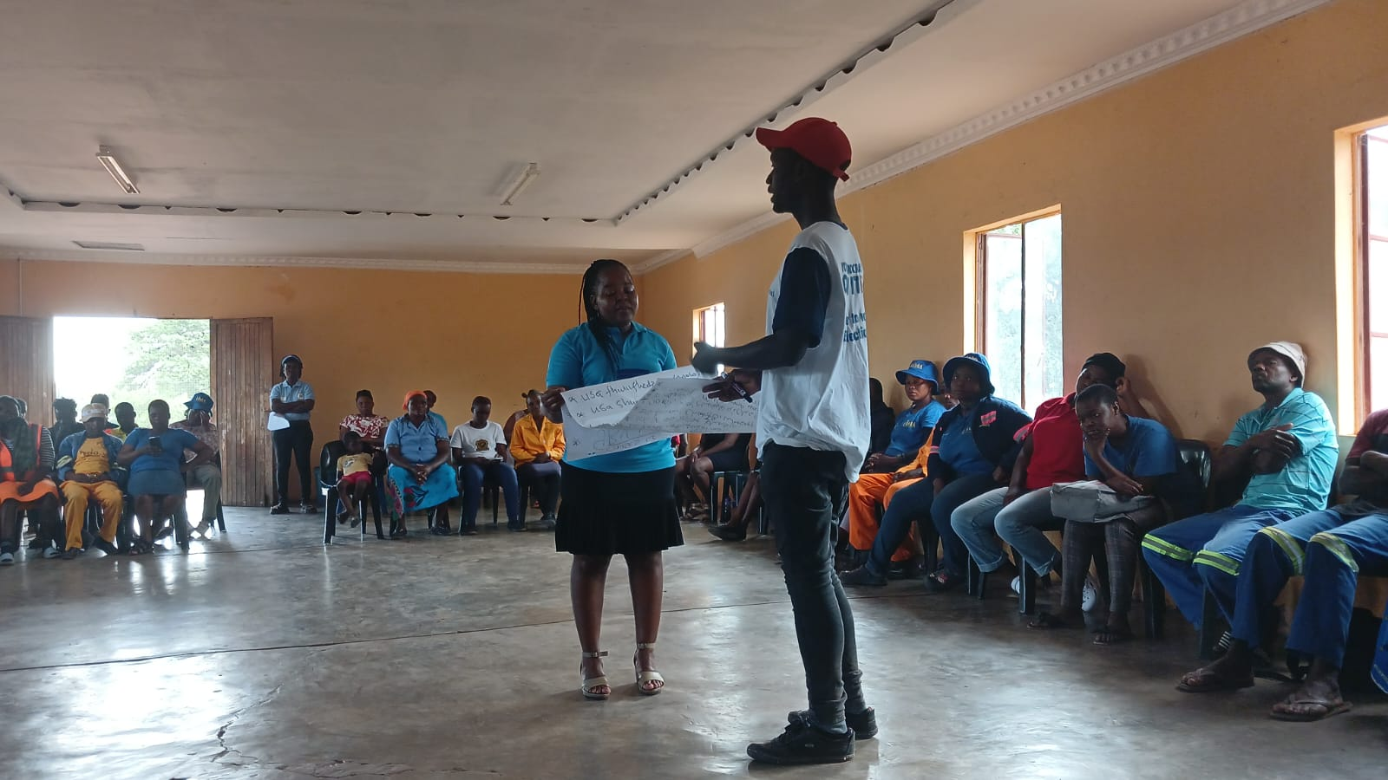
Achievements at societal level
my actions have led to significant changes in laws, policies and practices, particularly in the areas of gender ideology. For instance they have taken steps to defend women's rights and protect freedom of conscience by using clear and accuracy language and policies that recognize women as biologically female and men as biologically. As a leader in the field of GBV and gender equality, I am committed to creating new knowledge and sharing it with organizations like gender links to inform their work and improve their impact, I engage with communities to understand their experiences, needs and perspectives.
Women’s Voice and Leadership Learning and Sharing Summit 2025

Slide 9
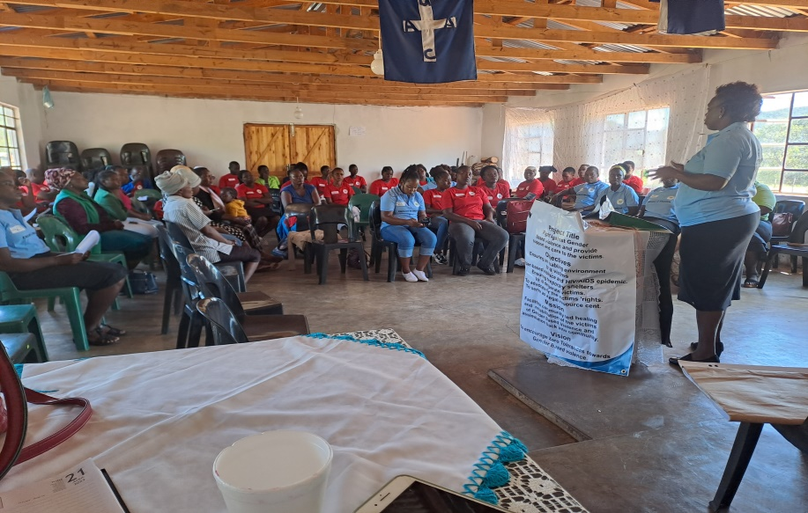
Leadership qualities
I have a clear understanding of the issues and challenges facing our communities, and I am able to envision a better future for all. This allows me to develop and implement effective strategies for creating positive change. I am able to think critically and strategically, analyzing complex problems and developing effective solutions that address the root causes of GBV and promote gender equality. My leadership has helped to empower survivors of GBV, providing them with the support resources and services they need to heal and rebuilt their lives.
Share videos/photos of evidence
Women’s Voice and Leadership Learning and Sharing Summit 2025

Slide 10
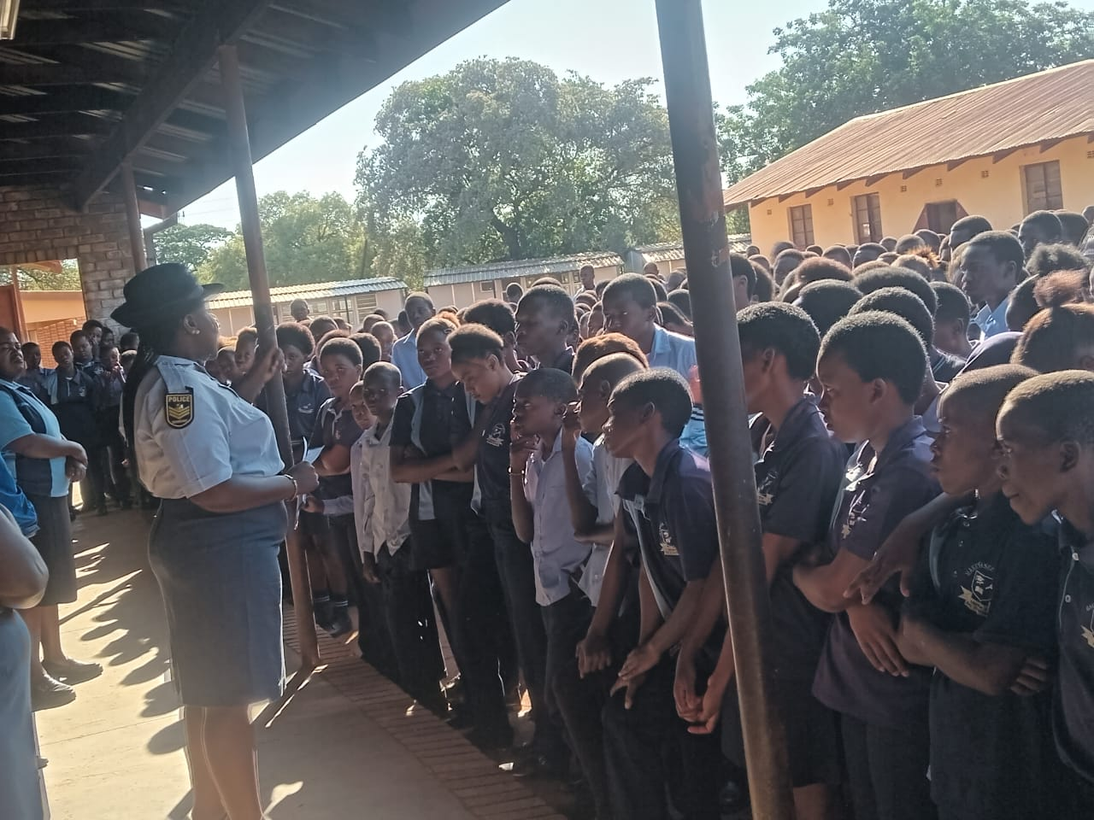
Contribution to gender equality
As a dedicated advocate for gender equality, I have made significant contributions to promoting and advancing gender equality in my locality. I have conducted numerous gender sensitivity training sessions for community members , including men and women and also learners at school level, to educate them on the importance of gender equality and the need to challenge patriarchal norms and stereotypes. These training sessions have helped to change attitudes and behaviors and have empowered individuals to be come agents of change.
Share videos/photos of evidence
Women’s Voice and Leadership Learning and Sharing Summit 2025

Slide 11
Next steps
My future plans for GBV and gender equality are quite ambious. I'm excited so share that I will be working closely with organizations to support their efforts in preventing and responding to GBV. We will be focusing on providing safe accommodation, legal assistance , psychosocial support and cash assistance to survivors of GBV. I'm also looking forward to implementing prevention programs and community engagement initiatives that promote women's empowerment and challenges harmful gender norms. This will involve collaborating with local organizations ,governments and community leaders to develop and implement effective strategies for preventing GBV and promoting gender equality.
Women’s Voice and Leadership Learning and Sharing Summit 2025

Slide 12
Next steps | Description | timeline | responsible
1.Conduct research | Conduct research on GBV and gender equality issues to identify trends | 3 months | Research team
2.Develop GBV prevention toolkit | Develop a toolkit on GBV prevention, including practical guidance on designing and implementing effective GBV prevention programs. | 6 months | Program team
3. Provide technical assistance | To Life Savers Foundation on GBV and gender equality issues. | ongoing | Technical assistance team
4. Facilitate training and capacity building | For Life Savers Foundation staff on GBV and gender equality issues | Quarterly | Training team
5.Publish research and analysis | Publish research and analysis on GBV and gender equality issues, including findings and recommendations | Bi-annually | Research team
6.Disseminate findings | To gender links and other stakeholders, including policymakers . | ongoing | Communications team
7. Monitor and evaluate | The impact of GBV prevention programs and provide feedback to gender links and other stakeholders including other donors | ongoing | evaluation

