Slide 1








LEARNING
AND SHARING
SUMMIT 2025
South Africa, Johannesburg
March 2025
By
Tebello Lejakane
Women’s Voice and Leadership Learning and Sharing Summit 2025

Slide 2
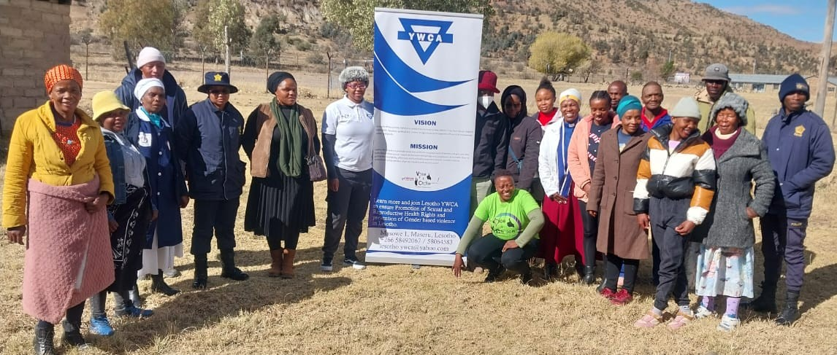
SYNOPSIS
Describe the change that has occurred.
Photo
Through Lesotho YWCA’s commnity and school dialogues there have been a great impact on students in schools as well as community leaders and the community at large. We, without a doubt, have seen a huge change in attitudes and mindsets within the targeted beneficiaries, towards SRHR, CSE and HIV-related services for women and girls.
Women’s Voice and Leadership Learning and Sharing Summit 2025

Slide 3
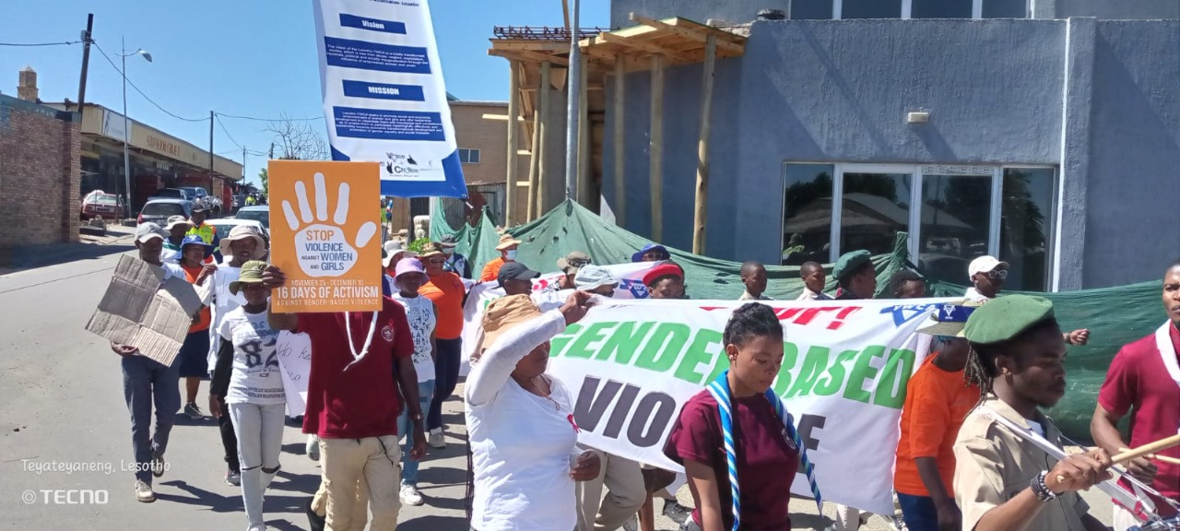
OBJECTIVES
What did the process/ project set out to do?
Photo
The project was aimed to create a conducive, safe and protective environment where sexual and reproductive health and rights of all people, especially adolescent girls, young woman, and key populations was intended to be respected, promoted, protected and fulfilled, but also to enhance meaningful participation of communities and relevant stakeholders on Comprehensive Sexuality Education (CSE). The increased knowledge for role players were holistically and sustainably run through programs aimed to reinforce SRHR and related rights/HIV-related services, including improved health for women and girls.
Women’s Voice and Leadership Learning and Sharing Summit 2025

Slide 4
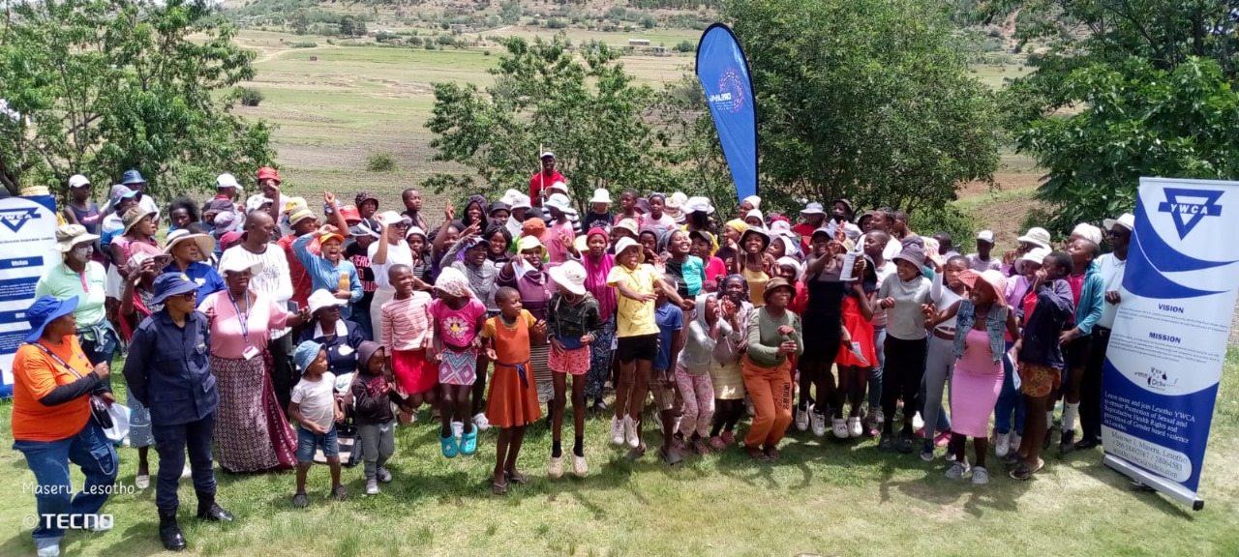
ACTIVITIES
What evidence or means of verification do you have for this change?
Photo
conducted 11 school dialogues on SRHR .
conducted 4 community dialogues on SRHR
conducted 6 dialogues with community leaders and stakeholder on SRHR (1 dialogue per district)
Developed and distributed IEC materials including brochures and flyers.
Established men and boys clubs(1 per district for 3 districts)
A 16 Days Activism Against GBV march
3 youth workshops during school holidays
Booked 2 radio slots and had 2 separate radio interviews
Baseline and evaluation reports were written
Developed and administered 60 baseline questioners
Developed and administered follow-up survey and report
Women’s Voice and Leadership Learning and Sharing Summit 2025

Slide 5
Contribution to change
What contribution did your organisation make to this change?
Having realised that there was lack of understanding on gender-based violence, SRHR, HIV and Comprehensive Sexuaity education amongst community members and students, the Lesotho YWCA mobilized organizations and trained personnel who worked together in educating the beneficiaries.
During our stakeholders meetings, community leaders conformed that there were limited to no reports of gender-based violence, and this was because victims normally do not get help from the child and gender protecion Unit,also there are no effective implementations of laws and policies by different stakeholders in Lesotho.
LYWCA mobilized Child and Gender Protection Unit officers so as to ensure the communities that their doors are open and they are ready to help.
Women’s Voice and Leadership Learning and Sharing Summit 2025

Slide 6
Population Group this change most closely related to
Category | Women | Men | Total | % Women
Direct beneficiaries | 1600 | 1130 | 2730 | 58.6%
Indirect beneficiaries (e.g. through other networks) | 45 | 0 | 45 | 100%
Online beneficiaries (e.g. website access, mailing lists, scholarly articles) | 151 | 74 | 224 | 61.9%
Total | 1796 | 1203 | 2999
Women’s Voice and Leadership Learning and Sharing Summit 2025

Slide 7
Significance of change
What is the significance of the change?
The main goal was to empower survivors of GBV, we saw it fit to provide a safe space where they are believed, respected, supported and provided with justice
To help people understand that gender equality is essential to prevent GBV.
Improved understanding and knowledge on GBV and SRHR among different community members where we were able to conduct community dialogues
increased understanding and knowledge on the existing laws that are meant to prevent, protect and mitigate GBV in Lesotho
There is a huge change in communities and schools that we have reached as people were taught to recognise that GBV in unacceptable and going forward, there is no doubt that will challenge harmful stereotypes.
Women’s Voice and Leadership Learning and Sharing Summit 2025

Slide 8
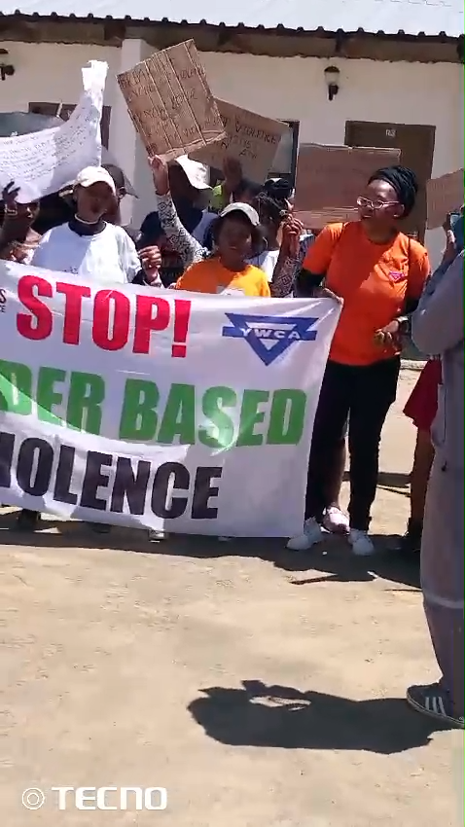
RESULTS
2999 beneficiaries were reached which most of them were women still with the support of men. This was a huge success because it is more than what was intended to have been reached.
There has been a number of media coverage through the radio and social media platforms such as LinkedIn, Facebook, Tik Tok and Instagram.
Improved understanding and knowledge on HIV,GBV and SRHR among different community members where we were able to conduct community dialogues
An increase in understanding and knowledge on the existing laws that are meant to prevent, protect and mitigate GBV in Lesotho was visible
Include evidence here – photos/clippings
Women’s Voice and Leadership Learning and Sharing Summit 2025

Slide 9
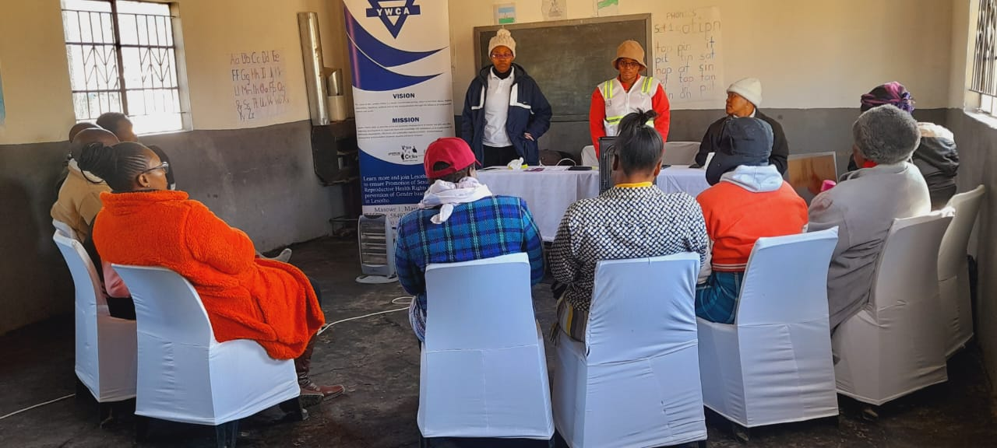
Evidence
Due to the evaluation conducted after every event shows that, there is an improved understanding and knowledge among students where the school dialogues were conducted
There has been improved knowledge and understanding on the gender-based violence and existing laws and policies within the country that are meant to end gender-based violence in the communities
According to the child and gender protection unit in the districts where the project was implemented there are increased number of reported cases
Include evidence here – photos/clippings
Women’s Voice and Leadership Learning and Sharing Summit 2025

Slide 10
CHALLENGES AND LESSONS LEARNT
Regardless of beneficiaries attending our dialogues in quite impressive numbers, some of them refused to sign the attendance forms as we had a target of reaching 2730 beneficiaries,this led to the dialogues being completed later than expected because the targeted number was not reached on time.
To reach the number of targeted beneficiaries, we had to work with more private schools, of which majority of them had low enrollment rates. Moreover we had to conduct extra activities such as youth workshops during school holidays.
Poor community attendance at our public gatherings required us to align our activities with existing events already scheduled on the chiefs’ timetables for the targeted villages. This occasionally resulted in delays in implementation.
Due to the inadequate community turnover for public gatherings, we had to collaborate with other agendas of the already planned public gatherings in the communities.
The majority of the private schools we collaborated with were slow to react to the suggested dates, which caused the implementation to be delayed.
We had meetings with the school committees and principals whereby we explained the relevance of the project in relation to their curriculum, that arouse interest in giving us more slots in their schools.
Women’s Voice and Leadership Learning and Sharing Summit 2025

Slide 11
SUSTAINABILITY AND REPLICATION
Continue facilitating effective community gatherings with our community leaders.
Keep up the women empowerment movements and work towards fighting against GBV and educate girls about their Sexual Rights and Reproductive Health as well as HIV.
The aim is to go back to our already existing Boy's Clubs and do refresher dialogues
We are still going to commemorate activities and days that entail HIV/ AIDS, GBV and SRHR.
The distribution of IEC material would still go on
Women’s Voice and Leadership Learning and Sharing Summit 2025

Slide 12
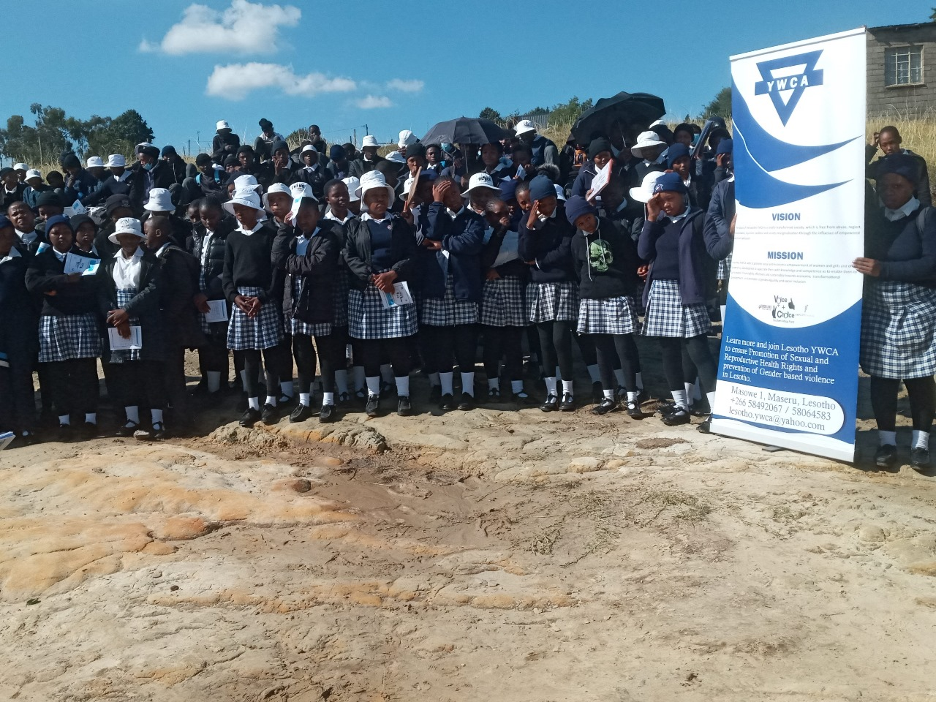
NEXT STEPS
Keep up strengthened partnerships with relevant partners, community members, community leaders and government ministries so as to ensure sustainability.
Include evidence here – photos/clippings
Women’s Voice and Leadership Learning and Sharing Summit 2025

