Slide 1







LEARNING
AND SHARING
SUMMIT 2025
Story of Change Template
(South Africa, Johannesburg, March 2025, Rozanne Myburgh and Boitumelo Bapela)
Women’s Voice and Leadership Learning and Sharing Summit 2025

Slide 2
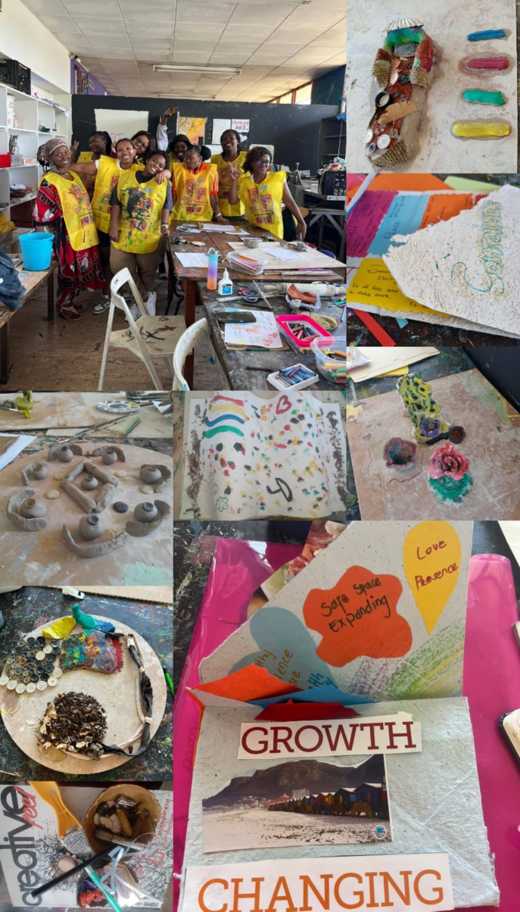
SYNOPSIS
Creating safe spaces for adolescent girls and parent support groups by increasing our capacity to deliver afterschool programmes. It will result in access to safe spaces, increased mental health support, better educational outcomes, increased emotional literacy and increased agency for female adolescents (10-18 years). These afterschool programmes become a movement as adolescents can advocate and support each other.
Women’s Voice and Leadership Learning and Sharing Summit 2025

Slide 3
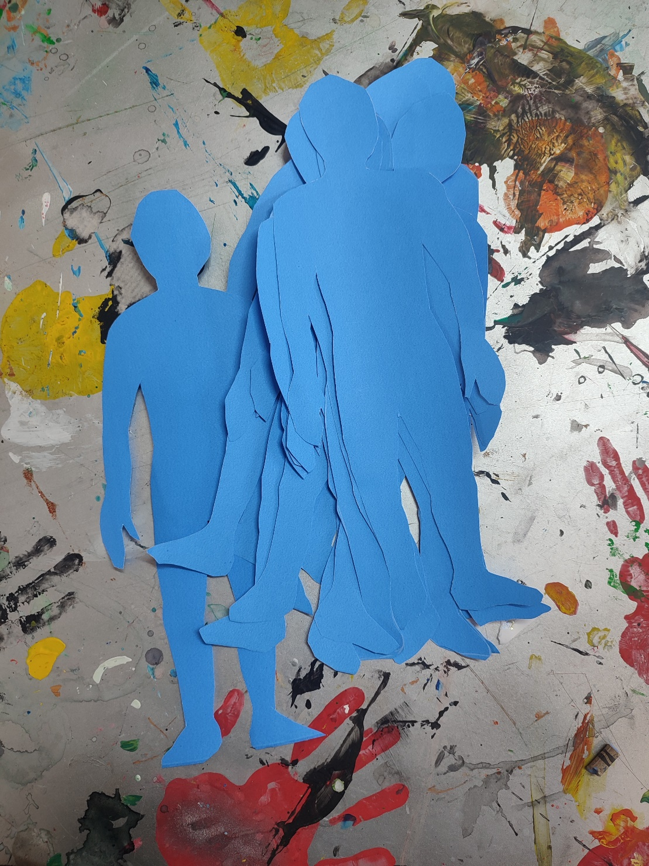
OBJECTIVES
What will the process/project aim to achieve?
Increasing access to safe, supportive afterschool spaces for adolescent girls.
Parent support.
Addressing gender-based violence and sexual and reproductive health.
Movement building through the use of social media, networking with other organisations, faith-based and community-based as well as local political structures in the areas of implementation.
Women’s Voice and Leadership Learning and Sharing Summit 2025

Slide 4
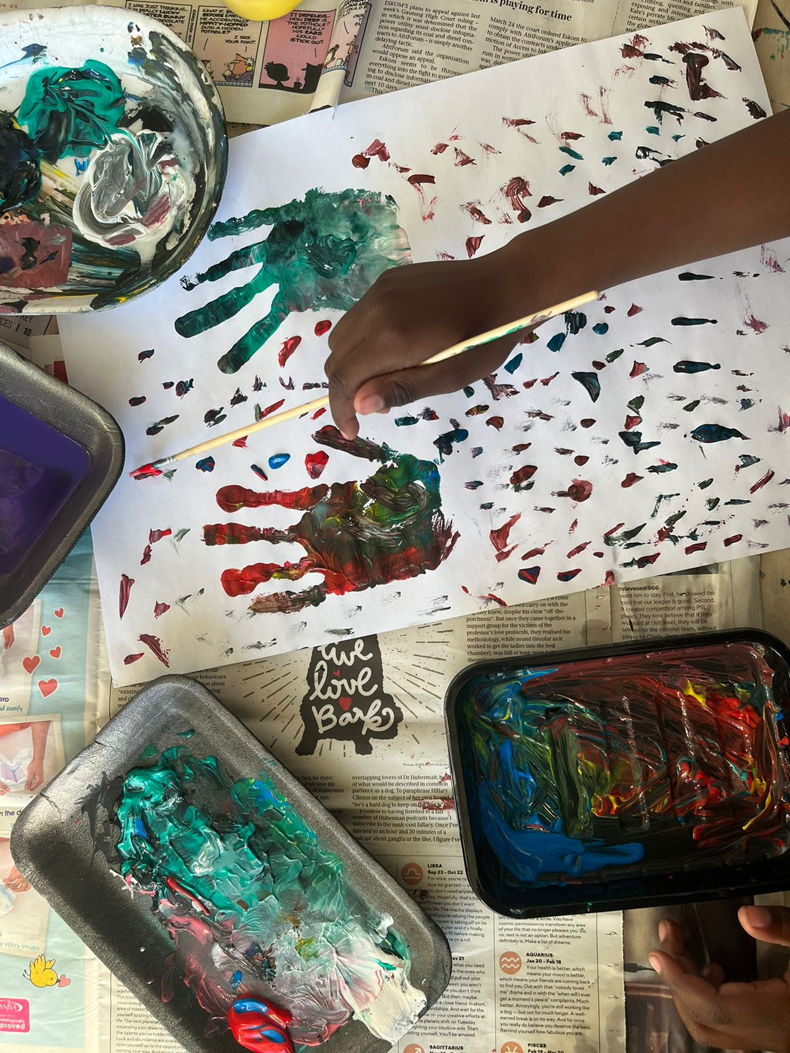
Planned Activities
What evidence or means of verification will you have for this change?
Registers
Facilitators reports
Supervisor reports
Needs assessment and post implementation questionnaires
Women’s Voice and Leadership Learning and Sharing Summit 2025

Slide 5
Contribution to change
What contribution will your organisation make to this change?
Because of the therapeutic nature of our afterschool programme based in arts that is traditionally an advocacy tool, coupled with the increased capacity for empathy we intend to allow the participants to have agency in how they want to form a movement. The therapeutic part provides them with an internal value for advocacy and the arts gives them external tools for advocacy.
Women’s Voice and Leadership Learning and Sharing Summit 2025

Slide 6
Population Group this change will impact
Category | Women | Men | Total | % Women
Direct beneficiaries | 360 | 0 | 360 | 100%
Indirect beneficiaries (e.g. through other networks) | 100 | 50 | 150 | 66%
Online beneficiaries (e.g. website access, mailing lists, scholarly articles) | 700 | 300 | 1000 | 70%
Total | 1160 | 350 | 1510 | 77%
Women’s Voice and Leadership Learning and Sharing Summit 2025

Slide 7
Significance of change
What will be the significance of the change? Please provide further information on what this change will mean for the movement and its goals, and what effect this change may have on the next steps in this area of work.
Women’s Voice and Leadership Learning and Sharing Summit 2025

Slide 8
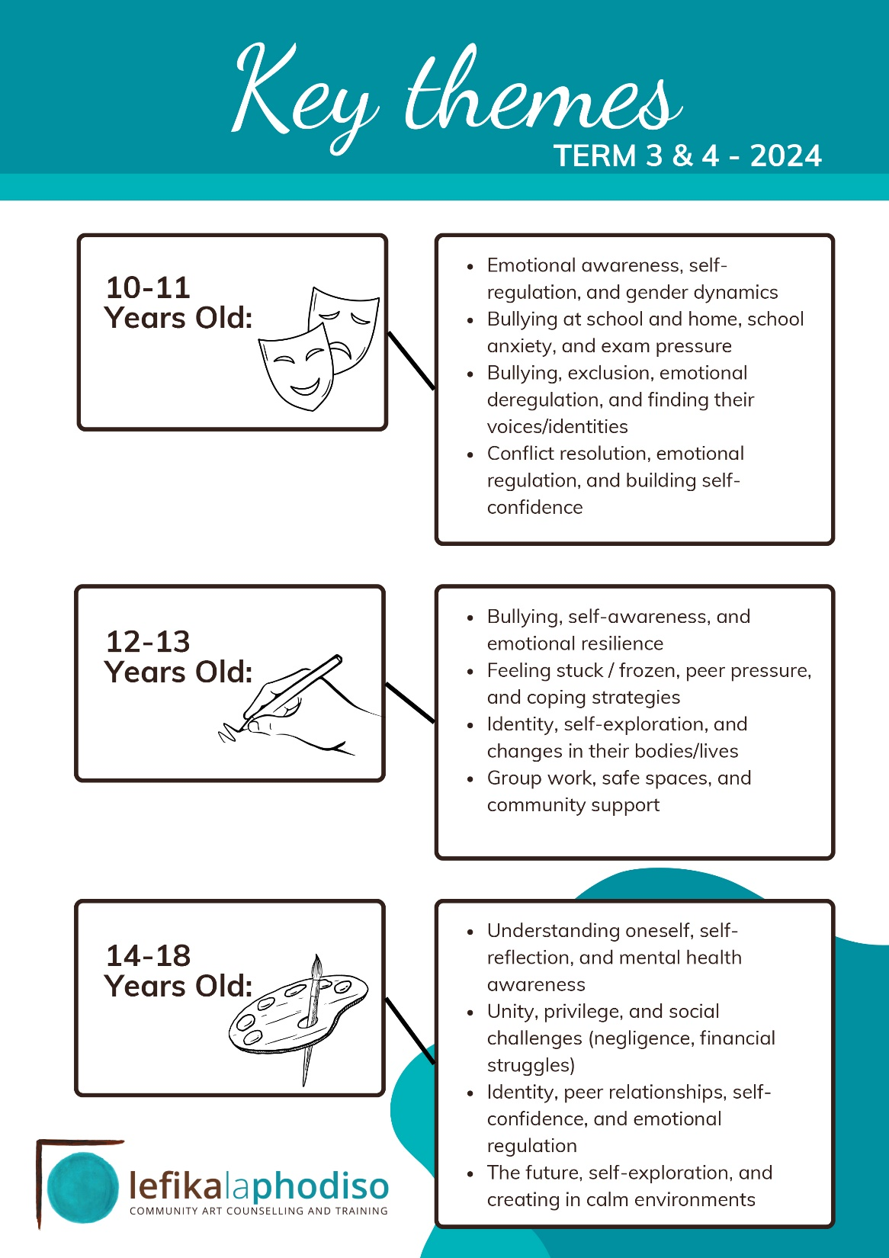
RESULTS
Please share some of the results you aim to achieve, for example:
Female adolescent empowerment through
  improved emotional literacy
  increased school attendance, and
  greater self-confidence
Women’s Voice and Leadership Learning and Sharing Summit 2025

Slide 9
Anticipated Challenges and Lessons to Learn
What are the main challenges you anticipate? How do you plan to overcome these challenges?
Social risk
Economic risk
Human resource risk
Women’s Voice and Leadership Learning and Sharing Summit 2025

Slide 10
SUSTAINABILITY AND REPLICATION
How will the work be sustained/kept going?
  Through continuous fundraising and grant applications
How will the work be shared or cascaded to other organisations?
  Through our Community Art Counselling training programme
Women’s Voice and Leadership Learning and Sharing Summit 2025

Slide 11
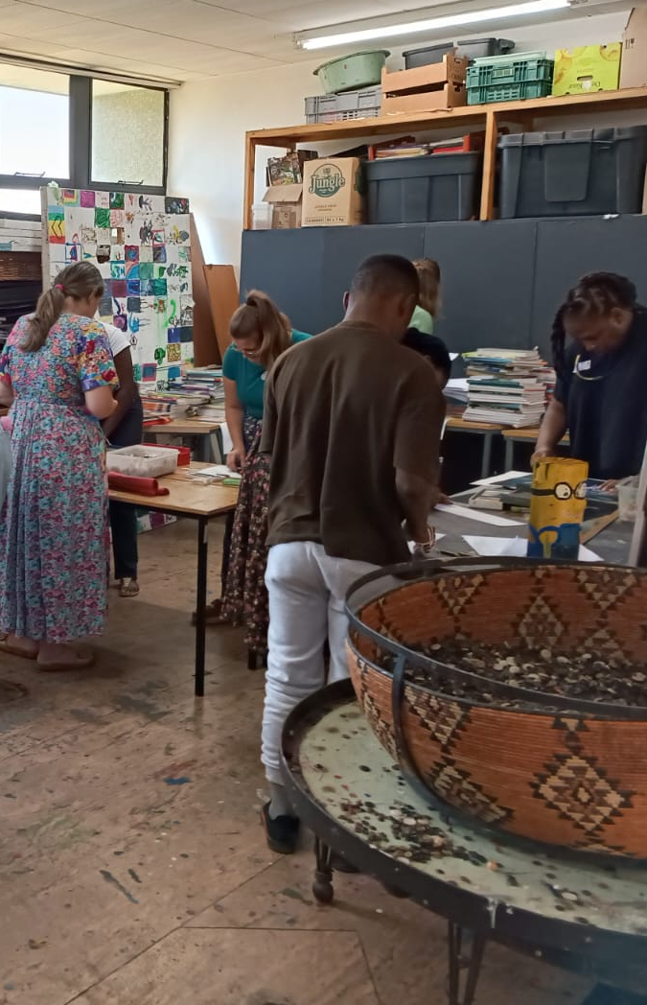
NEXT STEPS
What will be the key priorities moving forward?
1. Trauma-Informed Interventions
2. Strengthening Community and Parental Engagement
3. Addressing the Intersection of GBV and Mental Health
4. Strengthening Partnerships and Advocacy Efforts
5. Expanding Digital and Media-Based Outreach
Women’s Voice and Leadership Learning and Sharing Summit 2025

