Slide 1


Voice and Choice Summit 2026-Leadership Category
Your logo goes here
Botswana: Young Leader Advancing LGBTIQ+ Health Equity Through Evidence-Driven Advocacy
Voice and Choice Summit 2026 \ Voice and Choice Summit 2026

Slide 2
Synopsis– brief overview what this is about
Name | KAGISHO KGOSIETSILE RAMOKWAKWA
Designation | MONITORING & EVALUATION OFFICER
Organisation | FRIENDS OF DIVERSITY ORGANISATION
Country | BOTSWANA
Category | LEADERSHIP
Summary | This presentation highlights how evidence-driven leadership can dismantle health-related barriers faced by LGBTIQ+ communities in Botswana. Through my work in monitoring and evaluation, I transformed lived experiences of discrimination into credible data used to strengthen advocacy, improve healthcare awareness, and promote inclusive service delivery. By working with communities, healthcare providers and civil society partners, the initiative contributes to advancing SDG 3, SDG 5 and SDG 10 while supporting the goals of the SADC Gender Protocol.
Voice and Choice Summit 2026 \ Voice and Choice Summit 2026

Slide 3

Background(problem, actions, change, evidence)
Kagisho is a youth leader and human rights activist from Botswana working with Friends of Diversity.
As a Monitoring and Evaluation Professional, my work focuses on:
Documenting lived experiences within communities
Identifying structural inequalities in service delivery
Generating credible evidence for advocacy
Strengthening accountability within institutions.
Voice and Choice Summit 2026 \ Voice and Choice Summit 2026

Slide 4

Background(problem, actions, change, evidence)
Evidence: Include Photos or videos
Despite progress in human rights, LGBTIQ+ communities in Botswana continue to face barriers in accessing healthcare.
Key challenges include:
• Stigma and discrimination in healthcare facilities • Misgendering and breaches of confidentiality • Limited provider knowledge on inclusive care • Fear and mistrust of public health institutions
As a result, many LGBTIQ+ individuals delay or avoid healthcare services.
Voice and Choice Summit 2026 \ Voice and Choice Summit 2026

Slide 5
Change
Key Actions that drove change
1. Participatory Evidence Generation
We worked directly with LGBTIQ+ youth and gender-diverse community members to document lived experiences of stigma, discrimination, and barriers in healthcare settings. This process ensured that advocacy efforts were grounded in credible community-generated evidence.
2. Mapping Inclusive Healthcare Spaces
In collaboration with civil society partners, we identified and mapped healthcare facilities considered safe or unsafe for LGBTIQ+ individuals. This provided communities with clearer pathways to access services while encouraging greater accountability within health institutions.
Voice and Choice Summit 2026 \ Voice and Choice Summit 2026

Slide 6
Change
3. Community Dialogues and Youth Engagement Through structured dialogues and workshops, community members were able to openly discuss health-related challenges and co-create solutions. These platforms strengthened community participation and amplified youth voices in advocacy processes.
4. Capacity Building for Healthcare Providers We engaged healthcare providers through training sessions and dialogue forums focused on inclusive service delivery, confidentiality, and respectful care for LGBTIQ+ patients.
5. Evidence-Based Advocacy Findings from monitoring and evaluation processes were translated into advocacy briefs and discussions with civil society organisations and health stakeholders, helping elevate LGBTIQ+ health concerns within broader health equity conversations.
Voice and Choice Summit 2026 \ Voice and Choice Summit 2026

Slide 7

Impact
Community Level
The initiative contributed to increased awareness, confidence, and engagement among LGBTIQ+ youth and gender-diverse individuals when accessing healthcare services.
Through community dialogues, participatory data collection, and awareness activities, community members gained clearer information about:
Healthcare facilities considered safe and inclusive
Their rights within healthcare settings
Mechanisms for reporting discrimination and seeking support
As a result, many LGBTIQ+ individuals now feel more confident seeking healthcare services without fear of stigma or humiliation.
The work also strengthened community participation, ensuring that youth voices play an active role in shaping advocacy priorities and health system engagement.
Voice and Choice Summit 2026 \ Voice and Choice Summit 2026

Slide 8
Impact
Institutional Level
The institutional level, the initiative contributed to improved engagement between healthcare providers and civil society organisations working on health equity.
Through dialogue sessions, workshops, and evidence-sharing platforms, healthcare providers were exposed to discussions around:
Inclusive healthcare practices
Respectful engagement with LGBTIQ+ patients
Confidentiality and patient dignity
These engagements helped create opportunities for constructive dialogue between healthcare institutions and civil society organisations, laying the groundwork for more inclusive service delivery practices.
The initiative also contributed to greater awareness among healthcare stakeholders about the specific barriers faced by LGBTIQ+ communities.
Voice and Choice Summit 2026 \ Voice and Choice Summit 2026

Slide 9
Impact
Advocacy and Systems Change
The initiative strengthened evidence-based advocacy efforts focused on equitable healthcare access.
Monitoring and evaluation findings were used to:
document systemic barriers affecting LGBTIQ+ communities
support advocacy discussions with civil society networks
contribute to broader conversations on inclusive healthcare policies
By grounding advocacy efforts in credible community-generated evidence, the initiative helped shift the narrative from isolated incidents of discrimination to recognition of systemic challenges that require institutional response.
Voice and Choice Summit 2026 \ Voice and Choice Summit 2026

Slide 10
Recognition
My leadership has been recognised through contributions to evidence-driven advocacy and inclusive health programming within civil society initiatives.
Leadership in Monitoring & Evaluation
• Led the development and implementation of monitoring and evaluation systems for LGBTIQ+ health initiatives at Friends of Diversity • Strengthened the use of community-generated evidence to inform advocacy and programme design • Promoted the integration of monitoring, evaluation, and learning within project implementation
Voice and Choice Summit 2026 \ Voice and Choice Summit 2026

Slide 11
Recognition
Advocacy and Knowledge Contribution
• Contributed to discussions on removing health-related barriers affecting LGBTIQ+ communities • Supported the documentation of lived experiences to inform evidence-based advocacy • Elevated community voices within broader conversations on inclusive healthcare
Collaboration and Partnerships
• Worked with organisations such as BONELA, Nothing Without Us, SISONKE and other civil society organisations. • Supported collaboration between civil society organisations and healthcare stakeholders • Strengthened partnerships aimed at promoting inclusive and equitable healthcare services
Recognition of this work reflects the growing importance of evidence-based leadership within social justice movements.
Voice and Choice Summit 2026 \ Voice and Choice Summit 2026

Slide 12
Challenges & Lessons learnt
Challenges & mitigation
Persistent stigma within institutions • Some healthcare providers still hold misconceptions about LGBTIQ+ individuals, which can influence how services are delivered. • Changing attitudes within institutional systems takes time and requires continuous engagement and awareness.
Limited resources for community-led monitoring • Civil society organisations often operate with limited financial and technical resources to sustain long-term monitoring initiatives. • This can affect the scale and frequency of data collection and community engagement activities.
Fear among community members to report violations • Many LGBTIQ+ individuals remain hesitant to report discrimination due to fear of further stigma, confidentiality breaches, or retaliation. • Building trust within communities therefore requires sustained engagement and safe reporting mechanisms.
LESSONS LEARNT
Evidence strengthens advocacy credibility • When advocacy is supported by credible data and documented experiences, institutions are more likely to acknowledge systemic challenges and engage in dialogue.
Community participation builds trust and ownership • Involving community members as active participants in monitoring and documentation processes strengthens trust and ensures that advocacy reflects real lived experiences.
Strategic partnerships amplify impact • Collaboration with civil society organisations and health stakeholders helps expand reach, strengthen advocacy efforts, and promote collective action toward inclusive healthcare systems.
Voice and Choice Summit 2026 \ Voice and Choice Summit 2026

Slide 13
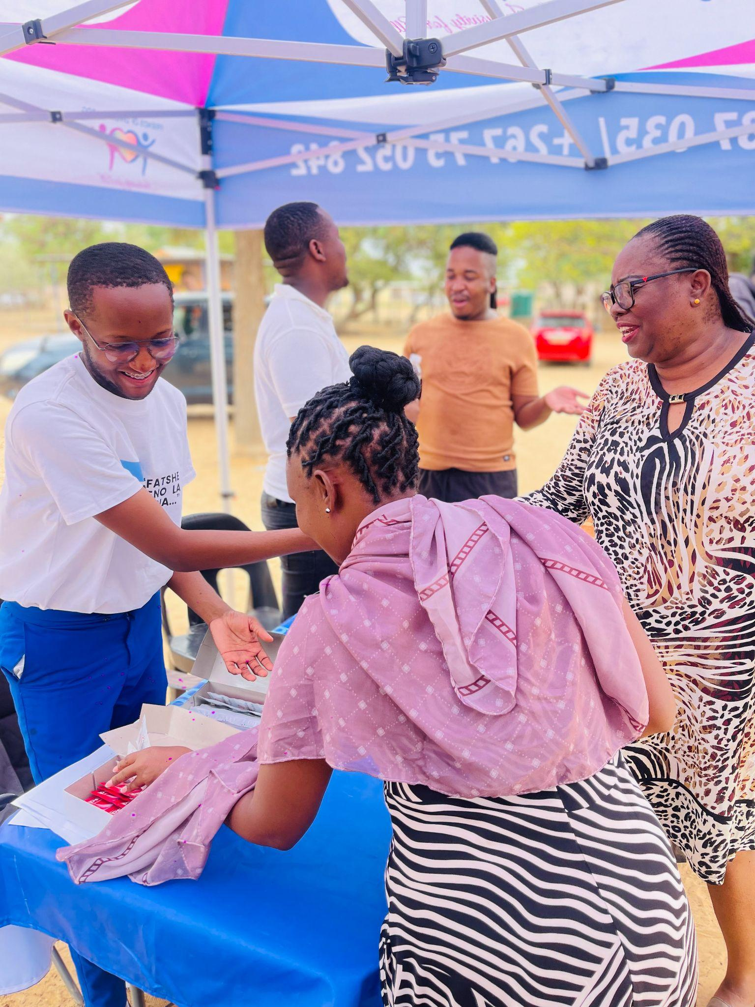
Sustainability
Sustainability is supported by embedding this work within community engagement, institutional systems, and civil society partnerships.
Institutionalised Monitoring & Evaluation • Strengthening M&E systems to continuously document healthcare experiences and track progress in inclusive service delivery.
Community-Led Documentation • Supporting LGBTIQ+ youth and community members to document lived experiences and contribute to ongoing advocacy efforts.
Strategic Partnerships • Collaboration with civil society organisations and health stakeholders to sustain dialogue on inclusive healthcare practices.
Capacity Building for Providers • Continued training and engagement with healthcare providers to promote respectful and inclusive service delivery.
Voice and Choice Summit 2026 \ Voice and Choice Summit 2026

Slide 14
Next Steps
Expanding Safe Healthcare Mapping • Identify and document more healthcare facilities that provide inclusive services.
Strengthening Institutional Engagement • Continue dialogue with healthcare providers and health institutions on inclusive care.
Scaling Evidence-Based Advocacy • Use monitoring and evaluation findings to inform advocacy at national and regional levels.
Supporting Youth Leadership • Empower young leaders to participate in advocacy and community engagement.
Voice and Choice Summit 2026 \ Voice and Choice Summit 2026

Slide 15
QUOTE FROM A MEMBER OF THE COMMUNITY
“For the first time, I walked into a clinic without feeling like I had to hide who I am.” ~ Resego Joseph
“Now I can walk in knowing I will be treated with dignity.”~ KB (Pseudonym)
Voice and Choice Summit 2026 \ Voice and Choice Summit 2026

