Slide 1

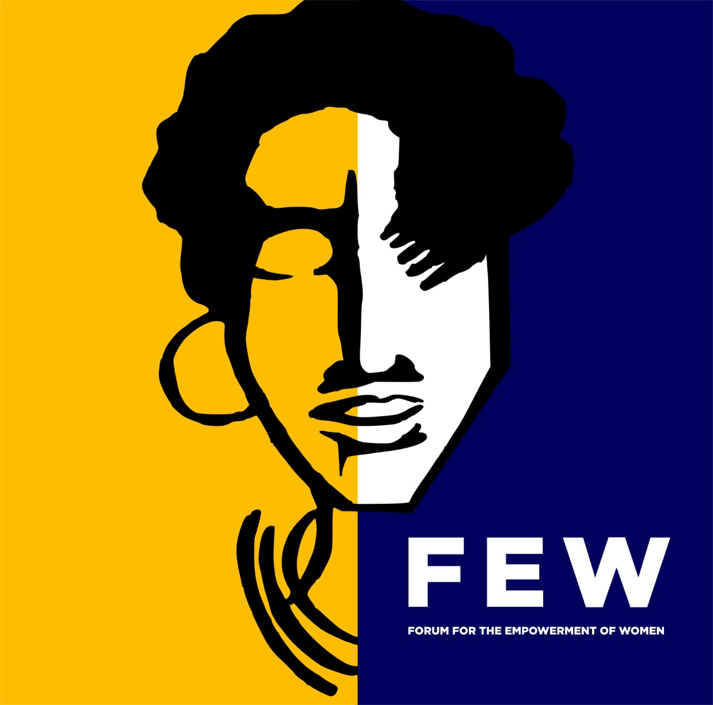
Voice and Choice
Summit 2026-Leadership Category
Your logo goes here
A young director restoring organisaational power through black queer feminist leadership.
Voice and Choice Summit 2026 \ Voice and Choice Summit 2026

Slide 2
Synopsis– brief overview what this is about
Name | Jamilla Jade Madingwane
Designation | Executive Director
Organisation | Forum for the Empowerment of Women
Country | South Africa
Category | Leadership
Summary | This presentation reflects on leadership within a legacy community organisation and the responsibility of guiding it through periods of transition and rebuilding. As Executive Director of the Forum for the Empowerment of Women, my leadership is shaped by the organisation’s history, including years of governance and leadership challenges. Stepping into this role has required strengthening internal systems while continuing to advance advocacy for lesbian, bisexual and queer women. The work involves balancing organisational operations, financial oversight, and movement-building while remaining accountable to the communities we serve. It also requires rebuilding trust, stabilising the organisation, and ensuring long-term sustainability. My leadership approach is grounded in Black queer feminist values that prioritise collective care, honesty, and responsibility. I believe leadership must create spaces where LBQ people are centred, affirmed, and protected. Ultimately, this work is about honouring the legacy of FEW while building a stronger and more resilient organisation for the future.
Voice and Choice Summit 2026 \ Voice and Choice Summit 2026

Slide 3
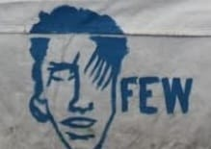
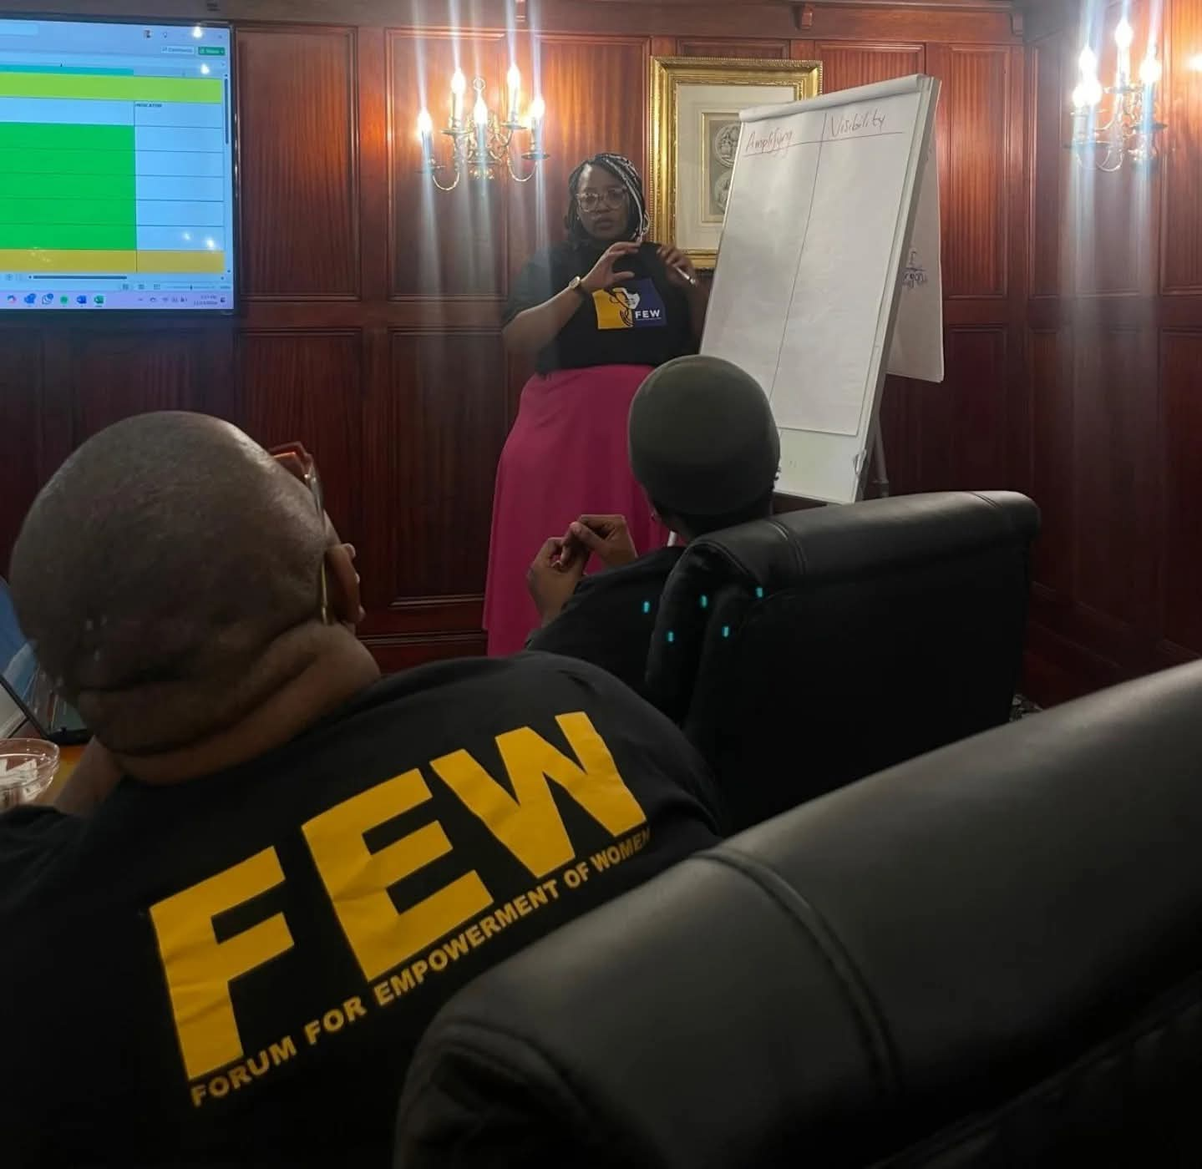
Background(problem, actions, change, evidence)
Forum for the Empowerment of Women is a legacy organization that has historically provided advocacy, support, and community for lesbian, bisexual, and queer (LBQ) women in South Africa. However, over time the organization faced leadership transitions, governance challenges, and organizational instability, which affected its ability to operate at full capacity and maintain trust with the communities it serves.
At the same time, LBQ women particularly those in townships and marginalized communities continue to face high levels of violence, discrimination, and social exclusion despite constitutional protections.
As Executive Director, I stepped into this moment with the responsibility of stabilizing the organization, strengthening governance systems, and rebuilding trust with the community. My role has been to guide FEW through a process of rebuilding while ensuring that the organization remains rooted in its mission to advocate for the dignity, safety, and visibility of LBQ women.
Evidence: Include Photos or videos
Voice and Choice Summit 2026 \ Voice and Choice Summit 2026

Slide 4
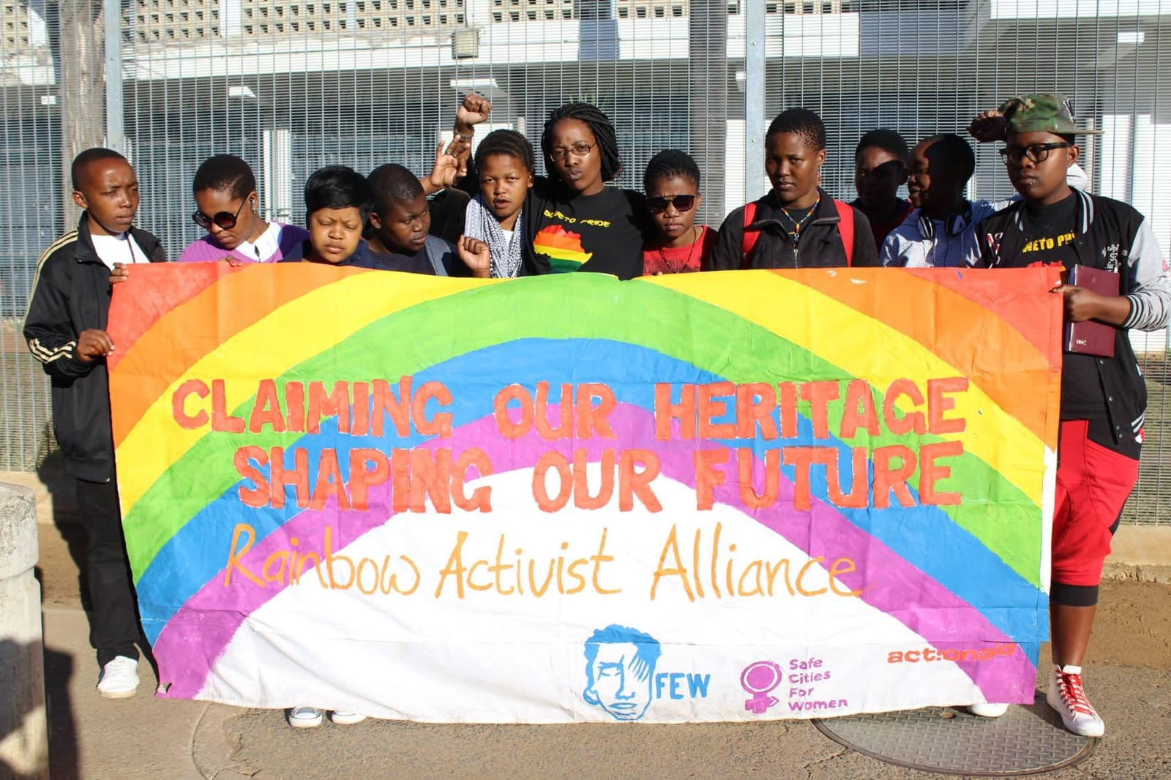
Background(problem, actions, change, evidence)
FEW is one of South Africa’s long-standing, community-led organisations dedicated to advancing the rights, safety, and visibility of lesbian, bisexual, and queer (LBQ) women. What makes FEW unique is its grassroots foundation and legacy of community organising, creating spaces where LBQ women can access support, leadership development, and advocacy while being centred and affirmed.
FEW addresses the violence, discrimination, and social exclusion faced by LBQ women in marginalised communities. The organisation works to strengthen community support, advocate for safety and dignity, and ensure that LBQ voices are represented in broader gender justice and human rights movements.
Before the rebuilding process, FEW experienced leadership transitions and governance challenges that affected organisational stability and community trust. This created a need to strengthen internal systems, restore accountability, and rebuild the organisation so it can continue its legacy of advocacy and support for LBQ communities.
Evidence: Include Photos or videos
Voice and Choice Summit 2026 \ Voice and Choice Summit 2026

Slide 5
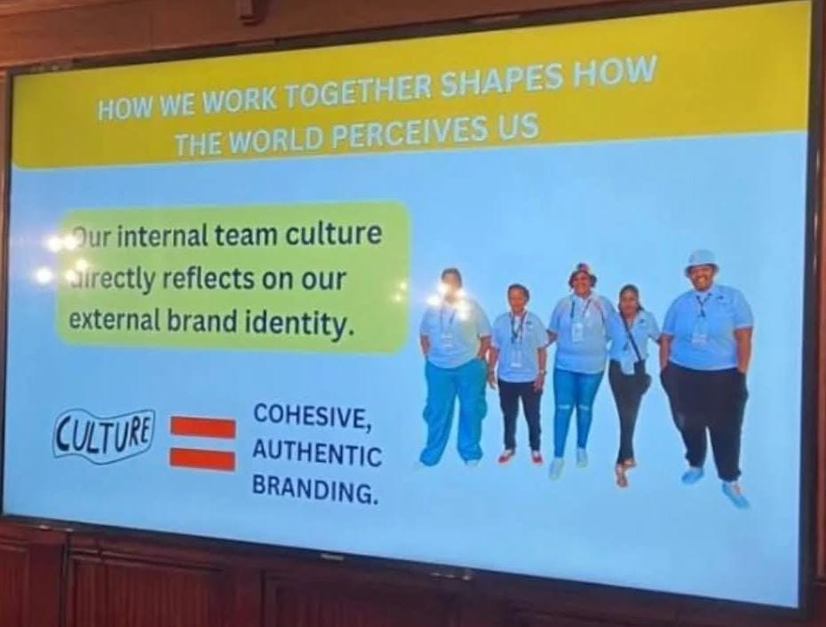
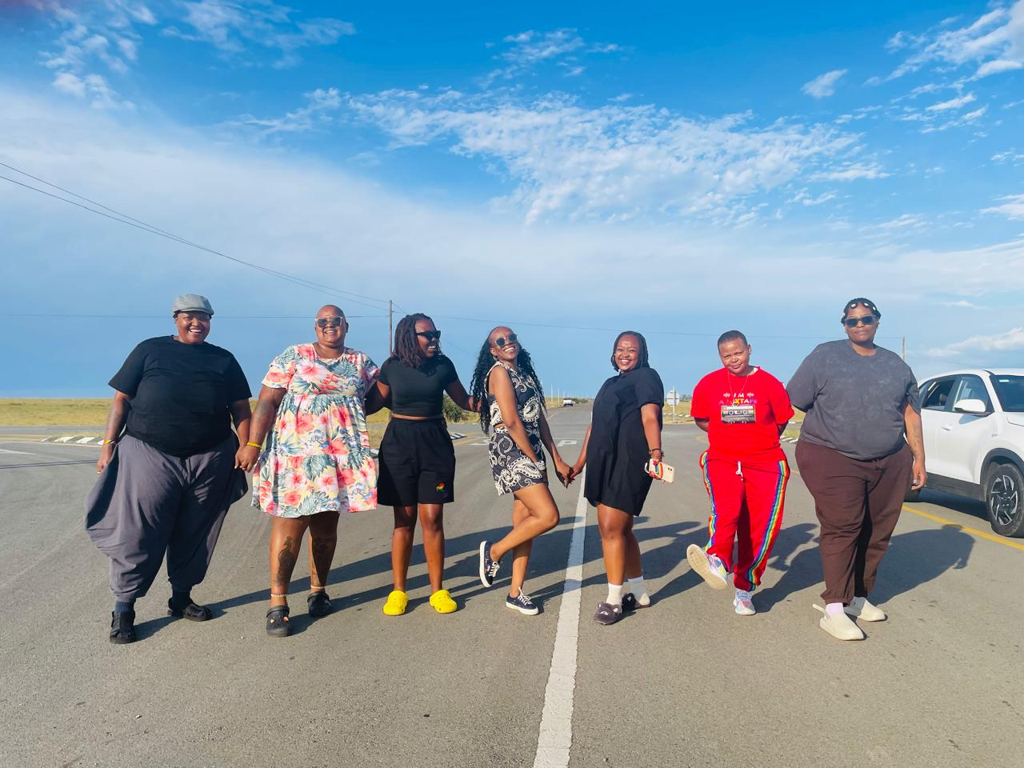
Change
The change began through a deliberate process of organisational stabilisation and rebuilding. This included strengthening governance structures, improving financial and operational systems, and re-establishing accountability within the organisation. At the same time, we prioritised rebuilding trust with the community and partners while continuing advocacy and support for LBQ women.
Activities and actions
Key actions included reviewing internal policies, strengthening financial oversight, rebuilding partnerships, and re-centering community engagement and advocacy work. We also focused on creating a more stable organisational structure that supports both staff and community programs.
Who led and participated in the change
The rebuilding process has been collectively led by the Executive Director, the board, staff members, and community partners, with the guidance and participation of LBQ women who remain at the centre of the organisation’s work. This collective effort has been essential in restoring stability and strengthening the organisation for the future.
Evidence: Include Photos or videos
Voice and Choice Summit 2026 \ Voice and Choice Summit 2026

Slide 6

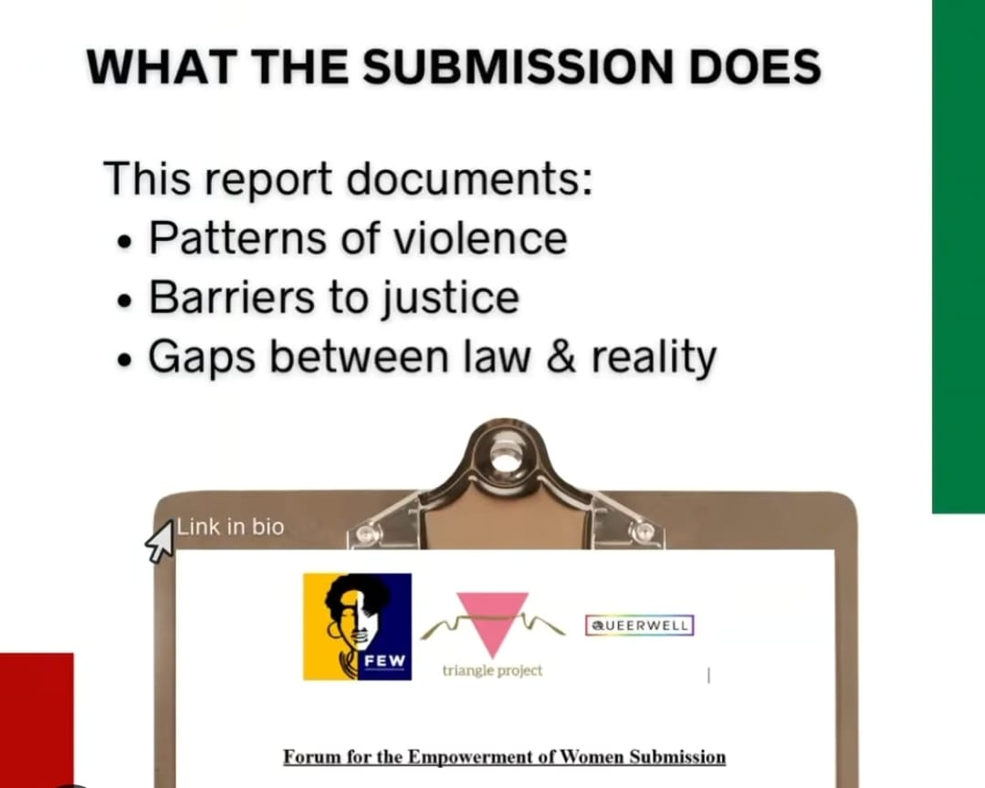
Impact
Level of Change
The change takes place at local and national and global, strengthening community support while contributing to broader advocacy for the rights and visibility of Black LBQ women.
Type of Change
It is a combination of service delivery and advocacy, guided by FEW’s 2025–2029 strategy, focusing on organisational strengthening, community empowerment, resource mobilisation, and social justice advocacy.
Who Benefiting?
Black lesbian, bisexual, and queer (LBQ) women, particularly those in marginalised communities, as well as the broader LGBTQI+ movement.
How are they benefitting?
Through stronger organisational support, psychosocial and economic empowerment programs, safer community spaces, and increased advocacy for their rights and visibility.
Evidence of Change
Evidence includes stronger governance and operational systems, increased fundraising efforts, active community programs, and continued advocacy and partnerships advancing LBQ rights.
Evidence: Include Photos or videos
Voice and Choice Summit 2026 \ Voice and Choice Summit 2026

Slide 7
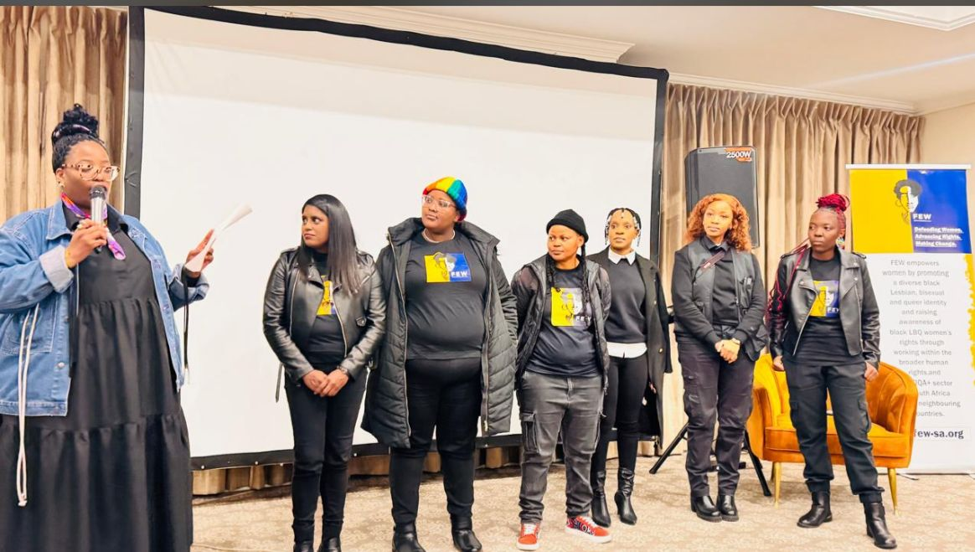
Recognition
How has your work as a leader been recognized? Affirmed?
My leadership has been recognised through the trust placed in me to guide a legacy organisation through a period of rebuilding and transition. Being appointed as Executive Director reflects the confidence that the board, staff, and community have in my ability to stabilise and strengthen the organisation.
It is also affirmed through continued partnerships, community engagement, and the growing confidence of LBQ women who look to the organisation as a space for support, advocacy, and leadership. For me, the most meaningful recognition comes from seeing the organisation regain stability and knowing that the work continues to serve and empower the communities we are accountable to.
Evidence: Include Photos or videos
Voice and Choice Summit 2026 \ Voice and Choice Summit 2026

Slide 8
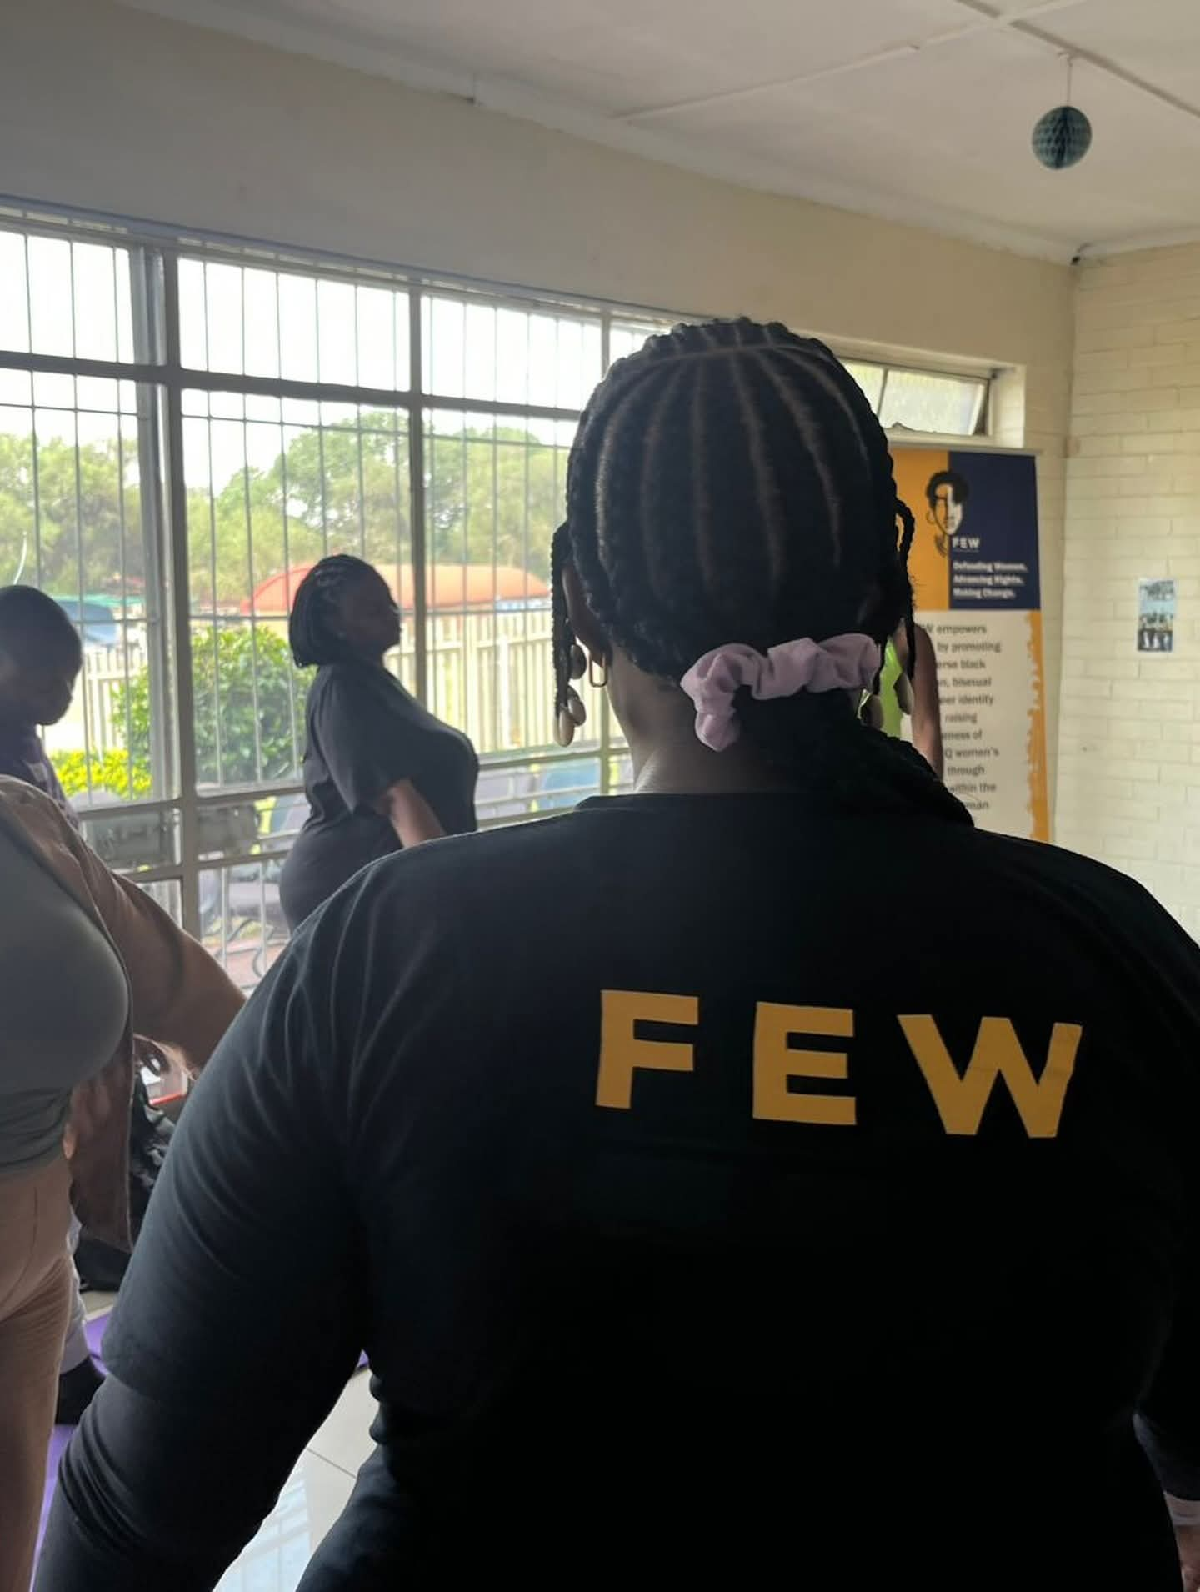
Challenges & Lessons learnt
Challenges & mitigation
The organisation faced leadership transitions, governance gaps, limited resources, and rebuilding trust with the community and partners during a period of instability.
Mitigation:
To address this, we focused on strengthening governance and internal systems, improving financial oversight, rebuilding partnerships, and re-centering community engagement. These efforts have helped stabilise the organisation and support its long-term sustainability.
What lessons have you learnt?
Voice and Choice Summit 2026 \ Voice and Choice Summit 2026

Slide 9
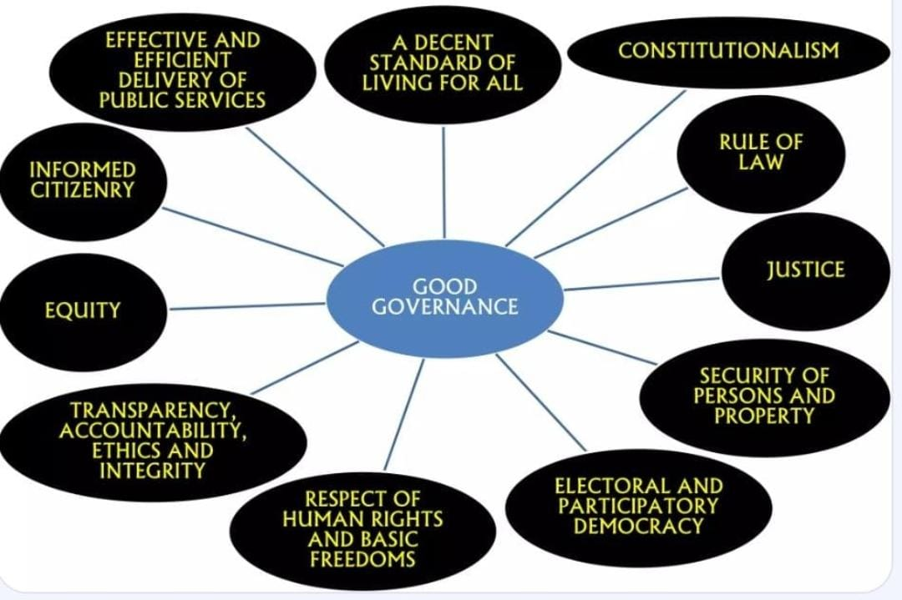
Sustainability
Sustainability Measures
Sustainability has been strengthened through improved governance, stronger financial oversight, and clearer operational systems. The organisation is also focusing on diversifying funding sources, strengthening partnerships, and investing in leadership and community capacity to ensure long-term impact.
Sustaining and Scaling the Work
To sustain and scale the work, we aim to expand fundraising and resource mobilisation, strengthen community programs, and deepen advocacy and partnerships. This will allow the organisation to grow its impact while continuing to centre and support Black LBQ women in marginalised communities.
Evidence: Include Photos or videos
Voice and Choice Summit 2026 \ Voice and Choice Summit 2026

Slide 10
Next Steps
What are your plans?
Organisational Strengthening
We aim to strengthen governance, leadership, and internal systems to ensure the organisation operates in a safe, accountable, and sustainable way.
2. Fundraising and Resource Mobilisation
We plan to diversify funding sources and build long-term partnerships to ensure sustainable resources that support impactful programs and advocacy.
3. Community Empowerment
We will expand psychosocial support, leadership development, and economic empowerment initiatives to improve the wellbeing and resilience of Black LBQ women.
4. Social Justice Advocacy
We will continue to drive policy advocacy, public awareness campaigns, and movement partnerships that advance the rights, safety, and visibility of Black LBQ women.
Voice and Choice Summit 2026 \ Voice and Choice Summit 2026

