Slide 1


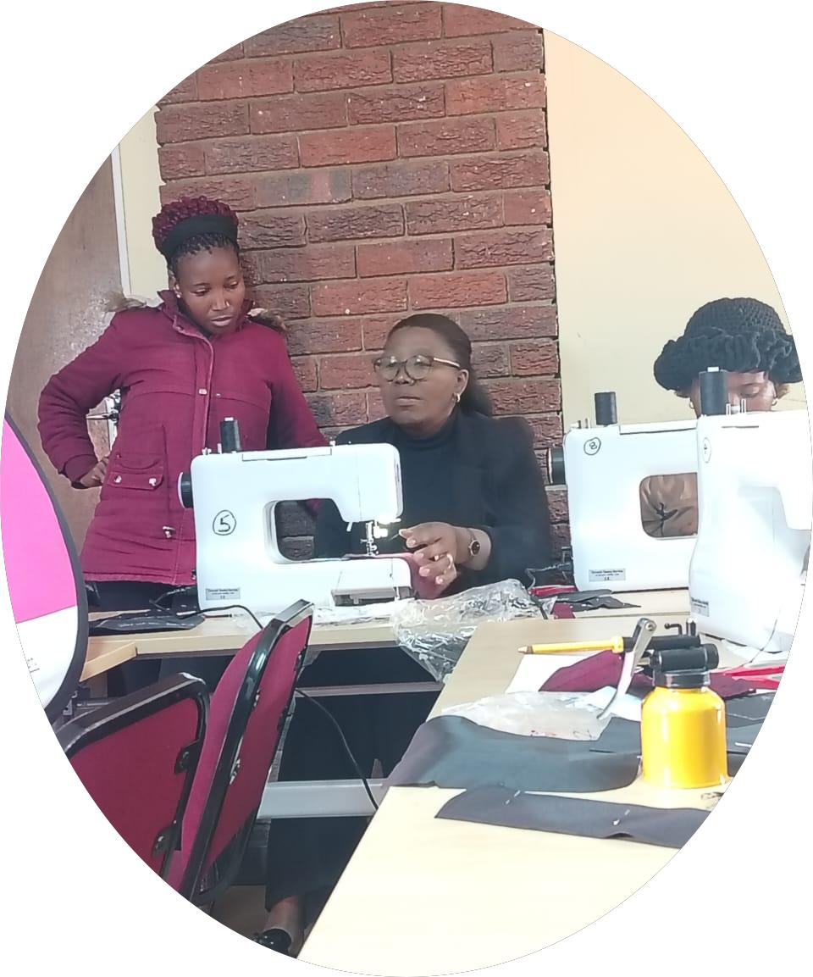
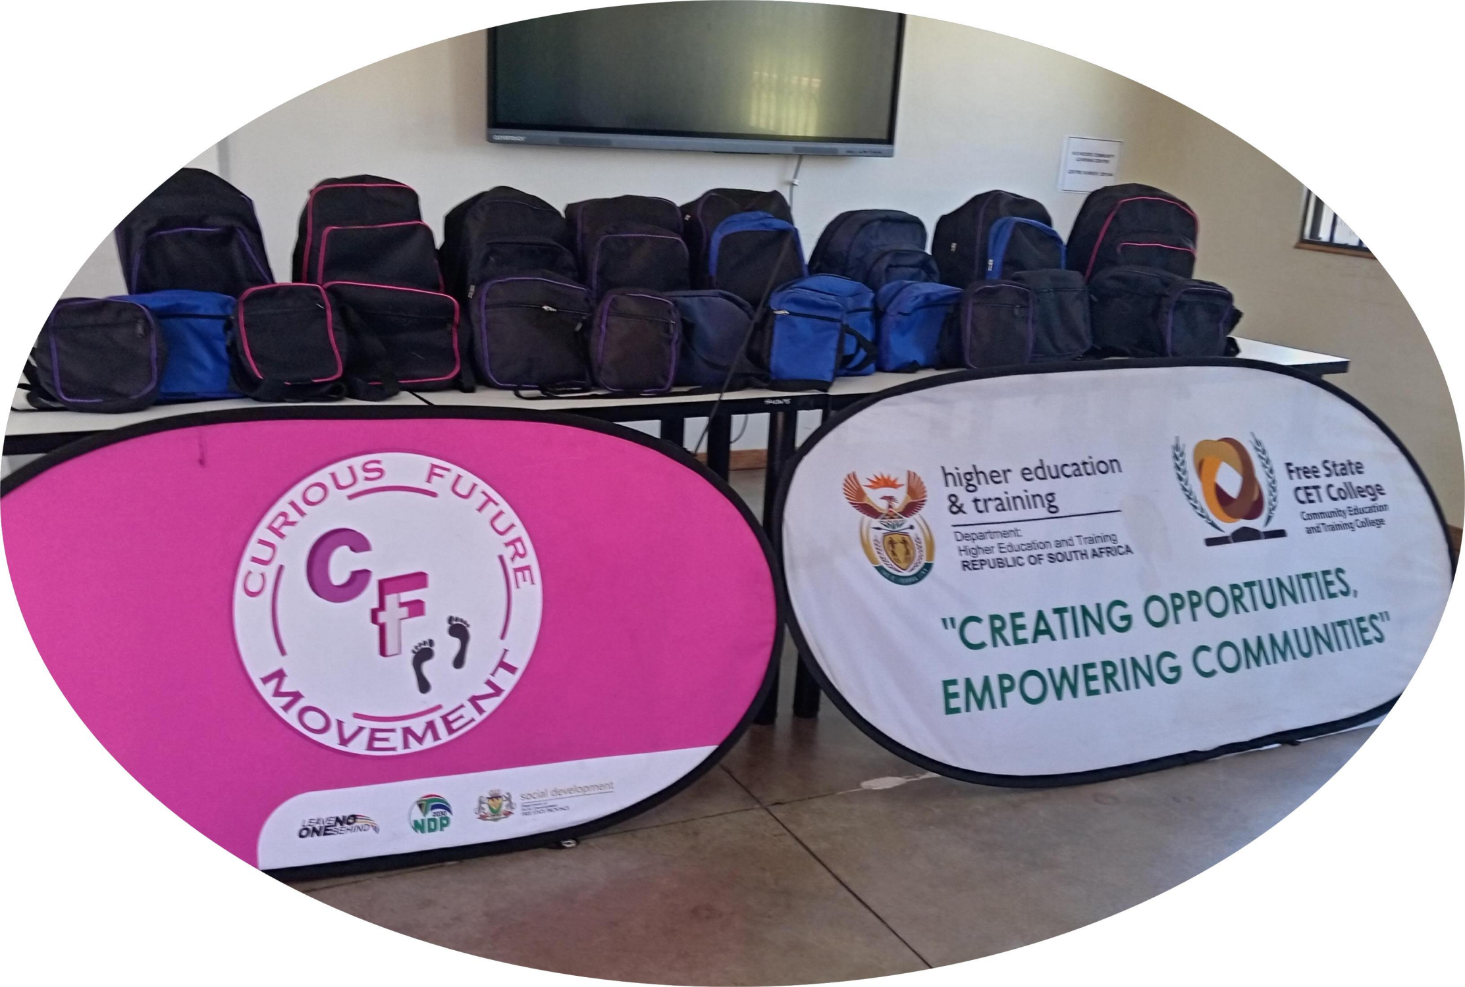
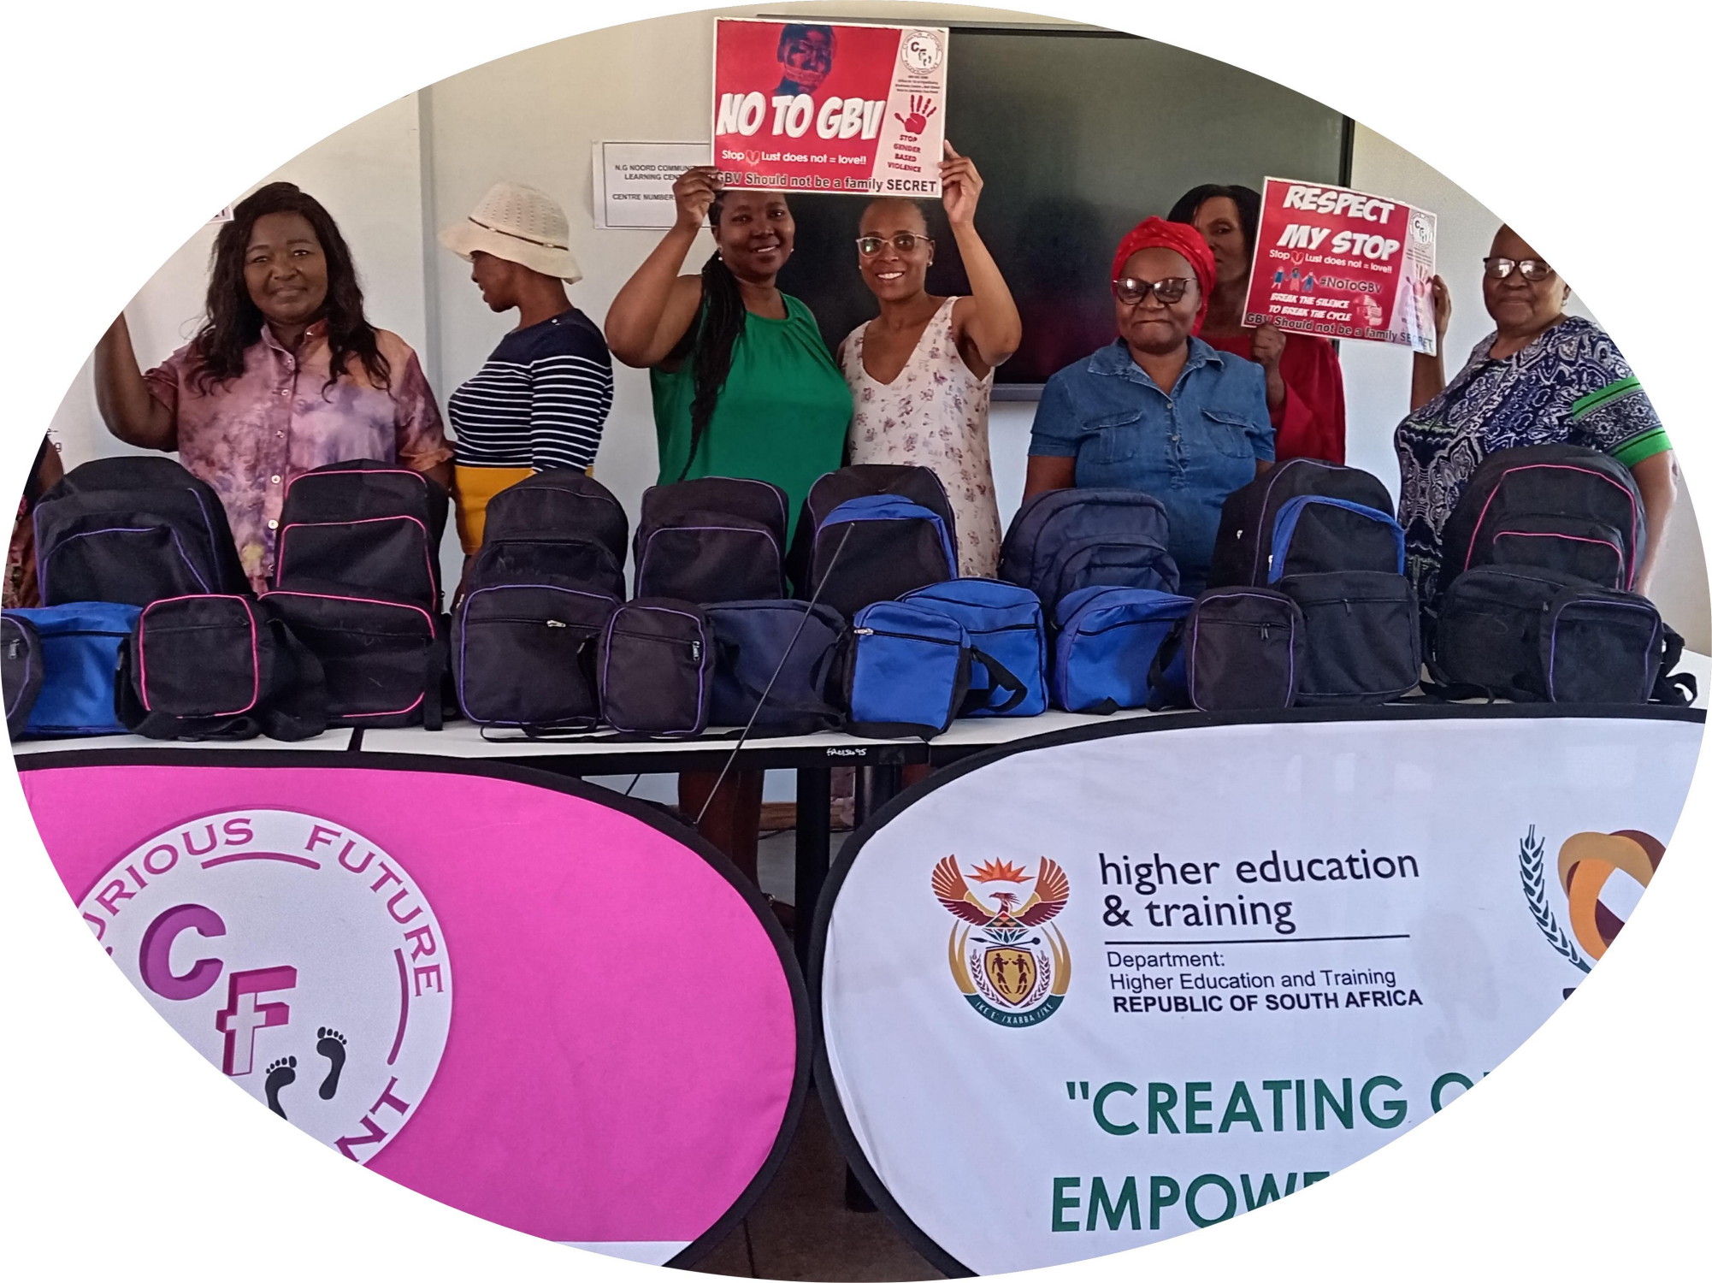
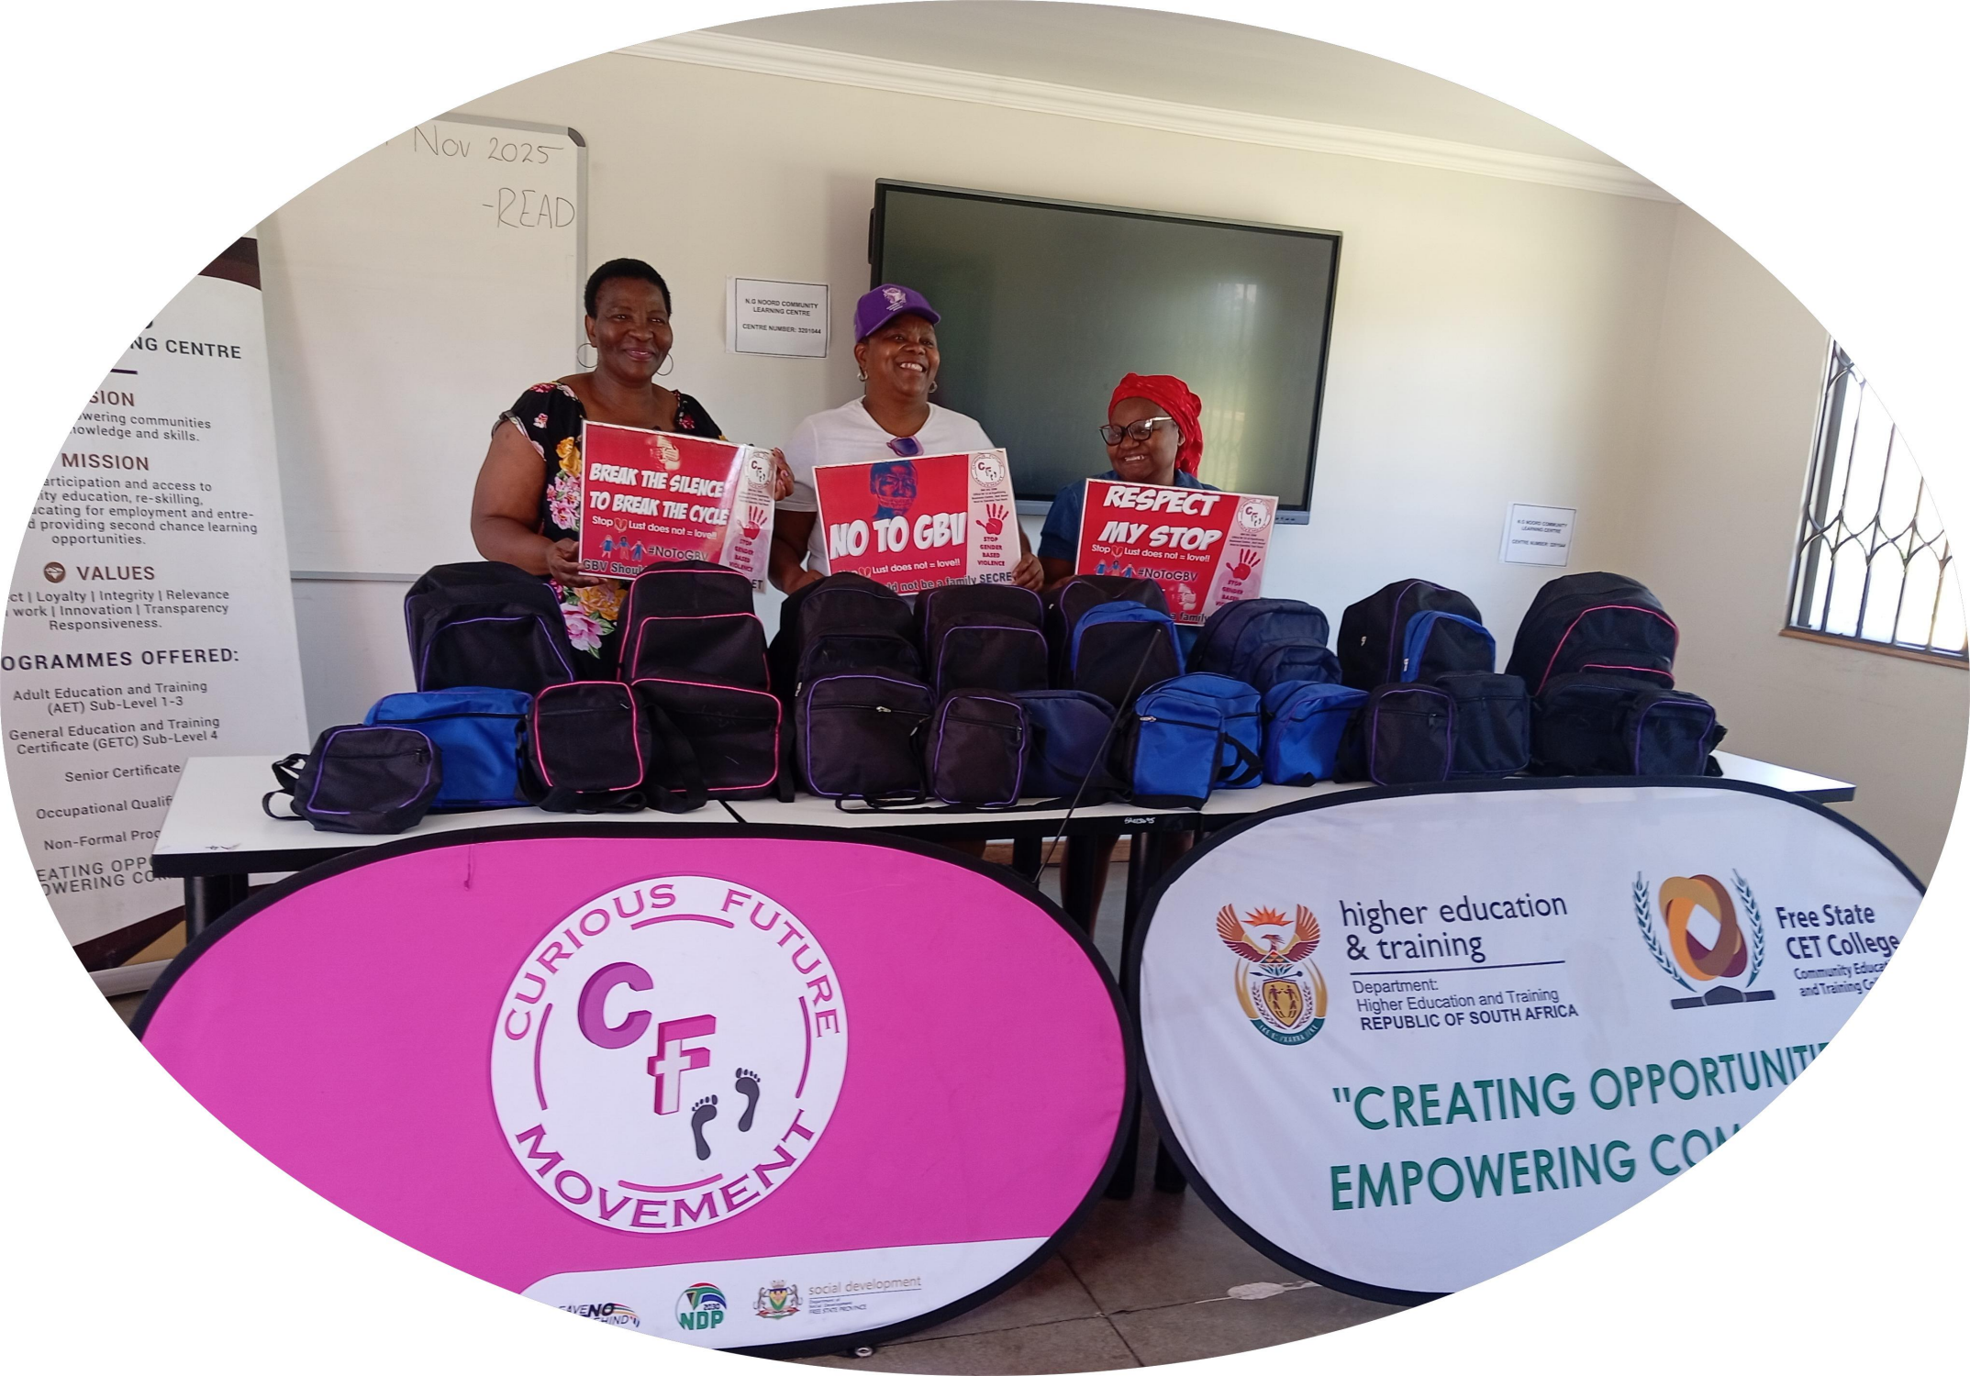
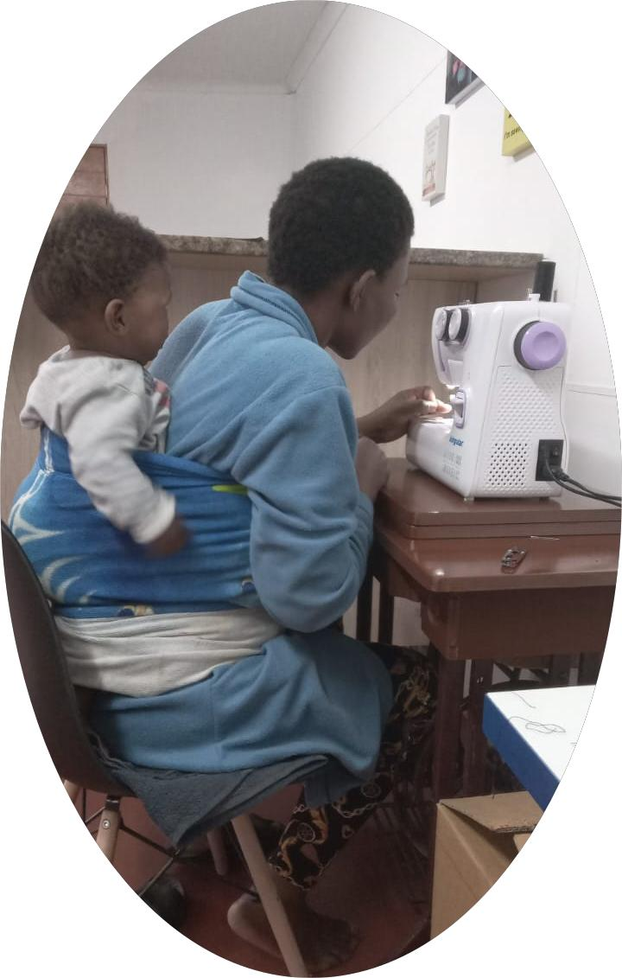
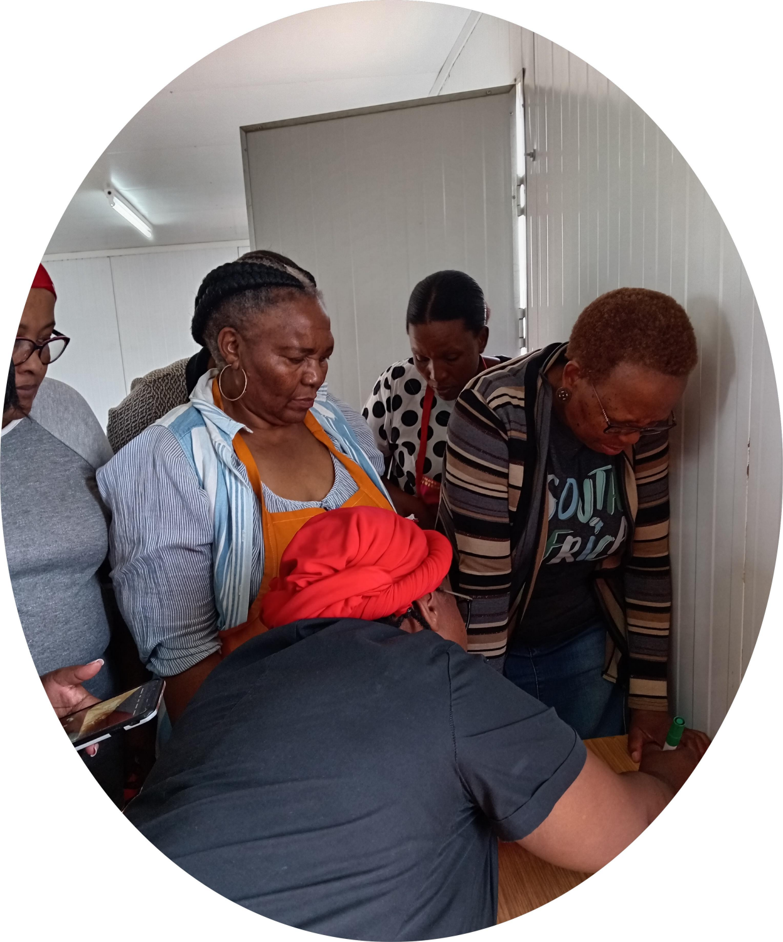
Voice and Choice Summit 2026-Leadership DRIVER OF CHANGE STORY
South Africa,Leave No One Behind Skills Development Training
“SEWING:The only time stabbing something repeatedly is Socially acceptable”-Unknown
Voice and Choice Summit 2026 \ Voice and Choice Summit 2026

Slide 2
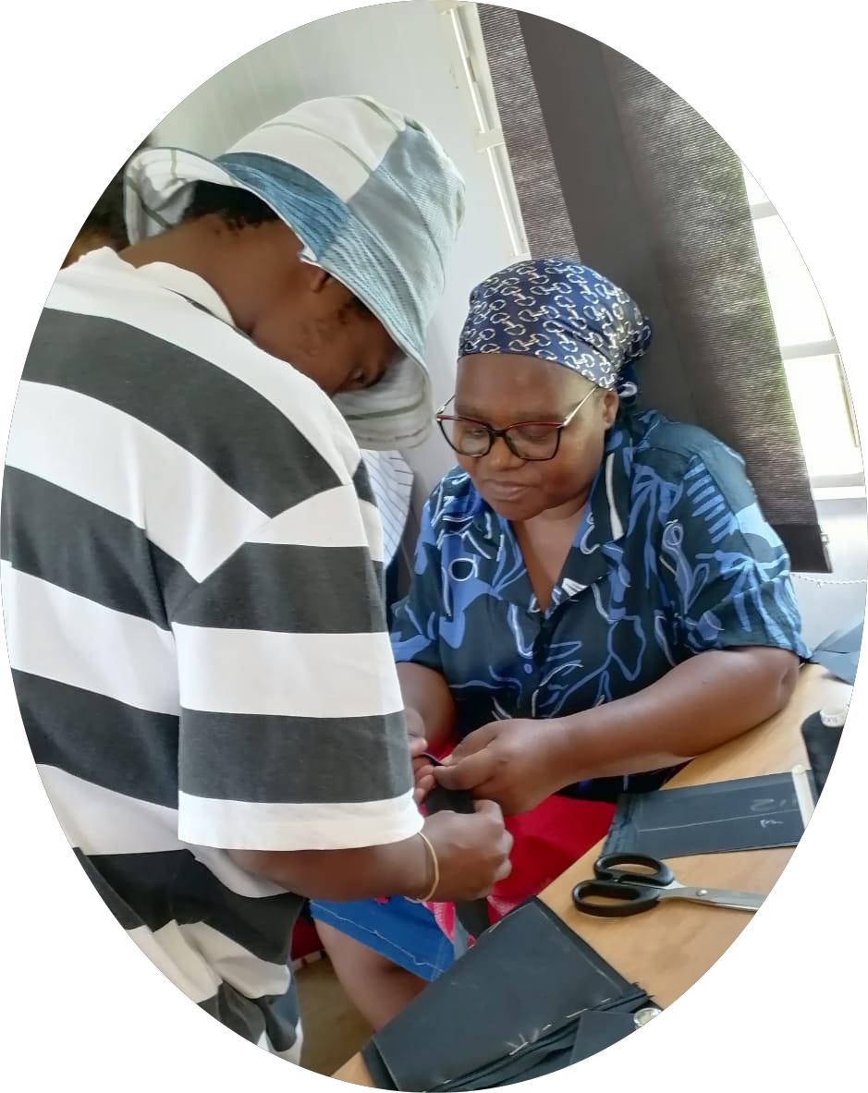
Synopsis– brief overview what this is about
Name | BARBARA BAISANG
Designation | PROGRAMME MANAGER
Organisation | CURIOUS FUTURE MOVEMENT
Country | SOUTH AFRICA
Category | DRIVER OF CHANGE
Summary | She is not a victim but a survivor who became an overcomer,like a star that shines brighter at night,she also allowed her spark to glow amidst her night season.she gained a skill to make bags through a GBVFFund funded project,she helped CFM to achieve our target of empowering 30+ women, She is RWVL Genderlink funded Project Facilitator and has empowered 31 other women with the same Bag making skill(15 Victim Support and Shelter clients & 16 Women from the Community and CFM Staff) “Healing out Loud,Because I nearly died in Silence”
Voice and Choice Summit 2026 \ Voice and Choice Summit 2026

Slide 3
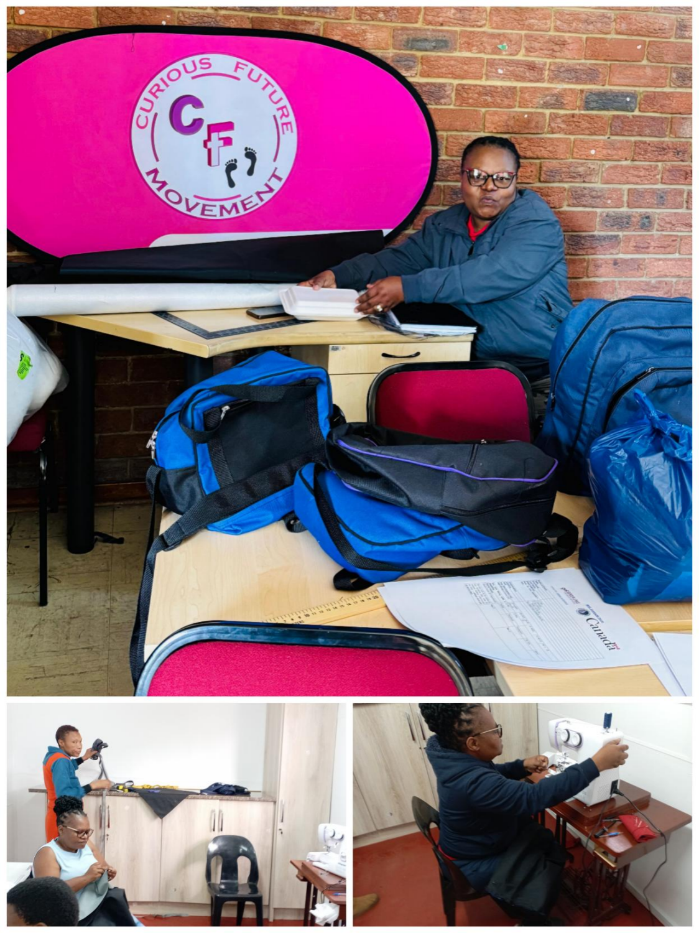
Background(problem, actions, change, evidence)
Give some background. Briefly describe the context or problem the community or individual was facing before the intervention.
Shibe Seheshe a 52 years old woman and mother of 3,a survivor of emotional and economic abuse, one of our staff is her client staying not far from her, Shibe runs her business from her home because her spouse prefers it that way to control how far the business should operate for her to be financially dependent on him although not providing for the family , as a results this affects the growth and exposure of her business and limit her ability to reach more clients based on her capacity and capabilities.
From Vaalpark Free State, South Africa
Experienced Seamstress with the ability to train others
“I don`t run from my problems,I Sit in front of my machine and deal with them,One stich at a time like a normal Sewaholic -Unknown”
Voice and Choice Summit 2026 \ Voice and Choice Summit 2026

Slide 4
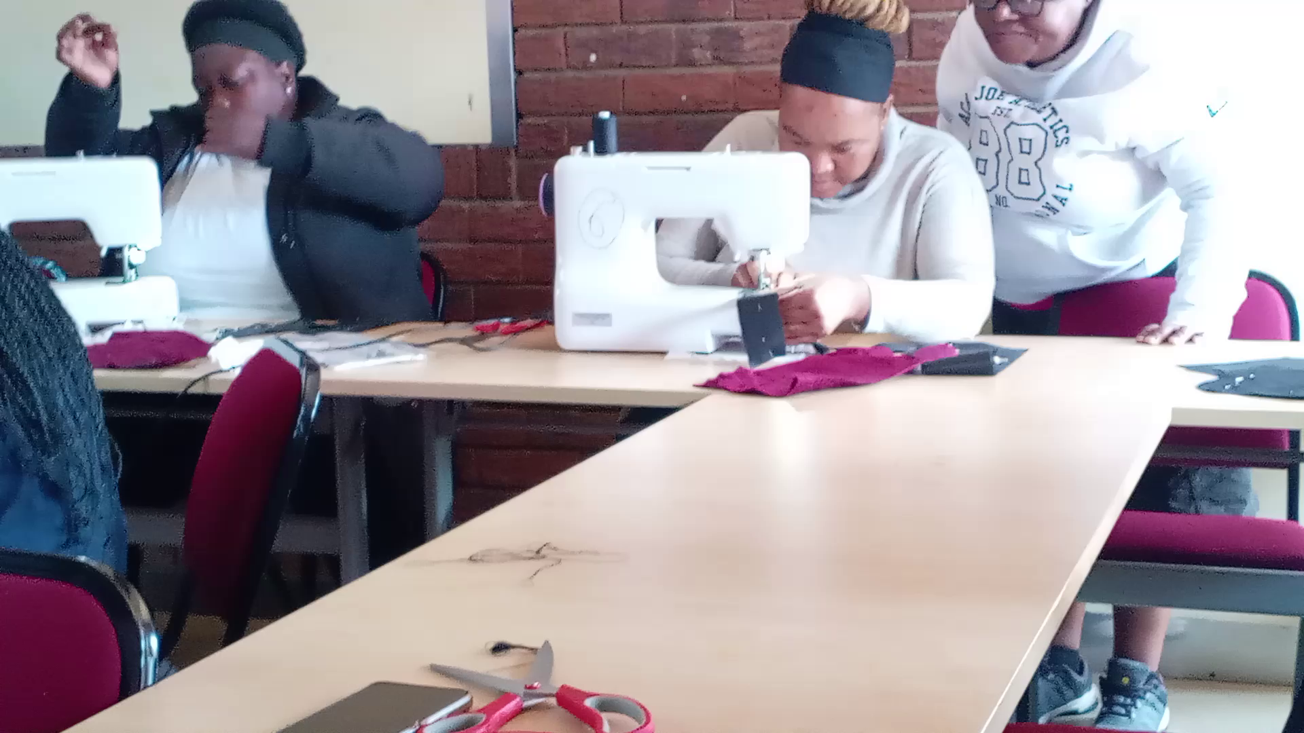
Background(problem, actions, change, evidence)
Shibe is passionate about Women and Youth empowerment, she is a founder and coach of a local football for the boys in her neighborhood which she used to sponsor from her pocket with the limited income she was making from her sewing business ,She has the ability to work with people and teach them, her patience with her “students” is amazing,some of them took longer to learn and understand than the others but she actually encouraged them and none of them dropped out of the project, because she assured them that they are not alone and she supports them until they complete each bag
We are breaking a cycle of Financial abuse and dependency by providing sewing skills to women
Shibe`s situation when we met her was not different from most of our Shelter clients”Survivors “ who were finding themselves having to go back to their abusive partners when they are released from the Shelter because they don`t have a alternative place to go to and even if they were to be accomodated by their relatives because they are unemployed becoming a financial burden to their families was another issue as a results they were readmitted back into the shelter but in her case the difference is that she had the skill but was denied the right to be financially independant
“SEWING -Its not a craft,Its a therapy”-Unknown
Voice and Choice Summit 2026 \ Voice and Choice Summit 2026

Slide 5
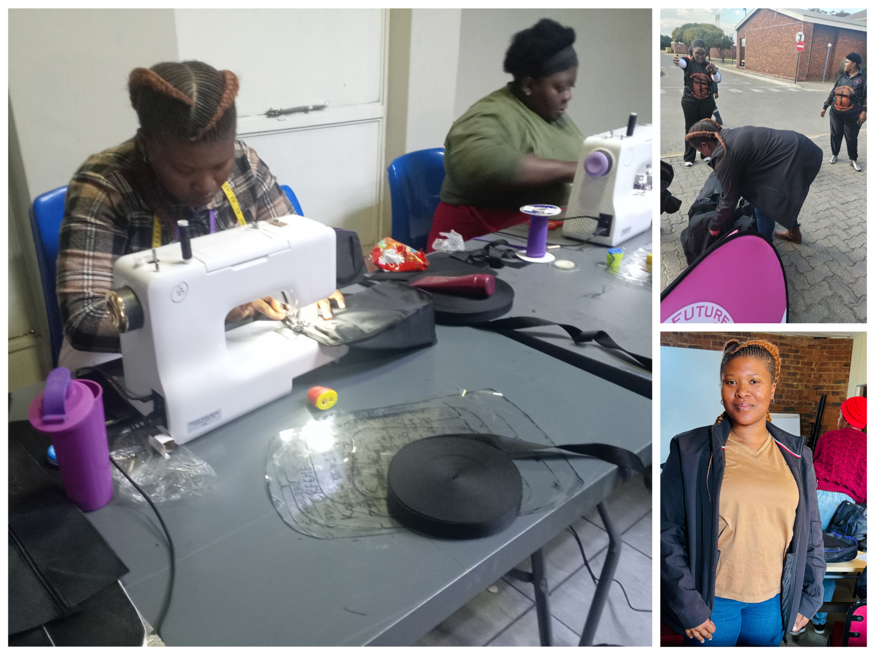
Change
How did the change come about?
• Lerato Phokojoe from our Victim Support Services, like many other women who never had access to a sewing machine before, she learned to switch the machine on for the first time,thread the machine,cut patterns and she made all her 7 bags and helped other women who were struggling in the group
• Lerato is one of Shibe`s students with lot of potential, her passion to learn compelled us to borrow her a sewing machine because she was getting orders for Luch bags and side bags, with the cut off material she made herself a water cooler for water bottle and recycled her daughter jean pants by making a skirt for her.
“SEWING:A creative mess is better than tidy idleness”-Unknown
Voice and Choice Summit 2026 \ Voice and Choice Summit 2026

Slide 6
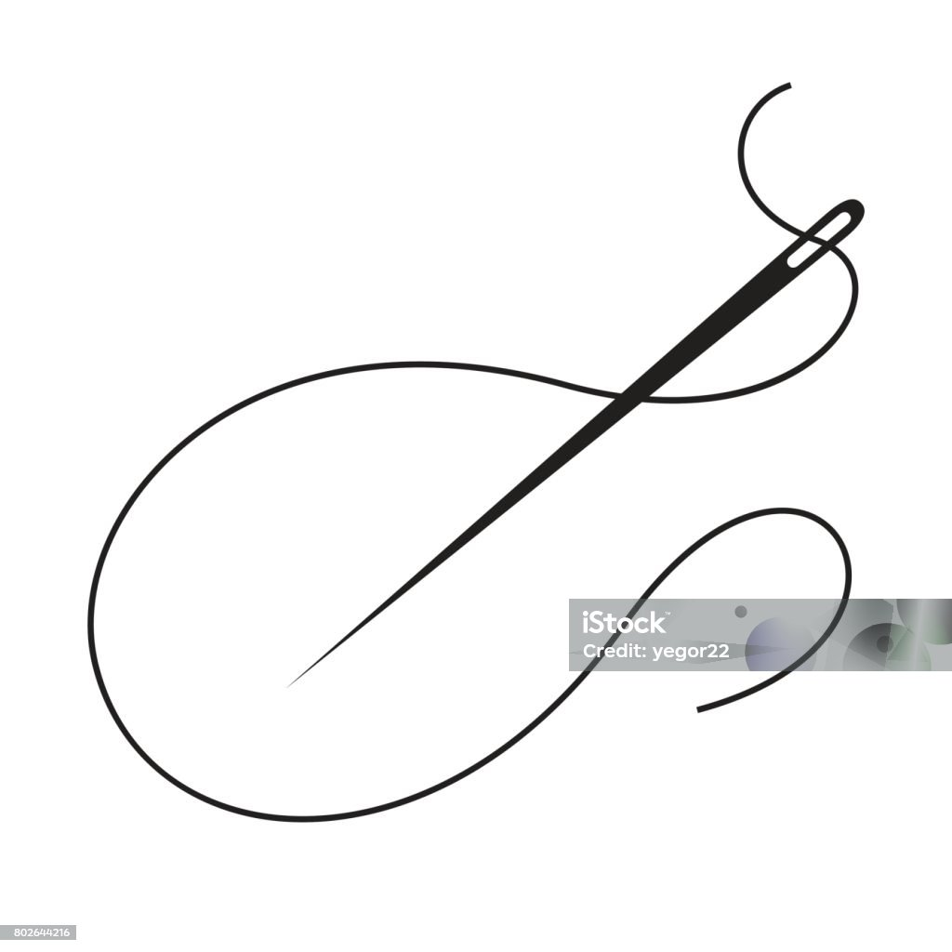
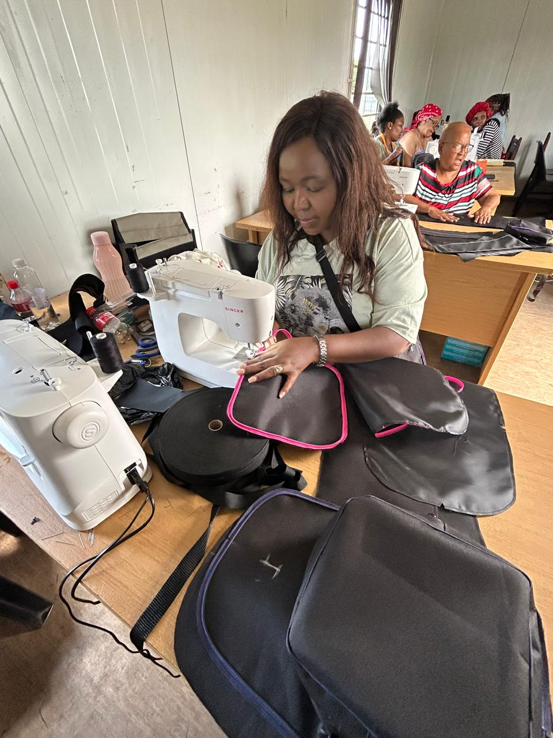
Impact
Describe the change that has occurred?
The change happened locally at Zamdela and Sasolburg
Our change in service delivery aligned with GBVF NSP Pillar 5
Women who are survivors of GBV and unemployed women from the community
They learned a sewing skill(to make bags)
We have Thembi Masilela on the picture busy making a bag at community learning centre and they also completed registers and evaluation forms
“When life gives You Scraps.....Sew Something”-Unknown
Voice and Choice Summit 2026 \ Voice and Choice Summit 2026

Slide 7
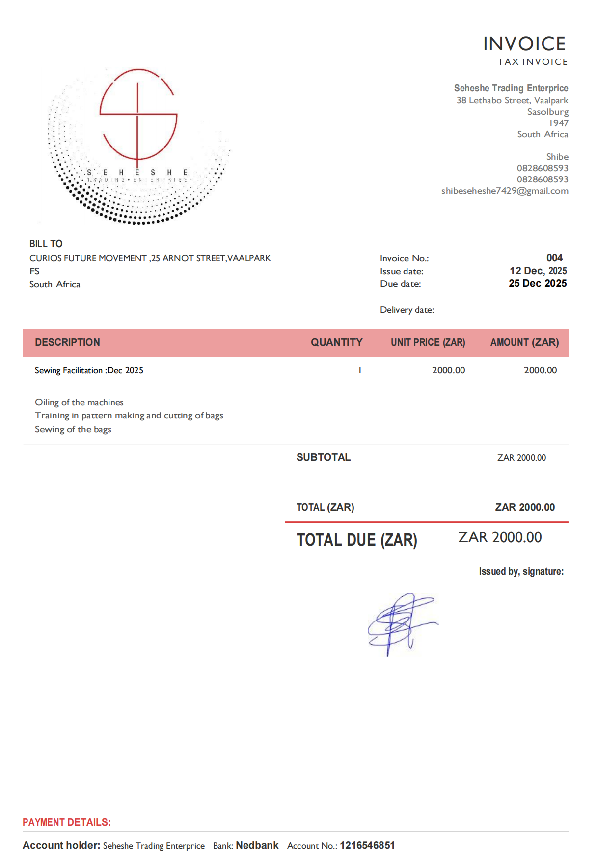
Recognition
Shibe volunteered most of her time teaching our clients in the Shelter to make bags,and when funding was available Our Board approved that she should be honored for her time and from GBVF Fund R1500,00 for her effort to empower other women. and also with the Genderlink funds Shibe is paid R2000,00 as a honorarium from our HR budget for facilitating training at the Community Learning Centre and shelter clients from August -December 2025 and February 2026,
“Sewing is the art of creating soething beautiful from chaos-unknown”
Voice and Choice Summit 2026 \ Voice and Choice Summit 2026

Slide 8
Challenges & Lessons learnt
Challenges & mitigation
We were behind with starting the sewing project due to the issue of the Venue, however when we started on the 2nd June we had to work around our obstacle and asked the beneficiaries that we start with the theory part of the training for a week at our cramped office space while we were finalizing venue arrangement with SEDFA, initially each woman had to make 5 side bags(the same kind) but the Facilitator who is one of the beneficiaries of our Pilot project advised us that it is better that the woman make 7 different bags instead of one kind so that their target market is not narrowed by One bag so the ladies learned to make Creche Bag/School Bag/Lunch Box/Bible Bag/Sports Bag/Sport's Bag/Side Bag in 27 Days, again with delays that are beyond our control forcing us to wait for the supplier to deliver the sewing machine it actually provided us an opportunity to discuss a plan of action in order to make up for the lost time, a window of opportunity to do more presented itself, for our sanitary pads sewing project
What lessons have you learnt?
Throughout these project we have learned that flexibility and inclusivity are the key ingredients to its success, because it has proven to us from the first phase that rigidity is a set up for failure, We had to apply the principle of Nothing for Us without Us.
“Sewing is a way to quiet the mind, to relax the body and to feed the soul”-Marie Bostwicks”
Voice and Choice Summit 2026 \ Voice and Choice Summit 2026

Slide 9
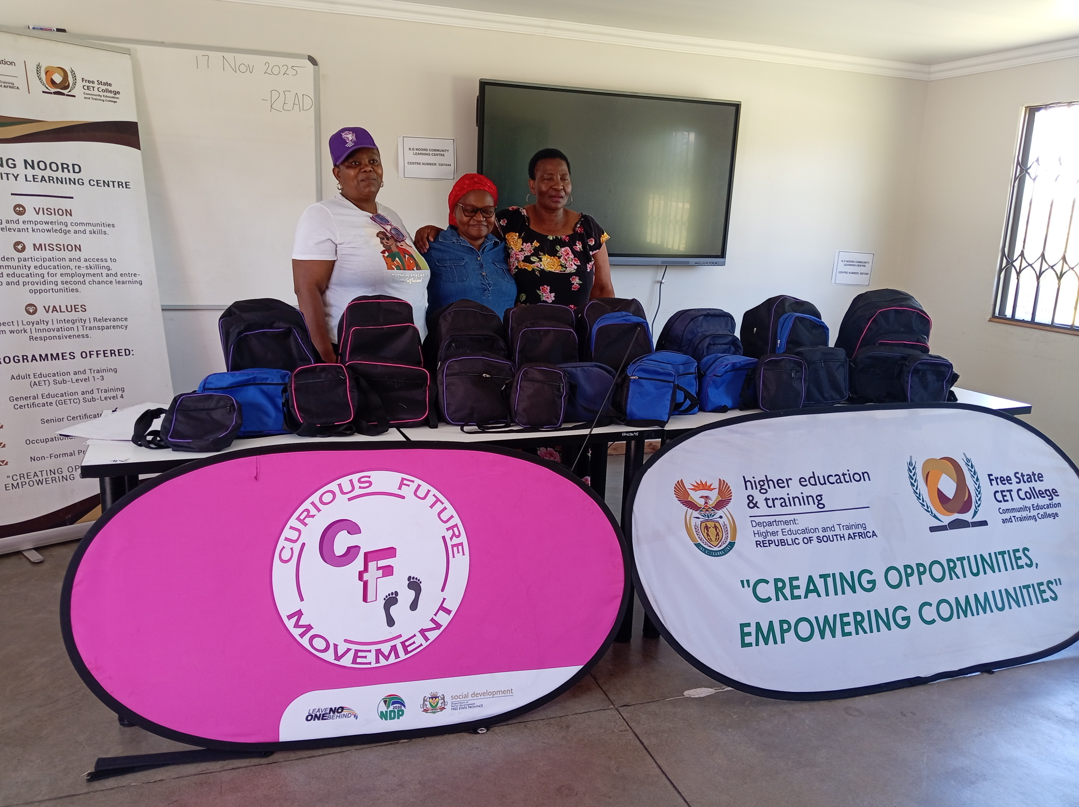
Sustainability
We collaborated with SEDFA and Sasolburg Community Learning Centre regarding safe training venue which is a challenge we had at the beginning that led to a delay in starting the project as a results we are able to provide skills to our clients(survivors)without exposing them to the community by having separate training venues
We received 5 extra heavy duty sewing machines from Seriti Mines,We trained 5 of our staff members who already had sewing skills and are grooming another survivor with potential to also and we will continue knocking at doors seeking funding and collaboration to ensure continuety and sustainability
“The best antidepressant is a sewing machine and a room full of fabric”-Sewing moments
Voice and Choice Summit 2026 \ Voice and Choice Summit 2026

Slide 10
Next Steps
To have our training accredited with SETA
To seek funding for Shibe and Lerato to register for a facilitation course because we know their are capability
To be able to create employment for our Survivors by producing Bags at a large scale for companies and retailers (Long Term)
To extend the Skills empowerment for Women in the rural area specifically in the North West (Long Term)
“Never underestimate the power of a woman with the sewing machine”-unknown
Voice and Choice Summit 2026 \ Voice and Choice Summit 2026

