Slide 1

Voice and Choice Summit 2026- Leadership Category
Zimbabwe : SRHR Education for healthier communities
Zimbabwe, Harare, 15 March 2025, Vimbai Rugare Nyika
Voice and Choice Summit 2026 \ Voice and Choice Summit 2026

Slide 2
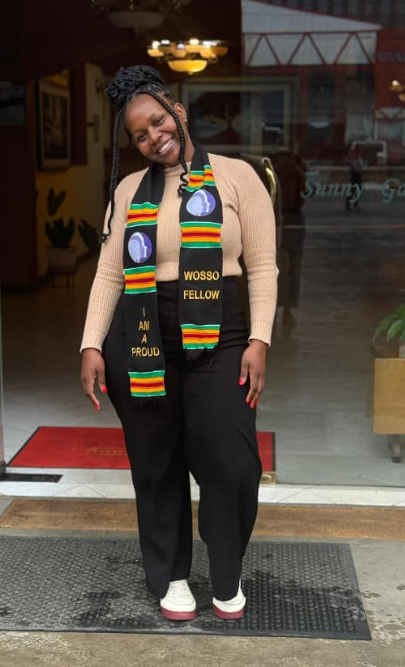
Background
About myself
Vimbai Rugare Nyika, Zimbabwean, Women of the South Speak Out alumni, Programs Officer – Women’s Action Group, feminist, SRHR advocate promoting access to information and health for marginalized communities.
About my intervention
With support from GL, I engaged 40 community members in Marondera District on Bodily Autonomy and Integrity , SRHR, and Positive Masculinity (HeForShe).
Intervention was evidence-based : informed by recommendations gathered from my work with WAG in Marondera. Gender Inequality, GBV and limited knowledge on SRHR was rife. This incapacitated community members from making informed choices about their sexual and reproductive health, enjoying equal opportunities and practicing autonomy over their bodies.
Voice and Choice Summit 2026 \ Voice and Choice Summit 2026

Slide 3
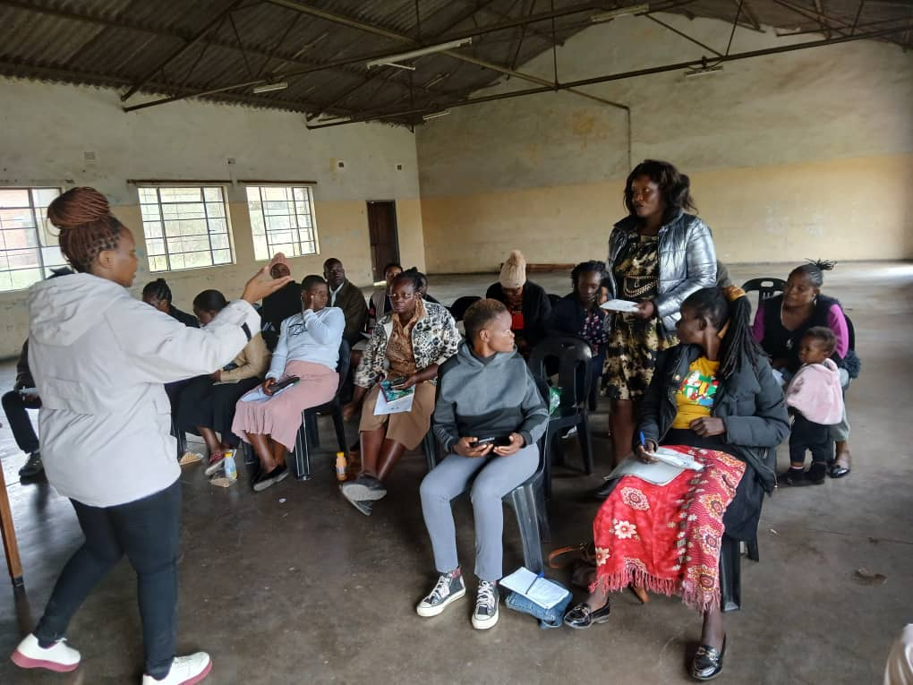
Change
How the change come about
Trainings (online and offline).
Topics covered : SRHR, Termination of Pregnancy, Post-Abortion Care, bodily autonomy, bodily integrity, positive masculinity, advocacy and movement building. 20 men and 20 women participated in sessions.
Outcomes
Increased understanding of the above themes = increased capacity to make informed choices about one’s SRH wellbeing
Increased capacity to assist other community members with reliable, accurate, life-saving information
An enhanced sense of solidarity – participants networked and identified areas of synergy in their work as community champions
Voice and Choice Summit 2026 \ Voice and Choice Summit 2026

Slide 4
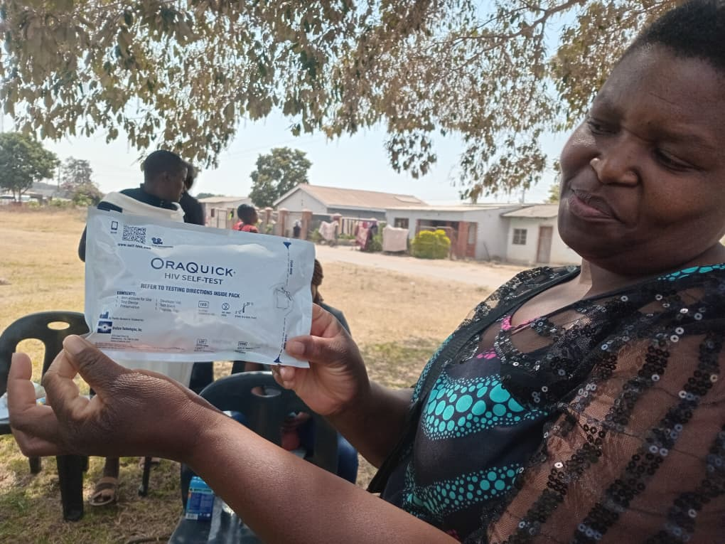
The change
The change that has occurred :
Changes occurred at multiple levels
Individual level : an increased understanding of SRHR, BAI and Gender Equality as human rights, enhanced confidence to share accurate information and refer others for access to services, shifts in mindsets (eg. from believing women should be beaten ‘once in a while to ensure they stay in line’ to believing ‘I should use my power as a man in a positive way.’)
Community level : reliable referral points for reliable/accurate information, leading to increased confidence in service delivery, resulting in increased uptake of available services, strengthened solidarity resulting in stronger grassroots movements for access.
National level : Over time, the intervention contributes towards the realization of national-level targets eg. the Zimbabwe National GBV Strategy for 2023-2030 (Vision: a genderjust society free from all forms of GBV by 2030 ; Goal : A 20 percent reduction in the prevalence of all forms of Gender Based Violence and Harmful Practices by 2030.)
Voice and Choice Summit 2026 \ Voice and Choice Summit 2026

Slide 5
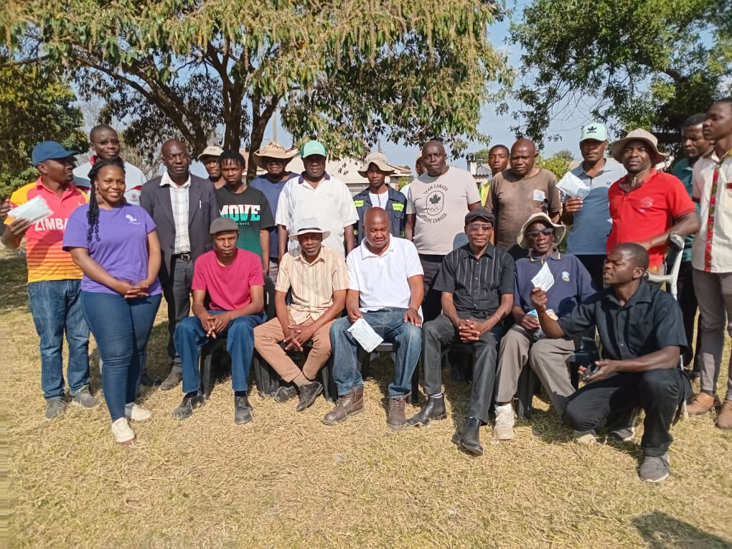
Sustainability
Sustainability and scale-up measures :
The intervention was built on Women’s Action Group’s programs; this ensures institution-level sustainability as areas of focus are areas of interest for WAG.
Partnership with local stakeholders(MWACSMED) ensures continuity beyond the intervention timeline
The model is self-sustaining as trained participants are residents of Marondera
Voice and Choice Summit 2026 \ Voice and Choice Summit 2026

Slide 6
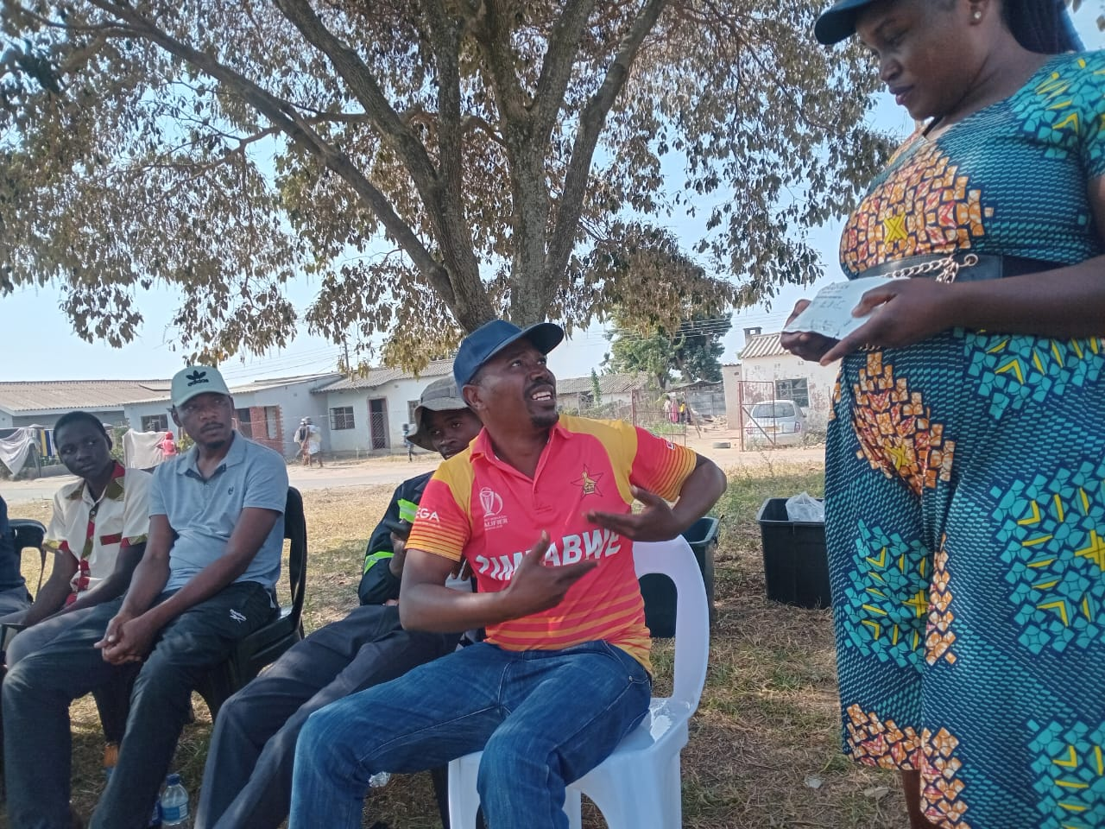
Challenges & Lessons learnt
Challenges & mitigation
Resistance to new knowledge : consistent information was shared, myths were busted and respectful dialogue was upheld to ensure trainings were safe spaces for learning.
Lessons learnt
Now, more than ever, we need to think beyond funding.
Voice and Choice Summit 2026 \ Voice and Choice Summit 2026

Slide 7
Next Steps
Plans
Participating in the WOSSO Alumni network
WhatsApp group discussions
Fundraising (thinking beyond donor funds)
Voice and Choice Summit 2026 \ Voice and Choice Summit 2026

