Slide 1
LGBTIAQ
Do you know anyone who does not quite conform to your traditional definition of male and female?
What is your relationship with that person?
Has this changed over time?
Has this helped you to challenge your own stereotypes

Slide 2
My story
High school friend
Different but not queer.
Natural relationship – led to an understanding
Contextualised
Part of my gender journey

Slide 3
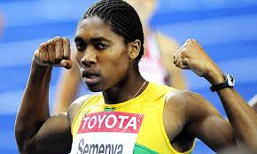
Every day stories:Castor Semenya
Gender or sex verification test?

Slide 4
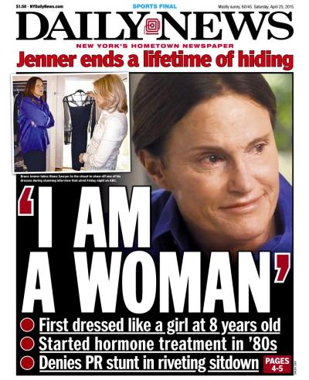
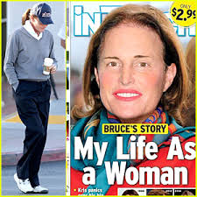
Bruce Jenner

Slide 5
The Five Sexes: Why Male and Female Are Not Enough – A. Fausto- Sterling
Western culture is deeply committed to the idea that there are only two sexes. Evenlanguage refuses other possibilities.
But if the state and the legal system have an interest in maintaining a two-party sexual system, they are in defiance of nature.

Slide 6
Theory of the five sexes cont..
For biologically speaking, there are many gradations running from female to male; and depending on how one calls the shots, one can argue that along that spectrum lie at least five sexes-- and perhaps even more.

Slide 7
Theory of five sexes continued
For some time medical investigators have recognized the concept of the intersexual body.
But the standard medical literature uses the term intersex as a catch-all for three majorsubgroups with some mixture of male and female characteristics: the so-called true

Slide 8
Theory of five sexes continued
Hermaphrodites, whom I call herms, who possess one testis and one ovary
Male pseudohermaphrodites (the "merms"), who have testes and some aspects of the female genitalia but no ovaries;
Female pseudohermaphrodites (the "ferms"), who have ovaries and some aspects of the male genitalia but lack testes.

Slide 9
Theory of the five sexes
M-F
M
M/F
H
F/M
F
Merm
Herm
Ferm

Slide 10
Why is LGBTI a gender issue?
Could be biologically based
Could be a matter of choice
Challenges social norms – M/F
Challenges deeply ingrained stereo types- roles.

Slide 11
Some terms
Gender identity
Sexual orientation
Homophobia
Lesbian/ Gay
Bisexual
Transgender
Intersex
Asexual
Queer

Slide 12
Cuts across cultures: Africa
https://www.youtube.com/watch?v=8y3xsXIibSw.

Slide 13
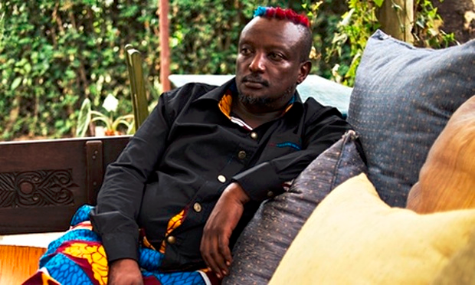
Speaking out
https://youtu.be/8xFjTzp7198
w.theguardian.com/books/2014/feb/16/binyavanga-wainaina-gay-rights-kenya-africa

Slide 14
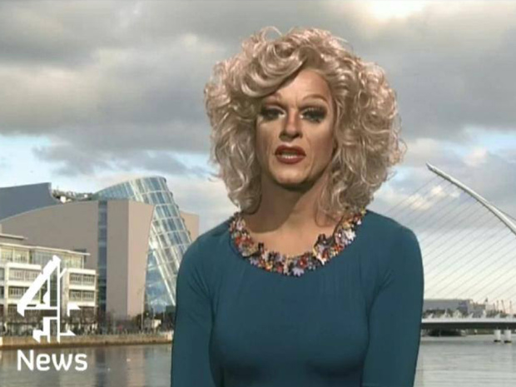
Western
https://www.youtube.com/watch?v=WXayhUzWnl0

Slide 15

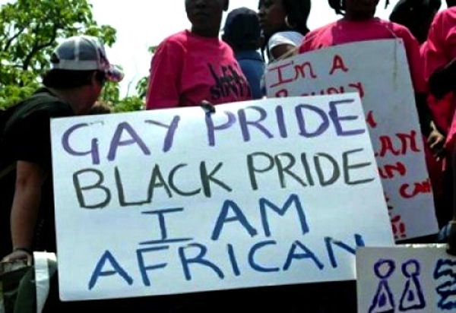
Laws and practices in our countries
Outlawing
Persecuting
Tolerating
Accepting
Celebrating diversity
Normalising

Slide 16
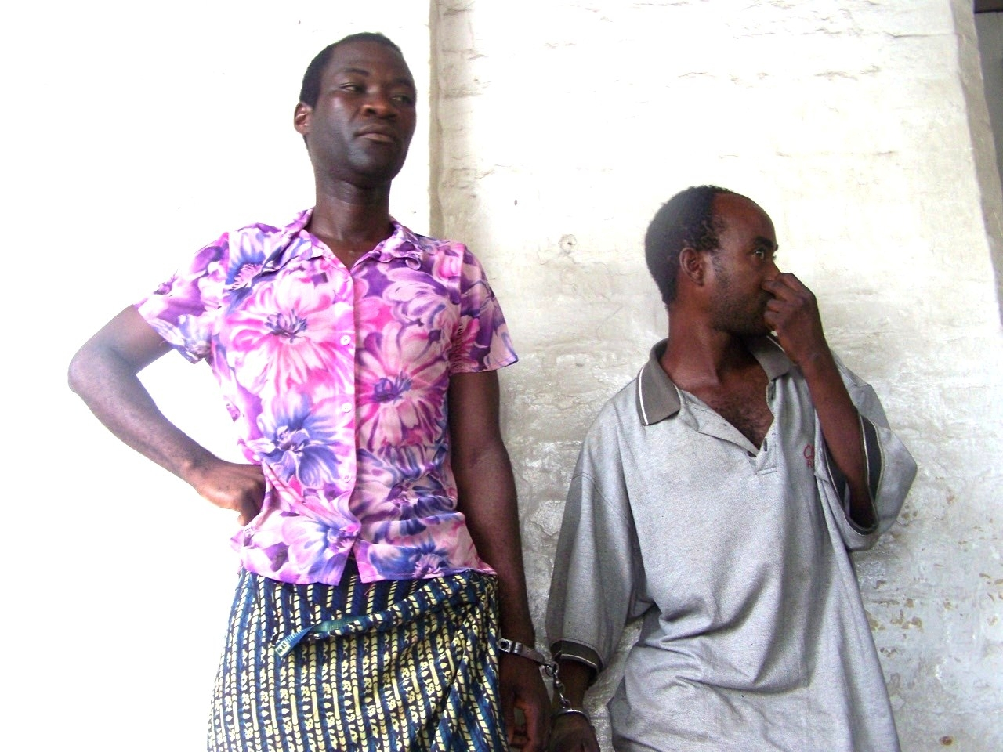
Malawi case

Slide 17
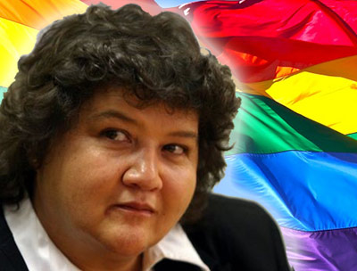
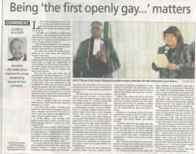
SA minister
I am deeply ambivalent about the ritualised staging of confessions which require some of us to make public declarations about aspects of our lives that are deemed to be different from a deeply entrenched norm. In an ideal world, this would scarcely have mattered. After all, in an ideal world the only normal thing about any human being would be that none of us are truly normal.
But we do not live in an ideal world.
Further info
http://www.genderlinks.org.za/page/policy-briefs

Slide 18
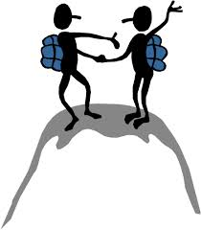
Training techniques
Personal experience
Conversations
Examples, case studies
Audio visual
Direction/ discussion
Known to the unknown – new info and terms.
Where to go for more info
Application – attitude quiz

