Slide 1


Strengthening Gender and Sexual and Reproductive Health and Rights(SRHR) in Local Government
Date:
Venue:
By Country Manager

Slide 2
Background
In the last ten years GL worked with 425 councils to roll out the COE process.
Local councils have showcased good practices in district, national and regional Gender Justice and Local Governments between 2010 and 2018.
New instruments in place: updated Protocol of 2016, the Sustainable Development Goals (SDGs), the Beijing Plus Twenty Review, and the Africa Agenda 2063.
SRHR is a priority in all the instruments and will be therefore be a focus area for the next phase.

Slide 3
Objectives of the SRHR programme
Strengthen gender and SRHR plans and budgeting at local level.
Train local councils and young people on SRHR.
Enhance SRHR at community level through developing youth and gender aware policies, services and service directories.
Promote better information and greater freedom of choice for adolescents and young people.
Use social media and IT to demand greater accountability and delivery on SRHR.
Gather and share good practices through annual SADC Gender Protocol@Work summits.

Slide 4
SRHR Frameworks
Global – CEDAW, Beijing Platform for Action, Sustainable Development Goals, International Conference on Population and Development (ICDP).
Continental – Maputo Protocol, African Union Gender Strategy*
Regional – SADC Protocol on Gender and Development, Health Protocol, SADC SRHR Strategy and Scorecard (pending), SADC model law to end child marriages.

Slide 5
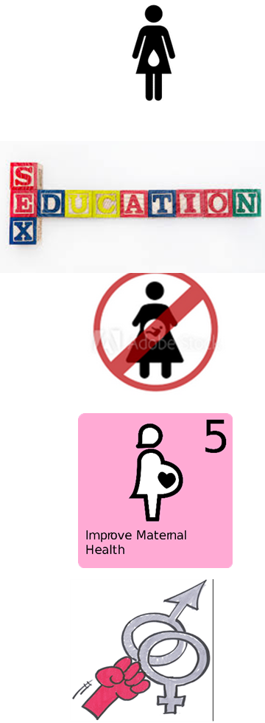
Regional SRHR priorities
Menstrual health
Teenage pregnancies
Access to youth friendly SRHR services
Child marriages
Maternal health
HIV and AIDS – in particular amongst youth and adolescents
Access to safe abortion
Comprehensive sexual education (CSE)

Slide 6
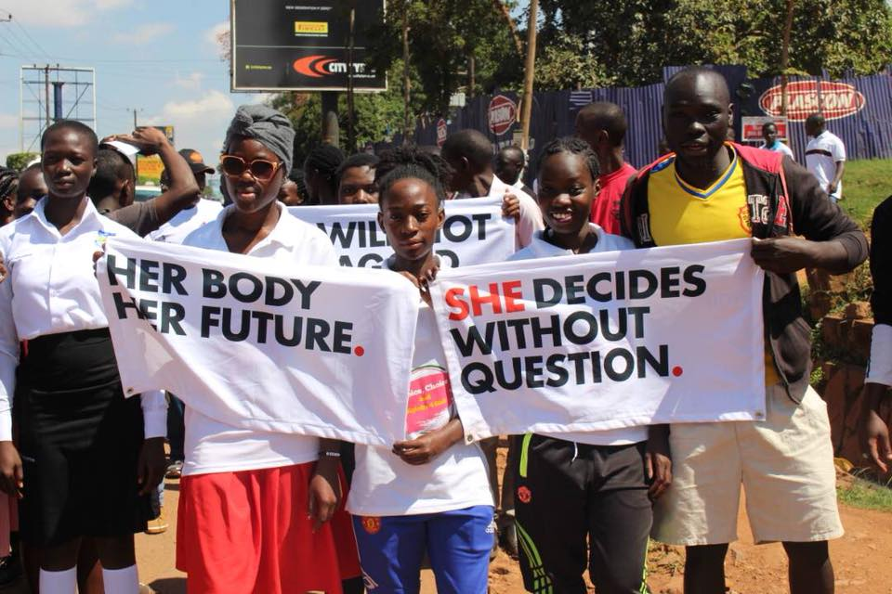
SRHR Campaigns
Child not Bride – child marriage campaign
My body my choice - seek to raise the discourse on reproductive justice and abortion as a key sexual and reproductive health and rights issue.
Metoo – Campaign about sexual harassment in the entertainment industry
Mini-Metoo – campaign on sexual abuse of children
Not in my name
She Decides - a global movement to promote, provide, protect and enhance the fundamental rights of every girl and woman.
Total Shut Down – South Africa campaign to force government to act on GBV
Not in my name – South Africa Campaign by the men’s movement to speak out against VAW
Add country specific campaigns

Slide 7
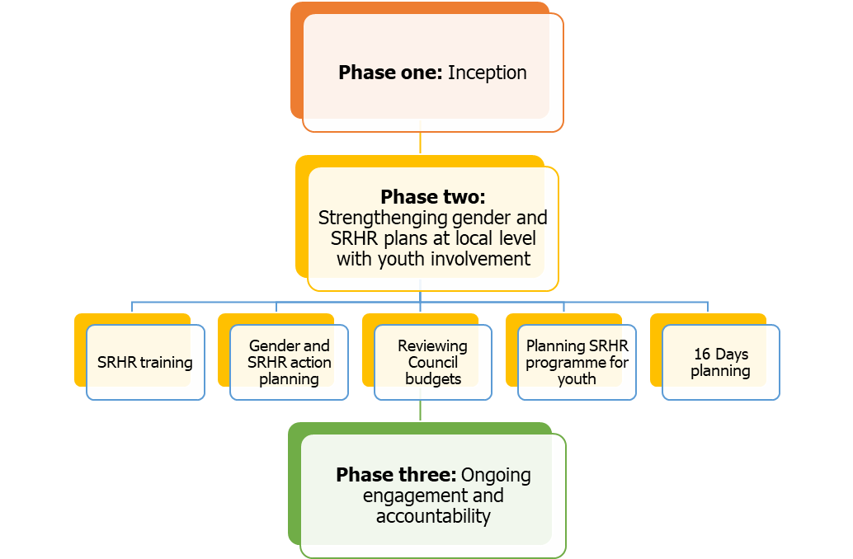
How the programme will work

Slide 8
Target groups
Councillors
Council officials
Ministries/departments of Health/Gender
Youth structures/junior councils
Clinics
Media

Slide 9
Immediate actions
Inception meetings will be in groups, pairs or individual.
At the inception meeting agree on a strategy on how to get young people on board.
Decide on the dates for phase two, venue and who will be invited.
Develop a Task list for phase two.

Slide 10
Join the SRHR conversation
Country manager email
HoP@genderlinks.org.za
advisor@genderlinks.org.za
alliance@genderlinks.org.za
@GenderProtocol
@GenderLinks
Community of Practice - http://genderlinks.org.za/gender-links-community/alliance-community-practice/

