Slide 1



PROMOTING GENDER-INCLUSIVEE LOCAL ECONOMIC DEVELOPMENT IN SOUTH AFRICA
START UP ENTREPRENEURS
NAME OF THE BUSINESS: MIRACLES BEAUTY PARLOUR PARTICIPANT NAME:KEAMOGETSE MILLICENT SIYENI COUNCIL:SOLPLAATJIE MUNICIPALITY
Please include photographs of the business!

Slide 2
MY EXPERIENCE DURING SUNRISE CAMPAIGN
Key lesson from Life Skill and Entrepreneurship training
I have learned about emotional control and self control
I learned of how to be an independent woman.
How to raise my children and what to teach them.
Putting myself first before others
How to calculate business expenses and income.
I also learned about time management and financial management.
Memorable moments(e.g Mentorship, Group Work, Support etc)
Working together as a team in tasks
Helping each other through difficult tasks.

Slide 3
HOW MY LIFE HAS CHANGED
Personal growth (confidence, independence, safety)
I have a lot more confidence and believe in my abilities.
I am a proudly independent woman supporting herself and her family.
I am safe and protected by my community and family.
I make my own positive life choices.
People approach me for advice and encouragement (a lot of people come to me for advice in business
and freeing themselves from GBV)
Family impact (children, relationships, community respect)
My children are safe and living a life I have wanted for them
I am in a healthy relationship and I can freely express myself in it.
My community is very supportive and they are respecting me in a way they have never done.
Income and lifestyle improvements
I am now able to contribute towards household needs.
I have now improved the quality of life for myself and my family.

Slide 4
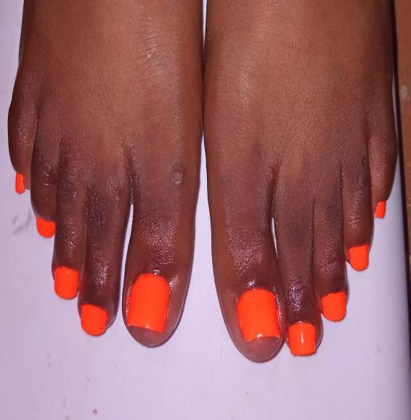
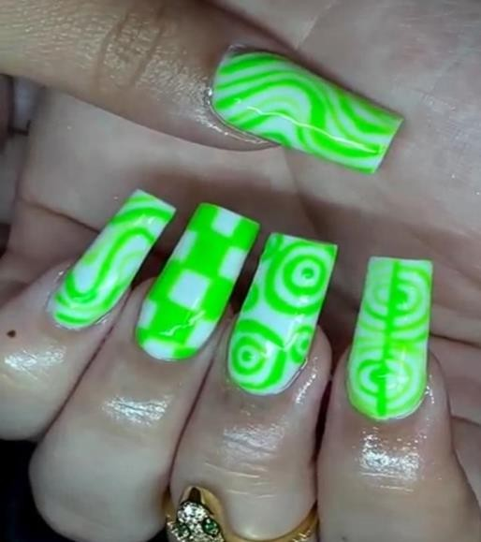
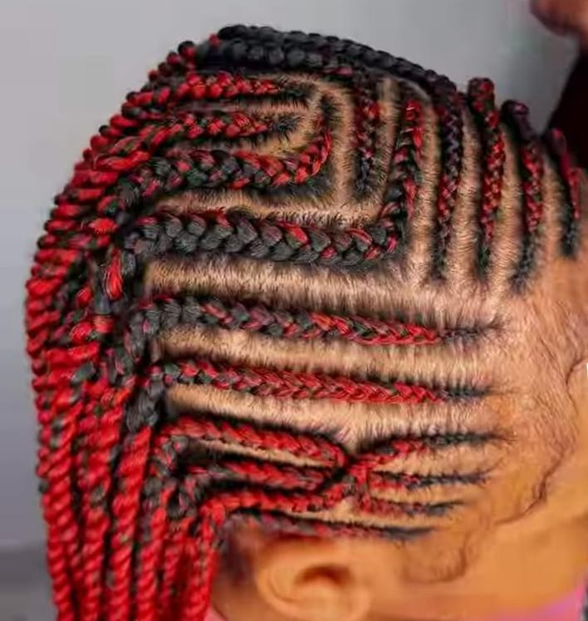
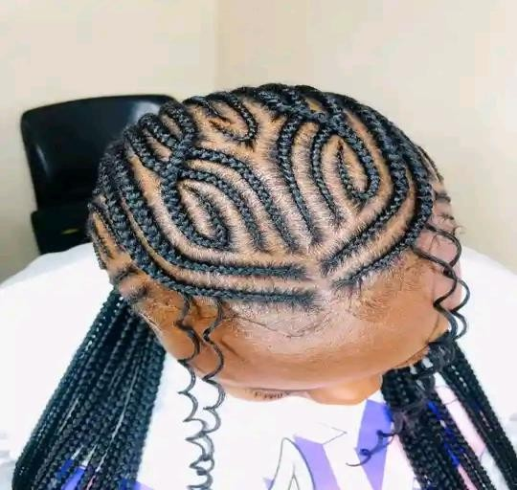
PLEASE DESCRIBE THE BUSINESS
Name of business and products/services
Photo or video
offered
Miracles Beauty Parlour
Hair products, hair styling,
manicure and pedicure
Achievements so far Challenges still faced
and how they’re managed
New trends –I practice them everyday so that they are perfect.
House calls and operating at the
Attending college and having to
salon –I work by appointments.
attend to my clients after class- I work by appointments.
4. I learn new styles at college since
am doing a hairdressing course

Slide 5
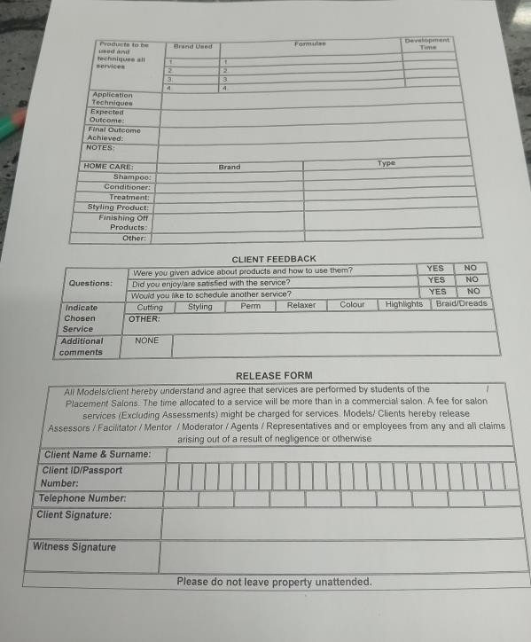
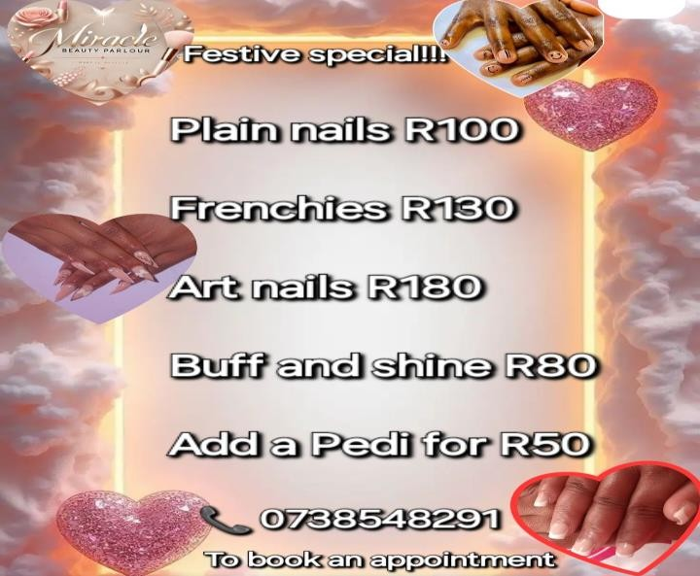
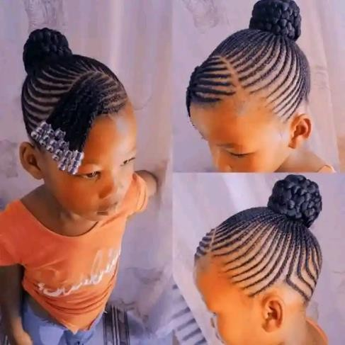
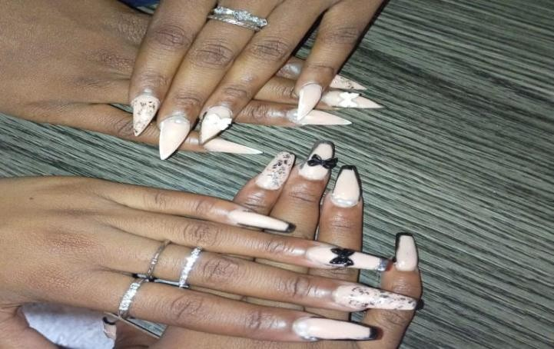
CUSTOMER BASE AND COMPETION?
Who are your customers? • Evidence
1. All age groups, male and female, A- listers, school children and office workers
Have you increased the number of customers since starting
the LED Programme? Yes or No
Yes
How did you do this?
By marketing my services through the following platform
Social media (Facebook and WhatsApp and TikTok)
Who is your competition?
Other beauty salons within my area.
Gwens salon, Adama’s hair salon, and Priscilla’s hair
salon
How do you handle competition in your business?
1. I provide quality products and services at a
reasonable price
2. I treat my customers with respect and allow my
customers to give feedback about my services.
3. Help clients choose styles that will suit them
best.

Slide 6
NEW PRODUCTS OR SERVICES?
Do you have any new business
Evidence
products or services?
No ,but I am planning in the next year or two to introduce new
services like pedicure and
massages
What new products are in the
business
How are they performing compared to
your initial products?
How do you advertise/market your products?

Slide 7
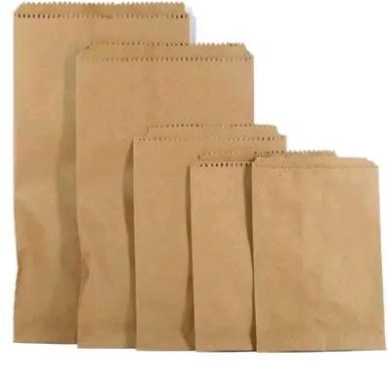


QUALITY AND PACKAGING
Are your customers happy with the quality of your products or services?
Yes
If you have answered yes please give more information.
Evidence
My clients recommend me to friends and family.
My clients compliment my products and services
Do you have any branding available for your products? Explain
Not yet , still on it and its at the stage of finalization, however my business has got a business name and logo
I also promote my business on social media platforms.
Have you changed the packaging or marketing of your business to attract more customers? Please explain.
1. Yes, I was using black plastic bags I now use paper bags to pack the products in when customers buy.

Slide 8
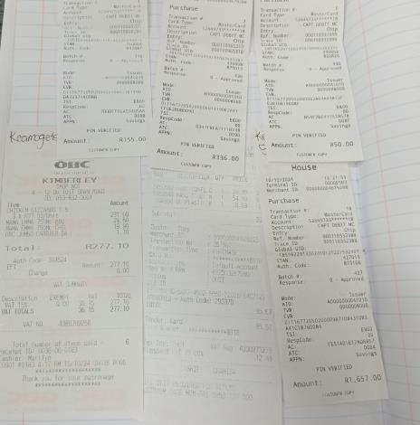
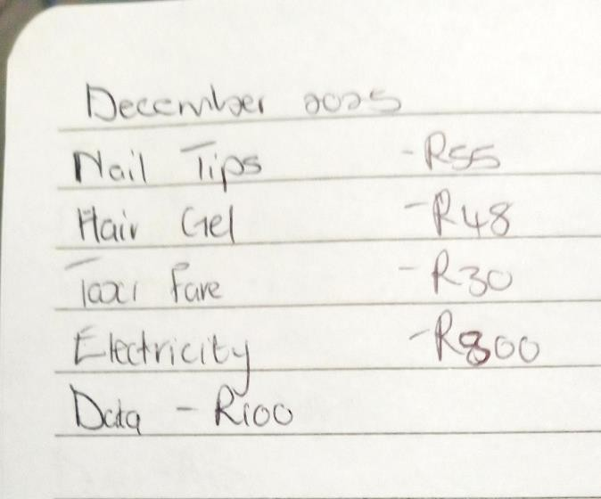
BUSINESS MANAGEMENT
Have you hired more staff? How many • Evidence
full-time and how many part-time?
Yes, I have 1 part time staff member
How do you manage your stock and
I keep records of stock bought and sold and what's remaining.
I check my stock on a weekly
check regularly? Please explain.
basis.
Have you been able to price your
products better so that you can earn a surplus from the business? Please
explain.
1. Yes ,my prices are reasonable
but my profit is more.

Slide 9
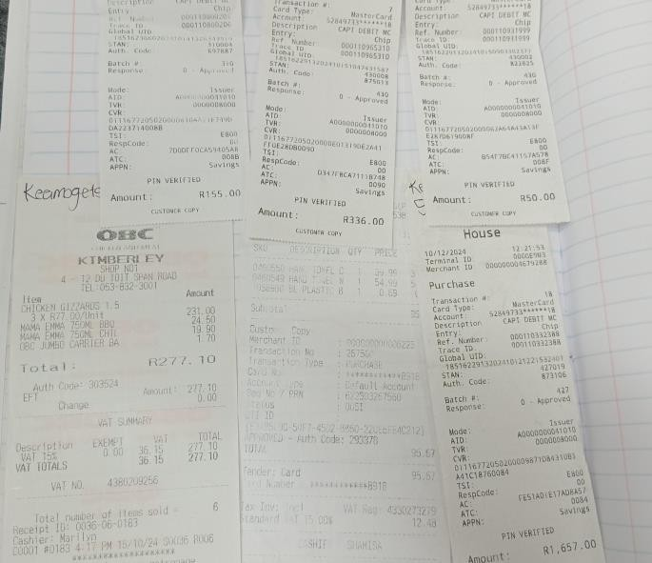
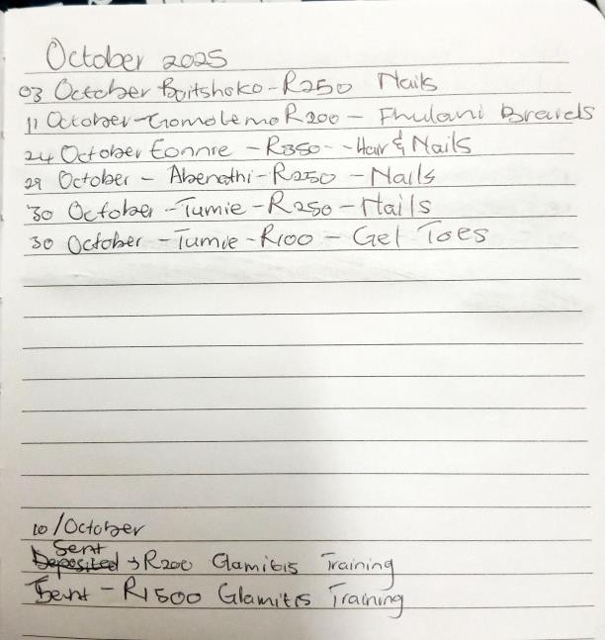
FINANCIAL MANAGEMENT
Do you have a record-keeping system in place?
Evidence
Explain.
Yes, I write every customer that comes in
Every product I sell I keep record
Every stock I buy I keep record
I use a book where I write down money
spent ,transport money, product bought .
If yes, how is it helping you to manage your
business?
To know how much stock is left and how much sold
To know how much stock I should buy
To know how many customers I had for
Do you have a bank account for your
the day
business?
Yes, I have an FNB account.

Slide 10
SAVINGS AND SELF SUFFICIENCY
Are you a member of a savings • Evidence
group?
No
Are you saving money? How much have you been able to save so far?
Yes, but after my products were stolen I had to buy new stock with my savings which were R2 900
Have you managed to increase household income?
1. Yes

Slide 11
INCOME AND EXPENSES FOR THE BUSINESS FOR PAST THREE TO SIX MONTHS
INCOME EXPENSES
ITEM | AMOUNT
Sales | R12 170
TOTAL | R12 170
ITEM | AMOUNT
Transport & Airtime | R780
Electricity and water | R4 800
Stock | R1 548
TOTAL | R7 128

Slide 12
CHALLENGES
What challenges have you experienced in your business?
Limited space and less equipment.
Space for storage
Lack of funding for expansion.
4. Enough time for customers due to me attending college( its
short term because am enhancing my skills for my business)
Balancing business with family and school
How have you addressed these
1. I have rearranged the times lots for clients to accommodate
me.
2. I make schedules for the business so that I do not have to
juggle two things at once.

Slide 13
SUSTAINABILITY
How will you sustain your business?
Add more products to the business
Purchase more equipment for business expansion
I must improve on my customer service to ensure that my customers are always happy and satisfied.
I reward loyalty for customers by giving them discounts and
also reward them with free hair products when they have done
their hair or nails 2 or 3 times in a month.
What other sustainability measures are you putting in place for your business?
Expand clients and customers
Extend house calls
Add skin care products

Slide 14
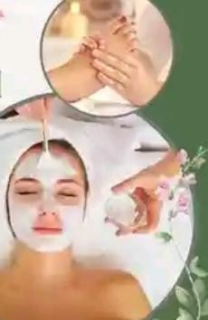
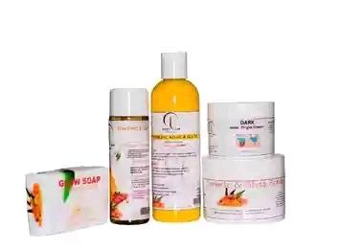
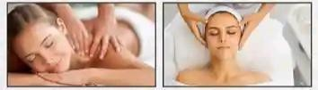
WHAT PLANS HAVE YOU MADE TO GROW YOUR BUSINESS IN THE NEXT 6 MONTHS?
Evidence
Expand clients and customers
Hire more staff
Add body massages
Adding skin care products
To make my brand visible and known

Slide 15
ADDITIONAL INFORMATION?
What other changes have you experienced in your business? Explain
I had changes of having to plan a daily and weekly schedule to accommodate family business and college
I had to also offer small discounts to attract new clients.
Do you have any additional information to share
1. The sunrise campaign has taught me to value myself more
and know that I can put my mind to anything to improve
myself as an entrepreneur/ business woman.
2. I would like to thank Gender link, Sunrise campaign,
Solplaatjie Municipality and the funders for giving me the
opportunity to become an independent business woman.
THANK YOU.

