Slide 1


Voice and Choice Summit 2026-Story of Change Category
Your logo goes here
Title/Name of the Story
“In Gboko, Benue State Nigeria: Traditional Chief Commits to ensure Accessible SRHR for women with Disabilities.”
(Nigeria, Gboko South, 4th Feburary, 2026, Jennifer Abomger)
Voice and Choice Summit 2026 \ Voice and Choice Summit 2026

Slide 2
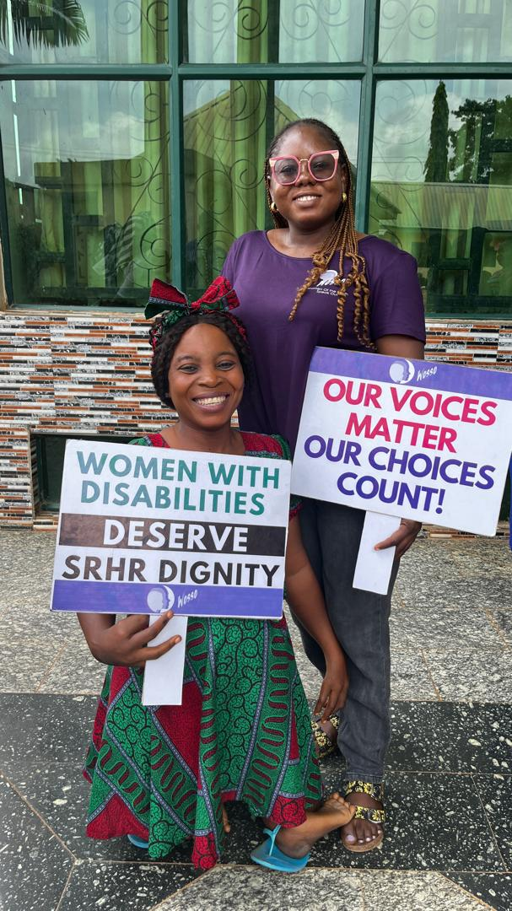
Background
🚨 The Problem
Women and girls with disabilities in Gboko face severe exclusion from Sexual and Reproductive Health and Rights (SRHR) due to:
Inaccessible and non-inclusive healthcare services
Lack of confidentiality and fear of discrimination
Harmful cultural beliefs portraying women with disabilities as asexual
Low awareness of SRHR as a fundamental human right
Voice and Choice Summit 2026 \ Voice and Choice Summit 2026

Slide 3
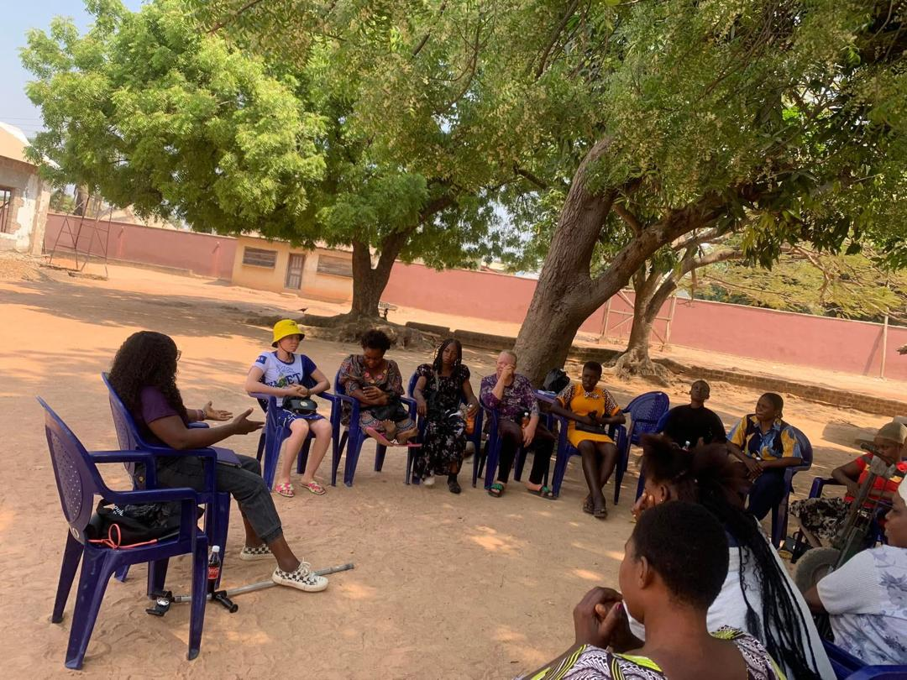
Background
🎯 Key Objectives
Empower women with disabilities with SRHR knowledge
Build confidence and self-advocacy skills
Challenge harmful stereotypes
Transform attitudes of healthcare providers and community leaders
Promote inclusive, rights-based SRHR services
Voice and Choice Summit 2026 \ Voice and Choice Summit 2026

Slide 4
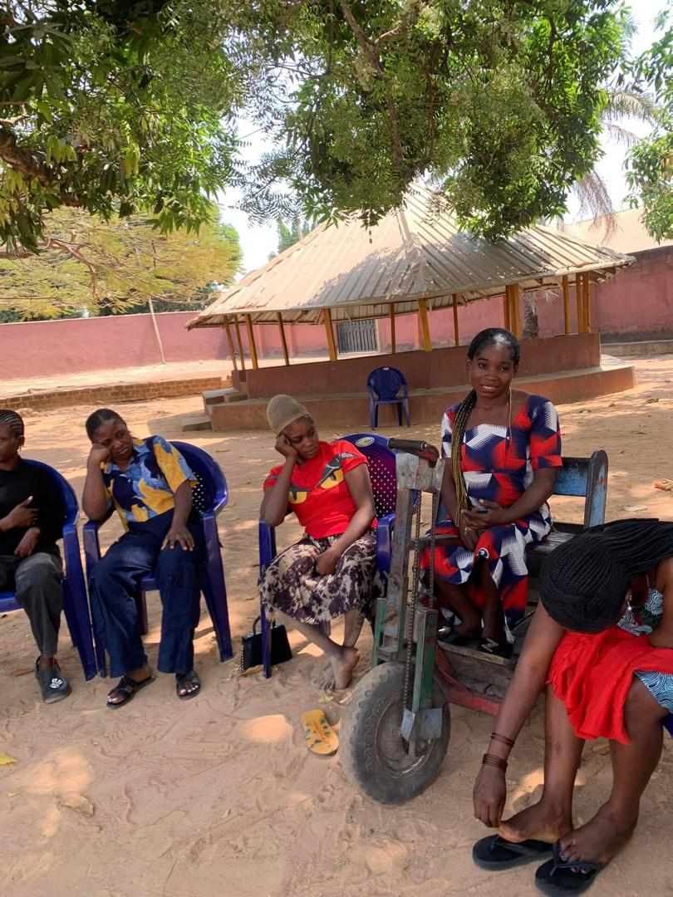
Background
📊 Situation Before the Project
Baseline (January 2024) revealed:
Many women are unaware of their SRHR
10 of 20 had children without antenatal care
3 experienced unsafe abortion after denial of services
Widespread fear, stigma, and silence
Voice and Choice Summit 2026 \ Voice and Choice Summit 2026

Slide 5
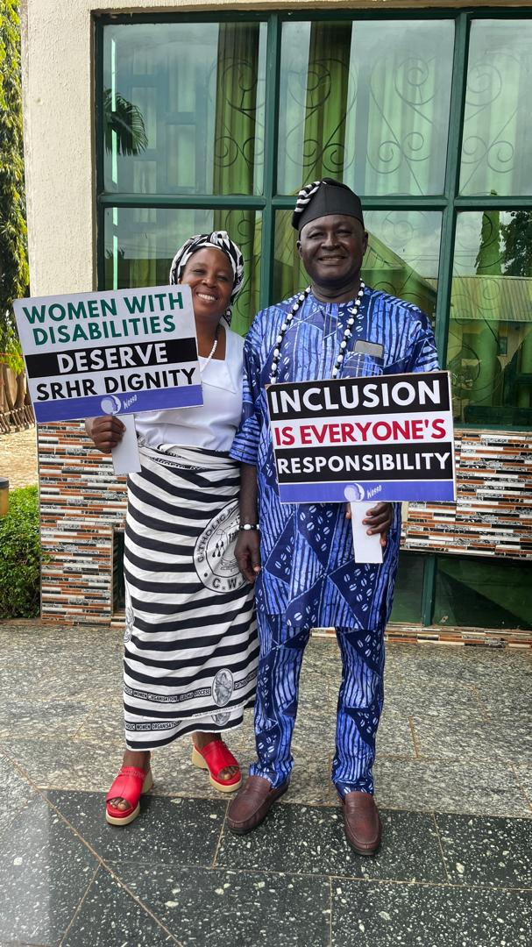
Change
⚙️ Key Actions That Brought Change
Empowered 20 women and girls with disabilities with SRHR knowledge
Created a structured dialogue space between rights holders and duty bearers
Facilitated honest storytelling on stigma, denial of services, and confidentiality breaches
Challenged harmful myths about disability and sexuality
Guided reflection for healthcare providers, religious and traditional leaders
Evidence: Include Photos or videos
Voice and Choice Summit 2026 \ Voice and Choice Summit 2026

Slide 6
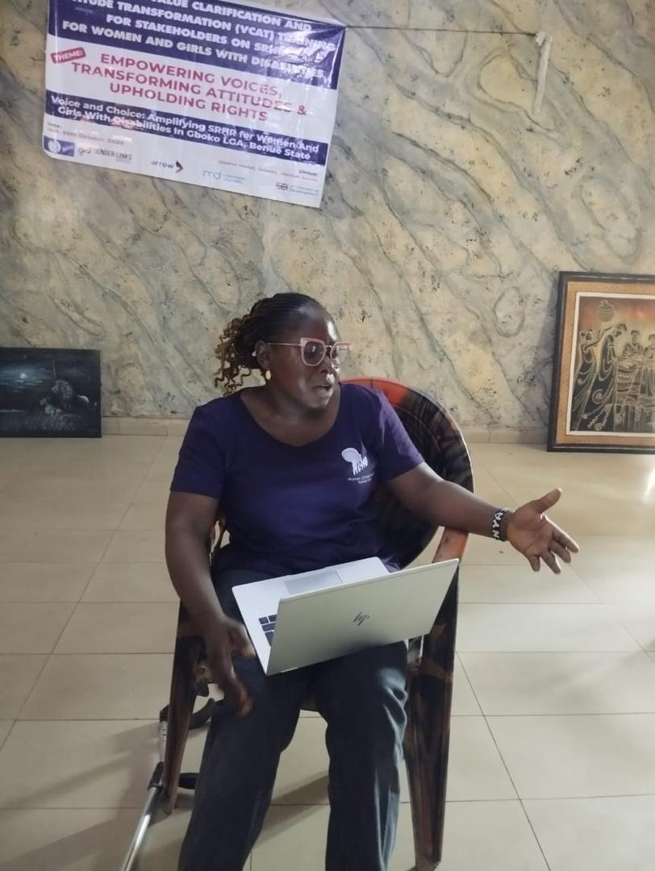
Change
👥 Who Led and Participated?
Jennifer Abomnger (WOSSO Fellow, Founder – Grassroots Women with Disabilities Alliance)
Participated by:
Women and girls with disabilities (rights holders)
Healthcare providers
Religious leaders
Traditional leaders
Community chief
🔄 Direct Outcome
Community chief publicly pledged to mobilize leaders for ongoing awareness sessions (beginning February 2026);shifting the work from project-led to community-owned.
Voice and Choice Summit 2026 \ Voice and Choice Summit 2026

Slide 7
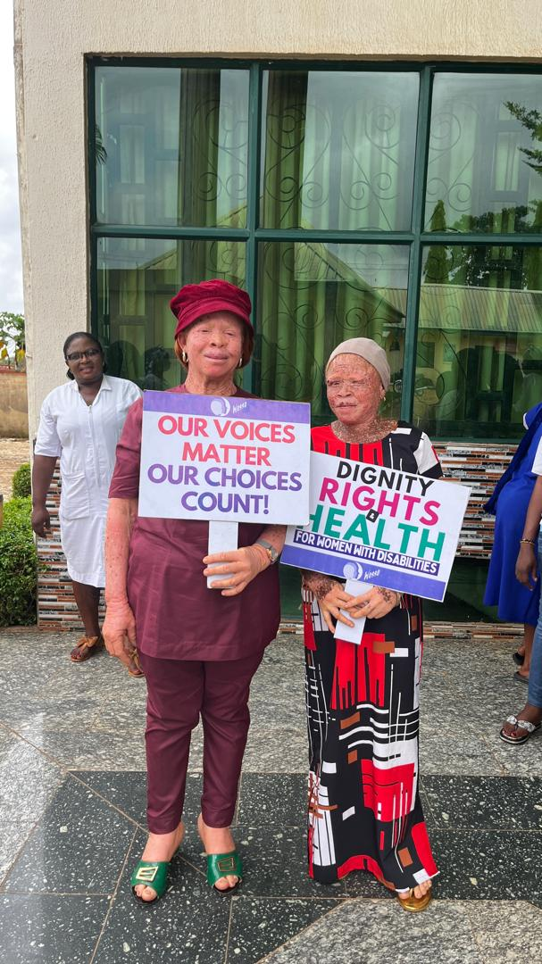
Change
🔄 The Change
A shift from silence and stigma to
voice, awareness, and community accountability around SRHR for women with disabilities.
✅ Nature of the Change
Strongly positive and transformative
SRHR recognized as a human right
Harmful myths openly challenged
Dialogue between rights holders and leaders normalized
Evidence: Include Photos or videos
Voice and Choice Summit 2026 \ Voice and Choice Summit 2026

Slide 8
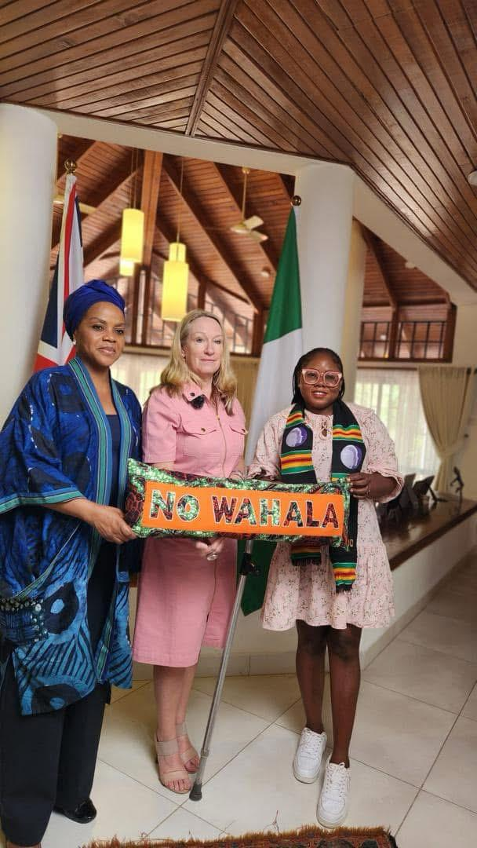
The change
🔄 The Change
A shift from silence and stigma to
voice, awareness, and community accountability around SRHR for women with disabilities.
✅ Nature of the Change
Strongly positive and transformative
SRHR recognized as a human right
Harmful myths openly challenged
Dialogue between rights holders and leaders normalized
Evidence: Include Photos or videos
Voice and Choice Summit 2026 \ Voice and Choice Summit 2026

Slide 9
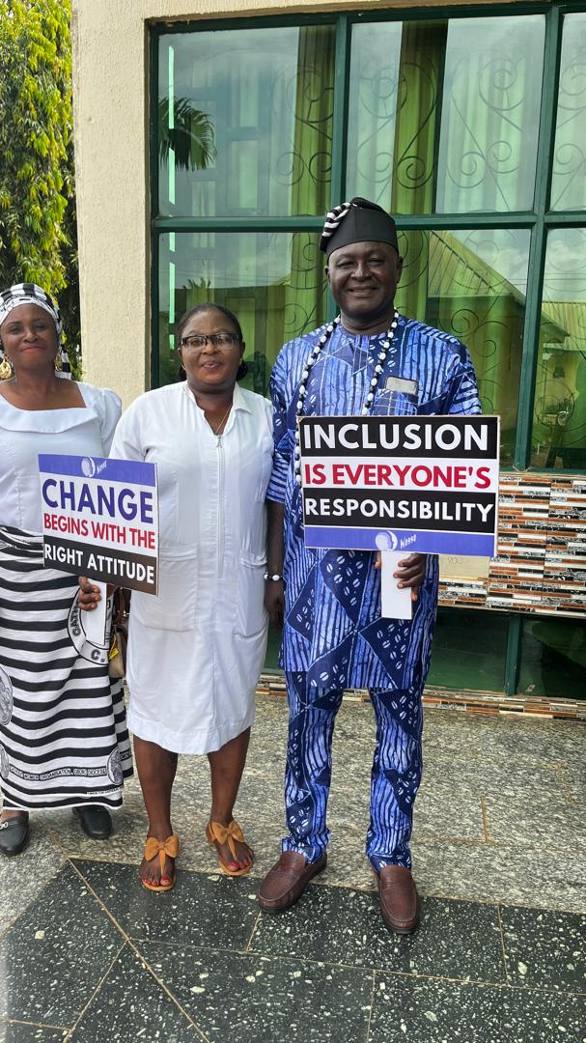
The change
👥 Who Benefited & How?
Women and girls with disabilities:
Increased knowledge of their SRHR
Greater confidence to seek services
Stronger self-advocacy
Healthcare providers & leaders:
Improved awareness of inclusive, rights-based service delivery
Public commitment to sustain engagement
📈 Situation Now
SRHR is openly discussed in the community
Leadership has pledged ongoing awareness sessions (starting February 2026)
Grassroots Women with Disabilities Alliance established to sustain advocacy
Shift from project activity to community-owned inclusion effort
Evidence: Include Photos or videos
Voice and Choice Summit 2026 \ Voice and Choice Summit 2026

Slide 10
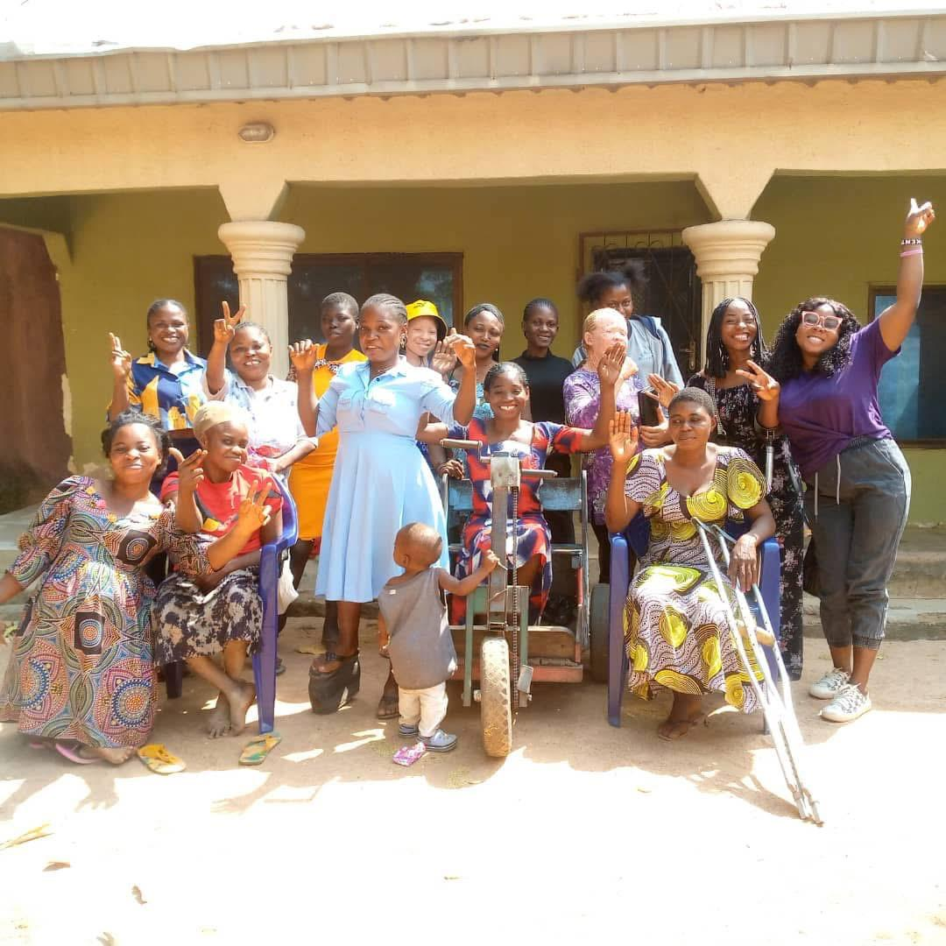
Significance of Change
🌍 What This Change Means for the Movement
Moves women with disabilities from beneficiaries to rights holders and leaders
Demonstrates that intersectional advocacy (gender + disability) is actionable, not theoretical
Challenges the invisibility of women with disabilities within mainstream SRHR spaces
Shows that norm change is possible through structured, community-led dialogue
🔥 Strategic Significance
This project proves that:
Empowerment alone is not enough — duty bearers must confront bias
Sustainable change happens when communities own the process
Power can shift when lived experience is centered
Evidence: Include Photos or videos
Voice and Choice Summit 2026 \ Voice and Choice Summit 2026

Slide 11
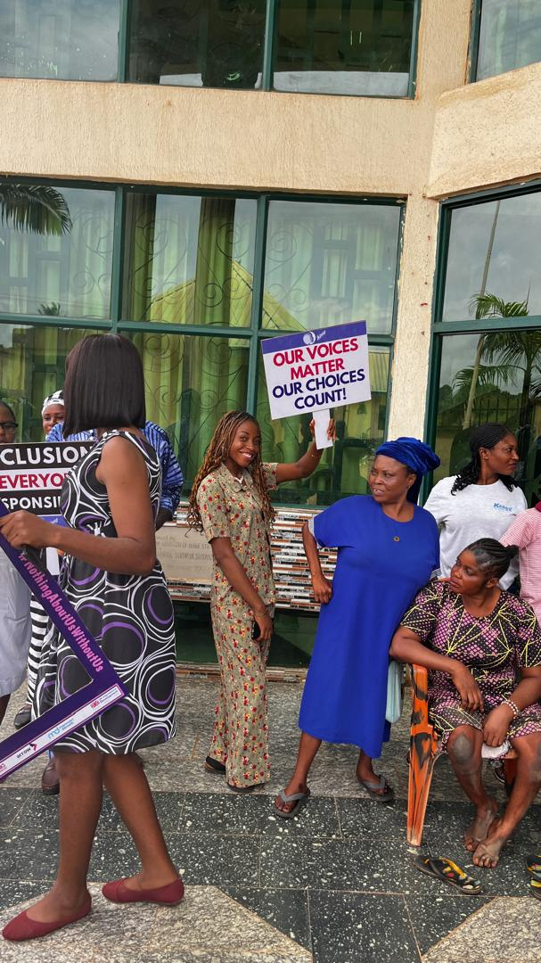
Significance of Change
🚀 What Happens Next?
Monthly/quarterly community awareness sessions (starting February 2026)
Expansion of VCAT model to additional communities
Strengthening referral pathways within healthcare facilities
Mentoring women with disabilities as SRHR champions
Scaling through the Grassroots Women with Disabilities Alliance
🎯 Long-Term Vision
Institutionalized, disability-inclusive SRHR systems
across communities in Benue State and beyond.
Evidence: Include Photos or videos
Voice and Choice Summit 2026 \ Voice and Choice Summit 2026

Slide 12
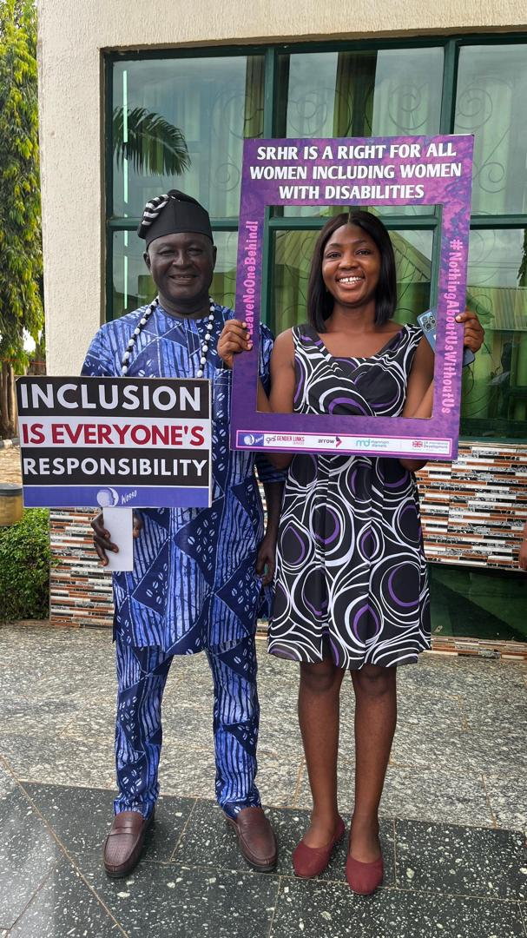
Sustainability
🔒 Sustainability Measures Already in Place
1️⃣ Community Leadership Commitment
Public pledge by the community chief
Monthly/quarterly awareness sessions beginning February 2026
Mobilization of leaders and authority figures
2️⃣ Institutional Platform Established
Grassroots Women with Disabilities Alliance founded
Structured platform for continued advocacy, peer education, and accountability
3️⃣ Capacity Built Across Stakeholders
Women with disabilities equipped as SRHR advocates
Healthcare providers and community leaders sensitized on inclusive practices
Shared ownership between rights holders and duty bearers
Voice and Choice Summit 2026 \ Voice and Choice Summit 2026

Slide 13
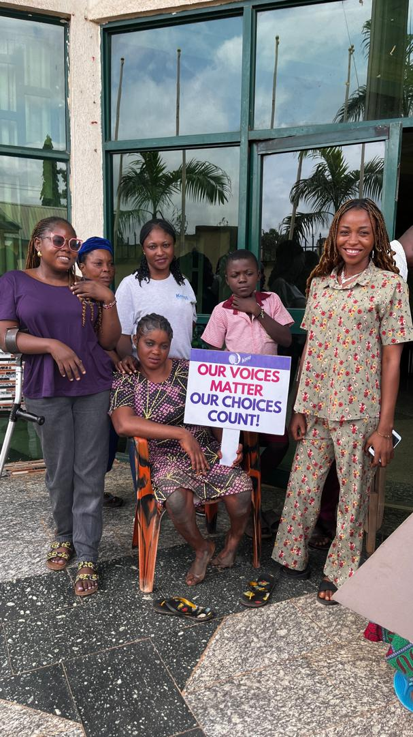
Sustainability
🚀 Scaling Strategy
Replicate the Inclusive VCAT model in other LGAs in Benue State
Strengthen referral pathways within healthcare facilities
Document lessons learned to inform state-level SRHR and disability advocacy
Build partnerships with civil society and government actors
Mentor women with disabilities as community SRHR champions 🎯 Long-Term Sustainability Vision
From a project
To a community-owned norm shift
To institutionalized inclusive SRHR systems.
Voice and Choice Summit 2026 \ Voice and Choice Summit 2026

Slide 14
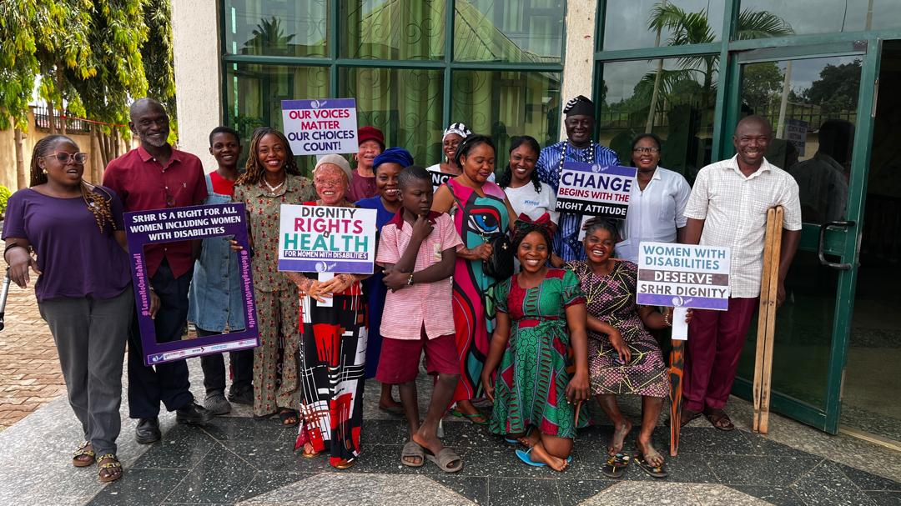
Beneficiaries
Number of;
Female – Direct beneficiaries= 50
Male – Direct beneficiaries=4
Female – Indirect beneficiaries (e.g. through other networks)=10
Male – Indirect beneficiaries (e.g. through other networks)=5
Female – Online beneficiaries (e.g. website access, mailing lists, scholarly articles)=0
Male – Online beneficiaries (e.g. website access, mailing lists, scholarly articles)=0
Evidence: Include Photos or videos
Voice and Choice Summit 2026 \ Voice and Choice Summit 2026

Slide 15
Challenges & Lessons learnt
⚠️ Key Challenges
1️⃣ Deep-Rooted Cultural and Religious Beliefs
Strong norms portraying women with disabilities as asexual or unfit for reproductive choice.
2️⃣ Fear and Internalized Stigma Among Women
Some participants were initially hesitant to speak due to past discrimination.
3️⃣ Resistance from Service Providers
Initial defensiveness when harmful practices were discussed.
4️⃣ Limited Resources
Scaling beyond one community required strategic prioritization.
🛠️ Mitigation Strategies
Used Values Clarification & Attitude Transformation (VCAT) to guide reflection rather than confrontation
Created safe spaces before mixed stakeholder dialogues
Centered lived experience storytelling to humanize the issue
Engaged community leadership early to build buy-in
Focused on depth over breadth to ensure meaningful change
Voice and Choice Summit 2026 \ Voice and Choice Summit 2026

Slide 16
Challenges & Lessons learnt
📚 Key Lessons Learned
1️⃣ Norm Change Requires Dialogue, Not Accusation
People shift when they reflect — not when they feel attacked.
2️⃣ Empowerment Must Be Paired With Systems Change
Building women’s confidence is not enough if duty bearers remain unchanged.
3️⃣ Community Ownership Is Critical for Sustainability
Public leadership commitment transforms a project into a movement.
4️⃣ Intersectionality Must Be Practiced, Not Just Spoken About
Disability inclusion must be intentionally integrated into SRHR advocacy.
Voice and Choice Summit 2026 \ Voice and Choice Summit 2026

Slide 17
Next Steps
🌱 Short-Term Plans (2026)
Launch monthly/quarterly community SRHR awareness sessions (February 2026)
Strengthen referral pathways with local healthcare facilities
Mentor trained women with disabilities as peer SRHR champions
Document outcomes and lessons for replication
🌍 Medium-Term Plans
Expand the Inclusive VCAT model to additional Local Government Areas in Benue State
Engage state-level Ministry of Health and Women Affairs stakeholders
Develop a disability-inclusive SRHR advocacy toolkit
Build partnerships with feminist and disability rights movements
Voice and Choice Summit 2026 \ Voice and Choice Summit 2026

Slide 18
Next Steps
🚀 Long-Term Vision
Institutionalize inclusive SRHR practices within public healthcare systems
Position women with disabilities as policy advocates at state and national levels
Scale the model across Nigeria through strategic partnerships
Strengthen the Grassroots Women with Disabilities Alliance as a leading intersectional advocacy platform
Voice and Choice Summit 2026 \ Voice and Choice Summit 2026

Slide 19

Voice and Choice Summit 2026 \ Voice and Choice Summit 2026

