Slide 1







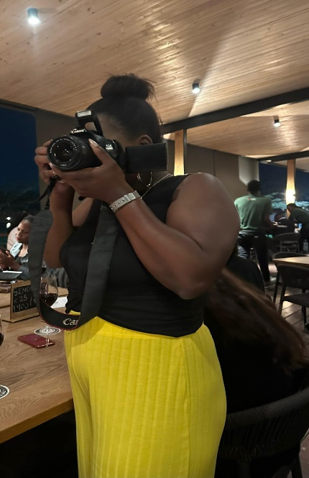
LEARNING
AND SHARING
SUMMIT 2025
COMMUNICATIONS AND REACH PRESENTATION
COMPILED BY: NOKWETHEMBA MNOMIYA
(South Africa, Kwa-Zulu Natal, 04-07 March 2025)
“Empowering communities, one project at a time because real change starts with action”
Women’s Voice and Leadership Learning and Sharing Summit 2025

Slide 2
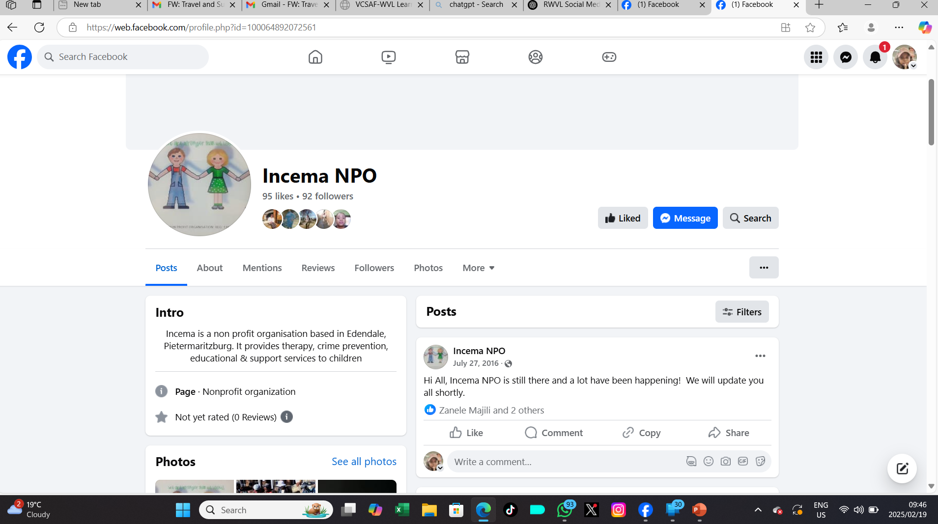
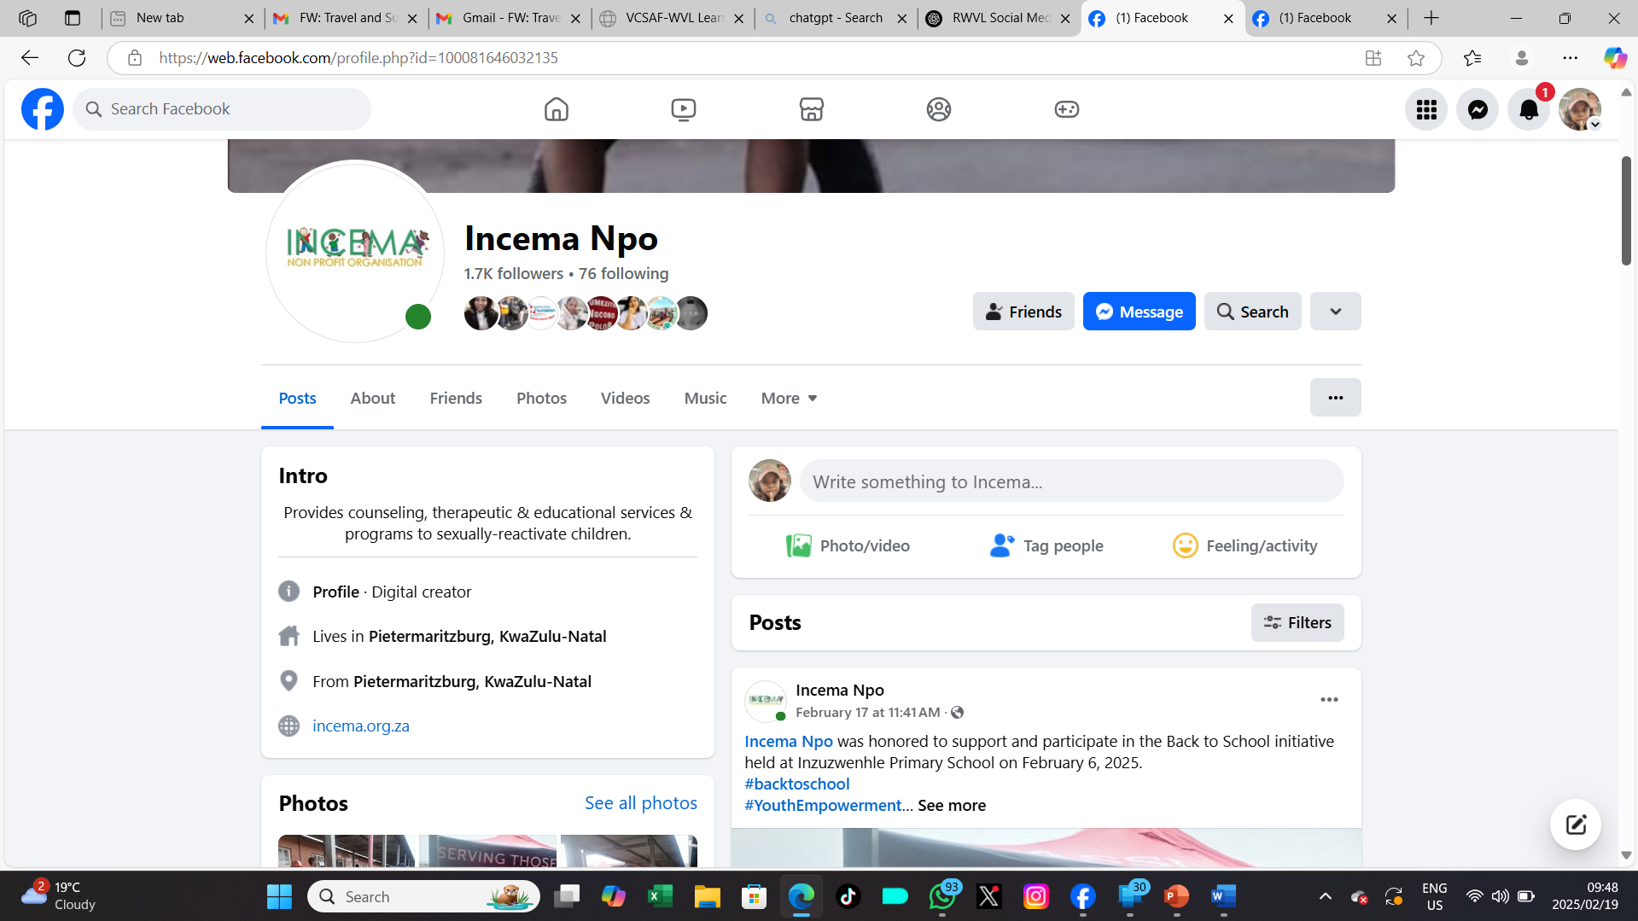
Planned objective
Before WVL, we had 92 followers on Facebook, and no other social media pages. During the WVL and VCSA grant, we expanded our reach, and we now have 1.7K followers. This growth reflects increased engagement and visibility.
For this RWVL grant, we anticipate reaching even more people by ensuring that our social media platforms remain consistently updated with relevant content. This will help us maintain audience interest, attract new followers, and strengthen our impact.
We are currently in the process of updating our website to ensure that it becomes more informative and attractive to the donors. We will link it with our social media pages and aim to use it as our main marketing tool.
We are working on our LinkedIn page.
Women’s Voice and Leadership Learning and Sharing Summit 2025

Slide 3
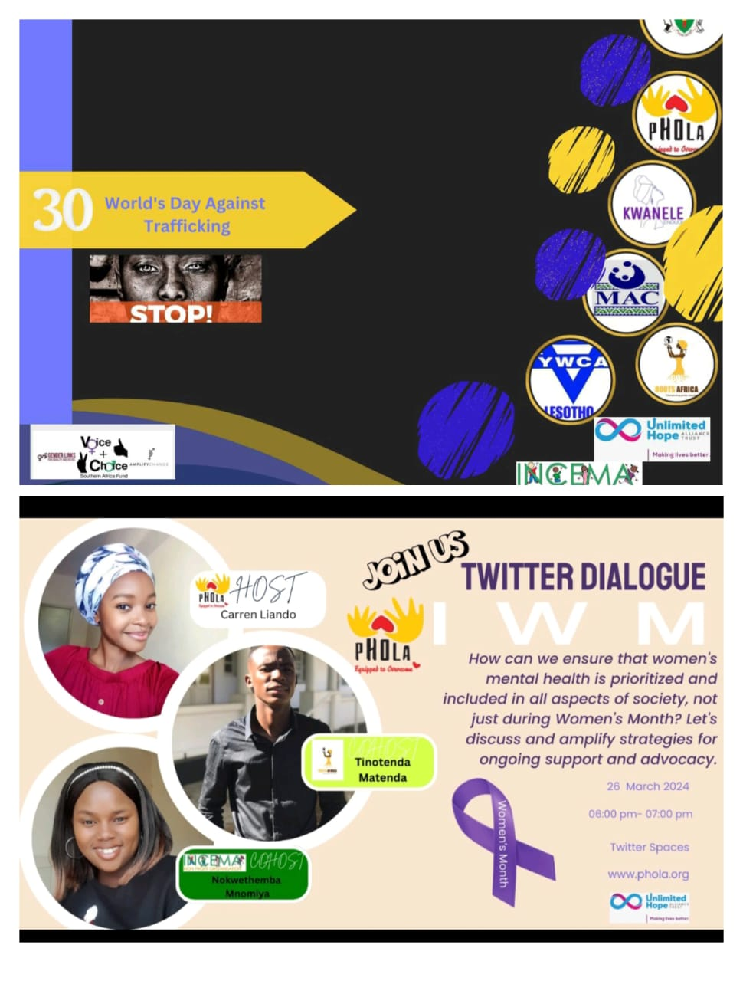
PARTNERS AND NETWORKS
We have created meaningful networks through collaborations with VCSA and the previous WVL grantees in the past four years. We have learnt from each other, shared resources and skills.
Other partners either than those mentioned in the poster : The New heritage foundation, NCPD, Ikhaya lamathongo (THO), One in Nine, SASOPSBIZ, JAW, TGPSA
We created regional networks through the implementation of the “I am a man campaign and running of the ongoing social media campaigns. We further created global networks through the WOSSO fellowship program.
We are working with (GRIT) to expand their reach to KZN through their app. We will be encouraging Incema clients to use GRIT app to access online support services.
Women’s Voice and Leadership Learning and Sharing Summit 2025

Slide 4
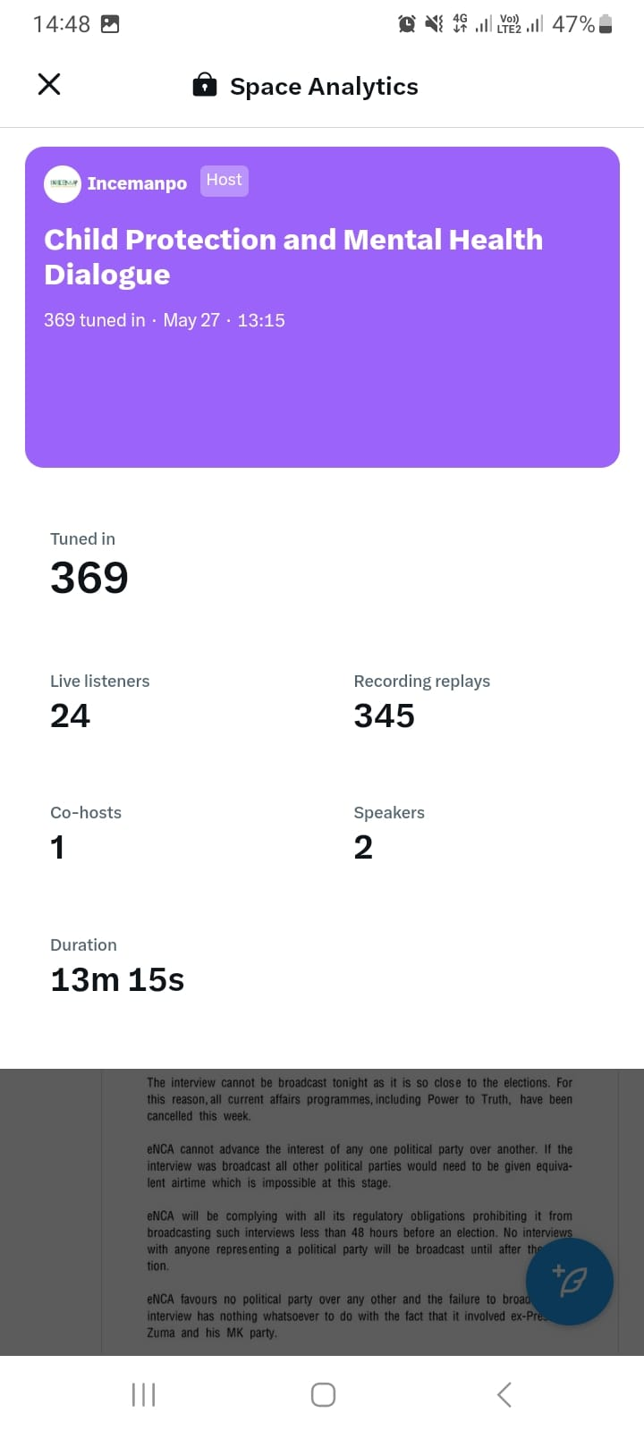
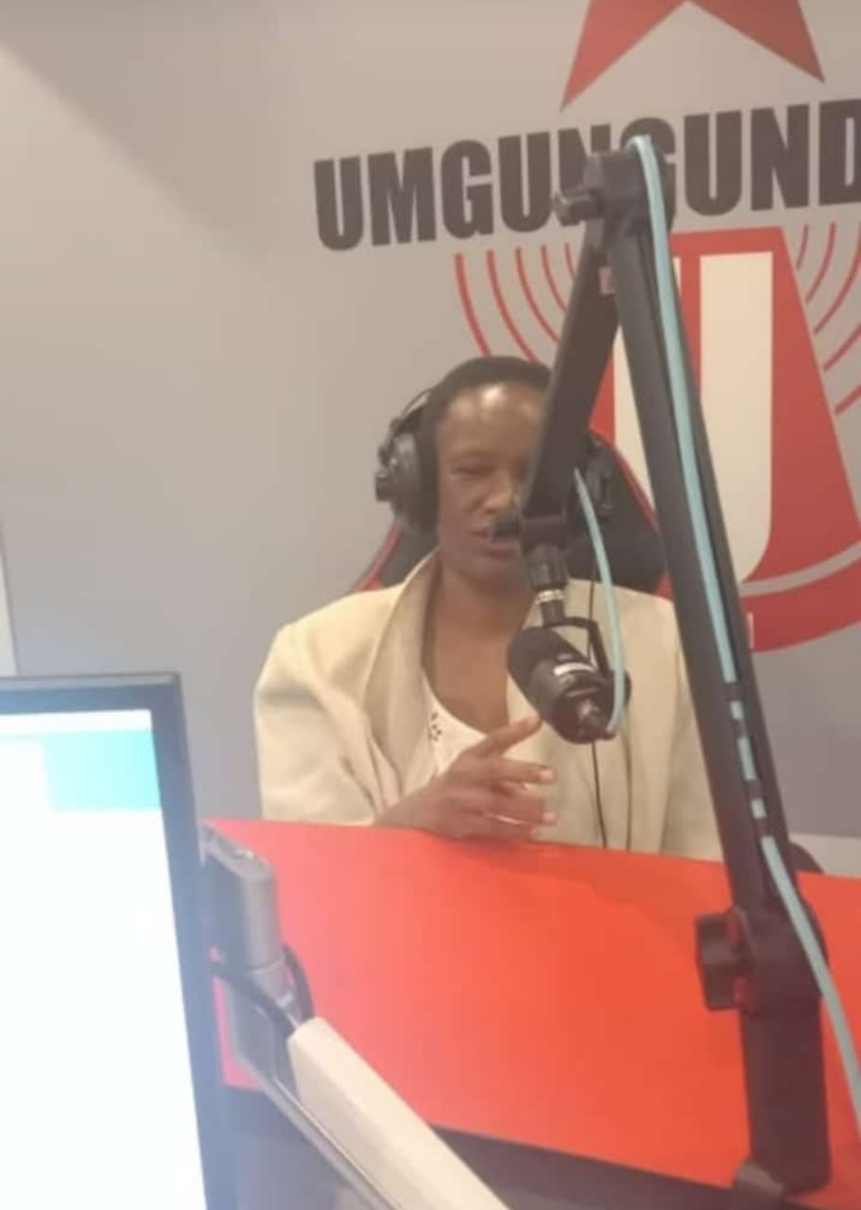
We plan to further build networks and alliances through our social media activities to enhance collaboration, share knowledge, and strengthen our impact.
Our relationship with TGPSA introduced us to online news articles with the “ Health for Umzansi” where we have been publishing educational articles.
Locally, we have a great relationship with institutions of higher learning such as UKZN, DUT and TVET collages. Our SRHR program helped us to create a pyramid approach system with HSRC and the Department of health. We then learn to further use online tools.
We have created an maintained a good relationship with GCIS and this helped us to conduct education through radio.
We have kept a strong and healthy stakeholder relationships with government departments, civil society organisations, traditional council, local government and business sectors. This is the investments we survived with through difficult times
Social media will help us attract potential funders, donors, policymakers, and development agencies interested in our work.
Women’s Voice and Leadership Learning and Sharing Summit 2025

Slide 5

Expected Impact
Our online educational poster
Through our social media activities, we aim to increase awareness of critical issues such as Child on Child sexual violence and related matters, Gender-based violence, sexual and reproductive health, and mental health issues.
By fostering community engagement, we hope to create a space where people can actively participate in discussions and programs, including online discussions.
We have gained interest in blogging and Vloging, we are incorporating it in our website to expand spaces for conversations and education.
We aim to expand our reach, attract collaborators, and connect with potential funders, learn from others and improve our service.
Additionally, use of social media will enable us to advocate for positive change in policy and societal attitudes.
We had started to conducted online educational programs. This showed positive impact, we intend to continue should we get funds
Women’s Voice and Leadership Learning and Sharing Summit 2025

Slide 6
Followers | Before RWVL | Current
Facebook | 92 | 1700
Twitter | 0 | 194
Tik-Tok | 0 | 89
YouTube | 0 | 0
Instagram | 121 | 259
Likes | Before RWVL | Current
Facebook | 95 | 2061
Twitter | 0 | 325
Tik-Tok | 0 | 185
YouTube | 0 | 0
Instagram | 72 | 864
Women’s Voice and Leadership Learning and Sharing Summit 2025

Slide 7
Impressions | Before RWVL | Current
Facebook | 20 | 1028
Twitter | 94 | 3489
Tik-Tok | 0 | 0
YouTube | 0 | 0
Instagram | 12 | 856
Women’s Voice and Leadership Learning and Sharing Summit 2025

Slide 8
Anticipated Challenges
What challenges do you anticipate facing? How do you plan to overcome them?
The main challenge is the financial uncertainty. Our programs needs continuous funding. The organization needs a dedicated communications official. We will be inviting a skilled person to consult on part time bases, however; we are willing to share this person with other organisations.
What lessons do you expect to learn?
We need to employ a dedicated person to be responsible for communications and social media. We have also learned that when posting on social media, long paragraphs are not always necessary—what matters is writing a short, catchy caption that grabs attention.
How do you plan to apply the lessons learned?
We will boost our social media posts. When we secure more funding, we will hire a communications officer.
Women’s Voice and Leadership Learning and Sharing Summit 2025

Slide 9
NEXT STEPS
What will be your key priorities moving forward
Expanding networks and partnerships with organizations focused on Child protection, Gender-based violence, Sexual and Reproductive Health, and other mental health related issues.
Enhancing social media presence by consistently updating platforms with engaging content to raise awareness, attract funders, and foster community engagement.
Securing funding and introduce income generating activities to sustain and expand initiatives, including hiring a communications officer.
Upgrade and maintain the website, introduce LinkedIn page, recruit volunteers, and expand our reach through networks.
Advocating and running awareness campaigns.
Women’s Voice and Leadership Learning and Sharing Summit 2025

