Slide 1


Voice and Choice Summit 2026-Story of Change Category
Your logo goes here
Title/Name of the Story
Reclaiming Community Space Through Practice-Based Empowerment in Rural KwaMnyandu
(South Africa, Johannesburg, March 2026 and Phila Vilakazi)
Voice and Choice Summit 2026 \ Voice and Choice Summit 2026

Slide 2
Synopsis– brief overview what this is about
Name | Phila Vilakazi
Designation | Programmes Officer
Organisation | Sasopsbiz Foundation
Country | South Africa
Category | Change
Summary | This is a story of how a determined group of young women and two males, supported by their community, reclaimed an abandoned hall and transformed it into a valuable community asset. The change was made possible through collaboration between traditional leadership, the local NPO Imbewuyesizwe, the UCENI network, and Sasopsbiz Foundation, demonstrating the power of partnerships in driving rural community transformation. Ultimately, it is a story that demonstrates the effectiveness of Sasopsbiz Foundation’s Practice-Based Community Empowerment Model, showing how community-led action can turn local challenges into opportunities for women to start businesses, access work, and build sustainable livelihoods.
Voice and Choice Summit 2026 \ Voice and Choice Summit 2026

Slide 3
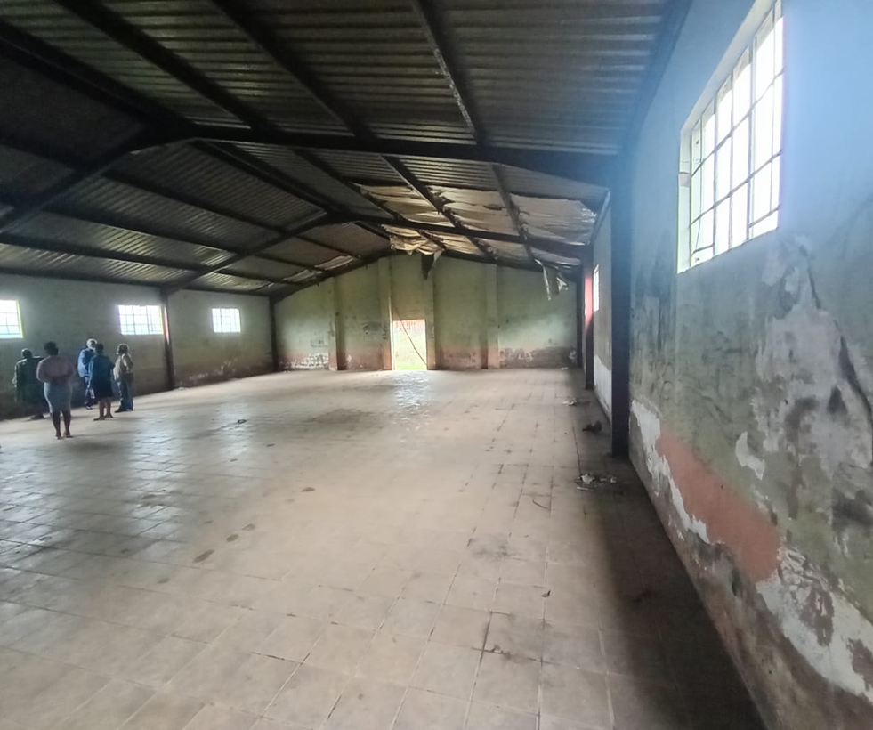
Background
Location: Situated in Elandskop, roughly 30-40km from central Pietermaritzburg.
Education: Home to Kwamnyandu Primary School (Public, Quintile 3)
Food Insecurity: Residents face significant challenges with the rising cost of living, leading to food insecurity.
Infrastructure and Services: The area, particularly around Vulindlela, faces challenges with inadequate services and, in some areas, significant water shortages.
Economic Drivers: High unemployment has necessitated a reliance on social grants.
Impact on Youth: Poverty in the area contributes to low self-esteem and anxiety among youth,
Evidence: Include Photos or videos
Voice and Choice Summit 2026 \ Voice and Choice Summit 2026

Slide 4
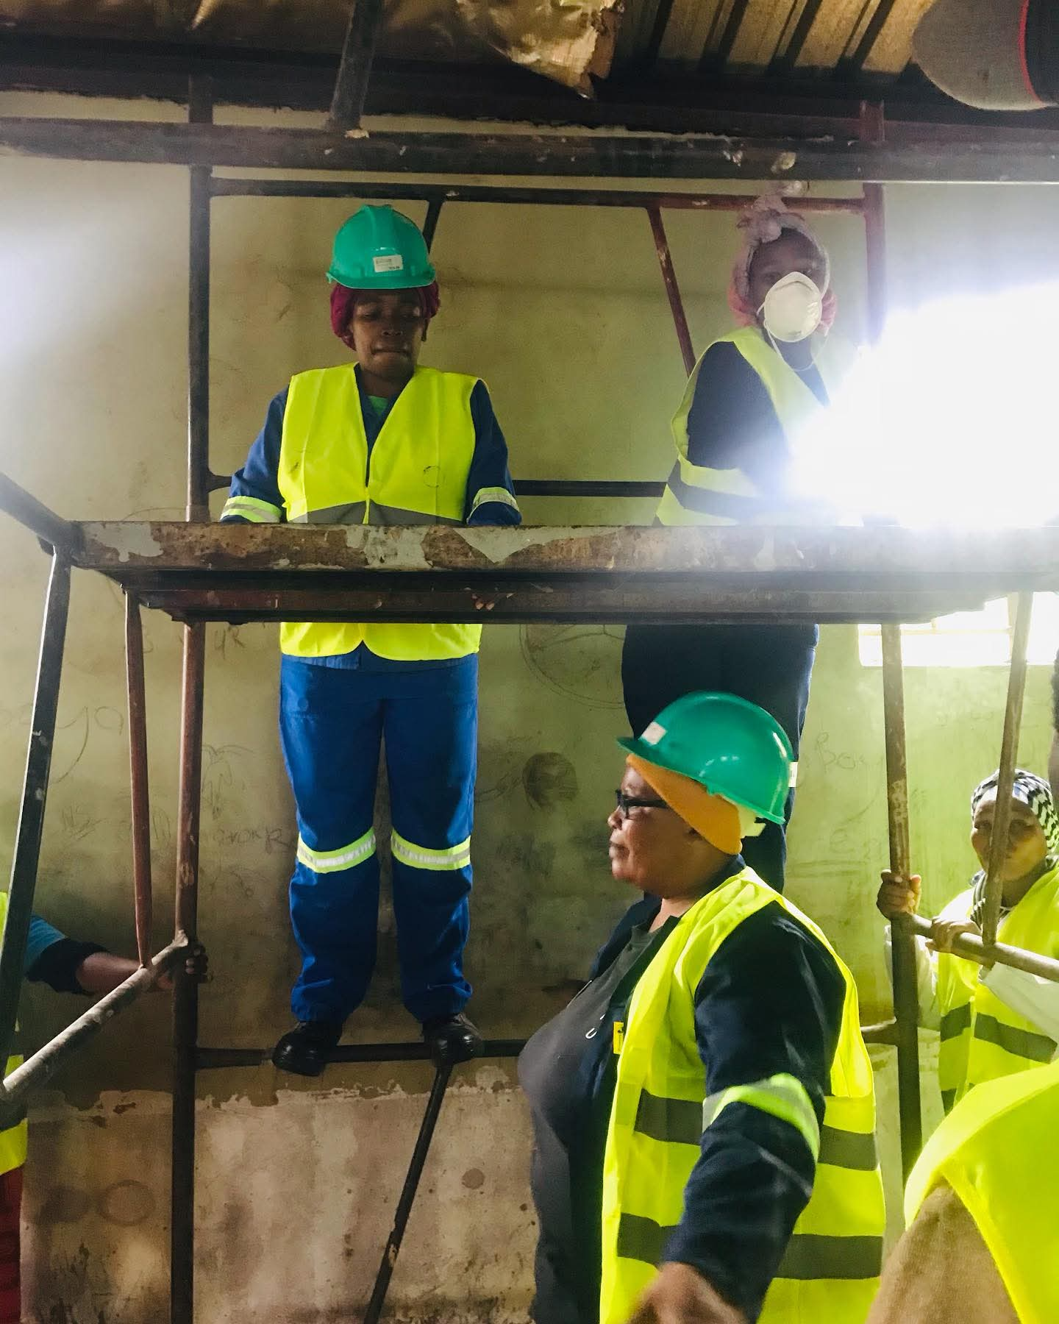
Context
Situation When We Arrived in KwaMnyandu
High unemployment and poverty plagued the rural community, particularly affecting women and youth.
The community hall had been abandoned for over 20 years and was occupied by drug users, making it unsafe and a source of fear for residents.
Multiple attempts by different sectors of the community to reclaim the hall had failed, including efforts by former residents, middle-class stakeholders, and municipal officials.
Even calls on local radio and proposals to convert the hall into a studio or library by various government departments did not materialize, leaving the hall a persistent problem due to vagrants and safety concerns.
The local NPO Imbewuyesizwe approached Sasopsbiz Foundation with a bigger vision of turning the hall into a community asset
Evidence: Include Photos or videos
Voice and Choice Summit 2026 \ Voice and Choice Summit 2026

Slide 5
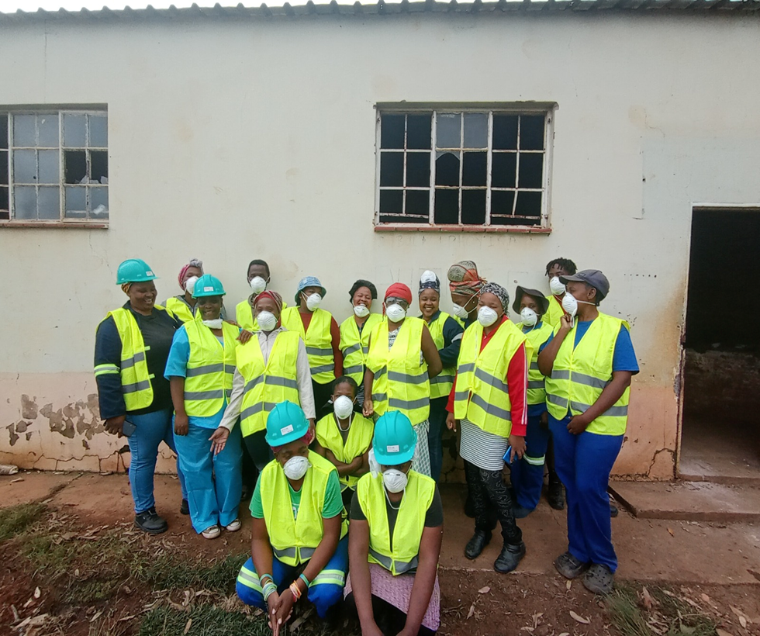
Objectives
Reclaim and rehabilitate the abandoned community hall so it could once again serve as a safe and productive space for the community.
Equip young women with practical trade skills through the Sasops Women in Trades (SWITS) Programme, including painting, door repair, and window installation.
Create pathways to livelihoods and entrepreneurship by enabling women to access work opportunities and start their own businesses.
Mobilise community collaboration by bringing together traditional leadership, local organisations such as Imbewuyesizwe, and partners within the UCENI network to drive sustainable community-led development.
Evidence: Include Photos or videos
Voice and Choice Summit 2026 \ Voice and Choice Summit 2026

Slide 6
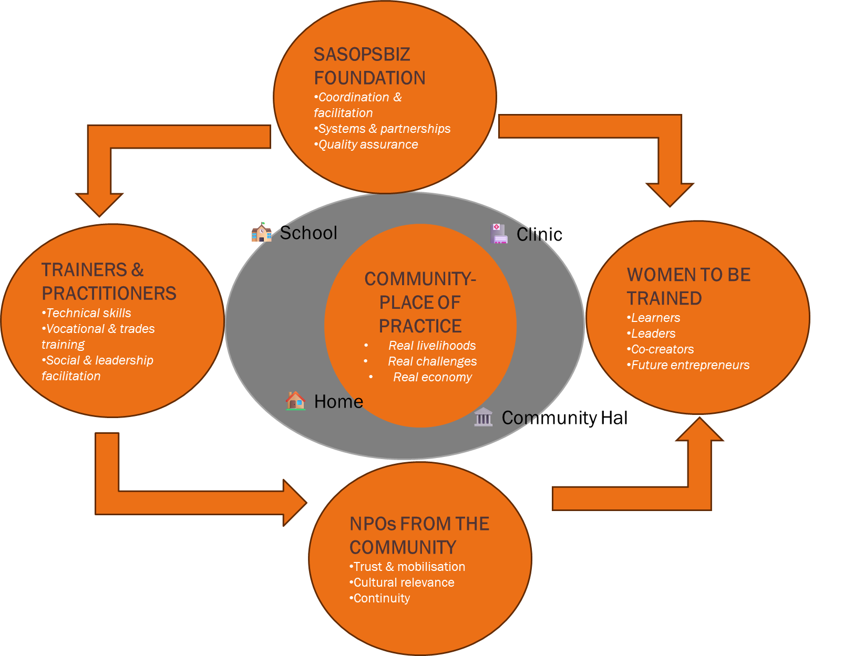
APPROACH
At the Centre: Community – The Place of Practice
Real environments where learning and development happen
Real livelihoods, Real challenges, Real economy
Examples:🏠 Homes | 🏫 Schools | 🏥 Clinics | 🏛 Community Spaces
The Four Actors That Drive the Model
Sasopsbiz Foundation
System leadership, Coordination & facilitation, Partnerships & systems building, Quality assurance
2. Trainers & Practitioners
Skills transfer, Technical skills training, Vocational & trade instruction, Social and leadership facilitation
3. Women to be Trained
Change agents, LearnersLeaders. Co-creators, Future entrepreneurs
4. Community NPOs
Local anchors, Community trust & mobilization, Cultural relevance, Continuity and sustainability
How the Model Works
Community Challenge → Place of Practice → Skills Training → Economic Opportunity
Voice and Choice Summit 2026 \ Voice and Choice Summit 2026

Slide 7
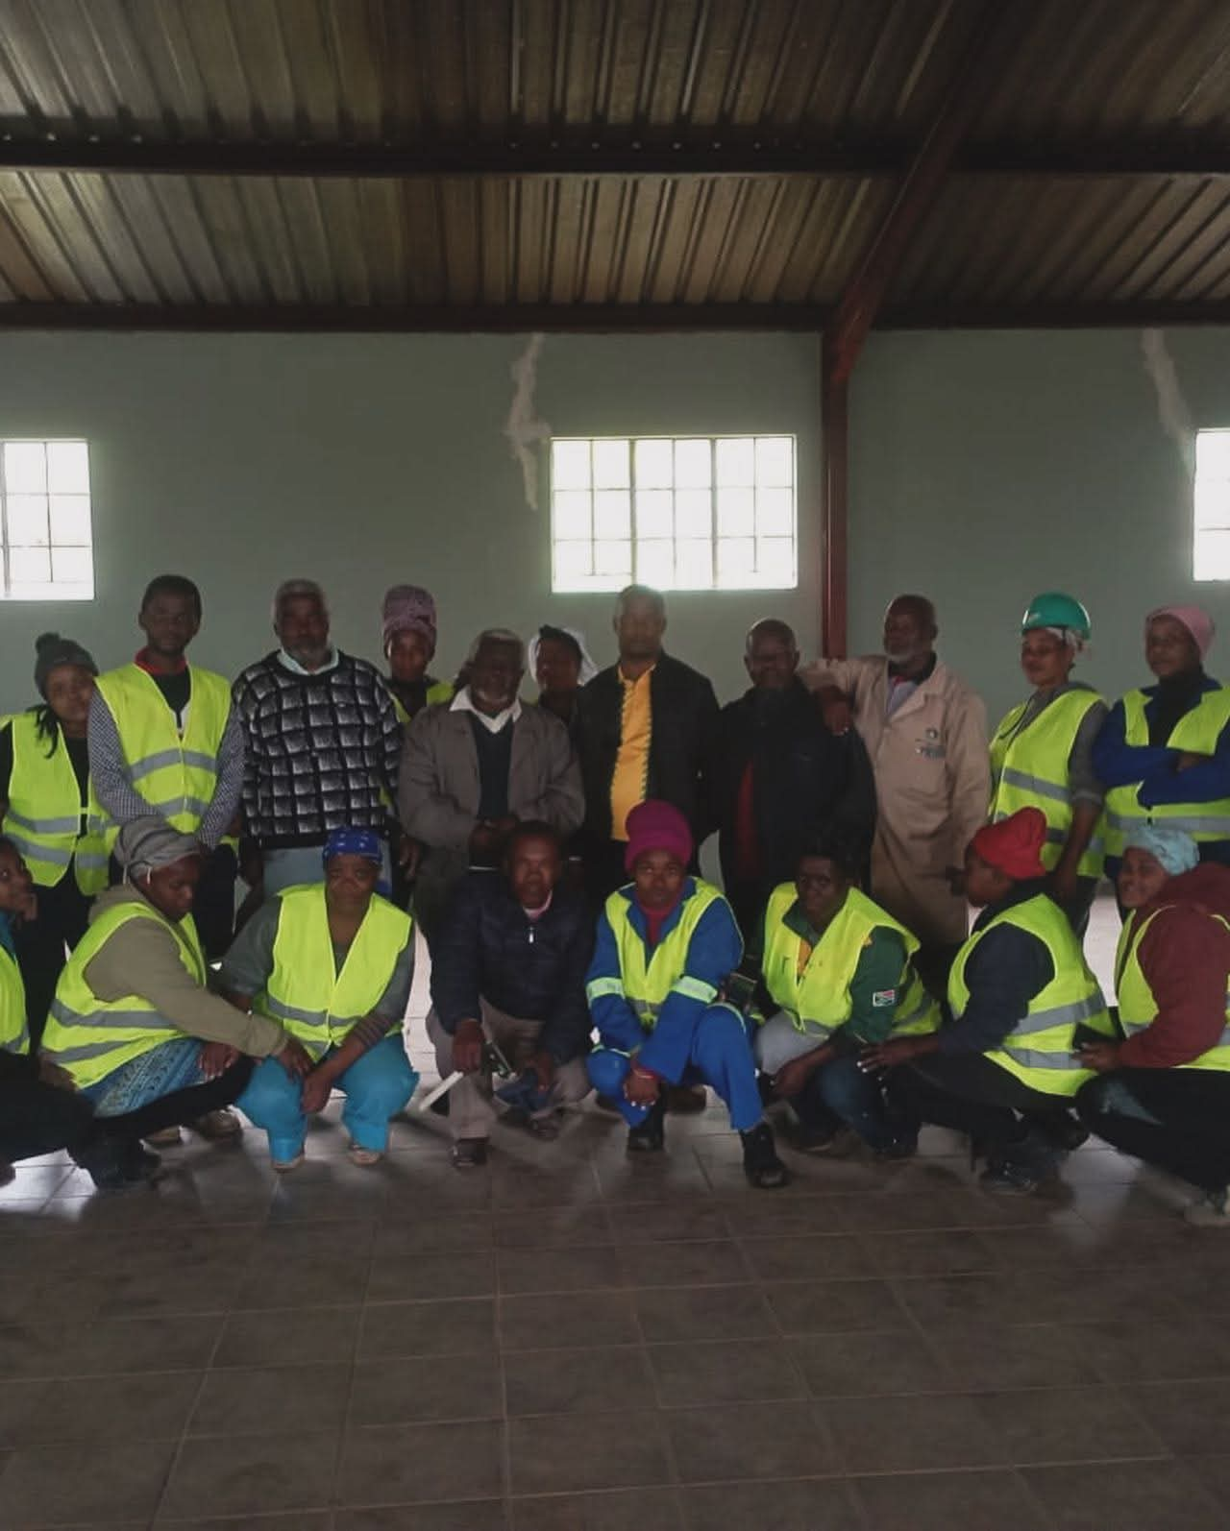
WHY THIS MODEL WORKS
1. Real Problems → Real Learning
Training happens while solving real community challenges, not in classrooms.
2. Community Is the Classroom
Homes, schools, clinics, and community infrastructure become places of practice.
3. Strong Local Anchors
Partnerships with local NPOs, traditional leadership, and networks like UCENI ensure trust, mobilisation, and sustainability.
4. Skills → Livelihoods → Businesses
Participants gain marketable skills, access work opportunities, and start enterprises.
5. Systems, Not Projects
Sasopsbiz Foundation coordinates trainers, communities, partners, and learners, creating an ecosystem that can scale and replicate.
Key Lesson: When communities become places of practice, development moves from theory to real economic opportunity.
Evidence: Include Photos or videos
Voice and Choice Summit 2026 \ Voice and Choice Summit 2026

Slide 8
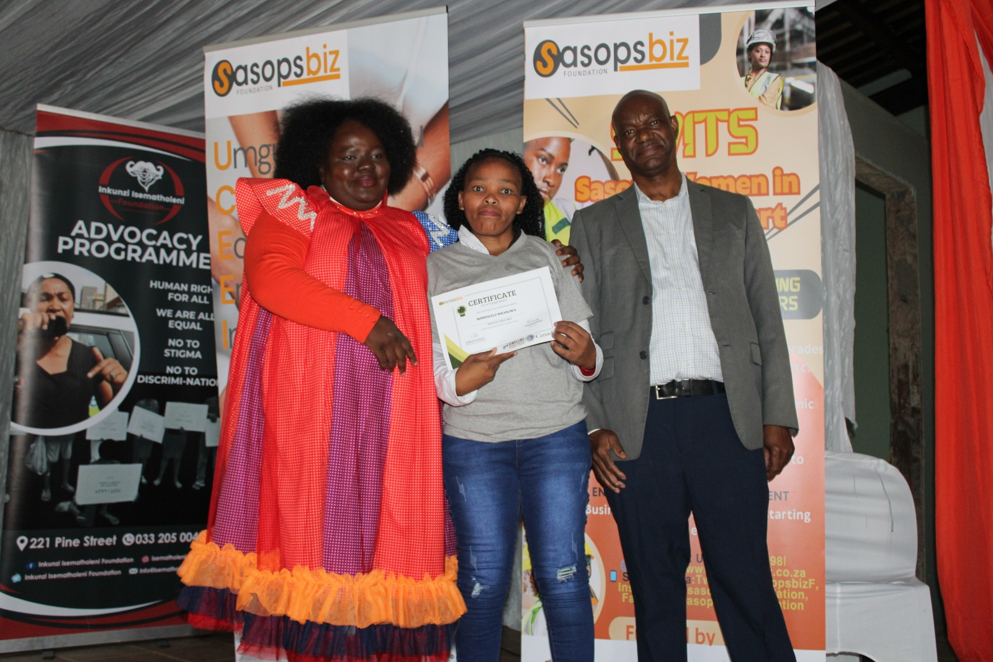
Actions
Local young women leadership identified the opportunity: The local NPO Imbewuyesizwe, led by Nontobeko Phungula, approached Sasopsbiz Foundation with a vision to reclaim the abandoned hall and create opportunities for women.
Sasopsbiz introduced the solution: Through the Practice-Based Community Empowerment Model and the Sasops Women in Trades (SWITS) Programme, the hall was turned into a live training site.
Skills training through real work: 19 young women and 2 males(1 LGBTQI+) were trained and graduated in painting, door repair, and window installation by a qualified female trainer while refurbishing the hall.
Collaboration made it possible: The change was driven through partnerships with Imbewuyesizwe, traditional leadership, community members, the UCENI network, and Inkunzi Isematholeni, which helped support the drug users occupying the hall.
Evidence: Include Photos or videos
Voice and Choice Summit 2026 \ Voice and Choice Summit 2026

Slide 9
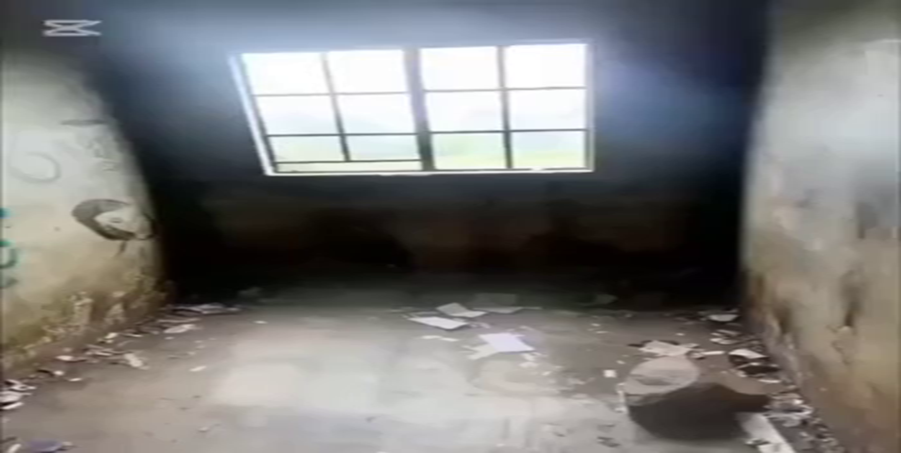
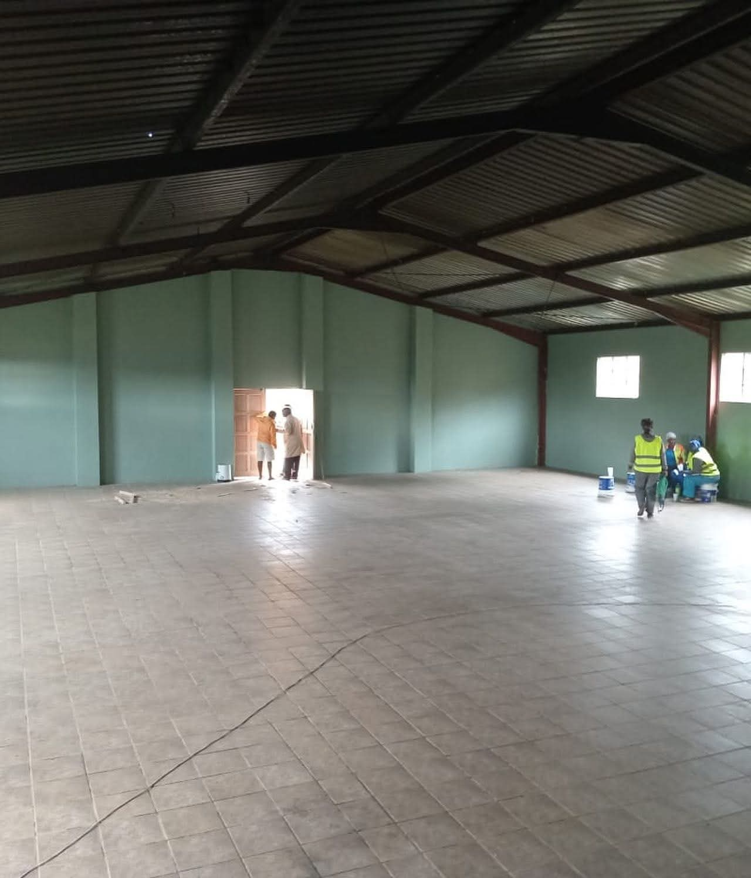
The change – impact
What changed: In KwaMnyandu, rural KwaZulu-Natal, an abandoned community hall that had been unsafe and occupied by drug users for over 20 years was restored and reclaimed through the Sasops Women in Trades (SWITS) Programme, led by Sasopsbiz Foundation in partnership with Imbewuyesizwe NPO.
Nature of the change: The change was highly positive, transforming a neglected and feared space into a safe and productive community asset.
Who benefited:19 young women gained practical skills in painting, door repair, and window installation and graduated from the training programme.
Some participants now earn income, work with the trainer, or have started their own businesses.
The wider community benefits from a restored hall that can be used for events, programmes, and gatherings.
Situation now: The hall is fully operational and actively used by the community, serving as a hub for social activities, programmes, and local economic opportunities while demonstrating the power of community collaboration and practice-based empowerment.
Evidence: Include Photos or
Voice and Choice Summit 2026 \ Voice and Choice Summit 2026

Slide 10
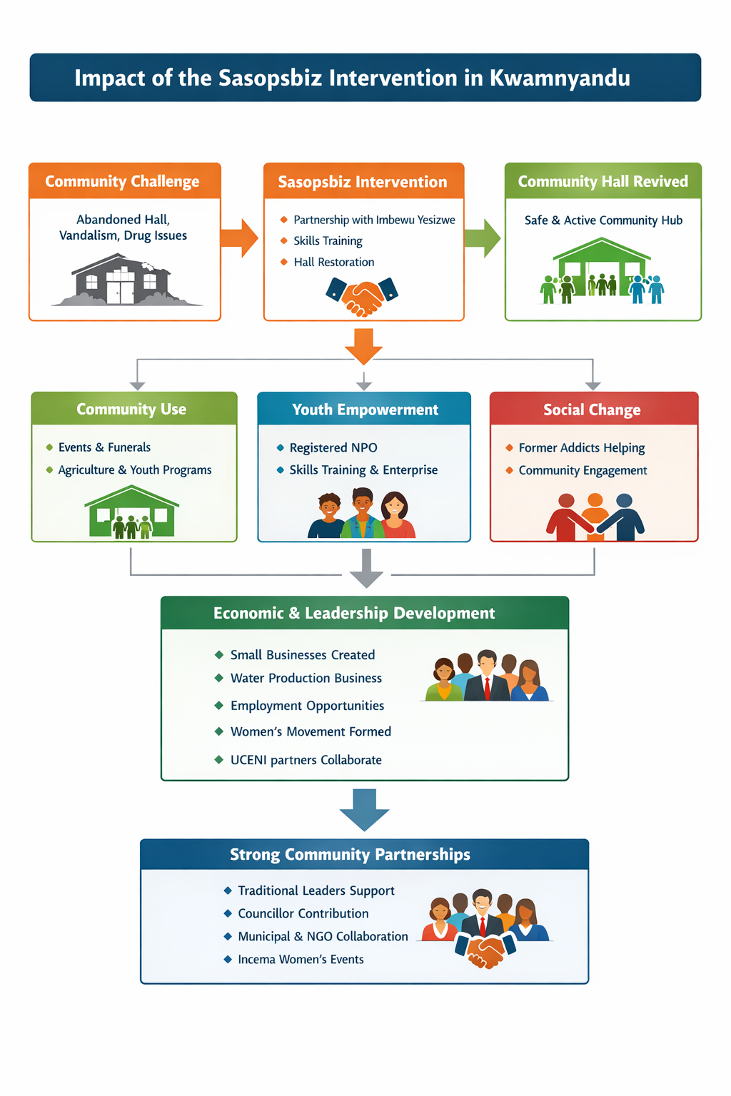
THE IMPACT

Slide 11
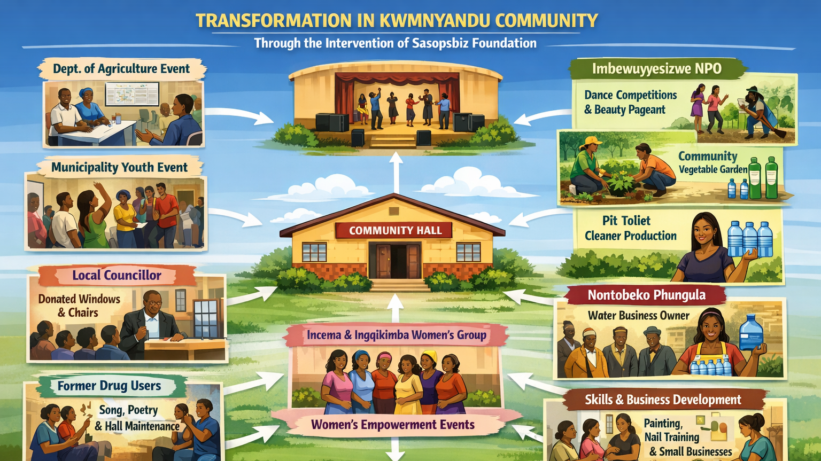

Slide 12
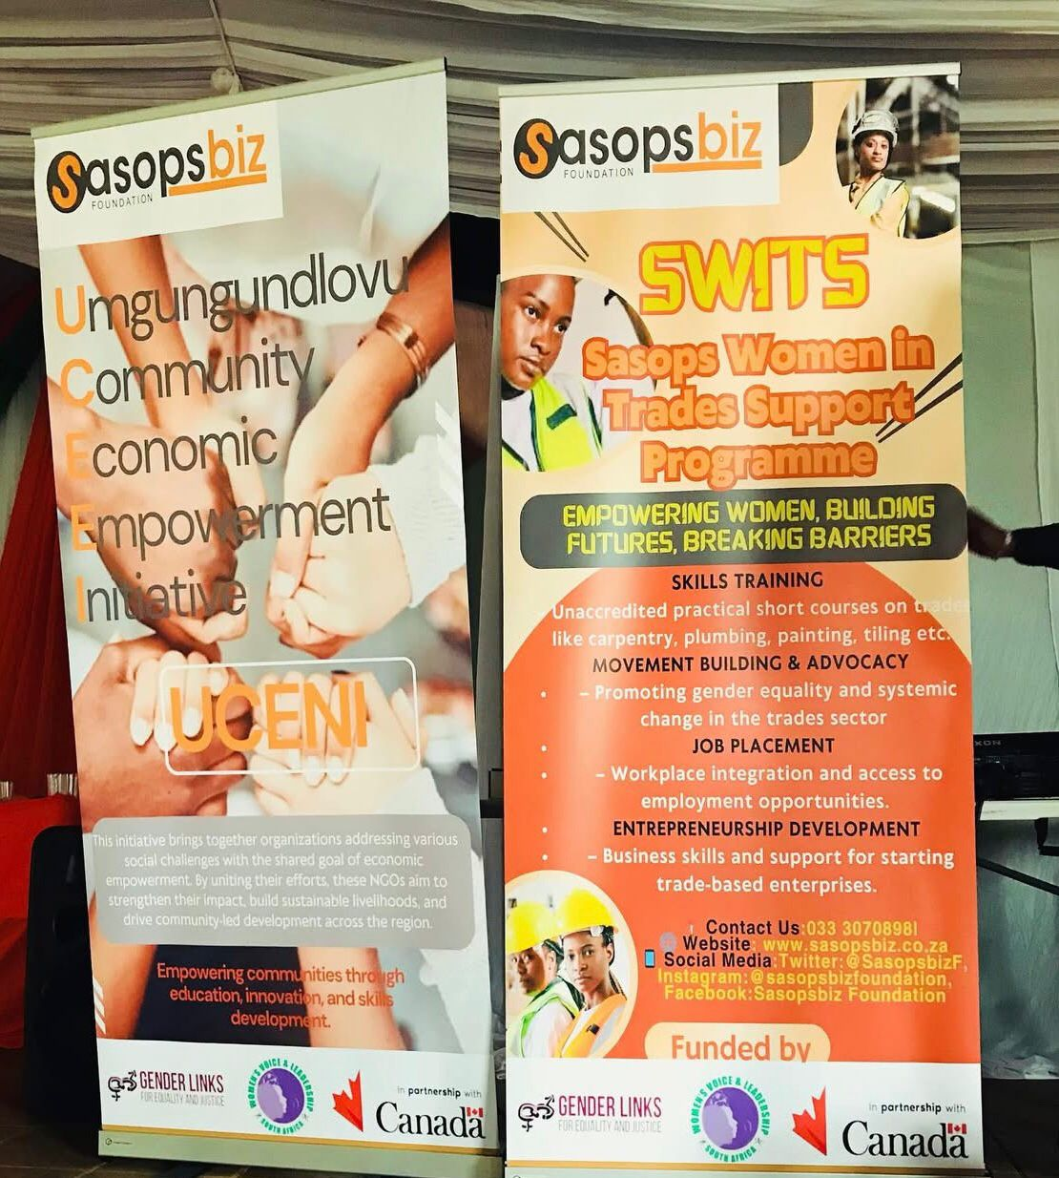
Significance of the Change
Advancing the movement: This story demonstrates how practice-based community empowerment can translate ideas about women’s economic empowerment into practical, visible change. By turning a neglected community space into a training and economic opportunity hub, the initiative shows how women can move from exclusion to active participation in local economies.
Strengthening the model: The success in KwaMnyandu validates Sasopsbiz Foundation’s Practice-Based Community Empowerment Model, proving that real community challenges can become platforms for skills development, enterprise creation, and community renewal.
Building stronger networks: Through collaboration with Imbewuyesizwe NPO, traditional leadership, and the UCENI network, the project demonstrates the importance of local partnerships and community ownership in sustaining change.
Next steps: The results create a pathway to scale the model to other communities, train more women in trades, strengthen women-led businesses, and expand the network of community partners working together to drive sustainable rural economic development.
Voice and Choice Summit 2026 \ Voice and Choice Summit 2026

Slide 13
Beneficiaries
 | Number of participants
Female – Direct beneficiaries | 19
Male – Direct beneficiaries | 2
Female – Indirect beneficiaries (e.g. through other networks) | 87
Male – Indirect beneficiaries (e.g. through other networks) | 16
Female – Online beneficiaries (e.g. website access, mailing lists, scholarly articles) | 0
Male – Online beneficiaries (e.g. website access, mailing lists, scholarly articles) | 0
Total | 124
Voice and Choice Summit 2026 \ Voice and Choice Summit 2026

Slide 14
Challenges & Lessons learnt
CHALLENGES
1. Sustaining economic opportunities: If trainees do not consistently access work opportunities, some may struggle to convert their skills into sustainable income.
Mitigation: Continue linking graduates to projects, mentorship, and enterprise development through the Sasopsbiz community and business support programmes.
2. Maintenance of the community hall: Without ongoing care and community ownership, the facility could fall back into neglect.
Mitigation: Strengthen local stewardship through Imbewuyesizwe NPO, traditional leadership, and community users of the hall.
3. Limited financial resources to expand the model: Scaling the initiative to other communities may be constrained by funding and resources.
Mitigation: Build partnerships through the UCENI network and demonstrate the model’s impact to attract support from development partners.
4. Social challenges in the community: Issues such as substance abuse or unemployment could continue to affect the community environment.
Mitigation: Maintain partnerships with organisations such as Inkunzi Isematholeni and expand community-based programmes that address social and economic challenges together.
What lessons have you learnt?
Real problems create meaningful learning: Using a real community challenge as the training site made the learning practical and immediately relevant.
Local leadership is essential: The role of Imbewuyesizwe NPO and traditional leadership was critical in mobilising the community and building trust.
Partnerships strengthen impact: Collaboration between Sasopsbiz Foundation, community organisations, UCENI network partners, and Inkunzi Isematholeni made it possible to address both economic and social challenges.
Women respond strongly to opportunity: When given access to practical skills, mentorship, and support, women can quickly transition from trainees to income earners and entrepreneurs.
Community assets can drive development: Neglected infrastructure, when reclaimed and used as a place of practice, can become a catalyst for skills development, livelihoods, and community renewal
Voice and Choice Summit 2026 \ Voice and Choice Summit 2026

Slide 15

Sustainability
Sustainability Measures
Local ownership: The hall is now under the stewardship of Imbewuyesizwe NPO and community leadership, ensuring continued use and maintenance.
Skills that generate livelihoods: The 20 trained women gained practical trade skills that allow them to access work opportunities, continue working with the trainer, or run their own small businesses.
Ongoing mentorship: All trainees become part of the Sasopsbiz community, giving them access to mentorship, enterprise support, and business development opportunities such as the Sasopsbiz Business Bootcamp.
Community utilisation of the hall: The hall is now actively used for community events, programmes, and gatherings, making it a valued community asset.
Expanded training programmes: Future SWITS cohorts can train more women and youth, creating a larger pool of skilled workers and entrepreneurs in rural communities.
Evidence: Include Photos or videos
Voice and Choice Summit 2026 \ Voice and Choice Summit 2026

Slide 16
Next Steps
Expand training opportunities: Run additional cohorts of the Sasops Women in Trades (SWITS) Programme to train more women and youth in practical trades.
Strengthen women-led enterprises: Support graduates to formalise their businesses, access contracts, and expand their services through mentorship and business development support.
Leverage the hall as a community hub: Continue using the restored hall for skills training, youth programmes, community events, and economic activities.
Scale the model to other communities: Through the UCENI network, identify other rural areas with similar challenges and apply the Practice-Based Community Empowerment Model to transform community assets and create livelihoods.
Voice and Choice Summit 2026 \ Voice and Choice Summit 2026

Slide 17

Before and After at KwaMnyandu Hall

