Slide 1



Mauritius: Trans Woman Building a Trans-Led Movement for Health, Equality, and Institutional Change
Voice & Choice Summit 2026
Hana Telvave Founder & Director – EkiT Mauritius
Category: Driver of Change – Leadership

Slide 2

The problem
For years, trans people in Mauritius were spoken about but rarely leading their own movement.
Trans issues became just a letter in the broader LGBT agenda, leaving gender identity needs invisible.
Advocacy was shaped in institutional spaces while trans people continued to face exclusion in healthcare, education and employment.
Many trans activists, including myself, were present in campaigns but rarely had decision-making power.
Voice and Choice Summit 2026 \ Voice and Choice Summit 2026

Slide 3


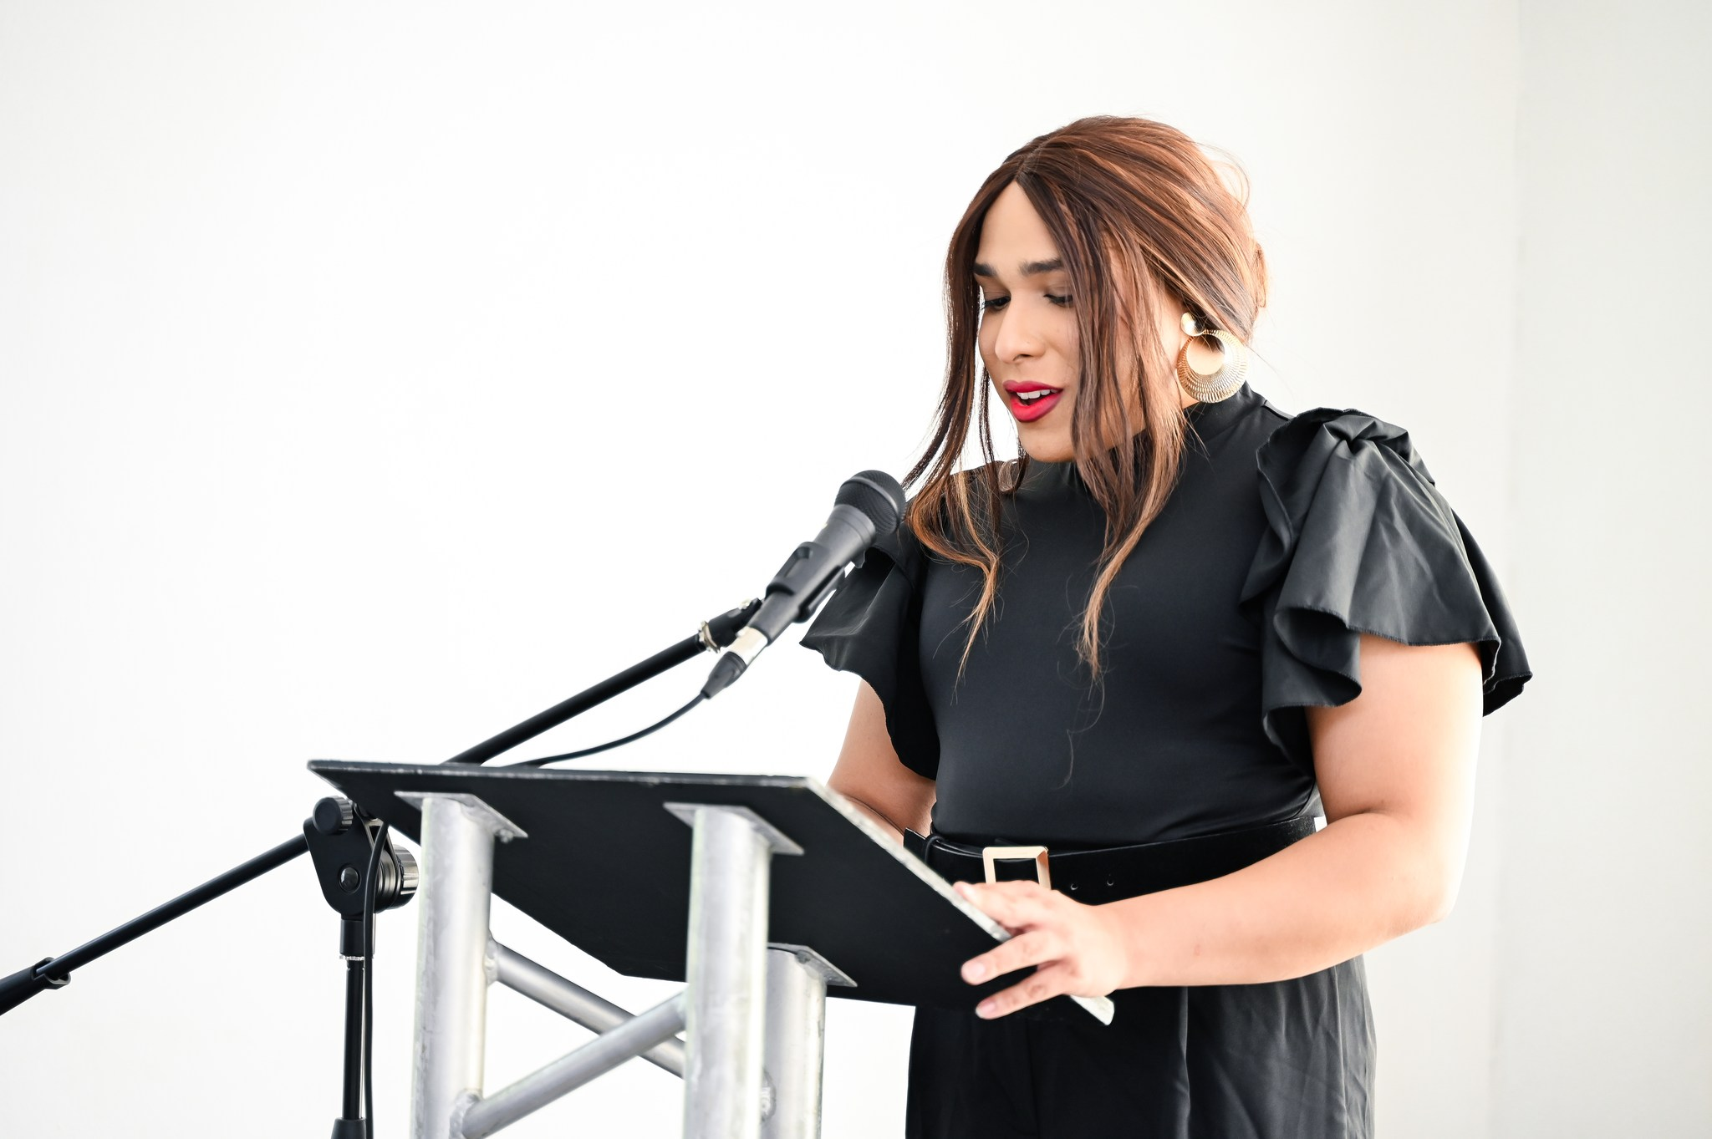
What we are doing
We are redefining trans-led leadership. Our approach is grounded in a decolonial philosophy that centers gender identity as a distinct issue.
Instead of a hierarchy, we build a network of leadership where every community member can contribute.
We listen to the smallest voices in our community and support them to grow into future leaders and advocates.
Voice and Choice Summit 2026 \ Voice and Choice Summit 2026

Slide 4

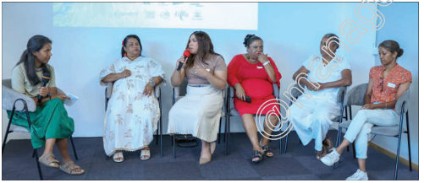
The Change
Trans rights advocacy in Mauritius is becoming visible, public and trans-led.
Community members now participate as storytellers, strategists and advocates.
Funding and resources are beginning to reach trans-led initiatives directly.
Public attitudes are shifting:
• 82% believe communities should protect trans people • 97% say they would never commit violence
Voice and Choice Summit 2026 \ Voice and Choice Summit 2026

Slide 5
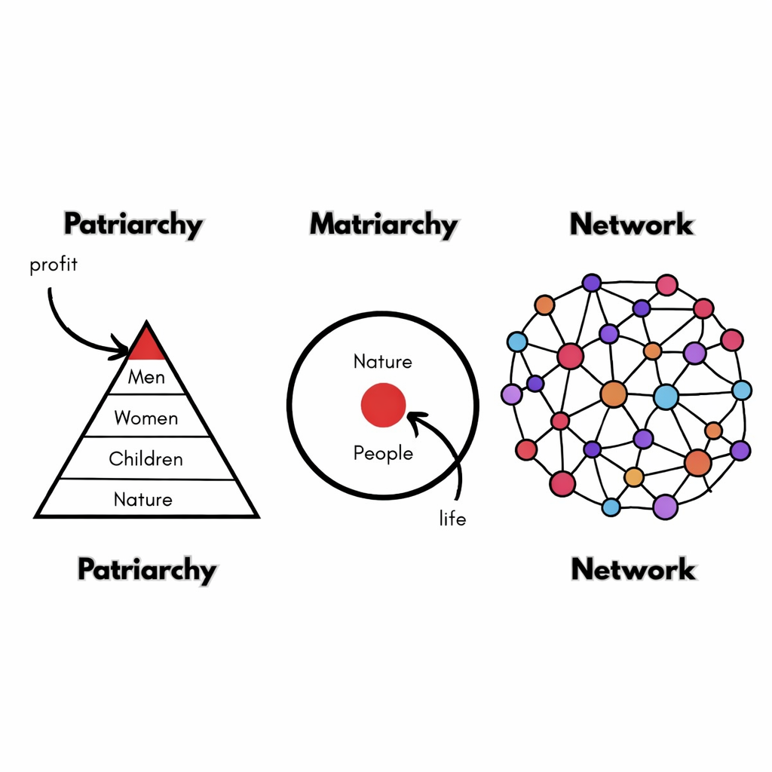
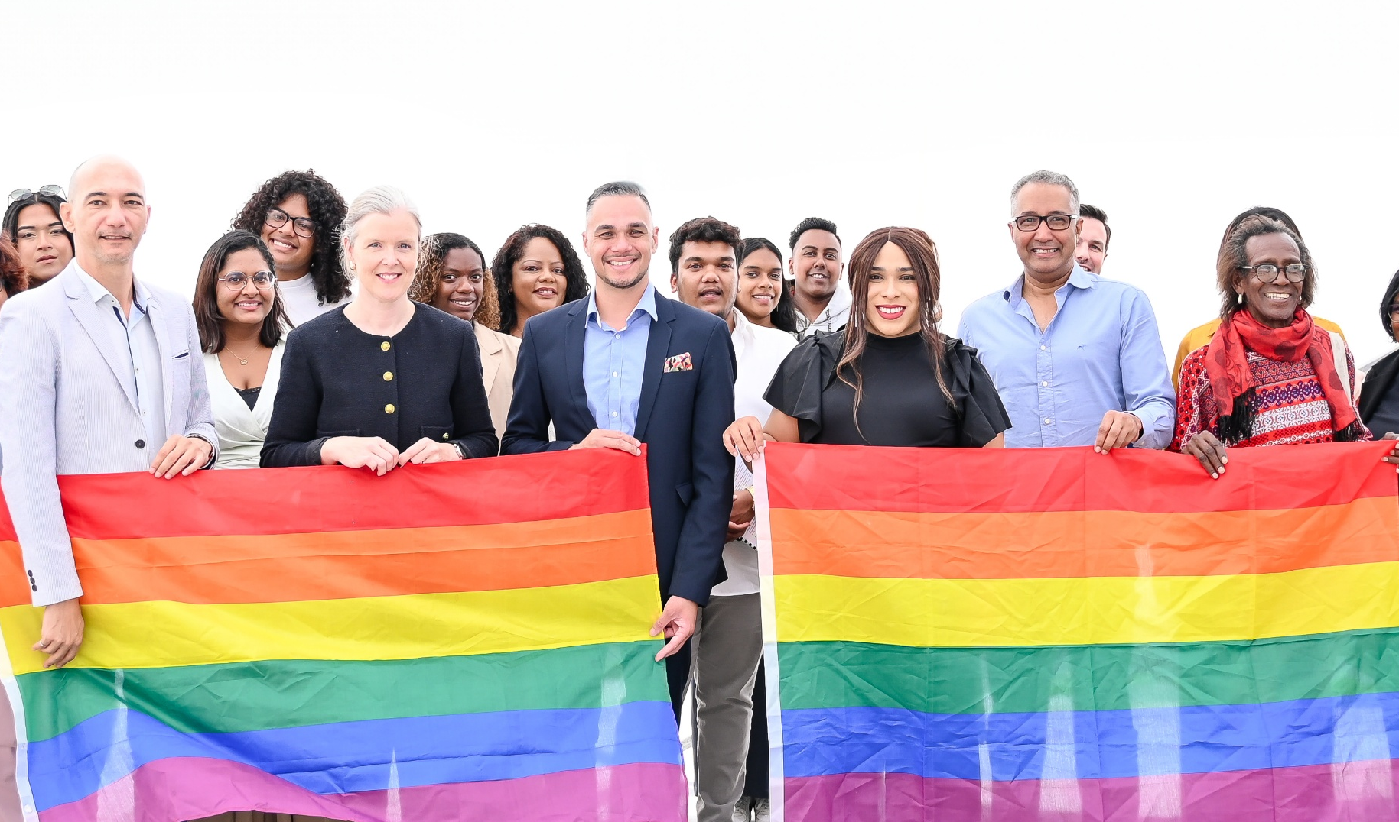
Why This Matters
Our movement proposes another leadership model.
Not the pyramid of patriarchy and capitalism Not only the circle of traditional power structures
But a network — a web of relationships and shared leadership.
This approach creates new possibilities for how movements can grow while centering dignity, care and community knowledge.
Voice and Choice Summit 2026 \ Voice and Choice Summit 2026

Slide 6

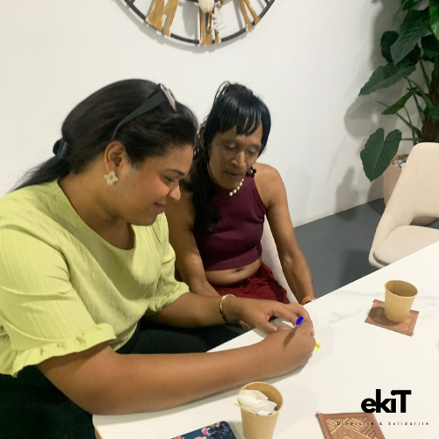
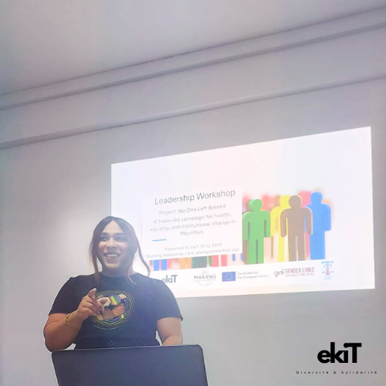
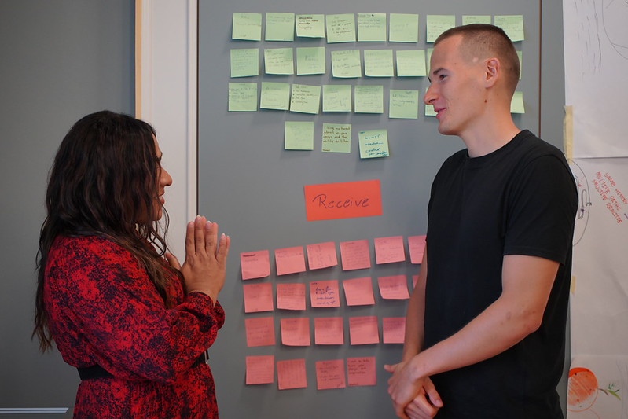
Challenges & Lessons
Challenges
• Building legitimacy for a trans-led movement • Resistance from institutions and public stigma • Backlash and hate speech when visibility increases
Lessons
• Care must be central to leadership • Safety and dignity allow communities to grow • Sustainable movements develop leaders, not followers
Voice and Choice Summit 2026 \ Voice and Choice Summit 2026

Slide 7
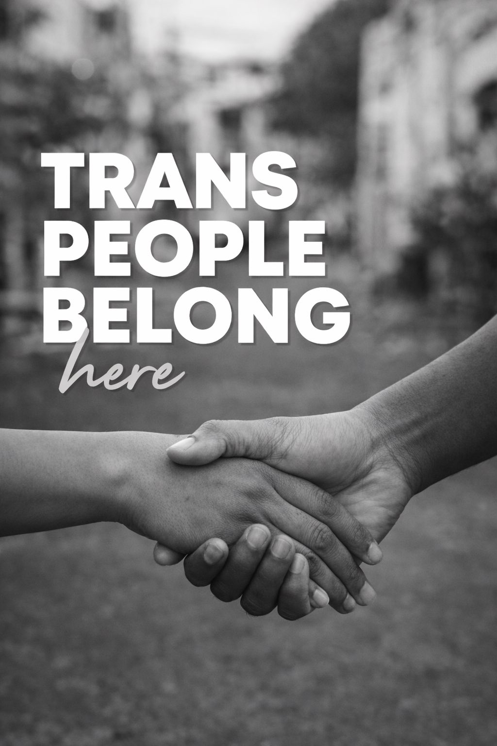
Sustainability Steps
EkiT is strengthening governance systems and leadership pipelines to ensure the movement grows beyond one person.
Our priorities include:
• developing new trans leaders • building partnerships and funding opportunities • expanding storytelling and advocacy campaigns
Our long-term goal is to restore the role of trans people as protectors of dignity, ancestral knowledge, safety and community balance in society.
Voice and Choice Summit 2026 \ Voice and Choice Summit 2026

