Slide 1


Voice and Choice Summit 2026-Story of Change Category
Your logo goes here
SOUTH AFRICA: TFGBV FROM GROUP CHATS TO CHANGEMAKERS.
Voice and Choice Summit 2026 \ Voice and Choice Summit 2026

Slide 2
Synopsis– brief overview what this is about
Name | South Africa: TFGBV from group chats to changemakers
Designation | Eldim Tshiwala - Administrative Assistant & Finance Support
Organisation | Gender Rights In Tech
Country | South Africa
Category | Gender Based Violence
Summary | This presentation showcases GRIT’s Youth Led Research Project on Technology-Facilitated Gender-Based Violence (TFGBV). 25 young people, based in Johannesburg, conducted research on digital harms and violence. They then developed recommendations on how to raise awareness on this and create safer spaces for children online.
Voice and Choice Summit 2026 \ Voice and Choice Summit 2026

Slide 3
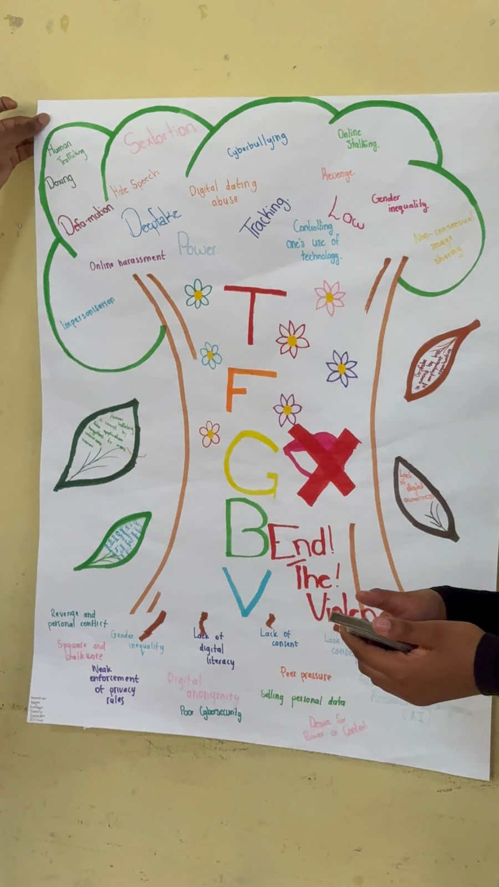
Background(problem, actions, change, evidence)
Give some background. Briefly describe the context or problem.
TFGBV is highly prevalent amongst increasing amongst SA youth.
Limited awareness means that TFGBV is overlooked or minimised and not recognised as a form of GBV.
A lot of young people experience harm and don’t know how to name it, let alone how to deal with its aftermath.
These young people knew something was wrong online. This project provided a platform to explore their digital experiences and become the researchers, the advocates, and a voice for change.
Voice and Choice Summit 2026 \ Voice and Choice Summit 2026

Slide 4
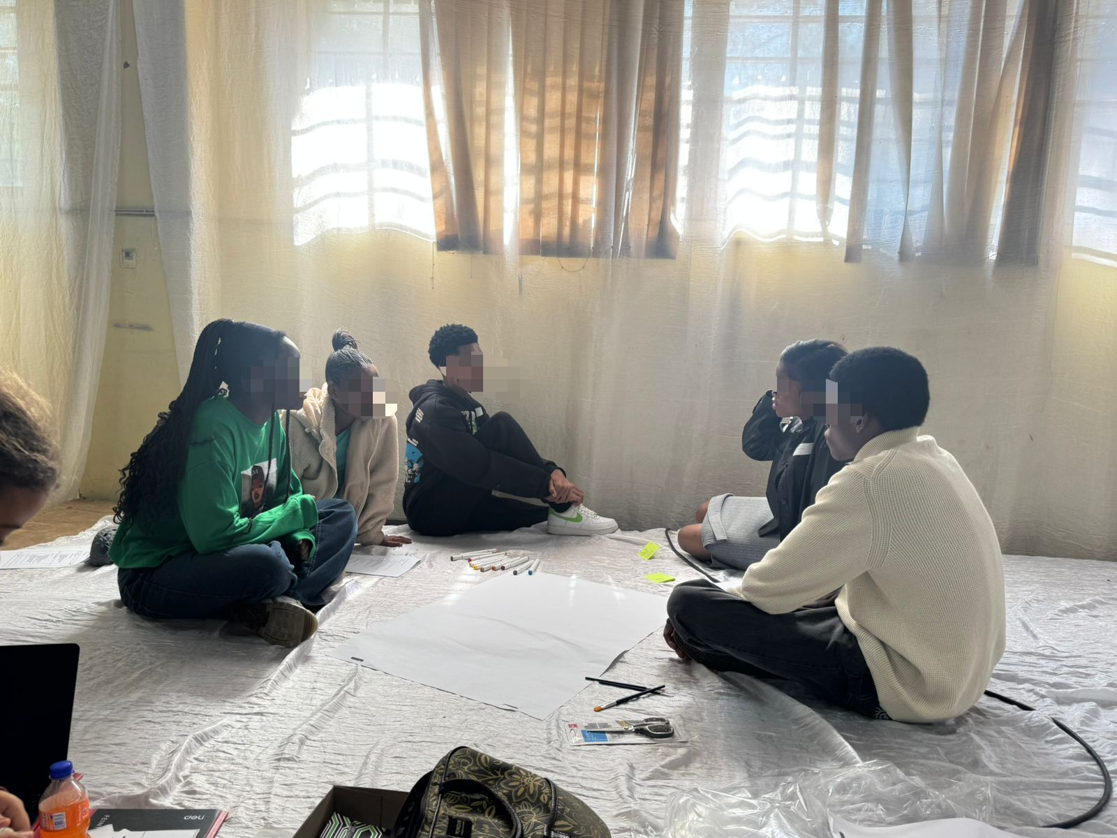
Background
Briefly describe the context or problem the project set out to address.
GRIT implemented a youth-led research project with 25 young people in Johannesburg, Gauteng, creating a safe space to explore and discuss their digital experiences
Prior to the project, participants lacked the language and framework to identify what they were experiencing as TFGBV.
Through this project, the young people themselves built out the knowledge base to increase awareness and understanding.
Equipped with research skills and a deeper understanding of digital harm, participants developed recommendations for making digital spaces safer and raised awareness in their communities.
Voice and Choice Summit 2026 \ Voice and Choice Summit 2026

Slide 5
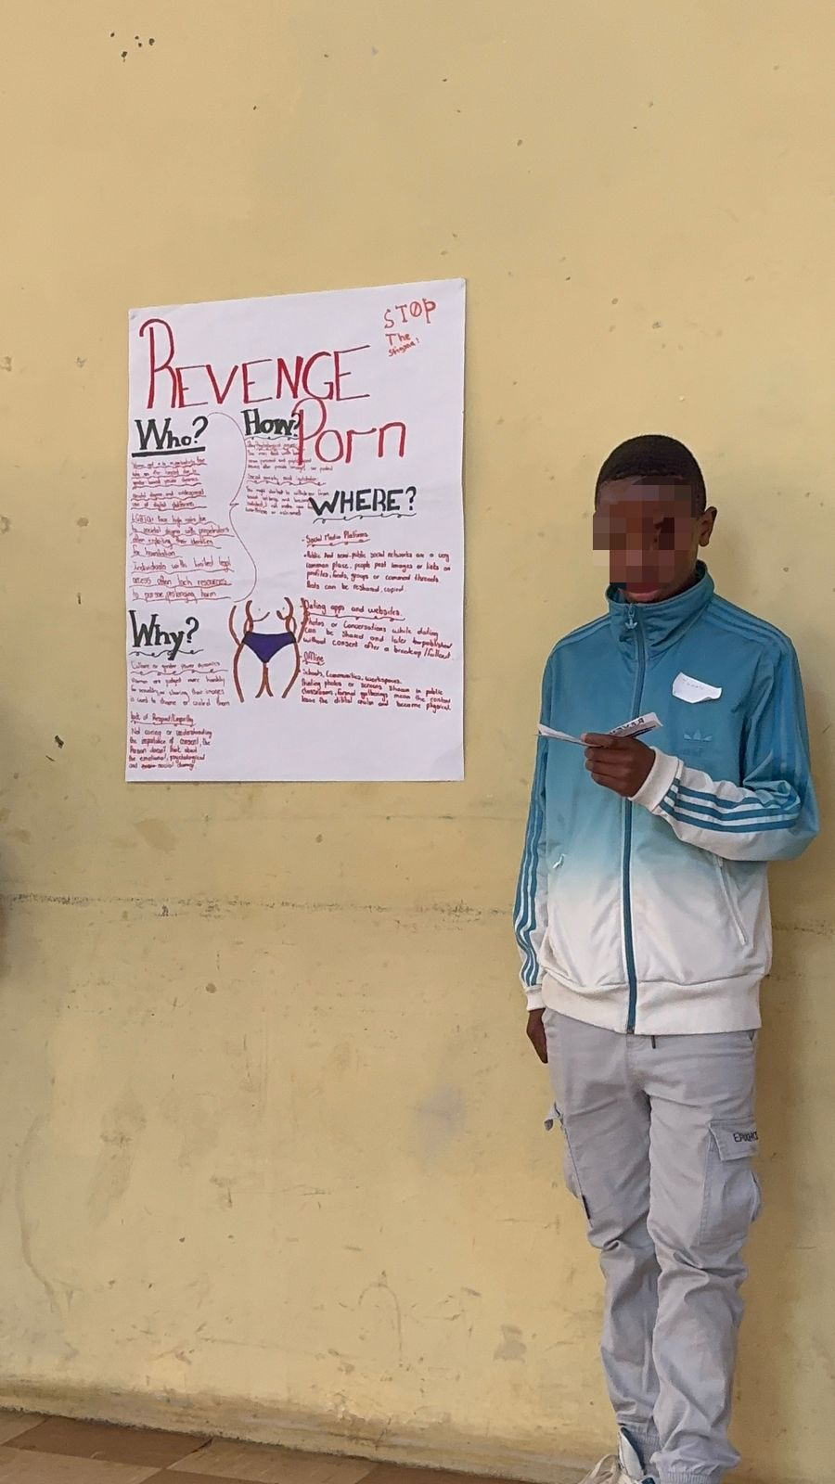
Context
TFGBV: is the use of digital platforms to amplify and enable the acts of violence, based 0n gender or sexual identity.
Online harm often reinforces offline violence. Global research tells us that about 58% of women experience some sort of TFGBV, with men/boys often being the perpetrators. TFGBV experiences are often shaped by race, sexual identity, economic status, etc. All these highly influence how violence is addressed and reported.
This project addressed the severe lack of reliable and relevant data in South Africa, major research gaps where there is inconsistent definitions, lack of regional data, the population was not well represented. Even though there is proof that TFGBV is increasing, these present gaps in the research tell us that we still don't fully understand young people or know how best to support them.
Voice and Choice Summit 2026 \ Voice and Choice Summit 2026

Slide 6
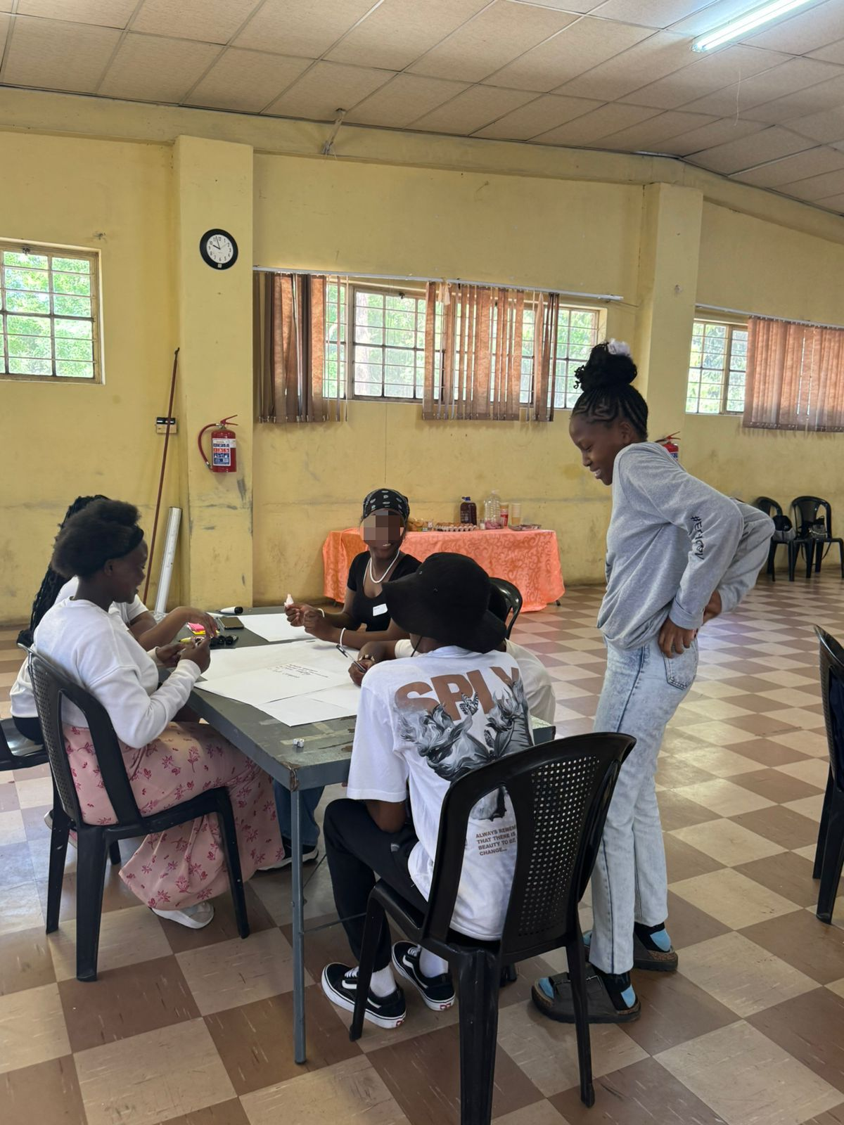
Actions
How did the change come about?
The objective was to create a supportive space for the youth to learn research skills, discuss TFGBV, and co-create recommendations.
Before the project, there were very few spaces where youth are given the platform to discuss TFGBV and how it impacts them and were not mandated to shape responses to this form of GBV.
The project was implemented by GRIT (Gender Rights in Tech), an organisation working at the intersection of violence, gender justice, and technology to promote survivor-centred and youth-informed interventions for post-violence care for those who are often excluded from tech development.
Voice and Choice Summit 2026 \ Voice and Choice Summit 2026

Slide 7
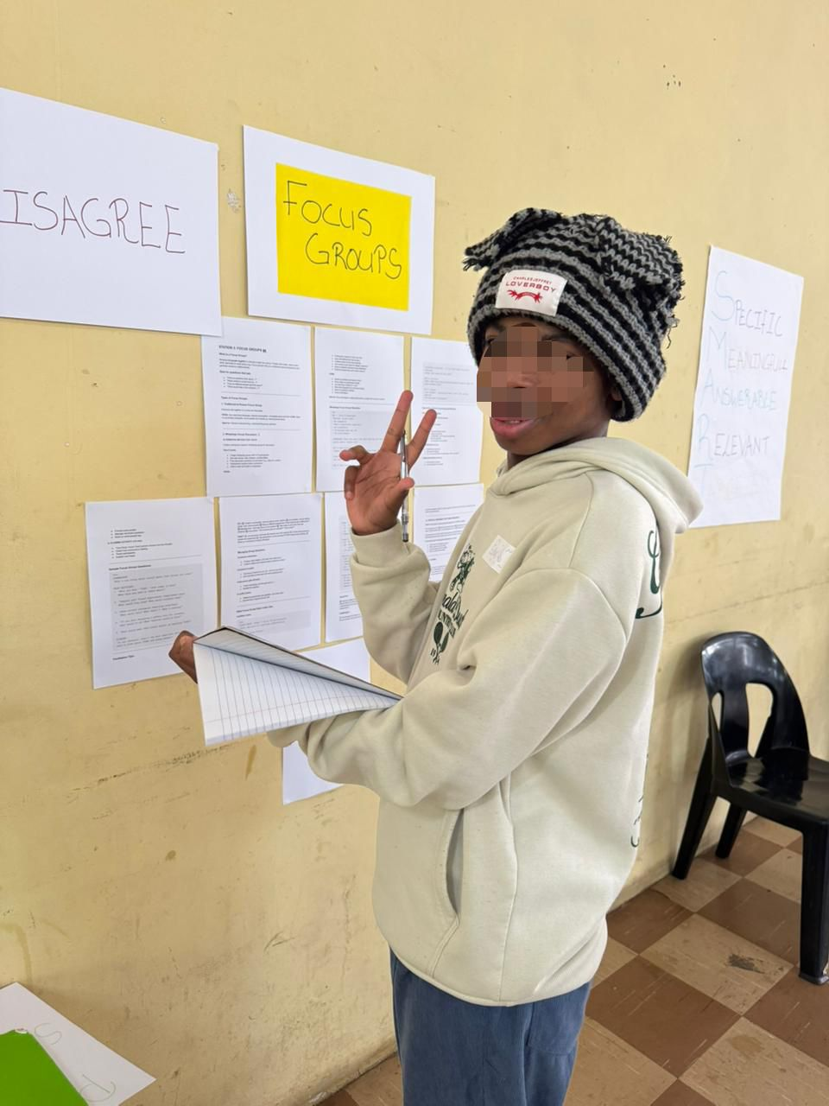
The change – impact
The project demonstrated measurable shifts in awareness, confidence, and leadership capacity among participants in relation to TFGBV.
Participants showed a significant increase in their ability to identify, articulate, and respond to TFGBV. The young people moved from limited awareness to active engagement with the issue.
By building participants' research capacity, the project expanded the existing evidence base on TFGBV while simultaneously establishing young people as legitimate knowledge producers on the issue.
Post-project, participants are meaningfully involved in shaping responses to TFGBV, representing a shift from exclusion to active participation in advocacy and decision-making processes
Voice and Choice Summit 2026 \ Voice and Choice Summit 2026

Slide 8
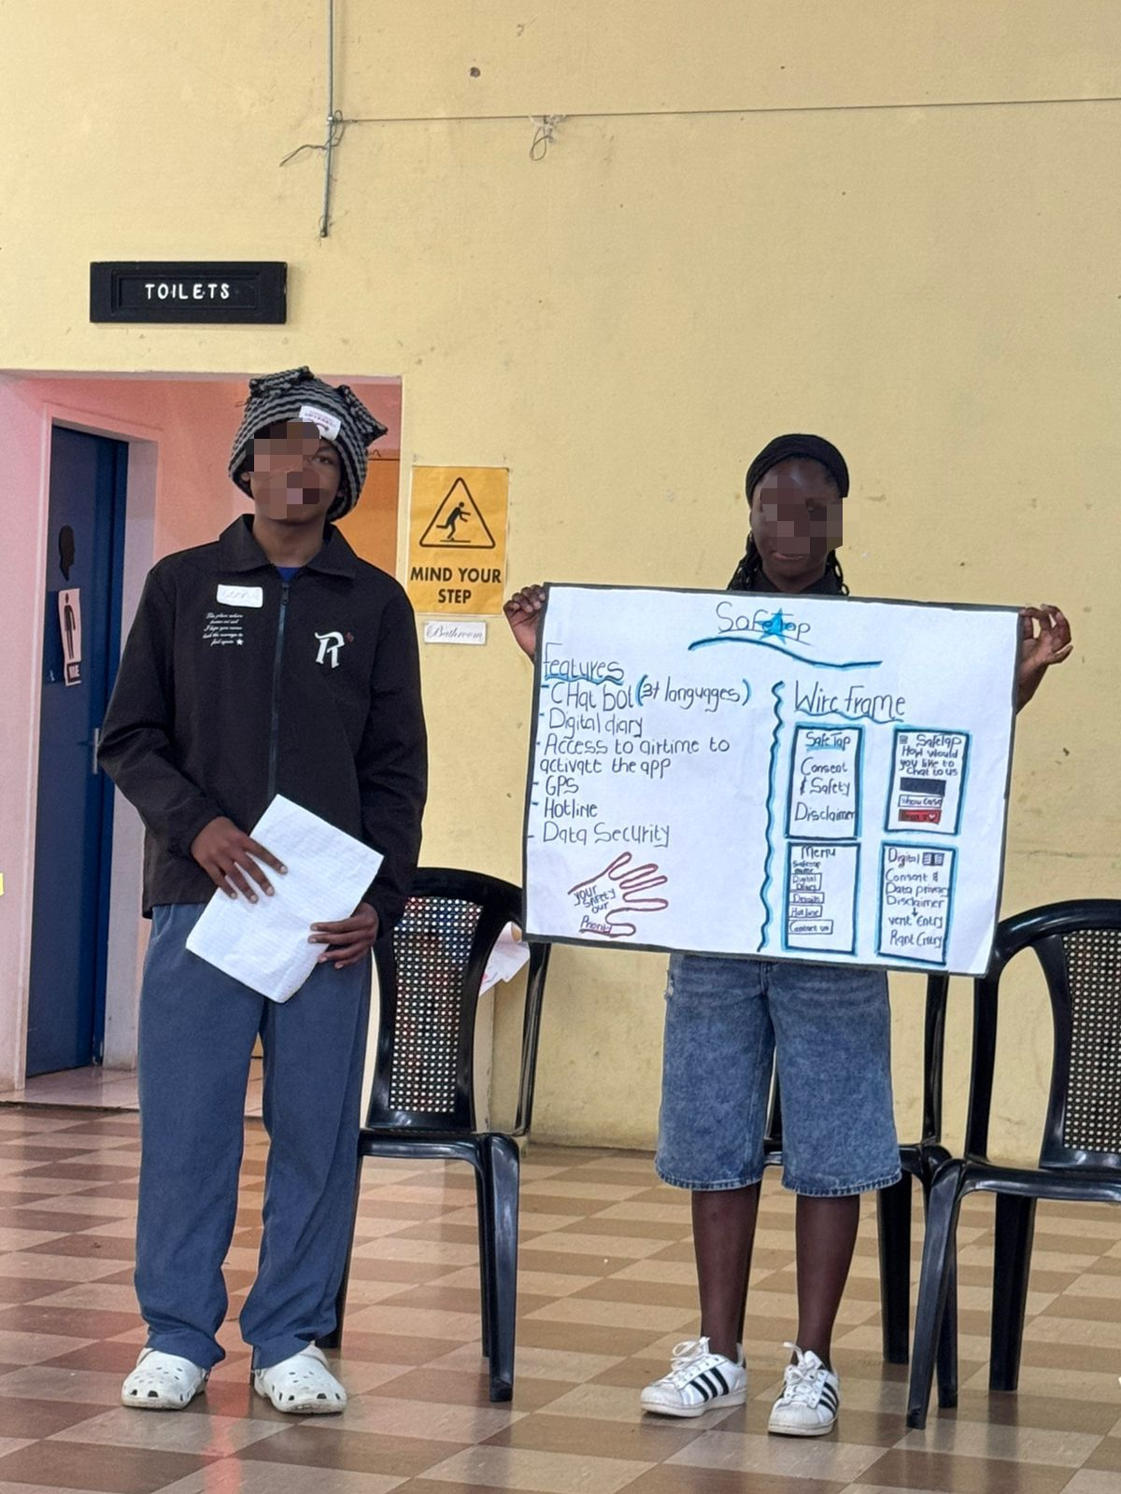
Significance of the Change
• This initiative strengthens the gender justice ecosystem by demonstrating the value of youth leadership in addressing forms of violence and harm that young people encounter in their daily lives, and where adult-led interventions may have limited insight
The insights generated will inform the design of future technology-based interventions aimed at improving safety and accountability in South Africa’s digital environments.
• The work also contributes to the expansion of youth-led research and the strengthening of the Zuzi AI chatbot by integrating youth-generated data and perspectives. These insights will inform future youth-focused programmes and summits.
• More broadly, the initiative lays the groundwork for scaling a participatory model in which young people are not only protected from digital harms but are meaningfully empowered to shape safer digital spaces.
Voice and Choice Summit 2026 \ Voice and Choice Summit 2026

Slide 9
Beneficiaries
 | Number of participants
Female – Direct beneficiaries | 13
Male – Direct beneficiaries | 12
Female – Indirect beneficiaries (e.g. through other networks) | +- 9000
Male – Indirect beneficiaries (e.g. through other networks) | +- 4500
Female – Online beneficiaries (e.g. website access, mailing lists, scholarly articles)
Male – Online beneficiaries (e.g. website access, mailing lists, scholarly articles)
Total | +/- 13525
Voice and Choice Summit 2026 \ Voice and Choice Summit 2026

Slide 10
Challenges & Lessons learnt
Challenges & mitigation:
Ensuring safety and emotional wellbeing for youth while talking about difficult topics like violence, sex, dating, gender, and TFGBV.
Throughout the project we used a trauma informed and survivor centered approach which aided in creating a safe space where everyone feel comfortable enough to share.
Through the discussions we had with the participants they were able to understand and identify their experiences
What lessons have you learnt?
A key lesson that we learnt was that when the youth is given trust and a safe space to lead they will engage deeply and contribute meaningful insights despite the complexity of the issues
Voice and Choice Summit 2026 \ Voice and Choice Summit 2026

Slide 11
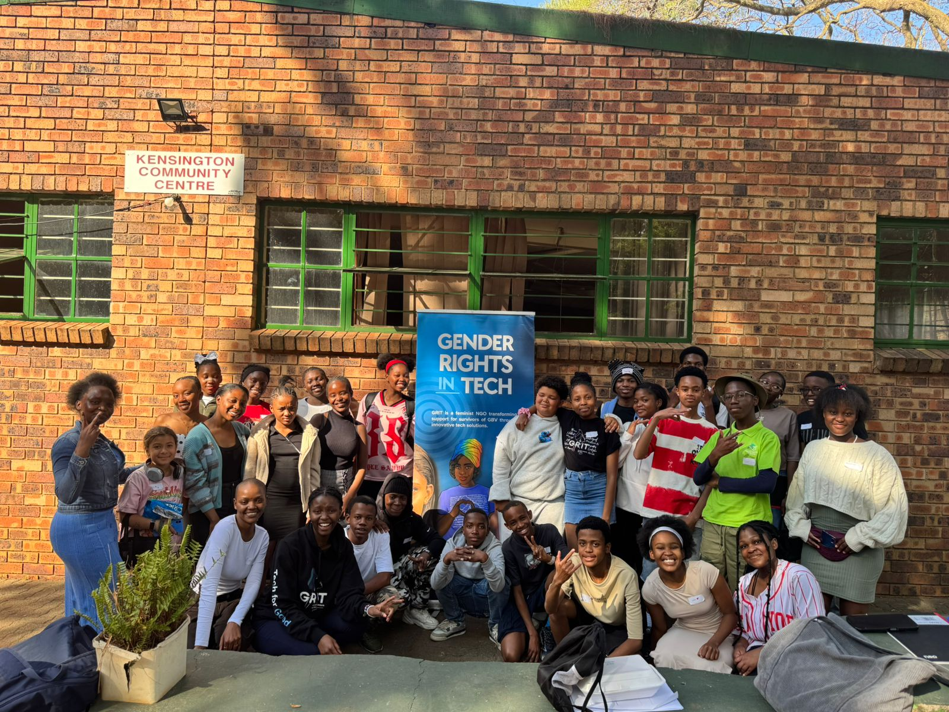
Sustainability
• Youth capacity building: The project prioritised equipping young participants with research and digital literacy skills that extend beyond the programme period, enabling continued engagement with issues of online safety and digital rights in their communities.
• Knowledge dissemination: Youth-led research emerging from the project is already being shared in both local and international spaces, including platforms such as Women Deliver Conference, ensuring that young people’s insights inform broader conversations on gender justice and digital safety.
• Integration into digital tools: Findings from the youth researchers have been incorporated into the Zuzi AI chatbot, strengthening the platform with contextually grounded insights and ensuring that the learning continues to inform digital support systems.
• Foundation for scale: The project has established a replicable youth-led research model that can be adapted and implemented in other communities.
Voice and Choice Summit 2026 \ Voice and Choice Summit 2026

Slide 12
Next Steps
What are your plans?
• Next phase – from research to action: The upcoming phase will expand the project to co-design and test interventions that directly improve safety in online spaces, with youth researchers playing an active role in shaping digital tools, resources, and programmes.
• Long-term vision: This approach supports a sustainable model where young people are not only protected from digital harms but empowered as leaders in designing safer digital environments.
• Ongoing youth engagement: GRIT will continue to engage the cohort through youth summits and follow-up spaces that enable participants to share experiences, deepen their understanding of Technology-Facilitated Gender-Based Violence (TFGBV), and remain connected to the programme.
• Strengthening digital tools: Insights generated by the youth researchers will inform the continued development of the Zuzi AI dataset, ensuring that the tool remains contextually relevant and responsive to the evolving realities young people face online.
• Expanding youth participation: GRIT will extend this approach to engage young people from additional communities, broadening the diversity of youth voices that inform our research, digital tools, and programme design.
Voice and Choice Summit 2026 \ Voice and Choice Summit 2026

