Slide 1



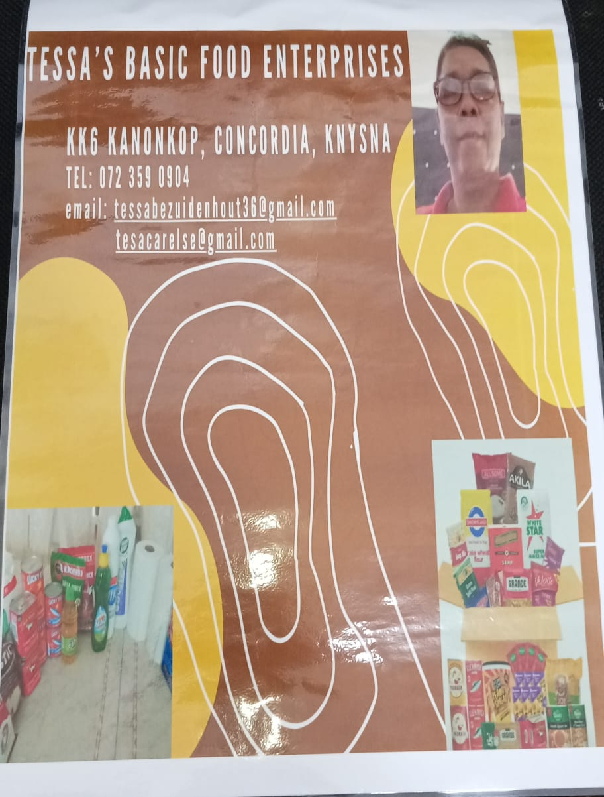
PROMOTING GENDER-INCLUSIVEE LOCAL ECONOMIC DEVELOPMENT IN SOUTH AFRICA
ESTABLISHED ENTREPRENEURS
NAME OF THE BUSINESS:Tessa's Basic Food Enterprises
PARTICIPANT NAME:Fagmeeda Bezuidenhout
COUNCIL: Knysna Municipality

Slide 2
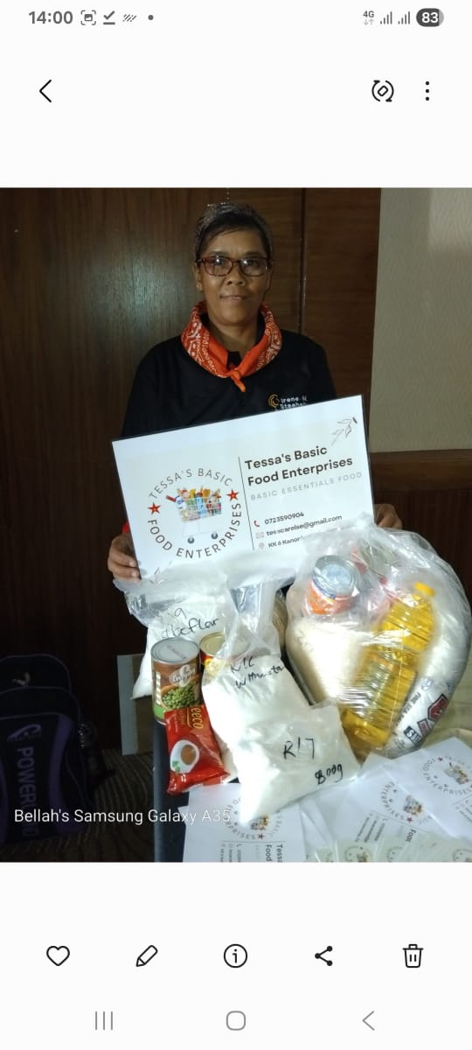
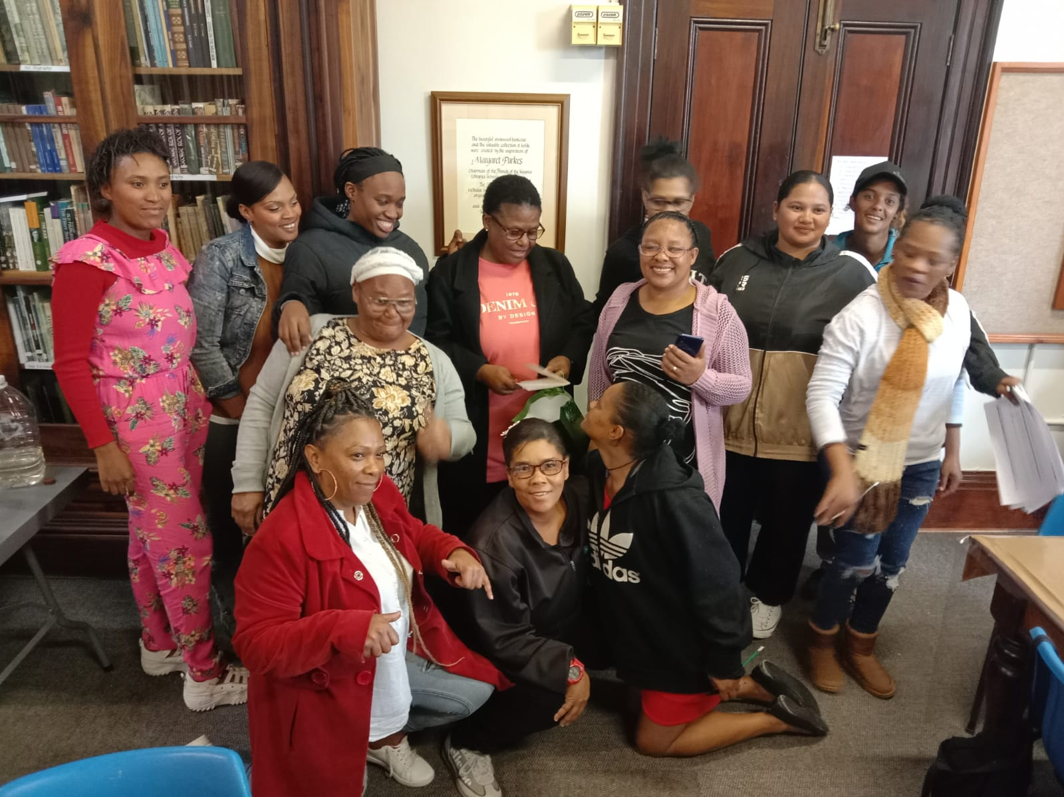
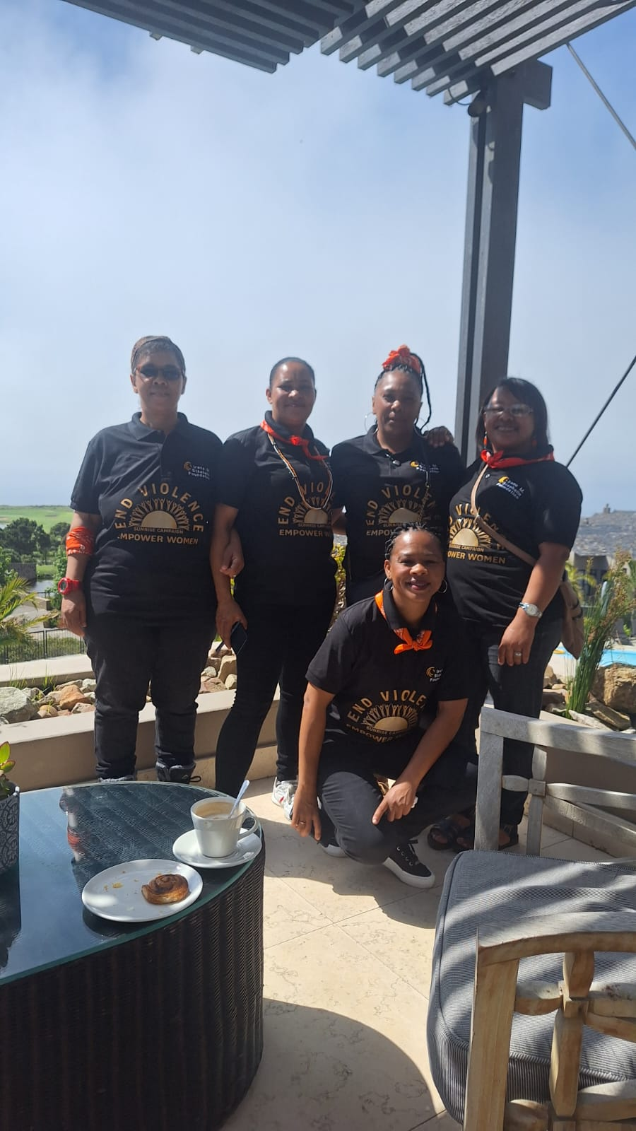
Training and Skills Gained
Memorable moment during groupwork, life skills and mentorship.
Learned about Genderbased violence
Learned how to become an entreprenuer an entered the market because I love what
I do and believe that my products will have a positive impact in my community.
Learned about myself as a person and realise I am a social entrepreneur, want to have a positive in the lives of community members.
I know now how to switch on and off a computer I can write my own emails.
I know how to delete a sentence
Any other relevant training
I have learned alot about the Constitution of S.A.
I now know that I also have rights as a woman.
I also learned about Equality that everyone’s equal before the law and has the right to equal protectionan

Slide 3
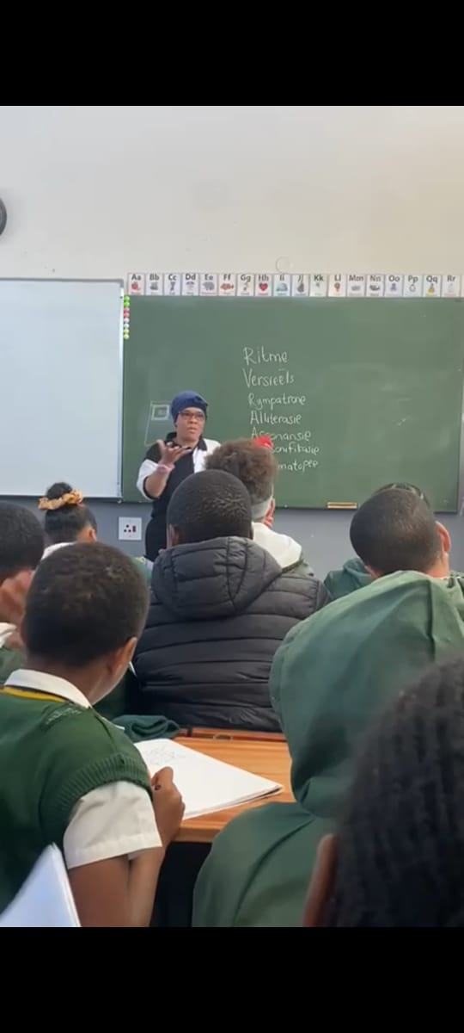
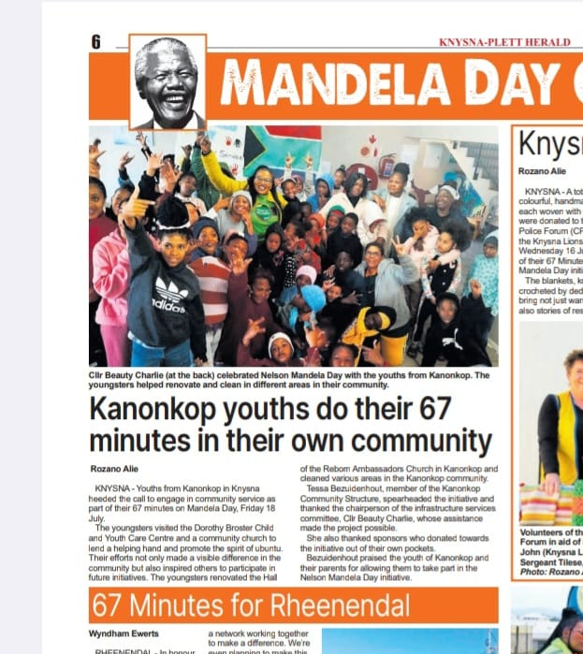
Family and Community Impact
My business has a great impact on my family.
I am now fearless is a women doing her own business.
I'm more confident about my business now
I'm now fearless
I've learned how to be more calm, relaxed and interact more with my children my family is very supportive to my business the community is respecting me now as a business woman
My business is now my family legacy.
The community is respecting me now as a business women
My communication skills improved now with people around me
I am not just a business women wanting to make a quick buck but also to look out for their best interest as my fellow community.

Slide 4
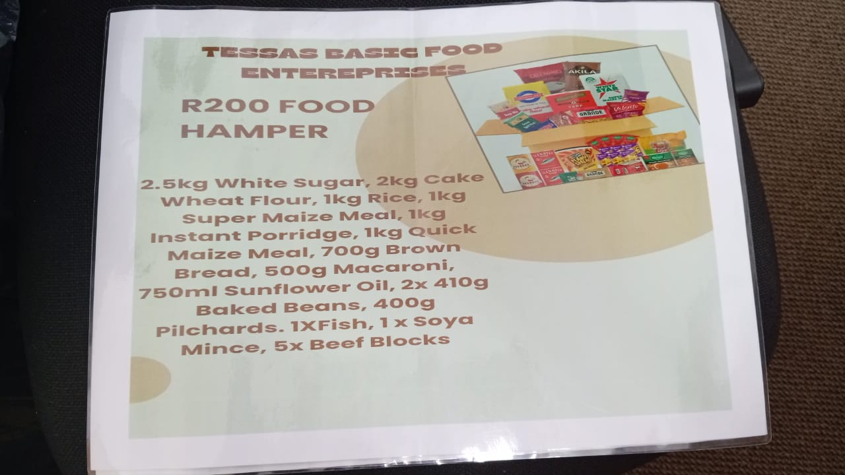
BRANDING OF THE BUSINESS
Name of business and products/services offered
Tessa's Basic Food Enterprises, the name is clear and recognizable, business colours, I have business cards and billboard infront of my house.
I promote my business on WhatsApp status and other social media
platforms.
I'm rending services for the less fortunate & elderly persons
I'm selling affordable hampers
Achievements so far Challenges still faced and how they’re managed
I've achieved alot because I'm always learning new things about my business
although there's still a few challenges like sometimes my business is very slow because people doesn't always have money to buy but I sometimes make my hampers a bit smaller for those in need.
I remain motivated to succeed and inspire other women in my community.

Slide 5
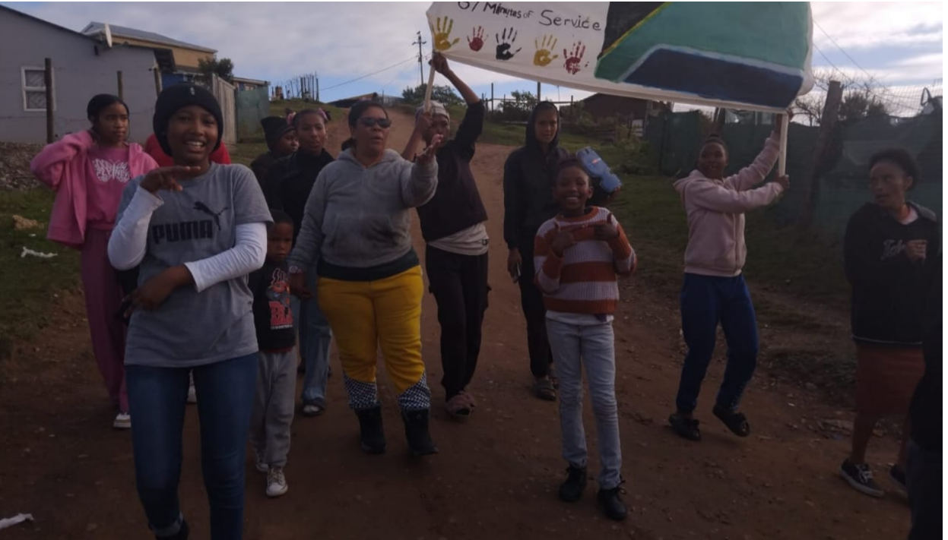
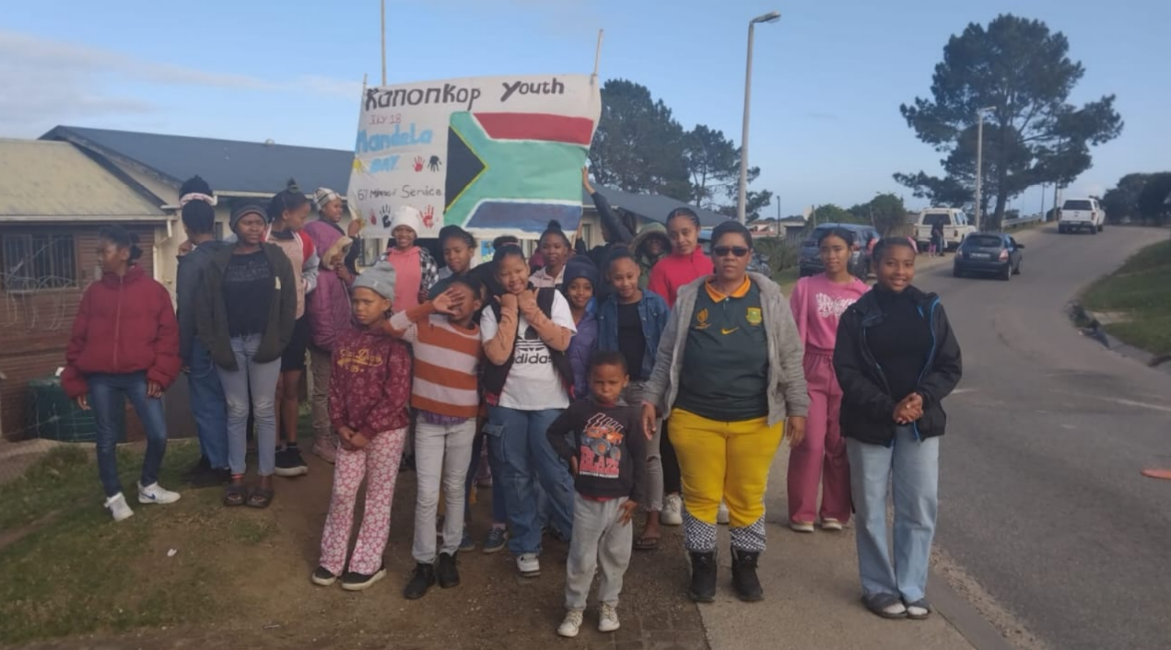
CUSTOMER BASE AND COMPETITION?
Who are your customers?
my family & my community
Have you increased the number of customers since starting the LED Programme? Yes or No
yes
How did you do this? Extended to othere areas.
on social media
telling friends & family
Who is your competition?
chinese shops, foreigns shops
How do you handle competition in your business?
I've dropped my prices just a little bit & done better packaging -adapts prices according to customer budget.

Slide 6
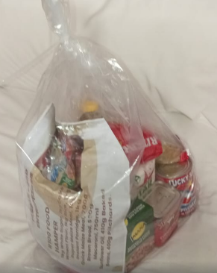
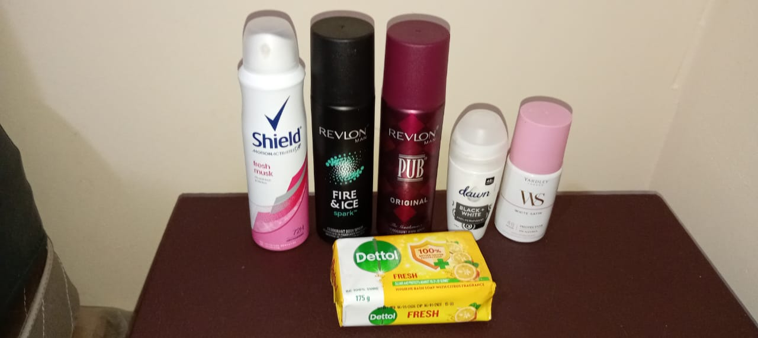
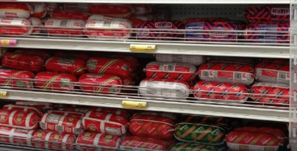
NEW PRODUCTS OR SERVICES?
Do you have any new business products or services?
yes
What new products are in the business?
added toiletries
How are they performing compared to your initial products?
postive performance for my customers due to affordable pricing
How do you advertise/market your products?
WOM, social media, family and friends, billboard in front of my home

Slide 7
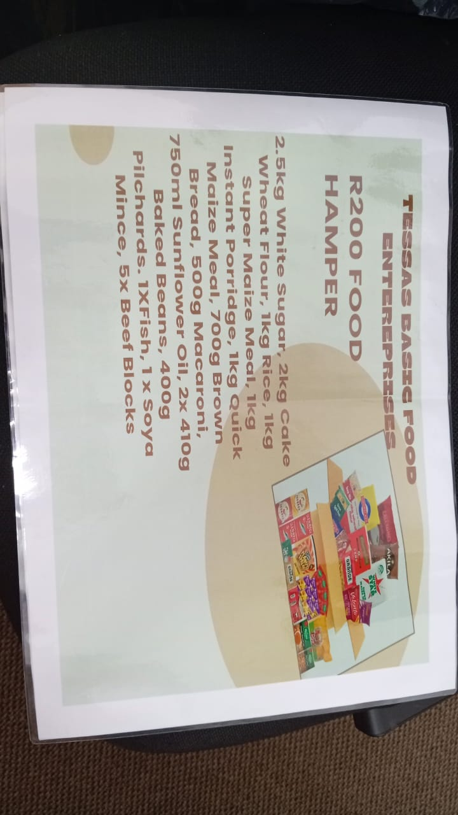
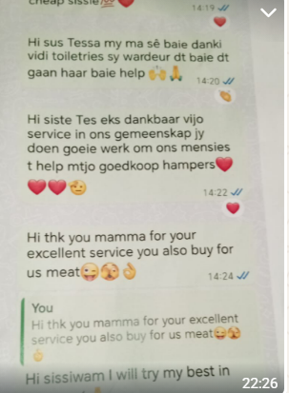
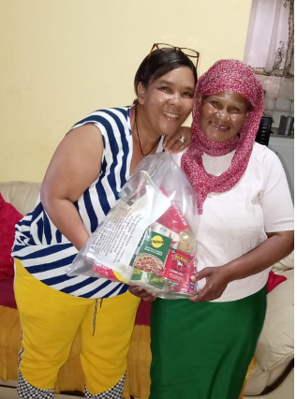
QUALITY AND PACKAGING
Are your customers happy with the quality of your products or services?
yes
If you have answered yes please give more information.
I've bought better packaging and include a picture of the content of the products inside the hamper.
Do you have any branding available for your products? Explain
yes I have a billboard with my business name on it
Have you changed the packaging or marketing of your business to attract more customers? Please explain.
yes I've put better pricing on my foodhampers
Comments & products

Slide 8
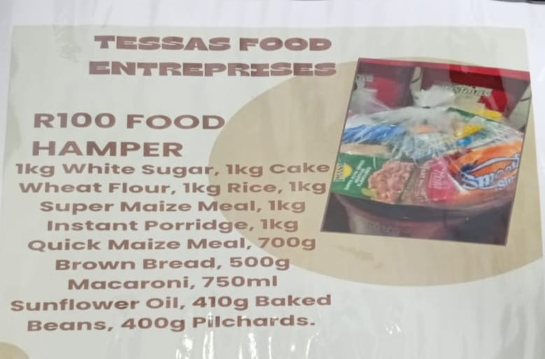
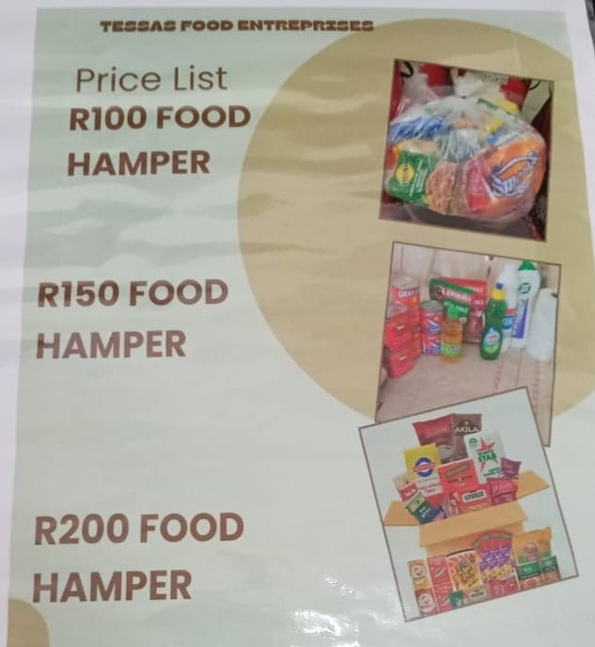
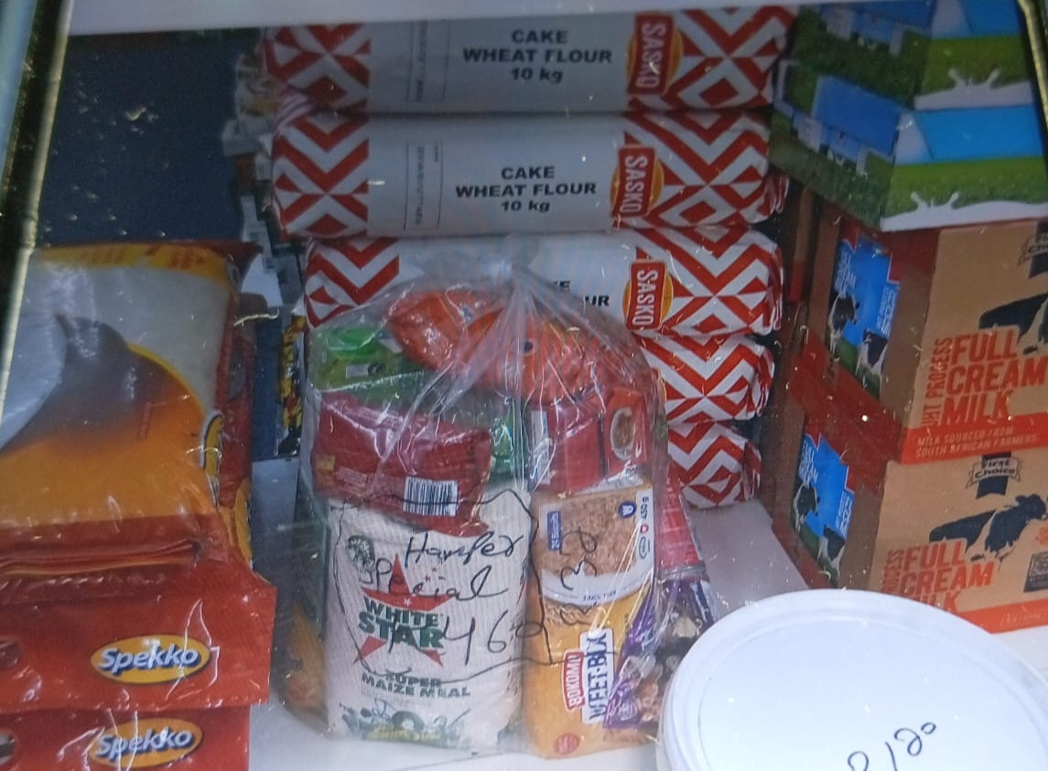
BUSINESS MANAGEMENT
I do weekly stock management in order to check regulary.
I try to stock every 2nd week, due to customer demand to avoid shinkage and ensure proper storage for my products.
the stock I've sold fur the day I record in my stock control book
Custormers can view the content of the food hamper and the pricing at an afordable price, this ensure I earn surplus.
storage space

Slide 9
FINANCIAL MANAGEMENT AND STORAGE
Do you have a record-keeping system in place? Explain
yes . My future plans is to keep better records of my sales and expenses and save part of my profits to buy more stock.
it's helping me alot because then I know what product is selling more faster, due to keeping the detailed records off my sales and expenditure.
Evidence

Slide 10
SAVINGS AND SELF SUFFICIENCY
I now manage my business money well, save for emergencies, and plan how to invest profits.
I avoid debt and making financial decisions wisely.
One of my challenge was not having enough money to buy stock,and sometimes customers are not consistent. I also had to learn how to keep records and manage my time between family and business.
Have increase household income, I can now assisst with paying houshold bills, reduce financial stress at home and my family’s standard of living has improved since I started the business.

Slide 11
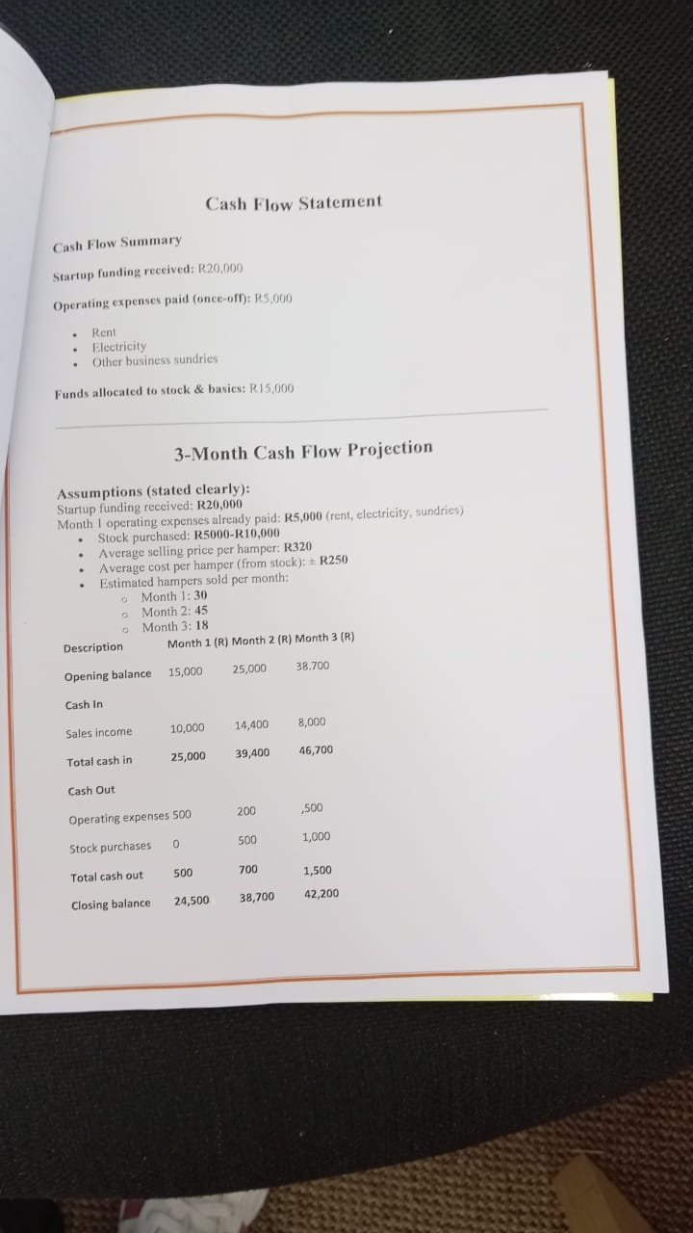
BUSINESS PLAN
I manage to create a business plan that will enable me to reach more customers by promoting my products on WhatsApp and offering small discounts to attract new buyers.
I can now apply for more funding due to have a business plan.

Slide 12
CHALLENGES
I've noticed that my quality of my product wasn't too good, upgrated to better quality branding.
Due to economical inflation-costing of goods is high.
Due to unemployment, poverty in my area, it is hampering also my business
Not having enough money to buy stock-inconsistency of customers hampering the cash flow, waiting for repay.
Needed to learn how to manage my time between family and business.

Slide 13
SUSTAINABILITY
to always comunicate with my customers how to improve the quality of my products.
My business is a viable small business with strong community impact, with proper management and support, the business has the potensial to grow sustianable while making a meaningfull difference in the lives of vulnerable community members.
Proper budgeting and to save, will ensure money for future stock and to reinvest profits.

