Slide 1



PROMOTING GENDER-INCLUSIVEE LOCAL
ECONOMIC DEVELOPMENT IN SOUTH AFRICA START UP ENTREPRENEURS
NAME OF THE BUSINESS PARTICIPANT NAME:ENNY KHOMBOMONE MTHEMBI
COUNCIL: MARULENG
Please include photographs of the business!

Slide 2
MY EXPERIENCE DURING SUNRISE CAMPAIGN
During the sunrise campaign,
to stand up for yourself.
to treat my children the same or equal.
to use a computer and it was something I have known before.
In Entrepreneurship workshops
time management
Financial management
Marketing strategies
Mentorship played sgnificant role,
offering guidance on product development and business operations.
Group work and support from peers and mentors helped my business to overcome challenges and refine my business

Slide 3
HOW MY LIFE HAS CHANGED
Starting my business has boosted my:
confidence and independence,
allowing me to take control of my life and finances.
increase in income
improved my financial stability and security,
Family Impact:
positively impacted my family relationships and dynamics
gained respect in my community and expanded my social network.
opening up new opportunities.
Overall , my business has brought about lifestyle improvements ,including flexibility and autonomy.

Slide 4

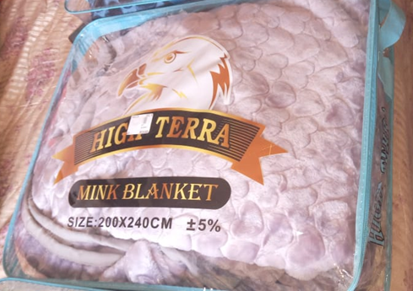
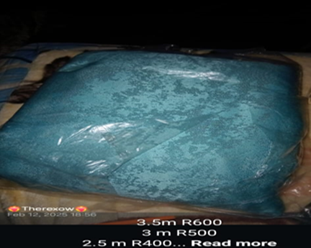
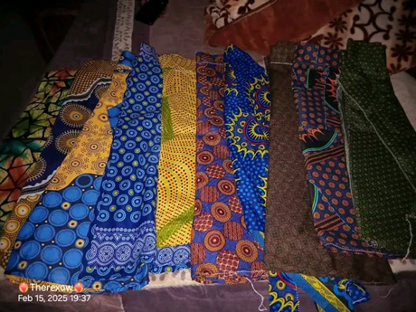
PLEASE DESCRIBE THE BUSINESS
Business overview:Enny’s Business is an online and door-door sales of blanket, curtains and skirts.No physical storefront.
Services:Online sales through social media and door-to-door sales without transportation.
Achievements:Built loyalty with customers both online and on-site.
Challenges:Logistics and delivery due to no transport.

Slide 5
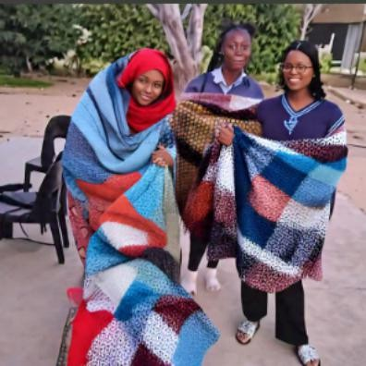
CUSTOMER BASE AND COMPETION?
Customer Base:Individuals
and familes seeking cozy blankets and comforters.
Growth:Yes, customer base
has increased through social media marketing (WhatsApp and Facebook).
Competitors: Local home
goods stores and online markertplaces.
Competitive strategy:Focus
on unique products and excellent customer service.
Competitive
Advantage:Personalized
service and building strong customer relationships.

Slide 6
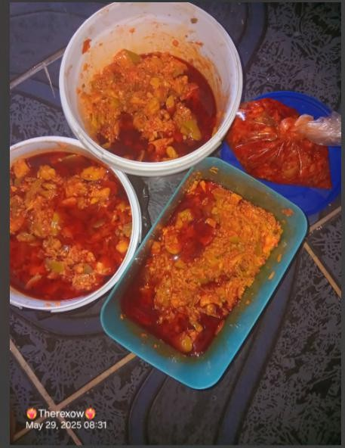
NEW PRODUCTS OR SERVICES?
Enny’s business has
expanded to include
beansatchar,skirts and clothing.
The beans,atchar and skirts
are selling well as unique traditional food.
The blankets remain top
selling product,but the new items are gaining popularity.
Enny’s business promotes
new product on social
media,highlighting their versality and practical use.

Slide 7
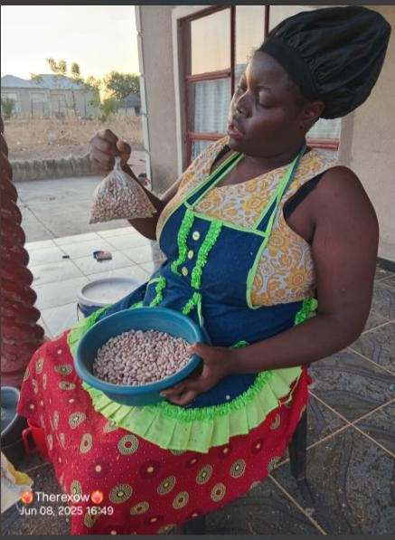
QUALITY AND PACKAGING
As a new business with limited resources, I’m aware that my customers aren’t satisfied with the packaging of my products which is an area to improve upon. Currently, I don’t have branding or distinctive packaging, but I intend to develop these aspects in the future to enhance my products appeal and build customer loyalty, but for now, I’m planning to revamp the packaging and marketing.

Slide 8
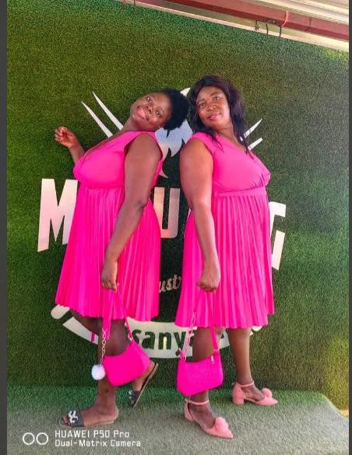
BUSINESS MANAGEMENT
As a starup,I haven’t hired additional stuff yet, but I’m currently working with my daughter. I’m planning to expand the team as the business grows.I regularly check inventory levels and monitor sales trends to optimize stocking and pricing, aiming to minimize surplus and maximize products.

Slide 9
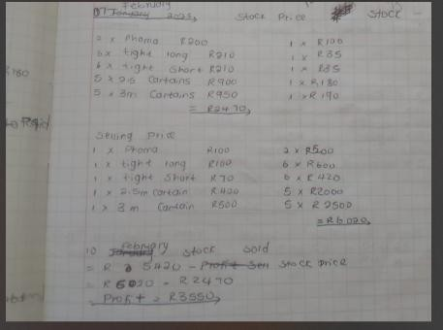
FINANCIAL MANAGEMENT
managing my finances using a manual bookkeeping system
more organized and efficient record-keeping system.
planning to open a business account bank next month,
will help me better manage my finances,
separate personal and business expenses, and streamline my financial transactions.

Slide 10
SAVINGS AND SELF SUFFICIENCY
Yes I am part of one of the stokvel in my community. We are about 15 members and we contribute R200.00 each month, the goal is to share the money amongst ourselves at the end of the year, December.
I also do save up a portin of my business income to ensure finacial stability and future growth. I’ve been able to increase household income ,which has improved my family’s financial weellbeing and security.

Slide 11
INCOME AND EXPENSES FOR THE BUSINESS FOR PAST THREE TO SIX MONTHS
INCOME
EXPENSES
ITEM | AMOUNT
BEANS | R4800
BLANKETS | R9000
CURTAINS | R6000
ATCHAR | R400
CHILD SUPPORT | R3360
TOTAL | R23 560,00
ITEM | AMOUNT
SALARY | R9000
BEANS | R9000
BLANKETS | R9000
CURTAINS | R6000
ATCHAR | R700
TOTAL | R33 700,00

Slide 12
CHALLENGES
In my business,I’ve faced challenges such as
managing production costs,
maintaining quality control, and
competing with larger companies.
To address these challenges
implemented efficient production processes,
invested in quality control measures,and
focused on buildingstrong relationships with customers to differentiate my brand,

Slide 13
SUSTAINABILITY
To sustain my business
continuously innovate and adapt to market trends and customer needs.
implementing eco-friendly practices,such as using sustainable materials and reducing waste,
prioritizing sustainability, aim to build a long-term successful business that benefits both my customers and the enviroment.

Slide 14
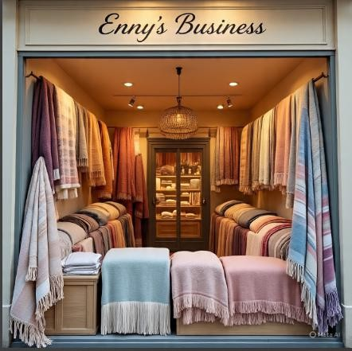
WHAT PLANS HAVE YOU MADE TO GROW YOUR BUSINESS IN THE NEXT 6 MONTHS?
In the next 6 months ,I plan to expand my product
line ,Improve quality control,and develop a branding strategy to increase customer satisfaction and loyalty.I’ll also focus on enhancing my online precence through social media by opening a business page.

Slide 15
ADDITIONAL INFORMATION?
My business has undergone significant changes,including adapting to new market trends and consumer demands.I’ve had to innovate and diversify my products,such as blankets ,skirts,artchar and sewing cloth to stay competitive,Networking and building relationships with suppliers and customers has been crucial to my business growth and success.I’ve also learned to prioritize tasks,manage my time effectively and make data-driven decisions.Through these experiences, I’ve develped resilience,creativity and a stronger entreprenual mindset.

