Slide 1



PROMOTING GENDER-INCLUSIVEE LOCAL ECONOMIC DEVELOPMENT IN SOUTH AFRICA
START- UP ENTREPRENEURS
NAME OF THE BUSINESS
PARTICIPANT NAME:ELSIE PIETERSE
COUNCIL: GEORGE MUNICIPALITY
Please include photographs of the business!

Slide 2
MY EXPERIENCE DURING SUNRISE CAMPAIGN
Key lesson from Life Skills and Entrepreneurship training
Memorable moments(e.g Mentorship, Group Work, Support etc)
Key Lessons:
Life Skills & Entrepreneurship:
depend on myself and not on others to better my life.
talk about my story to inspire other woman.
Entrepreneurship
do my budget and
plan for my business.
Group
nice support system,
listen to each others story and
have empathy for each other.

Slide 3
HOW MY LIFE HAS CHANGED
Personal growth
confidence, don’t tolerate abuse
independence,
safety
Family impact
Children: My children love each other, we are happy as family, no shouting. Communication
relationships :A say in the relationship, Don’t depend on my partner anymore.
community respect: Respected because I am now a business woman.
Income changes or lifestyle improvements
Income has changed, Life style has changed, family contributions
My own income

Slide 4
PLEASE DESCRIBE THE BUSINESS
Name of business and products/services offered
Elsie’s Meat Supply
Achievements
Have more customers
More money
Challenges
Loadsheding
No transport for delivery
Photo or video

Slide 5
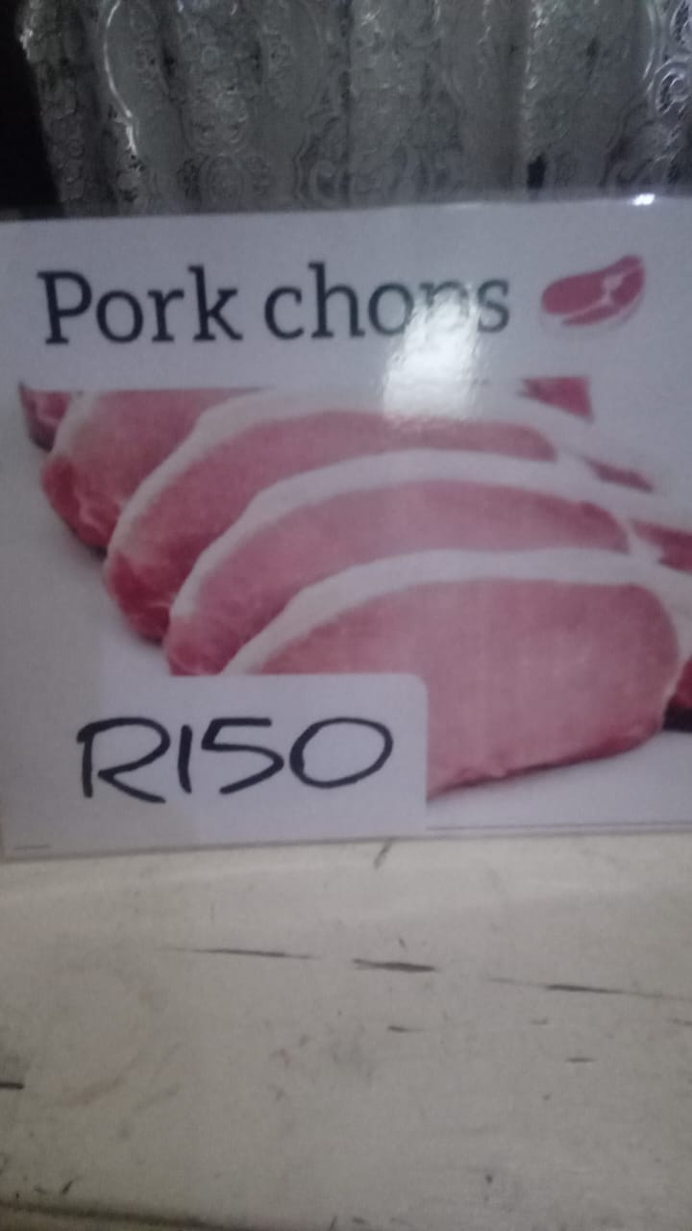
CUSTOMER BASE AND COMPETION?
Who are your customers?
Community
Have you increased the number of customers since starting the LED Programme? Yes
How did you do this?
Fresh meat
Affordable
Who is your competition?
Supermarkets
People selling same products as me.
How do you handle competition in your business?
Reasonable pricing
Fresh from butcher
Evidence

Slide 6
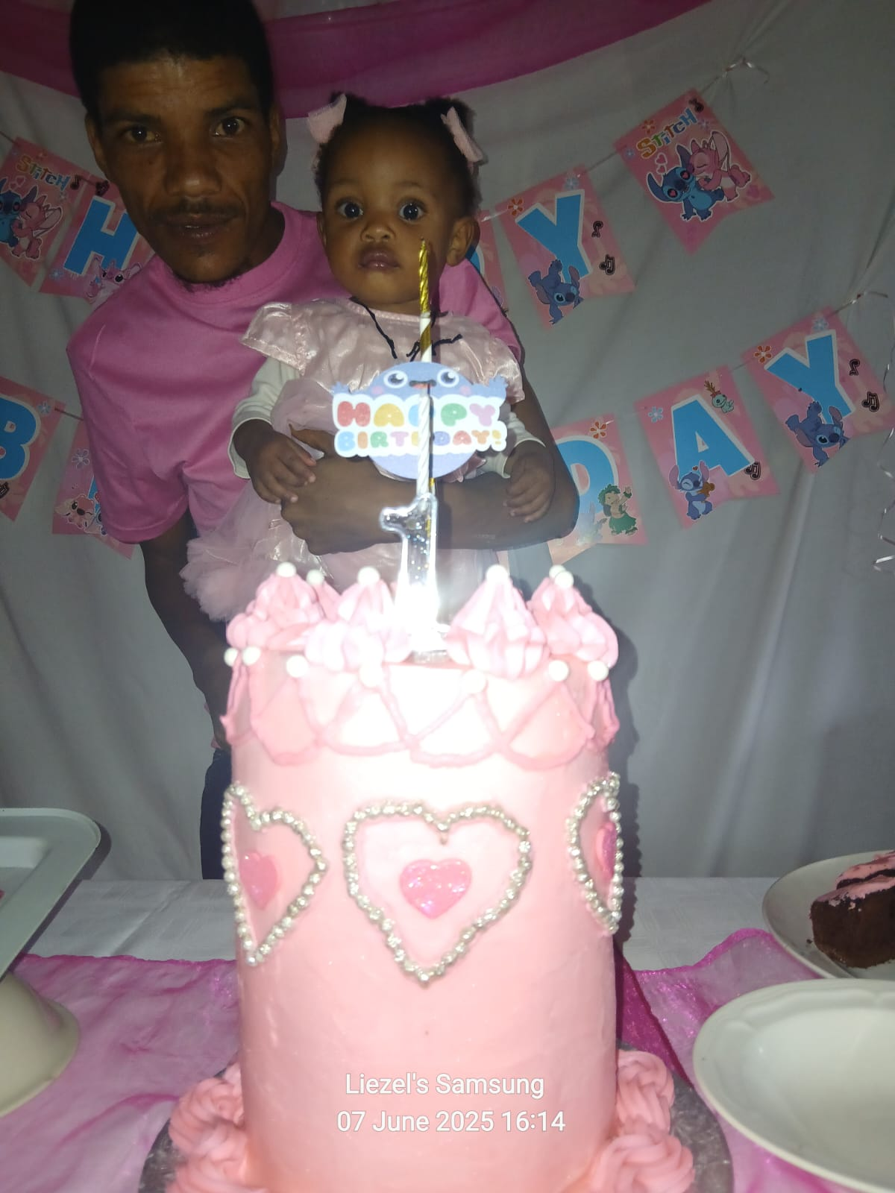
NEW PRODUCTS OR SERVICES?
Do you have any new business products or services? Yes
What new products are in the business? Birthday Cakes
How are they performing compared to your initial products? Selling very well
How do you advertise/market your products?
Posters,
Whatsup,
Word of mouth,

Slide 7
QUALITY AND PACKAGING
Are your customers happy with the quality of your products or services? Yes they are very happy
If you have answered yes please give more information.
People come because of referrals
Do you have any branding available for your products? Explain
No branding yet,
planning for it soon.
Have you changed the packaging or marketing of your business to attract more customers? Please explain.
Don’t require big packaging
More advertising for more customers

Slide 8
BUSINESS MANAGEMENT
Have you hired more staff? How many full-time and how many part-time?
No I have not hired any staff.
How do you manage your stock and check regularly? Please explain.
Weekly stock taking
Have you been able to price your products better so that you can earn a surplus from the business? Please explain.
Yes I have.
buy my meat in bulk for better price,

Slide 9
FINANCIAL MANAGEMENT
Do you have a record-keeping system in place? Explain
Yes
If yes, how is it helping you to manage your business?
It has helped me to see what my Income and expenses is on a weekly& monthly basis.
Do you have a bank account for your business?
Yes I have a bank account for my business.
Evidence

Slide 10
SAVINGS AND SELF SUFFICIENCY
Are you a member of a savings group?
No, I am not a member of a saving group.
Are you saving money? How much have you been able to save so far?
Yes, I’m saving R100 per week. I have saved R1200 so far.
Have you managed to increase household income?
Yes I have increased my household income by 30% more then I’ve had before.
Evidence

Slide 11
INCOME AND EXPENSES FOR THE BUSINESS FOR PAST THREE TO SIX MONTHS
INCOME
EXPENSES
ITEM | AMOUNT
From Sales | 12000
TOTAL | 12000
ITEM | AMOUNT
Stock | 6900
Transport | 360
Electricity | 600
TOTAL | 7860

Slide 12
CHALLENGES
What challenges have you experienced in your business?
Credit and some don’t pay
Struggle to get payment.
How have you addressed these?
I fight for my money
Decide not to give credit for difficult customer.

Slide 13
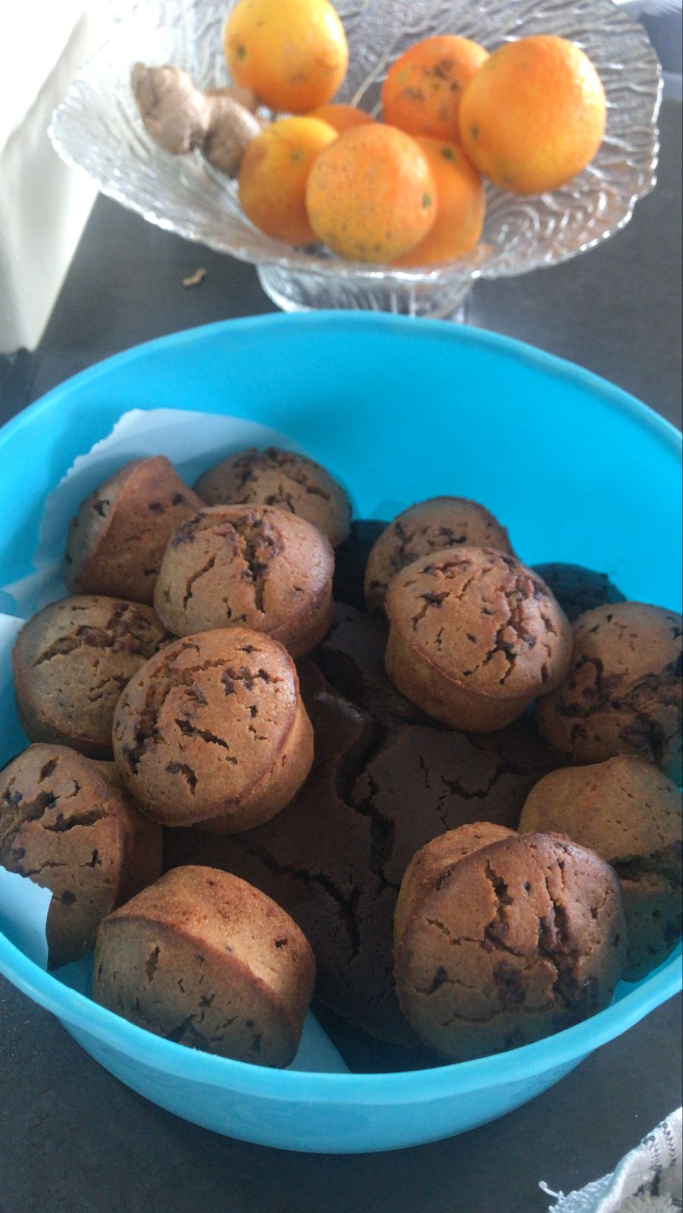
SUSTAINABILITY
How will you sustain your business?
Add more different meat
Add more products like scones
What other sustainability measures are you putting in place for your business?
Bigger space to open spaza shop

Slide 14
WHAT PLANS HAVE YOU MADE TO GROW YOUR BUSINESS IN THE NEXT 6 MONTHS?
To open spaza
Add other types of meat
Add other cakes
Evidence

Slide 15
ADDITIONAL INFORMATION?
What other changes have you experienced in your business? Explain
That business is not always stable
That credit is not a good idea
That I need to buy a bigger fridge as the business is growing
Do you have any additional information to share?
Appreciate the following: George Municipality
Gender Links
Funders
Fellow women

