Slide 1







LEARNING AND SHARING SUMMIT 2025
Driver of Change South Africa, JHB
Presented by: Lebogang Francis Sindan

Slide 2

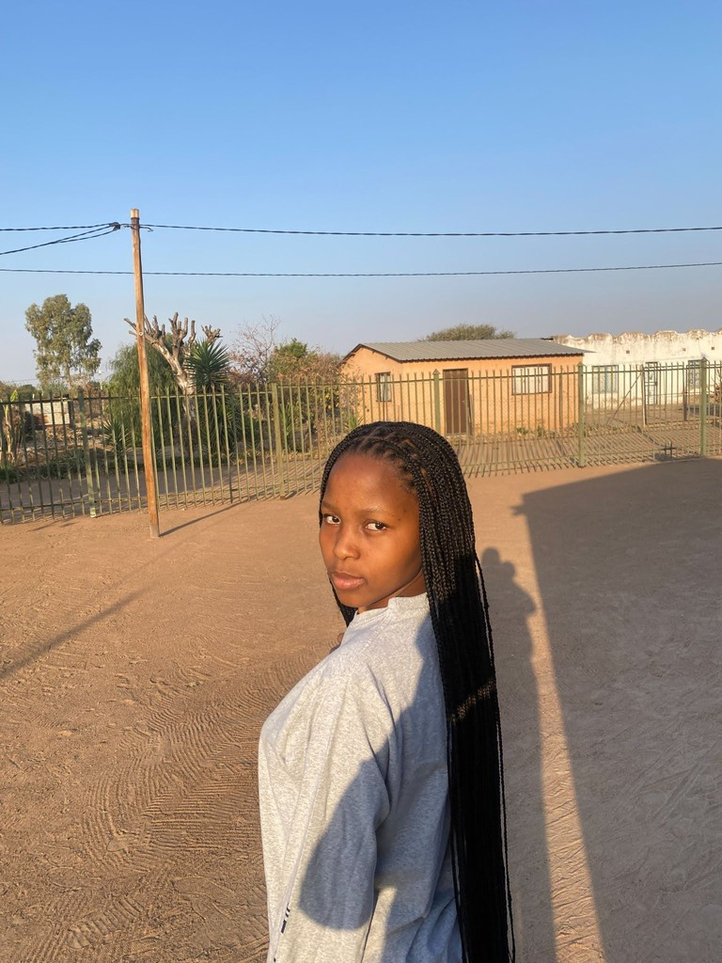
Gender Rights in Tech (GRIT): A brief background
I am Lebogang Francis Sindani
I am from Ga-motle, a hidden village in North West.
I am a Support Officer and Tech Liaison at GRIT
What makes me unique?
As young as I am I have been in rooms with people I never thought I would be with and it’s so fascinating when people usually ask about my age which comes across as unique.

Slide 3
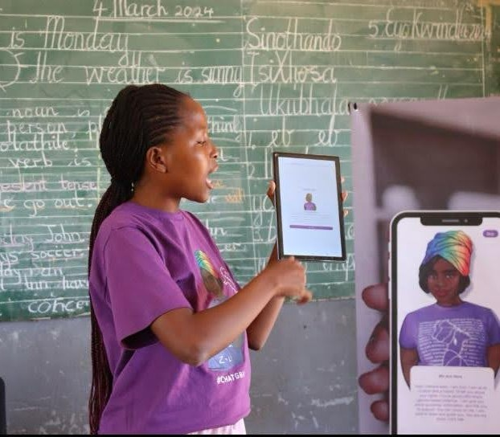
What Drives me:
Vision
I want to live in a world where gender doesn’t limit anyone’s potential.
I believe in a future where everyone has equal opportunities to succeed, regardless of gender.
Passionate about making a difference and breaking down barriers. Focus on creating opportunities for women and marginalized genders, especially in fields like technology.
Objectives
My goal: Use my private investigation skills to combat gender-based violence. Ensure fairness for everyone, regardless of gender or background.
Encourage women to pursue careers in underrepresented fields like tech. Committed to creating a world where no one is limited by gender, age, or past. Support a society where everyone is free to chase their dreams.
I am Fully committed to making gender equality a reality in everything I do. Being part of a female-led organization has shown me the power of women in traditionally male-dominated roles.
Proud to be a woman in tech, a field often seen as for men.
I Want to encourage more women to pursue their passion for technology. I am Committed to pushing boundaries, supporting others, and inspiring change.
I Believe that gender should never limit what we can achieve.

Slide 4
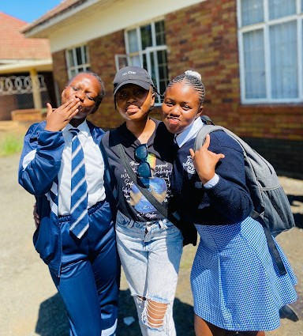
What do I do?
I’m a change-maker challenging society’s limits, especially around gender.
I take action by showing up in spaces where women are often overlooked, like tech.
I believe real change comes from leading by example.
My goal is to inspire others, especially young people, to believe in themselves.
I advocate for a more inclusive world where no one is held back by outdated norms.

Slide 5
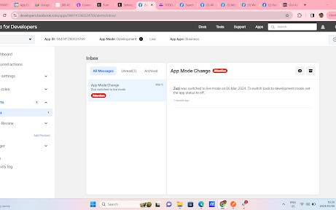
Personal achievements
During workshops, we found people are more comfortable accessing Zuzi, our chatbot, on Facebook due to free access.
Integrated website features into Facebook using APIs on Chatfuel.
I was invited to present at the Global Gathering Conference in Portugal
I am a young women in Tech
I am building wire frames for our tech to be better suited for survivors.

Slide 6
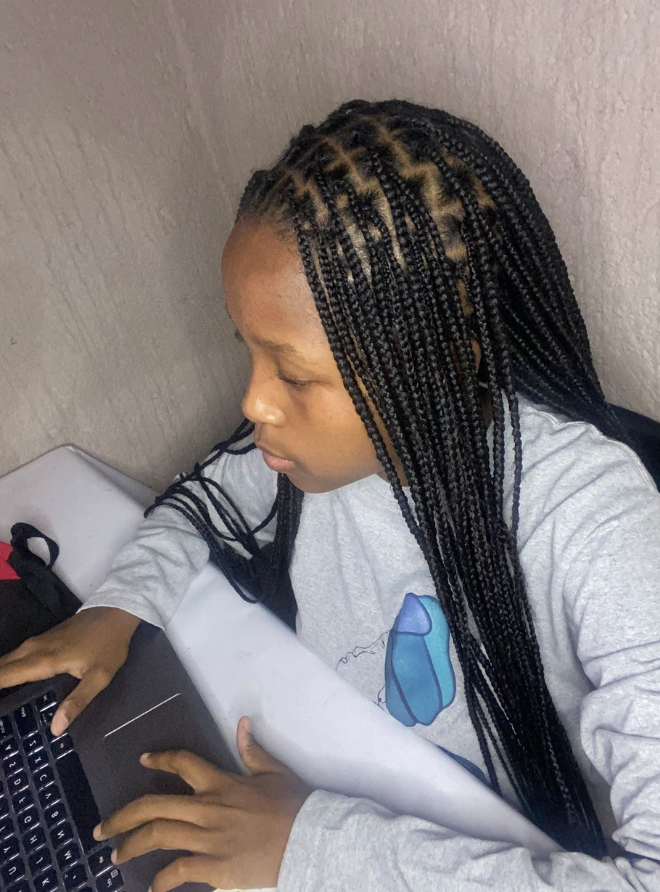

Change at the individual level
Working has given me the chance to visit different places and meet diverse people. I have learned that not everyone has the same mindset or opportunities.
I have realized that challenges vary based on a person’s background or location. This experience taught me to stop assuming everyone has the same access or perspective.
It has made me more open, understanding, and empathetic toward others’ challenges.
What skills; knowledge; values and attitudes I have gained:
One of my proudest moments: presenting to GL, a dream come true. The experience helped me refine my presentation skills.
Taught me how to connect with a diverse audience. Improved my ability to think quickly and present ideas clearly.
Who else has been responsible for this change?
he change in my life is thanks to GRIT, the organization that chose me. Without GRIT, I wouldn’t have had opportunities like presenting to GL. GRIT gave me the chance to grow and face challenges I never imagined. Their belief in me boosted my confidence and progress.
I’m grateful for the opportunities they provided and for pushing me beyond my limits.

Slide 7
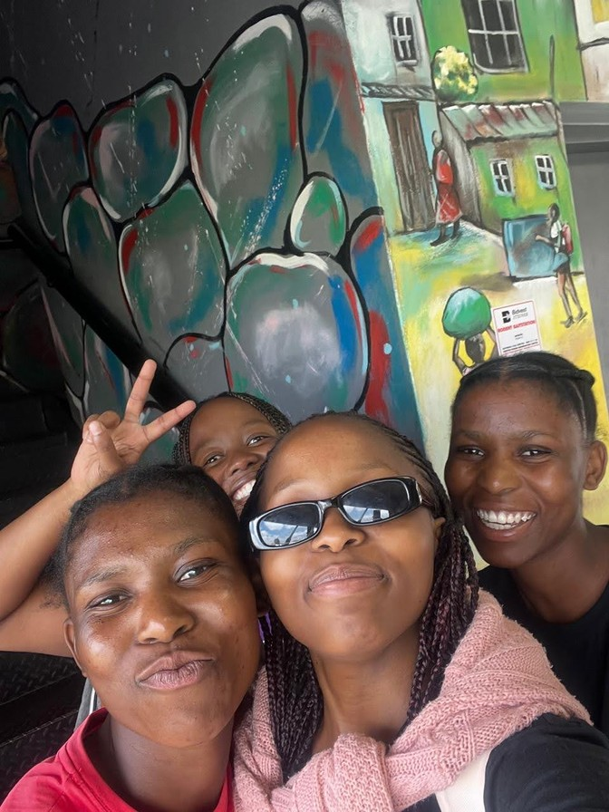
Achievements at a community level
What are your greatest achievements at community level?
Giving Back to Community
Proud to support the community that helped me grow, inspiring others to believe in themselves.
Ensuring Equal Access
Found a way to get our app onto Huawei devices, so no one feels excluded based on their phone.
Creating Opportunities for All
Striving to make sure everyone has equal access to the resources we offer.
Changes in my life have started inspiring others.
During a recent workshop with school children, many asked questions. They want to see themselves in similar spaces and achieve their dreams. It’s fulfilling to know my journey is motivating others.
People often ask how I reached where I am today.
Innovation
Innovation has helped me discover new ways to support my community. Example: Overcame the issue of our app not being available on Huawei devices. Found a solution to ensure everyone could still use it, regardless of their phone.
This experience motivated me to learn more about technology and problem-solving. It reinforced the importance of thinking creatively and finding solutions for the community.

Slide 8
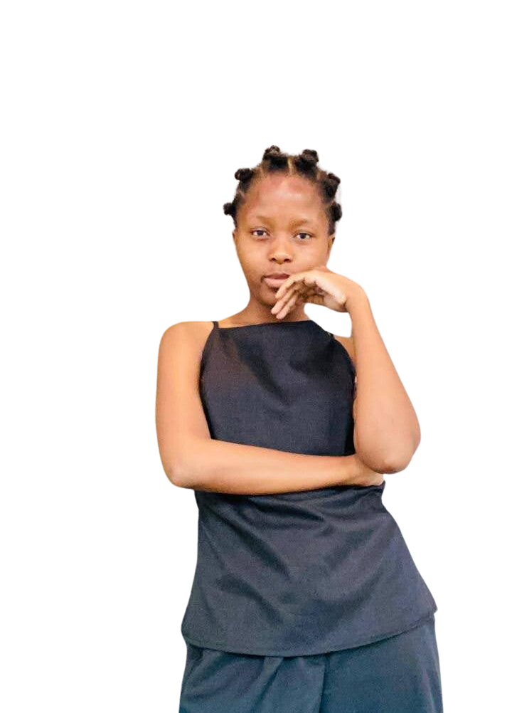
Achievements at a societal level
How have my actions actions changed laws, policies and or practices?
Self-Taught Data Scientist
Learned through Udemy and hands-on projects.
Challenging the University Myth
Success is possible with determination, not just a degree.
Proving Persistence Pays Off
Achieved my goals with the right resources and mindset
Teaching Digital Rights
Leading workshops to educate on digital rights and real-world challenges.
Turning Ideas into Action
Transformed group ideas into wireframes, making them tangible.
Empowering Through Learning
Helping others gain skills to navigate digital spaces and solve problems.

Slide 9
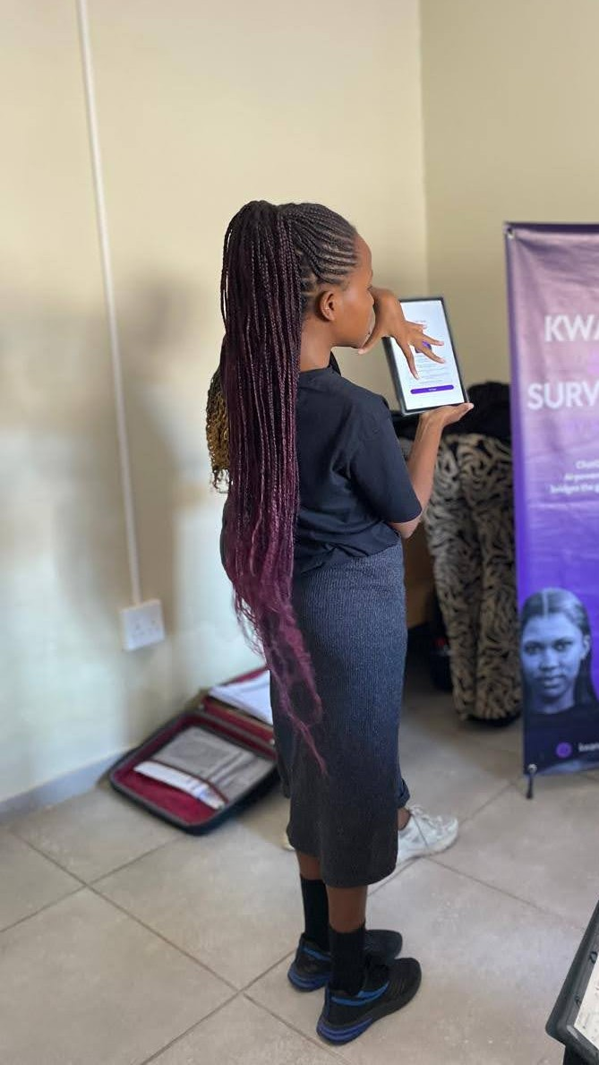
Leadership qualities
What leadership qualities enable you to make the changes you are making?
Never Giving Up
Always push forward, no matter the challenges.
Leading with Empathy
Understand others’ needs and help make things easier.
Leading by Example
Success at a young age in unexpected fields, proving determination makes anything possible.
NPC: 2021/70992808 | 286-451NPO

Slide 10
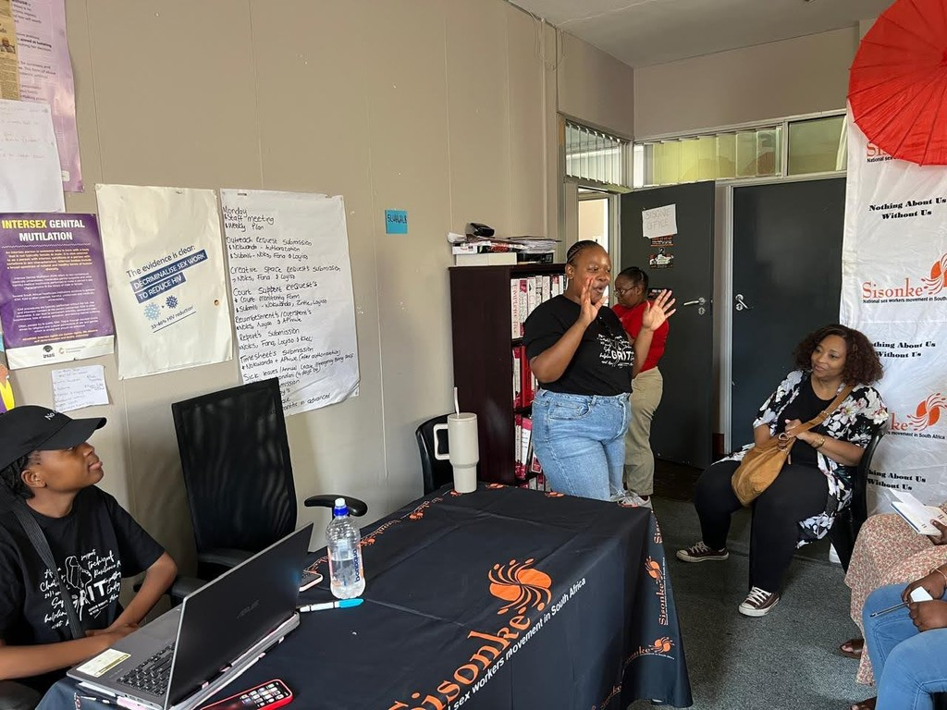
Contribution to Gender Equality
Challenging Gender Stereotypes
Break down barriers, proving gender doesn’t limit potential.
Empowering All Genders
Advocate for equal access to resources and opportunities.
Raising Awareness on GBV
Actively involved in spreading awareness and creating a safer environment for everyone.

Slide 11
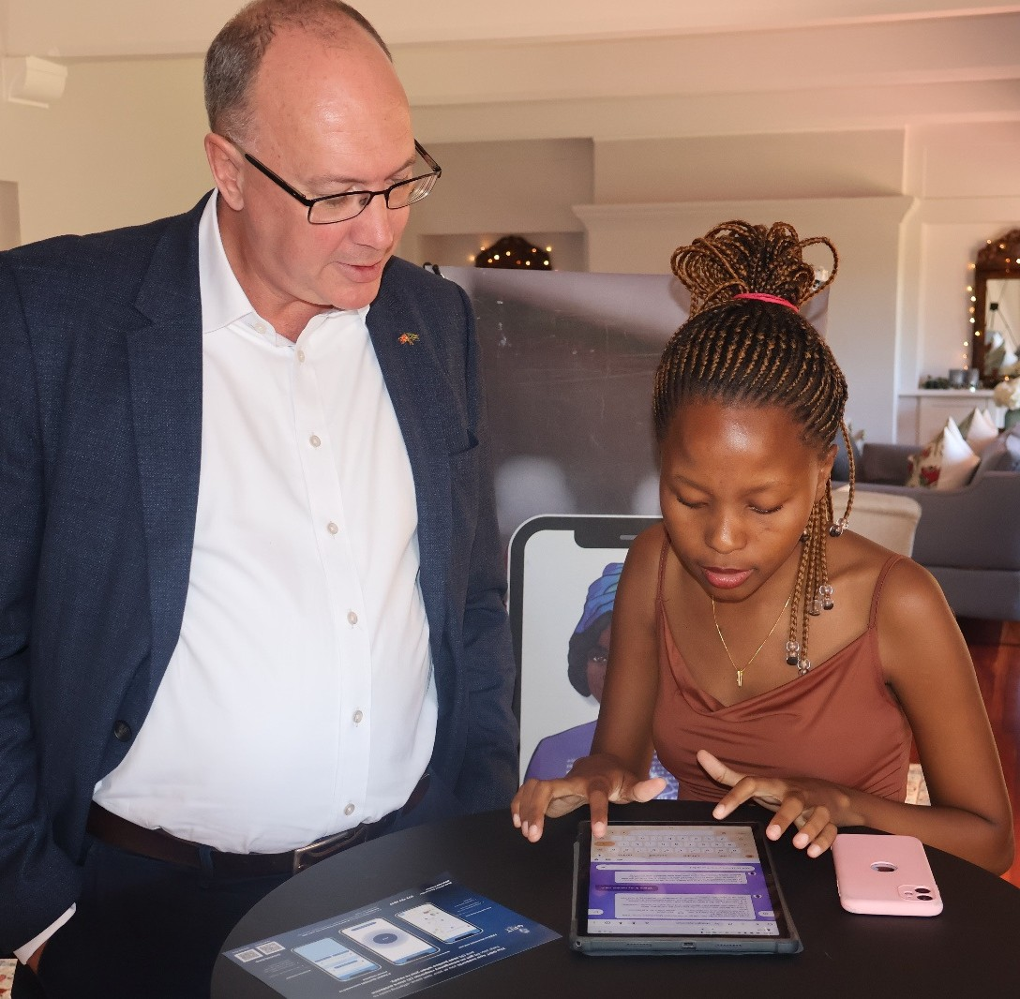
Next Steps- Future Plans
Growing in Data Science
Use data to solve real-world problems and make a difference.
Private Investigator for GBV Cases Volunteer to support and bring justice to survivors of gender- based violence.
Making a Real Impact
Committed to creating positive change and inspiring others along the way.

Slide 12
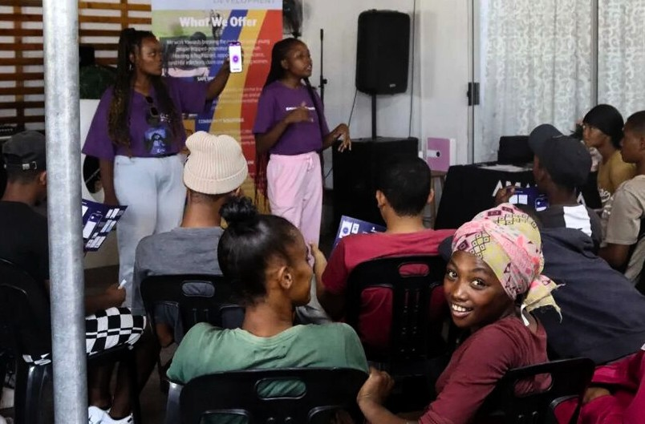
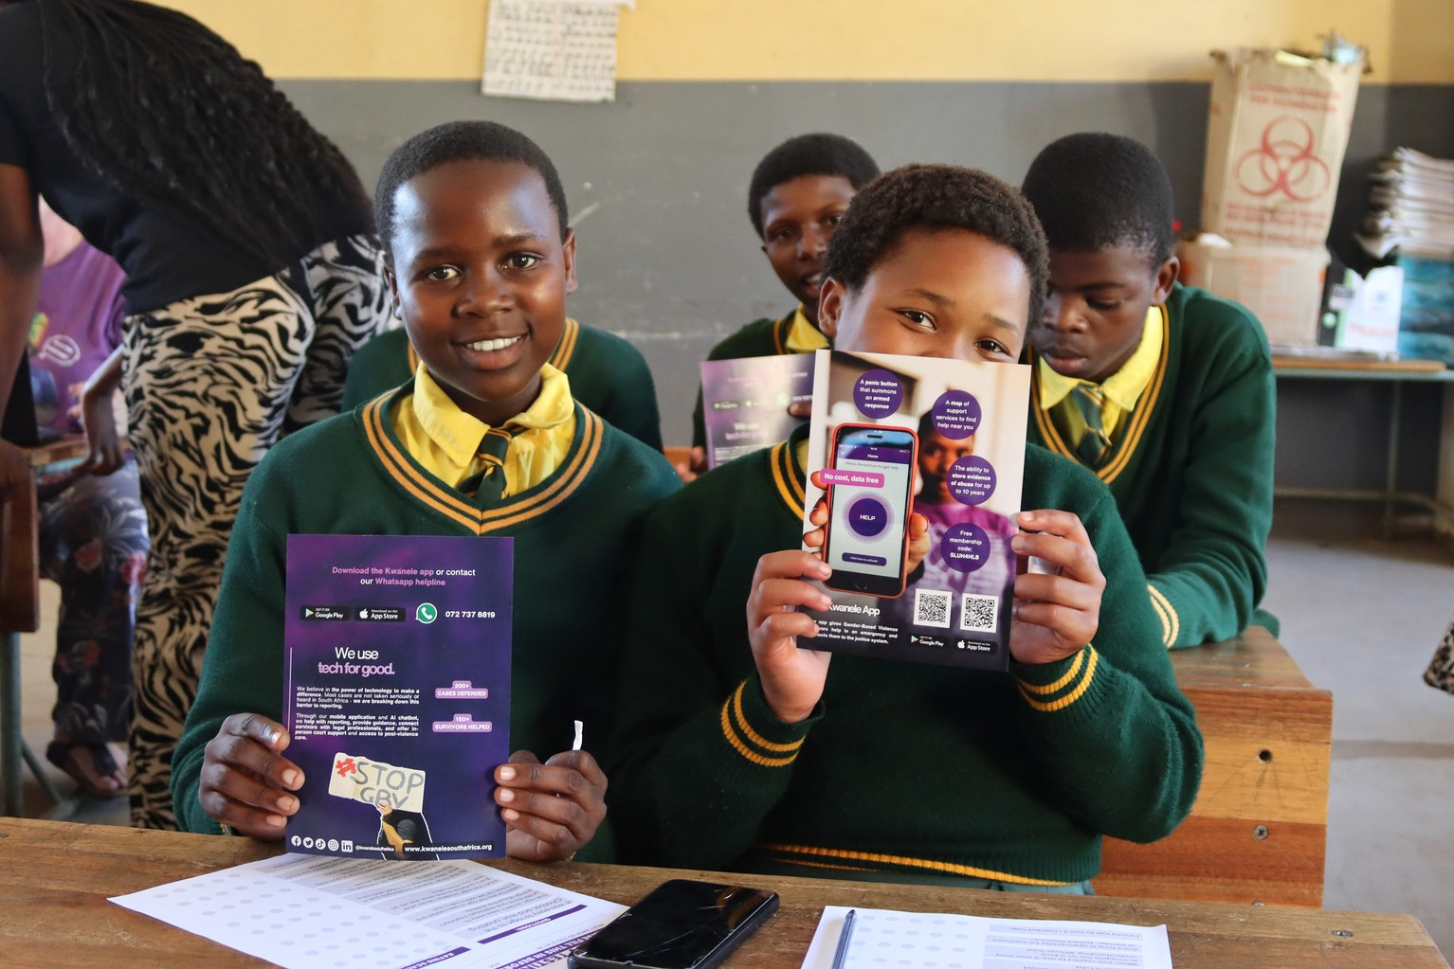
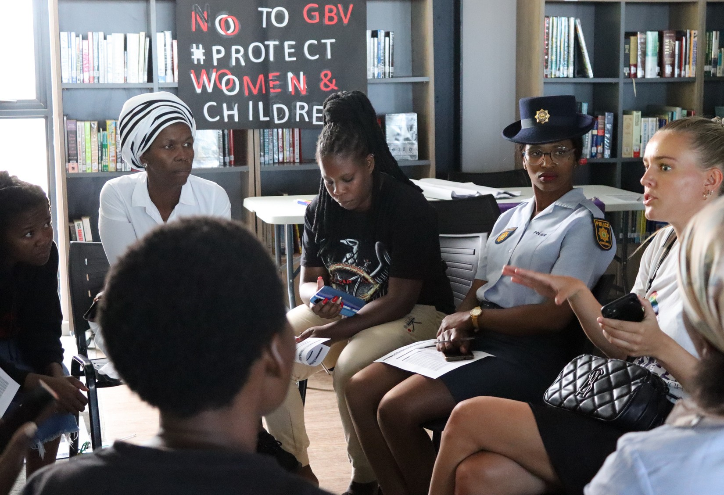
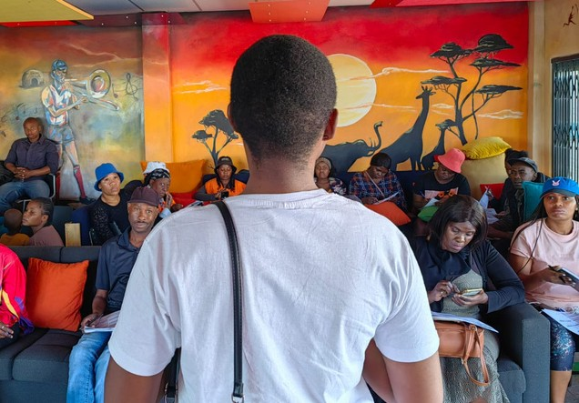
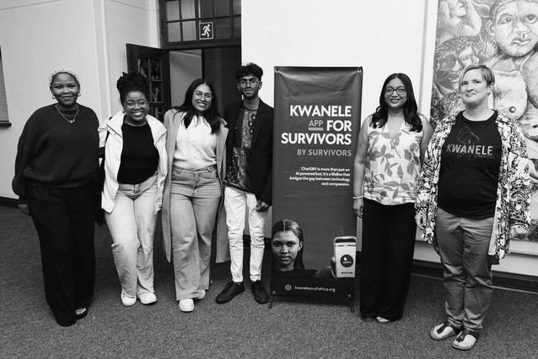
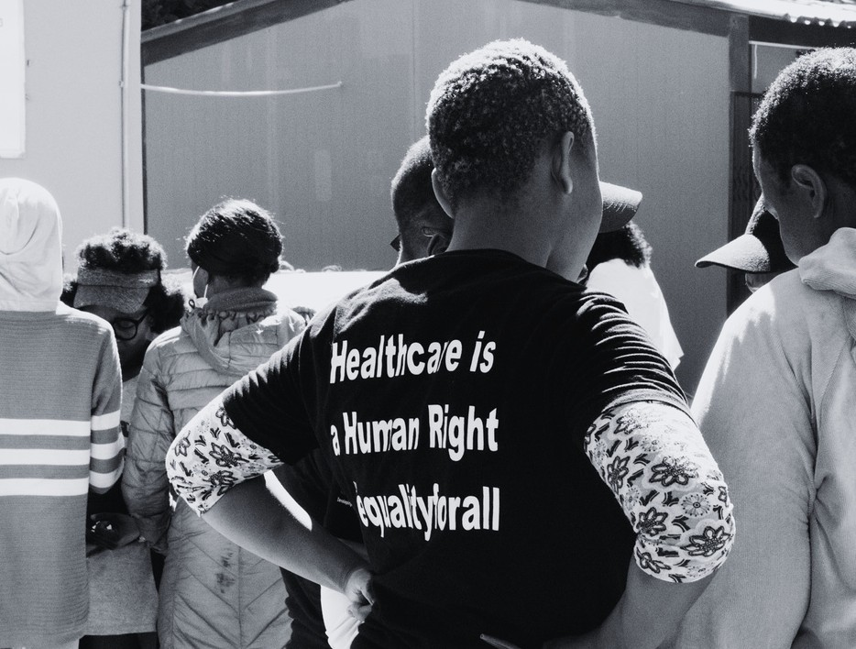
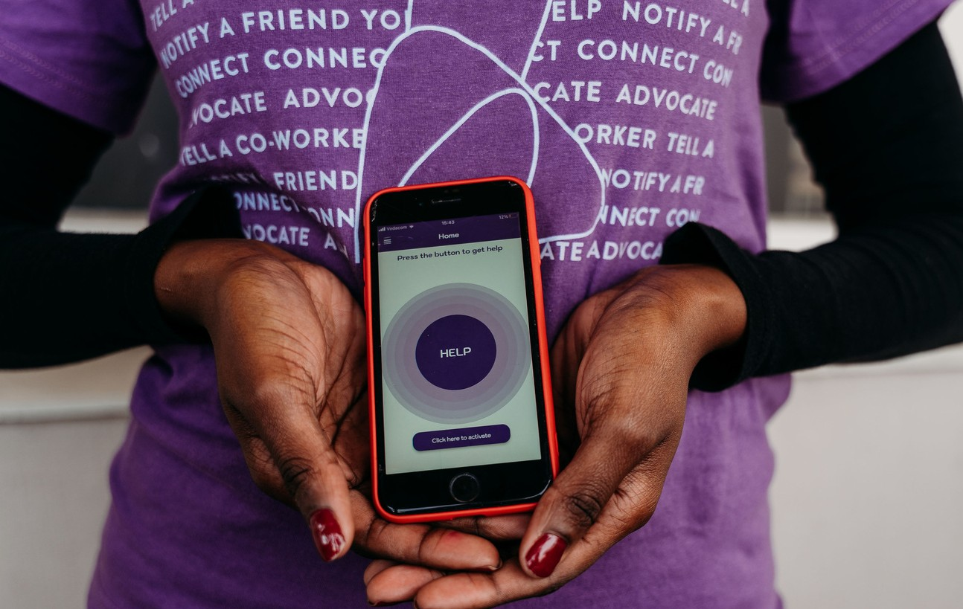
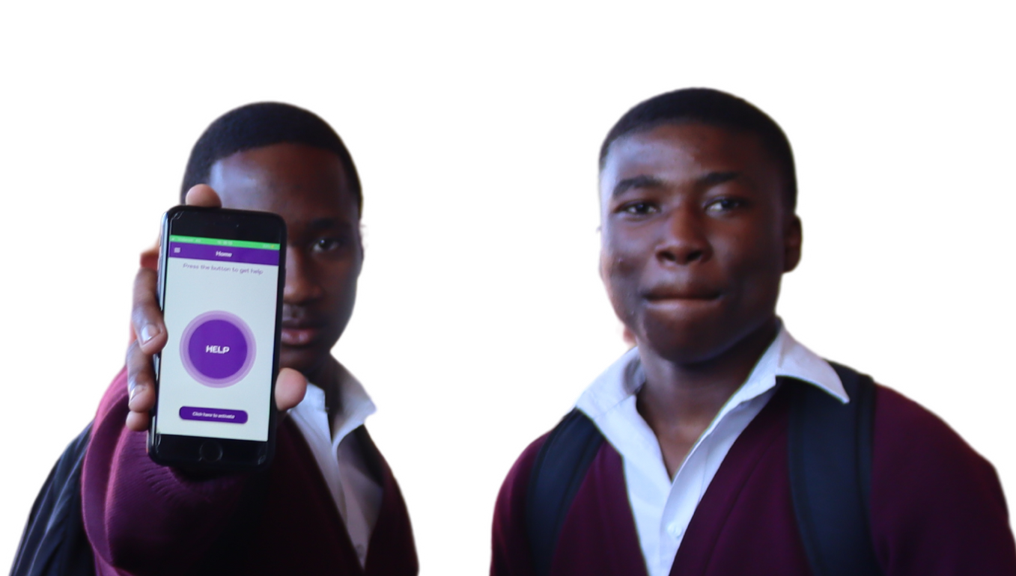
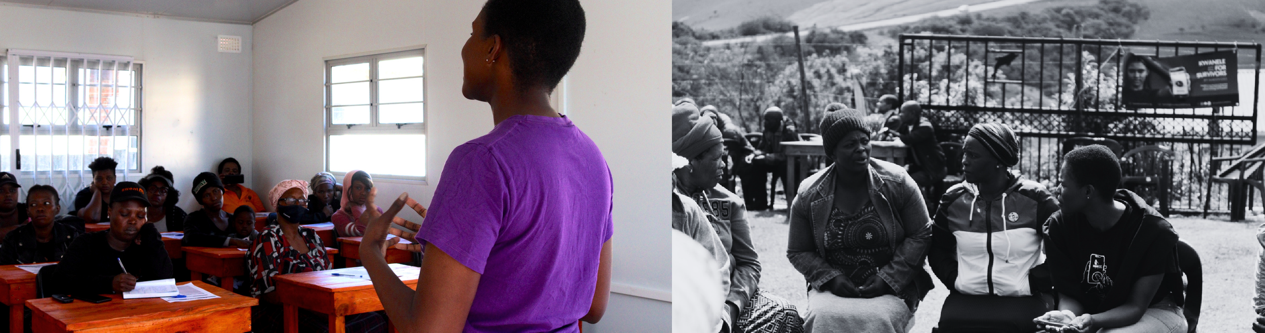
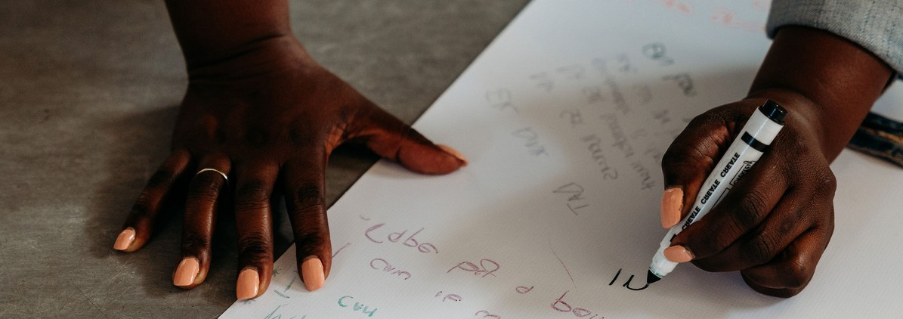

Slide 13

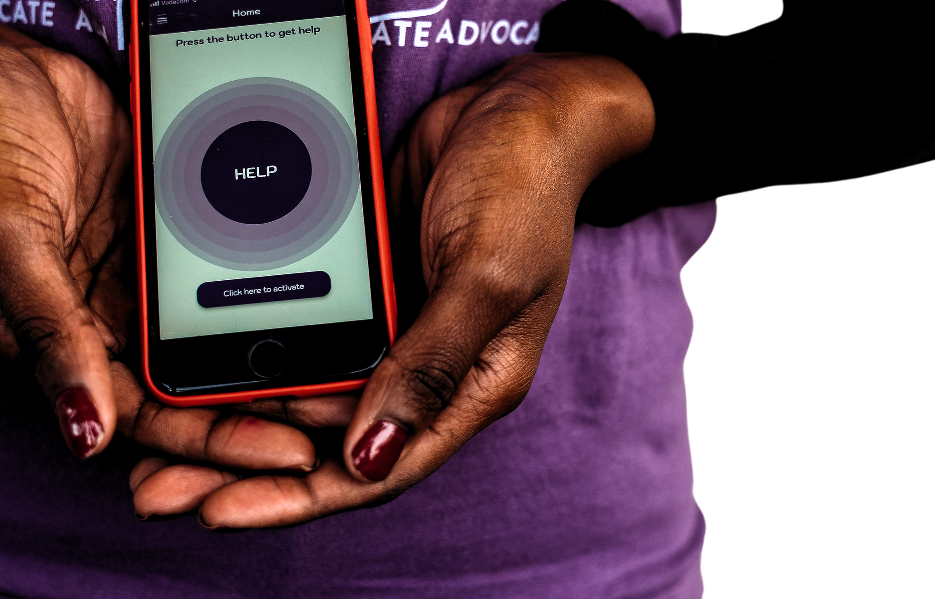

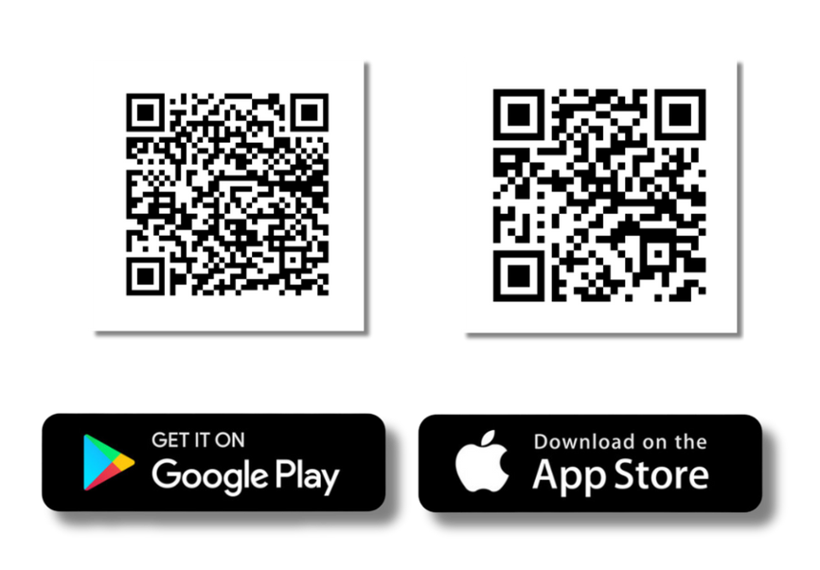
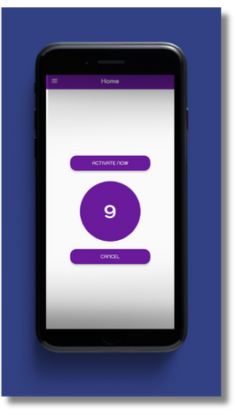
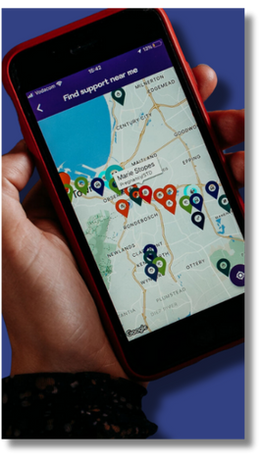
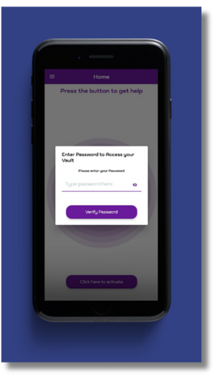
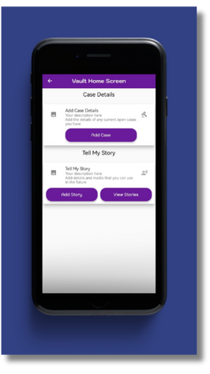
Download our immediate reporting, safety and
evidence-storing app, GRIT.
Need legal advice or general support? Reach out and
message us via our Whatsapp line at 072 737 8819.
shamryn@grit-gbv.org |
www.grit-gbv.org

