Slide 1

WEP CHALLENGE 2021

Slide 2
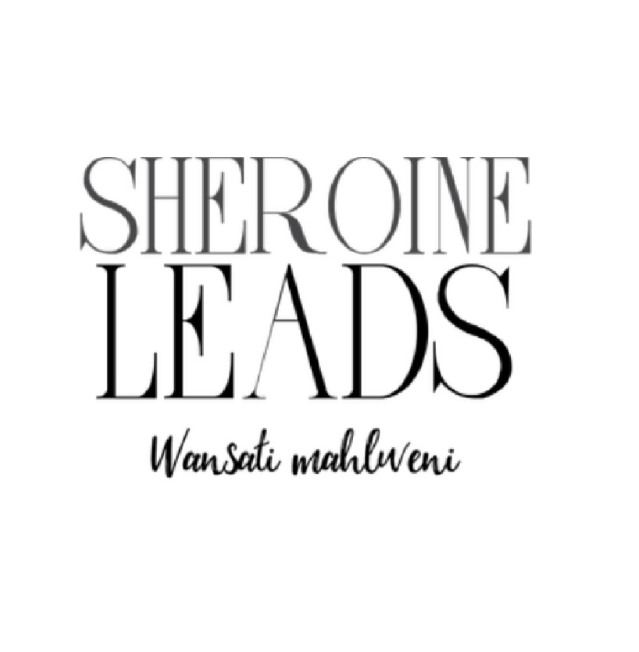



SHEroine Leads
Keletso Kgalema
Who prefers to be called Pholosho is a 25 years old female from the Limpopo Province.
Societal issues affecting South Africans particularly women and young girls residing in rural communities inspired Keletso to founding SHEroine Leads. Empowering community members and alleviating poverty is the end goal.

Slide 3
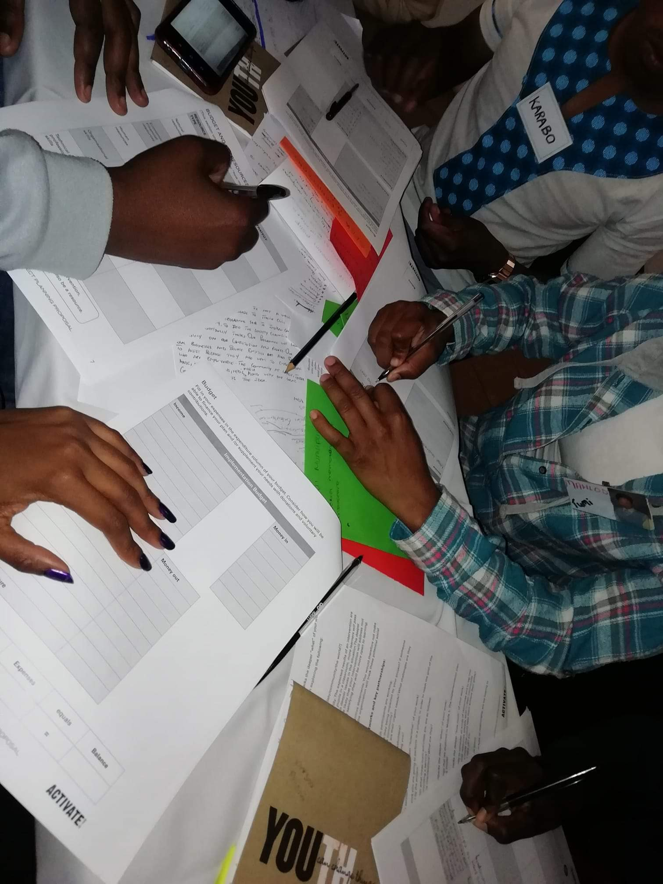
What customer needs are being addressed
SHEroine introduces freedom,unity,comfortability and the sense of belonging.
The need for digital literacy (STEM & introduction to computer practice), mentorship & coaching/peer learning, leadership classes, job hunting or opportunity assistance

Slide 4
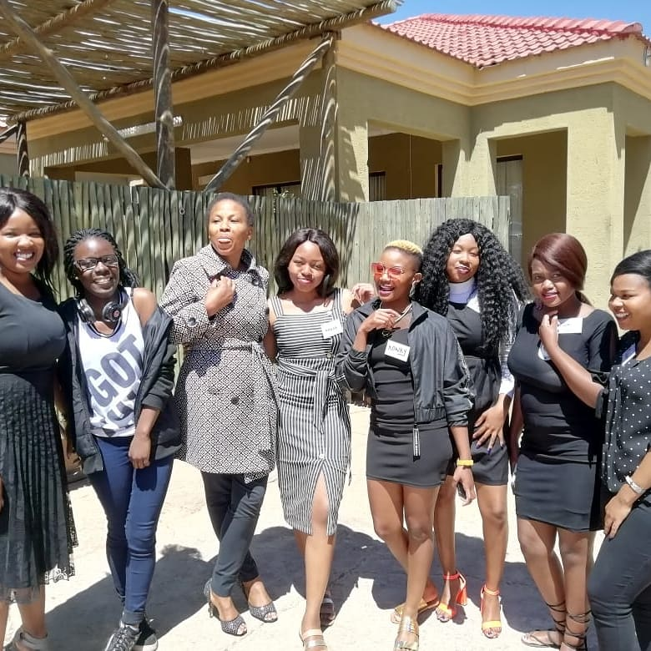
How has the business impacted on other enterprises owned by young women?
The existence of SHEroine Leads has been a motivation to young women in business to introduce ICT in their businesses. Being the first of its kind it also serves as prove that rural communities can improve and women can be in the forefront of this change.

Slide 5
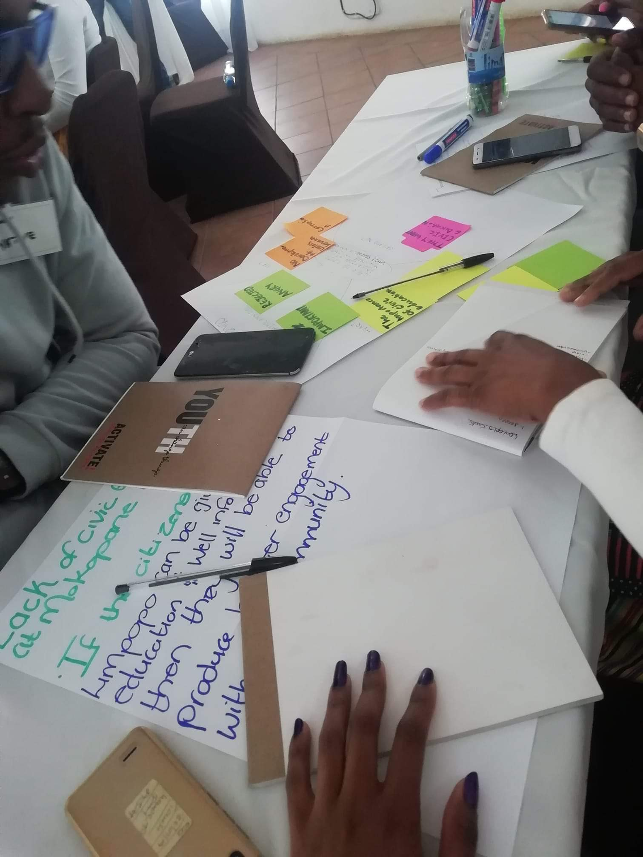
What is the nature of the business?
The company entails of a Resource Hub whereby Introduction to digital literacy both young and elderly take classes. Introducing STEM to young girls and boys.
Sharing a safe space for everyone to partake in hackathon that allows thought conversations and encourage confidence for public speaking. The sessions also assist individuals with work preparedness, interviews and self devotion on a daily basis.
Day to day tutoring, #StudyBuddy, Introduction to market place on social media,

Slide 6

How viable and implementable is the solution being proposed?
The idea is unique with its target market being those residing the community it is intiated. The competition is only located in town & does not offer services offered by SHEroine Leads. The timing of the implementation of the business is perfect as rural communities currently need digital literacy most as the pandemic has strengthen the urge for computer literacy. Marketing the business is easy and affordable. The disadvantage is the need for a large workspace and a better computer centre to expand the opportunity.

Slide 7
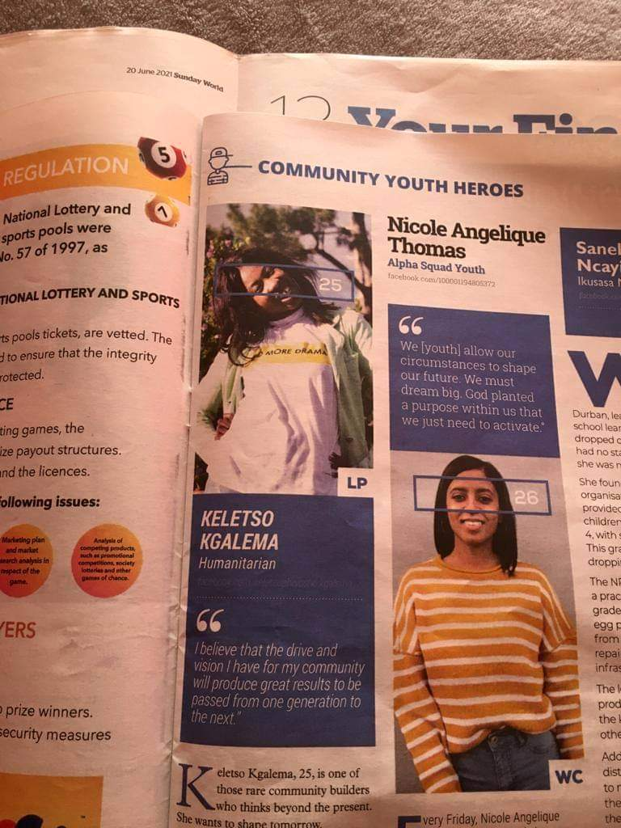
What makes the business unique?
The business serves as a solution to the drastic teenage pregnancy, illiteracy, alcohol and substance abuse. It encourages independence and empowers youth to be proactive and exposes youth in disadvantaged backgrounds to dream beyond their current circumstances. A bridge from rural communities to the rest of the world.

Slide 8
Use of ICT to promote economic and employment opportunities for young women?
SHEroine Leads is one of the few opportunities that creates a new view to the world. The only opportunity that introduces the usage of computers for children and adults in a rural communities of Ga-Mmapuru. Introducing digital literacy has not only been a solution to decreasing unemployment but to introduce rural communities to the digital world.

Slide 9
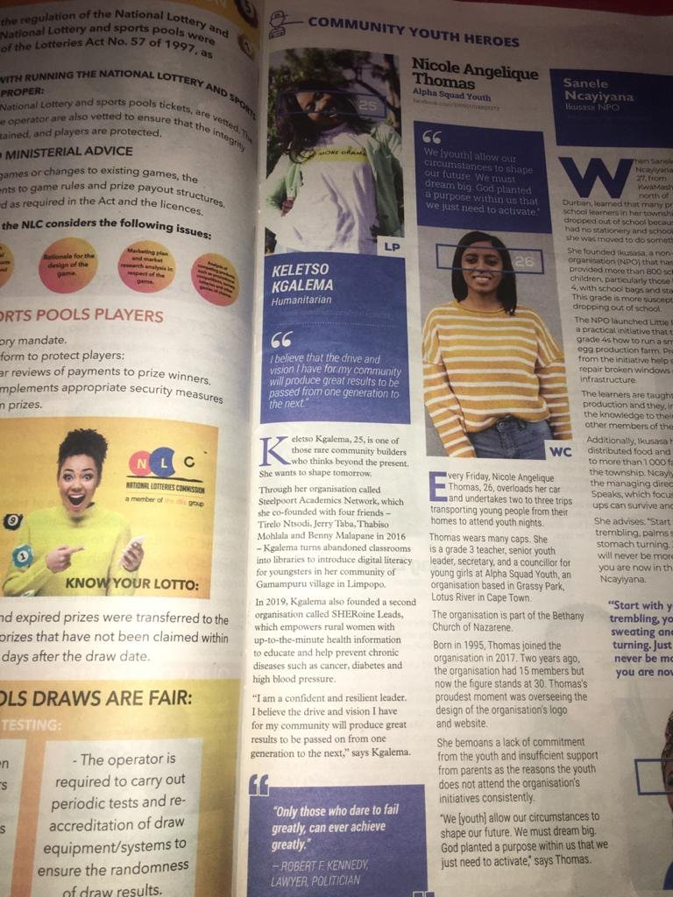
How have you managed the impact of the COVID-19 pandemic?
The regulations put in place for the lockdown has affected the initiative financially and with the need for enough space for activities while adhering to Covid-19 protocols vast decisions have been taken while compromising on other activities.

Slide 10
Anything else you would like to add
The founder of the initiative is an active citizen as part of the organizations Democracy Works Foundation, Activate Change Drivers, Youth Capital Influencers and World Literacy Foundation. Keletso is also an Unsung Heroes Award winner by Sunday World for the year 2021 in the catergory of Community Development.

