Slide 1

WEP CHALLENGE 2021

Slide 2




Moemi Farming Enterprise
Moeletsi Mirage Taiwe
26 Years old female Entrepeneur based in Dennilton, Groblersdal in Possesion of a Public management and Governance BA Degree From the University Of Johannesburg, 2019 Mail and Guardian Top 200 Young South South African Entrepreneurs as well as Best Crop Student farmer from the buhle Farmers academy and Recently Acknowledge by The department of Agriculture Limpopo as one of the thriving businesses during The covid 19 Pandemic
Growing up in The city and Going home to the Rural villages in Mpheleng during School Holidays The magnificent changes in the ways of life and the abundant resources that where available with lack of access to information, Resource, Knowledge and prejudice against women being the cause of most issues which contributed to the increased rate of poverty, gender violence, Malnutrition, with the Province being Amongst others the agricultural hub of South Africa with ample oppurtunities and vacant land available while the Backyard gardens were able to feed most of the community, with the Cultural knowledge that had been part of the village to that which I had gained and still continue to acquire Moemi( Sesotho Name: The one who stands) was born. Gathering women creating collaborations and creating partnership equipping them with the skill and knowledge not only to be labourors but entrepreneurs instill in our Human capital the urge and ability to stand and be able to produce not only for the village but surrounding town’s and industries
Insert Relevant pic of business history, logo etc

Slide 3
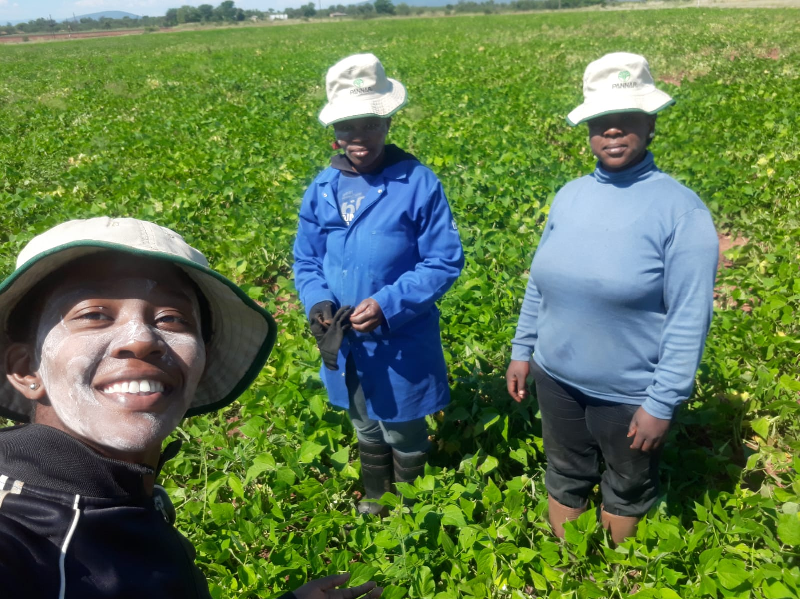
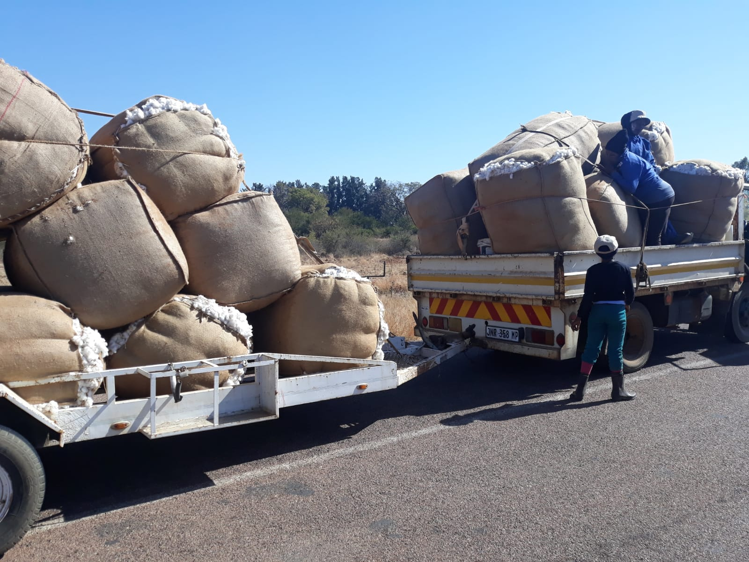
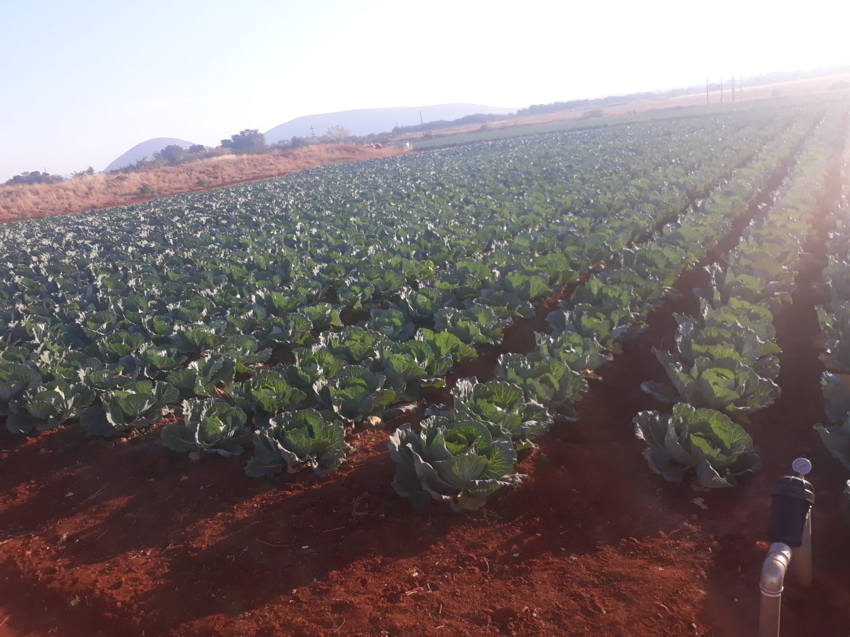
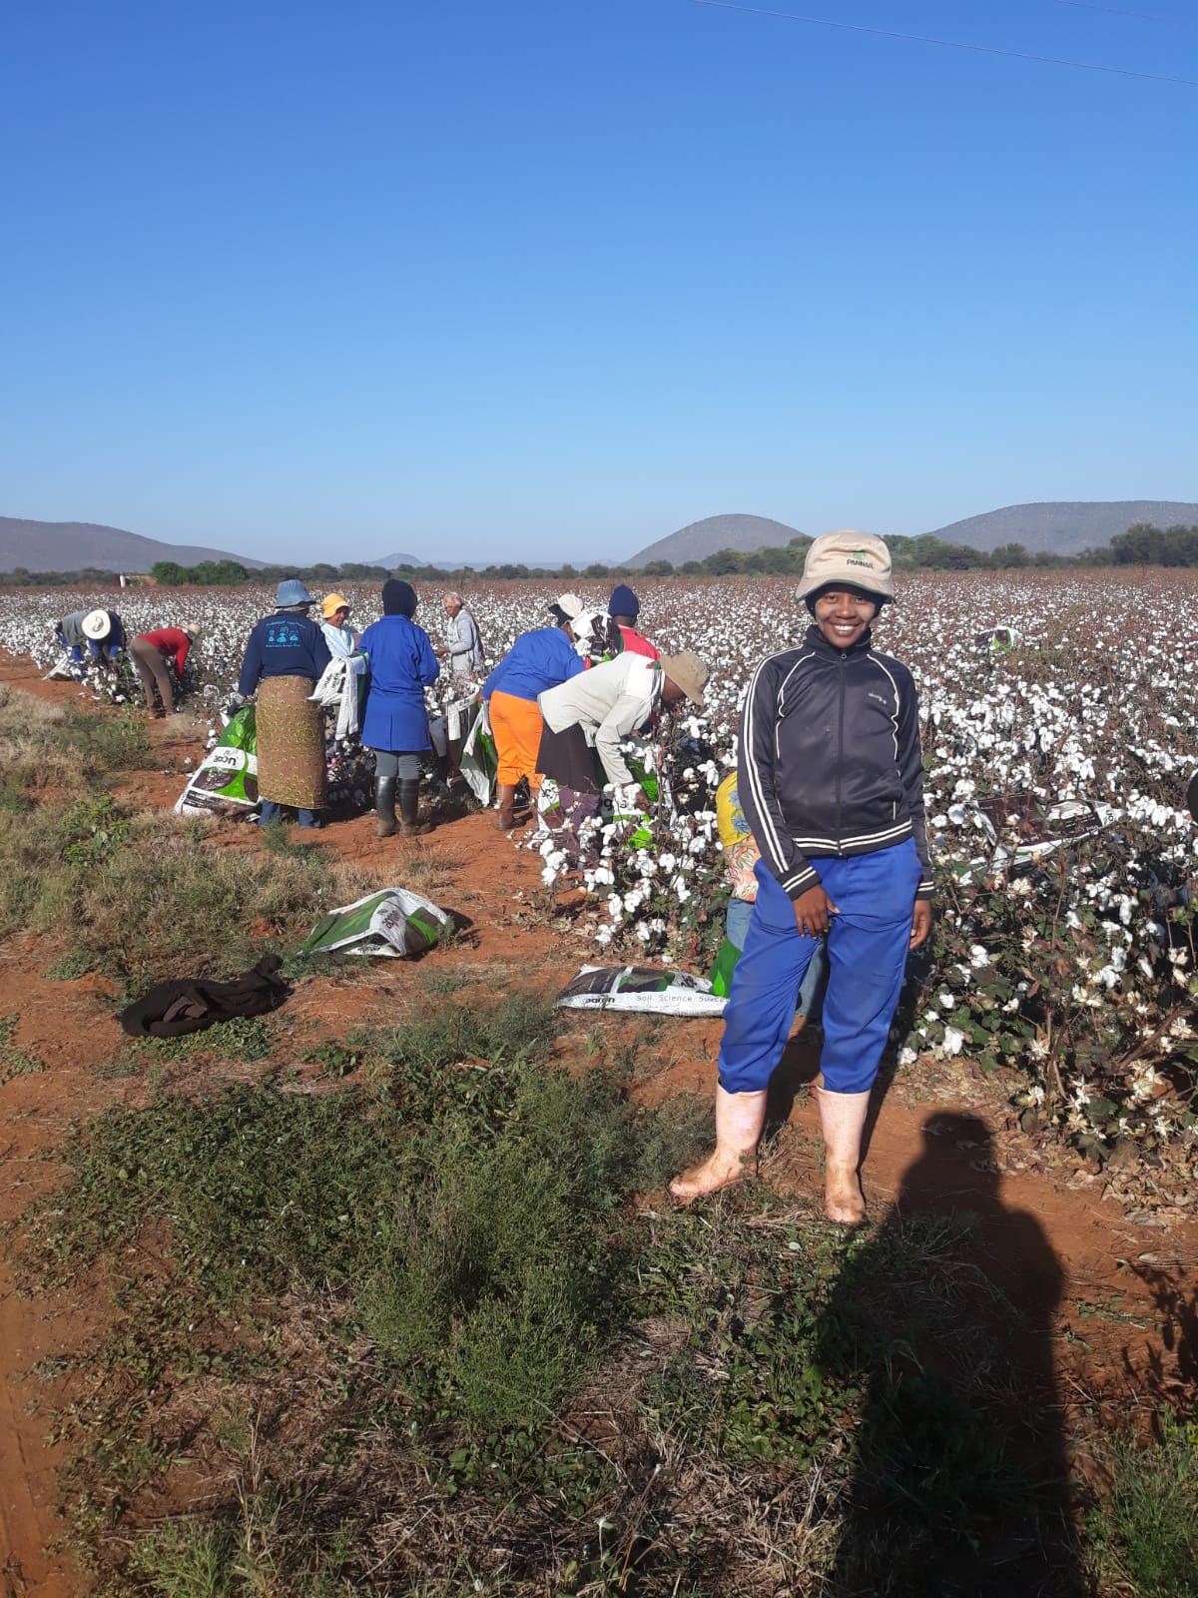
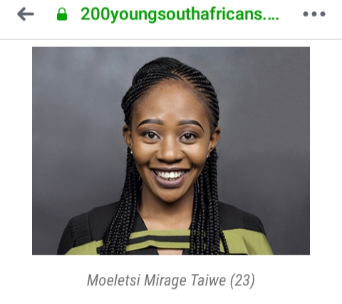
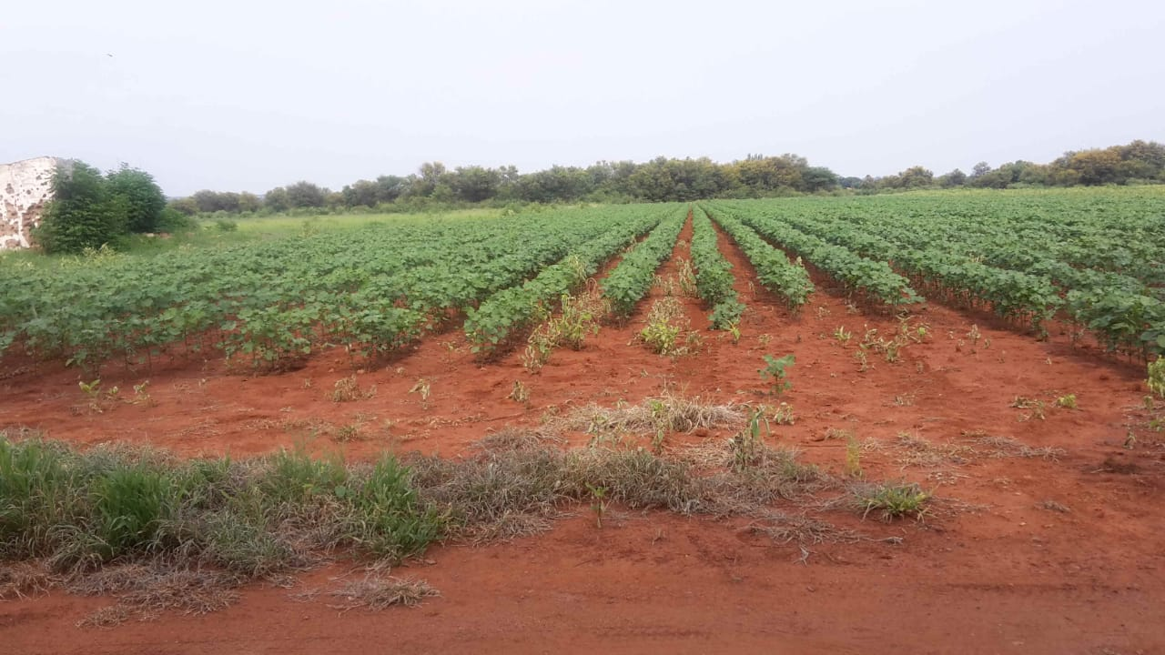
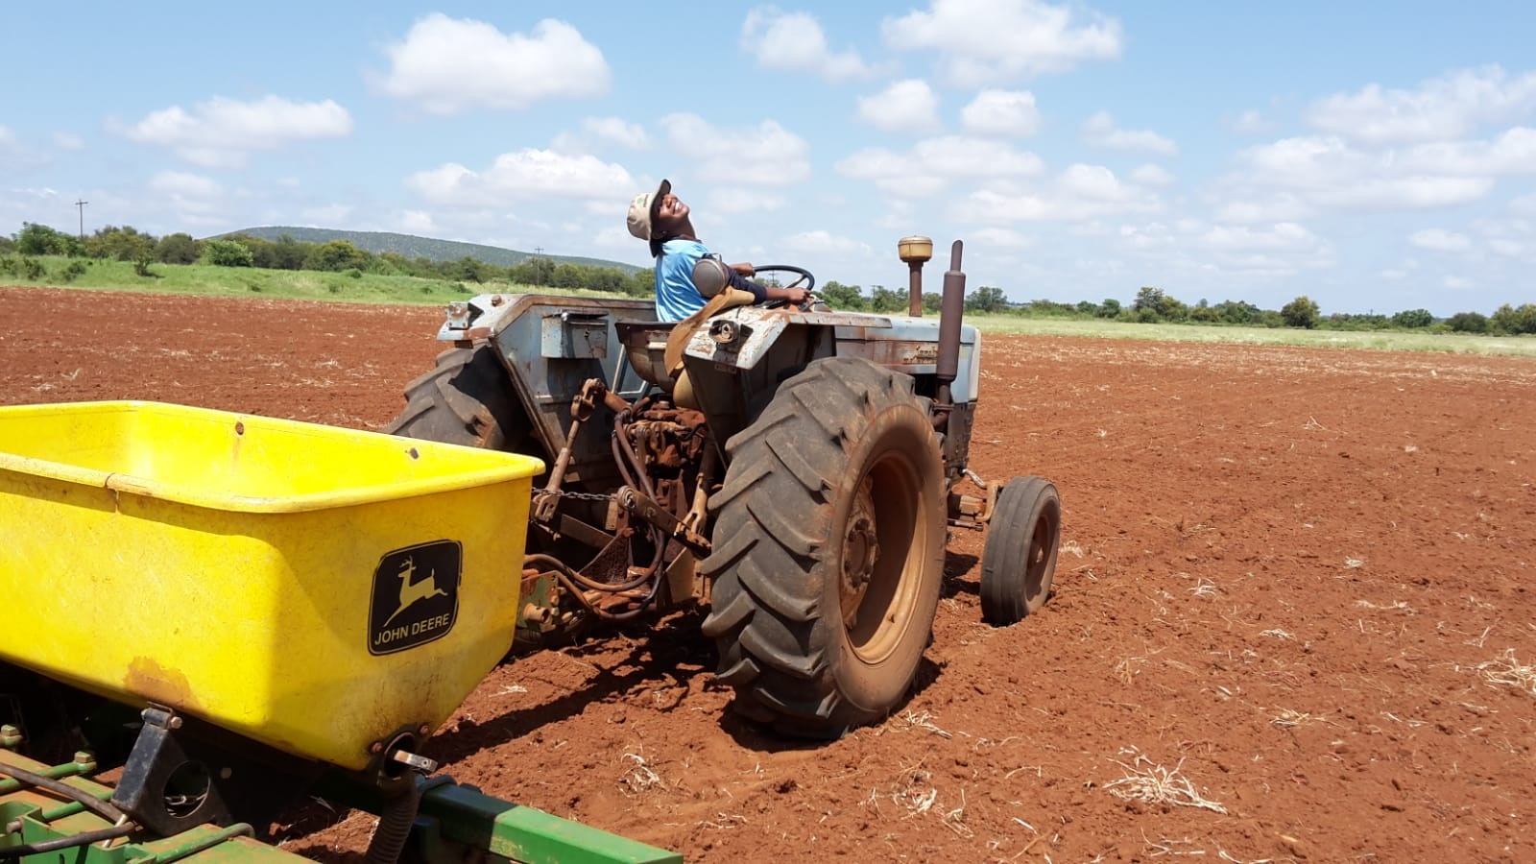
  Moemi Is a 100 % female owned farm, Which prides itself in the Championing and Serving in the agricultural Sector a space which is Male dominant and Constitutes 80-90% of the provinces Domestic Products with a Planned, Monitored and evaluated Approach to business ,a reputable producer of The following with the aim of introducing agro processing
              A Grade Cotton
              Quality ALL Sweet variety Watermelons
              Vegetables ranging from Sugar beans, Spinach to Cabbage,
With the current Aim and Goal being to Agro process: participate in the Agricultural value

Slide 4
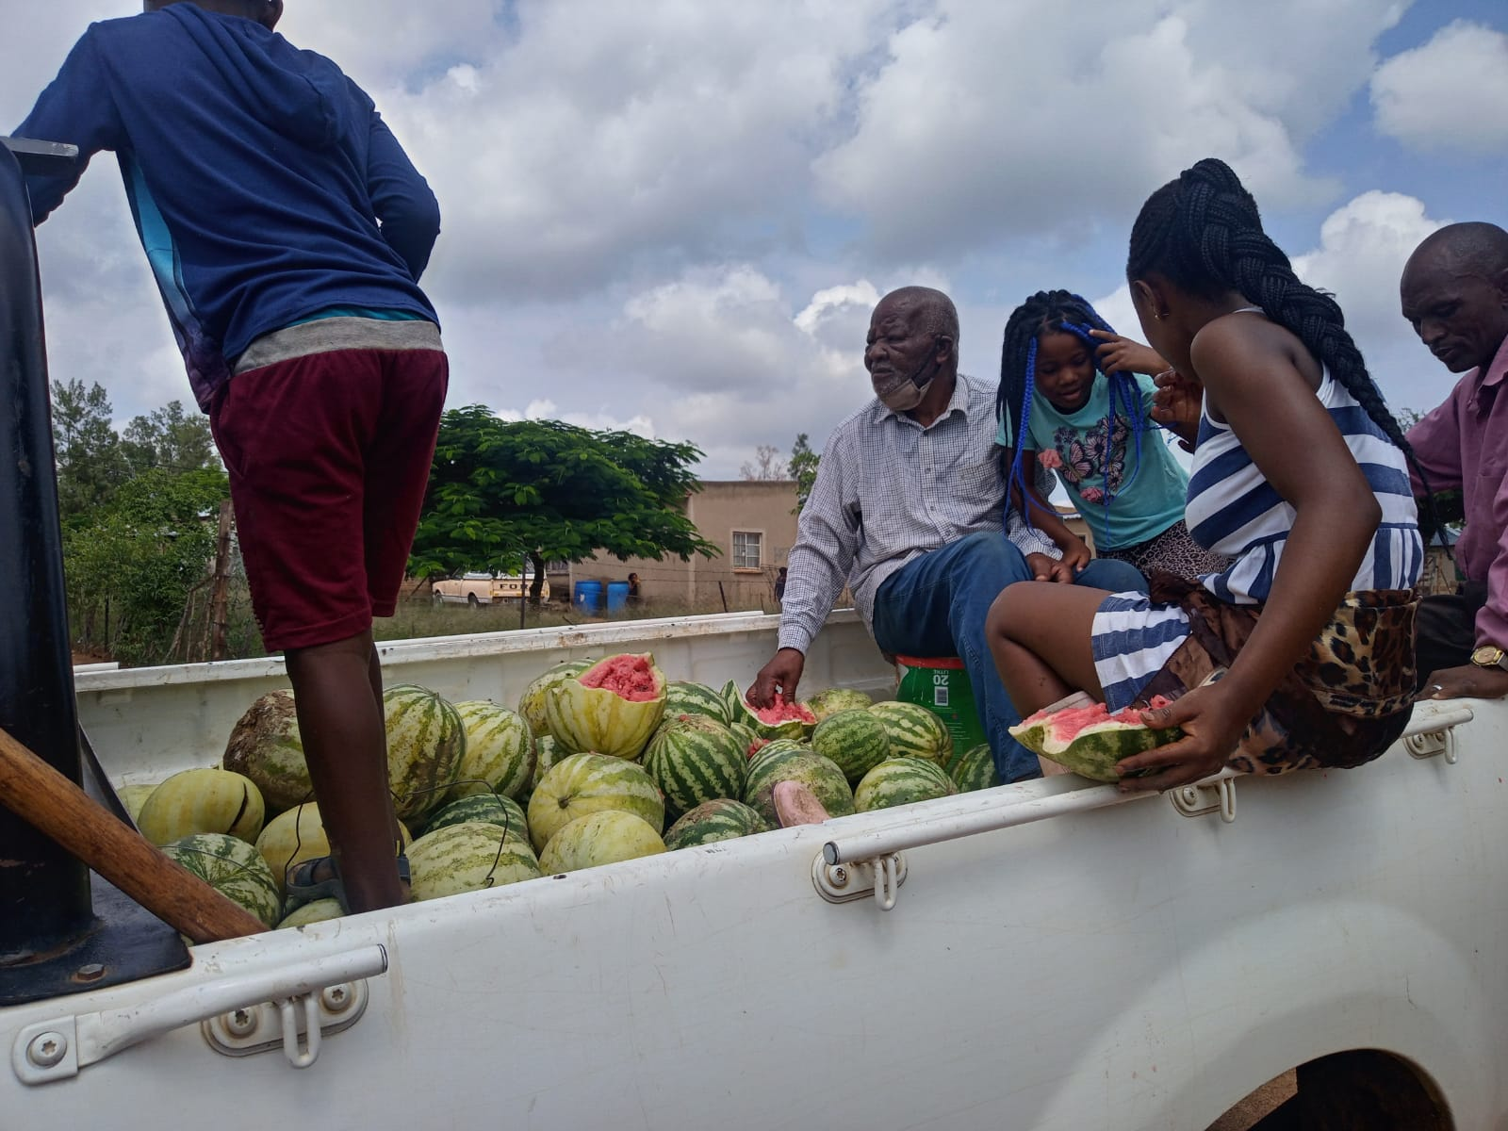
What customer needs are being addressed
Access to healthier Foods
Malnutrion and Balnced diet
Clients are able to choose from a variety of available dishes and are able to supplement unhealthy eating habbits
Easy and Affordable Acces to Foods
Easy acces to Market as produce is available in the village Lessening the traveling time and transport money being able to have more buying power
Fresh Produce straight from the Ground to the pot, Minimizing Transport expenses which results in the produce being more affordable and more quantities bought locally

Slide 5
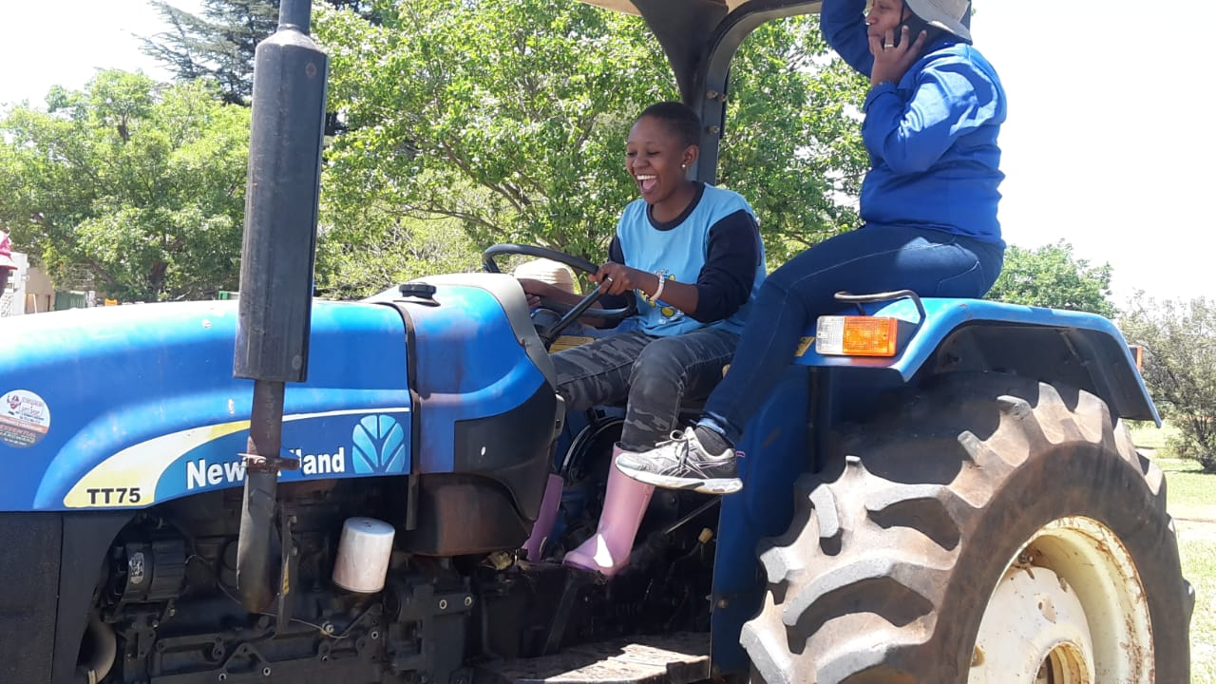
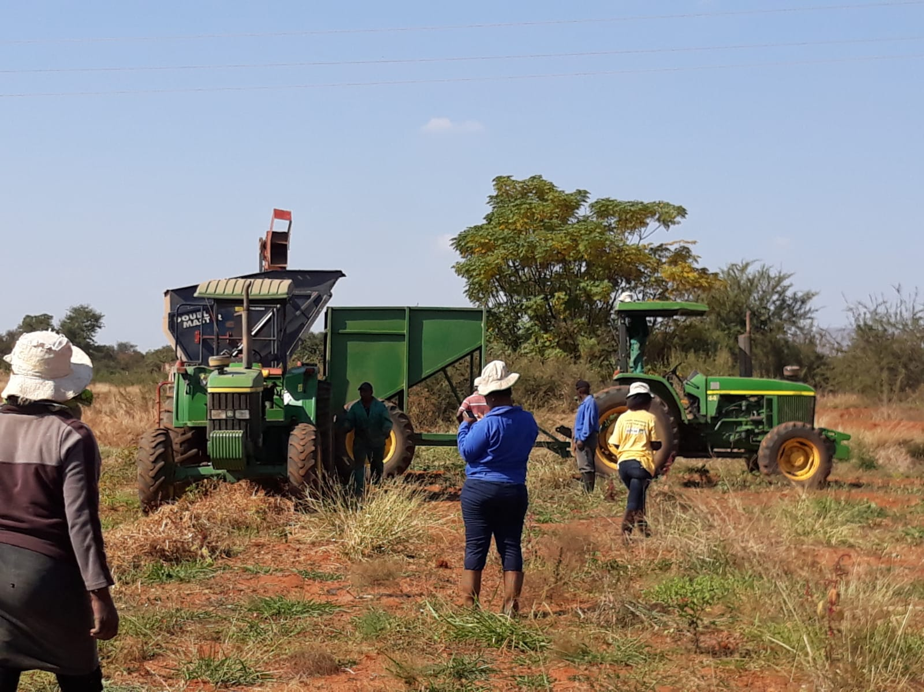
Impact on other enterprises owned by young women?
Moemi Has Trandferd skills and Knowledge Partnering with acredited development practitioners
  Women and youth around the village and suspending villages are able to acquire skills and knowledge from the Farm and get and get hands on practical understanding and idea with regards to what is needed when how and the amount
Legislation and Compliance Requirements
  We Share information with regards to the requirement for smallholder farms with surrounding entrepreneurs Regarding registration compliance and Basic requirements regarding Startups to be able to create a business and be in a position to be granted acces to available opurtunities from private as well as government institutions
Access To Networking Opportunities as well as Marketing
  Colllaborations and partnership are amongst the values of Moemi Farming Enterprise with a rich culture and history of successful partnerships we have been able to provide networking oppurtynities with potential investors and stakeholders in the value chain as well as Marketing of their produce And the relevant suppliers with our current setup being partnerships with the locals to produce the quantity mostly needed by bulk buyers whereas we are not able to supply produce from one farm but would than source from the local farmers as well

Slide 6
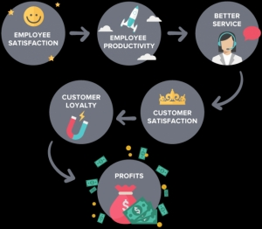
How viable and implementable is the solution being proposed?
Women and the Youth are able to acquier skills while working as labourers And given the opportunity to unskilled and develop themselves to being Farmers or suppliers of the produce With higher potential of partnerships or collaborations while the company keeps its required workforce and required needs for its daily operations
Some are able to start up backyard gardens instilling self reliance and encouraging the culture and practice of being independent curbing the slope of poverty
Workforce is hired as labour while attaining and developing Their skills at the same time gaining experience and confidence utilizing company resources upskilling themwith adequate training which in turn ensures that produce meets and surpass requirement adding value in terms of Human capital as well as quality of produce capitalizing and ensuring Market standards are met which generates forecasted income and the company is able to meet its profit Margin at the same time contribute to empowering and supporting women and children in their different ventures and aspirations

Slide 7
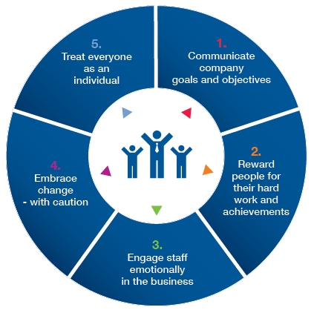

What makes the business unique?
What Makes the business unique is the innovative way in which management as well as staff approach business, with a Planned Monitored evaluated approach to running the Business
Employees are treated as Individuals with the rotational job dut Approach
Customer satisfaction
Development centred approach
Not about profit margins only but capturing the hearts and mouths of both our client and human capital providing wonderful experiences in all or encounters with an always open farm for their meaningful suggestions as well as contribution
Our contribution to the Foood scheme programs in our surrounding schools making the people claim our produce as their own and proud to be associated with it

Slide 8
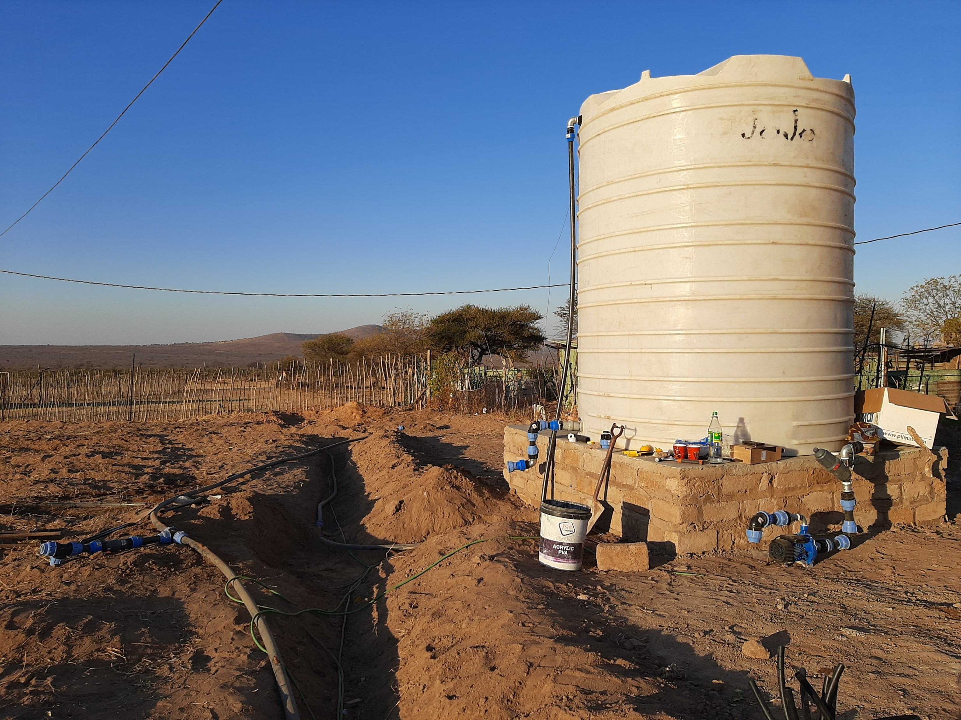
Use of ICT to promote economic and employment opportunities for young women?
We have installed a new Irrigation system that allows for the saving of water as well as time on the and the expense that take 80% of the operational cost which is electricity
In the process of introducing agro processing which will open a world of new opurtunities as well as markets as the machinery as well as the tractors will be learnt and driven by the project champions which will be women and yout providing women with access to what has always been seen as man duty to be reconsidered and normalized again ensuring and requiring the latest and fastest methods of processing which need the latest technology upgrading not only our human capital but also surrounding farms as they to will see another opportunity with sets them apart and is technology driven

Slide 9
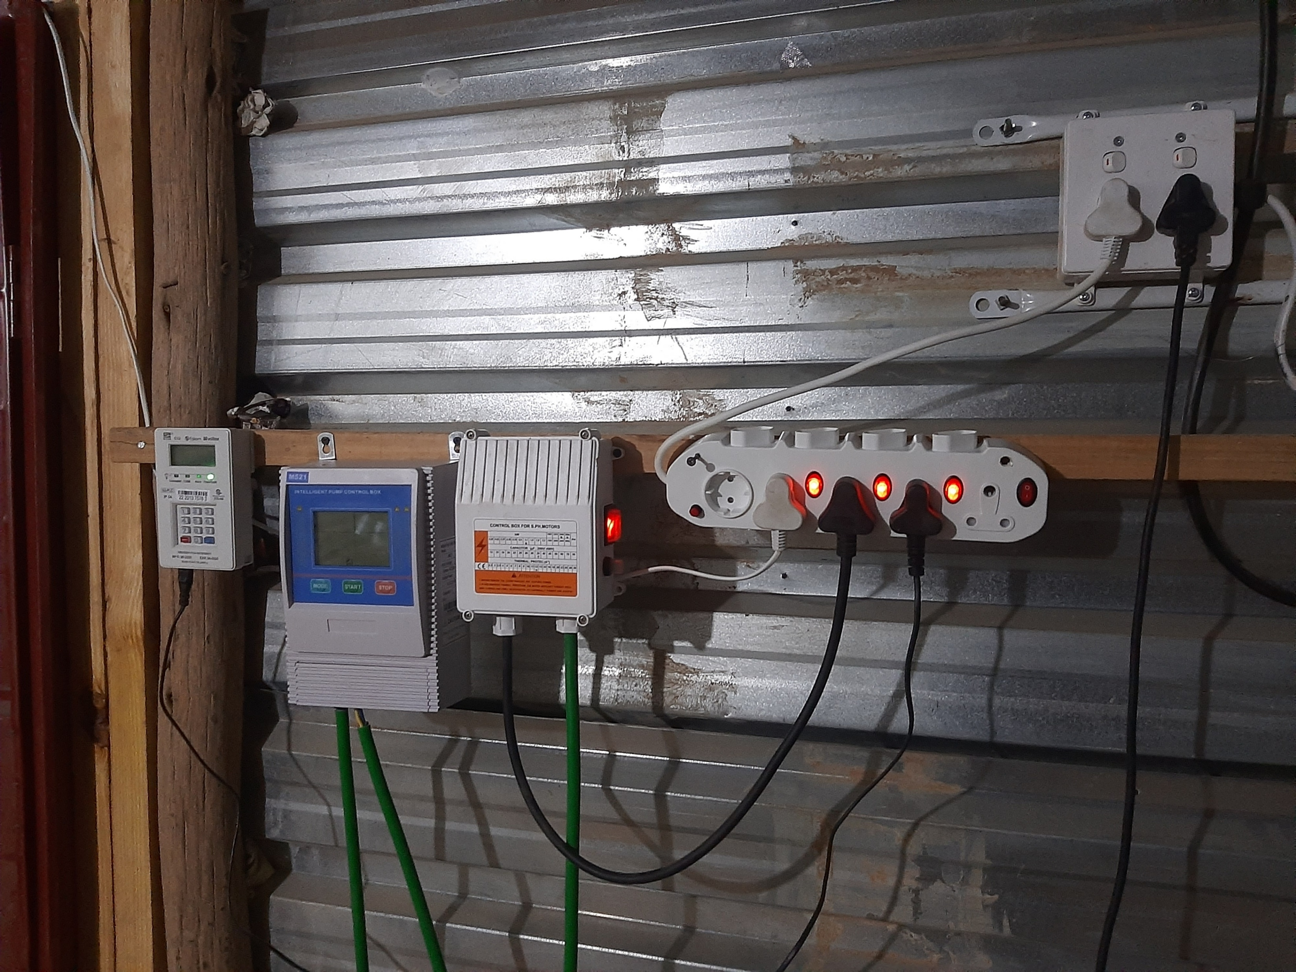
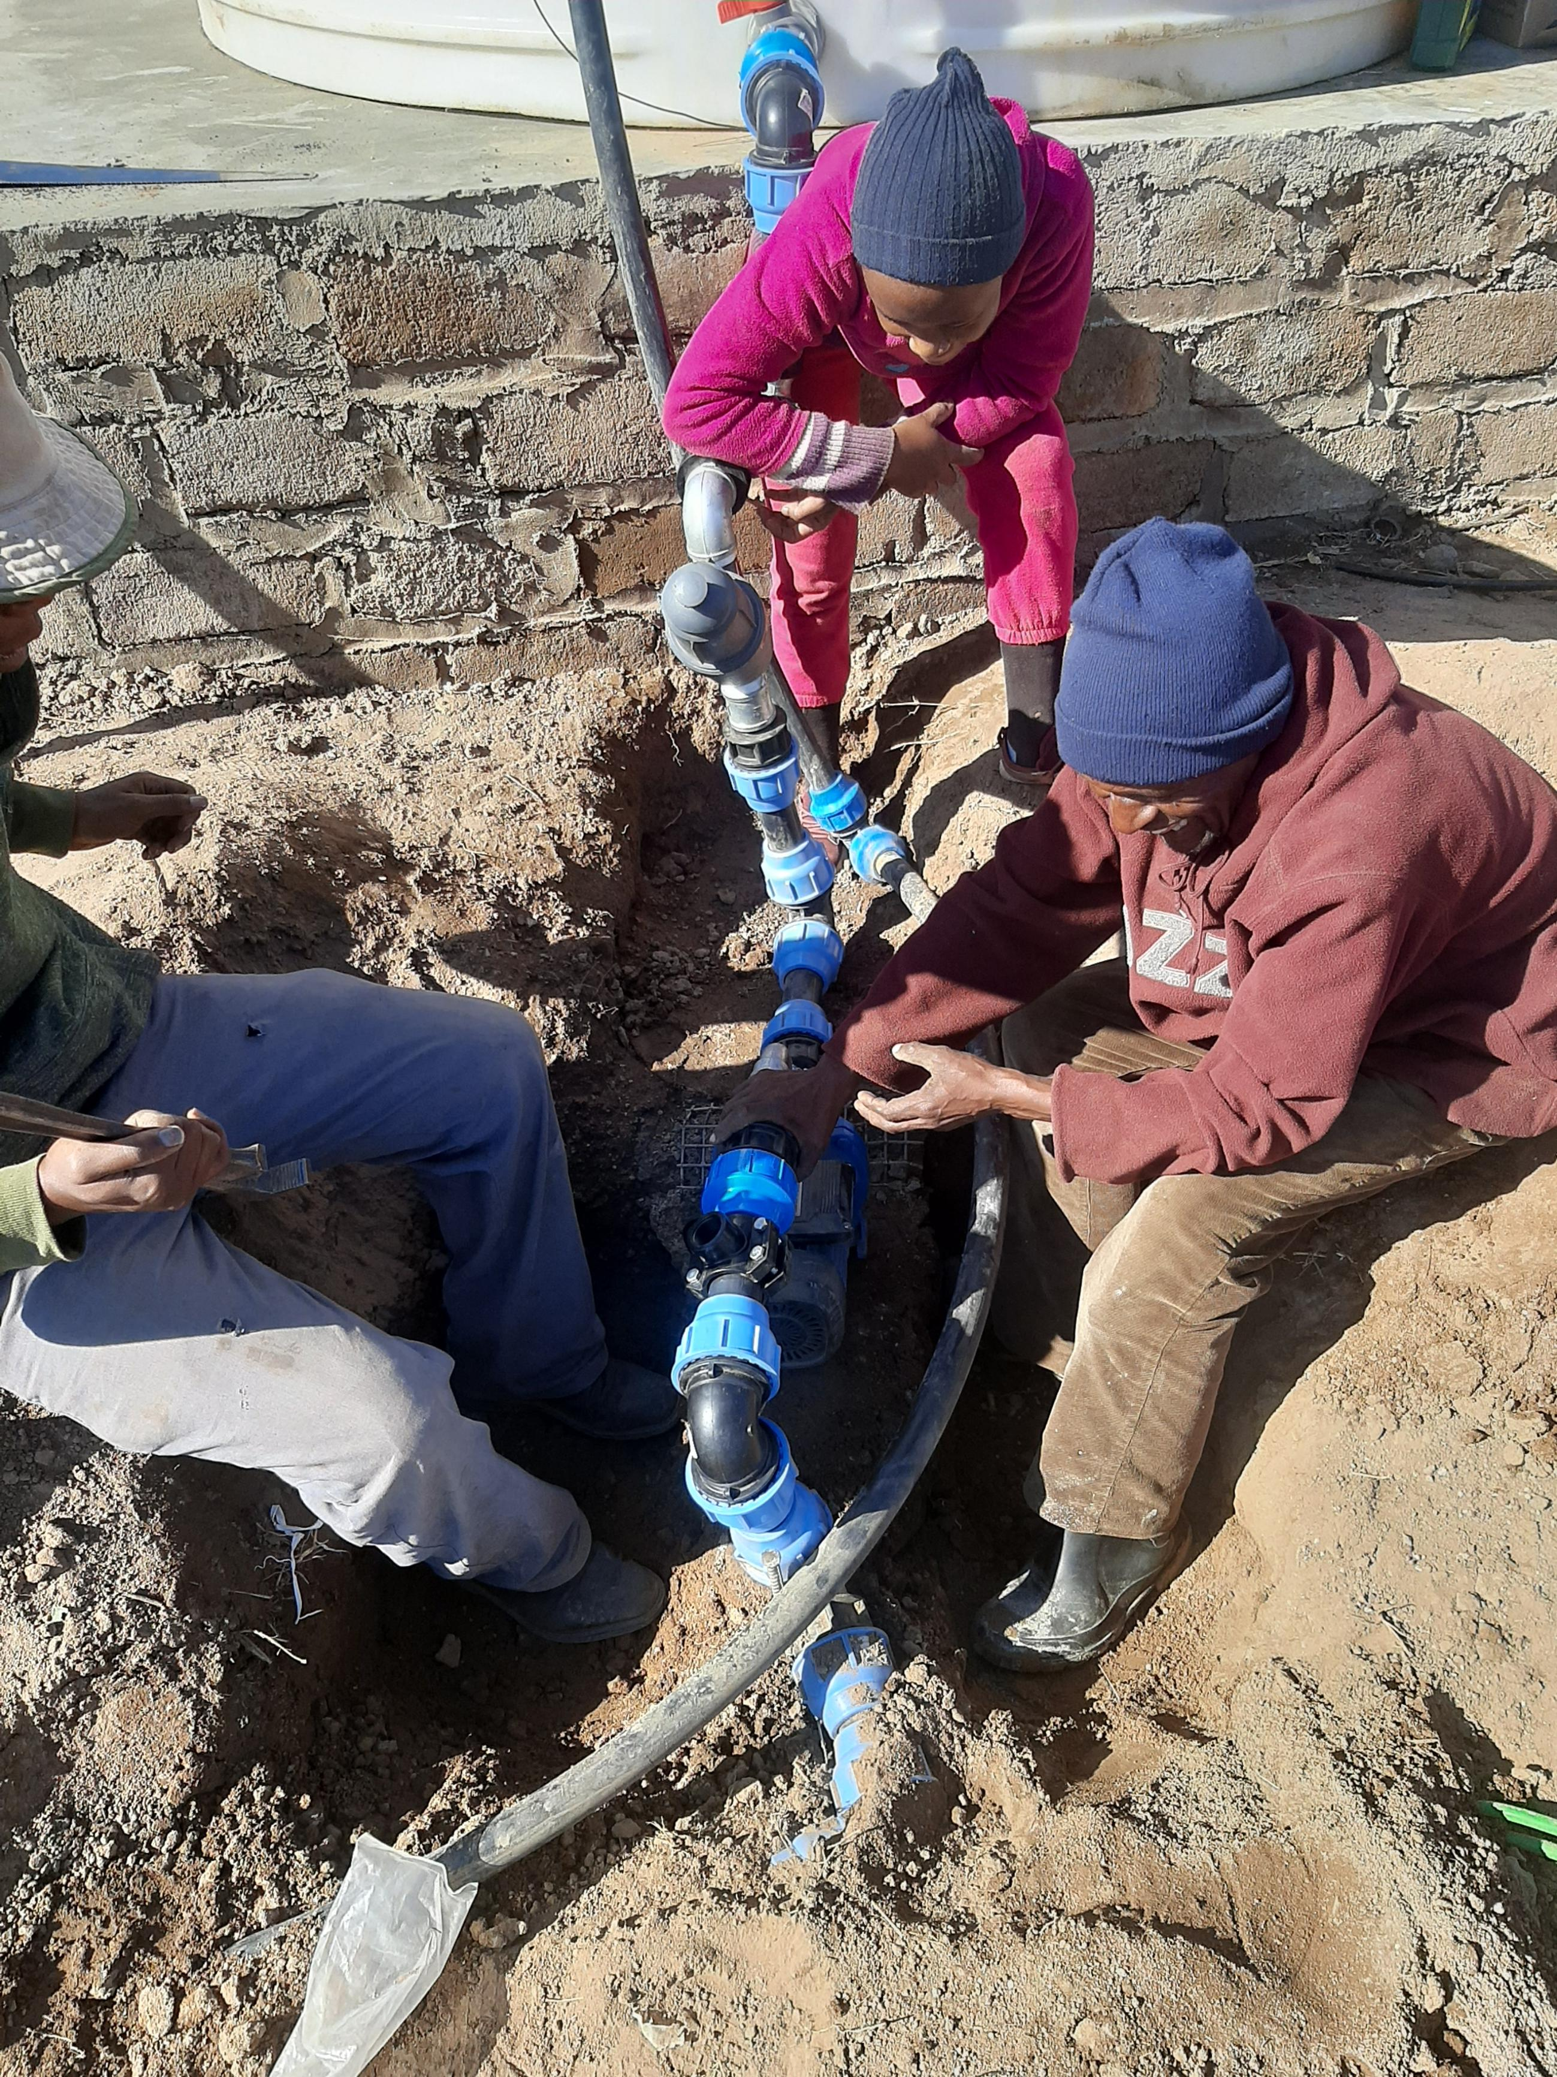
How have you managed the impact of the COVID-19 pandemic?
We converted to changing our Irrigation system which was able to afford us the less expenses in terms Of hours worked as well as electrical expenses ensuring that we keep our Current human capital with the ability to require more as even in terms of disease management less inputs will be used as we will be irrigating where the plant is instead of the whole and will be producing more as there is adequate and structured planning with regards to the produce to to the new system installed

Slide 10
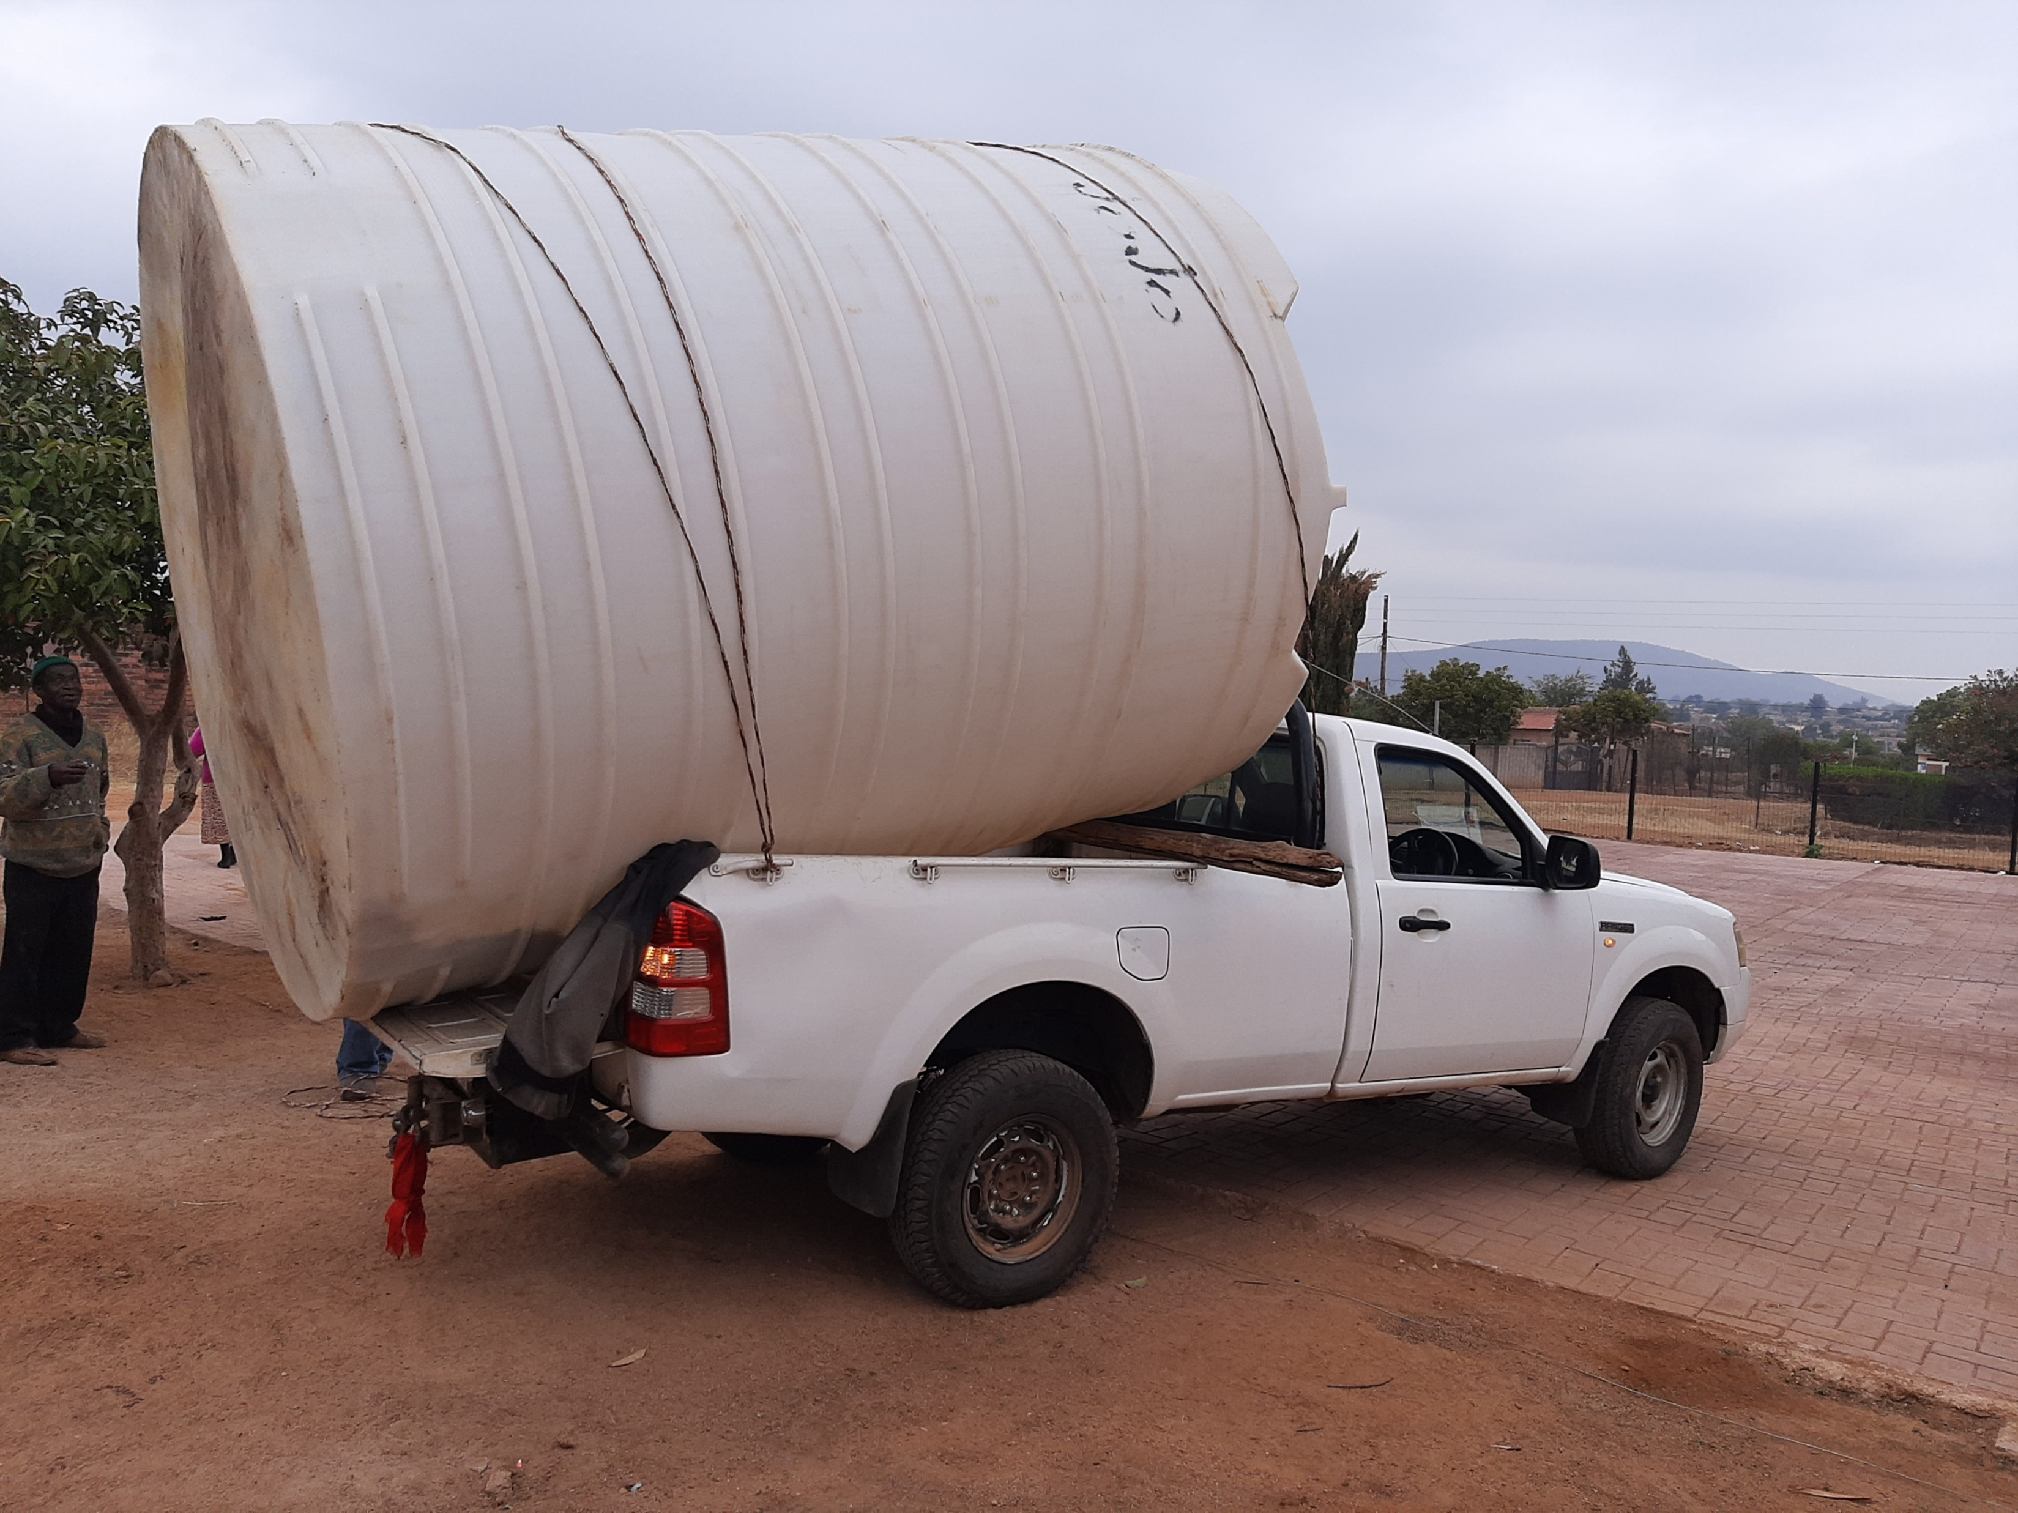
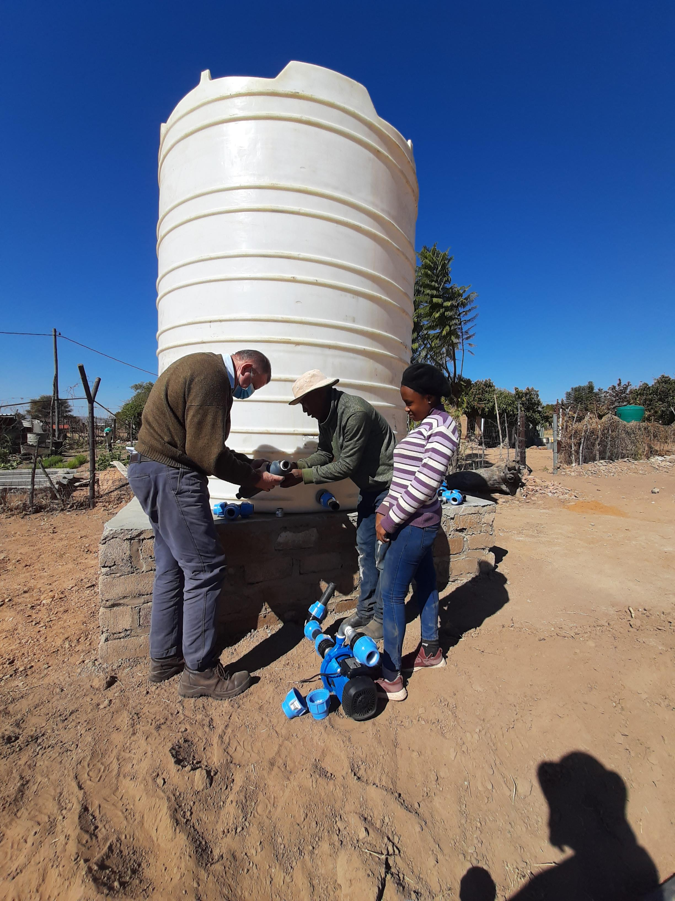
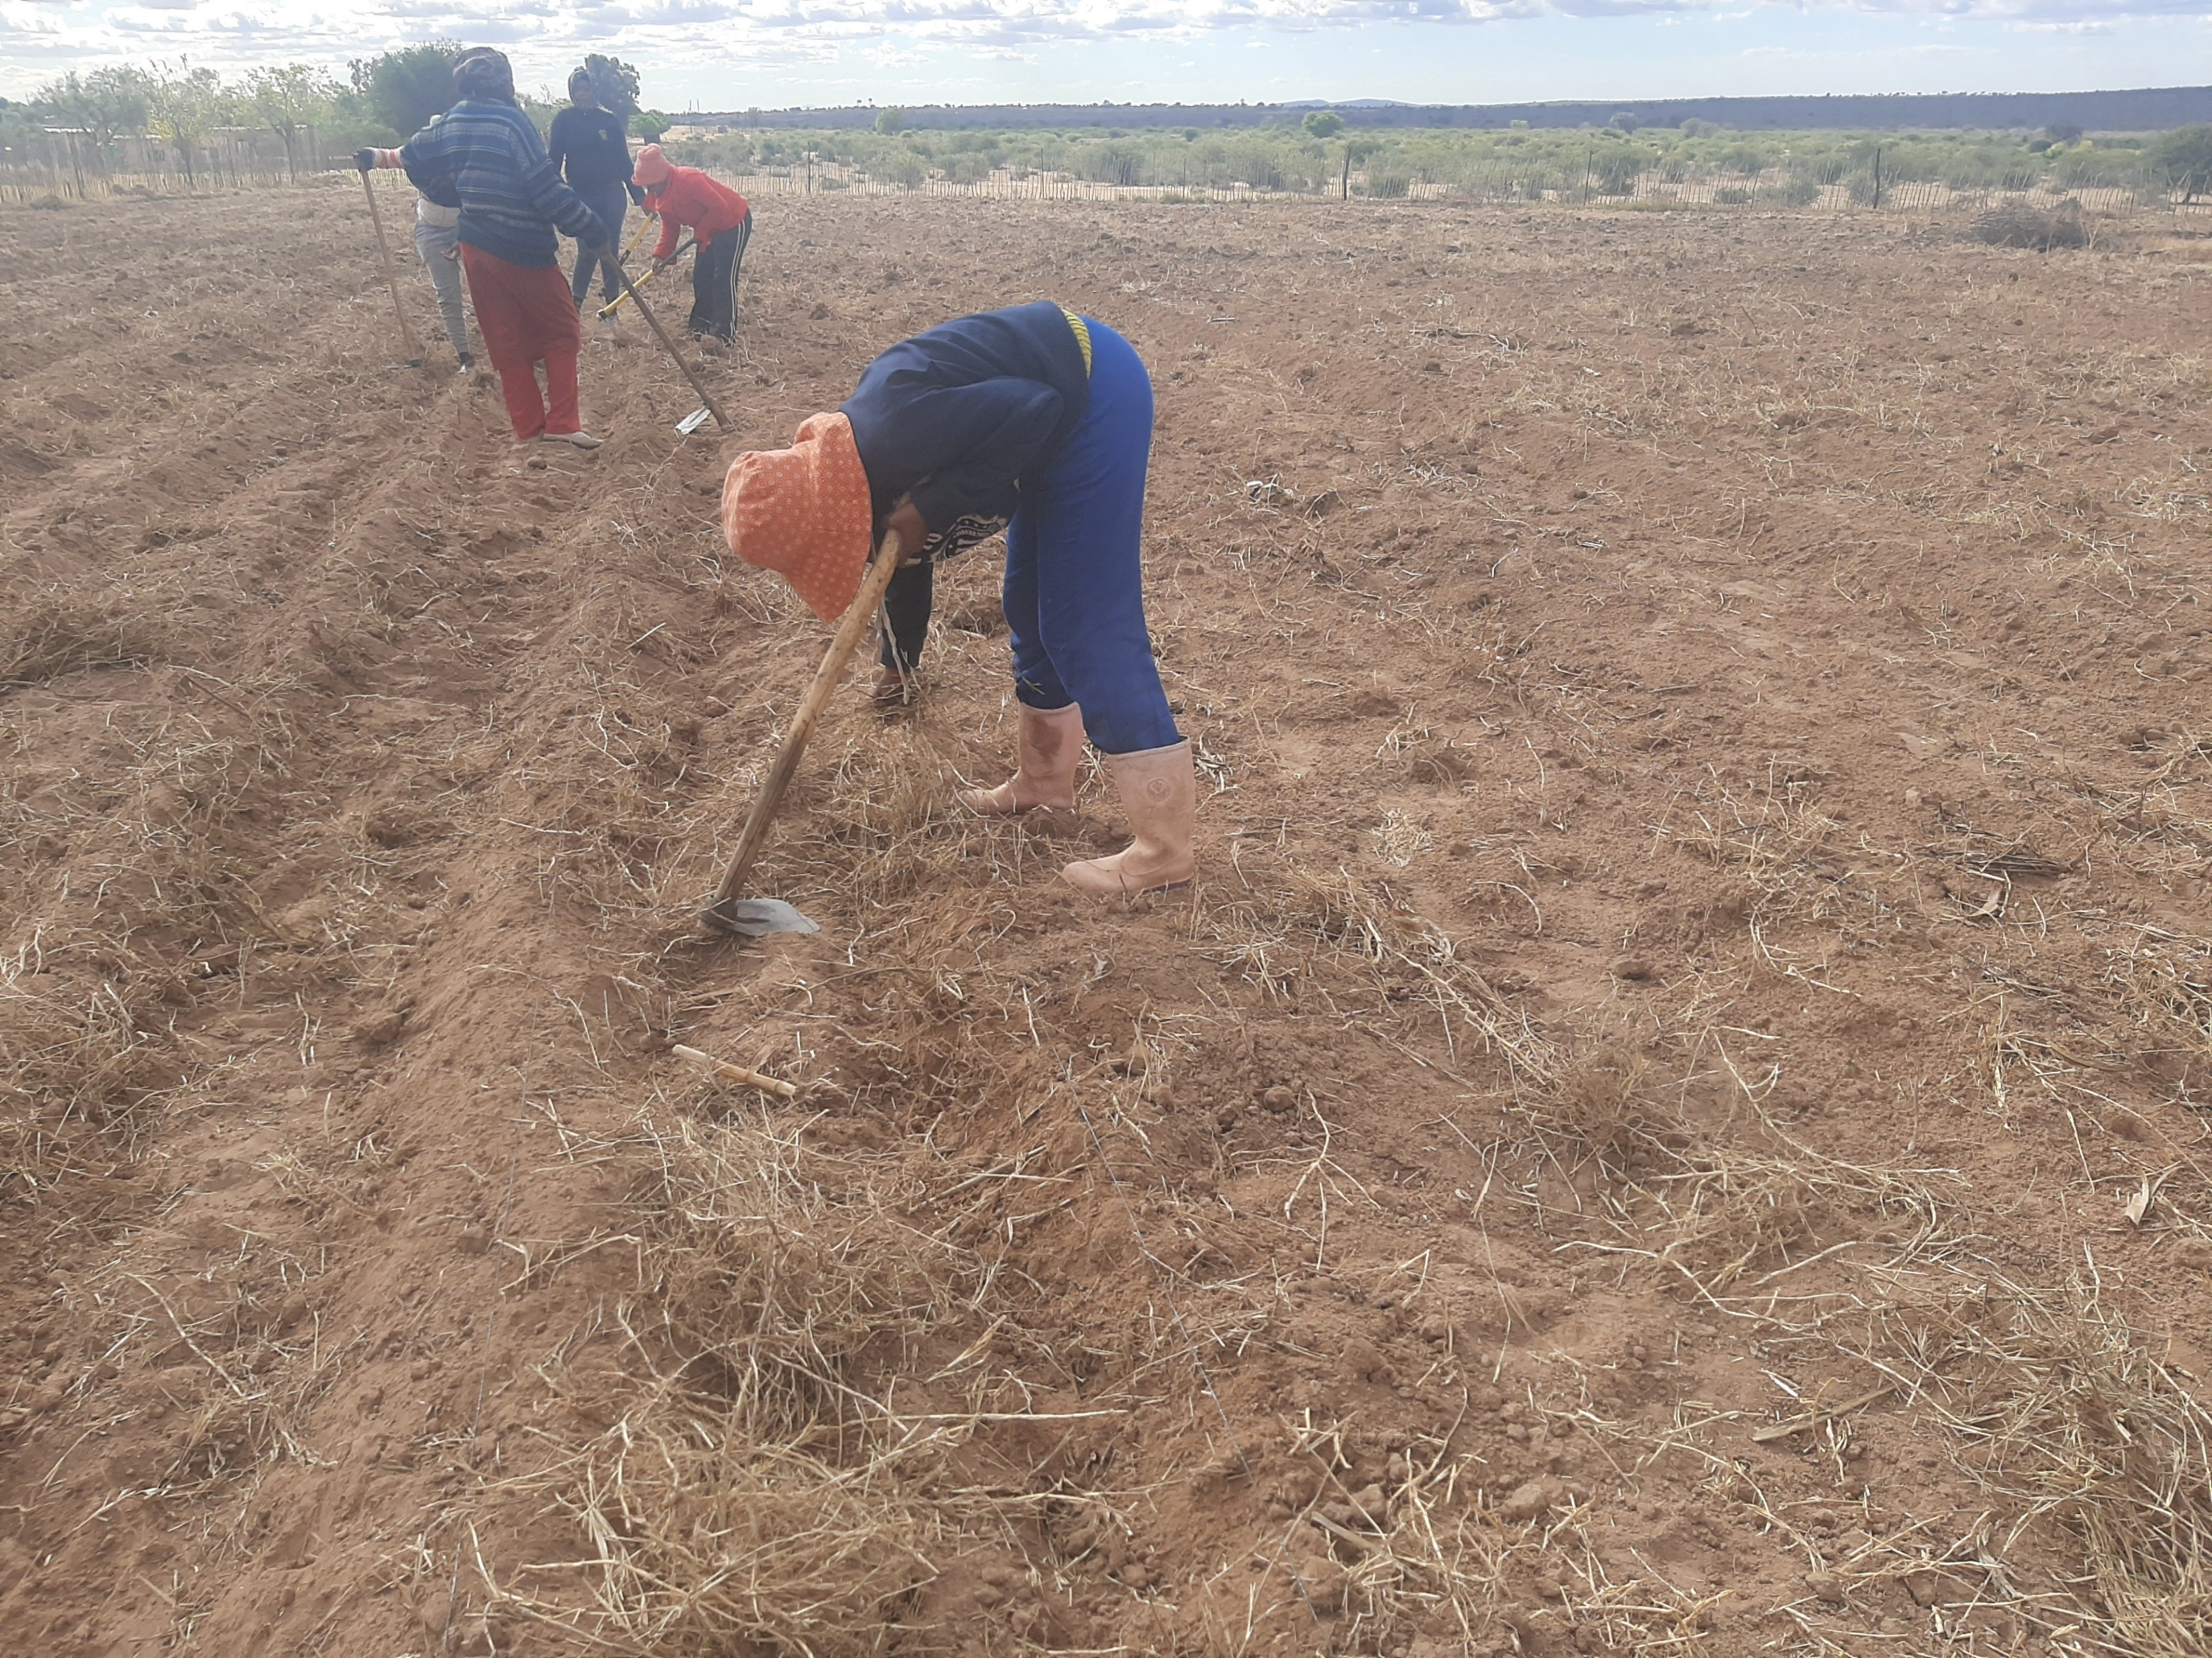
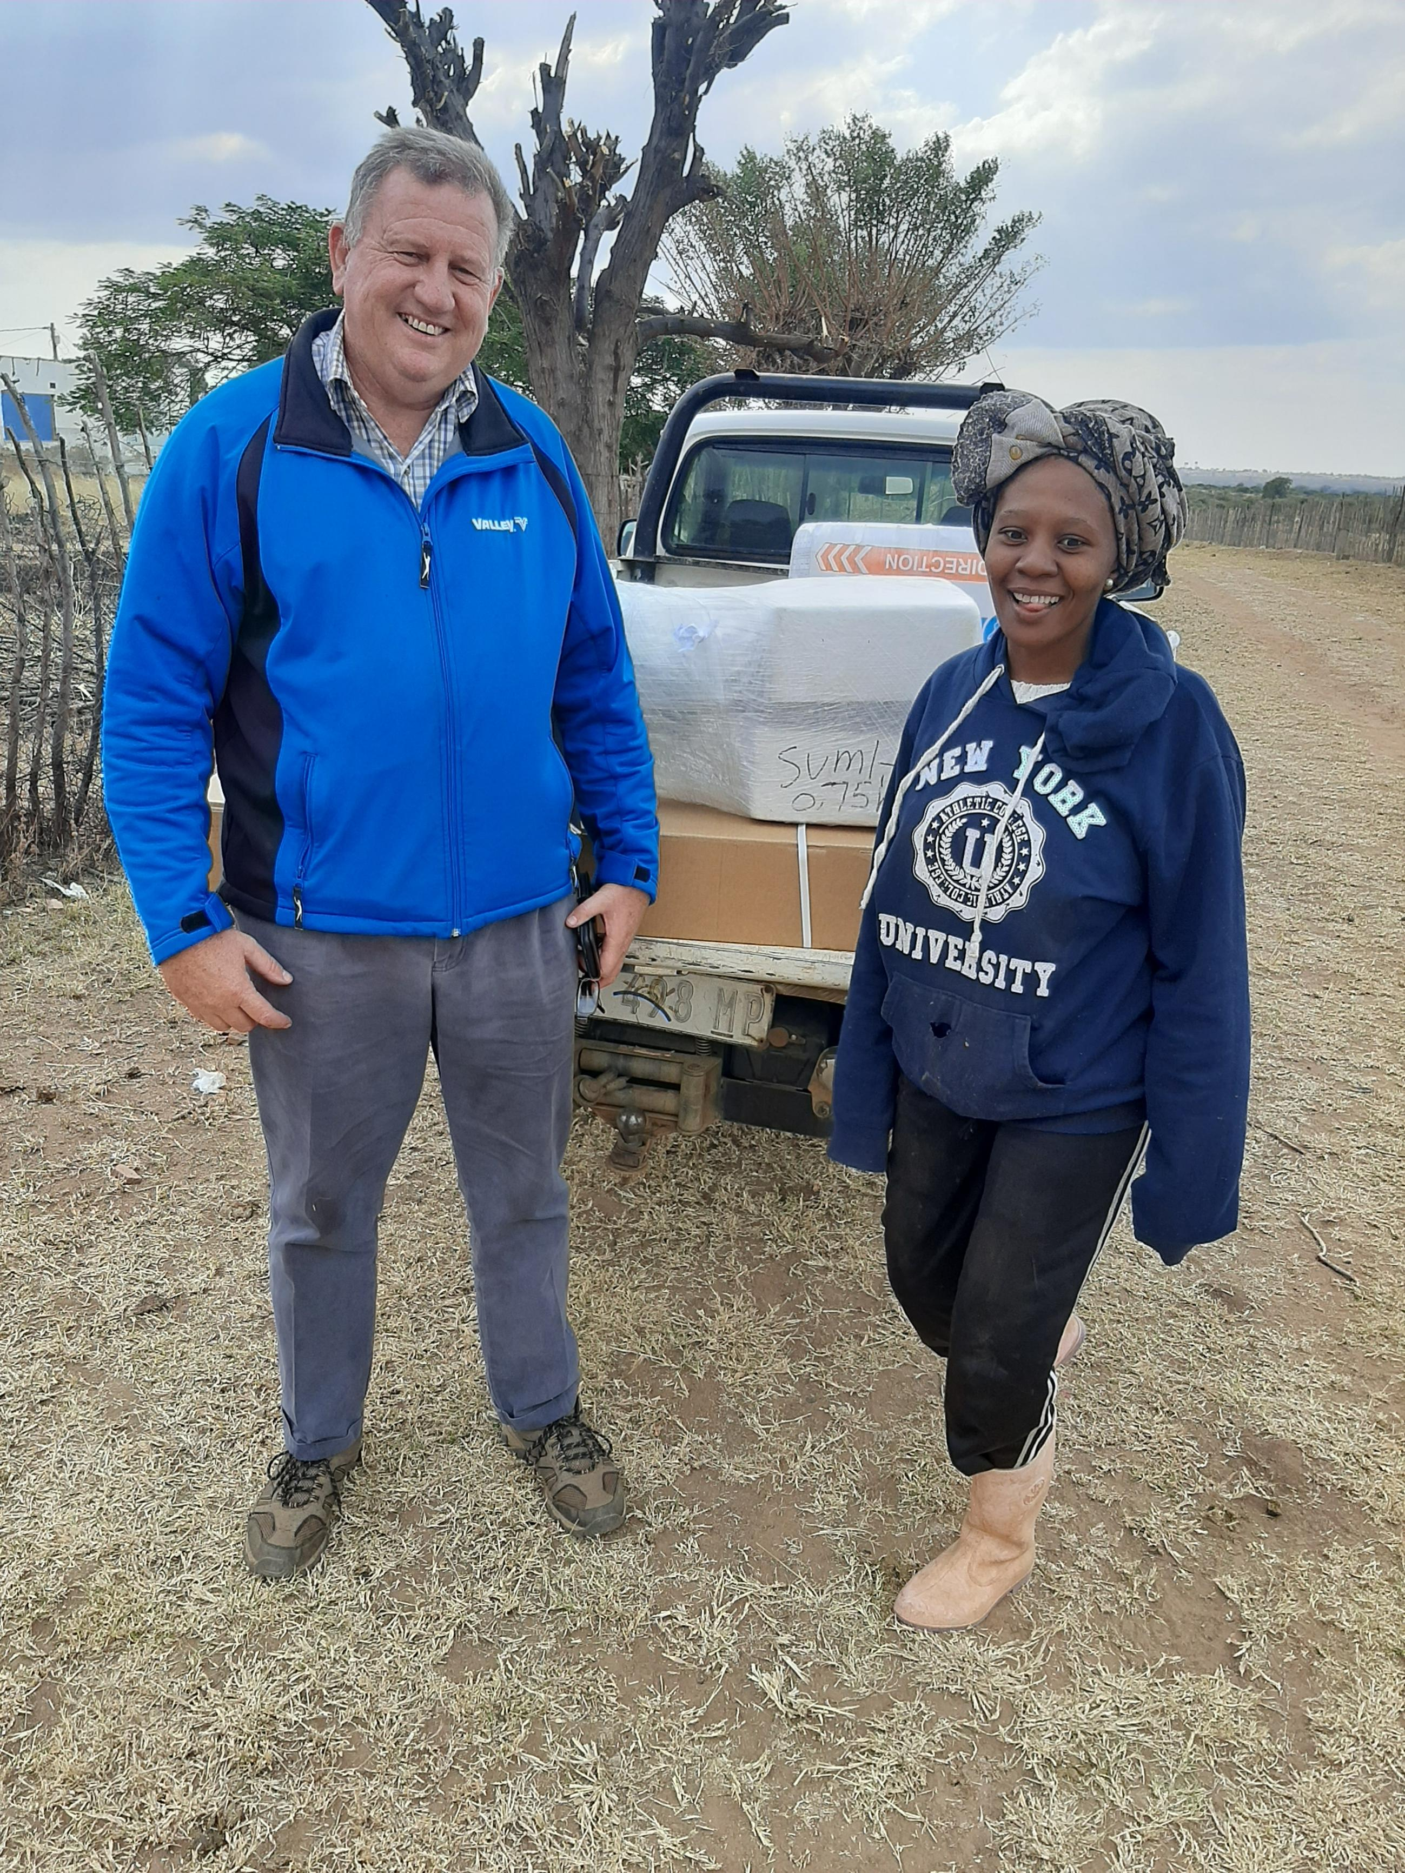
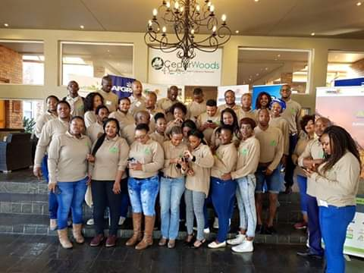
Moemi Farming Enterprise
moemifarming.co.za
https://youtu.be/HGfN0iaXlDQ

