Slide 1

WEP CHALLENGE 2021

Slide 2

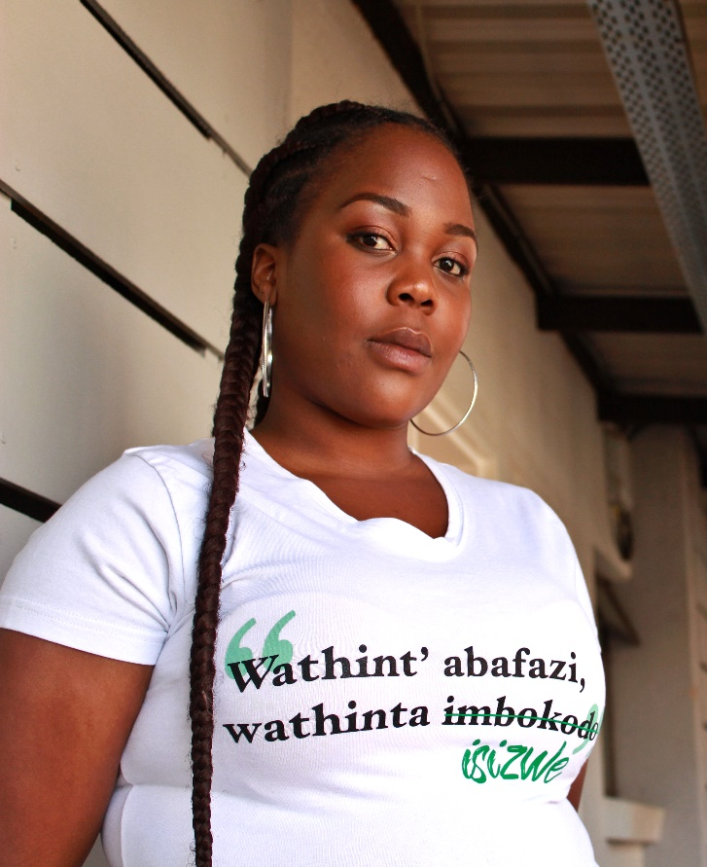



Archive Amabali Wethu
Yolanda Dyantyi – Executive Director
A 24 year old radical African feminist and activist against gender-based violence and broader social injustice. Born and Bred in Johannesburg, South Africa, she’s passionate about addressing social development through promoting entrepreneurship and implementing creative collaborative skills transferal interventions.
Archive Amabali Wethu was conceptualized and influenced by Yolanda Dyantyi’s history and experiences with first hand violence and how she chose to challenge the system through her activism. By sharing her experiences on various platforms on the internet via social media and on the ground in varying movements and organization's, she’s appreciated the power that lies in storytelling and connecting with people in relation to influencing social and political reform.

Slide 3
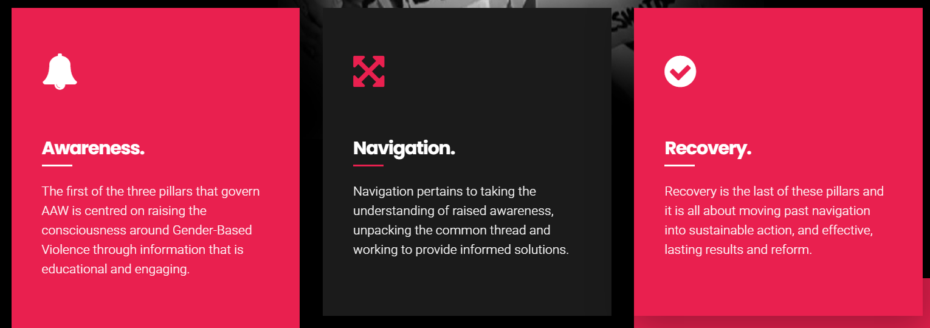
What is the nature of the business?
Archive Amabali Wethu is a registered Not-For-Profit Organization and collective established as a result of having a shared interest and inclination towards finding and using creative innovative ways of advocacy and awareness-raising about the plight of marginalized groups in South Africa.
Through the use of civic technology, multimedia and the arts we are inspired by the power of storytelling and our history has shown that many revolutions and movements are born from conscious raising by the act of sharing ideas, knowledge, and personal experience.
We believe that our experiences and stories (data) are powerful tools that can inspire the creation of a movement that aspires to a non-violent future for everyone. As a team and organization, our three-pillar approach based on Awareness, Navigation and Recovery guides and motivates us to use the fast growing social media platforms and the internet to inspire

Slide 4
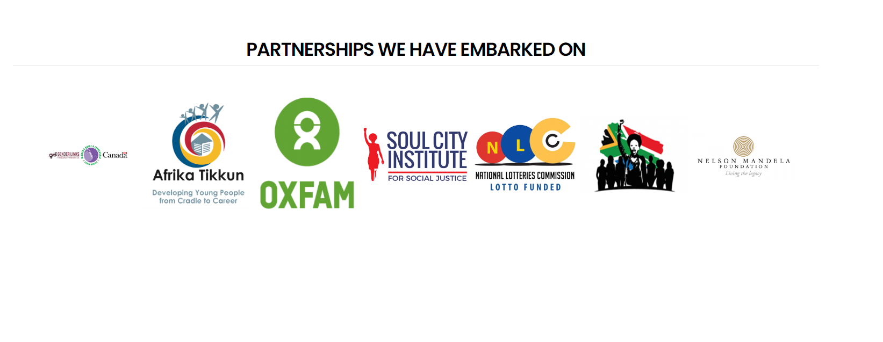
What customer needs are being addressed
Social Media Campaigns
Conceptualization, Developing and managing campaigns (eg. Mining Bodies campaign in partnership with Nelson Mandela Foundation)
Consulting services
Policy advocacy and provide communications strategies
Workshops
Project Management
Multimedia services
- Social media managing
- Videography & Photography
Visual Reports (Production services)
Podcasting (www.soundcloud.com/amabali_pod)
Infographics
Case Study Videos

Slide 5
How has the business impacted on other enterprises owned by young women?
Archive Amabali Wethu’s current website was designed and created by a Black woman – Nosipho Motsamai – who owns a start up called Motsamai Group.
We intentionally collaborate with as many freelance creatives that we can find. We outsource certain services that we may need for programmes and projects we’re working on internally or with clients.
It is part of our objectives to work with women and we prioritize collaborating and supporting other Black/African women social entrepreneurs and creatives first.

Slide 6

How viable and implementable is the solution being proposed?
The solution is highly viable as most organizations have been forced to move to digital solutions in faster ways they'd never anticipated. This also means there's a vacancy for services and skills that was previously not in demand, particularly in the civil society sector.
By providing some of the skills and expertise we have on digital activism, content creation and social media campaigning, we help organizations drive their message forward reaching online communities untapped before.

Slide 7

What makes the business unique?
We're a social enterprise - a breed between being a social justice organization and also a business that functions to make profit.
We're young and women led and passionate about creating our own lives of independence through doing the work we love the most.
By creating and facilitating platforms of engagement online that spotlight the activism happening across South Africa and the continent and establishing an archive of histories of feminist activism changing our societies for the better.
Archive Amabali Wethu interviews Vavasati International Women’s Festival curators, 2019.

Slide 8
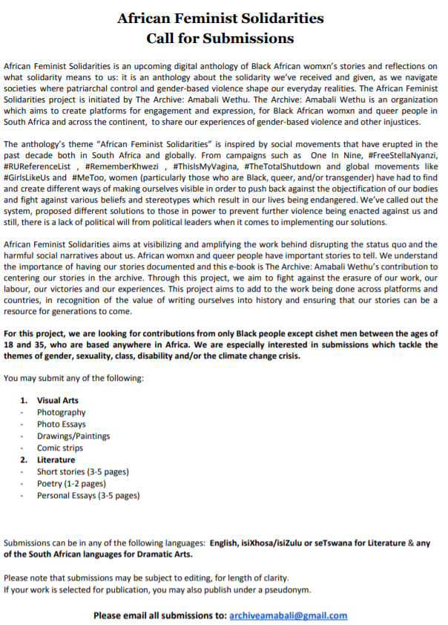

Use of ICT to promote economic and employment opportunities for young women?
As an organization we always do our best to work with other young people. Because the services we provide are multimedia related we don't always have the skill inhouse therefore we like to collaborate and partner with as many talented, passionate creatives and technicians across the country.
When we get new clients we ensure to always seek young people to collaborate with on various projects.
Advert

Slide 9
How have you managed the impact of the COVID-19 pandemic?
We've had to develop a website and we are grateful that we have one because it has served as a means to advertise and market ourselves an organization and business.
We worked with women entrepreneurs who designed and developed our current website and that was an intentional move on our end. To support and work with other women entrepreneurs a we build our legacies together.
We use opportunities such as the WEP challenge to promote ourselves in hopes to be given recognition and the support we desperately need.

Slide 10
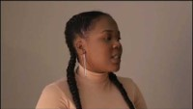
Anything else you would like to add
Being awarded this opportunity and receiving funding would go directly towards ensuring the completion of the African Feminist Solidarities anthology project as well as investing in equipment for our organisation’s media department.

