Slide 1
Pelere Group Limited
WEP CHALLENGE-UN WOMEN

Slide 2
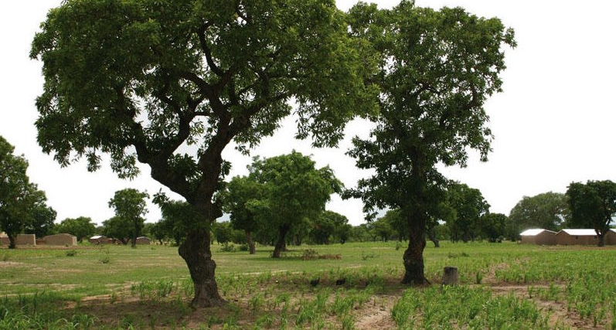

Slide 3

Problem
Extreme poverty in Northern Uganda due to the Lord’s Resistance Army (LRA) war.
Deforestation for charcoal production.
Only 20% of potential shea nut production is being utilized.
Rising demand for organic shea butter products.
Improve society and environment through making premium quality shea nut products

Slide 4
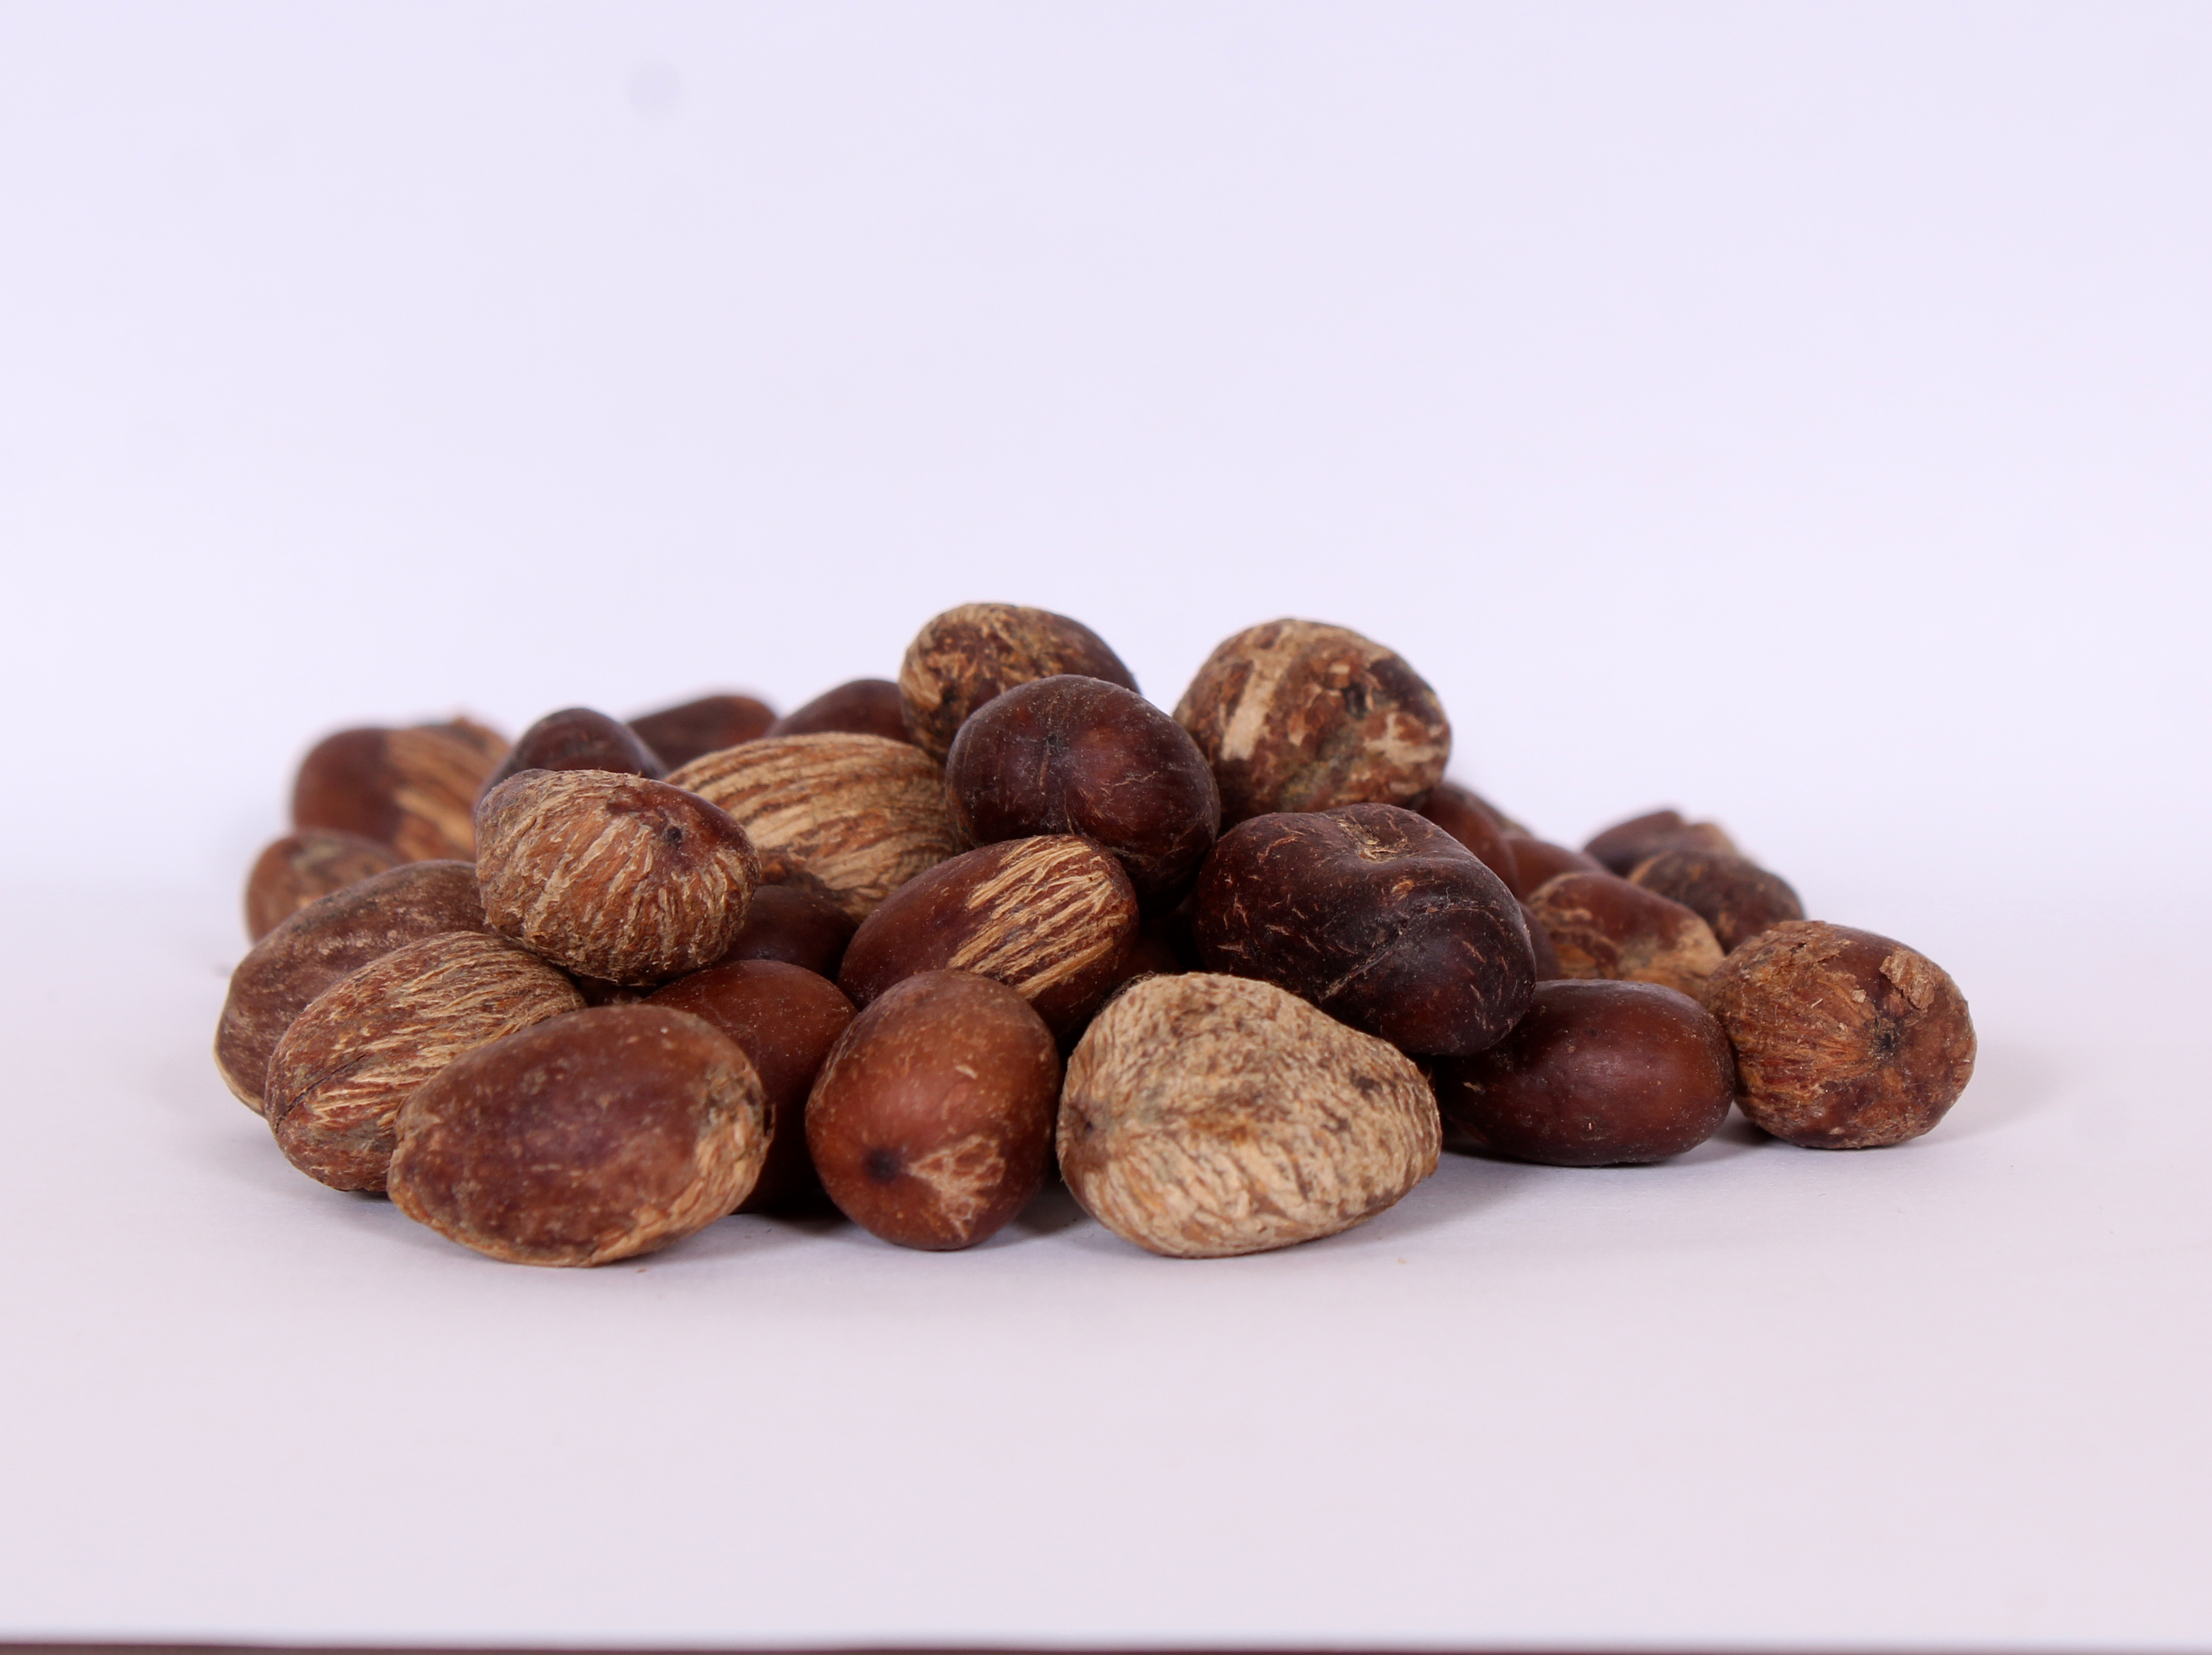
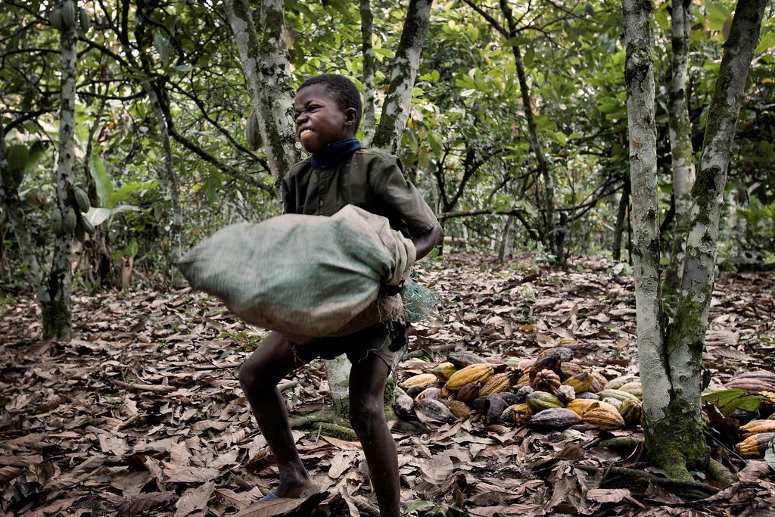
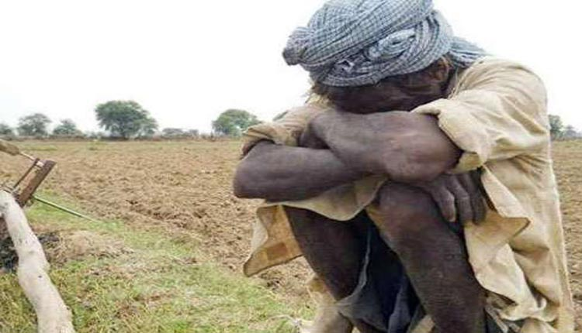
The traditional approach
Profit goes to traders and manufacturers outside Uganda
Extreme poverty in Northern Uganda due to the Lord’s Resistance Army (LRA) war.
Deforestation for charcoal production.

Slide 5
The PELERE APPROACH
Improve society and environment through making premium quality shea fruit products

Slide 6


Inclusive Business Model
COMMUNITY COLLECTION
PROCESSING/PRODUCTION
SALE
Skilling/Training the farmers, collection, drying and cracking of nuts
50 shea grower groups with 20–30 members each
West Nile and Acholi region.
Post-harvest handling and Processing.
Processing of the shea nuts into shea butter in our Gulu facility.
Processing of the shea butter into different finished products in our Kampala facility.
Marketing and distribution to customers
Uganda(supermarkets, jumia, wholesellers, distributors)
Export markets

Slide 7
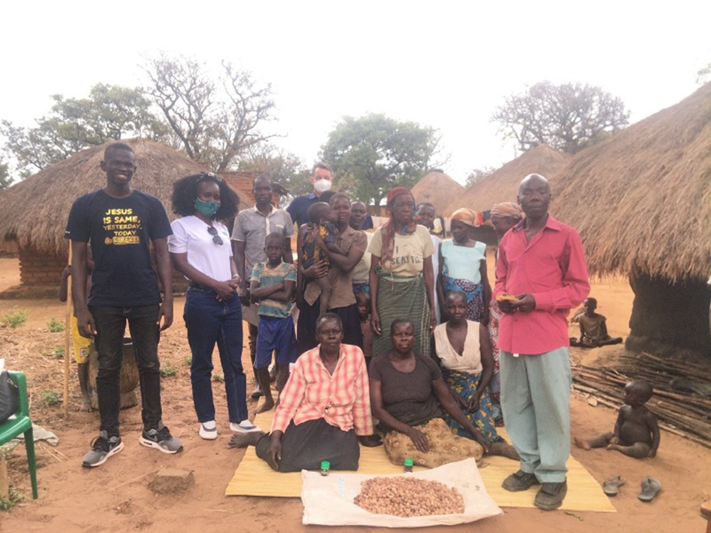
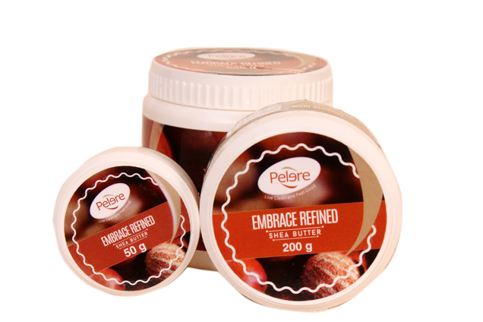
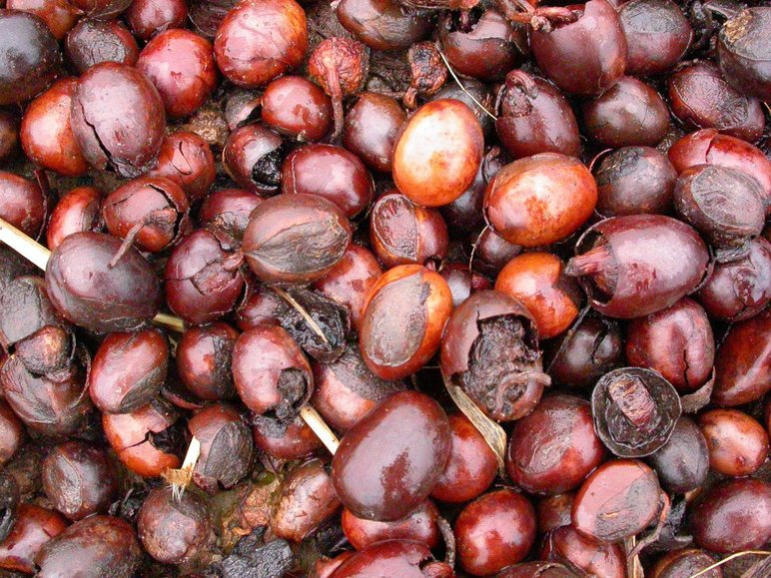
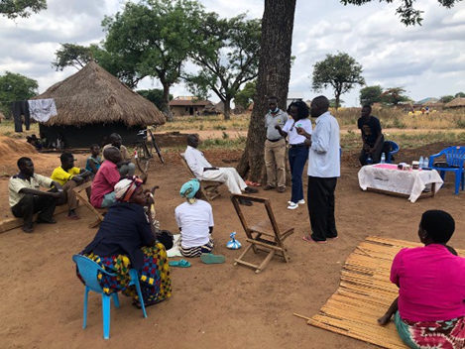
SUSTAINABLE ,RESPONSIBLE SOURCING

Slide 8

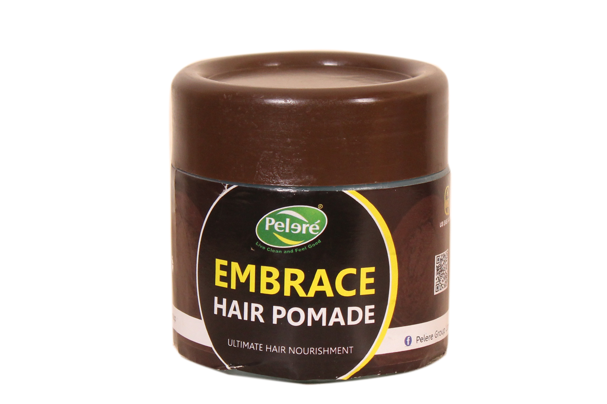
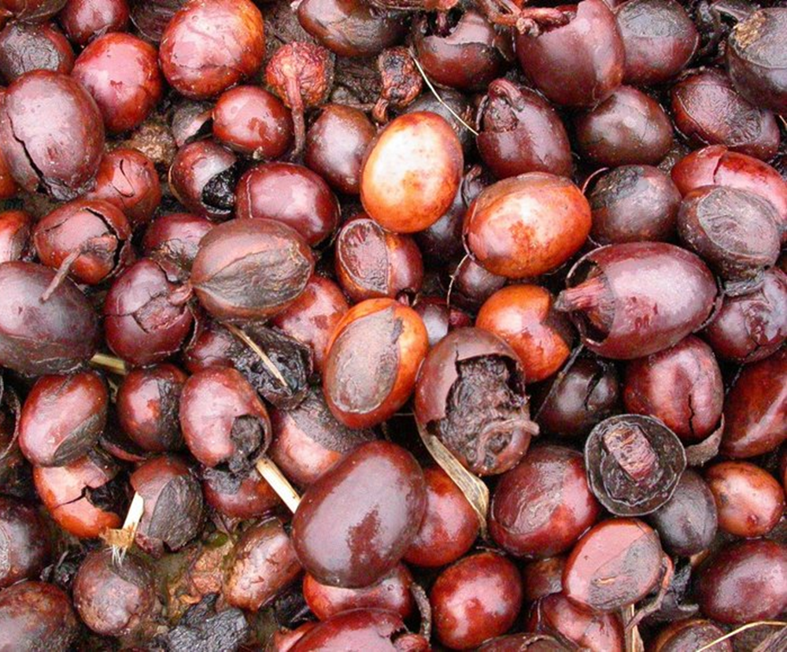
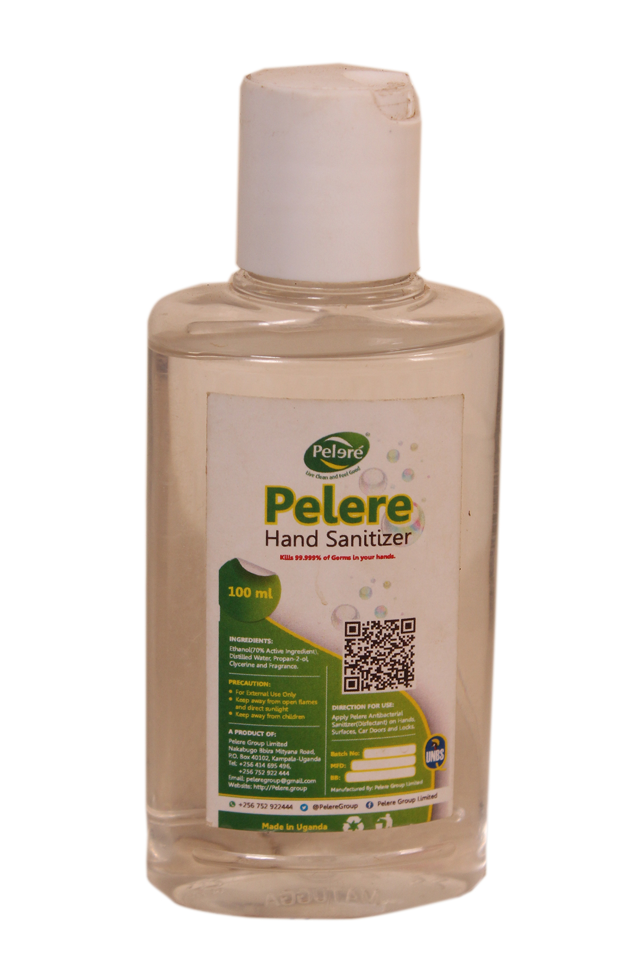
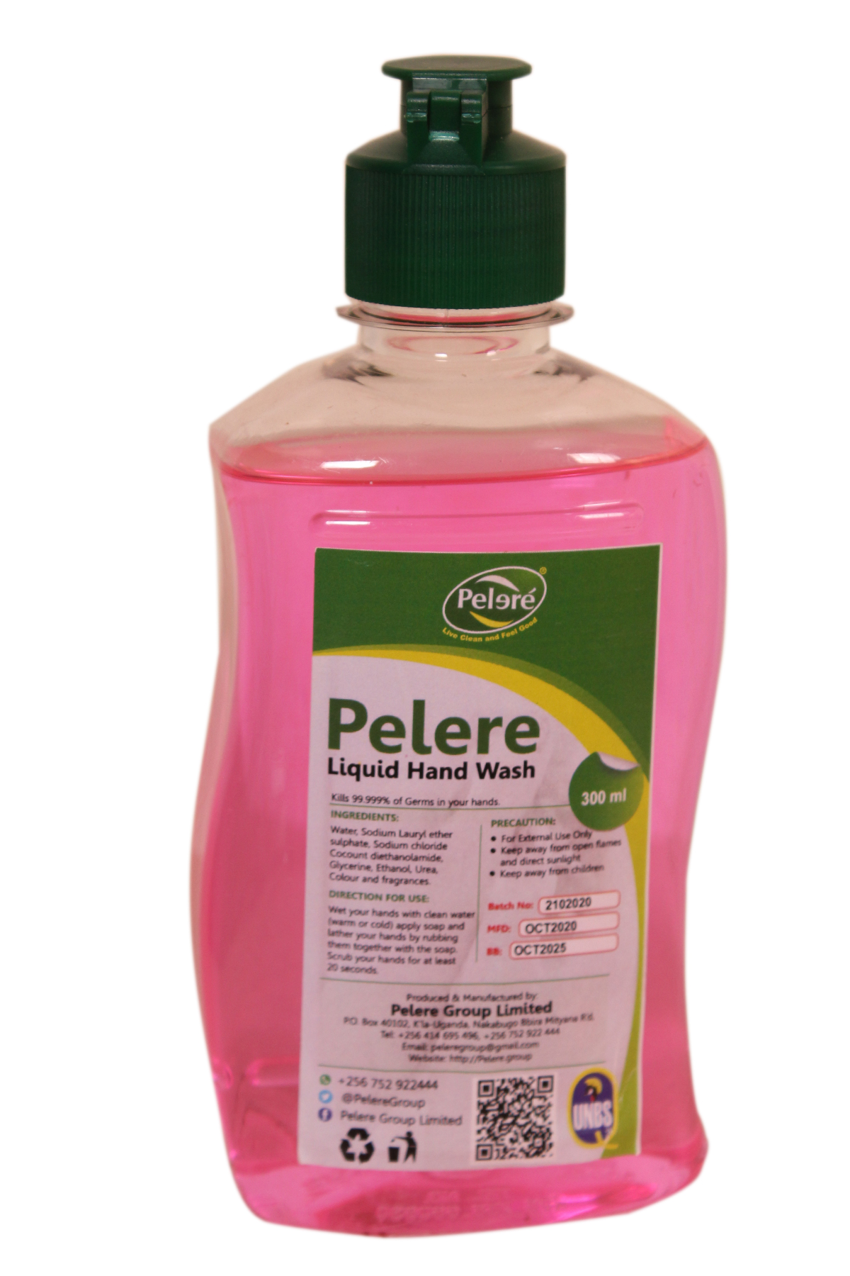
PELERE PRODUCTS
New product line as response to COVID

Slide 9
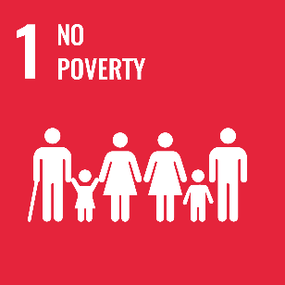

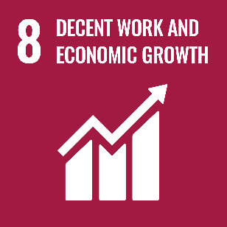

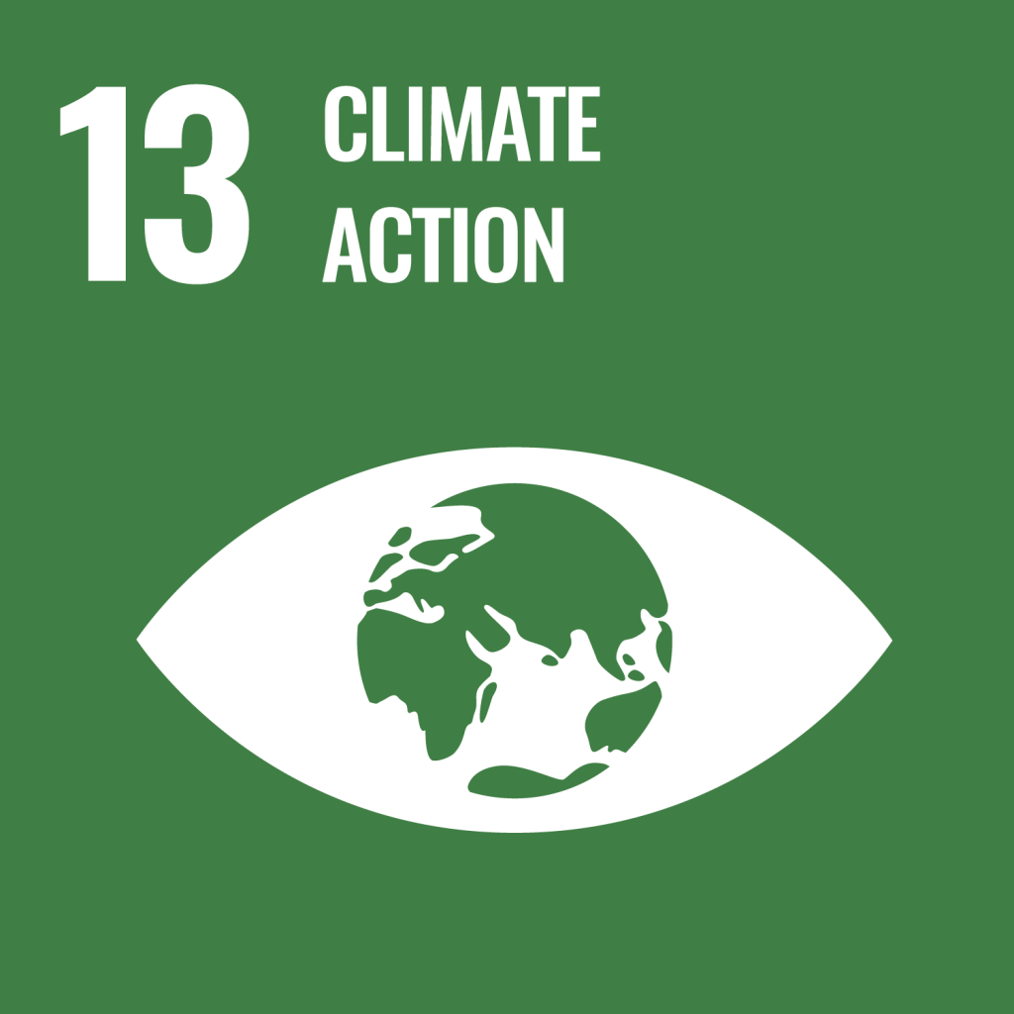
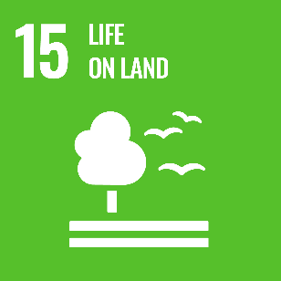
IMPACT
 | Current 2020 | 2021 | 2022 | 2023
Number of farmers working | 2,500 | 3,500 | 15,000 | 20,000
Total Amount of money for farmers | $20,000 | $50,000 | $150,000 | $500,000
Number of trees planted | 7,000 | 10,000 | 50,000 | 100,000
Number of Employees | 40 | 80 | 150 | 300

